Slide 1

MSC IN COMPUTATIONAL COGNITIVE SCIENCE
Brain Imaging – Methods and Applications
Module: Electroencephalography (EEG)
Lecture 1
What is EEG?
History and physical basis
Pierpaolo Croce
A.Y. 2026-2027

Slide 2
COURSE MAP
Brain Imaging – EEG: 10 lectures, 20 hours
What is EEG? History and physical basis
Spectral and time-frequency analysis
1
6
Cellular bases of EEG
Event-related potentials (ERPs)
2
7
From neurons to scalp: dipoles, volume conduction, rhythms
Spatial analysis and EEG microstates
3
8
Recording: electrodes, 10-20, montages, sampling, artifacts
Source imaging and connectivity
4
9
Preprocessing and ICA
Decoding (MVPA) and applications
5
10
physiology (1–3) → measurement (4–5) → analysis (6–10)
Brain Imaging · EEG · Lecture 1 · History and nature of EEG
2
Notes:
Present the logic of the course: from physiology (1-3) to measurement (4-5) to analysis (6-10).

Slide 3
TODAY
Learning objectives
Place EEG in the landscape of brain imaging methods (what it sees, what it misses).
1
Know the key historical steps, from Galvani's frogs to modern decoding.
2
Explain what the EEG measures: potential differences generated by synchronous postsynaptic currents.
3
Understand the three requirements for a scalp-visible signal and the effect of volume conduction.
4
Preview the analysis families covered in the course.
5
Brain Imaging · EEG · Lecture 1 · History and nature of EEG
3

Slide 4
MOTIVATION
Why listen to the brain's electricity?
86 × 10⁹
≈10¹⁴
≈20 %
1 ms
neurons in the human brain
synapses
of the body's energy at rest
(2 % of body mass)
time scale of neural events:
EEG can follow it
Neurons communicate with electrical and chemical signals. The EEG is the only widely available, non-invasive, cheap and portable tool that records this activity directly, with millisecond precision.
Metaphor The EEG is like a set of microphones outside a stadium: you cannot hear single conversations, but you clearly hear when thousands of fans chant together.
Brain Imaging · EEG · Lecture 1 · History and nature of EEG
4
Notes:
Numbers: Azevedo et al. 2009 (86 billion neurons); Raichle & Gusnard 2002 (≈20% of resting energy).

Slide 5
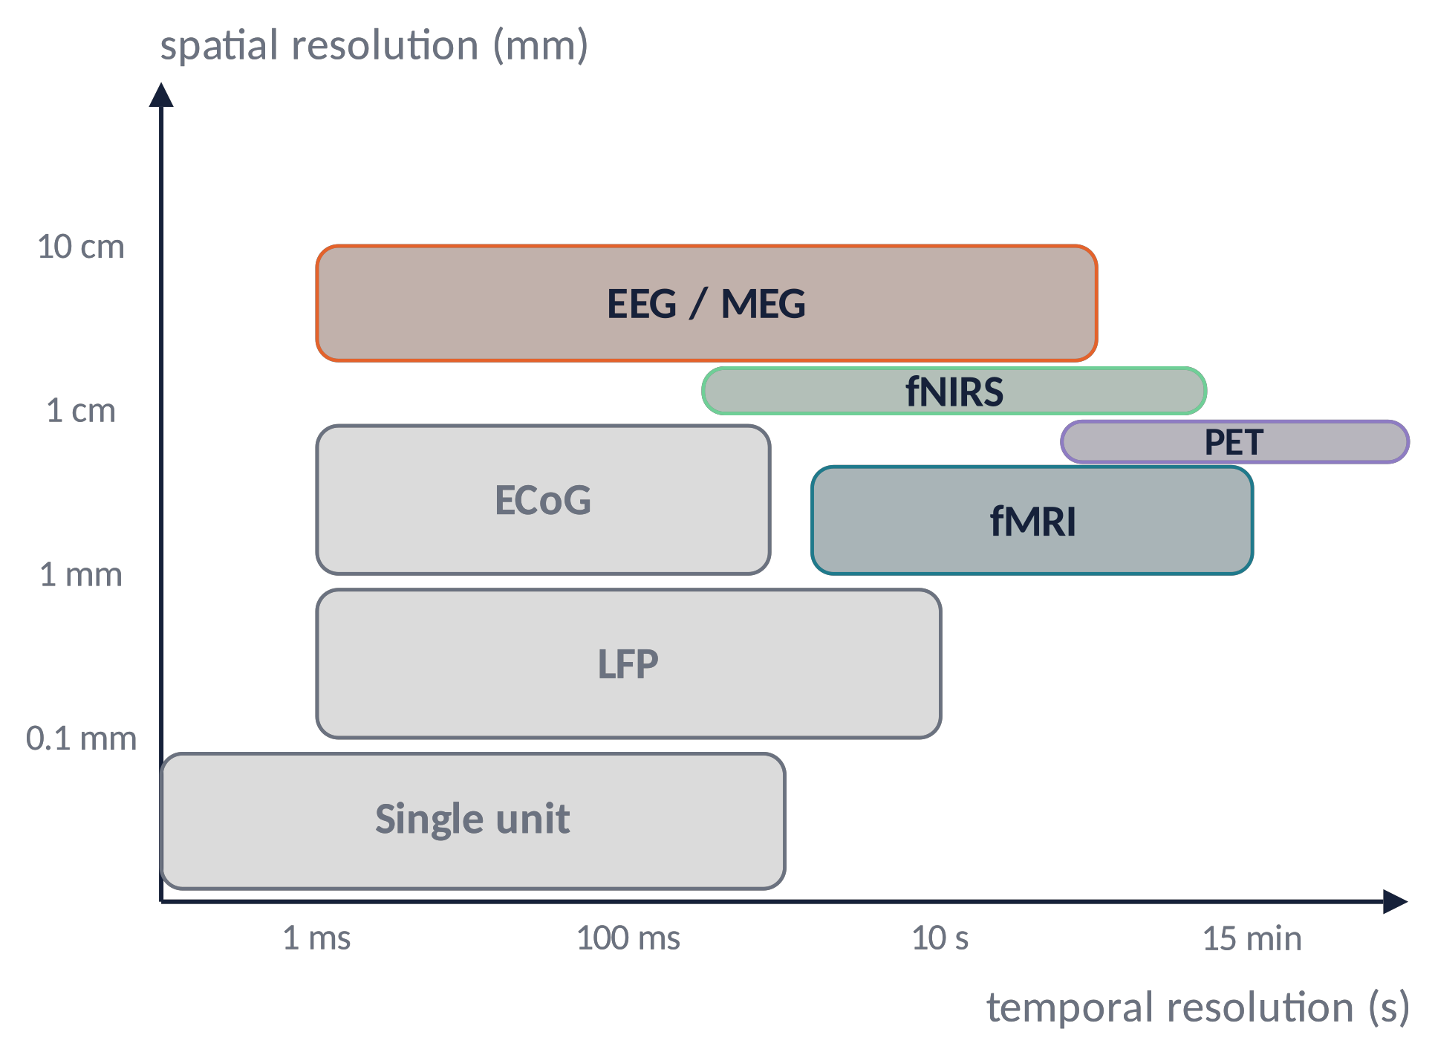
BRAIN IMAGING LANDSCAPE
Where does EEG sit? Spatial vs temporal resolution
EEG/MEG: milliseconds, but centimetres of spatial blur.
fMRI: millimetres, but seconds (slow blood response).
Invasive methods (ECoG, LFP, single units) are both sharp and fast, but require surgery.
No single method sees everything → multimodal imaging (EEG-fMRI, EEG-TMS).
Brain Imaging · EEG · Lecture 1 · History and nature of EEG
5
Notes:
Schematic after Sejnowski, Churchland & Movshon (2014). EEG/MEG: ms resolution but cm spatial blur.

Slide 6
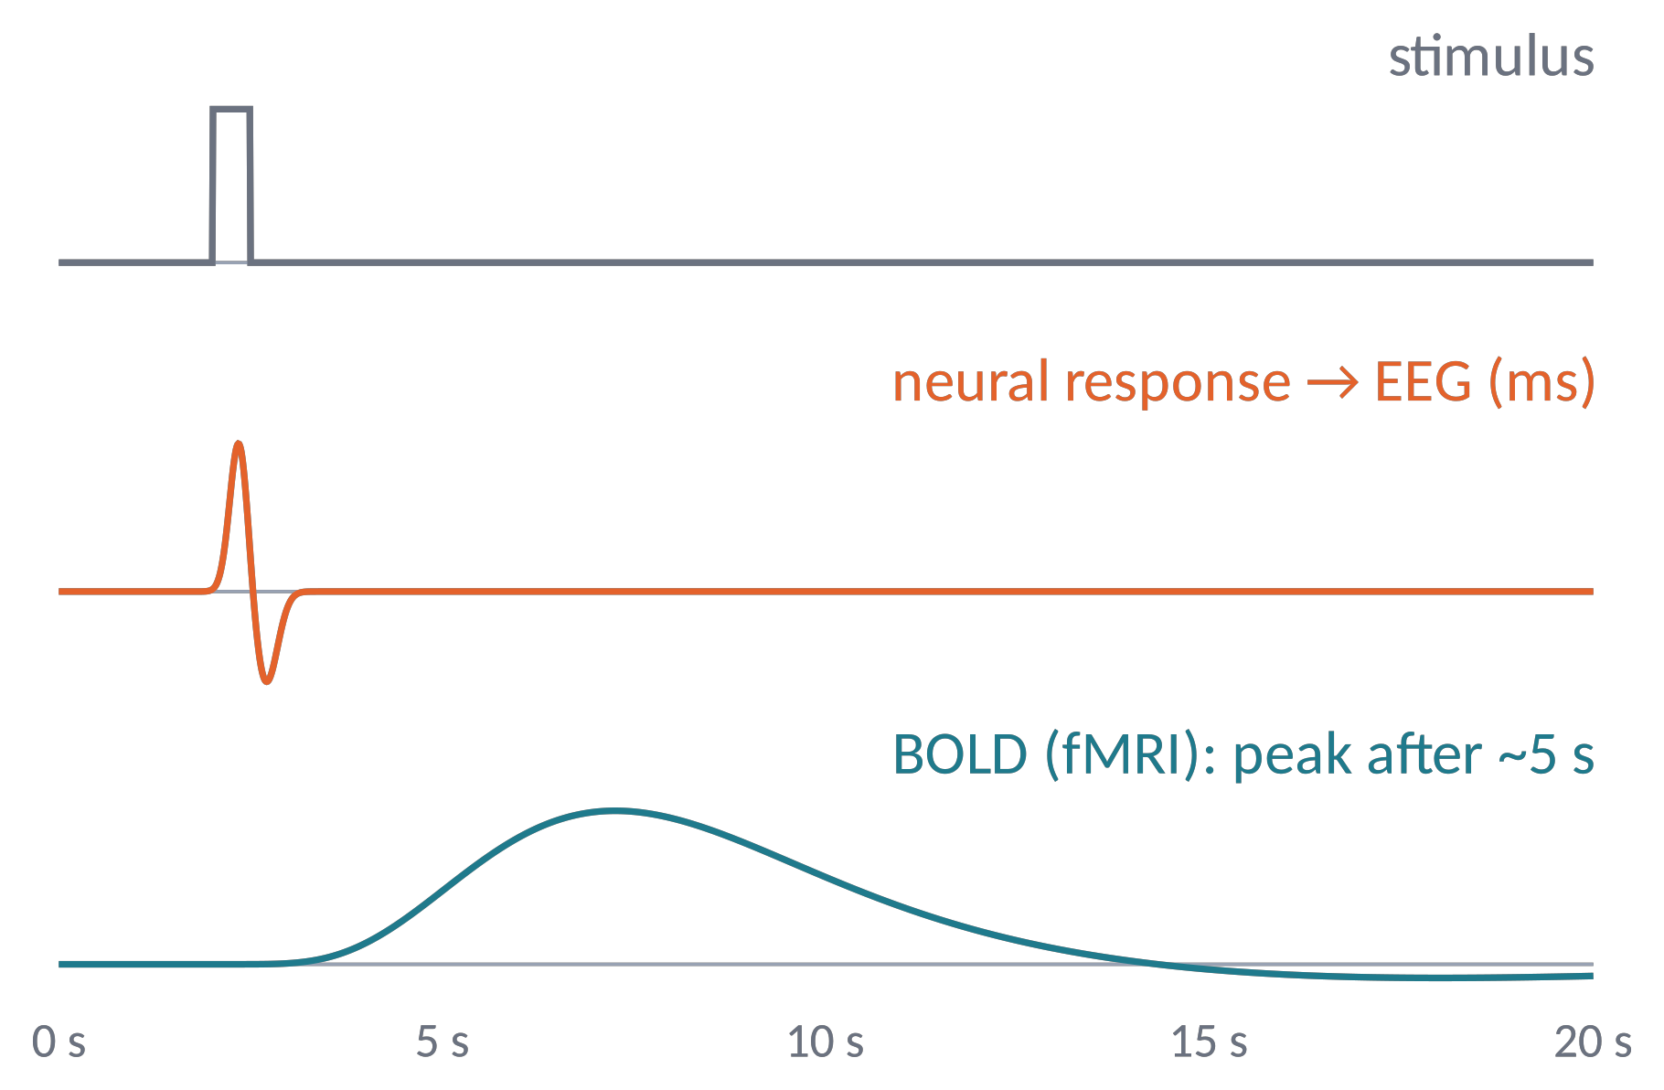
BRAIN IMAGING LANDSCAPE (2)
Direct (electrical) vs indirect (hemodynamic) signals
The EEG records the electric field of neuronal currents: no delay.
fMRI (BOLD) and fNIRS measure blood oxygenation, which follows activity through neurovascular coupling: a smooth response peaking ≈5 s later.
Two events 200 ms apart: distinct in EEG, merged in BOLD.
Metaphor EEG hears the thunder as it happens; fMRI sees the puddles that form afterwards.
Brain Imaging · EEG · Lecture 1 · History and nature of EEG
6
Notes:
BOLD follows neural activity through neurovascular coupling; canonical HRF peaks at ≈5-6 s (SPM double gamma).

Slide 7
01
A short history of EEG
7

Slide 8
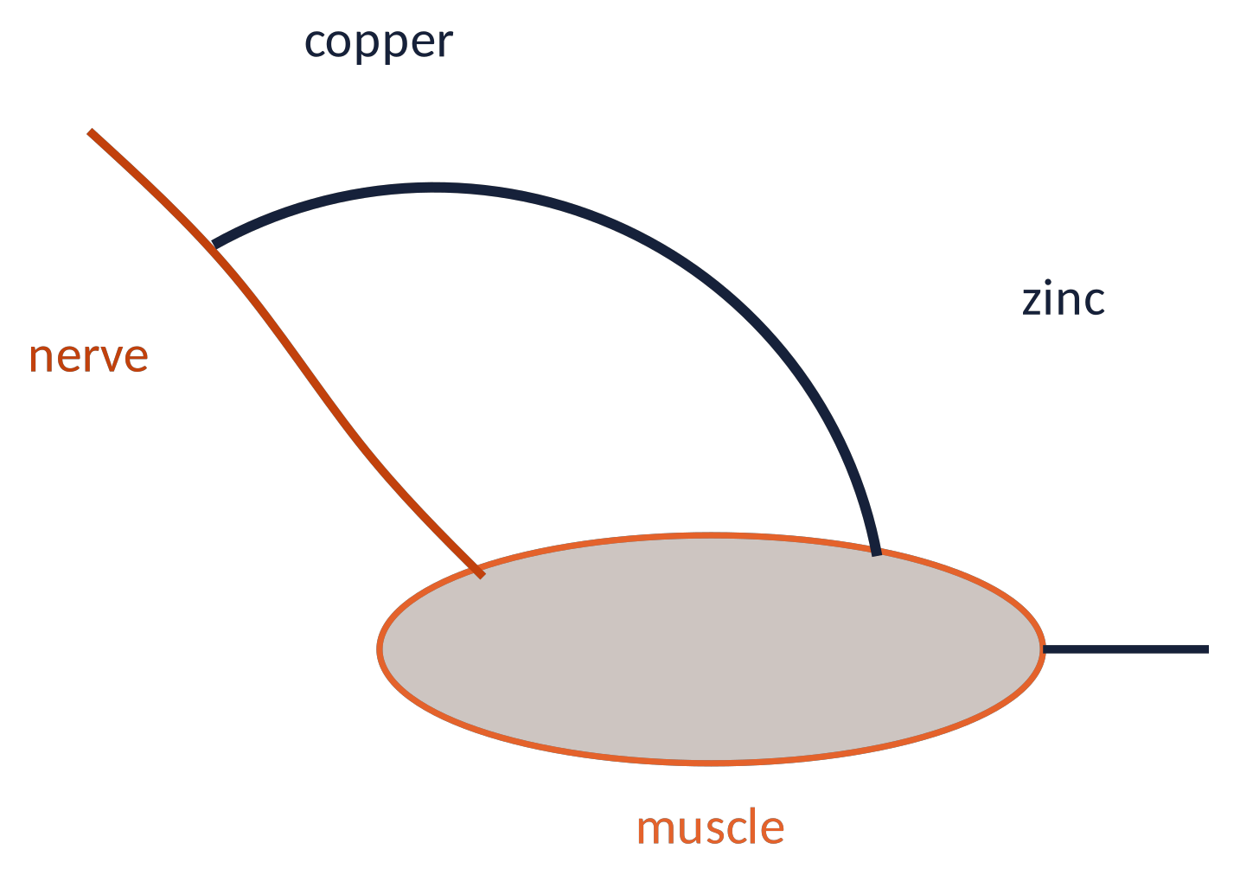
HISTORY (1)
Luigi Galvani and "animal electricity" (1791)
Bologna, 1780s: touching the nerve and the muscle of a dissected frog with an arc made of two different metals makes the leg twitch.
Galvani's interpretation: tissues produce their own electricity, animal electricity.
Alessandro Volta disagreed: the current came from the two metals → he invented the battery (1800).
Both were partly right: nerves and muscles are electrically excitable and generate currents. Galvani founded electrophysiology.
Brain Imaging · EEG · Lecture 1 · History and nature of EEG
8
Notes:
Galvani, De viribus electricitatis in motu musculari commentarius (Bologna, 1791). Dispute with Volta led to the battery (1800).

Slide 9
HISTORY (2)
From nerves to the brain (1840–1913)
1840s – E. du Bois-Reymond: the nerve impulse is an electrical "action current".
1
1850 – H. von Helmholtz: nerve conduction velocity is finite, ~25–40 m/s in the frog (not instantaneous!).
2
1870 – G. Fritsch & E. Hitzig: electrical stimulation of the dog cortex produces movements → the cortex is electrically excitable.
3
1875 – R. Caton: records spontaneous currents from the exposed cortex of rabbits and monkeys with a galvanometer.
4
1890 – A. Beck: sensory stimulation suppresses ongoing brain oscillations. 1913 – V. Pravdich-Neminsky: first "electrocerebrogram" of the dog.
5
Brain Imaging · EEG · Lecture 1 · History and nature of EEG
9
Notes:
Caton R. (1875) The electric currents of the brain. BMJ 2:278. Beck A. (1890). Pravdich-Neminsky V.V. (1913).

Slide 10
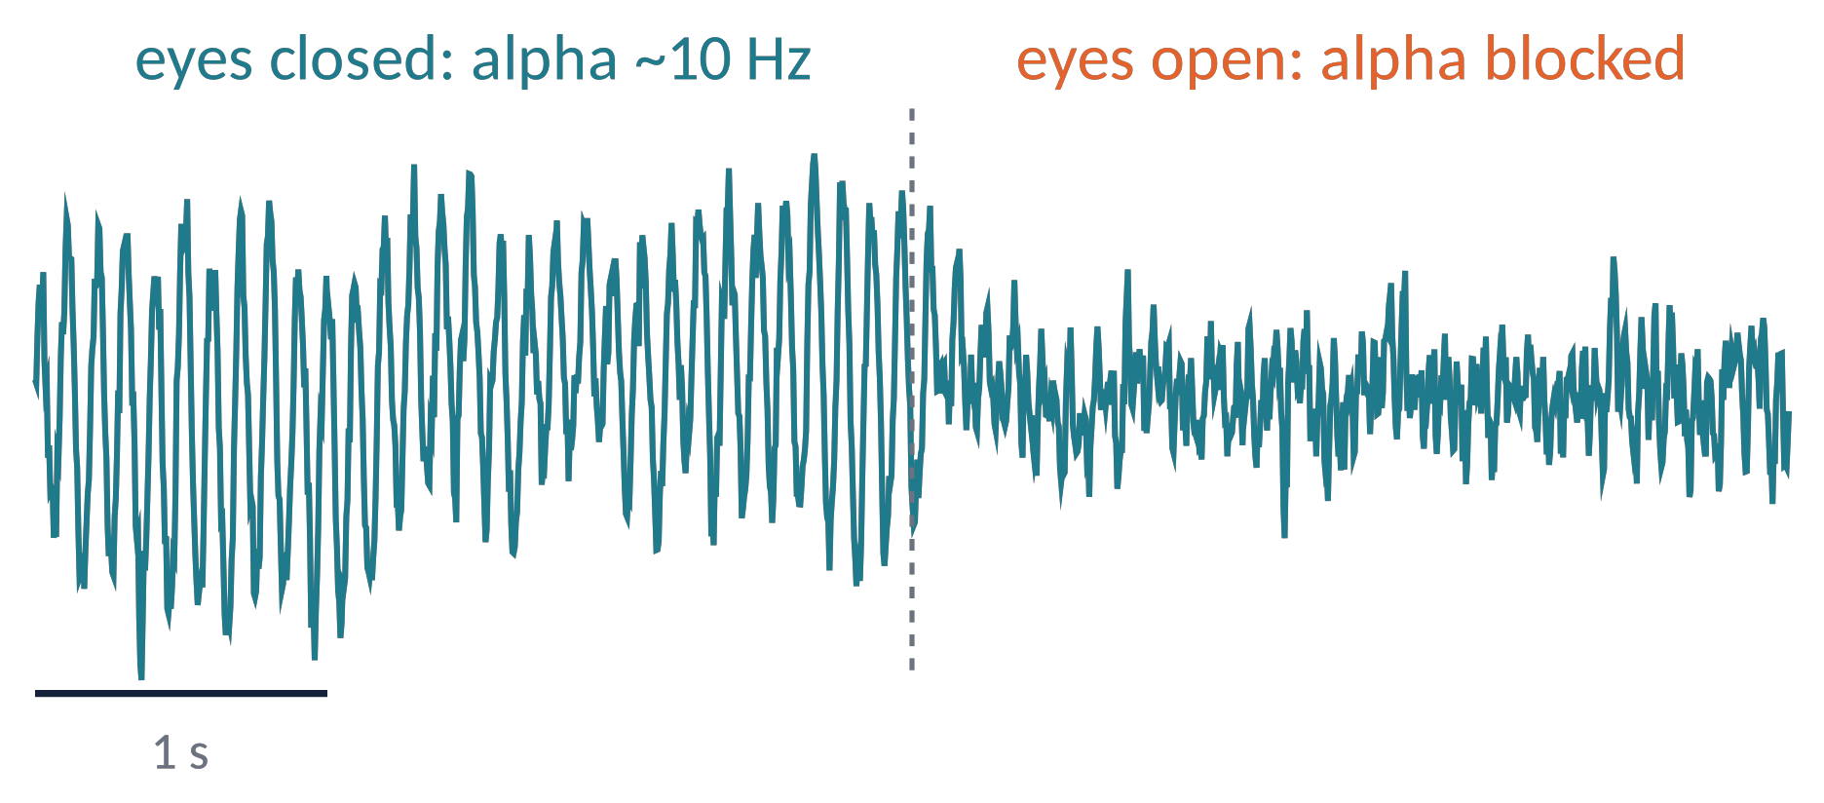
HISTORY (3)
Hans Berger and the first human EEG (1924)
Jena, 6 July 1924: psychiatrist Hans Berger records the first human EEG (a patient with a skull defect).
He waited 5 years before publishing (1929): "Über das Elektrenkephalogramm des Menschen".
He described the alpha rhythm (≈10 Hz, eyes closed) and the beta rhythm, and the alpha blocking when the eyes open ("Berger effect").
Brain Imaging · EEG · Lecture 1 · History and nature of EEG
10
Notes:
Berger H. (1929) Über das Elektrenkephalogramm des Menschen. Arch Psychiatr Nervenkr 87:527–570. 14 reports until 1938.

Slide 11
HISTORY (4)
From curiosity to clinic to computation
1934
Adrian & Matthews confirm the "Berger rhythm"
1964–65
CNV (Walter) and P300 (Sutton); FFT algorithm (Cooley & Tukey)
1935
3 Hz spike-and-wave in absence epilepsy (Gibbs, Davis, Lennox)
1987
EEG microstates (Lehmann)
1937
EEG stages of sleep (Loomis et al.)
1996
ICA for EEG (Makeig, Bell, Jung, Sejnowski)
1954
signal averaging → evoked potentials (Dawson)
2000s
brain-computer interfaces, open toolboxes (EEGLAB, FieldTrip, MNE)
1958
the international 10-20 system (Jasper)
2010s–
machine learning, decoding, deep learning
Brain Imaging · EEG · Lecture 1 · History and nature of EEG
11
Notes:
Adrian & Matthews 1934 Brain; Gibbs, Davis & Lennox 1935; Loomis et al. 1937; Jasper 1958; Dawson 1954; Walter et al. 1964; Sutton et al. 1965; Cooley & Tukey 1965; Lehmann et al. 1987; Makeig et al. 1996; Wolpaw et al. 2002; Delorme & Makeig 2004.

Slide 12
02
So what is EEG, really?
12

Slide 13
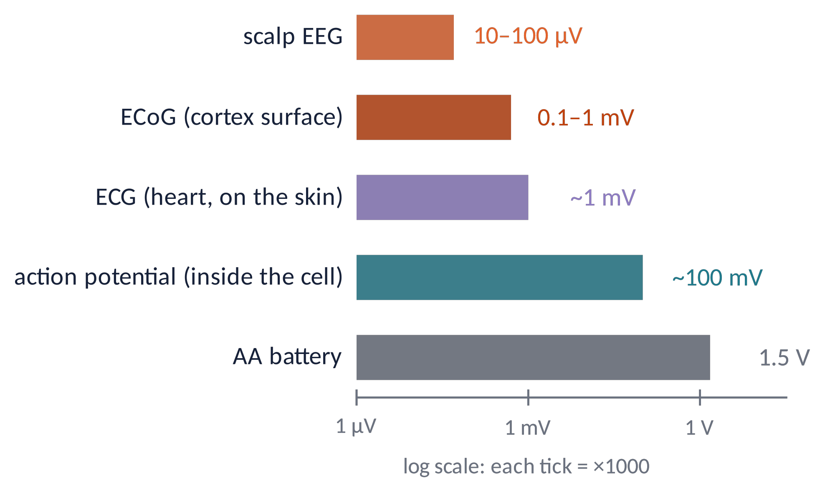
DEFINITION
EEG: a tiny voltage recorded on the scalp
The electroencephalogram is the time course of the potential difference between electrodes on the scalp, generated mainly by the summed postsynaptic currents of millions of cortical pyramidal neurons firing in synchrony.
Scalp EEG: 10–100 µV, i.e. 1000× smaller than the ECG measured on the same skin.
Frequencies of interest: ≈0.5–100 Hz.
⇒ high-gain amplifiers, low electrode impedance, careful artifact control.
Brain Imaging · EEG · Lecture 1 · History and nature of EEG
13
Notes:
Stress the microvolt scale: 1000× smaller than ECG. Hence the importance of amplifiers, impedance and artifacts (Lecture 4).

Slide 14
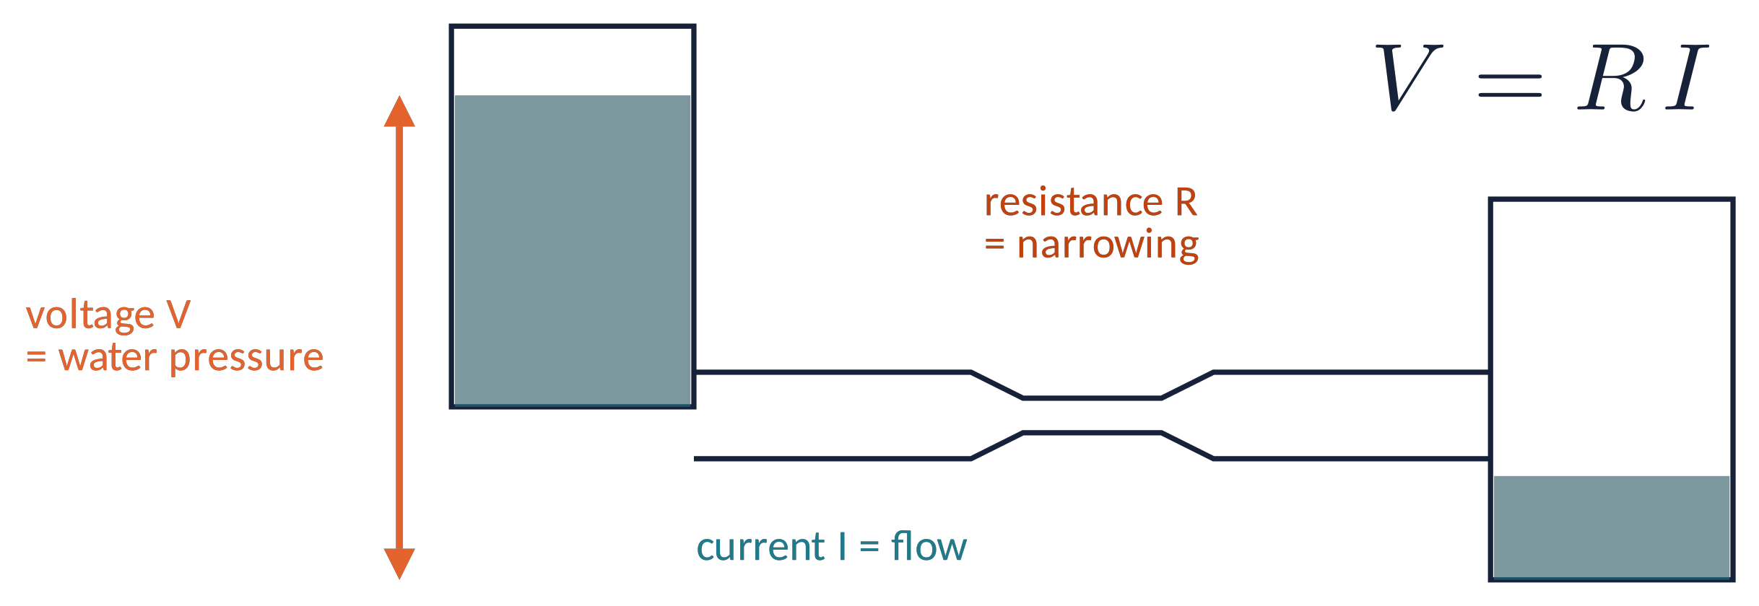
BASIC CONCEPTS
Voltage, current, resistance: a hydraulic analogy
Voltage V (volt)
the "pressure" that pushes charges between two points: always a difference (relative measure)
Current I (ampere)
the amount of charge (ions in the brain!) flowing per unit time
Resistance R (ohm)
how much a medium opposes the flow: tissue, skull, skin, gel
Brain Imaging · EEG · Lecture 1 · History and nature of EEG
14
Notes:
The water analogy helps students without a physics background. Ohm's law V = R I.

Slide 15
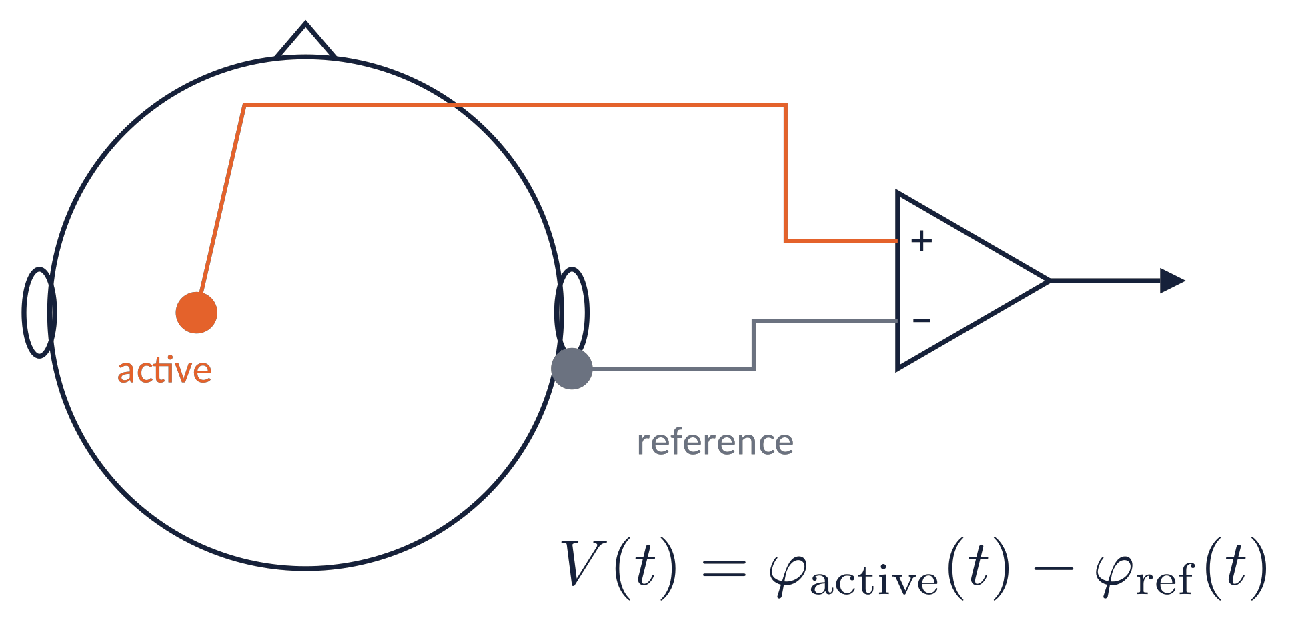
WHAT EEG MEASURES (1)
Every EEG channel is a potential difference
A voltmeter needs two points: the EEG amplifier measures active minus reference.
There is no electrically "silent" place on the body: the reference is never zero.
Changing the reference changes the traces (but not the underlying physics).
Metaphor Measuring altitude: a mountain is "3000 m" only with respect to sea level. Change the reference and all numbers change.
Brain Imaging · EEG · Lecture 1 · History and nature of EEG
15
Notes:
There is no 'absolute' potential: the choice of the reference changes the waveforms (Lecture 4: montages and re-referencing).

Slide 16
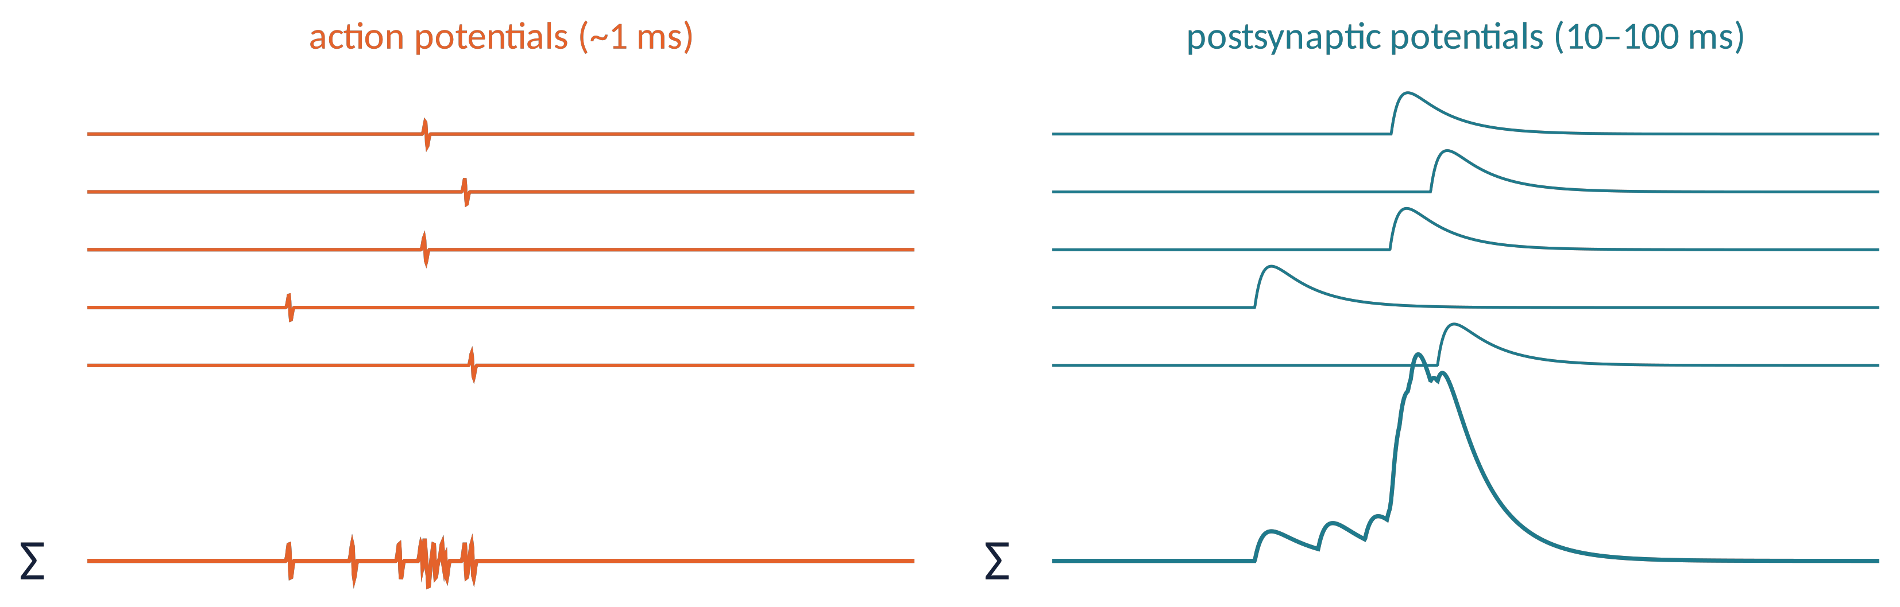
WHAT EEG MEASURES (2)
Spikes or synaptic potentials?
Action potentials: ≈1 ms, biphasic. Unless perfectly synchronous, they do not overlap in time and largely cancel out.
Postsynaptic potentials: 10–100 ms. Slow events from many neurons overlap and add up → they dominate the EEG (with the LFP).
Brain Imaging · EEG · Lecture 1 · History and nature of EEG
16
Notes:
Simulated data: 12 neurons with jittered events. Buzsáki, Anastassiou & Koch (2012) Nat Rev Neurosci 13:407.

Slide 17
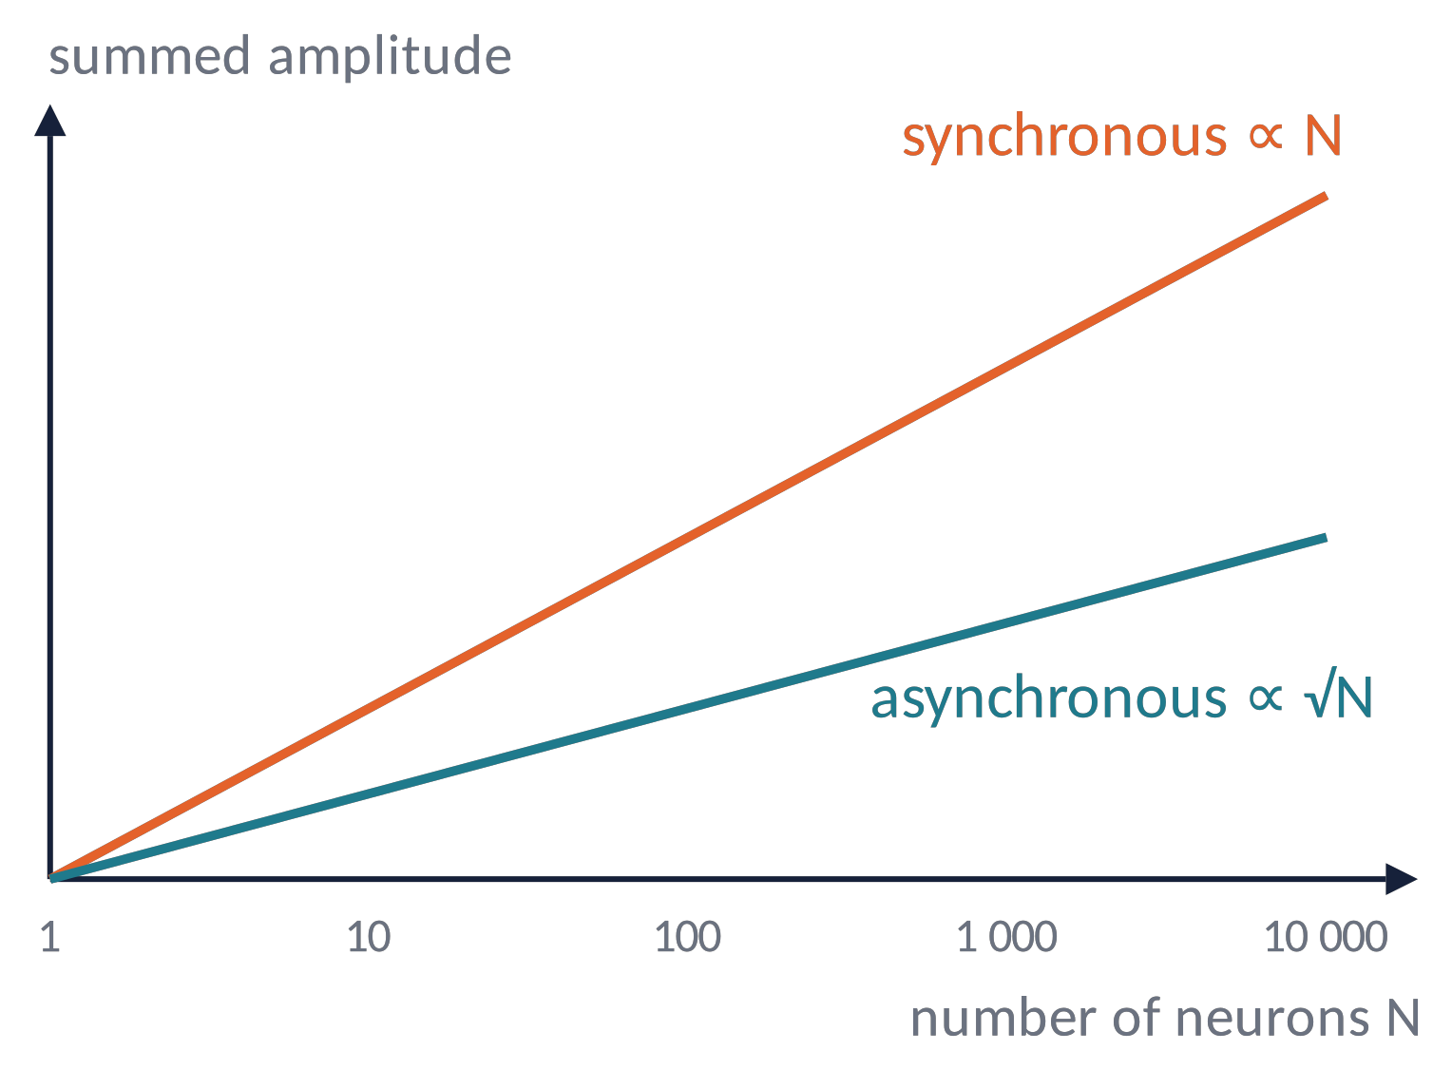
WHAT EEG MEASURES (3)
Synchrony: why a few percent of neurons dominate
N sources with random phases: the sum grows like √N.
N sources in phase: the sum grows like N.
With N = 10⁶ neurons: synchronous activity is ≈1000× larger than asynchronous activity.
The EEG is a measure of synchrony, not of the total amount of neural activity.
Metaphor A stadium: 50 000 people talking = a murmur; 50 000 people shouting the same chant = a roar heard kilometres away.
Brain Imaging · EEG · Lecture 1 · History and nature of EEG
17
Notes:
Random phases add like a random walk (∝√N); equal phases add linearly (∝N). With N = 10^6 the ratio is 1000.

Slide 18
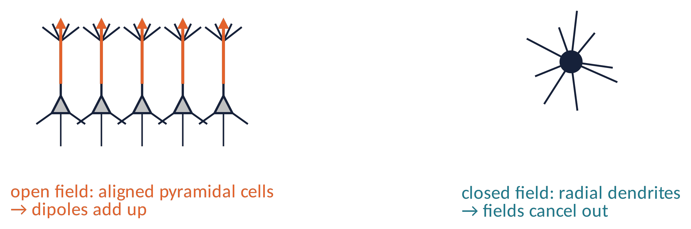
WHAT EEG MEASURES (4)
Geometry matters: open and closed fields
Cortical pyramidal neurons have long apical dendrites aligned perpendicular to the cortical surface: their dipoles add up → open field.
Stellate cells and many deep nuclei (e.g. thalamus) have radially symmetric dendrites: fields cancel at a distance → closed field, almost invisible on the scalp.
Brain Imaging · EEG · Lecture 1 · History and nature of EEG
18
Notes:
Lorente de Nó (1947) introduced open/closed fields. Pyramidal cells in layers III and V are the main generators.

Slide 19
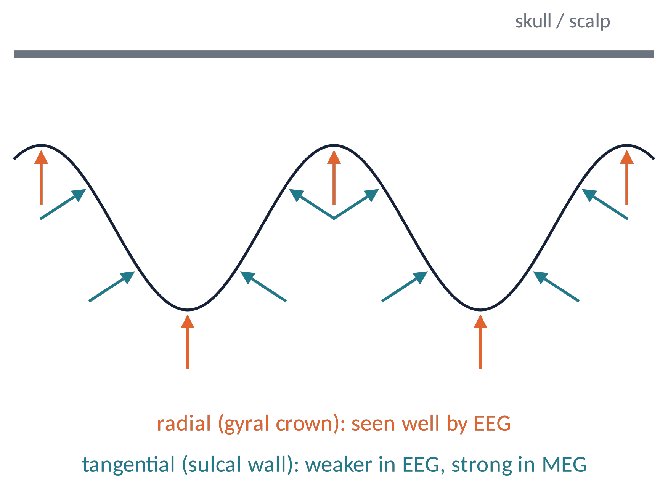
WHAT EEG MEASURES (5)
Three requirements for a scalp-visible signal
Synchrony: many postsynaptic events must occur at the same time.
1
Alignment: the neurons must have the same orientation (pyramidal cells).
2
Extent and orientation: typically ≥ 6–10 cm² of cortex, preferably with radial orientation (gyral crowns).
3
Much neural activity does not meet these requirements → absence of EEG change ≠ absence of neural activity.
Brain Imaging · EEG · Lecture 1 · History and nature of EEG
19
Notes:
Cooper et al. (1965): ≥6 cm² of synchronous cortex; Tao et al. (2005) Epilepsia: ≈10 cm² for interictal spikes on scalp EEG.

Slide 20
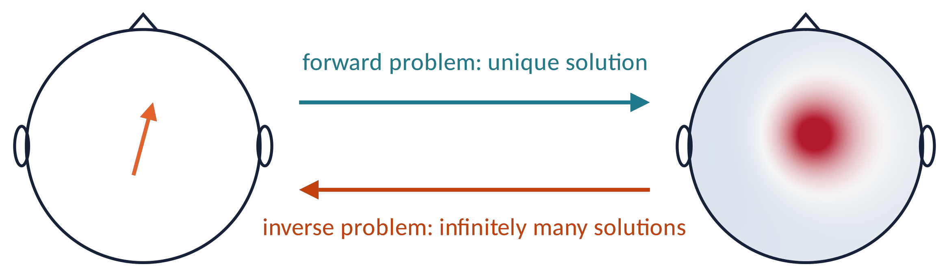
WHAT EEG MEASURES (6)
Volume conduction and the inverse problem
Currents spread through brain, CSF, skull (poor conductor) and scalp: each electrode sees a weighted mix of many sources, spatially blurred over centimetres.
Forward problem: sources → scalp map. Well posed.
Inverse problem: scalp map → sources. Ill posed (Helmholtz, 1853): infinitely many source configurations give the same map → we need constraints (Lecture 9).
Brain Imaging · EEG · Lecture 1 · History and nature of EEG
20
Notes:
Helmholtz (1853): an external field cannot uniquely determine the internal sources. Skull/brain conductivity ratio ≈1:15–1:80 (lower ratios in recent studies).

Slide 21
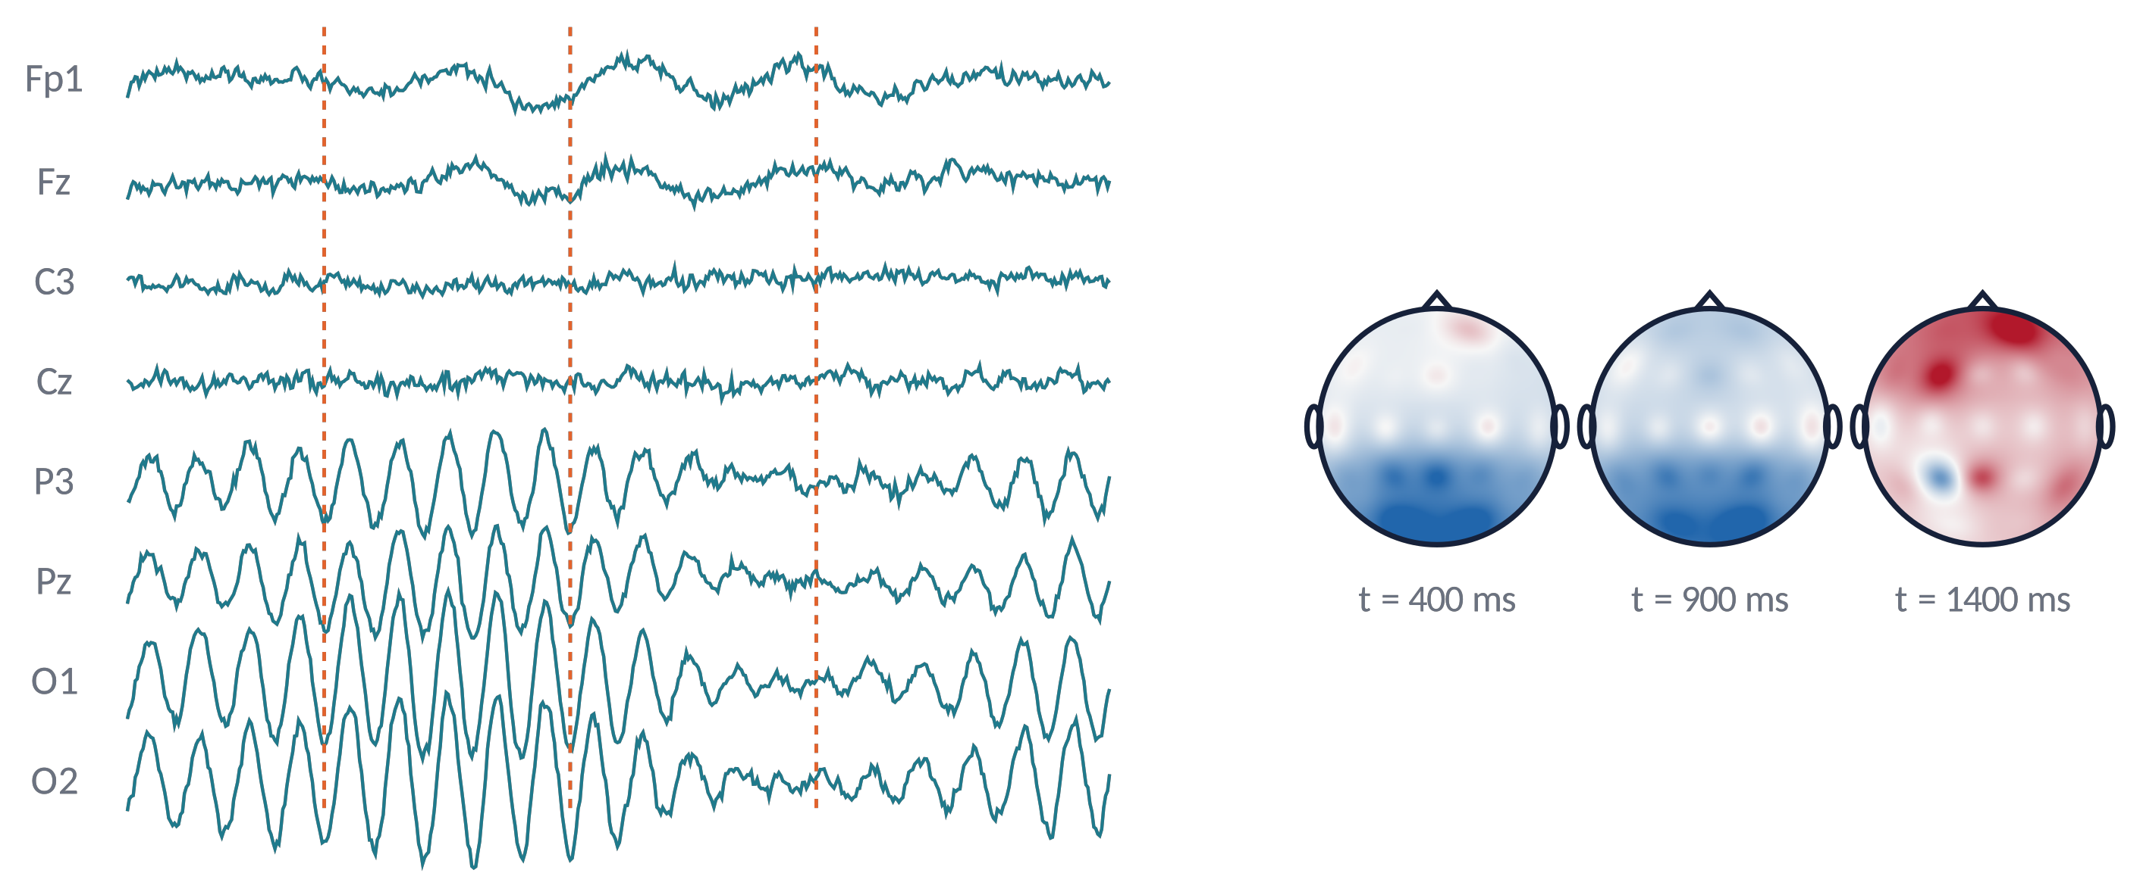
WHAT EEG MEASURES (7)
From channels to topographic maps
Each instant gives one value per electrode → an interpolated scalp map (topography).
The EEG is a movie of maps: time series (lectures 6–7) and spatial patterns (lectures 8–9).
Red/blue = positive/negative with respect to the reference or to the average.
Brain Imaging · EEG · Lecture 1 · History and nature of EEG
21
Notes:
Simulated 19-channel EEG with an occipital alpha source and a frontal slow source; maps interpolated on the scalp.

Slide 22
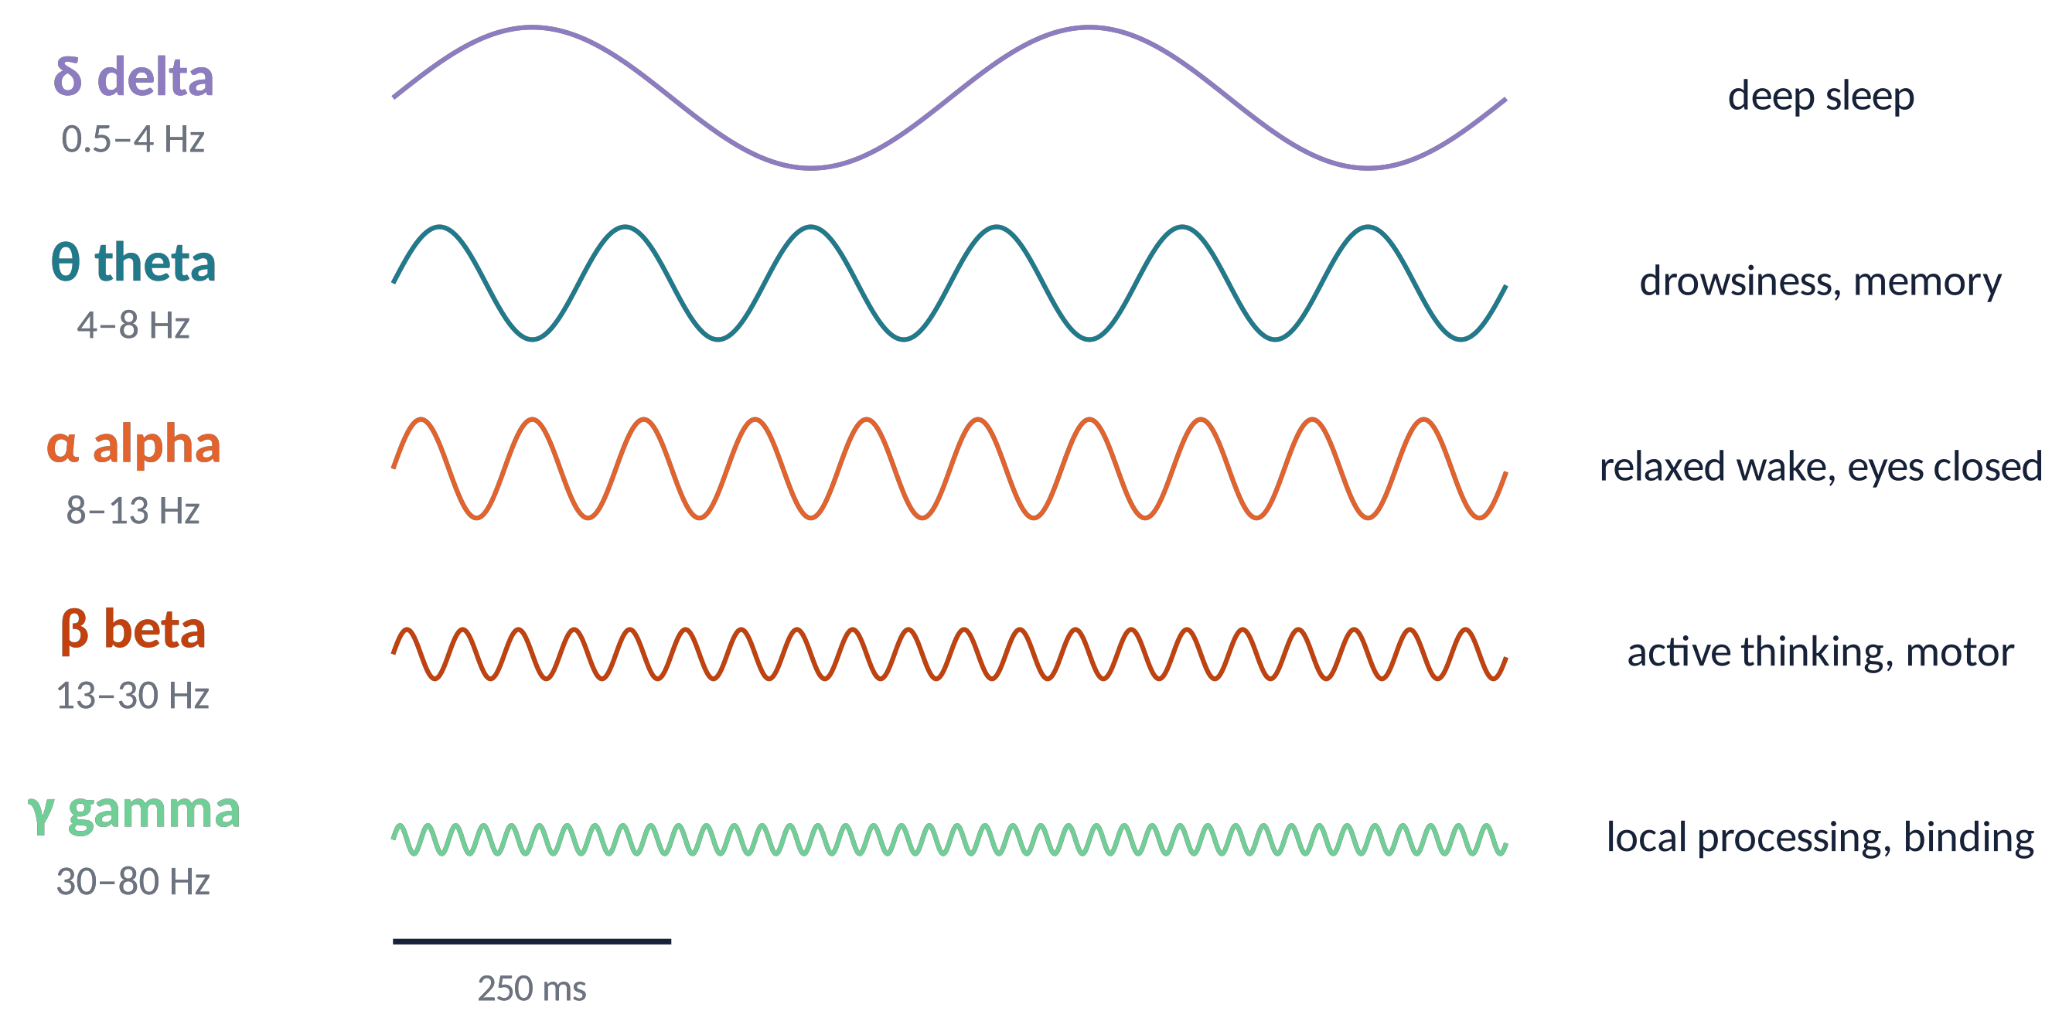
PREVIEW
The EEG rhythms
Rhythms are named with Greek letters, roughly in order of discovery.
Slower rhythms tend to be larger (more neurons synchronised over wider areas).
The power spectrum follows a 1/f trend with peaks (e.g. alpha): Lecture 6.
Brain Imaging · EEG · Lecture 1 · History and nature of EEG
22
Notes:
Band limits vary slightly across textbooks; the IFCN glossary (Kane et al., 2017) gives the standard definitions.

Slide 23
STRENGTHS AND LIMITS
EEG: what it is good at, what it is not
Strengths
millisecond temporal resolution
direct measure of neural (synaptic) activity
non-invasive, safe, silent, cheap, portable, wearable
compatible with movement, fMRI, TMS, real-time use (BCI)
clinical gold standard for epilepsy and sleep
Limitations
poor spatial resolution (cm), ill-posed inverse problem
mostly cortical, radial, synchronous activity
deep structures (hippocampus, thalamus) hardly visible
reference-dependent; sensitive to artifacts (eyes, muscles, heart, line noise)
positive/negative deflection ≠ excitation/inhibition
Brain Imaging · EEG · Lecture 1 · History and nature of EEG
23

Slide 24
ANALYSIS
What will we do with the EEG?
Preprocessing & ICA
Lecture 5
Spectra & time-frequency
Lecture 6
Event-related potentials
Lecture 7
Topographies & microstates
Lecture 8
Sources & connectivity
Lecture 9
Decoding (MVPA)
Lecture 10
Software: EEGLAB, FieldTrip, Brainstorm (MATLAB) · MNE-Python · custom scripts. Analyses are not mutually exclusive: they can (and should) be combined.
Brain Imaging · EEG · Lecture 1 · History and nature of EEG
24
Notes:
Software: EEGLAB (Delorme & Makeig 2004, MATLAB), FieldTrip (Oostenveld et al. 2011, MATLAB), Brainstorm (Tadel et al. 2011), MNE-Python (Gramfort et al. 2013).

Slide 25
CHECK YOUR UNDERSTANDING
Three questions
Why do ≈1 % of synchronously active pyramidal neurons contribute more to the EEG than the remaining 99 %?
1
A colleague says: "at Cz the brain potential is +12 µV". What is missing in this sentence?
2
You want to know whether two visual processes occur 150 ms or 250 ms after a stimulus. EEG or fMRI? Why?
3
Brain Imaging · EEG · Lecture 1 · History and nature of EEG
25
Notes:
Answers: (1) synchrony + alignment: synchronous sum ∝N; (2) no, EEG is a potential difference, it depends on the reference; (3) BOLD peaks ≈5 s later: two events 200 ms apart merge.

Slide 26
TAKE-HOME MESSAGES
Take-home messages
EEG = potential differences on the scalp, µV scale, ms resolution.
1
Generated mainly by synchronous postsynaptic currents of aligned cortical pyramidal neurons.
2
Synchrony, alignment, extent: much neural activity is invisible to the EEG.
3
Volume conduction blurs the scalp maps; the inverse problem is ill-posed.
4
A century of history: from Galvani and Berger to computational neuroscience.
5
Brain Imaging · EEG · Lecture 1 · History and nature of EEG
26

Slide 27
SUGGESTED READING
Suggested reading
Nunez P.L., Srinivasan R. (2006) Electric Fields of the Brain: The Neurophysics of EEG, 2nd ed. Oxford University Press.
Buzsáki G., Anastassiou C.A., Koch C. (2012) The origin of extracellular fields and currents — EEG, ECoG, LFP and spikes. Nat Rev Neurosci 13:407–420.
Cohen M.X. (2014) Analyzing Neural Time Series Data: Theory and Practice. MIT Press.
Luck S.J. (2014) An Introduction to the Event-Related Potential Technique, 2nd ed. MIT Press.
Berger H. (1929) Über das Elektrenkephalogramm des Menschen. Arch Psychiatr Nervenkr 87:527–570.
Caton R. (1875) The electric currents of the brain. Br Med J 2:278.
Sejnowski T.J., Churchland P.S., Movshon J.A. (2014) Putting big data to good use in neuroscience. Nat Neurosci 17:1440–1441.
Tao J.X. et al. (2005) Intracranial EEG substrates of scalp EEG interictal spikes. Epilepsia 46:669–676.
Brain Imaging · EEG · Lecture 1 · History and nature of EEG
27

