Slide 1

MSC IN COMPUTATIONAL COGNITIVE SCIENCE
Brain Imaging – Methods and Applications
Module: Electroencephalography (EEG)
Lecture 2
The cellular bases
of the EEG
Pierpaolo Croce
A.Y. 2026-2027

Slide 2
LECTURE 2
From ions to scalp potentials: today's path
The neuron and its membrane: why a cell has a voltage.
1
Resting potential: diffusion vs electric force, Nernst and Goldman equations.
2
Action potential: voltage-gated channels, threshold, propagation (Hodgkin–Huxley).
3
Synapses: EPSP/IPSP, temporal and spatial summation.
4
From synapses to EEG: sinks and sources, pyramidal cells, thalamocortical loops and rhythms.
5
Brain Imaging · EEG · Lecture 2 · Cellular bases of EEG
2
Notes:
Link to Lecture 1: we said EEG = synchronous postsynaptic currents. Today we open the black box of the single neuron.

Slide 3
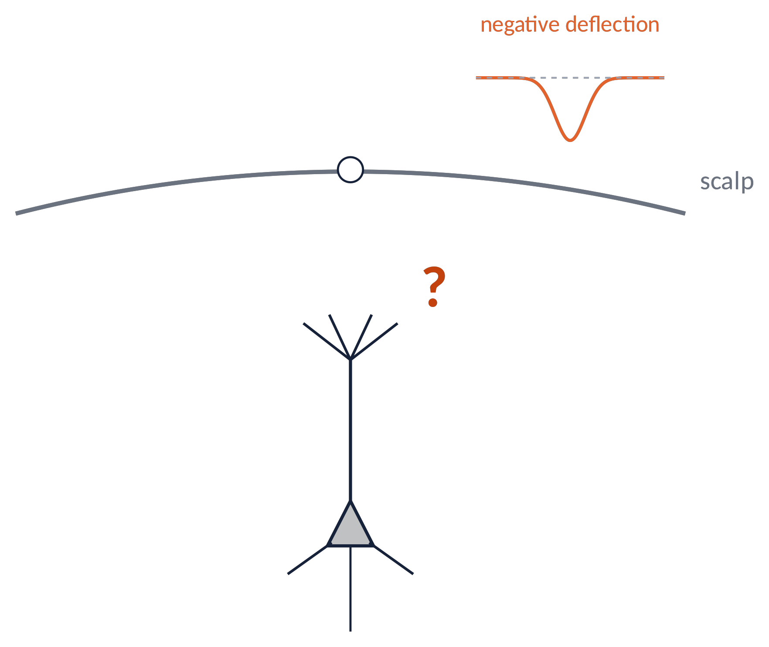
THE QUESTION
What happens in a neuron when the EEG goes down?
A scalp electrode records a negative deflection lasting tens of milliseconds.
Which cellular events produce it? Where do the currents flow? Why tens of ms and not 1 ms?
To answer we need four ingredients: membrane, ions, channels, synapses.
⚠ Polarity conventions differ: clinical EEG often plots negative up. Always check the axis.
Brain Imaging · EEG · Lecture 2 · Cellular bases of EEG
3
Notes:
By EEG convention negative is often plotted up (clinical) or down (research): always check the axis!

Slide 4
01
The neuron and its membrane
4

Slide 5
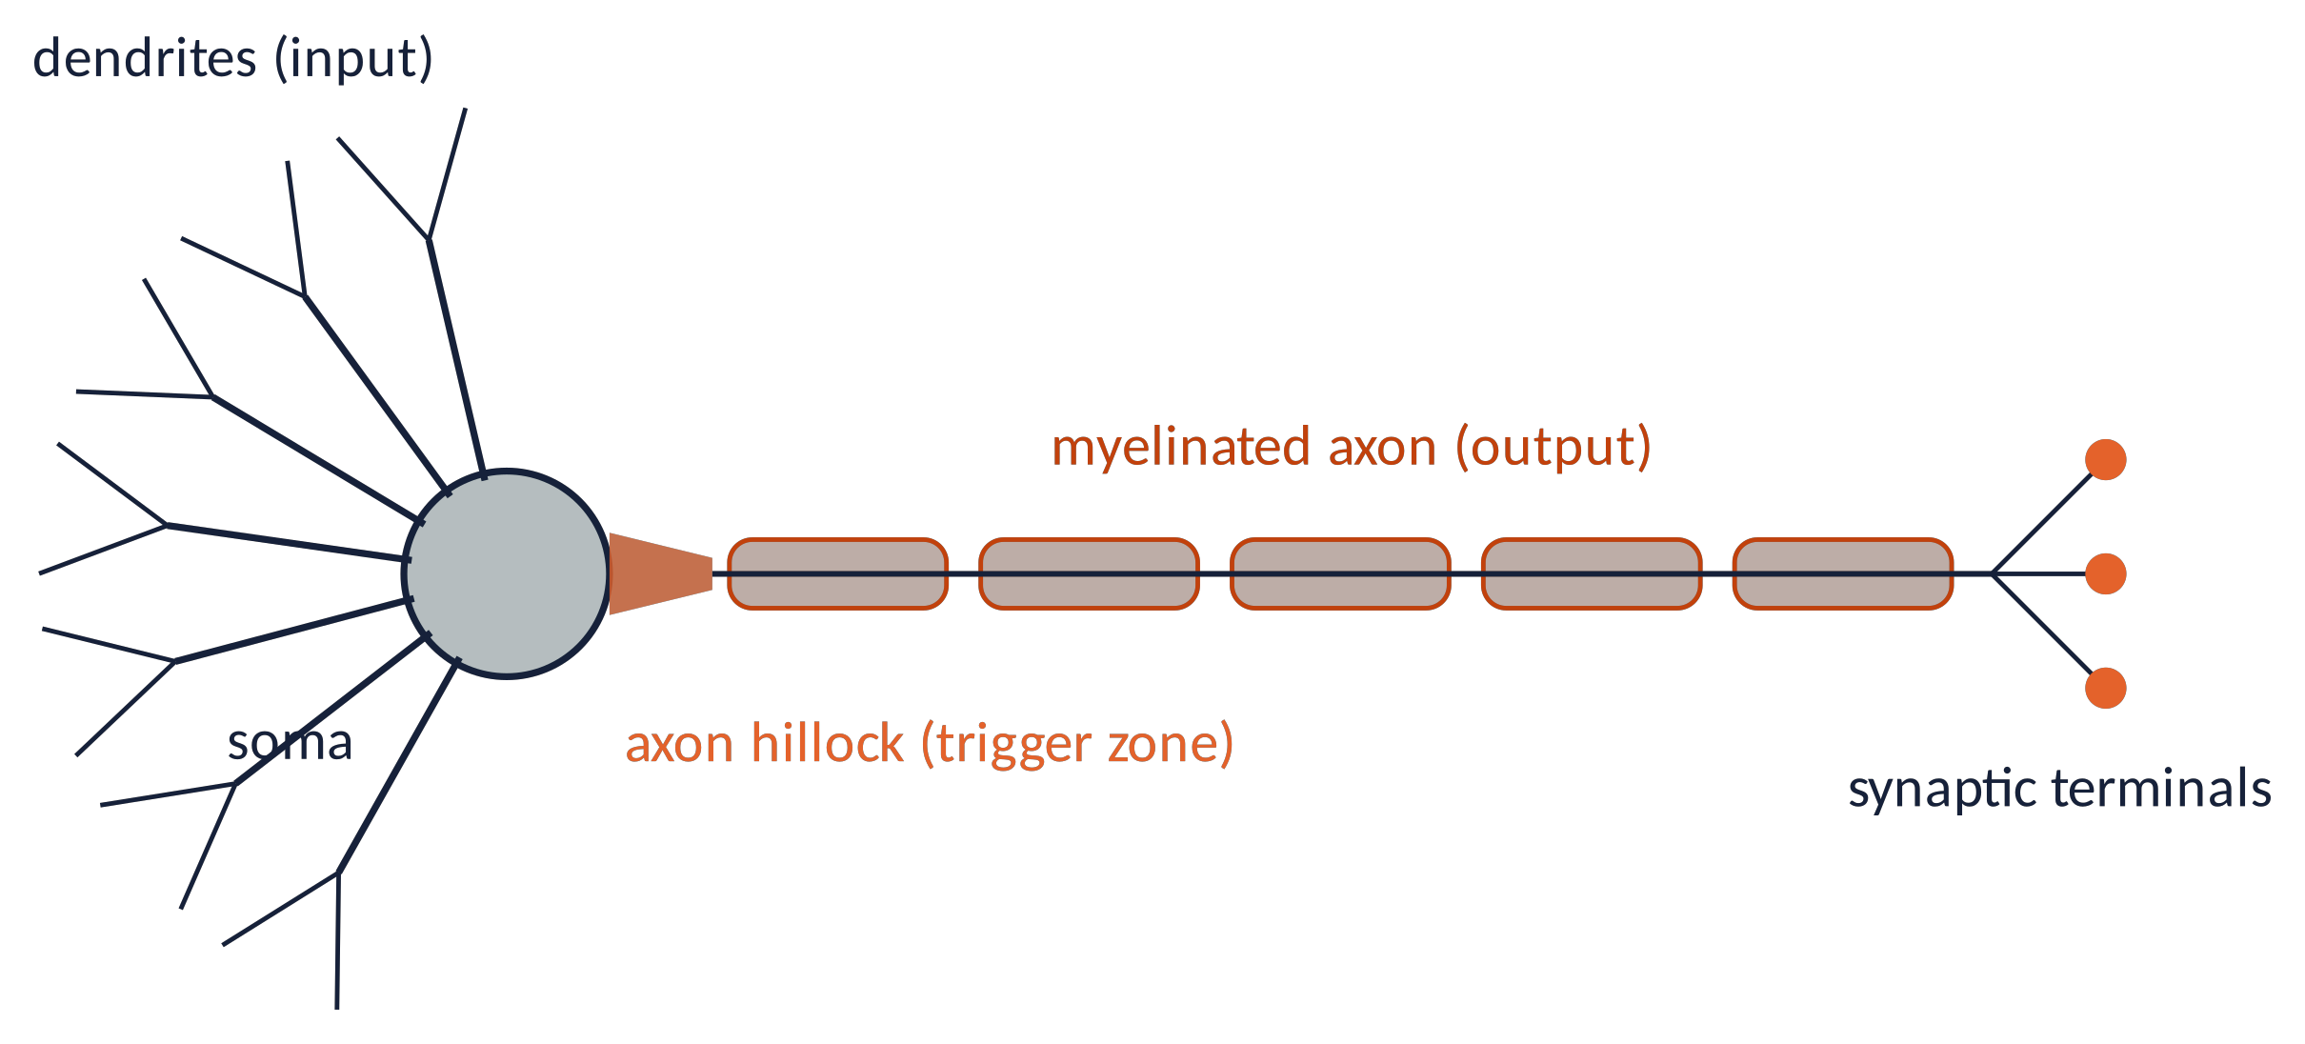
THE NEURON
A cell specialised to receive, integrate and transmit
Dendrites
receive thousands of synaptic inputs (≈10⁴ in a pyramidal cell)
Soma
cell body: nucleus, metabolism, integration
Axon hillock
highest density of Na⁺ channels: where spikes start
Axon & terminals
carry the spike and release neurotransmitter
Brain Imaging · EEG · Lecture 2 · Cellular bases of EEG
5
Notes:
Numbers: a cortical pyramidal cell receives ~10^4 synapses; dendrites ~90% of the membrane surface.

Slide 6
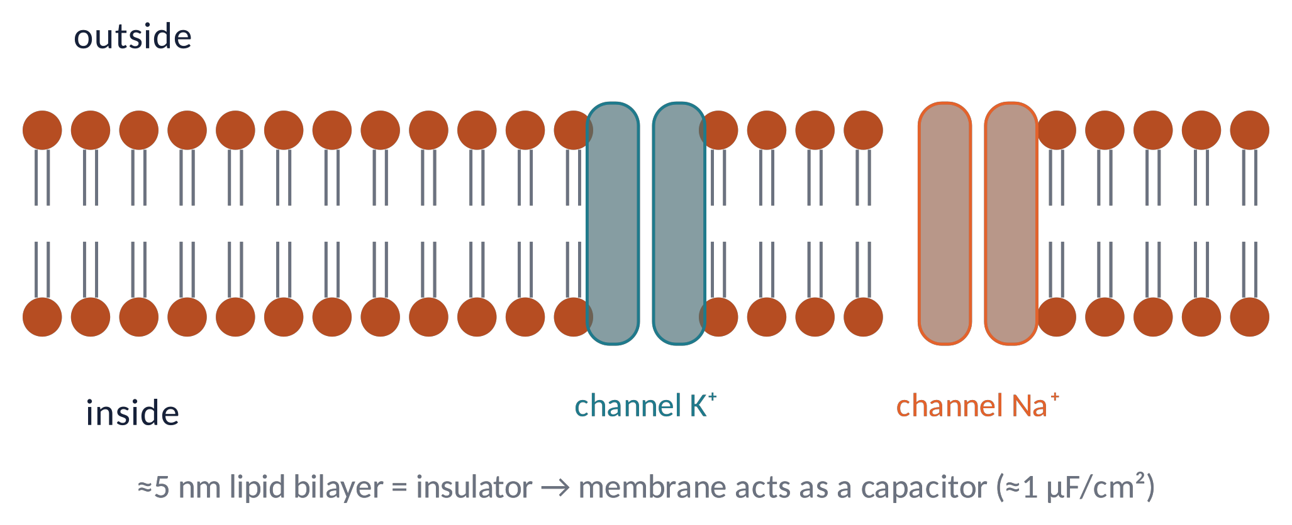
THE MEMBRANE
A thin insulator with gates: the membrane is a capacitor
The phospholipid bilayer (≈5 nm) does not let ions through: it separates charges → it behaves like a capacitor.
Ion channels are proteins that form selective pores: they open/close depending on voltage, ligands or mechanical stimuli.
Pumps (Na⁺/K⁺-ATPase) use ATP to keep concentrations different inside and outside.
Metaphor the membrane is a dam: the pumps fill the reservoir, the channels are the sluice gates.
Brain Imaging · EEG · Lecture 2 · Cellular bases of EEG
6
Notes:
Specific capacitance ≈1 µF/cm² (Hille, Ion Channels of Excitable Membranes).

Slide 7
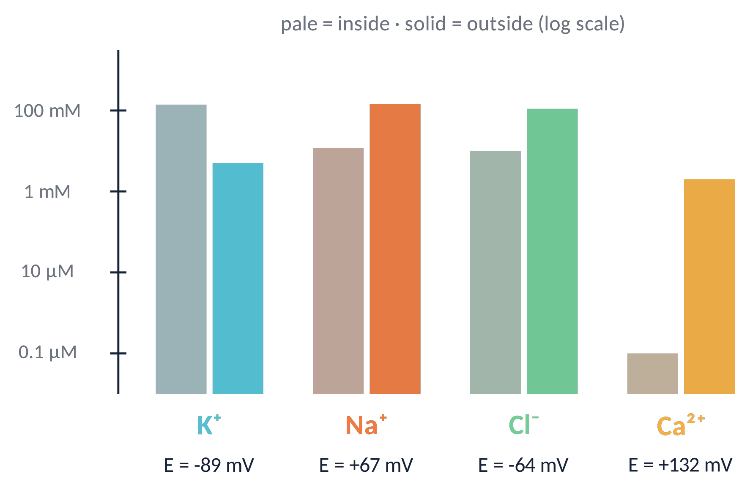
IONS
Unequal ion concentrations inside and outside
K⁺ is concentrated inside (≈140 vs 5 mM).
Na⁺, Cl⁻ and Ca²⁺ are concentrated outside.
Ca²⁺ inside is 10 000× lower: tiny influxes are powerful signals (e.g. transmitter release).
Each gradient stores energy, like a charged battery.
Brain Imaging · EEG · Lecture 2 · Cellular bases of EEG
7
Notes:
Typical mammalian values (Kandel et al., Principles of Neural Science; Hille 2001). E computed with the Nernst equation at 37 °C.

Slide 8
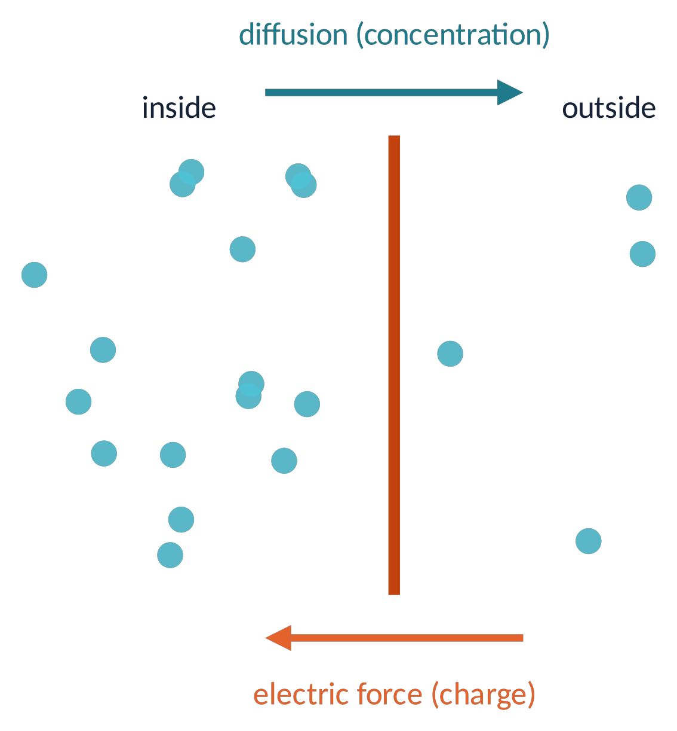
RESTING POTENTIAL (1)
Two forces on every ion: diffusion and electricity
If the membrane lets only K⁺ through, K⁺ diffuses out down its concentration gradient.
Every K⁺ that leaves carries a positive charge → the inside becomes negative → an electric force pulls K⁺ back.
Equilibrium when the two forces balance: the equilibrium (Nernst) potential.
E_{ion} = ( R T / z F ) · ln ( [ion]_{out} / [ion]_{in} )
At 37 °C, RT/F ≈ 26.7 mV → E_{K} ≈ −89 mV, E_{Na} ≈ +67 mV.
Brain Imaging · EEG · Lecture 2 · Cellular bases of EEG
8
Notes:
Thought experiment: membrane permeable only to K⁺. K⁺ leaves → inside becomes negative → electrical attraction pulls K⁺ back. Equilibrium at E_K.

Slide 9
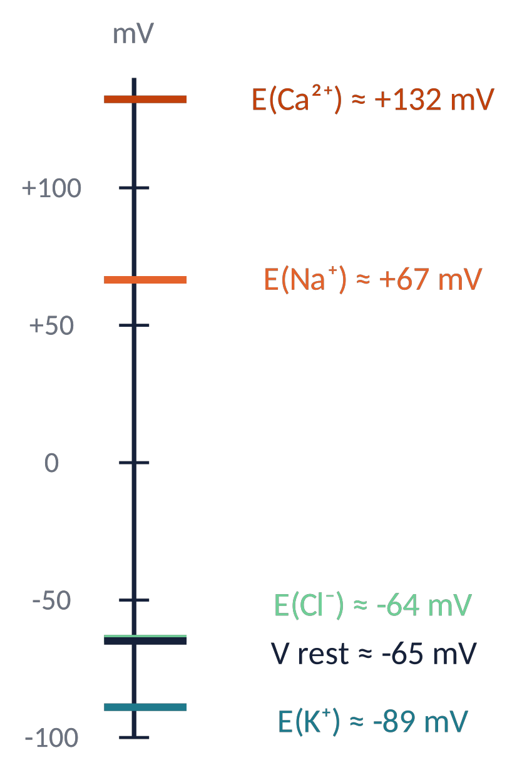
RESTING POTENTIAL (2)
The resting potential: a weighted vote of the ions
V_{rest} = ( R T / F ) ln [ ( p_{K} [K]_{o} + p_{Na} [Na]_{o} + p_{Cl} [Cl]_{i} ) / ( p_{K} [K]_{i} + p_{Na} [Na]_{i} + p_{Cl} [Cl]_{o} ) ]
Goldman–Hodgkin–Katz equation: each ion pulls V toward its own E, weighted by its permeability p.
At rest the membrane is mostly permeable to K⁺ (p_{K} : p_{Na} : p_{Cl} ≈ 1 : 0.05 : 0.45) → V_{rest} ≈ −65 mV, close to E_{K}.
Changing permeabilities (opening channels) moves V: this is how neurons signal.
The Na⁺/K⁺ pump (3 Na⁺ out, 2 K⁺ in) keeps the gradients in the long run.
Brain Imaging · EEG · Lecture 2 · Cellular bases of EEG
9
Notes:
GHK with pK:pNa:pCl = 1:0.05:0.45 gives ≈ −65 mV (Hodgkin & Katz 1949).

Slide 10
02
The action potential
10

Slide 11
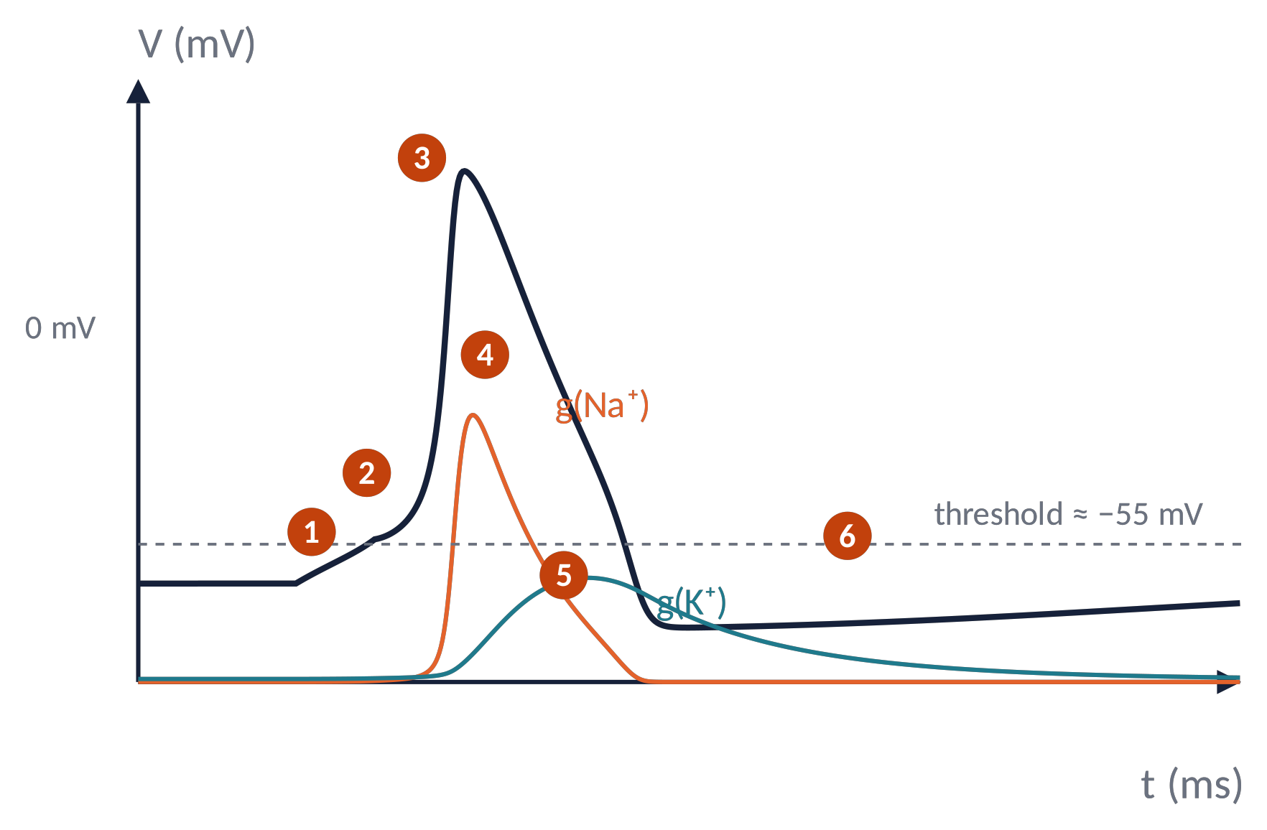
ACTION POTENTIAL (1)
Anatomy of a spike (Hodgkin–Huxley model)
1
Stimulus depolarises the membrane
2
Threshold: Na⁺ channels open (positive feedback)
3
Rising phase: Na⁺ rushes in, V → +40 mV
4
Na⁺ channels inactivate, K⁺ channels open
5
Repolarisation and after-hyperpolarisation (near E_{K})
6
Refractory period, return to rest
Brain Imaging · EEG · Lecture 2 · Cellular bases of EEG
11
Notes:
Simulated with the original HH (1952) squid-axon equations, modern convention (rest −65 mV). Nobel Prize 1963.

Slide 12
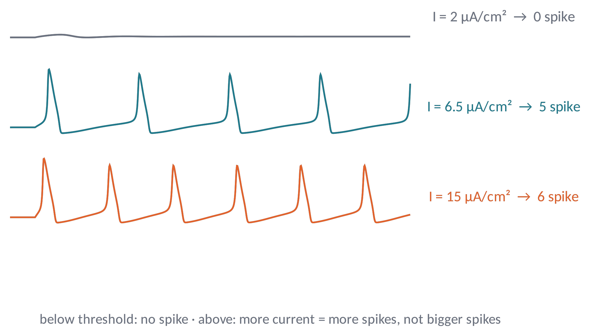
ACTION POTENTIAL (2)
All-or-none: information is in the rate, not the size
Below threshold: no spike. Above: a stereotyped spike of ≈100 mV and ≈1 ms.
A stronger input produces more spikes (rate code), not bigger ones.
After a spike, a refractory period (≈1–2 ms absolute) limits the maximum rate.
Metaphor a flushing toilet: press gently and nothing happens; press past the point and the flush is always the same.
Brain Imaging · EEG · Lecture 2 · Cellular bases of EEG
12
Notes:
Same HH model with sustained currents: below ~6 µA/cm² no repetitive firing; above it the rate increases with current.

Slide 13
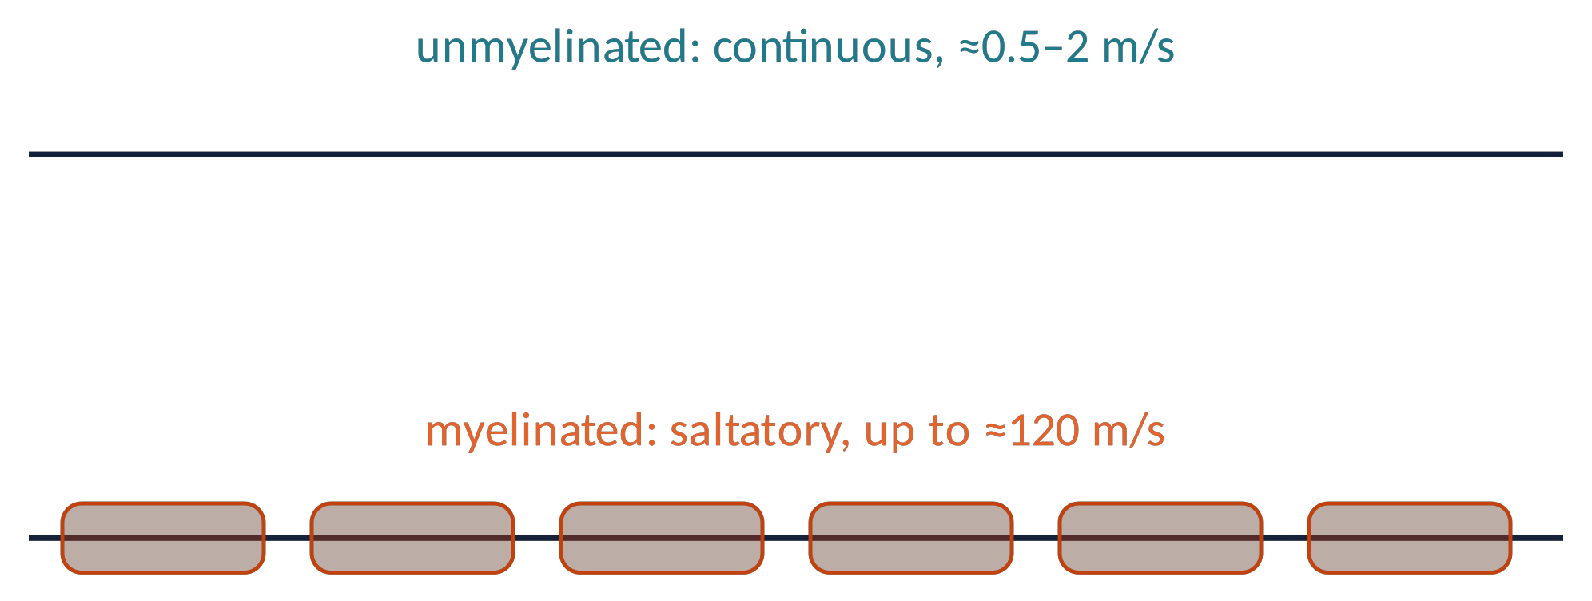
ACTION POTENTIAL (3)
Propagation: continuous and saltatory conduction
The spike regenerates itself along the axon: local currents depolarise the next patch above threshold.
Myelin (oligodendrocytes/Schwann cells) insulates the axon: the spike jumps from one node of Ranvier to the next → faster and cheaper.
For EEG: spikes are fast (≈1 ms) and travel away: they contribute little to the scalp signal (except high-frequency activity).
Brain Imaging · EEG · Lecture 2 · Cellular bases of EEG
13
Notes:
Conduction velocity: ~0.5–2 m/s unmyelinated C fibres, up to ~120 m/s large myelinated Aα fibres.

Slide 14
03
Synapses: where the EEG is born
14

Slide 15
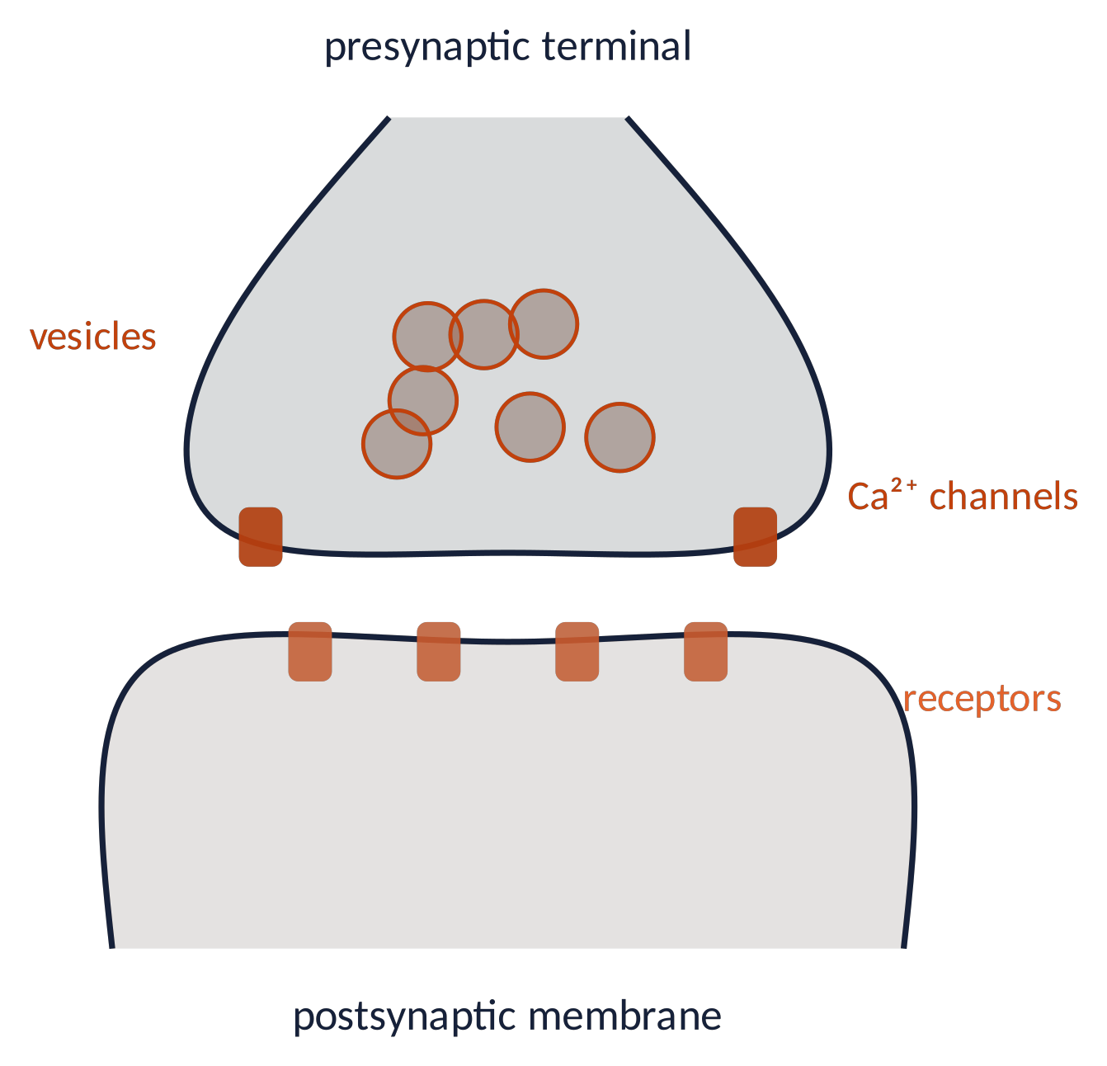
SYNAPSES (1)
Chemical synaptic transmission, step by step
The spike reaches the terminal
1
Voltage-gated Ca²⁺ channels open, Ca²⁺ enters
2
Vesicles fuse and release neurotransmitter
3
Transmitter binds postsynaptic receptors (ion channels)
4
Ions flow → postsynaptic potential (PSP) lasting 10–100 ms
5
Brain Imaging · EEG · Lecture 2 · Cellular bases of EEG
15
Notes:
Synaptic delay ≈0.5–1 ms. Ca²⁺ entry triggers vesicle fusion (SNARE proteins).

Slide 16
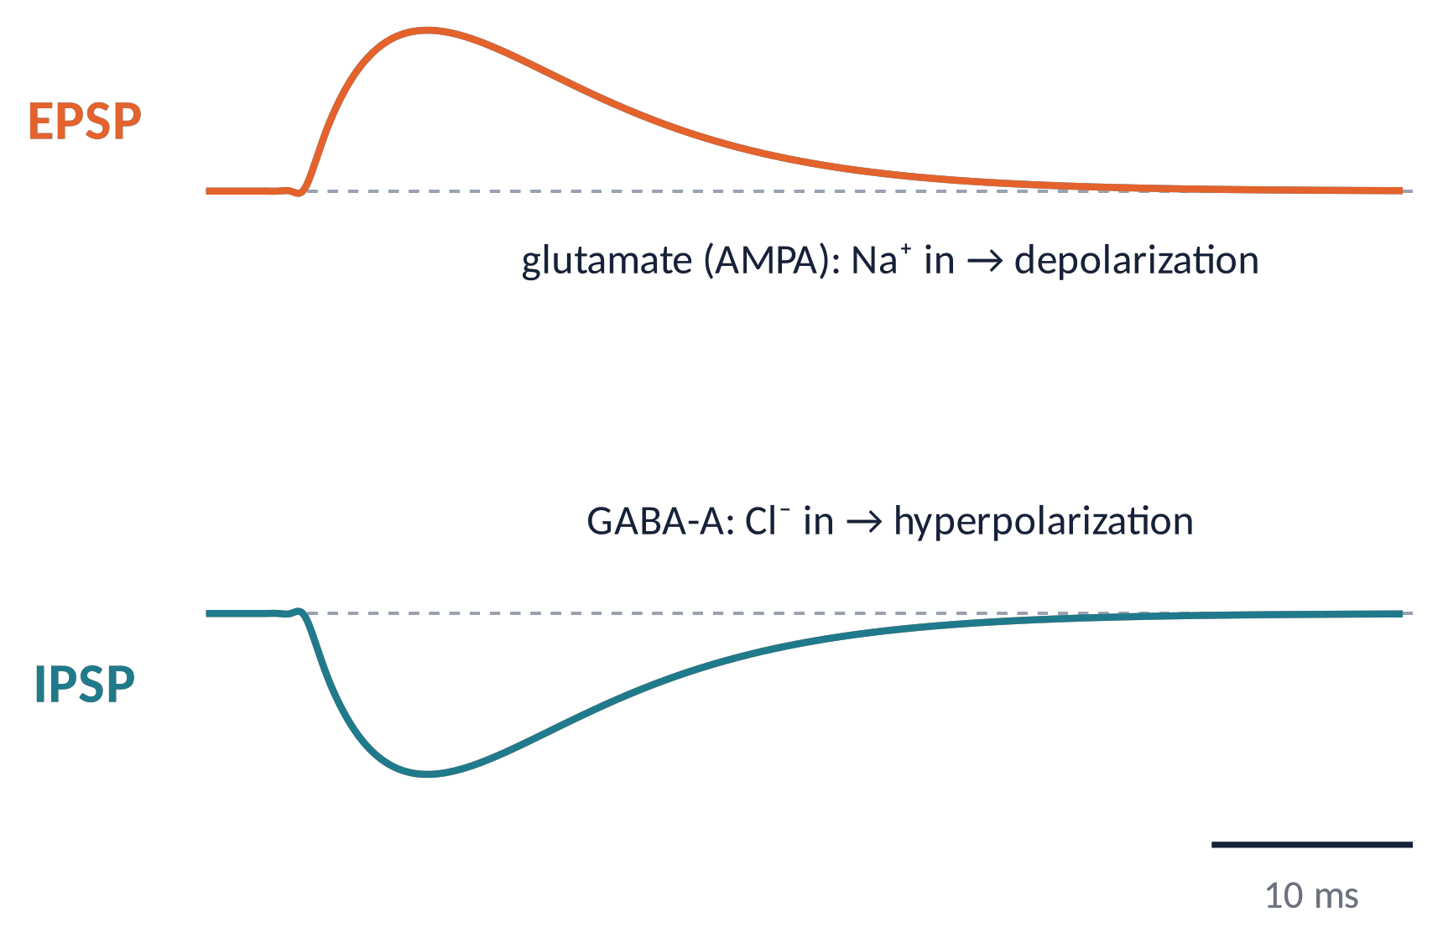
SYNAPSES (2)
Excitatory and inhibitory synapses
Excitatory (mostly glutamate): cation channels (AMPA, NMDA) → depolarisation = EPSP, moves V toward threshold.
Inhibitory (mostly GABA): Cl⁻ (GABA_{A}) or K⁺ (GABA_{B}) channels → hyperpolarisation or shunting = IPSP.
PSPs are graded (size ∝ input) and slow: ideal for summation.
Brain Imaging · EEG · Lecture 2 · Cellular bases of EEG
16
Notes:
Simulated alpha-function PSPs (τ = 6 ms). NMDA and GABA_B components are slower (100+ ms).

Slide 17
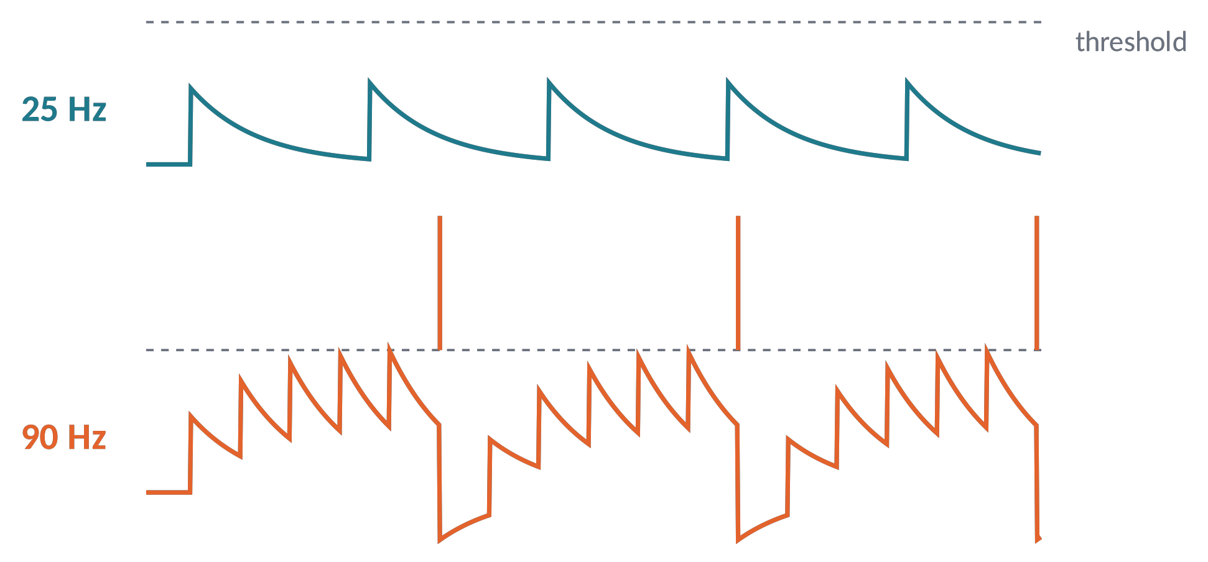
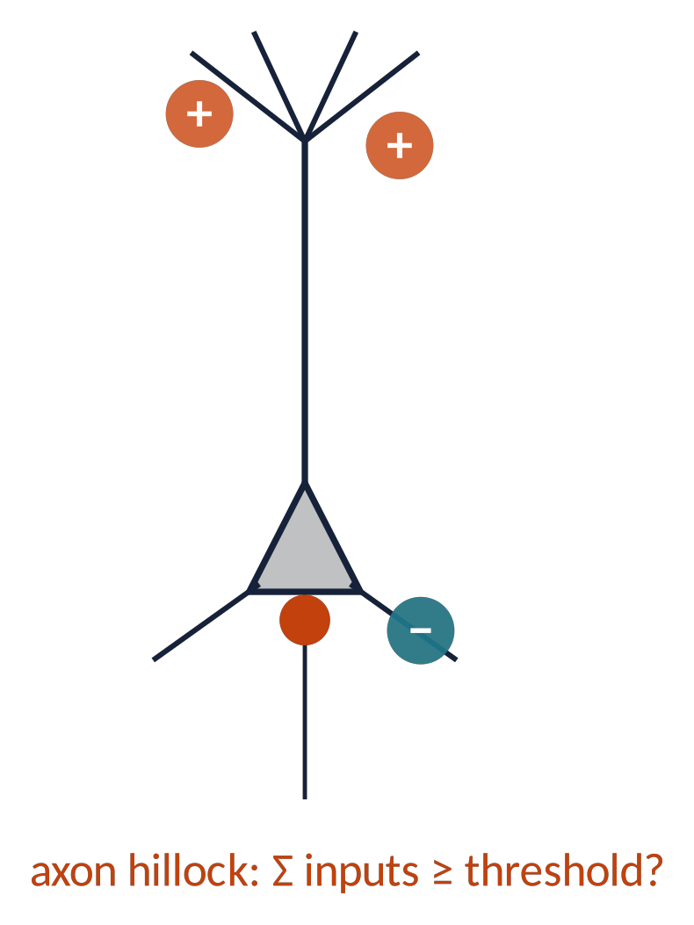
SYNAPSES (3)
Integration: temporal and spatial summation
Temporal: PSPs arriving close in time pile up before they decay → high input rates reach threshold.
Spatial: PSPs from different synapses add at the soma; IPSPs subtract.
The axon hillock decides: fire or not.
Metaphor a committee vote: yes (EPSP) and no (IPSP) votes, counted by the chair (axon hillock).
Brain Imaging · EEG · Lecture 2 · Cellular bases of EEG
17
Notes:
Leaky integrator with τ = 15 ms, EPSP = 8 mV, threshold −55 mV: 25 Hz input never fires, 90 Hz does.

Slide 18
04
From synapses to the scalp EEG
18

Slide 19
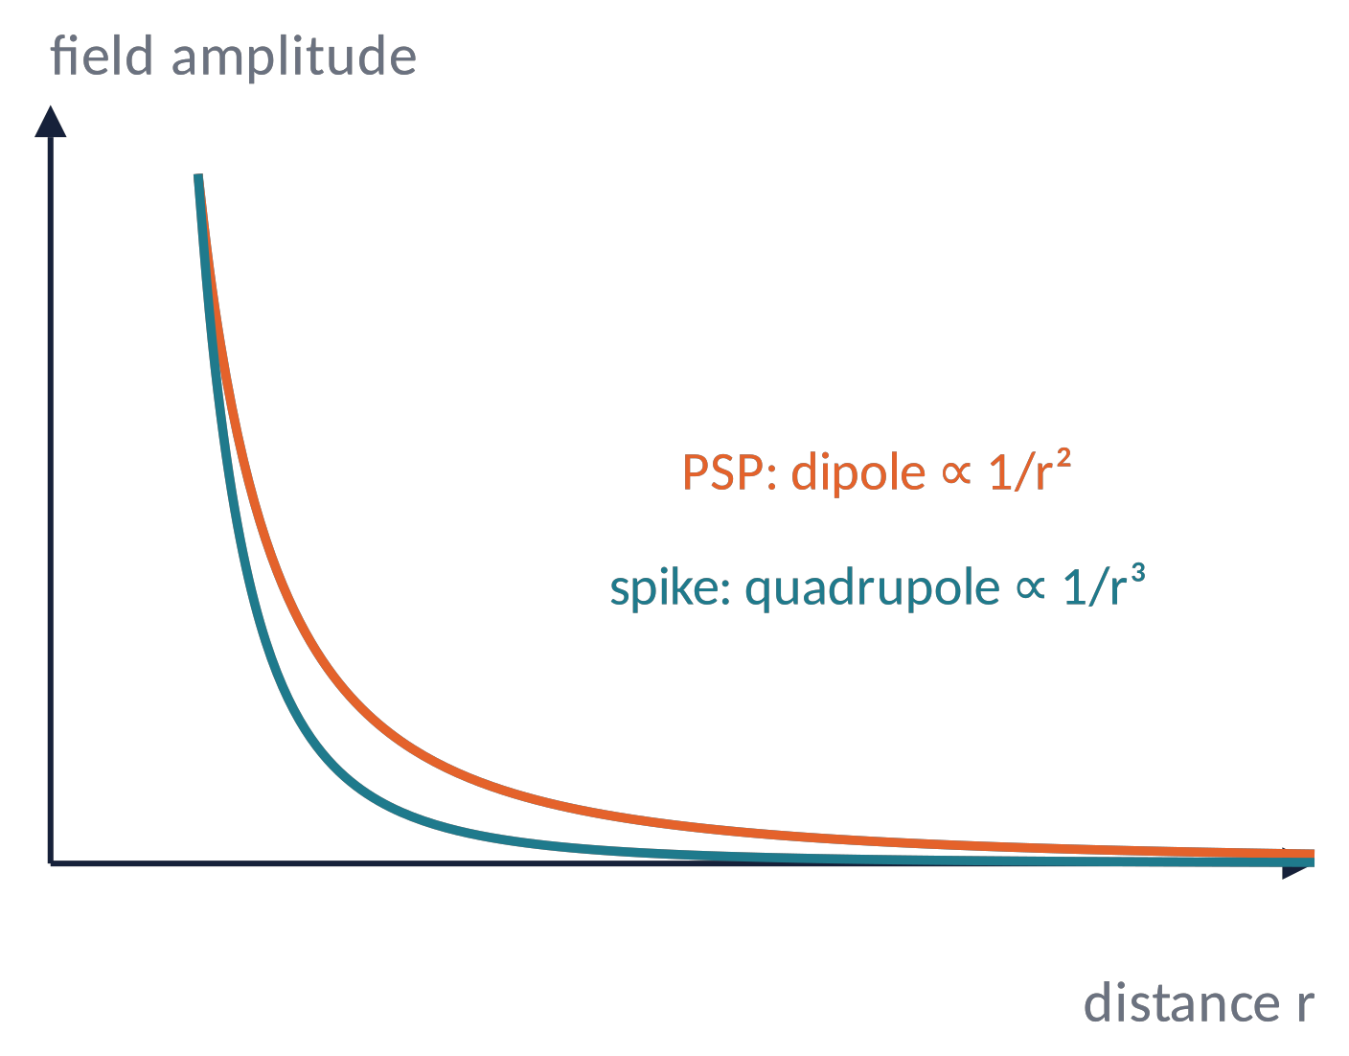
SYNAPSES → EEG (1)
Why postsynaptic potentials, not spikes, make the EEG
Postsynaptic potential
duration 10–100 ms
current dipole: field ∝ 1/r²
good temporal summation
Action potential
duration ≈1 ms
quadrupole: field ∝ 1/r³
poor temporal summation
Scalp EEG ≈ summed postsynaptic (dendritic) currents of many synchronous neurons.
Brain Imaging · EEG · Lecture 2 · Cellular bases of EEG
19
Notes:
Buzsáki, Anastassiou & Koch (2012); Nunez & Srinivasan (2006). High-gamma (>80 Hz) partly reflects spiking.

Slide 20
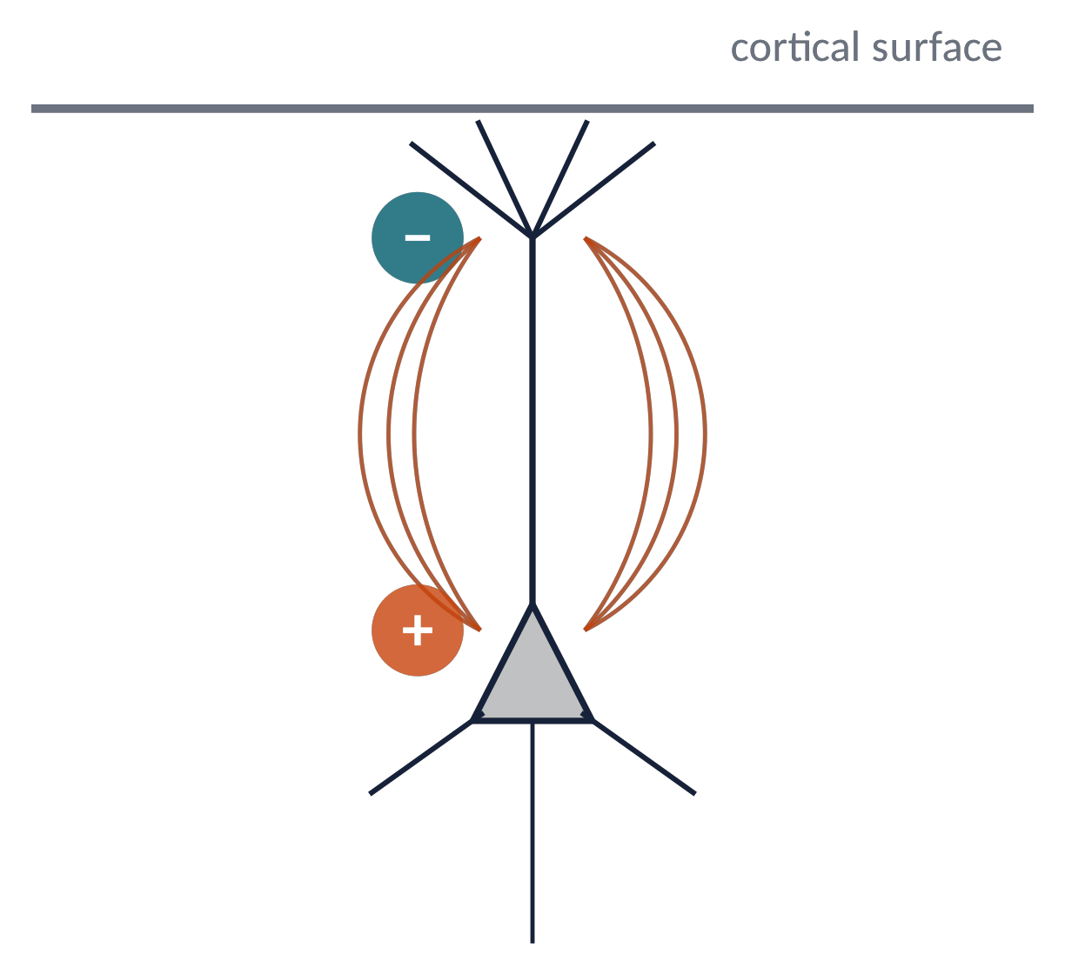
SYNAPSES → EEG (2)
Current sinks and sources: the origin of polarity
An excitatory synapse on the apical dendrite: positive ions enter → extracellular sink (−) near the surface.
Current exits along the cell (near the soma) → source (+) in depth. The loop closes in the extracellular space.
Sink above, source below = a current dipole → surface electrode sees a negative potential.
⚠ An IPSP near the soma produces the same pattern! Polarity alone cannot tell excitation from inhibition.
Brain Imaging · EEG · Lecture 2 · Cellular bases of EEG
20
Notes:
Classic scheme (e.g. Kandel; Speckmann & Elger). Same scalp polarity from superficial EPSP or deep IPSP: polarity is ambiguous.

Slide 21
SYNAPSES → EEG (3)
Pyramidal neurons are the main EEG generators
Pyramidal cells
≈70–80 % of neocortical neurons
long apical dendrites, parallel to each other
perpendicular to the cortical surface (layers III, V)
→ open field: they add up
Stellate cells and interneurons
≈20–30 % of neocortical neurons
radially symmetric dendrites
strong metabolic activity (visible in PET/fMRI)
→ closed field: "ghosts" for the EEG
Different methods see different cells: EEG ≠ fMRI is not an error, it is physiology.
Brain Imaging · EEG · Lecture 2 · Cellular bases of EEG
21
Notes:
Pyramidal cells ≈70–80% of neocortical neurons; stellate/interneurons ≈20–30% with closed-field geometry.

Slide 22
05
Thalamocortical loops and rhythms
22

Slide 23
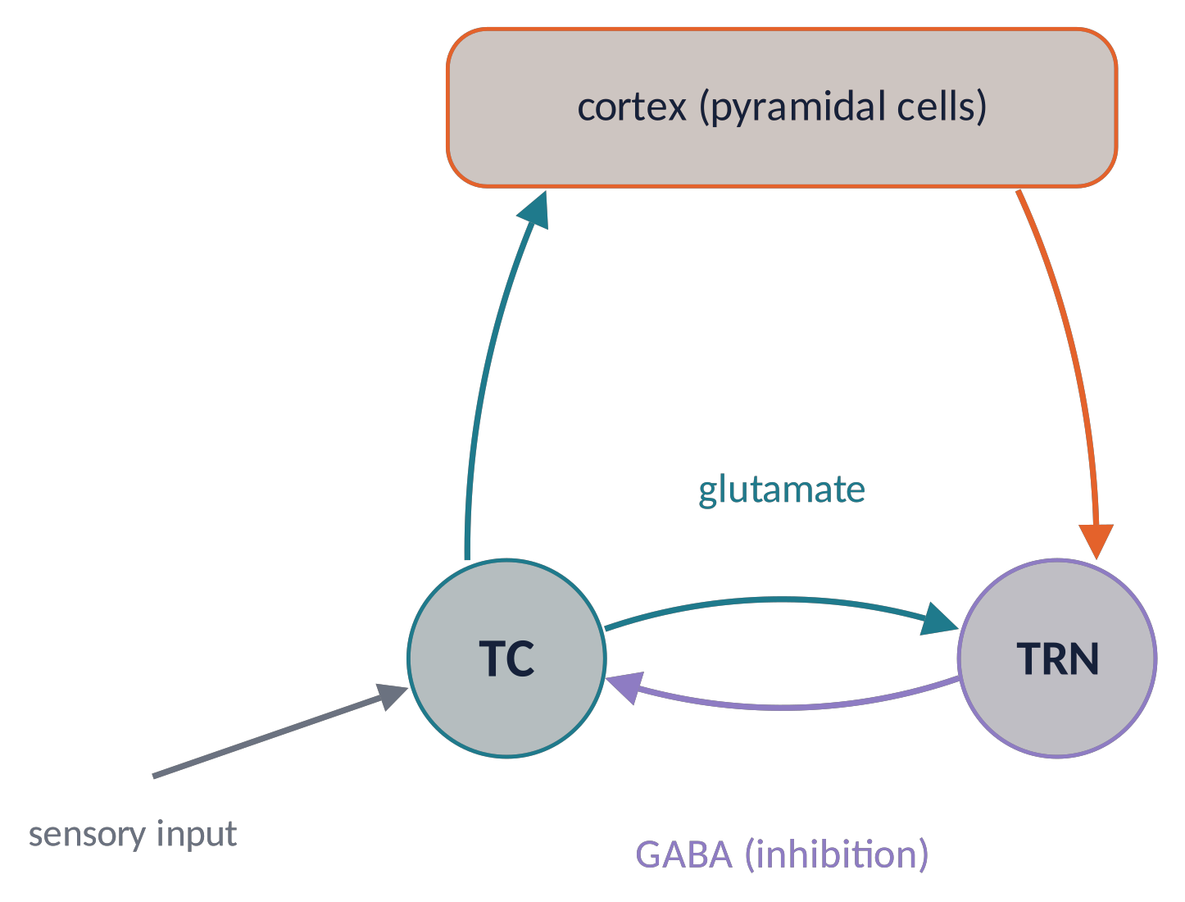
RHYTHMS (1)
The thalamocortical loop: a rhythm generator
Thalamocortical (TC) neurons relay sensory information to the cortex (glutamate).
The thalamic reticular nucleus (TRN) receives collaterals and inhibits TC cells (GABA).
Excitation → inhibition → rebound → excitation: the loop oscillates and paces large cortical populations.
The cortex does not "see" the thalamus directly, but the synchronised cortical PSPs it drives.
Brain Imaging · EEG · Lecture 2 · Cellular bases of EEG
23
Notes:
Steriade, McCormick & Sejnowski (1993) Science 262:679. TRN = thalamic reticular nucleus, GABAergic.

Slide 24
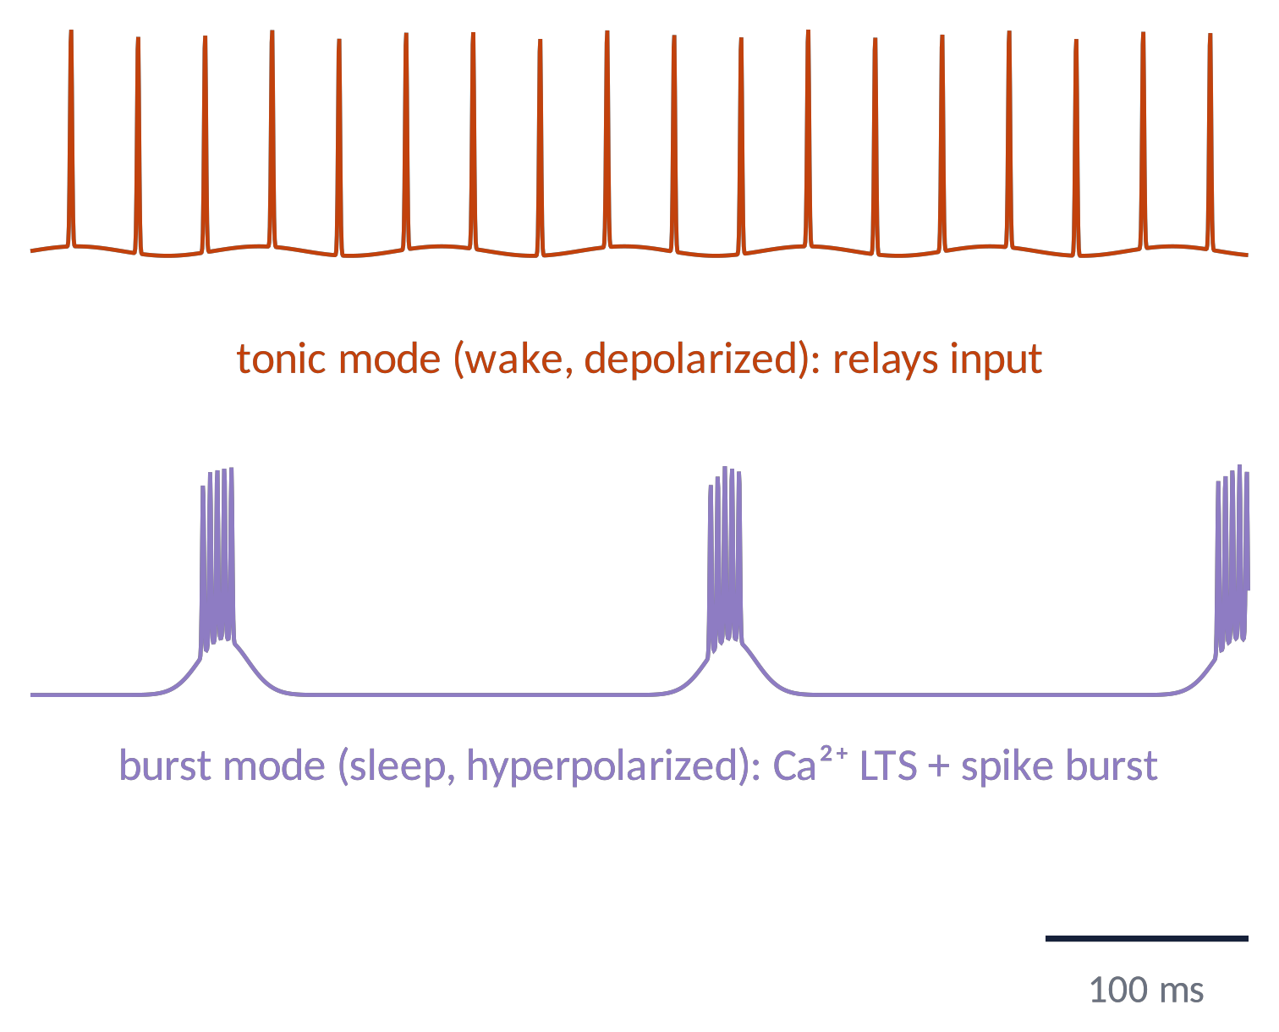
RHYTHMS (2)
Tonic vs burst firing: wake and sleep
Depolarised TC cell (wake, arousal): tonic firing, faithful relay of sensory input.
Hyperpolarised TC cell (drowsiness, sleep): T-type Ca²⁺ channels de-inactivate → low-threshold spike crowned by a burst.
Rhythmic bursts synchronise the cortex → sleep spindles (≈11–16 Hz) and delta waves.
Brain Imaging · EEG · Lecture 2 · Cellular bases of EEG
24
Notes:
Llinás & Jahnsen (1982) Nature 297:406: T-type Ca²⁺ low-threshold spike. Schematic traces.

Slide 25
RHYTHMS (3)
Alpha rhythm: a signature of active inhibition
In the lateral geniculate nucleus a subset of high-threshold TC neurons, coupled by gap junctions, bursts at alpha/theta frequencies (Hughes et al., 2004).
They drive GABAergic interneurons that rhythmically inhibit relay-mode TC neurons: information passes only in windows of the alpha cycle.
Gating-by-inhibition hypothesis: alpha increases over regions that should be ignored (e.g. visual cortex with eyes closed, unattended hemifield).
Metaphor alpha is a traffic light: while it blinks red, the road (the sensory relay) is closed most of the time.
Link to Lecture 1: Berger's alpha blocking = release of inhibition when the eyes open.
Brain Imaging · EEG · Lecture 2 · Cellular bases of EEG
25
Notes:
Hughes et al. (2004) Neuron 42:253; Lőrincz et al. (2008) J Neurosci 28:660; Klimesch (2012) TICS 16:606; Jensen & Mazaheri (2010) Front Hum Neurosci 4:186; Womelsdorf et al. (2014) Nat Neurosci 17:1031.

Slide 26
CHECK YOUR UNDERSTANDING
Three questions
Extracellular K⁺ doubles (5 → 10 mM). What happens to E_{K} and to the resting potential?
1
Give two physical reasons why PSPs, and not spikes, dominate the scalp EEG.
2
A negative wave appears at Fz. Can you conclude that the frontal cortex is excited?
3
Brain Imaging · EEG · Lecture 2 · Cellular bases of EEG
26
Notes:
(1) E_K shifts toward 0 → depolarisation (hyperkalaemia). (2) PSPs: longer and dipolar; spikes brief and quadrupolar. (3) No: superficial EPSP and deep IPSP give the same sign.

Slide 27
TAKE-HOME MESSAGES
Take-home messages
Ion gradients + selective permeability = membrane potential (Nernst, GHK; rest ≈ −65 mV).
1
Spikes are all-or-none, brief (≈1 ms), regenerative (HH).
2
PSPs are graded and slow (10–100 ms): they sum in time and space.
3
Synchronous PSPs in aligned pyramidal cells create sink–source dipoles → EEG. Polarity is ambiguous.
4
Thalamocortical loops pace the cortex: tonic vs burst modes, spindles, delta, alpha.
5
Brain Imaging · EEG · Lecture 2 · Cellular bases of EEG
27

Slide 28
SUGGESTED READING
Suggested reading
Kandel E.R. et al. (2021) Principles of Neural Science, 6th ed. McGraw-Hill — chapters on membrane potential, action potential, synaptic integration.
Hille B. (2001) Ion Channels of Excitable Membranes, 3rd ed. Sinauer.
Hodgkin A.L., Huxley A.F. (1952) A quantitative description of membrane current… J Physiol 117:500–544.
Buzsáki G., Anastassiou C.A., Koch C. (2012) The origin of extracellular fields and currents. Nat Rev Neurosci 13:407–420.
Steriade M., McCormick D.A., Sejnowski T.J. (1993) Thalamocortical oscillations in the sleeping and aroused brain. Science 262:679–685.
Llinás R., Jahnsen H. (1982) Electrophysiology of mammalian thalamic neurones in vitro. Nature 297:406–408.
Hughes S.W. et al. (2004) Synchronized oscillations at α and θ frequencies in the lateral geniculate nucleus. Neuron 42:253–268.
Klimesch W. (2012) α-band oscillations, attention, and controlled access to stored information. Trends Cogn Sci 16:606–617.
Womelsdorf T. et al. (2014) Dynamic circuit motifs underlying rhythmic gain control, gating and integration. Nat Neurosci 17:1031–1039.
Brain Imaging · EEG · Lecture 2 · Cellular bases of EEG
28

