Slide 1

MSC IN COMPUTATIONAL COGNITIVE SCIENCE
Brain Imaging – Methods and Applications
Module: Electroencephalography (EEG)
Lecture 3
From neurons to scalp:
dipoles, conduction, rhythms
Pierpaolo Croce
A.Y. 2026-2027

Slide 2
LECTURE 3
Today: from cells to the scalp signal
The scales of brain electrical activity: spikes, LFP, EEG.
1
The current dipole as the building block of scalp maps.
2
Volume conduction: head tissues, conductivities, lead field.
3
How montages and references change what we see.
4
The EEG rhythms: spectrum, bands, topography, vigilance and sleep.
5
Brain Imaging · EEG · Lecture 3 · From neurons to scalp
2
Notes:
Link: Lecture 2 explained single-cell currents; now we scale up to populations, the head as a conductor, and rhythms.

Slide 3
01
Scales of brain electrical activity
3

Slide 4
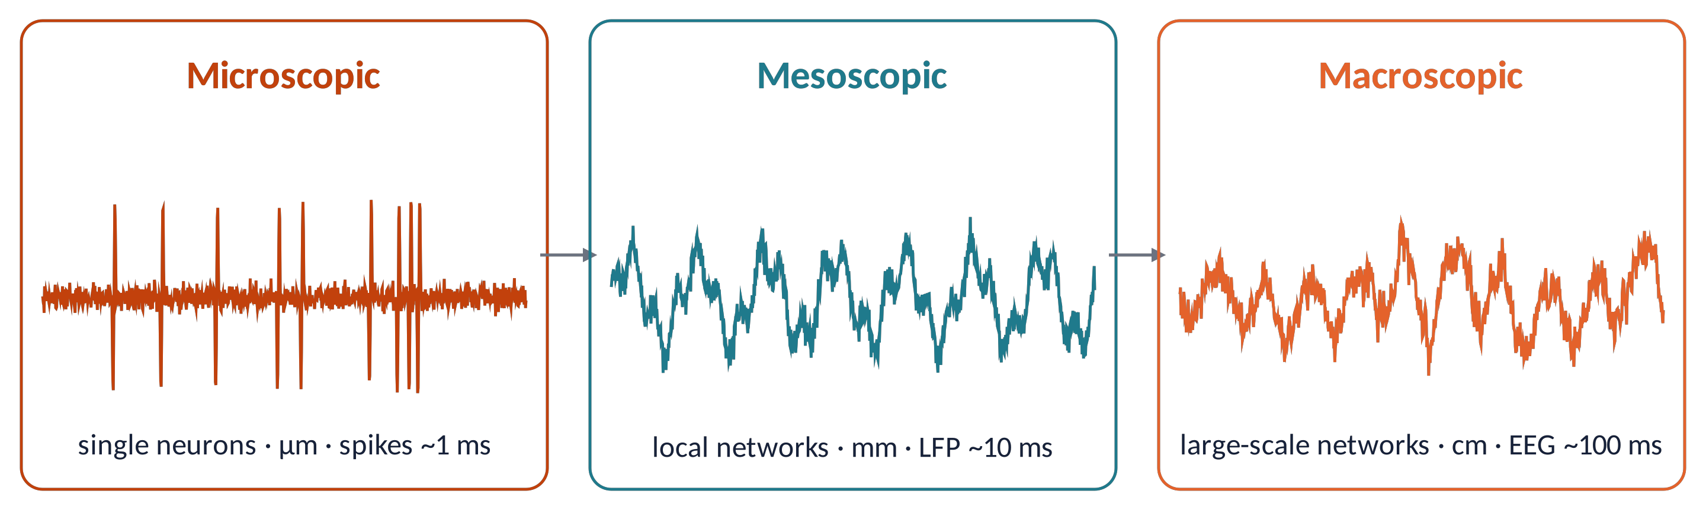
SCALES (1)
Micro, meso, macro: three windows on the same activity
Spikes (single/multi-unit): output of individual neurons, µm–100 µm, ~1 ms.
Local field potential (LFP): summed synaptic input of a local network (≈0.1–1 mm).
EEG: the LFPs of centimetres of cortex, filtered by the head. Each level loses detail but gains overview.
Brain Imaging · EEG · Lecture 3 · From neurons to scalp
4
Notes:
Adapted from Varela et al. (2001) Nat Rev Neurosci 2:229 and Le Van Quyen (2011) New Ideas Psychol 29:57.

Slide 5
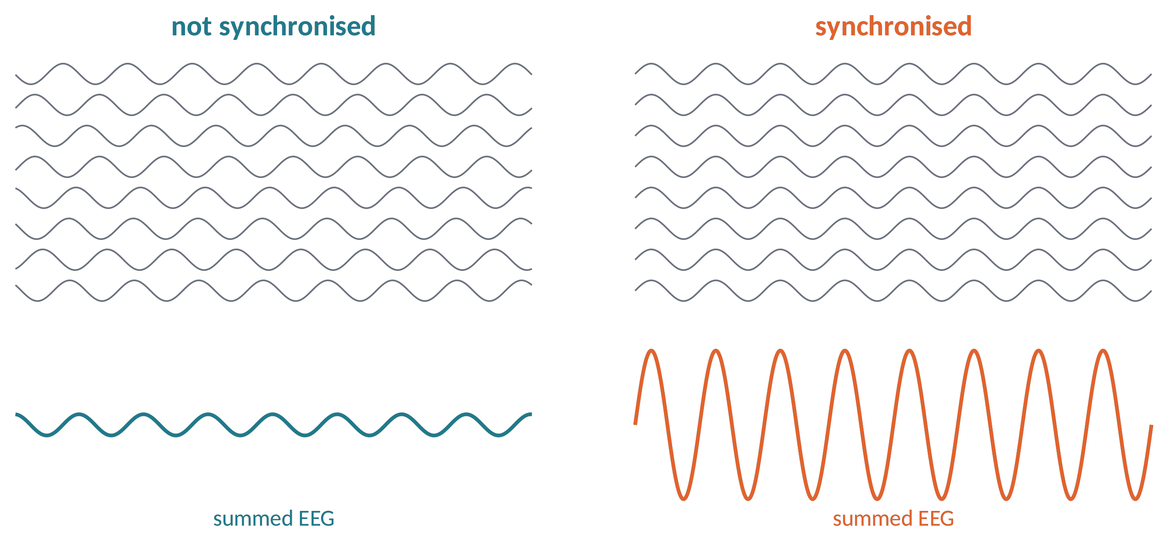
SCALES (2)
Neural synchronisation makes the EEG visible
Same neurons, same activity, same energy: only the timing differs.
Random phases → contributions cancel; aligned phases → they add up.
EEG amplitude reflects synchrony, not the amount of firing.
Metaphor a choir: 50 voices singing different songs = noise; the same song = music.
Brain Imaging · EEG · Lecture 3 · From neurons to scalp
5
Notes:
8 simulated oscillators at 8 Hz: random phases vs identical phases.

Slide 6
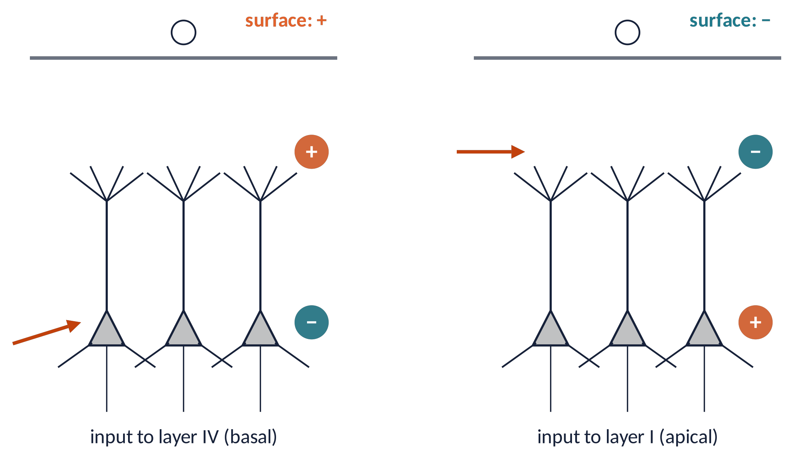
SCALES (3)
Where the synapse is decides the surface polarity
Thalamic input to layer IV (basal dendrites): sink deep, source superficial → surface positive.
Cortico-cortical input to layer I (apical tufts): sink superficial → surface negative.
Same kind of synapse (EPSP), opposite scalp sign: polarity tells where, not what.
Brain Imaging · EEG · Lecture 3 · From neurons to scalp
6
Notes:
Classic laminar scheme (e.g. Olejniczak 2006 J Clin Neurophysiol 23:186). Thalamic input to layer IV vs cortico-cortical input to layer I.

Slide 7
02
The current dipole
7

Slide 8
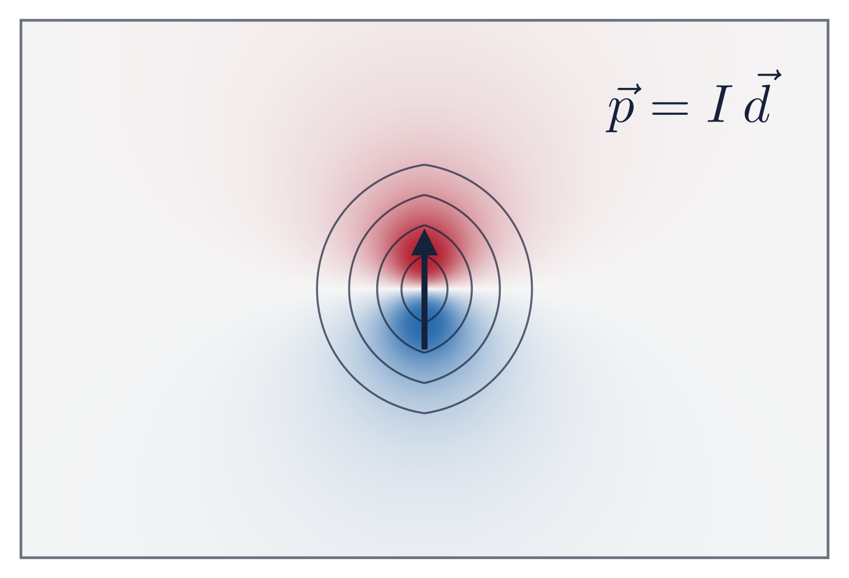
DIPOLE (1)
The current dipole: the atom of the EEG
A sink and a source separated by distance d, with current I: a current dipole p = I·d (A·m).
Its potential at distance r and angle θ:
V = p cos θ / ( 4π σ r² )
Positive in front, negative behind, zero on the "equator".
Falls as 1/r²: deep sources are weak and blurred.
Brain Imaging · EEG · Lecture 3 · From neurons to scalp
8
Notes:
Infinite homogeneous medium formula; in a real head the lead field replaces 1/(4πσ). Typical cortical dipole moment density ~0.1–1 nA·m/mm².

Slide 9
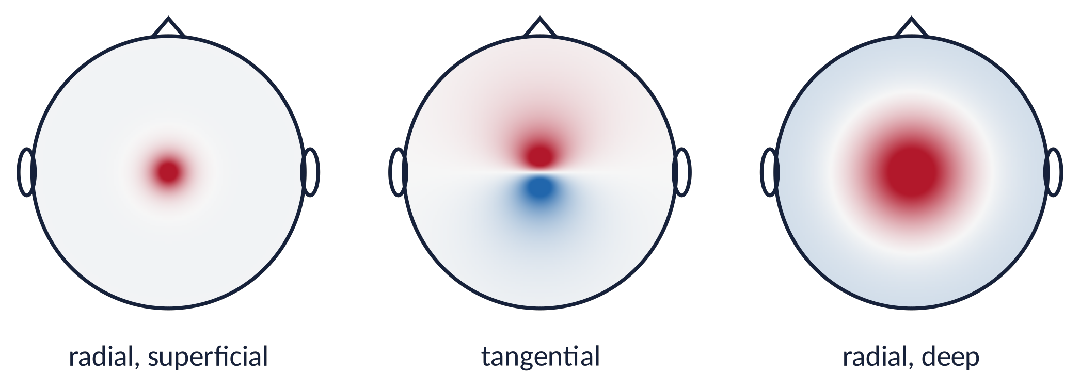
DIPOLE (2)
One dipole, three different scalp maps
Radial dipole (gyral crown): a single extremum above the source.
Tangential dipole (sulcal wall): a positive/negative pair; the source lies between the two poles, not under the maximum!
Deep dipole: wider and weaker map.
Brain Imaging · EEG · Lecture 3 · From neurons to scalp
9
Notes:
Simulated: single dipole in a sphere (homogeneous approximation + Gaussian blur for the skull). Radial → monopolar; tangential → bipolar; deep → wide and weak.

Slide 10
03
Volume conduction and head models
10

Slide 11
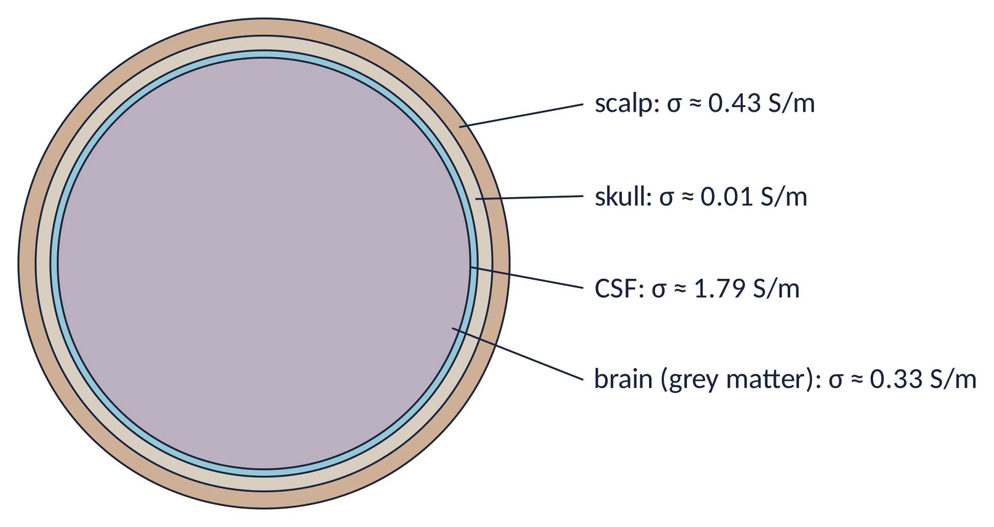
VOLUME CONDUCTION (1)
The head is a layered conductor
Currents spread through every tissue (volume conduction): the EEG sees them instantaneously (quasi-static regime).
The skull is ≈30–50× less conductive than the brain: it smears the potential laterally over several cm.
CSF is highly conductive and shunts currents.
MEG is almost insensitive to the skull → sharper maps (but blind to radial dipoles).
Metaphor the skull is a frosted glass: you still see the light, but not its exact shape.
Brain Imaging · EEG · Lecture 3 · From neurons to scalp
11
Notes:
Conductivities from Vorwerk et al. (2014) NeuroImage 100:590; skull/brain ratio historically 1:80 (Rush & Driscoll 1968), measured ~1:15–1:50 (Oostendorp et al. 2000).

Slide 12
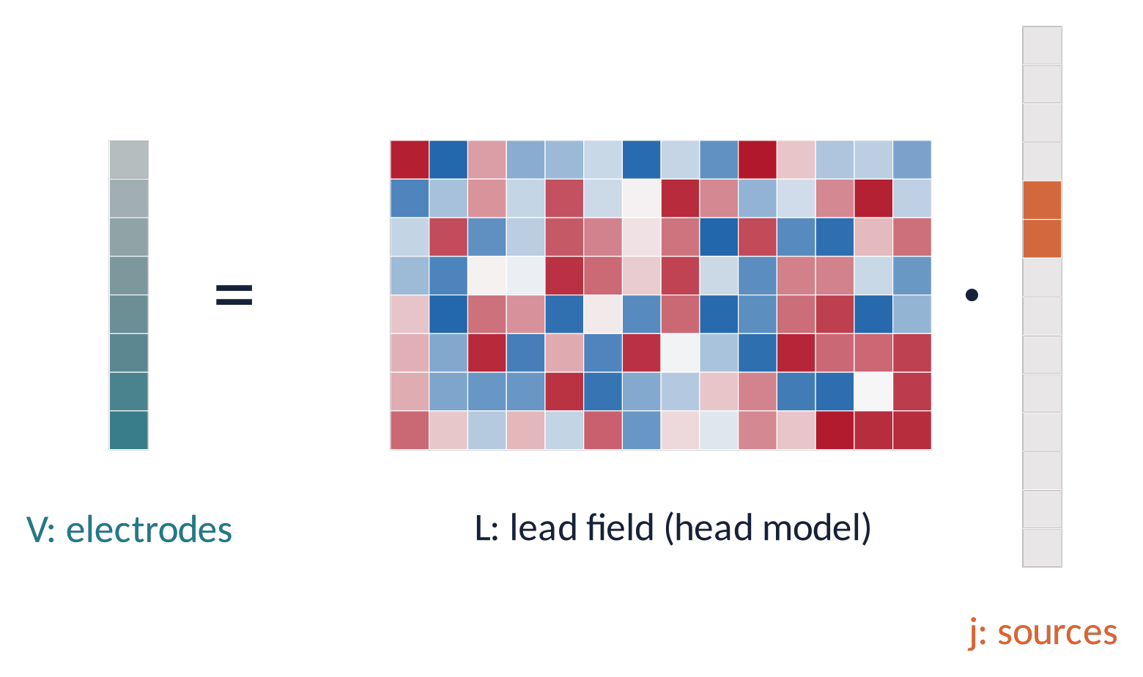
VOLUME CONDUCTION (2)
Head models and the lead field: V = L · j
Each electrode sees a weighted sum of all sources: the weights form the lead field L.
L depends only on geometry and conductivities (head model), not on the data.
Models: spheres (fast, approximate) → BEM → FEM (individual MRI, most accurate).
Forward: j → V (easy). Inverse: V → j (ill-posed, Lecture 9).
Consequence: neighbouring electrodes are correlated even without any brain interaction → beware of spurious connectivity (Lecture 9).
Brain Imaging · EEG · Lecture 3 · From neurons to scalp
12
Notes:
Forward models: spherical (analytic), BEM (boundary element), FEM (finite element) from individual MRI. Linear superposition holds because Maxwell's equations are linear in the quasi-static regime.

Slide 13
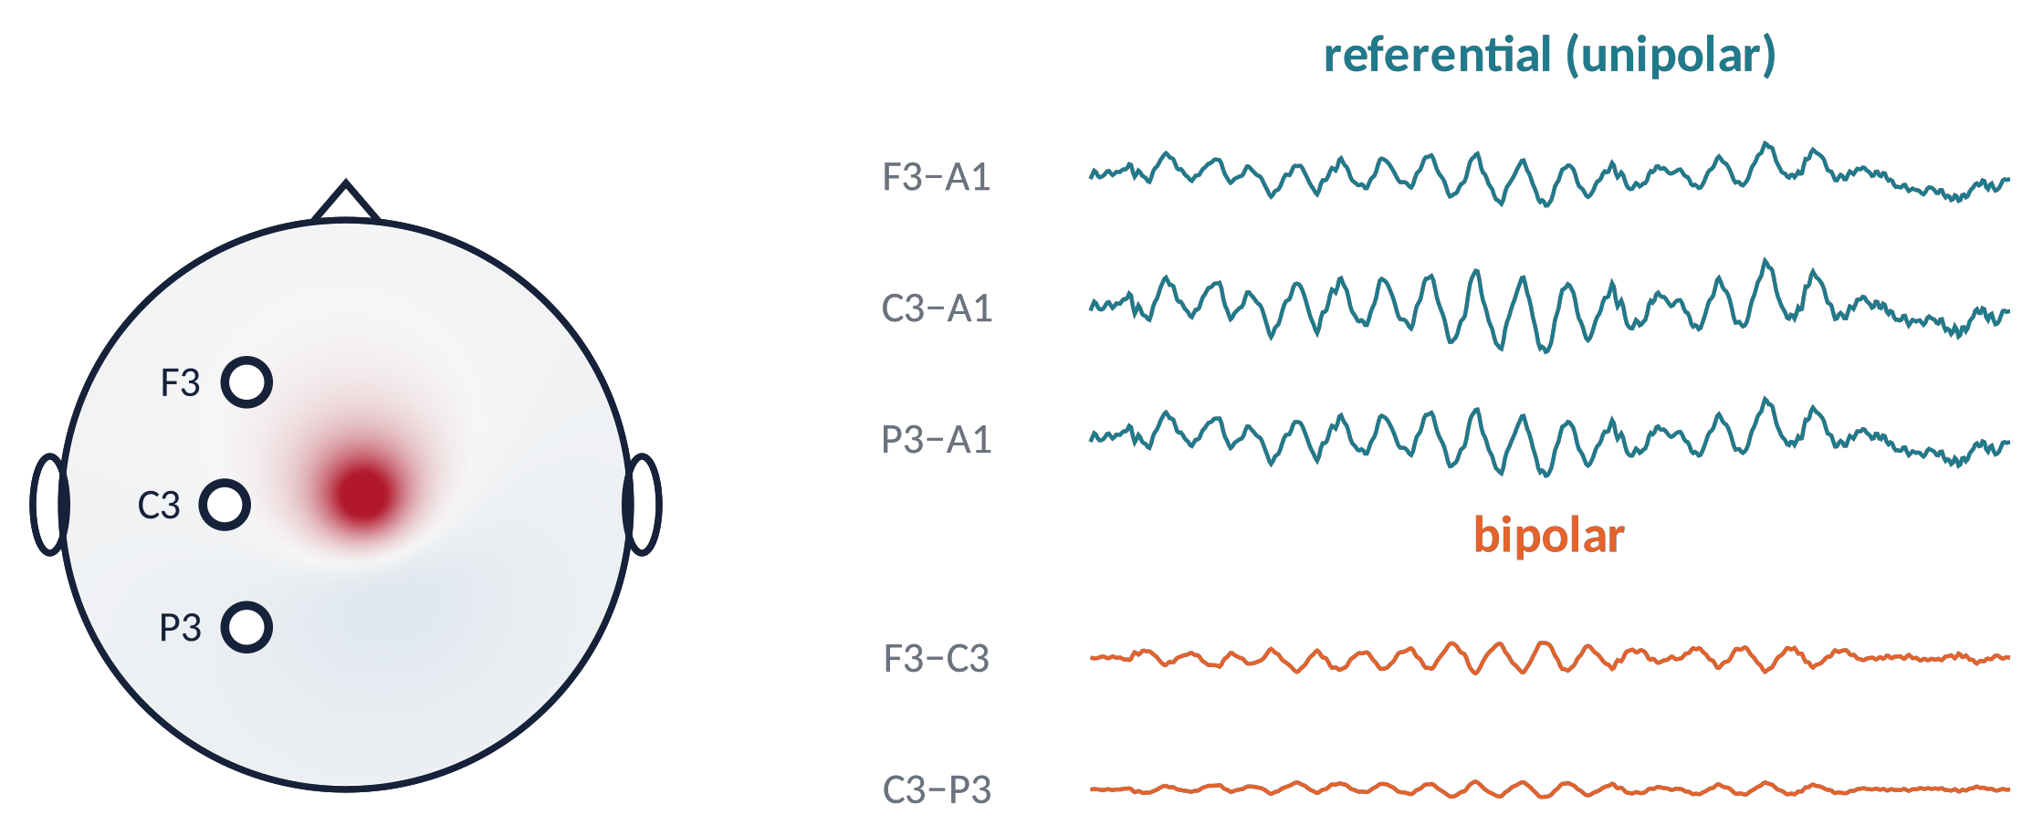
RECORDING GEOMETRY
Referential vs bipolar montages
Referential: each electrode vs a common reference (e.g. ear, mastoid, Cz, average).
Bipolar: difference between neighbouring electrodes → common activity cancels, local gradients remain.
Average reference and surface Laplacian (CSD) are re-referencing computed offline (Lecture 4).
No montage is "true": each is a different view of the same fields.
Brain Imaging · EEG · Lecture 3 · From neurons to scalp
13
Notes:
Simulated: C3 source with a common slow component in all channels. Bipolar derivations cancel common activity and show local gradients.

Slide 14
04
The EEG rhythms
14

Slide 15
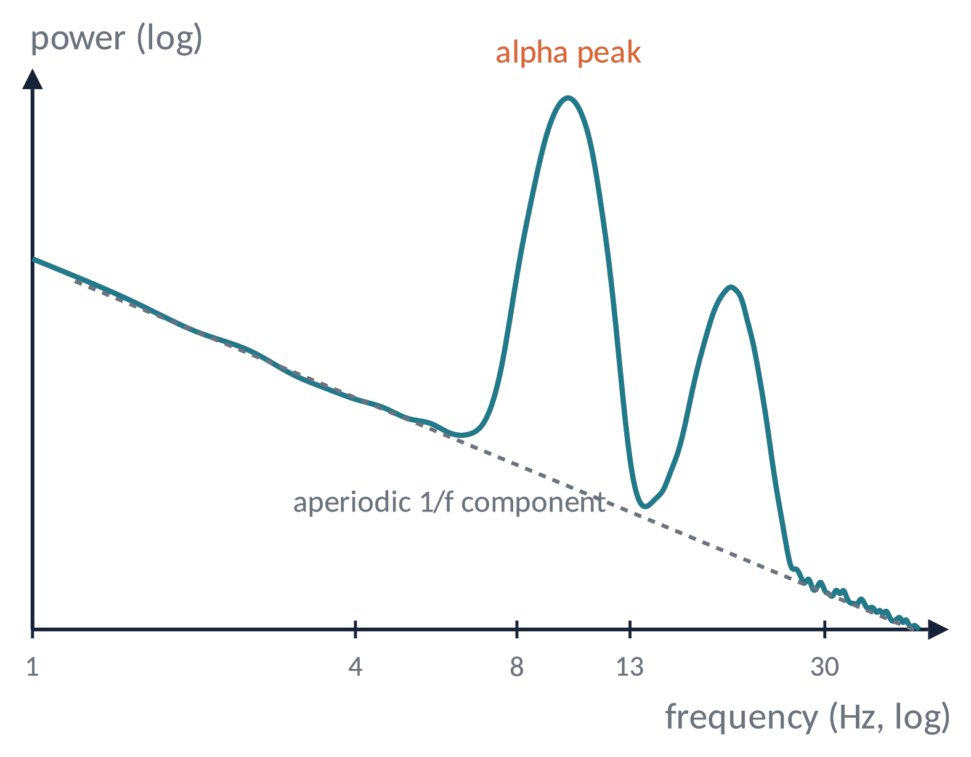
RHYTHMS (1)
The power spectrum: a 1/f background with peaks
Power decreases roughly as 1/f^{χ}: the aperiodic component (scale-free background).
On top: periodic peaks = true oscillations (alpha ≈10 Hz, beta ≈20 Hz).
Band power ≠ oscillation: a change in the 1/f slope changes "theta power" even without theta!
The aperiodic exponent may track the cortical excitation/inhibition balance (Gao et al., 2017).
Brain Imaging · EEG · Lecture 3 · From neurons to scalp
15
Notes:
Simulated spectrum (Welch). Separate periodic and aperiodic components: Donoghue et al. (2020) Nat Neurosci 23:1655 (FOOOF / specparam).

Slide 16
RHYTHMS (2)
The classical frequency bands
δ delta
0.5–4 Hz
deep sleep (N3), infants; focal delta in awake adults = lesion sign
θ theta
4–8 Hz
drowsiness; frontal-midline theta in working memory and cognitive control
α alpha
8–13 Hz
posterior, eyes closed; blocks with eyes opening; IAF ≈10 Hz in adults
μ mu
8–13 Hz
sensorimotor, arch-shaped; desynchronises with movement or motor imagery
β beta
13–30 Hz
sensorimotor, post-movement rebound; increased by benzodiazepines
γ gamma
30–80+ Hz
local processing; ⚠ contaminated by muscle and microsaccades
Brain Imaging · EEG · Lecture 3 · From neurons to scalp
16
Notes:
Band limits follow the IFCN glossary (Kane et al. 2017, Clin Neurophysiol Pract 2:170); exact limits vary across studies.

Slide 17
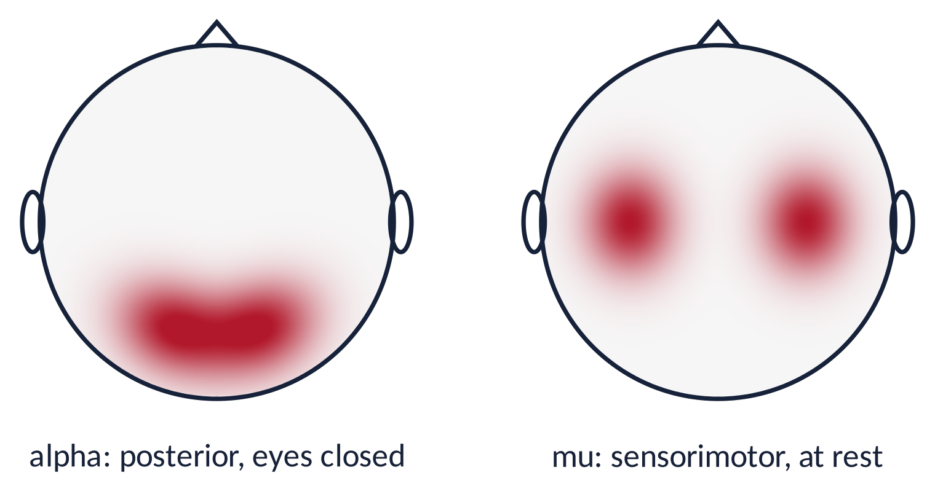
RHYTHMS (3)
Alpha and mu: same frequency, different places and roles
Alpha: occipito-parietal, maximal with eyes closed, reduced by visual input and attention.
Mu: over sensorimotor cortex (C3/C4), reduced by movement, motor imagery and action observation.
A power decrease = event-related desynchronisation (ERD); increase = ERS. Basis of motor-imagery BCIs (Lecture 10).
Metaphor idle rhythms are an engine idling: when the region gets work to do, the idle hum disappears.
Brain Imaging · EEG · Lecture 3 · From neurons to scalp
17
Notes:
Pfurtscheller & Lopes da Silva (1999) Clin Neurophysiol 110:1842 (ERD/ERS). Klimesch (1999) Brain Res Rev 29:169 (IAF and cognition).

Slide 18
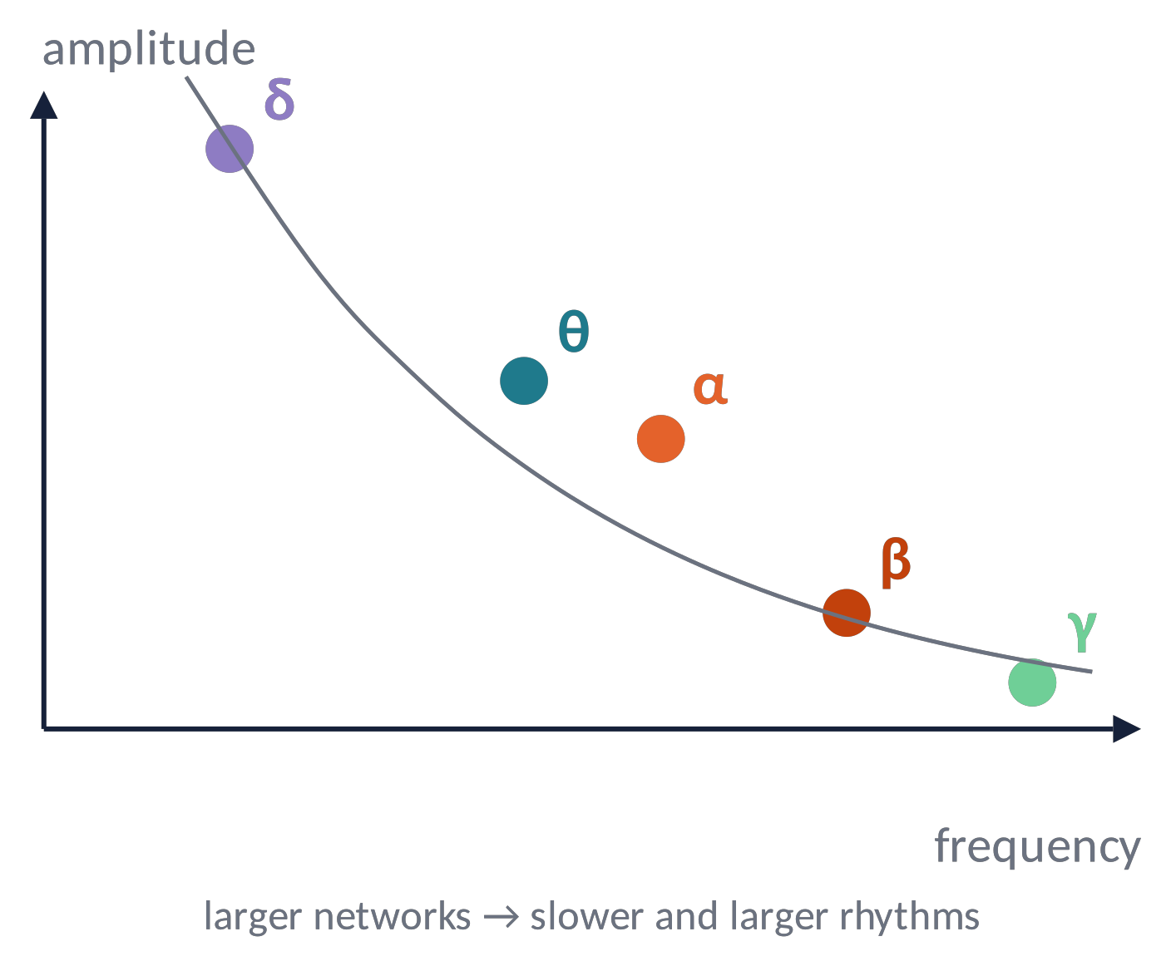
RHYTHMS (4)
Slower rhythms are larger: size of the network
Oscillations need round trips of activity; conduction delays limit how fast distant regions can stay in phase.
Slow rhythms engage large networks (more neurons → larger EEG); fast rhythms are local.
Brain rhythms form a hierarchy with roughly constant ratios between bands (Buzsáki & Draguhn, 2004).
Brain Imaging · EEG · Lecture 3 · From neurons to scalp
18
Notes:
Buzsáki & Draguhn (2004) Science 304:1926: slow oscillations recruit larger networks because of axonal conduction delays.

Slide 19
05
Resting-state EEG, vigilance and sleep
19

Slide 20
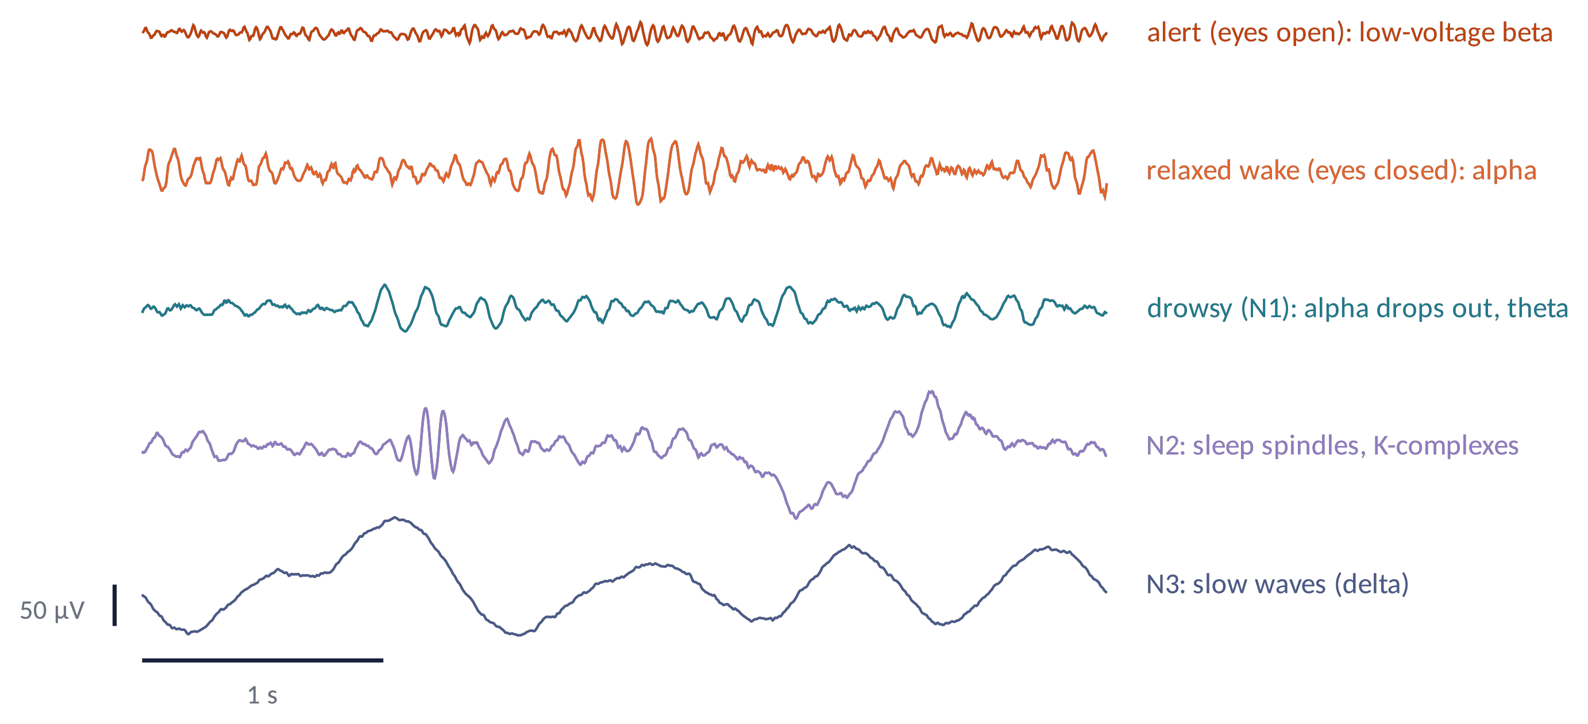
RESTING STATE (1)
The resting-state EEG probes arousal and vigilance
Within a few minutes of "rest", subjects drift along the vigilance continuum: alert → relaxed → drowsy → sleep.
Practical rule: always control vigilance (instructions, eyes-open/closed blocks, short recordings) when comparing groups.
Brain Imaging · EEG · Lecture 3 · From neurons to scalp
20
Notes:
Babiloni et al. (2020) Clin Neurophysiol 131:285 (IFCN rsEEG guidelines); Hegerl & Hensch (2014) VIGALL. Traces are simulated.

Slide 21
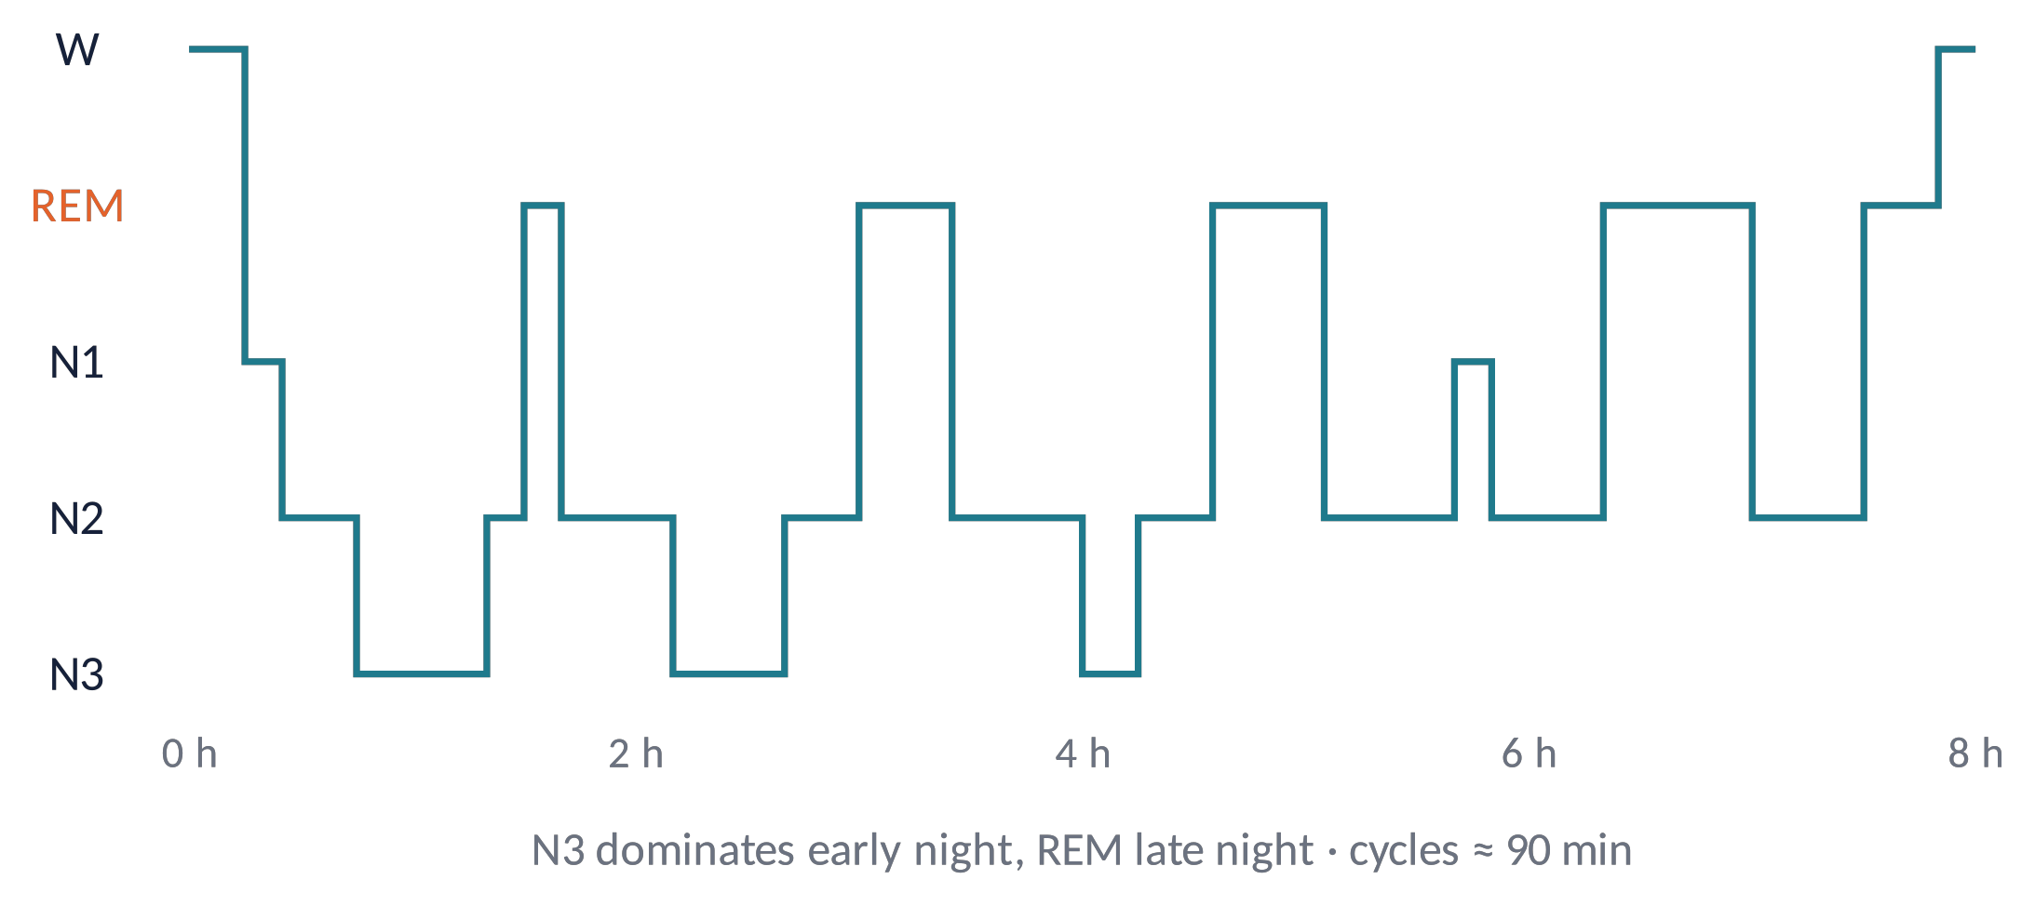
RESTING STATE (2)
Sleep: the EEG defines the stages
N1: alpha disappears, theta, vertex waves.
N2: sleep spindles (11–16 Hz, thalamocortical) and K-complexes.
N3: slow waves (<2 Hz, high amplitude): cortical up/down states.
REM: EEG similar to wake, rapid eye movements, muscle atonia, dreams.
Link to Lecture 2: spindles and delta arise from thalamocortical burst mode.
Brain Imaging · EEG · Lecture 3 · From neurons to scalp
21
Notes:
AASM scoring manual (Berry et al.). Spindles 11–16 Hz; slow waves ≥75 µV, 0.5–2 Hz; REM: low-voltage mixed EEG, rapid eye movements, muscle atonia.

Slide 22
CHECK YOUR UNDERSTANDING
Three questions
A map shows a positive maximum at C3 and a negative one at P3. Where is the source likely to be?
1
Fz and FCz are highly correlated. Does this prove the two regions communicate?
2
Patients show more "theta power" than controls. List two explanations other than more theta oscillations.
3
Brain Imaging · EEG · Lecture 3 · From neurons to scalp
22
Notes:
(1) Tangential dipole: source between the two extrema. (2) Correlation through volume conduction. (3) Check the aperiodic component and vigilance.

Slide 23
TAKE-HOME MESSAGES
Take-home messages
EEG = macroscopic view of synchronised LFPs over cm of cortex.
1
Current dipoles: radial → one extremum, tangential → a pair; amplitude ∝ 1/r².
2
The skull blurs; the lead field is linear (V = L·j); nearby channels are correlated.
3
Spectrum = 1/f background + oscillatory peaks; bands have typical topographies.
4
Resting EEG reflects vigilance; sleep stages are defined by the EEG.
5
Brain Imaging · EEG · Lecture 3 · From neurons to scalp
23

Slide 24
SUGGESTED READING
Suggested reading
Nunez P.L., Srinivasan R. (2006) Electric Fields of the Brain, 2nd ed. OUP — chapters on dipoles and head models.
Buzsáki G. (2006) Rhythms of the Brain. OUP.
Buzsáki G., Draguhn A. (2004) Neuronal oscillations in cortical networks. Science 304:1926–1929.
Varela F. et al. (2001) The brainweb: phase synchronization and large-scale integration. Nat Rev Neurosci 2:229–239.
Olejniczak P. (2006) Neurophysiologic basis of EEG. J Clin Neurophysiol 23:186–189.
Vorwerk J. et al. (2014) A guideline for head volume conductor modeling in EEG and MEG. NeuroImage 100:590–607.
Donoghue T. et al. (2020) Parameterizing neural power spectra into periodic and aperiodic components. Nat Neurosci 23:1655–1665.
Pfurtscheller G., Lopes da Silva F.H. (1999) Event-related EEG/MEG synchronization and desynchronization. Clin Neurophysiol 110:1842–1857.
Babiloni C. et al. (2020) International Federation of Clinical Neurophysiology (IFCN) – EEG research workgroup: recommendations on frequency and topographic analysis of resting state EEG rhythms. Clin Neurophysiol 131:285–307.
Brain Imaging · EEG · Lecture 3 · From neurons to scalp
24

