Slide 1

MSC IN COMPUTATIONAL COGNITIVE SCIENCE
Brain Imaging – Methods and Applications
Module: Electroencephalography (EEG)
Lecture 4
Recording the EEG:
electrodes, signals, artifacts
Pierpaolo Croce
A.Y. 2026-2027

Slide 2
LECTURE 4
Today: from the scalp to a clean data file
The recording chain: electrodes, amplifier, filters, ADC.
1
Electrodes, impedance and the 10-20 system.
2
Differential amplification, CMRR and the reference problem.
3
Digitisation: sampling, Nyquist, aliasing, resolution, filters.
4
Artifacts and a good-practice checklist.
5
Brain Imaging · EEG · Lecture 4 · Recording the EEG
2
Notes:
This is the most practical lecture: many analysis problems are born at recording time and cannot be fixed afterwards.

Slide 3
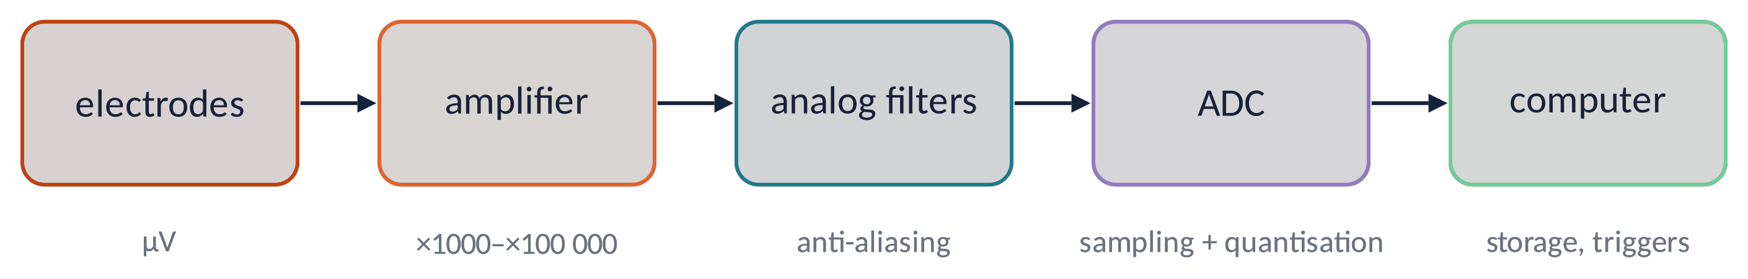
THE RECORDING CHAIN
Five stages between the brain and your hard disk
Signal of 10–100 µV must be amplified ≈10⁴–10⁵ times without adding noise.
Analog filters limit the band before sampling (anti-aliasing).
The ADC turns voltage into numbers: sampling rate and bit depth.
Triggers from the stimulation PC mark events in the data (essential for ERPs).
Metaphor a hi-fi system: a great speaker cannot fix a scratched record.
Brain Imaging · EEG · Lecture 4 · Recording the EEG
3
Notes:
Each stage can add noise or distortion; the EEG is only as good as its weakest link.

Slide 4
01
Electrodes and montage
4

Slide 5
ELECTRODES (1)
Types of electrodes
Wet (gel) Ag/AgCl
gold standard; stable, non-polarisable; low impedance; slow set-up
Saline / sponge
fast set-up (HydroCel); dry out in ≈1 h
Dry
no gel, wearable/BCI; higher impedance, motion-sensitive
Active
pre-amplifier at the electrode: less cable noise, tolerate higher impedance
The electrode–gel–skin interface is an electrochemical junction: it generates a DC potential that drifts with sweat and movement.
Brain Imaging · EEG · Lecture 4 · Recording the EEG
5
Notes:
Ag/AgCl is non-polarisable: stable half-cell potential, good for low frequencies. Dry electrodes: higher impedance, more motion artifacts.

Slide 6
ELECTRODES (2)
Impedance: keep it low and balanced
Impedance (Ω) = opposition of the electrode–skin junction to alternating current.
Typical targets: < 5–10 kΩ for passive electrodes; active systems tolerate < 25–50 kΩ.
High impedance → more skin potentials, line noise and low-frequency drifts → lower statistical power (Kappenman & Luck, 2010).
Balanced impedances between active and reference improve common-mode rejection.
Skin preparation: gentle abrasion, alcohol, enough gel — but no bridges between electrodes!
Metaphor the gel is a bridge between skin and metal: too little and the road is bumpy, too much and it floods into the neighbour's road (salt bridge).
Brain Imaging · EEG · Lecture 4 · Recording the EEG
6
Notes:
Kappenman & Luck (2010) Psychophysiology 47:888: high impedance increases low-frequency noise, especially in warm/humid conditions; effects on statistical power.

Slide 7
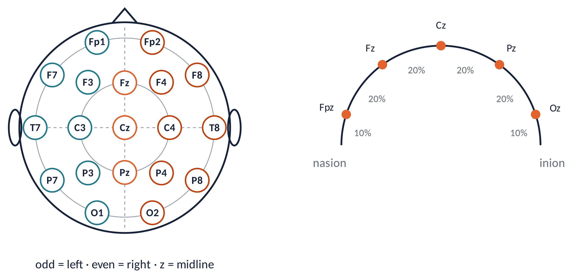
ELECTRODES (3)
The international 10-20 system
Positions at 10 % and 20 % of the nasion–inion and ear-to-ear distances: relative, so they adapt to every head.
Letters = region: Fp frontopolar, F frontal, C central, T temporal, P parietal, O occipital.
Numbers: odd = left, even = right, z = midline.
Brain Imaging · EEG · Lecture 4 · Recording the EEG
7
Notes:
Jasper (1958) Electroenceph Clin Neurophysiol 10:371. Distances are 10% and 20% of nasion–inion and preauricular distances → comparable positions across head sizes.

Slide 8
ELECTRODES (4)
How many electrodes? 10-10, 10-5 and high density
19–21
32–64
128–256
1–8
clinical 10-20: epilepsy, sleep
10-10: most cognitive studies, ERPs
high density (10-5, geodesic): source imaging, microstates
wearable, BCI, sleep headbands
More electrodes = better spatial sampling: scalp potentials vary over ≈2–3 cm, so ≥ 64–128 channels are needed for good topographies and source imaging.
But: longer set-up, more bad channels, more gel bridges. Choose the montage from the question.
Brain Imaging · EEG · Lecture 4 · Recording the EEG
8
Notes:
Oostenveld & Praamstra (2001) Clin Neurophysiol 112:713 (10-5 system). Srinivasan et al. (1998): ~2–3 cm spacing needed to sample scalp potentials without spatial aliasing.

Slide 9
02
Amplification and reference
9

Slide 10
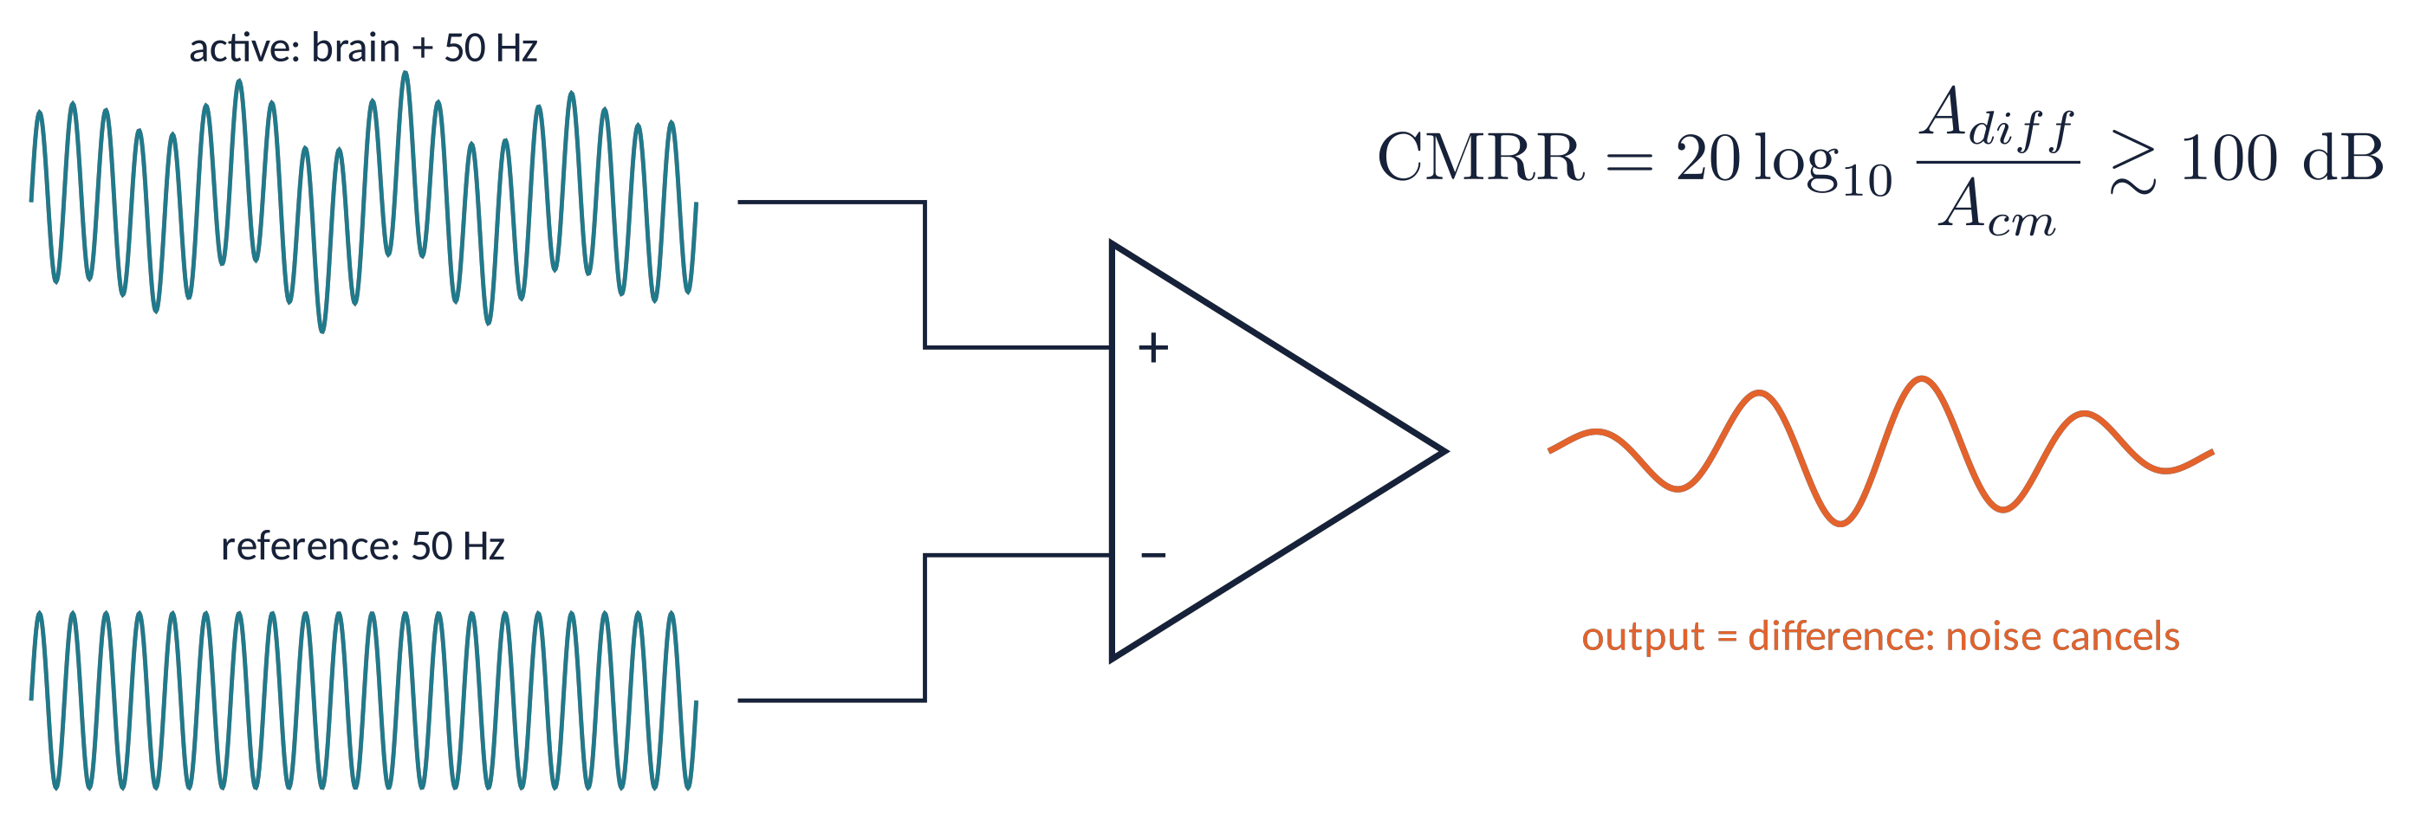
AMPLIFIER (1)
Differential amplification and common-mode rejection
The amplifier outputs active − reference: what is common to both inputs (mains, body potential) cancels.
CMRR: how well common signals are rejected (≥ 100 dB = 100 000×). Unbalanced impedances degrade it.
A separate ground electrode (or driven right leg) sets the amplifier's operating point.
Metaphor noise-cancelling headphones: they record the ambient noise and subtract it.
Brain Imaging · EEG · Lecture 4 · Recording the EEG
10
Notes:
Mains interference couples capacitively to the body and appears almost identically on all electrodes (common mode). A driven-right-leg / ground electrode helps.

Slide 11
REFERENCE (1)
There is no neutral reference
Vertex (Cz)
common in recording; kills activity at Cz
Linked mastoids / ears
classic for ERPs; mastoids are not silent (temporal activity)
Nose / chin
far from cortex but prone to muscle and eye artifacts
Average reference
mean of all channels: good with ≥ 64 evenly spread electrodes
REST (infinity reference)
model-based estimate of a reference at infinity (Yao, 2001)
Re-referencing is linear and can be done offline: V_{new}(ch) = V(ch) − V_{new ref}. Always report the reference.
Brain Imaging · EEG · Lecture 4 · Recording the EEG
11
Notes:
Yao (2001) Physiol Meas 22:693 (REST); Dien (1998) Behav Res Methods (average reference); Nunez & Srinivasan (2006).

Slide 12
03
Digitisation and filtering
12

Slide 13
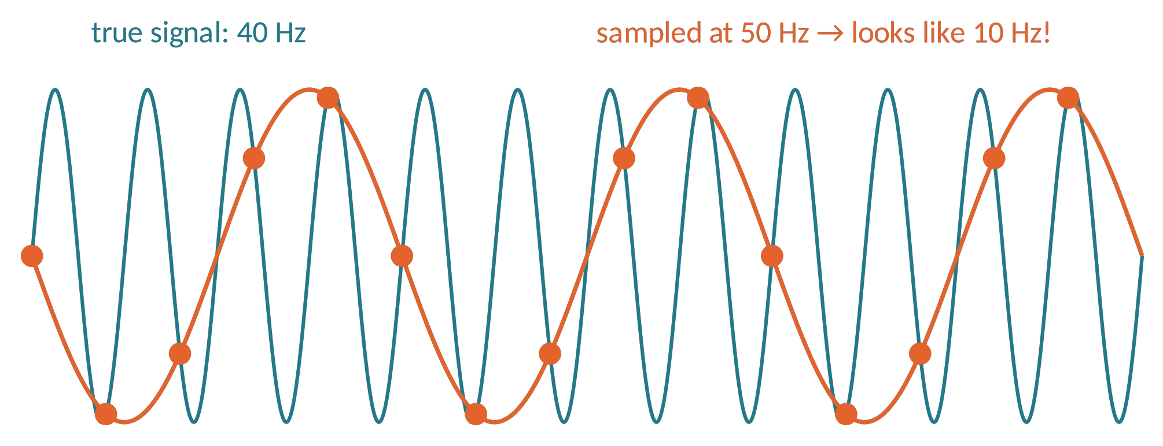
DIGITISATION (1)
Sampling, Nyquist and aliasing
f_{s} > 2 · f_{max} ( f_{Nyquist} = f_{s} / 2 )
Frequencies above f_{s}/2 do not disappear: they fold back as fake low frequencies (aliasing).
Typical EEG: f_{s} = 250–1000 Hz (higher for high-gamma or brainstem responses).
Metaphor the wagon-wheel effect in films: a fast wheel seems to turn slowly backwards.
Brain Imaging · EEG · Lecture 4 · Recording the EEG
13
Notes:
Nyquist–Shannon: a signal can be reconstructed if sampled at more than twice its highest frequency. Anti-aliasing low-pass must act BEFORE the ADC.

Slide 14
DIGITISATION (2)
Amplitude resolution and dynamic range
LSB = range / 2^{bits}
16 bit · 65 536 levels
±3 mV → ≈0.1 µV
24 bit · 16 777 216 levels
±400 mV → ≈0.05 µV
The range must contain large DC offsets and artifacts without clipping (saturation).
Modern 24-bit amplifiers record DC-coupled: slow potentials are preserved, drifts are removed offline.
Resolution ≪ noise floor (≈0.5–1 µV): bits are rarely the bottleneck today.
Brain Imaging · EEG · Lecture 4 · Recording the EEG
14
Notes:
24-bit DC-coupled amplifiers (e.g. ±400 mV range) have LSB ≈ 0.05 µV; 16-bit older systems needed high-pass filtering in hardware.

Slide 15
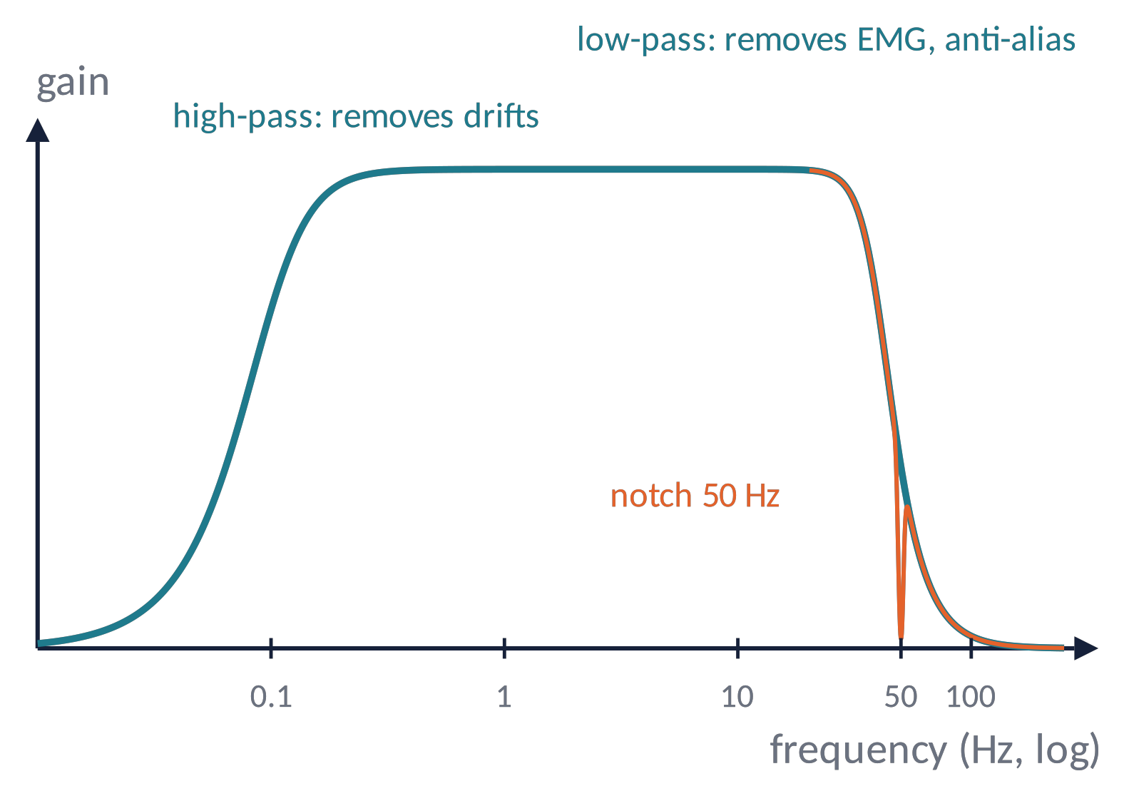
DIGITISATION (3)
Filters: useful but dangerous
High-pass (0.01–1 Hz): removes drifts. Too high (> 0.1–0.3 Hz) distorts slow ERPs and creates artificial peaks.
Low-pass (30–100 Hz): removes muscle noise; always one before the ADC (anti-alias).
Notch (50 Hz in Europe, 60 Hz in the Americas): removes line noise, but rings in time.
Rule: record wide-band, filter offline, report filter type, order and cut-off.
Metaphor a filter is a sieve: choose holes that keep the flour, not the stones — and be aware it also changes the texture.
Brain Imaging · EEG · Lecture 4 · Recording the EEG
15
Notes:
Widmann, Schröger & Maess (2015) J Neurosci Methods 250:34; Acunzo et al. (2012) J Neurosci Methods 209:212; Tanner et al. (2015) Psychophysiology 52:997 (high-pass > 0.1 Hz distorts ERPs).

Slide 16
04
Artifacts
16

Slide 17
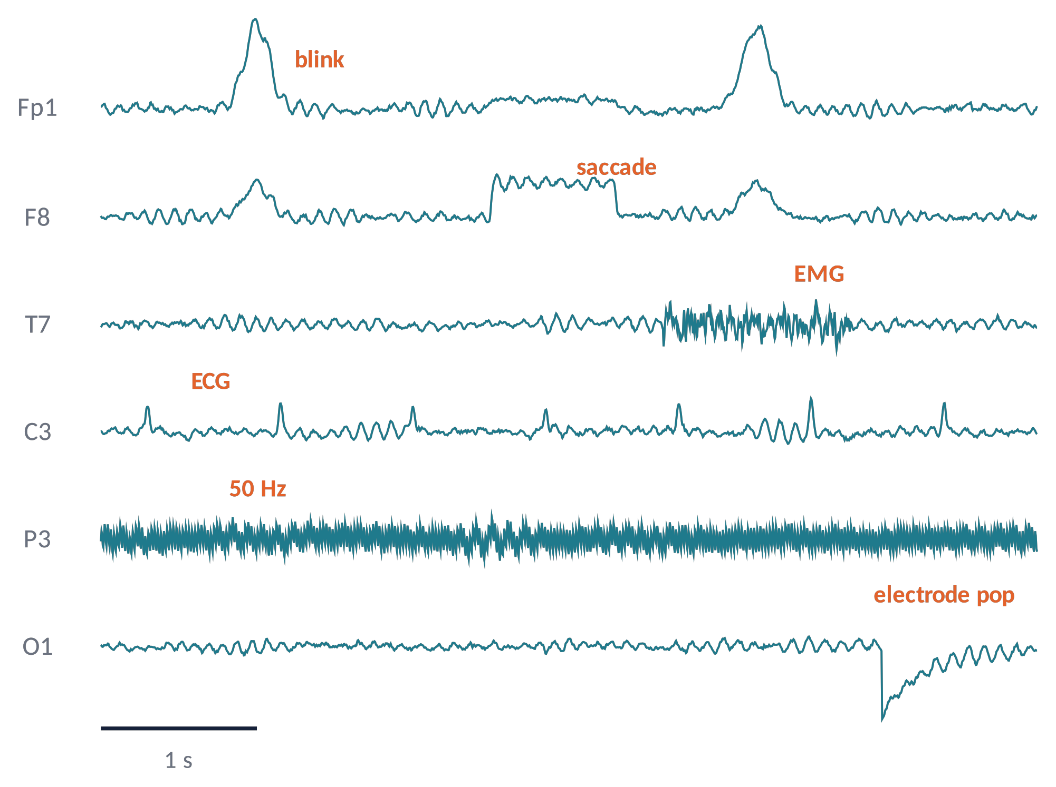
ARTIFACTS (1)
A gallery of artifacts
Eye blinks: frontal, 100–200 µV, 200–400 ms
Saccades: box-shaped, opposite polarity at F7/F8
Muscle (EMG): temporal/frontal, broadband > 20 Hz
ECG: regular sharp peaks ≈1 Hz
Line noise: 50/60 Hz sinusoid + harmonics
Electrode pop: sudden step on one channel
Brain Imaging · EEG · Lecture 4 · Recording the EEG
17
Notes:
Simulated examples. Physiological: ocular, muscular, cardiac, sweat, movement. Non-physiological: line noise, electrode pop, cable movement.

Slide 18
ARTIFACTS (2)
Eyes and muscles: the biggest offenders
Ocular
The eye is a dipole (cornea +, retina −): rotations and eyelid movements change the scalp field.
Blinks: large frontal positivity. Horizontal saccades: opposite steps at F7/F8.
Record EOG (above/below and beside the eyes) to identify them.
Muscular
Jaw, forehead, neck muscles: broadband, maximal at temporal sites and > 20 Hz.
It overlaps with beta and gamma: "gamma" effects may be muscle.
⚠ Microsaccades produce a spike potential that mimics induced gamma (Yuval-Greenberg et al., 2008).
Prevention beats correction: fixation cross, relaxed posture, breaks, instructions ("blink between trials").
Brain Imaging · EEG · Lecture 4 · Recording the EEG
18
Notes:
The eye is a dipole (cornea +, retina −): Berg & Scherg (1991). Microsaccade spike potentials mimic induced gamma: Yuval-Greenberg et al. (2008) Neuron 58:429.

Slide 19
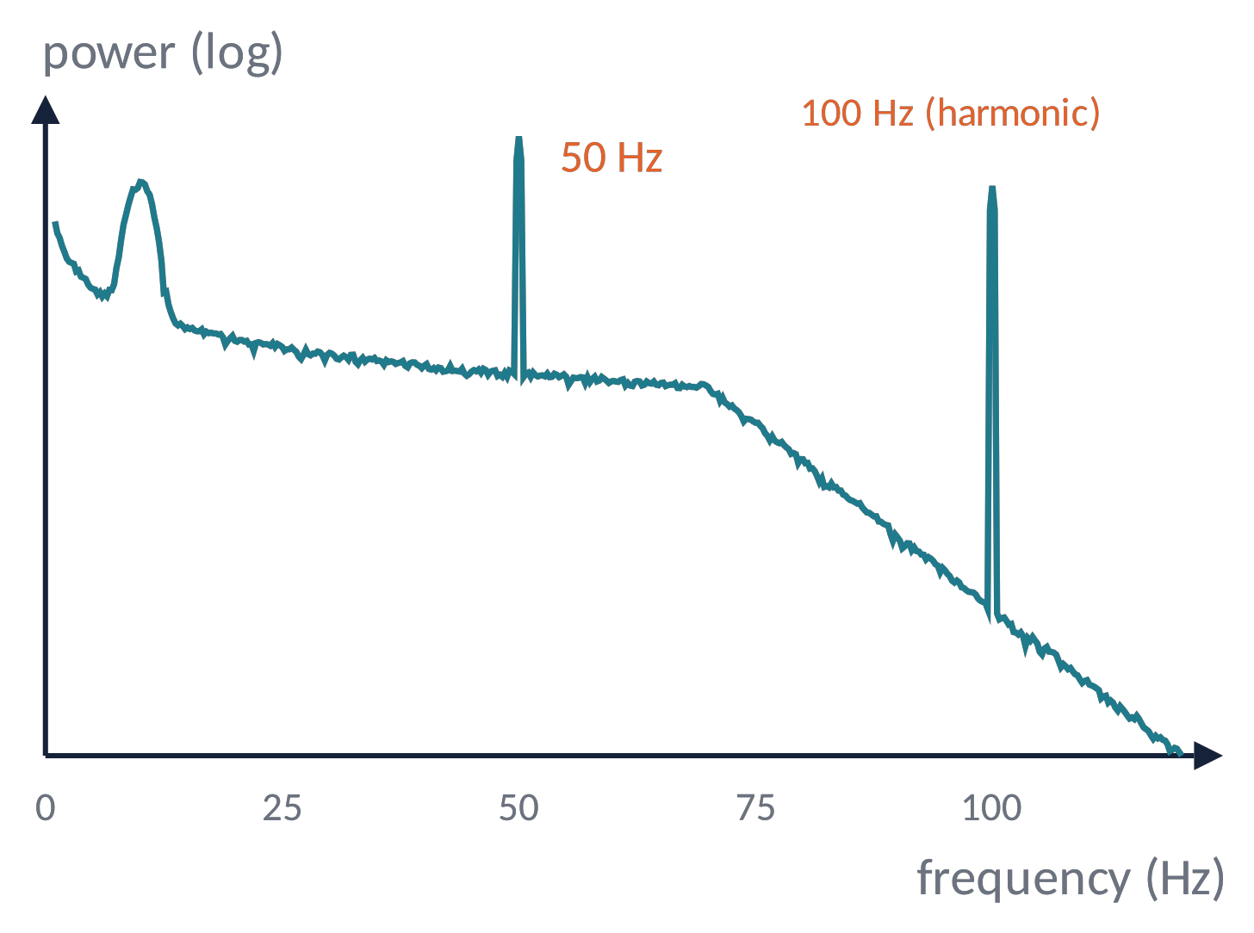
ARTIFACTS (3)
Line noise and its harmonics
Mains (50 Hz in Europe) couples into cables and the body; it is worse with high or unbalanced impedance.
Sources: lamps, monitors, power supplies, other devices; keep cables short and away from power lines.
Removal: notch filter, spectrum interpolation, CleanLine, Zapline (less distortion).
A 50 Hz peak ≫ neighbours = check that channel's electrode!
Brain Imaging · EEG · Lecture 4 · Recording the EEG
19
Notes:
Simulated spectrum with 50 Hz and 100 Hz components. Alternatives to notch: CleanLine / Zapline (de Cheveigné 2020 NeuroImage 207:116356).

Slide 20
05
Good recording practice
20

Slide 21
GOOD PRACTICE (1)
A recording checklist
1
Quiet, dimly lit, electrically clean room; participant comfortable and informed.
2
Measure head size, cap well centred (Cz at the vertex), impedances logged.
3
Check raw data on screen: blinks, jaw clench, eyes closed → alpha (a quick "sanity test").
4
Resting blocks (eyes open/closed) before tasks; breaks to reduce fatigue and drowsiness.
5
Triggers tested with a photodiode: measure the real stimulus–trigger delay.
6
Lab notebook: bad channels, events, anything unusual (sneezes, talking, movement).
Brain Imaging · EEG · Lecture 4 · Recording the EEG
21
Notes:
Keil et al. (2014) Psychophysiology 51:1: committee report on publication guidelines for EEG/MEG studies.

Slide 22
GOOD PRACTICE (2)
Data formats and sharing: EEG-BIDS
Vendor formats vary (BrainVision, BDF, EDF, EGI, CNT…): always keep the raw files.
EEG-BIDS (Pernet et al., 2019) organises data and metadata in a standard folder structure: subject/session/task, electrodes, channels, events, sidecar JSON.
Benefits: reproducibility, automatic pipelines, sharing on OpenNeuro.
Tools: MNE-BIDS (Python), bids-matlab-tools / EEGLAB plug-in.
sub-01/
eeg/
sub-01_task-oddball_eeg.vhdr
sub-01_task-oddball_eeg.json
sub-01_task-oddball_channels.tsv
sub-01_task-oddball_events.tsv
sub-01_electrodes.tsv
dataset_description.json
participants.tsv
Brain Imaging · EEG · Lecture 4 · Recording the EEG
22
Notes:
Pernet et al. (2019) Sci Data 6:103. Formats accepted: EDF, BDF, BrainVision, EEGLAB .set.

Slide 23
CHECK YOUR UNDERSTANDING
Three questions
You sample at 100 Hz without anti-aliasing and there is 60 Hz noise. What appears in your data?
1
Why does 50 Hz noise increase when one electrode has much higher impedance than the others?
2
You find a gamma increase at T7/T8 during a difficult task. Name two non-neural explanations.
3
Brain Imaging · EEG · Lecture 4 · Recording the EEG
23
Notes:
(1) Aliasing: 60 Hz sampled at 100 Hz → 40 Hz; must low-pass before ADC. (2) Common-mode: 50 Hz on both inputs cancels only if impedances are balanced. (3) Muscle or microsaccades.

Slide 24
TAKE-HOME MESSAGES
Take-home messages
Good data are made at recording time: impedance, montage, environment.
1
10-20 (and 10-10/10-5) give standard, relative positions.
2
Differential amplifiers reject common-mode noise; there is no neutral reference.
3
f_{s} > 2 f_{max} (Nyquist); filters help but distort: report them.
4
Know your artifacts (eyes, muscles, heart, mains) and store data in BIDS.
5
Brain Imaging · EEG · Lecture 4 · Recording the EEG
24

Slide 25
SUGGESTED READING
Suggested reading
Luck S.J. (2014) An Introduction to the Event-Related Potential Technique, 2nd ed. MIT Press — ch. 5 (recording) and 7 (filtering).
Jasper H.H. (1958) The ten-twenty electrode system of the International Federation. Electroencephalogr Clin Neurophysiol 10:371–375.
Oostenveld R., Praamstra P. (2001) The five percent electrode system for high-resolution EEG and ERP measurements. Clin Neurophysiol 112:713–719.
Kappenman E.S., Luck S.J. (2010) The effects of electrode impedance on data quality and statistical significance in ERP recordings. Psychophysiology 47:888–904.
Yao D. (2001) A method to standardize a reference of scalp EEG recordings to a point at infinity. Physiol Meas 22:693–711.
Widmann A., Schröger E., Maess B. (2015) Digital filter design for electrophysiological data – a practical approach. J Neurosci Methods 250:34–46.
Yuval-Greenberg S. et al. (2008) Transient induced gamma-band response in EEG as a manifestation of miniature saccades. Neuron 58:429–441.
Keil A. et al. (2014) Committee report: publication guidelines and recommendations for studies using EEG and MEG. Psychophysiology 51:1–21.
Pernet C.R. et al. (2019) EEG-BIDS, an extension to the brain imaging data structure for electroencephalography. Sci Data 6:103.
Brain Imaging · EEG · Lecture 4 · Recording the EEG
25

