Slide 1

MSC IN COMPUTATIONAL COGNITIVE SCIENCE
Brain Imaging – Methods and Applications
Module: Electroencephalography (EEG)
Lecture 5
Preprocessing and ICA:
from raw signal to clean data
Pierpaolo Croce
A.Y. 2026-2027

Slide 2
LECTURE 5
Today: turning raw EEG into analysable data
A standard pipeline and why the order matters.
1
Filtering and resampling without distorting the signal.
2
Bad channels, interpolation and re-referencing.
3
Epoching, baseline correction and artifact rejection.
4
Independent Component Analysis: theory, practice, ICLabel.
5
Brain Imaging · EEG · Lecture 5 · Preprocessing and ICA
2
Notes:
Preprocessing choices change results: document every step (Keil et al., 2014; Pernet et al., 2020 COBIDAS-MEEG).

Slide 3
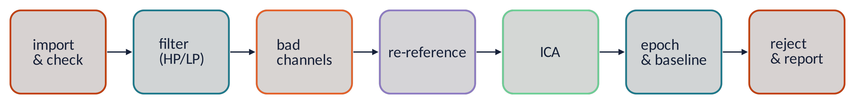
THE PIPELINE
Seven steps from raw file to clean epochs
Order matters: filter before epoching (edge effects), remove bad channels before average reference, ICA before baseline.
Every step is a choice with consequences: report parameters and software versions.
Look at the data before, during and after each step (plots, spectra, topographies).
"EEG is better left alone": minimal pipelines are often enough (Delorme, 2023).
Metaphor cooking: wash and cut the vegetables before cooking — but peel too much and nothing is left.
Brain Imaging · EEG · Lecture 5 · Preprocessing and ICA
3
Notes:
There is no single correct pipeline; what matters is that it is justified, reproducible and reported. Robbins et al. (2020) and Delorme (2023) show that simple pipelines are often as good as complex ones.

Slide 4
01
Filtering and resampling
4

Slide 5
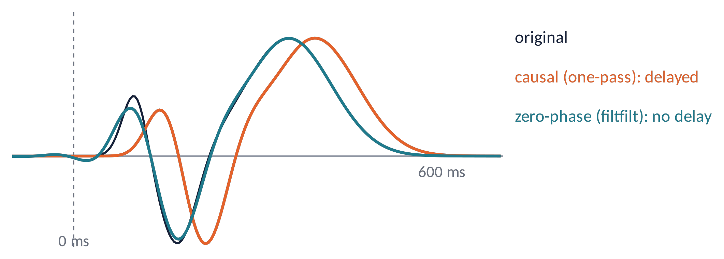
FILTERING (1)
Causal or zero-phase? FIR or IIR?
Causal (one pass): output depends only on the past → delays peaks.
Zero-phase (forward + backward, filtfilt): no delay, but acausal: small effects can appear before onset.
FIR: always stable, linear phase; IIR: steep with low order, but nonlinear phase.
Typical: HP 0.1 Hz for ERPs (≤ 0.1 Hz for slow components), 1 Hz for ICA, LP 30–40 Hz.
Filter the continuous data, not the epochs: edges produce artifacts. Report type, order, cut-off, transition band.
Metaphor a zero-phase filter is like editing a film afterwards: nothing is late, but you can "see the future".
Brain Imaging · EEG · Lecture 5 · Preprocessing and ICA
5
Notes:
Widmann, Schröger & Maess (2015) J Neurosci Methods 250:34. A one-pass causal filter delays the signal; a two-pass (forward-backward) filter has zero phase but is acausal: effects can leak before stimulus onset. For ERP latency studies prefer zero-phase or linear-phase FIR with delay correction; for onset latencies consider causal filters (VanRullen, 2011; Rousselet, 2012).

Slide 6
FILTERING (2)
Resampling and line-noise removal
Downsampling
1000 → 250 Hz saves memory and time. Always low-pass first (resample does it); never just take every 4th sample.
Notch filter
Simple but rings in time and removes brain activity at 50 Hz: avoid if you study gamma.
Spatial methods
CleanLine (regression of sinusoids), Zapline(-plus) (spatial filter): remove the line with minimal distortion.
Resample after high-pass filtering at the high rate? Order is flexible, but keep f_{s} > 2.5 × LP cut-off.
Check the spectrum before and after: a good step removes the peak, not the neighbours.
Brain Imaging · EEG · Lecture 5 · Preprocessing and ICA
6
Notes:
Downsampling functions (MATLAB resample, EEGLAB pop_resample) apply an anti-aliasing low-pass automatically. Zapline: de Cheveigné (2020) NeuroImage 207:116356; Zapline-plus: Klug & Kloosterman (2022) Hum Brain Mapp.

Slide 7
02
Bad channels and re-referencing
7

Slide 8
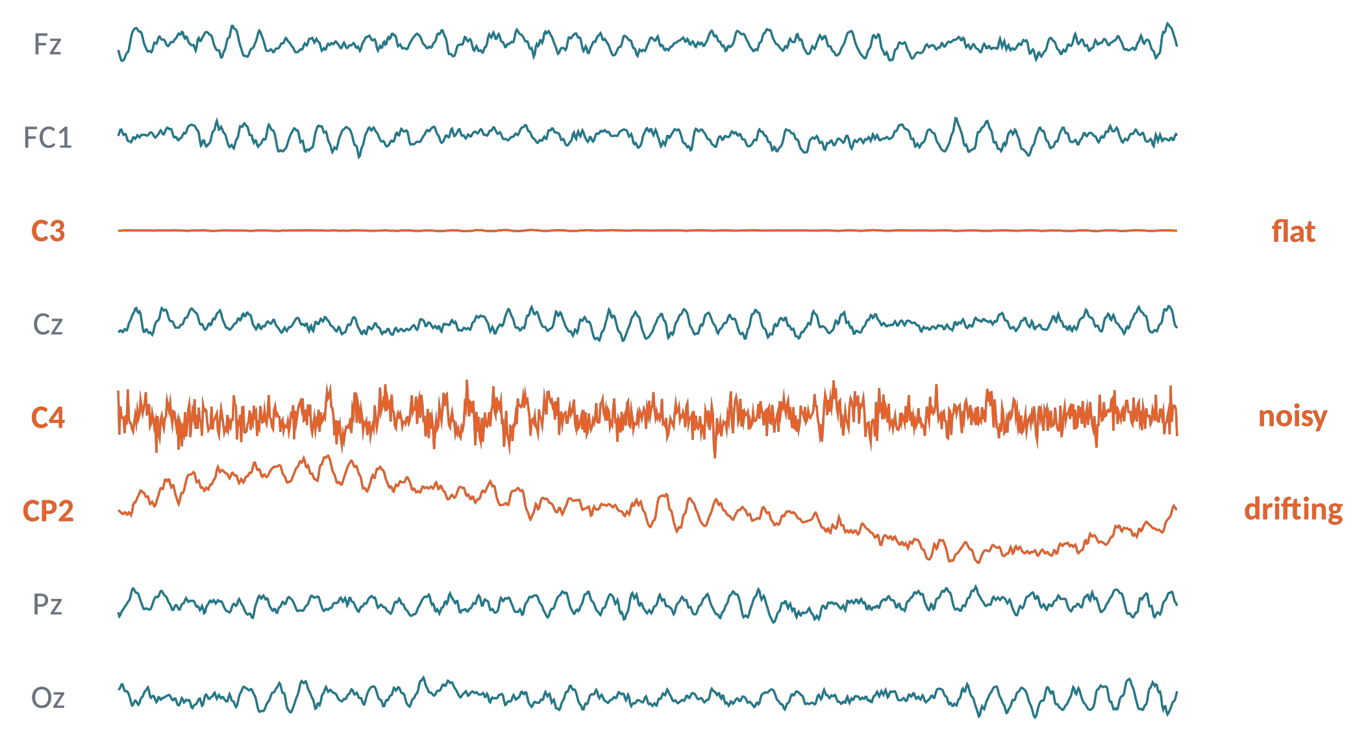
BAD CHANNELS (1)
Finding bad channels
Flat: disconnected electrode (variance ≈ 0).
Noisy: high-frequency noise, extreme variance (robust z > 3–5).
Drifting / uncorrelated: poor contact; low correlation with neighbours (r < 0.8) or poorly predicted by them (RANSAC).
Automatic detection (PREP, clean_rawdata) + visual inspection.
Rule of thumb: > 10–15 % bad channels → question the recording.
Metaphor an orchestra: one detuned violin is easier to mute than to ignore.
Brain Imaging · EEG · Lecture 5 · Preprocessing and ICA
8
Notes:
PREP pipeline: Bigdely-Shamlo et al. (2015) Front Neuroinform 9:16 (deviation, correlation, predictability via RANSAC, high-frequency noise). EEGLAB clean_rawdata: flat-line, channel correlation (default 0.8), line-noise criteria.

Slide 9
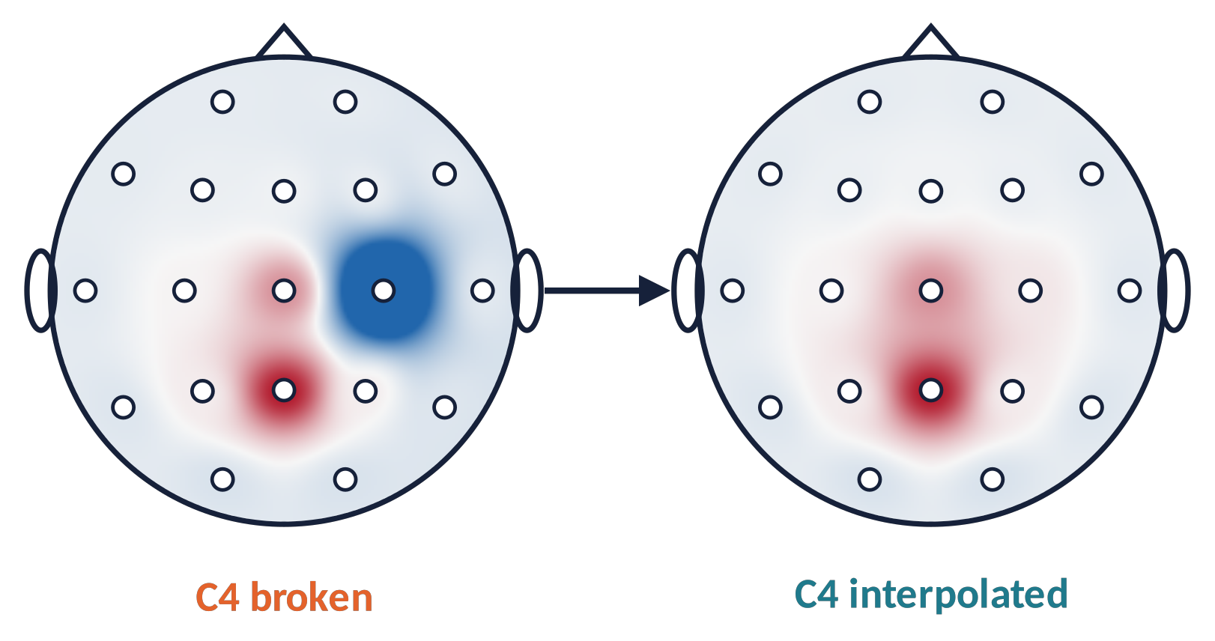
BAD CHANNELS (2)
Interpolation with spherical splines
The missing channel is estimated from its neighbours using the smooth field on the scalp (Perrin et al., 1989).
Works if bad channels are few and scattered; clusters of bad channels cannot be recovered.
⚠ Interpolation adds no new information: the data rank decreases.
V_{C4} ≈ Σ_{j} w_{j} · V_{j} (w from spherical splines)
Brain Imaging · EEG · Lecture 5 · Preprocessing and ICA
9
Notes:
Perrin et al. (1989) Electroencephalogr Clin Neurophysiol 72:184. Interpolated channels add no information: they reduce the data rank by one each. Interpolate before average reference so that every region contributes.

Slide 10
RE-REFERENCING
Average reference and the rank of the data
V_{avg}(ch) = V(ch) − (1/N) Σ_{k} V(k)
Remove/interpolate bad channels first: one bad channel contaminates all channels through the mean.
With ≥ 64 well-spread electrodes the average reference approximates a zero-potential reference (Dien, 1998).
After average reference the channels sum to zero → rank = N − 1 (minus 1 for each interpolated channel).
Tell ICA the true rank, or it will return spurious "ghost" components.
Brain Imaging · EEG · Lecture 5 · Preprocessing and ICA
10
Notes:
Average reference: V_avg(ch) = V(ch) − mean over channels. After it, the channels sum to zero → rank N−1. ICA must then use N−1 components (EEGLAB pop_runica 'pca' option or automatic rank detection) — otherwise ghost components appear (Kim et al., 2023).

Slide 11
03
Epochs, baseline and rejection
11

Slide 12
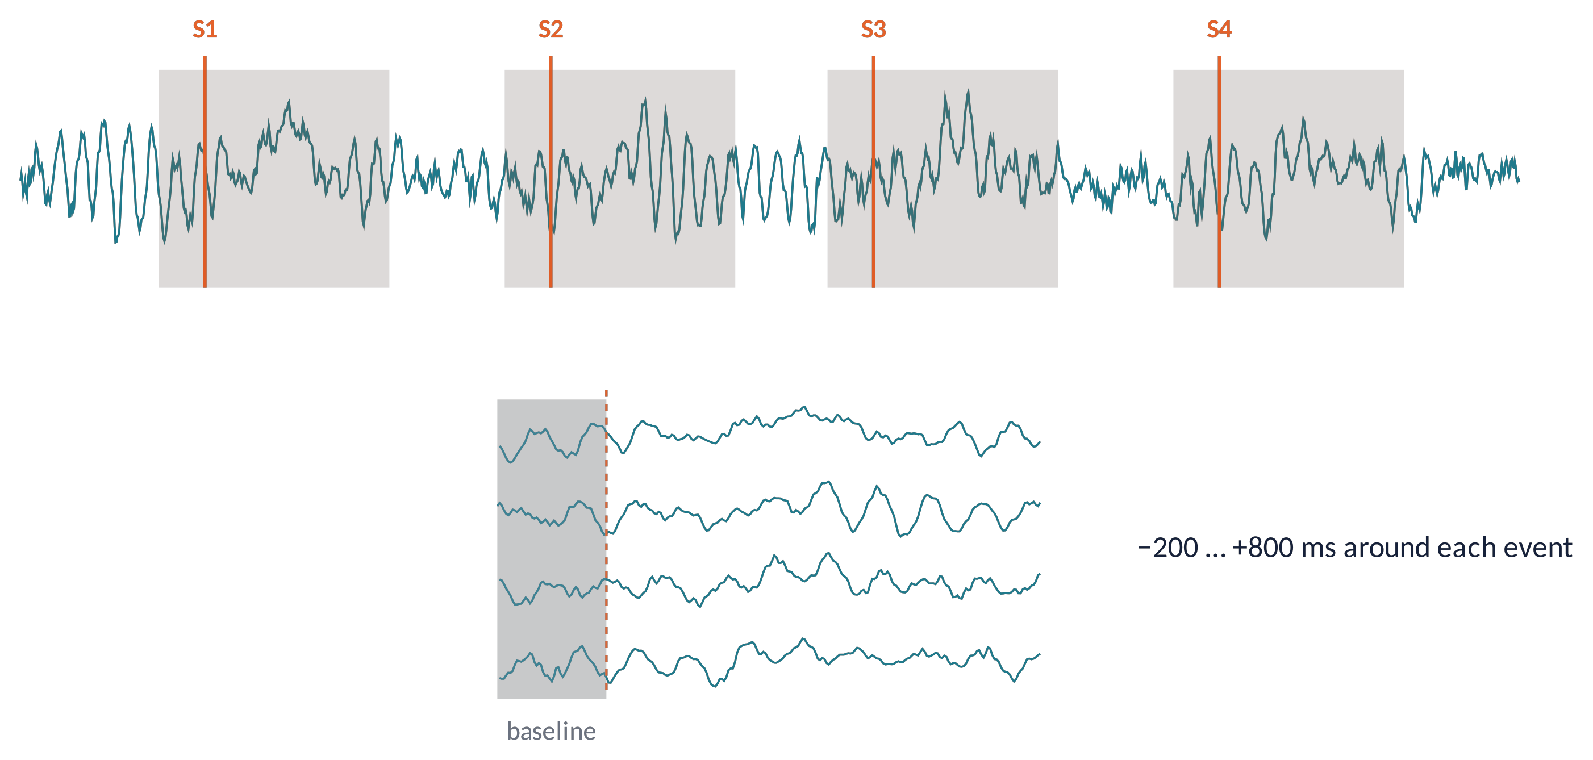
EPOCHS (1)
Cutting the continuous signal around events
Epoch = a time window locked to an event (stimulus or response), e.g. −200 … +800 ms.
Baseline correction: subtract the mean of the pre-stimulus interval from each channel and epoch.
Longer epochs for time-frequency analysis (wavelet edge effects) and for slow components.
Brain Imaging · EEG · Lecture 5 · Preprocessing and ICA
12
Notes:
Triggers must be verified (photodiode). Epoch windows should include a pre-stimulus baseline and extra margins if time-frequency analyses follow (edge effects of wavelets).

Slide 13
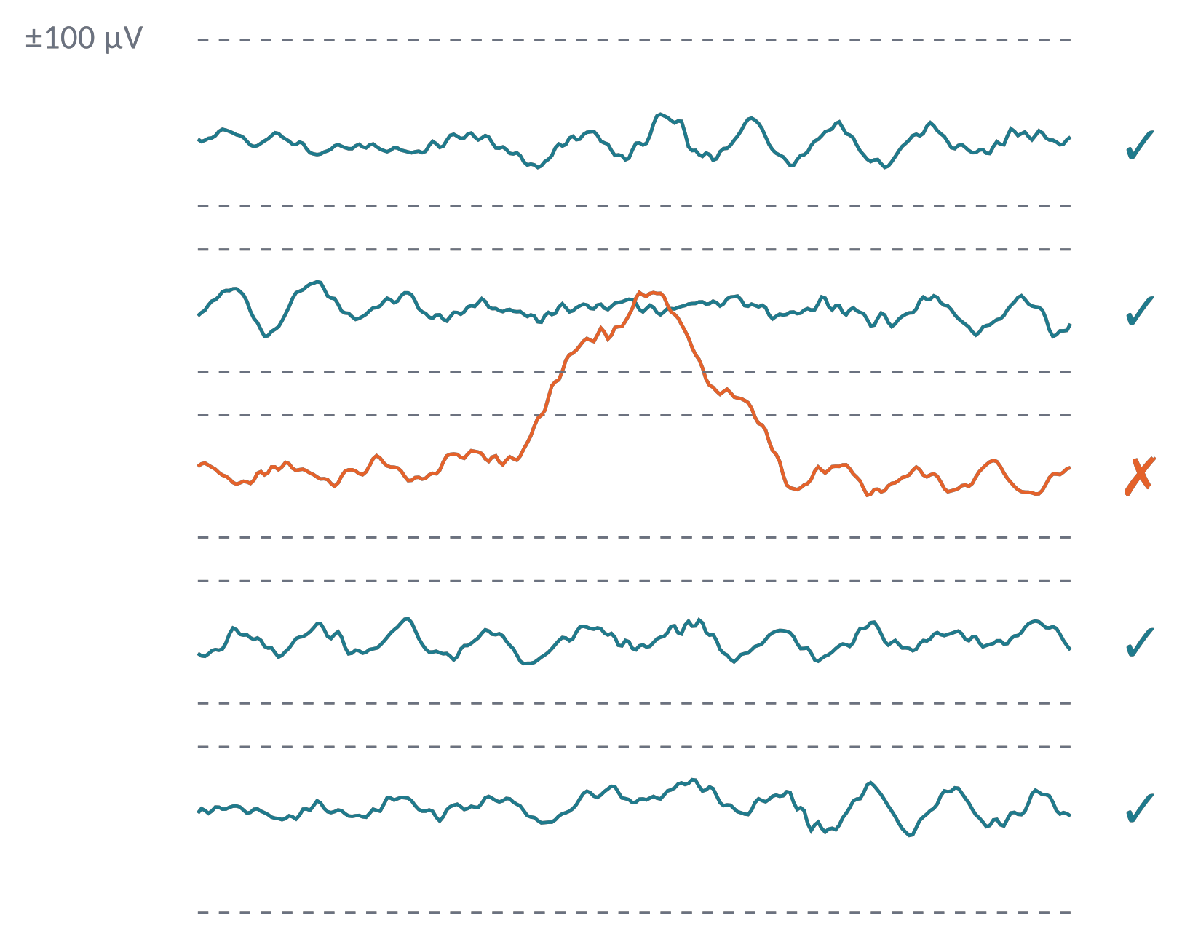
EPOCHS (2)
Rejecting bad epochs
Thresholds: absolute (±100 µV) or peak-to-peak in a moving window.
Statistics: improbable data, kurtosis, joint probability across channels.
ASR (Artifact Subspace Reconstruction): repairs short high-variance bursts on the continuous data (Mullen et al., 2015).
Keep enough trials and similar numbers across conditions; report rejection rates.
Correct what you can (ICA), reject what you must.
Brain Imaging · EEG · Lecture 5 · Preprocessing and ICA
13
Notes:
Luck (2014) ch. 6. Artifact Subspace Reconstruction: Mullen et al. (2015) IEEE TBME 62:2553; Chang et al. (2020) IEEE TBME 67:1114. Balance data quality against the number of trials; report how many trials were rejected per condition.

Slide 14
04
Independent Component Analysis
14

Slide 15
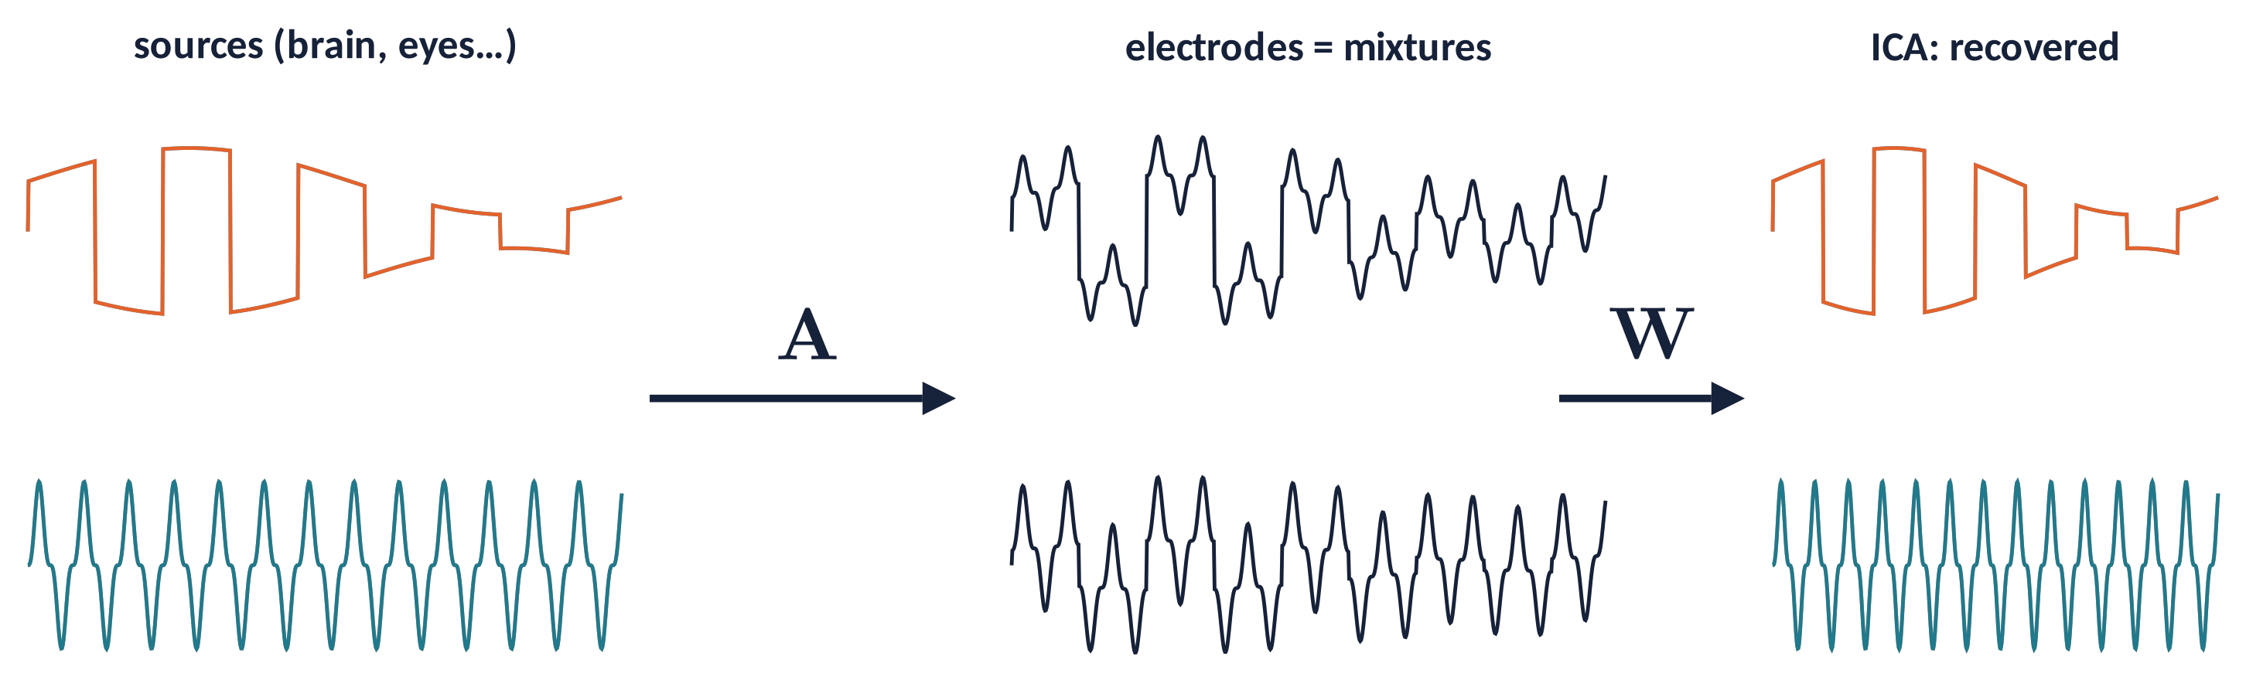
ICA (1)
The cocktail-party problem
Several people talk at once; each microphone records a different mixture. Can we recover each voice without knowing the room?
EEG: electrodes = microphones; brain, eyes, muscles, heart = speakers. Volume conduction = instantaneous linear mixing.
ICA is blind: it uses only the statistics of the data.
Brain Imaging · EEG · Lecture 5 · Preprocessing and ICA
15
Notes:
Bell & Sejnowski (1995) Neural Comput 7:1129; Makeig et al. (1996) NIPS 8; Jung et al. (2000) Psychophysiology 37:163. Each electrode records a weighted sum of all sources; ICA estimates an unmixing matrix W so that the outputs are maximally independent.

Slide 16
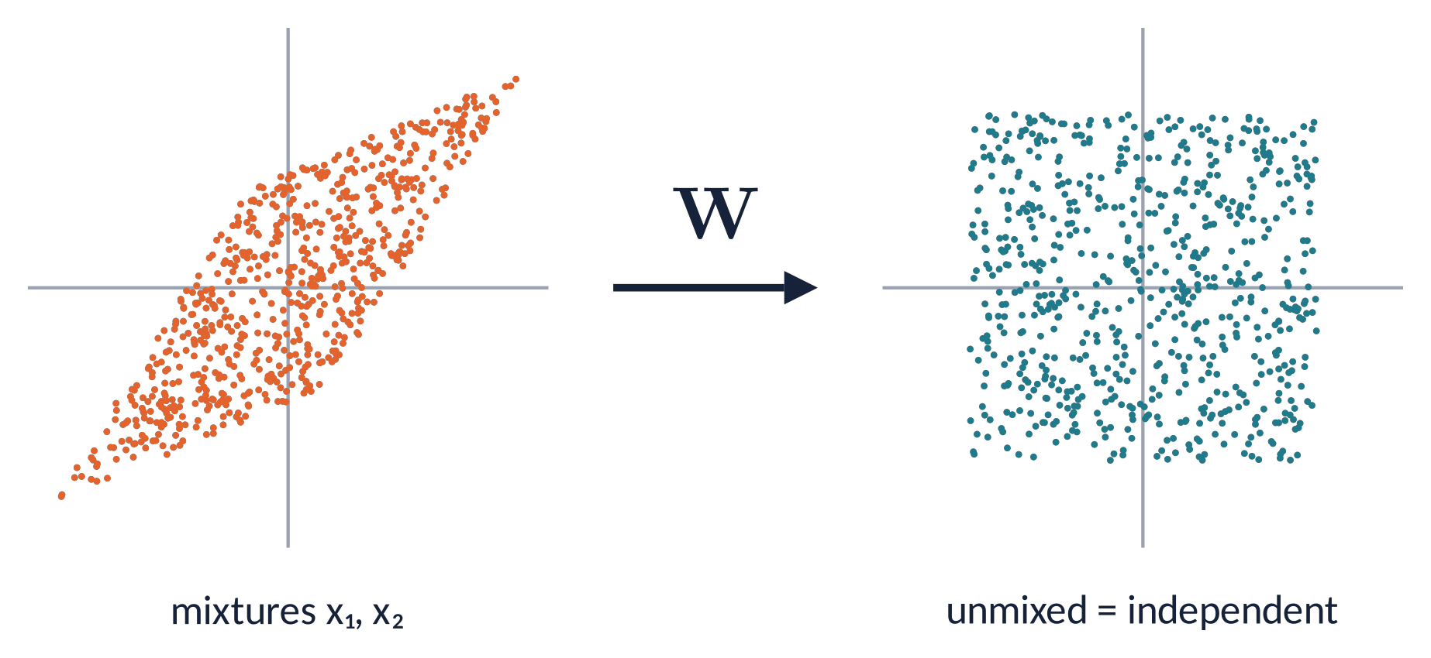
ICA (2)
The model and its assumptions
x(t) = A · s(t) ŝ(t) = W · x(t), W ≈ A⁻¹
Columns of A: scalp maps (topographies) of the components.
Rows of W: spatial filters that extract each component.
Assumptions
Sources statistically independent and non-Gaussian.
Mixing linear, instantaneous, stationary (fixed sources).
Number of sources ≤ number of channels (rank).
Order, sign and scale of components are arbitrary.
Brain Imaging · EEG · Lecture 5 · Preprocessing and ICA
16
Notes:
x(t) = A s(t); W ≈ A⁻¹; s(t) = W x(t). Columns of A = scalp maps of the components; rows of W = spatial filters. Ambiguities: order, sign and scale of the components are arbitrary. Hyvärinen & Oja (2000) Neural Netw 13:411.

Slide 17
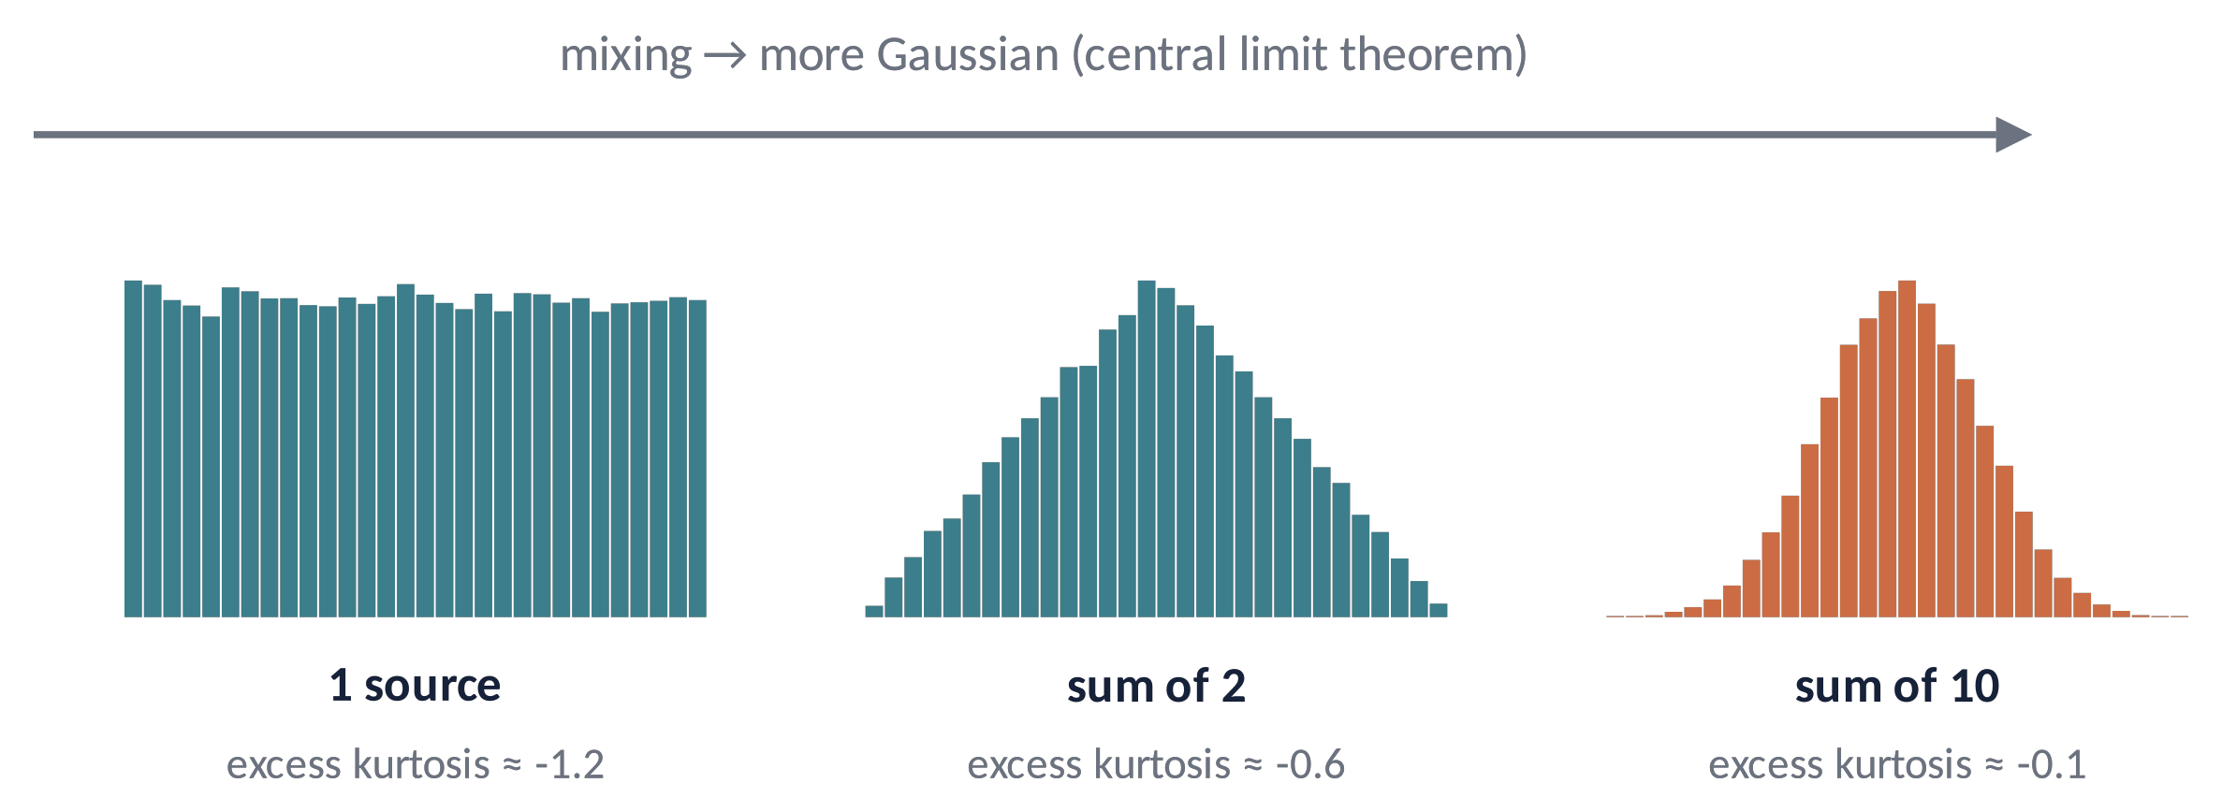
ICA (3)
Why non-Gaussianity reveals the sources
A mixture of independent sources is more Gaussian than each source (central limit theorem).
So: rotate the data until the outputs are as non-Gaussian as possible (kurtosis, negentropy) → you have found the sources.
Blinks and ECG are super-Gaussian (sparse, heavy tails); line noise is sub-Gaussian: extended Infomax handles both.
Metaphor a smoothie tastes "average": to recognise the fruits, look for the most distinctive flavours.
Brain Imaging · EEG · Lecture 5 · Preprocessing and ICA
17
Notes:
Central limit theorem: sums of independent variables tend to a Gaussian. So ICA looks for projections that are as non-Gaussian as possible (kurtosis, negentropy) — or, equivalently, maximises the information transmitted (Infomax). Blinks are super-Gaussian (sparse), line noise is sub-Gaussian.

Slide 18
ICA (4)
Algorithms and practical recipes
Infomax / ext. Infomax
maximises information flow; EEGLAB runica default (Bell & Sejnowski, 1995; Lee et al., 1999)
FastICA
fixed-point, maximises negentropy; fast but less stable across runs (Hyvärinen, 1999)
AMICA
adaptive mixture model; best separation in comparisons, slower (Delorme et al., 2012)
SOBI
uses temporal correlations (second-order); good for rhythmic sources (Belouchrani et al., 1997)
Train ICA on a 1-Hz high-passed copy, then apply the weights to the 0.1-Hz data (Winkler et al., 2015).
1
Enough data: ≈ 20–30 × N² samples (N = channels); remove gross, non-stereotyped artifacts first.
2
Set the number of components to the data rank (after reference and interpolation).
3
Brain Imaging · EEG · Lecture 5 · Preprocessing and ICA
18
Notes:
Infomax: Bell & Sejnowski (1995); extended Infomax: Lee, Girolami & Sejnowski (1999) Neural Comput 11:417; FastICA: Hyvärinen (1999) IEEE TNN 10:626; AMICA: Palmer et al. (2011); comparison: Delorme et al. (2012) PLoS One 7:e30135. 1-Hz high-pass for ICA: Winkler et al. (2015) EMBC; Klug & Gramann (2021) Eur J Neurosci. Data amount: Onton & Makeig (2006) suggest k·N² samples with k ≳ 20–30.

Slide 19
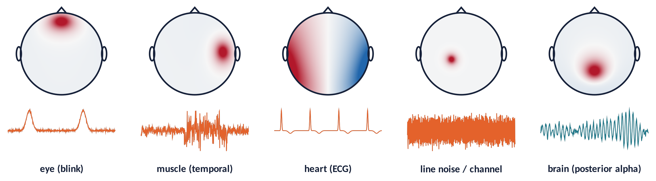
ICA (5)
Reading components: map, time course, spectrum
Brain ICs: smooth dipolar maps, 1/f spectrum with peaks (alpha, mu, beta).
Eye: strong frontal map; blinks/saccades; power at low frequencies.
Muscle: focal at the edge (temporal), broadband > 20 Hz. Heart: broad gradient, regular beats ≈ 1 Hz.
Channel / line: one electrode or 50 Hz only.
Brain Imaging · EEG · Lecture 5 · Preprocessing and ICA
19
Notes:
Chaumon, Bishop & Busch (2015) J Neurosci Methods 250:47 — a practical guide to IC classification. Eye: frontal map, blinks/saccades in time, low-frequency spectrum. Muscle: focal temporal/edge map, broadband >20 Hz. Heart: broad gradient, regular QRS. Channel noise: single-electrode map. Brain: dipolar map, 1/f spectrum with alpha peak.

Slide 20
ICA (6)
ICLabel: automatic component classification
Example: IC 1 (blink)
A neural network trained on thousands of expert-labelled components returns 7 class probabilities (Pion-Tonachini et al., 2019).
Typical rule: flag Eye and Muscle ICs with p > 0.8–0.9.
It is a help, not an oracle: check maps, spectra and time courses.
Report: algorithm, rank, how many ICs removed and by which criterion.
Brain
0.02
Muscle
0.01
Eye
0.95
Heart
0.00
Line Noise
0.00
Channel Noise
0.01
Other
0.01
Brain Imaging · EEG · Lecture 5 · Preprocessing and ICA
20
Notes:
Pion-Tonachini, Kreutz-Delgado & Makeig (2019) NeuroImage 198:181. Trained on >6000 datasets labelled by crowd-sourcing. Outputs 7 class probabilities. Common rule: remove eye and muscle ICs with p > 0.8–0.9; always check a few components by eye.

Slide 21
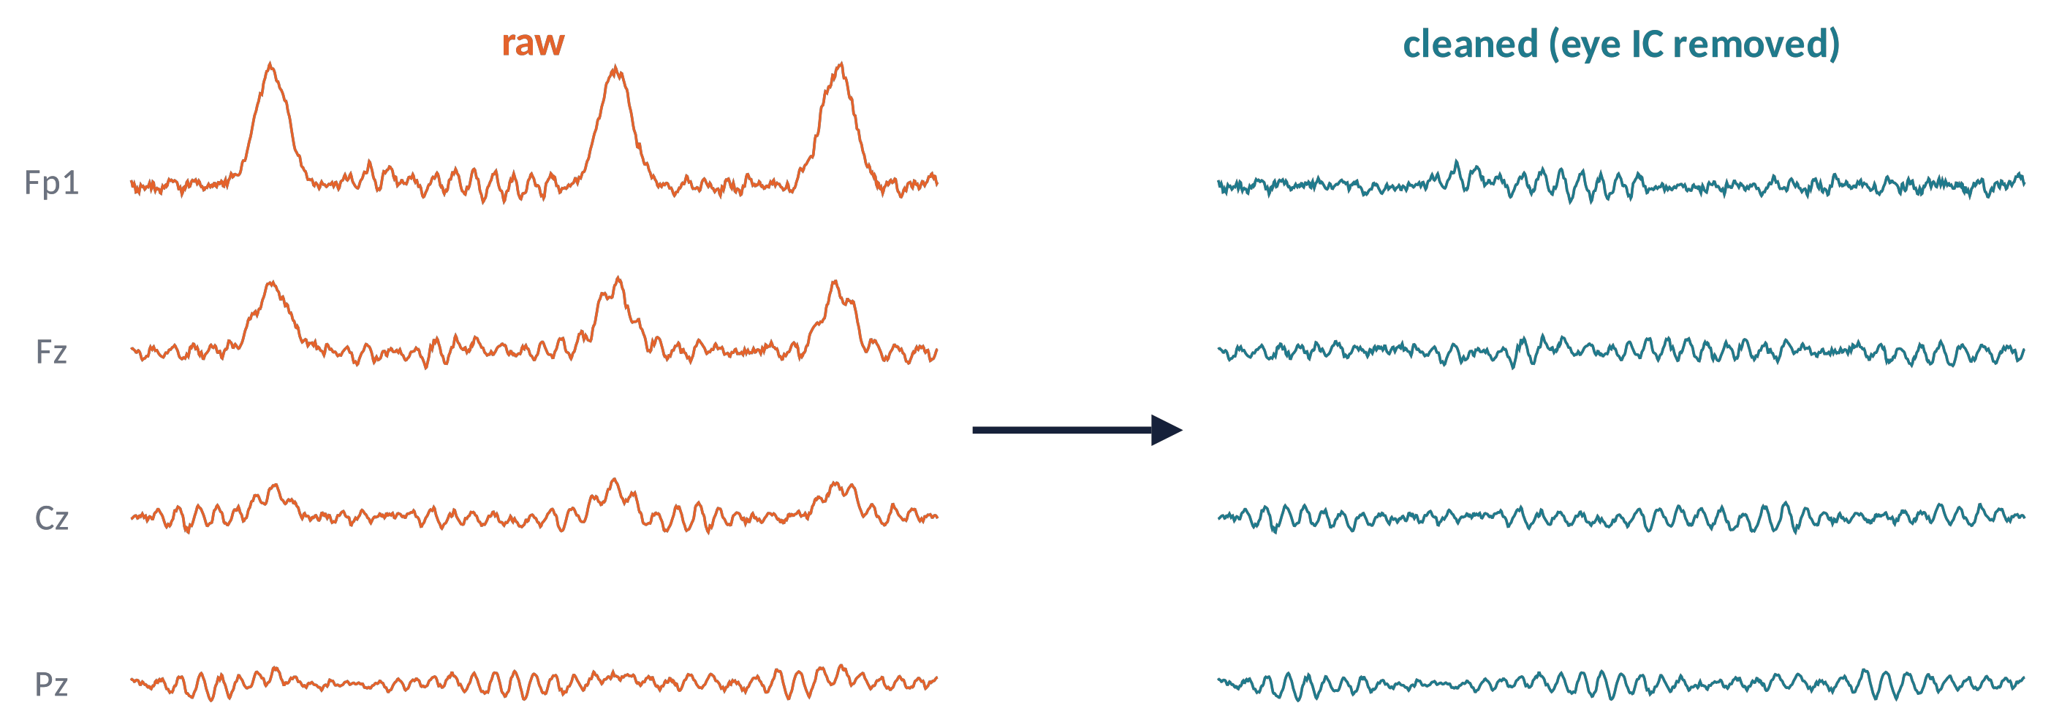
ICA (7)
Removing artifacts: back-projection
x_{clean}(t) = Σ_{k ∉ artifacts} a_{k} · s_{k}(t)
Set artifact components to zero and re-mix the rest: all trials are kept.
⚠ Poorly separated ICs contain brain signal too: remove only clear artifacts.
Brain Imaging · EEG · Lecture 5 · Preprocessing and ICA
21
Notes:
x_clean = A_{:,k∉art} s_{k∉art}. The artifact is subtracted from all channels at once, without losing trials. If a component mixes brain and artifact (poor separation), removing it also removes brain signal — hence the importance of good ICA training data.

Slide 22
05
Pipelines in practice
22

Slide 23
IN MATLAB
A minimal EEGLAB pipeline
EEG = pop_loadset('sub-01_task-oddball_eeg.set');
EEG = pop_eegfiltnew(EEG, 'locutoff', 0.1, 'hicutoff', 40); % zero-phase FIR
orig = EEG.chanlocs;
EEG = pop_clean_rawdata(EEG, 'FlatlineCriterion', 5, 'ChannelCriterion', 0.8, ...
'LineNoiseCriterion', 4, 'BurstCriterion', 'off', 'WindowCriterion', 'off');
EEG = pop_interp(EEG, orig, 'spherical'); % bad channels
EEG = pop_reref(EEG, []); % average reference
tmp = pop_eegfiltnew(EEG, 'locutoff', 1); % 1-Hz copy for ICA
tmp = pop_runica(tmp, 'icatype', 'runica', 'extended', 1, 'pca', rank(double(tmp.data')));
EEG.icaweights = tmp.icaweights; EEG.icasphere = tmp.icasphere;
EEG.icachansind = tmp.icachansind; EEG.icawinv = []; EEG = eeg_checkset(EEG);
EEG = pop_iclabel(EEG, 'default');
EEG = pop_icflag(EEG, [NaN NaN; 0.9 1; 0.9 1; NaN NaN; NaN NaN; NaN NaN; NaN NaN]);
EEG = pop_subcomp(EEG, find(EEG.reject.gcompreject), 0); % back-projection
EEG = pop_epoch(EEG, {'S1'}, [-0.2 0.8]);
EEG = pop_rmbase(EEG, [-200 0]);
Brain Imaging · EEG · Lecture 5 · Preprocessing and ICA
23
Notes:
Functions from EEGLAB (Delorme & Makeig, 2004) and its plug-ins clean_rawdata and ICLabel. ICLabel class order: Brain, Muscle, Eye, Heart, Line Noise, Channel Noise, Other. Adapt thresholds to your data and always inspect the result.

Slide 24
PIPELINES
Automated pipelines and reporting
PREP
robust referencing, bad-channel detection (Bigdely-Shamlo et al., 2015)
HAPPE
for infants and short, noisy recordings (Gabard-Durnam et al., 2018)
Automagic
large datasets, quality ratings per file (Pedroni et al., 2019)
MNE / FieldTrip
Python / MATLAB alternatives; same steps, different defaults
Automatic ≠ unsupervised: check quality metrics and plots for every subject.
Preprocessing choices create a "garden of forking paths": decide the pipeline before looking at the effects (pre-registration).
Report following COBIDAS-MEEG (Pernet et al., 2020) and share code + BIDS data.
Brain Imaging · EEG · Lecture 5 · Preprocessing and ICA
24
Notes:
PREP: Bigdely-Shamlo et al. (2015); HAPPE: Gabard-Durnam et al. (2018) Front Neurosci 12:97; APP: da Cruz et al. (2018); Automagic: Pedroni et al. (2019) NeuroImage 200:460; Delorme (2023) Sci Rep 13:2372 'EEG is better left alone'. Reporting: Keil et al. (2014); Pernet et al. (2020) Nat Neurosci 23:1473 (COBIDAS MEEG).

Slide 25
CHECK YOUR UNDERSTANDING
Three questions
Why must bad channels be removed before computing the average reference?
1
64 channels, average reference, 2 interpolated channels: how many ICs should you estimate?
2
An ERP difference starts 20 ms before the stimulus. What could explain it?
3
Brain Imaging · EEG · Lecture 5 · Preprocessing and ICA
25
Notes:
(1) The average includes the bad channel → noise spread everywhere. (2) Rank deficiency: 64 channels, average reference, 2 interpolated → rank 61. (3) Zero-phase filters are acausal: the effect may be a filter artifact; check with a causal filter.

Slide 26
TAKE-HOME MESSAGES
Take-home messages
A pipeline is a sequence of choices: justify, report, share.
1
Filter the continuous data; know the delay/acausality of your filters.
2
Bad channels out before average reference; interpolation reduces rank.
3
ICA = linear unmixing of independent, non-Gaussian sources.
4
Remove only clear artifact ICs; ICLabel helps, your eyes decide.
5
Brain Imaging · EEG · Lecture 5 · Preprocessing and ICA
26

Slide 27
SUGGESTED READING
Suggested reading
Widmann A., Schröger E., Maess B. (2015) Digital filter design for electrophysiological data – a practical approach. J Neurosci Methods 250:34–46.
Bigdely-Shamlo N. et al. (2015) The PREP pipeline: standardized preprocessing for large-scale EEG analysis. Front Neuroinform 9:16.
Perrin F. et al. (1989) Spherical splines for scalp potential and current density mapping. Electroencephalogr Clin Neurophysiol 72:184–187.
Bell A.J., Sejnowski T.J. (1995) An information-maximization approach to blind separation and blind deconvolution. Neural Comput 7:1129–1159.
Jung T.-P. et al. (2000) Removing electroencephalographic artifacts by blind source separation. Psychophysiology 37:163–178.
Hyvärinen A., Oja E. (2000) Independent component analysis: algorithms and applications. Neural Netw 13:411–430.
Delorme A. et al. (2012) Independent EEG sources are dipolar. PLoS One 7:e30135.
Chaumon M., Bishop D.V.M., Busch N.A. (2015) A practical guide to the selection of independent components of the EEG. J Neurosci Methods 250:47–63.
Pion-Tonachini L., Kreutz-Delgado K., Makeig S. (2019) ICLabel: an automated EEG independent component classifier. NeuroImage 198:181–197.
Mullen T.R. et al. (2015) Real-time neuroimaging and cognitive monitoring using wearable dry EEG. IEEE Trans Biomed Eng 62:2553–2567.
Delorme A. (2023) EEG is better left alone. Sci Rep 13:2372.
Pernet C. et al. (2020) Issues and recommendations from the OHBM COBIDAS MEEG committee. Nat Neurosci 23:1473–1483.
Brain Imaging · EEG · Lecture 5 · Preprocessing and ICA
27

