Slide 1

MSC IN COMPUTATIONAL COGNITIVE SCIENCE
Brain Imaging – Methods and Applications
Module: Electroencephalography (EEG)
Lecture 6
Spectral and
time-frequency analysis
Pierpaolo Croce
A.Y. 2026-2027

Slide 2
LECTURE 6
Today: rhythms as numbers
The Fourier transform: resolution, Nyquist, leakage, windows.
1
Power spectrum estimation: Welch, multitaper, 1/f vs peaks.
2
Time-frequency analysis: STFT, Morlet wavelets, baseline, ERD/ERS.
3
Evoked vs induced activity; phase and ITPC.
4
Cross-frequency coupling and common pitfalls.
5
Brain Imaging · EEG · Lecture 6 · Spectral and time-frequency analysis
2
Notes:
Main reference: Cohen M.X. (2014) Analyzing Neural Time Series Data, MIT Press — with MATLAB code for every method.

Slide 3
WHY FREQUENCY?
The EEG speaks in rhythms
Oscillations are synchronised population activity (Lecture 3): their frequency tells us about the circuit.
1
Different bands, different functions: alpha and attention, beta and movement, theta and memory, gamma and local processing.
2
The spectrum is a compact description of long recordings (resting state, sleep, clinical EEG).
3
Time-frequency shows when rhythms change: activity not phase-locked is invisible in the ERP.
4
Metaphor a prism splits white light into colours; the Fourier transform splits the EEG into rhythms.
Brain Imaging · EEG · Lecture 6 · Spectral and time-frequency analysis
3
Notes:
Buzsáki (2006) Rhythms of the Brain. Oscillations reflect synchronised activity of neural populations (Lecture 3); different bands have different generators and functional correlates.

Slide 4
01
From time to frequency
4

Slide 5
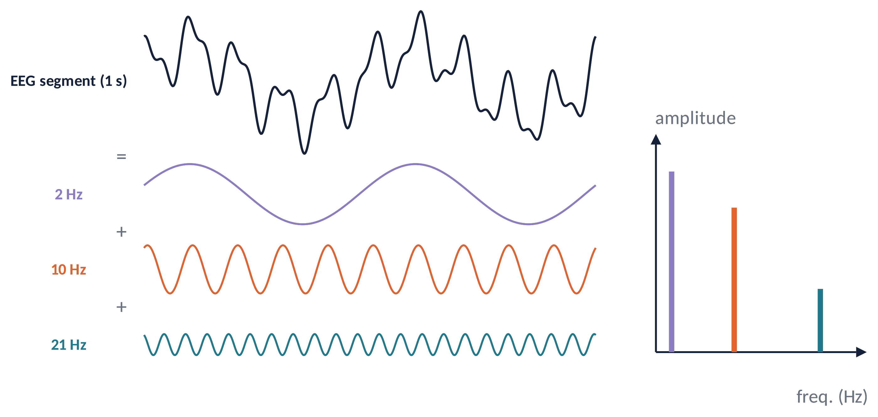
FOURIER (1)
Any signal is a sum of sinusoids
X(f) = Σ_{n} x(n) · e^{−i2πfn / fs}
Each frequency has an amplitude |X(f)| and a phase ∠X(f).
Power = |X(f)|²: how much variance lives at each frequency.
The transform is linear and invertible: no information is lost.
MATLAB: X = fft(x); P = abs(X).².
Brain Imaging · EEG · Lecture 6 · Spectral and time-frequency analysis
5
Notes:
Fourier (1822). DFT: X(f_k) = Σ_n x(n) e^(−i2πkn/N). Each complex coefficient has an amplitude |X| and a phase ∠X. Power = |X|². In MATLAB: X = fft(x)/N; f = (0:N-1)*fs/N.

Slide 6
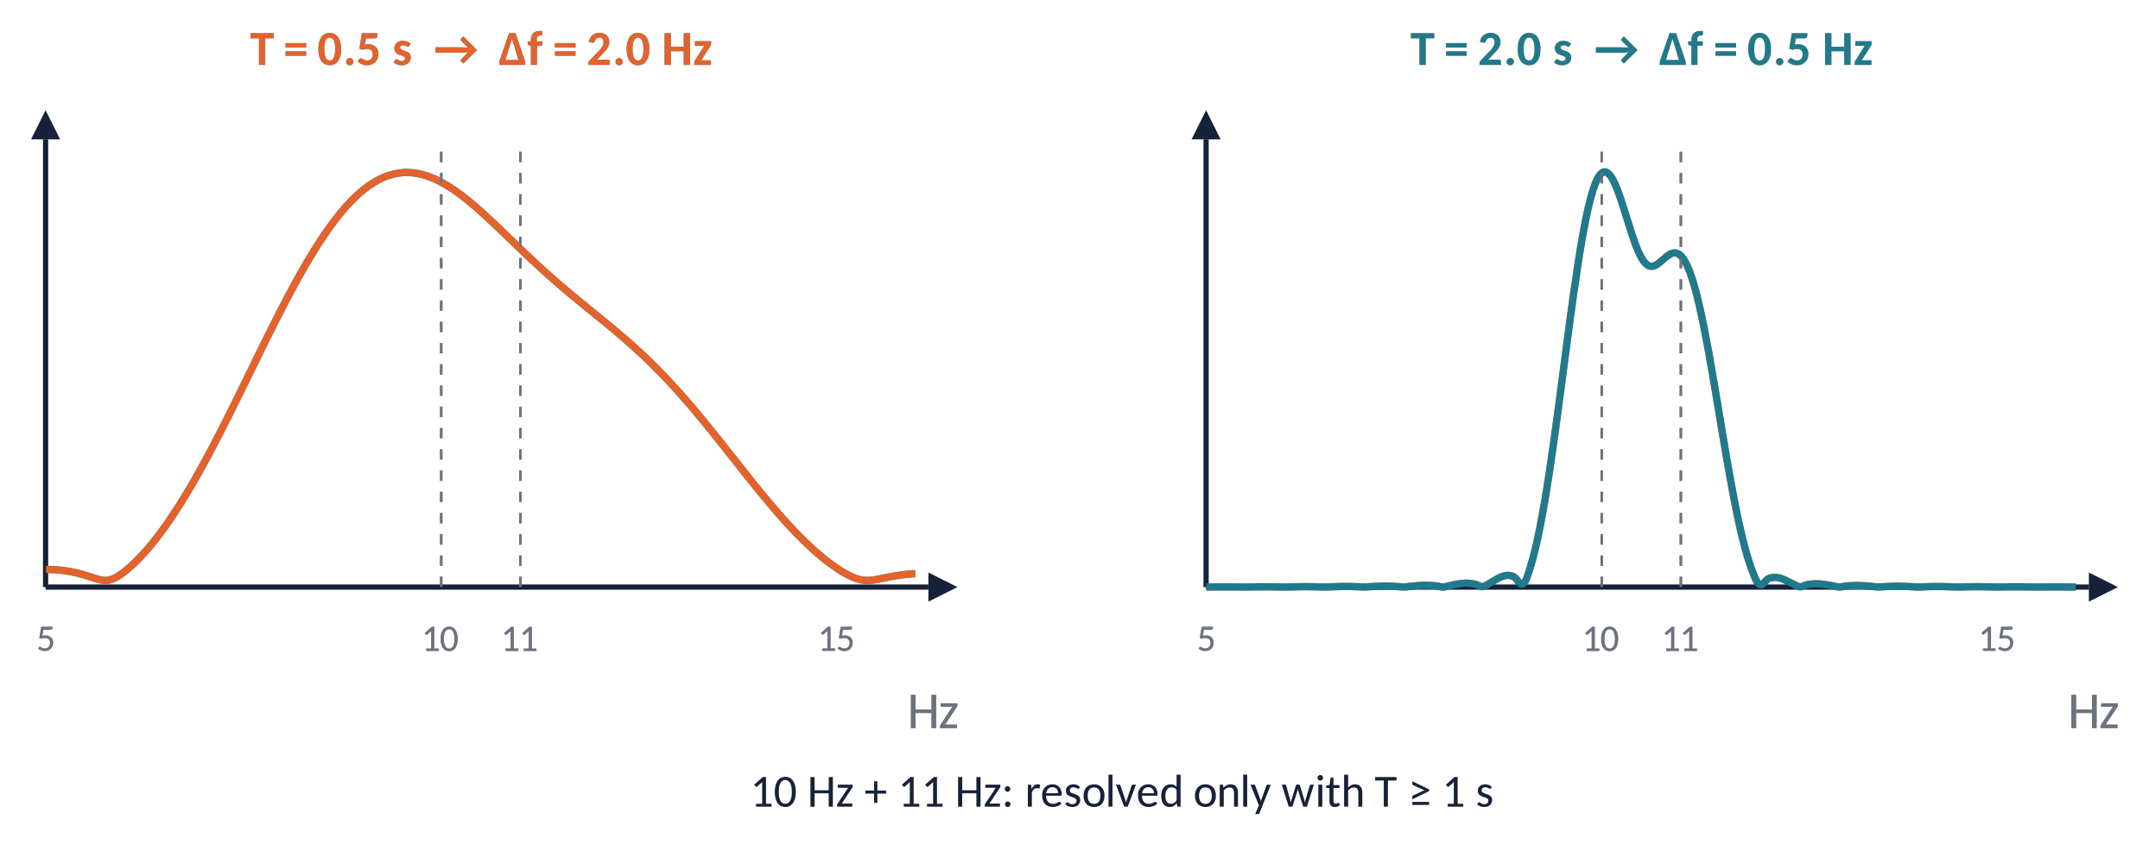
FOURIER (2)
Frequency resolution: Δf = 1/T
Δf = 1 / T f_{max} = f_{s} / 2
Longer windows → finer frequency resolution; the sampling rate sets only the maximum frequency.
Zero-padding makes the plot smoother but does not add resolution.
Brain Imaging · EEG · Lecture 6 · Spectral and time-frequency analysis
6
Notes:
The frequency spacing of the DFT is fs/N = 1/T. Zero-padding interpolates the spectrum but does not increase the true resolution. Two peaks closer than ~1/T cannot be separated.

Slide 7
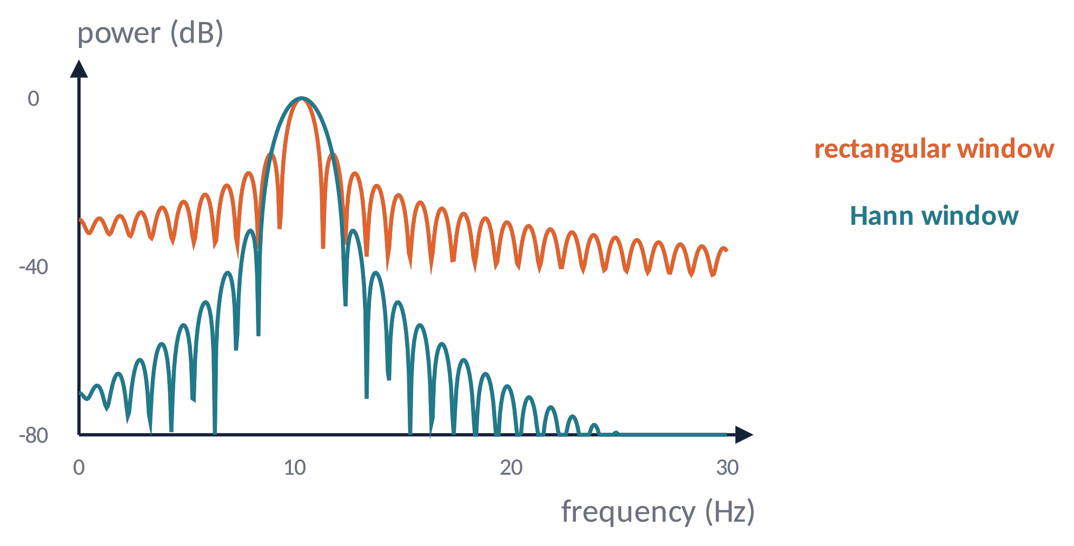
FOURIER (3)
Spectral leakage and tapers
A segment cut abruptly (rectangular window) spreads power to all frequencies: leakage.
Tapers (Hann, Hamming) fade the edges: side lobes drop by ≈ 30–40 dB, the main peak widens.
Always taper before the FFT (pwelch does it for you).
Metaphor a photo with a hard frame creates false edges; a soft vignette keeps the attention on the subject.
Brain Imaging · EEG · Lecture 6 · Spectral and time-frequency analysis
7
Notes:
Cutting a signal is multiplying it by a rectangular window: in frequency this convolves the spectrum with a sinc, whose side lobes spread power (leakage). Tapers (Hann, Hamming) trade a wider main lobe for much lower side lobes (Harris, 1978).

Slide 8
02
Estimating the power spectrum
8

Slide 9
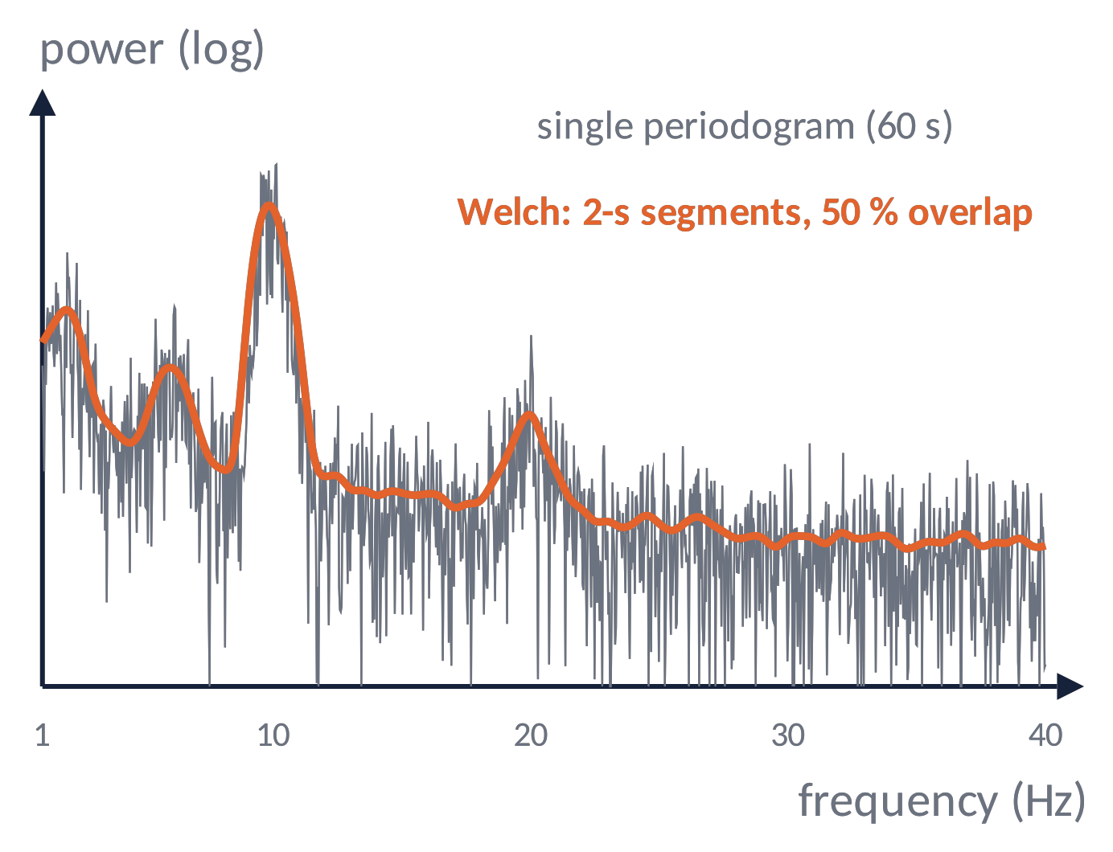
SPECTRUM (1)
Welch's method: average to reduce variance
The single periodogram is noisy: its variance does not shrink with longer recordings.
Welch: cut into overlapping segments (e.g. 2 s, 50 %), taper, FFT each, average the power.
Trade-off: shorter segments = more averages but coarser resolution.
MATLAB: [pxx,f] = pwelch(x, hann(2*fs), fs, [], fs);
Brain Imaging · EEG · Lecture 6 · Spectral and time-frequency analysis
9
Notes:
Welch (1967) IEEE Trans Audio Electroacoust 15:70. The raw periodogram is an inconsistent estimator: its variance does not decrease with longer data. Averaging K segments reduces variance ~1/K at the cost of resolution (1/segment length).

Slide 10
SPECTRUM (2)
Multitaper and units
Multitaper
Several orthogonal tapers (Slepian) on the same data, averaged: low variance with controlled smoothing ±W Hz (Thomson, 1982). Ideal for gamma and sleep.
Absolute power
µV²/Hz (density) or µV² (band). Depends on skull, impedance, reference.
Relative power
band / total power (e.g. 1–40 Hz): removes global scaling but bands become interdependent.
Logarithmic
log10 or dB = 10·log10(P/P_{ref}): power is skewed; logs make it closer to Gaussian for statistics.
Report: method, segment length, overlap, taper, frequency resolution, units. Plot spectra on log axes.
Brain Imaging · EEG · Lecture 6 · Spectral and time-frequency analysis
10
Notes:
Thomson (1982) Proc IEEE 70:1055; Percival & Walden (1993); Prerau et al. (2017) Physiology 32:60 for sleep. dB = 10·log10(P/Pref).

Slide 11
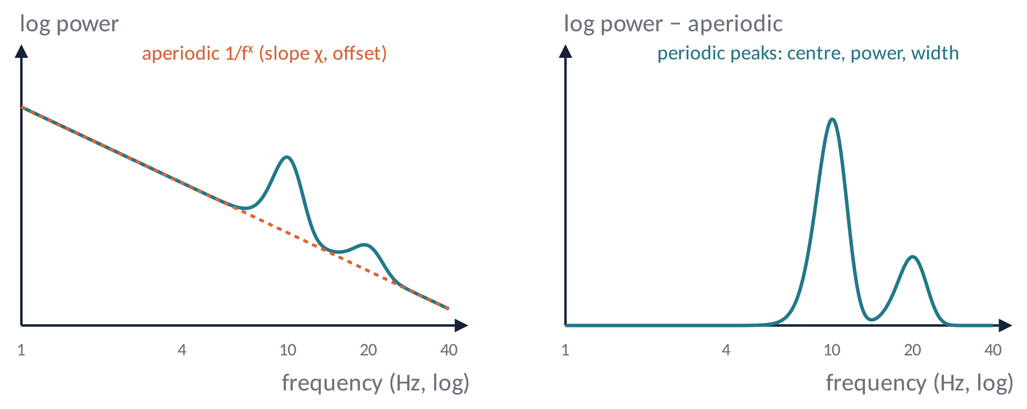
SPECTRUM (3)
Peaks on a 1/f background
log P(f) = b − log(k + f^{χ}) + Σ gaussian peaks
A change in "band power" can come from a peak or from a change of slope/offset of the background.
specparam/FOOOF separates the two (Donoghue et al., 2020); χ has been linked to the E/I balance and ageing.
Brain Imaging · EEG · Lecture 6 · Spectral and time-frequency analysis
11
Notes:
Donoghue et al. (2020) Nat Neurosci 23:1655 — specparam (formerly FOOOF). The aperiodic exponent χ has been linked to excitation/inhibition balance (Gao, Peterson & Voytek, 2017) and changes with age (Voytek et al., 2015).

Slide 12
SPECTRUM (4)
Band power and individual frequencies
P_{band} = Σ_{f ∈ band} P(f) · Δf
Fixed bands (δ, θ, α, β, γ) are conventions: people differ (IAF ≈ 8–12 Hz, decreasing with age).
1
Individual alpha frequency (peak or centre of gravity) → individually adjusted bands (Klimesch, 1999).
2
Ratios (θ/β, α asymmetry) are popular but fragile: check both numerator and denominator.
3
Always look at the spectrum before extracting numbers.
4
Brain Imaging · EEG · Lecture 6 · Spectral and time-frequency analysis
12
Notes:
Klimesch (1999) Brain Res Rev 29:169 — individual alpha frequency (IAF) and adjusted bands. Corcoran et al. (2018) Psychophysiology 55:e13064 — automated IAF estimation. Alpha asymmetry: Allen et al. (2004).

Slide 13
03
Time-frequency analysis
13

Slide 14
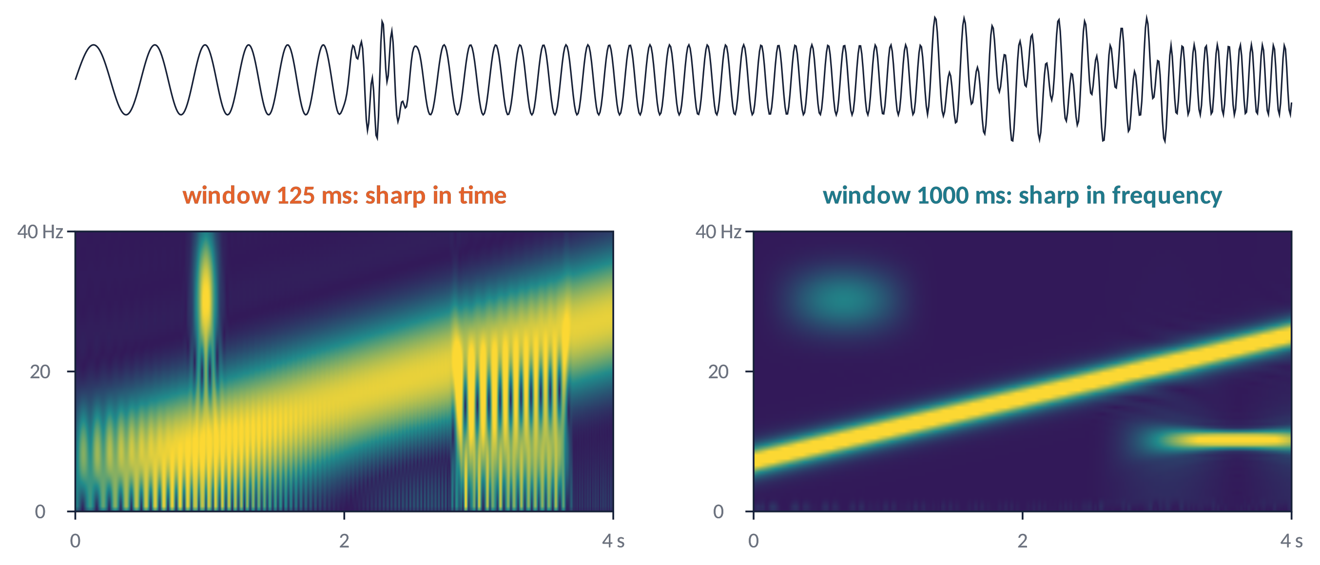
TIME-FREQUENCY (1)
STFT and the time–frequency trade-off
Δt · Δf ≥ 1 / 4π
Slide a window, FFT each position: short windows localise bursts, long windows separate frequencies.
Brain Imaging · EEG · Lecture 6 · Spectral and time-frequency analysis
14
Notes:
Gabor (1946): Δt·Δf ≥ 1/(4π). A window cannot be sharp in both time and frequency. The STFT uses the same window for all frequencies; wavelets adapt it.

Slide 15
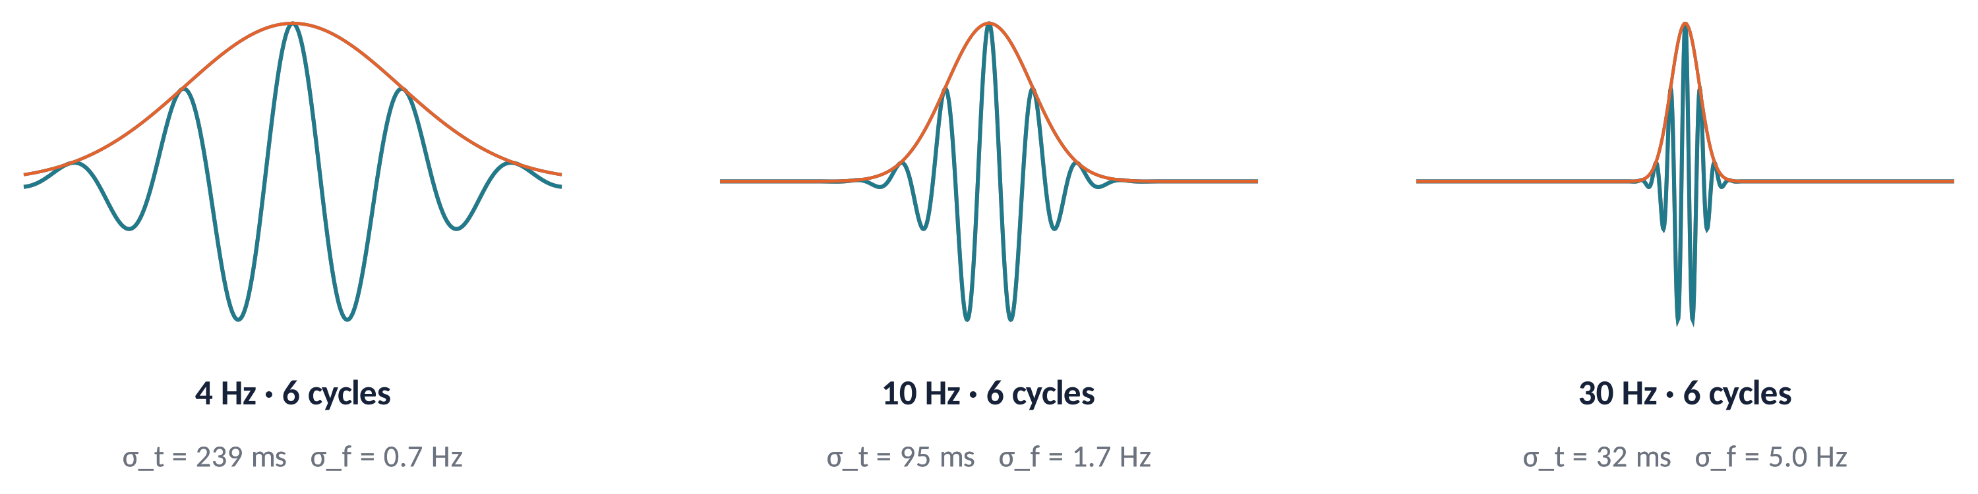
TIME-FREQUENCY (2)
Morlet wavelets: a window that scales with frequency
w(t) = e^{i2πft} · e^{−t²/2σ²}, σ_{t} = n / 2πf
A Morlet wavelet is a sine wave under a Gaussian: n cycles at every frequency → short at high f, long at low f.
Convolution with the complex wavelet → at each time: power = |z|², phase = ∠z.
Fast in practice: multiply in the frequency domain (FFT) and invert.
Brain Imaging · EEG · Lecture 6 · Spectral and time-frequency analysis
15
Notes:
Complex Morlet wavelet: w(t) = exp(i2πft)·exp(−t²/2σ²), σ = n/(2πf). Convolution of the signal with w gives a complex time series: |·|² = power, angle = phase. Cohen (2019) NeuroImage 199:81 recommends defining wavelets by their FWHM.

Slide 16
TIME-FREQUENCY (3)
How many cycles?
n ≈ 3
good temporal precision, poor frequency precision: transient events.
n ≈ 7
balanced: the usual compromise for 4–40 Hz.
n ≈ 12+
good frequency precision, blurred in time: sustained rhythms, SSVEP.
Common choice: frequencies log-spaced, cycles increasing 3 → 10 with frequency.
1
Report the FWHM in time and frequency, not only "n cycles" (Cohen, 2019).
2
Edge effects: epochs must extend ≈ 1.5 wavelet lengths beyond the window of interest.
3
Brain Imaging · EEG · Lecture 6 · Spectral and time-frequency analysis
16
Notes:
Typical choice: n increasing from 3 (low f) to 10 (high f), log-spaced frequencies. Report FWHM in time and frequency (Cohen, 2019). Edge effects: epochs must be longer than the analysis window by ~1.5 wavelet lengths on each side.

Slide 17
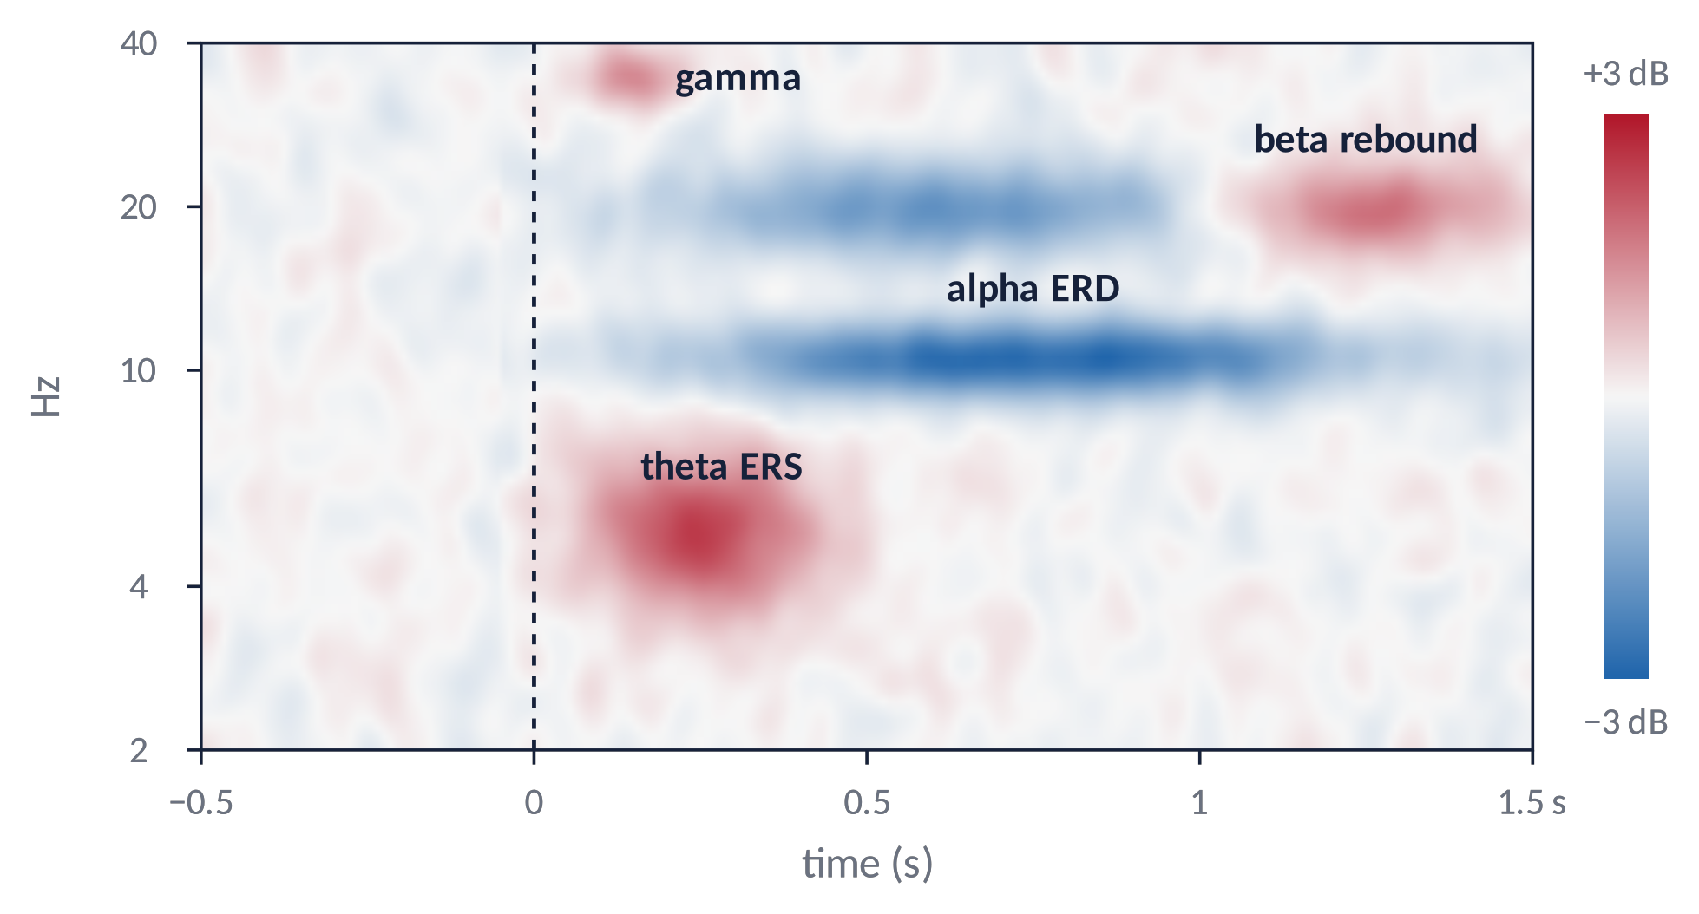
TIME-FREQUENCY (4)
The time-frequency map and baseline normalisation
dB(t,f) = 10 · log₁₀ [ P(t,f) / P_{base}(f) ]
Raw power follows 1/f: normalise each frequency to a pre-stimulus baseline.
ERD (decrease, blue) and ERS (increase, red): e.g. alpha/beta ERD during movement, beta rebound after it.
dB, % change or z-score: choose one and report it.
Brain Imaging · EEG · Lecture 6 · Spectral and time-frequency analysis
17
Notes:
Pfurtscheller & Lopes da Silva (1999) Clin Neurophysiol 110:1842 (ERD/ERS). Raw power is dominated by low frequencies (1/f): normalise to a pre-stimulus baseline. dB: 10·log10(P/Pbase); percentage: 100·(P−Pbase)/Pbase; z-score. Grandchamp & Delorme (2011) Front Psychol 2:236 on single-trial normalisation.

Slide 18
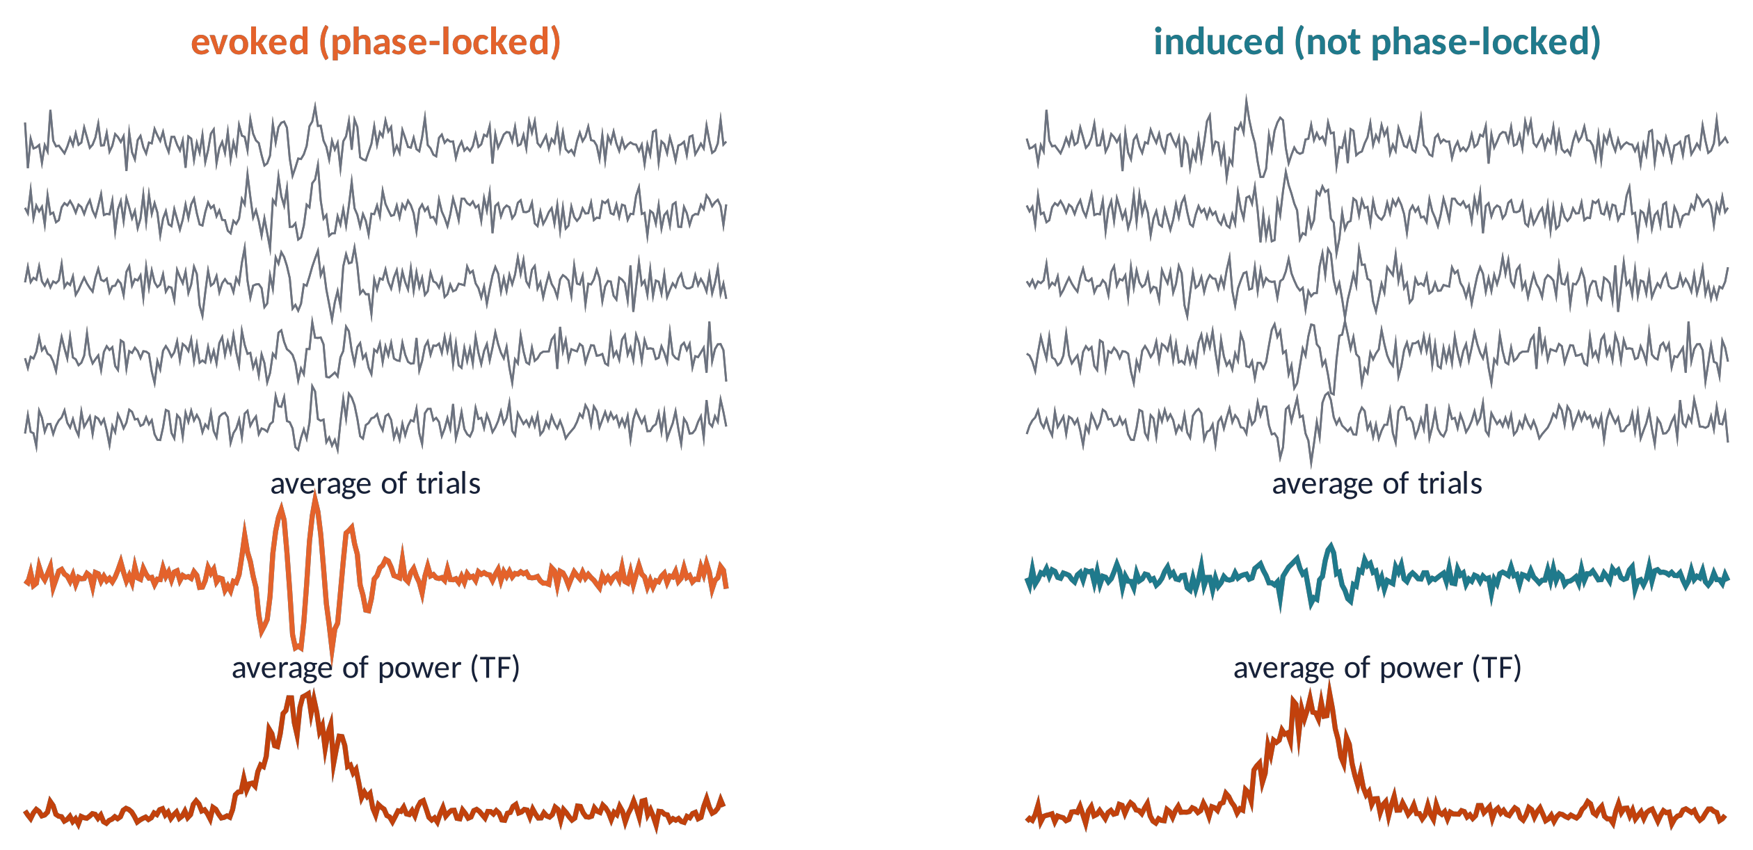
TIME-FREQUENCY (5)
Evoked versus induced activity
Evoked: same latency and phase in every trial → survives averaging (ERP).
Induced: time-locked but phase-jittered → cancels in the ERP, visible only in single-trial power.
Order matters: power then average (total) ≠ average then power (evoked).
Brain Imaging · EEG · Lecture 6 · Spectral and time-frequency analysis
18
Notes:
Tallon-Baudry & Bertrand (1999) Trends Cogn Sci 3:151. Total power = average of single-trial power; evoked power = power of the ERP; induced ≈ total − evoked (or power after subtracting the ERP from each trial).

Slide 19
04
Phase and coupling
19

Slide 20
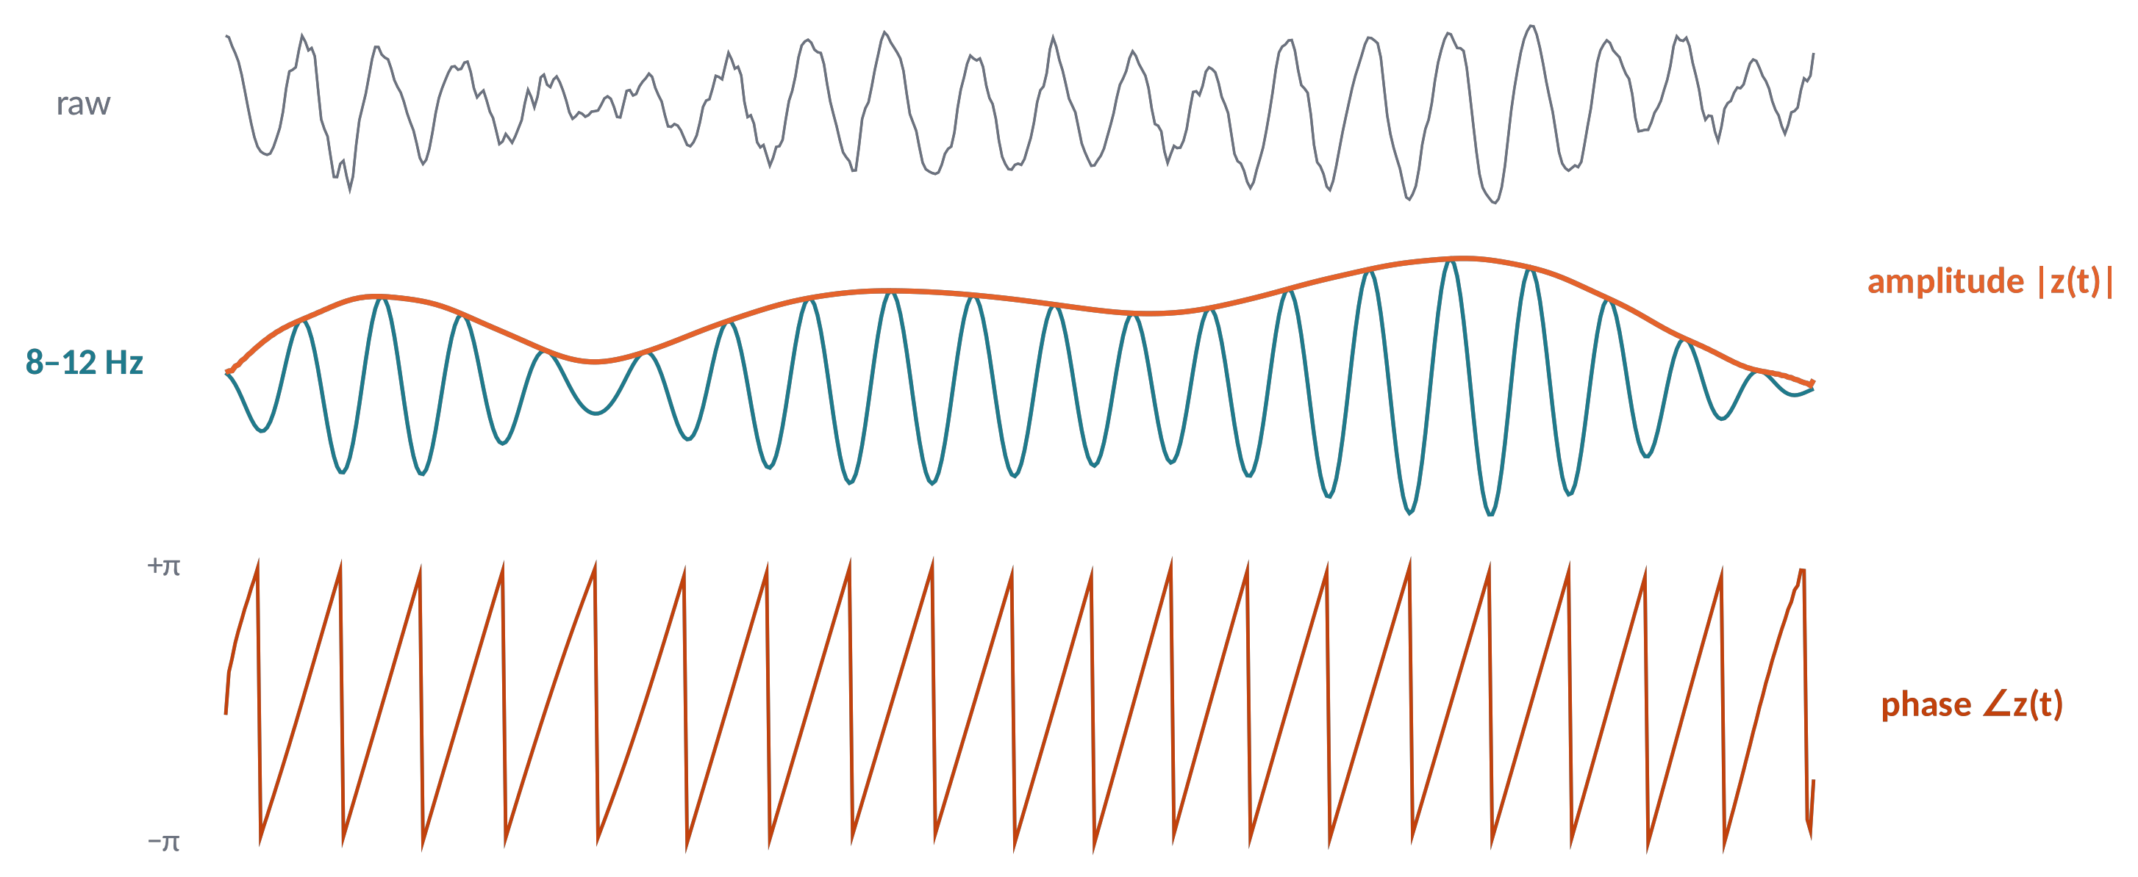
PHASE (1)
Band-pass + Hilbert: amplitude and phase over time
z(t) = x(t) + i·H[x](t) = A(t) · e^{iφ(t)}
Filter in a narrow band, then the analytic signal gives the instantaneous amplitude (envelope) and phase.
Brain Imaging · EEG · Lecture 6 · Spectral and time-frequency analysis
20
Notes:
The analytic signal z(t) = x(t) + i·H[x](t). Meaningful only for narrow-band signals: filter first. Equivalent in practice to complex wavelet convolution (Bruns, 2004).

Slide 21
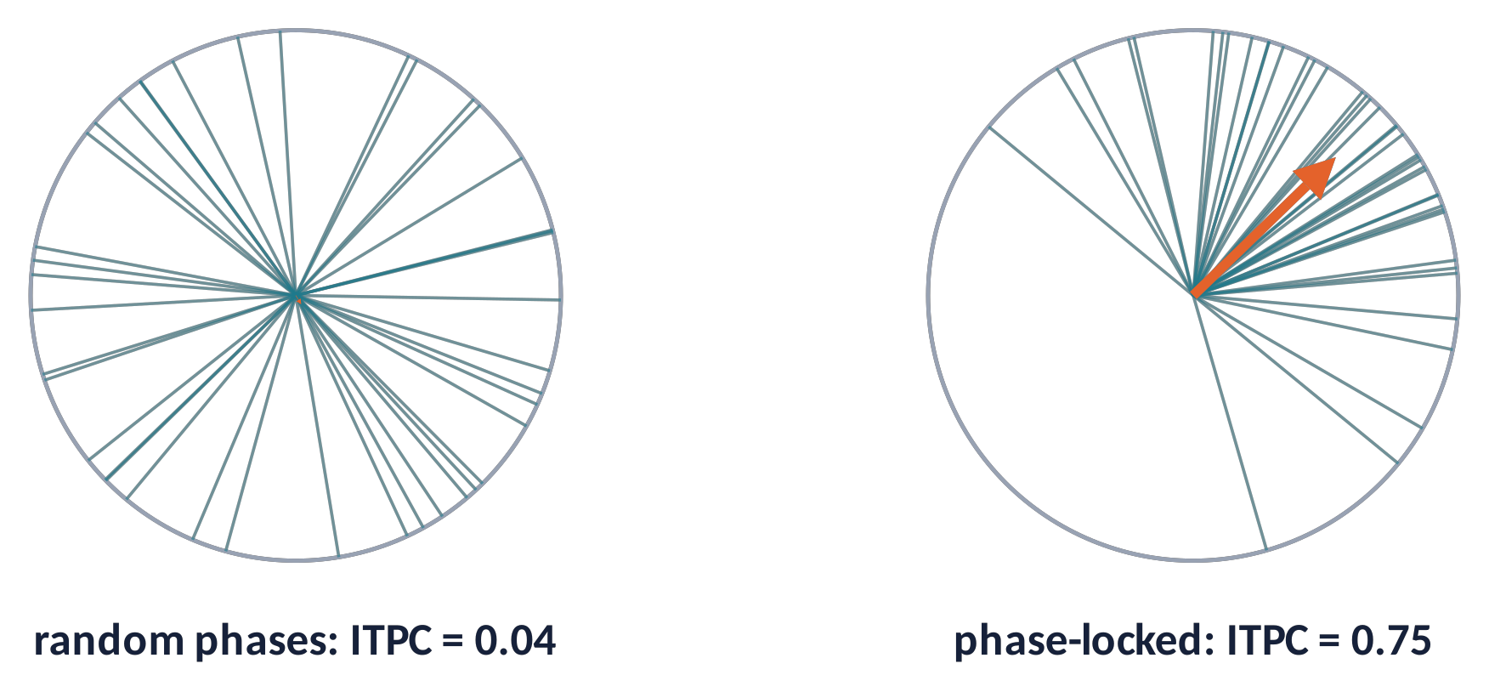
PHASE (2)
Inter-trial phase coherence
ITPC(t,f) = | (1/N) Σ_{k} e^{iφk(t,f)} |
Each trial's phase is a unit vector; average them: length 0 = random, 1 = perfectly aligned.
Independent of power: measures phase resetting / locking by the stimulus.
⚠ Biased by the number of trials (null ≈ 1/√N): equalise trial counts.
Metaphor a rowing crew: each rower has strength (amplitude), but the boat moves only if strokes are in phase.
Brain Imaging · EEG · Lecture 6 · Spectral and time-frequency analysis
21
Notes:
ITPC (also phase-locking factor, PLF): Tallon-Baudry et al. (1996) J Neurosci 16:4240. Biased by the number of trials: expected value under the null ≈ 1/√N. Compare conditions with equal trial numbers or use Rayleigh's Z = N·ITPC².

Slide 22
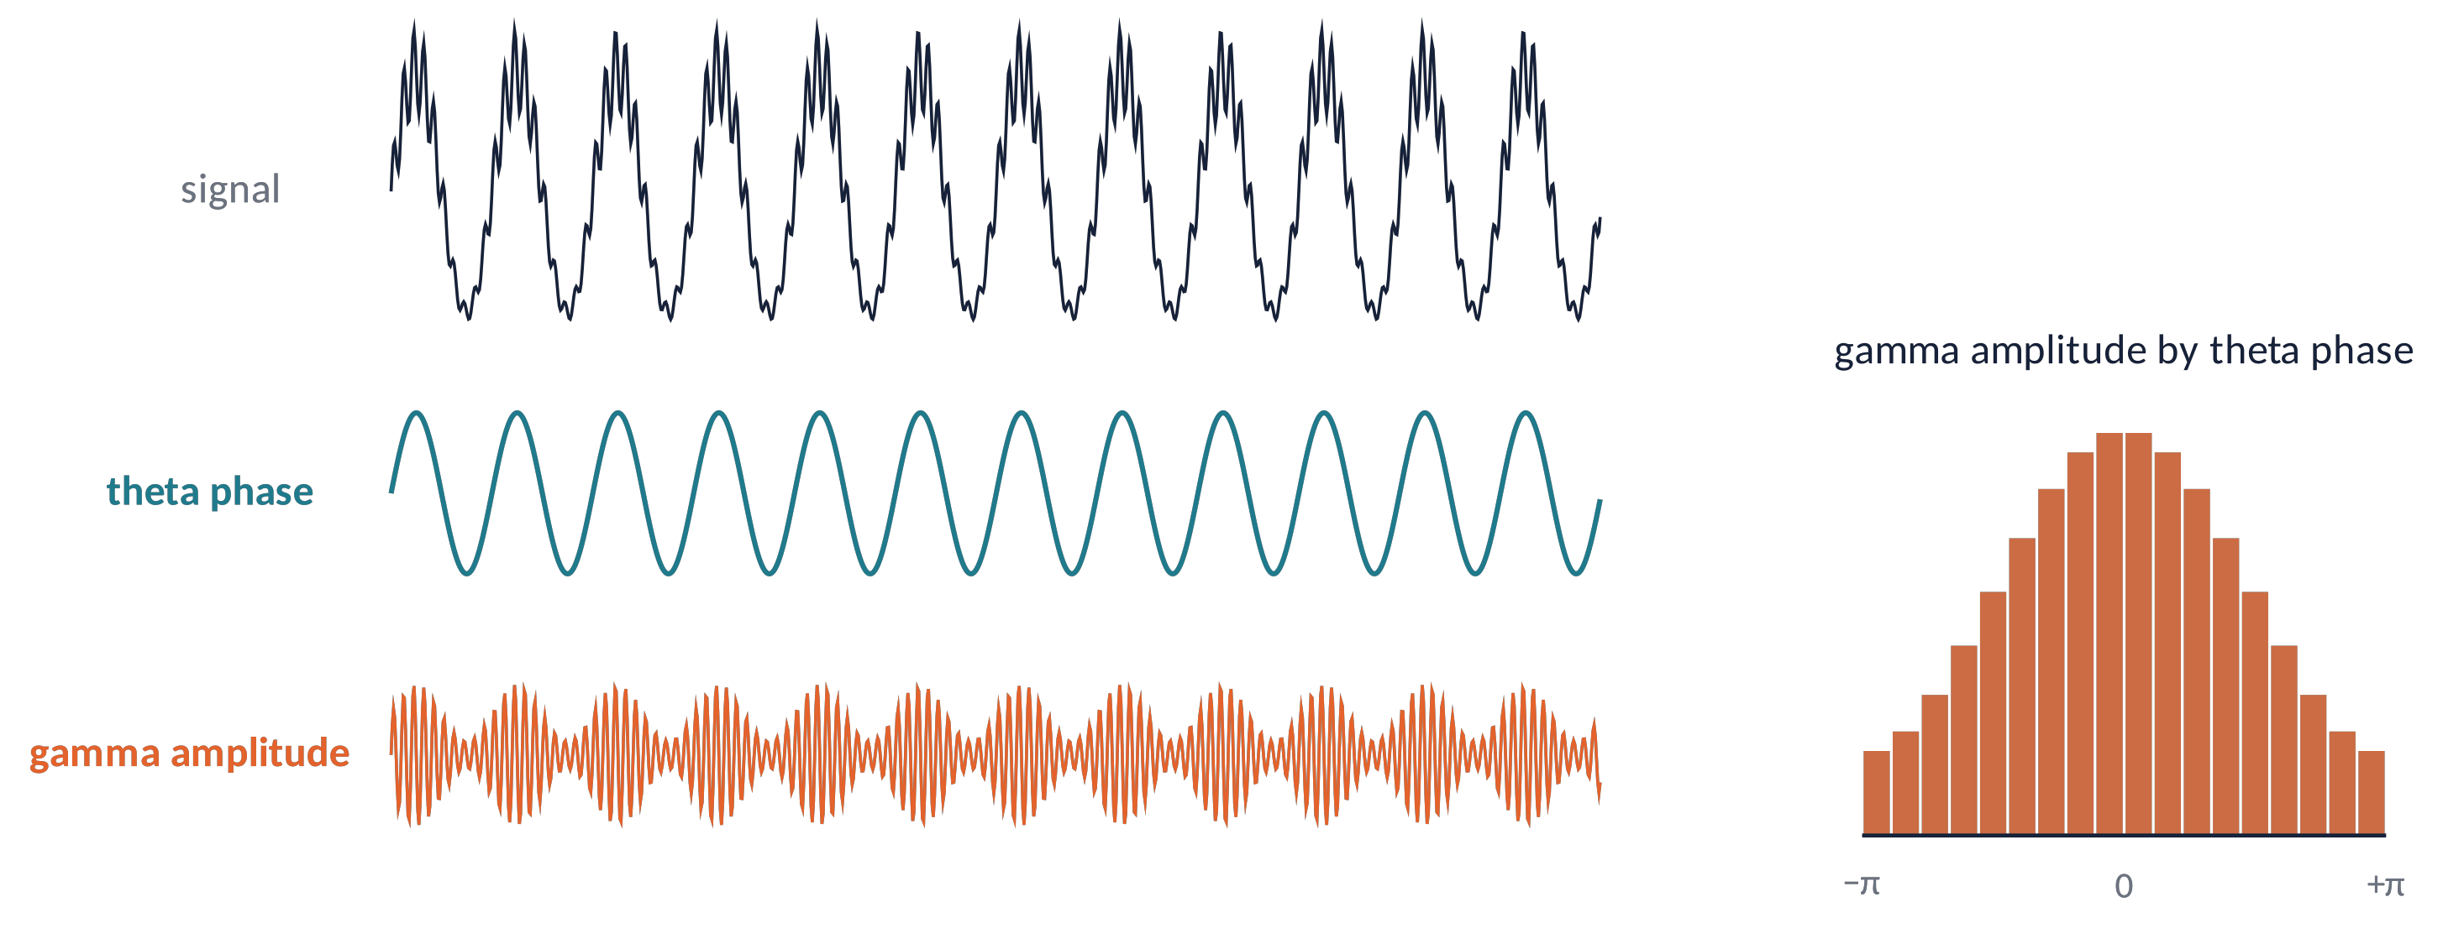
PHASE (3)
Cross-frequency coupling: phase–amplitude
PAC: the amplitude of a fast rhythm (gamma) depends on the phase of a slow one (theta) (Canolty et al., 2006).
Quantified by the modulation index (Tort et al., 2010): how far the amplitude-by-phase histogram is from flat.
⚠ Sharp, non-sinusoidal waves create spurious PAC: inspect the raw waveform (Cole & Voytek, 2017).
Brain Imaging · EEG · Lecture 6 · Spectral and time-frequency analysis
22
Notes:
Canolty et al. (2006) Science 313:1626; Tort et al. (2010) J Neurophysiol 104:1195 (modulation index). Pitfalls: non-sinusoidal waveforms and sharp edges produce spurious PAC (Aru et al., 2015 Curr Opin Neurobiol; Cole & Voytek, 2017 Trends Cogn Sci).

Slide 23
IN MATLAB
Welch spectrum and Morlet wavelet convolution
fs = EEG.srate; x = squeeze(EEG.data(chan,:,:)); % time x trials
[pxx, f] = pwelch(x(:), hann(2*fs), fs, [], fs); % Welch: 2-s Hann, 50% overlap
frex = logspace(log10(2), log10(40), 30); % 2-40 Hz, log-spaced
ncyc = logspace(log10(3), log10(10), 30); % 3 -> 10 cycles
wt = -2:1/fs:2; half = floor(numel(wt)/2);
nConv = numel(x) + numel(wt) - 1; X = fft(x(:).', nConv);
tf = zeros(numel(frex), size(x,1)); itpc = tf;
for fi = 1:numel(frex)
s = ncyc(fi) / (2*pi*frex(fi));
W = fft(exp(2i*pi*frex(fi)*wt) .* exp(-wt.^2/(2*s^2)), nConv);
as = ifft(X .* W ./ max(W)); as = reshape(as(half+1:end-half), size(x));
tf(fi,:) = mean(abs(as).^2, 2); % total power
itpc(fi,:) = abs(mean(exp(1i*angle(as)), 2)); % phase coherence
end
bl = EEG.times >= -400 & EEG.times <= -100;
tfdB = 10*log10(tf ./ mean(tf(:,bl), 2)); % baseline in dB
Brain Imaging · EEG · Lecture 6 · Spectral and time-frequency analysis
23
Notes:
Adapted from Cohen (2014) Analyzing Neural Time Series Data, ch. 12–13 and 19. EEG is an EEGLAB structure with epochs; chan = channel index. FieldTrip equivalent: ft_freqanalysis with cfg.method = 'wavelet' or 'mtmconvol'.

Slide 24
PITFALLS
Six ways to fool yourself with frequencies
1
A "band power" change that is really a 1/f slope change.
2
"Gamma" that is muscle or microsaccades.
3
Oscillations created by filters, edges or sharp ERPs.
4
An oscillation where there is only a transient: bursts ≠ sustained rhythms.
5
Thousands of time × frequency × channel tests: use cluster-based permutation (Maris & Oostenveld, 2007).
6
ITPC and coherence biased by unequal trial numbers.
Brain Imaging · EEG · Lecture 6 · Spectral and time-frequency analysis
24
Notes:
Muscle: Whitham et al. (2007); microsaccades: Yuval-Greenberg et al. (2008); multiple comparisons: Maris & Oostenveld (2007) J Neurosci Methods 164:177 (cluster-based permutation). Non-sinusoidal waveforms: Cole & Voytek (2017).

Slide 25
CHECK YOUR UNDERSTANDING
Three questions
With 500-ms windows, can you separate individual alpha peaks at 10 and 11 Hz? Why?
1
You want 4-Hz power with 7-cycle wavelets in −200…800 ms epochs. What is the problem?
2
A gamma burst is visible in single-trial power but not in the TF map of the ERP. Why?
3
Brain Imaging · EEG · Lecture 6 · Spectral and time-frequency analysis
25
Notes:
(1) Δf = 1/T = 2 Hz: 10 and 11 Hz cannot be separated; use ≥ 1 s. (2) At 4 Hz, 7 cycles ≈ 1.75 s of wavelet: epochs must be longer. (3) Induced: power after averaging (ERP) removes non-phase-locked activity.

Slide 26
TAKE-HOME MESSAGES
Take-home messages
Δf = 1/T: resolution needs time; taper to avoid leakage.
1
Average (Welch, multitaper) to get stable spectra; show them on log axes.
2
Separate peaks from the 1/f background.
3
Wavelets: cycles control the time–frequency trade-off; normalise to baseline.
4
Evoked ≠ induced; ITPC measures phase locking; PAC needs care.
5
Brain Imaging · EEG · Lecture 6 · Spectral and time-frequency analysis
26

Slide 27
SUGGESTED READING
Suggested reading
Cohen M.X. (2014) Analyzing Neural Time Series Data: Theory and Practice. MIT Press (MATLAB code).
Cohen M.X. (2019) A better way to define and describe Morlet wavelets for time-frequency analysis. NeuroImage 199:81–86.
Welch P. (1967) The use of fast Fourier transform for the estimation of power spectra. IEEE Trans Audio Electroacoust 15:70–73.
Thomson D.J. (1982) Spectrum estimation and harmonic analysis. Proc IEEE 70:1055–1096.
Donoghue T. et al. (2020) Parameterizing neural power spectra into periodic and aperiodic components. Nat Neurosci 23:1655–1665.
Klimesch W. (1999) EEG alpha and theta oscillations reflect cognitive and memory performance. Brain Res Rev 29:169–195.
Pfurtscheller G., Lopes da Silva F.H. (1999) Event-related EEG/MEG synchronization and desynchronization. Clin Neurophysiol 110:1842–1857.
Tallon-Baudry C., Bertrand O. (1999) Oscillatory gamma activity in humans and its role in object representation. Trends Cogn Sci 3:151–162.
Canolty R.T. et al. (2006) High gamma power is phase-locked to theta oscillations in human neocortex. Science 313:1626–1628.
Tort A.B.L. et al. (2010) Measuring phase-amplitude coupling between neuronal oscillations of different frequencies. J Neurophysiol 104:1195–1210.
Cole S.R., Voytek B. (2017) Brain oscillations and the importance of waveform shape. Trends Cogn Sci 21:137–149.
Maris E., Oostenveld R. (2007) Nonparametric statistical testing of EEG- and MEG-data. J Neurosci Methods 164:177–190.
Brain Imaging · EEG · Lecture 6 · Spectral and time-frequency analysis
27

