Slide 1

MSC IN COMPUTATIONAL COGNITIVE SCIENCE
Brain Imaging – Methods and Applications
Module: Electroencephalography (EEG)
Lecture 7
Event-related potentials:
from averages to components
Pierpaolo Croce
A.Y. 2026-2027

Slide 2
LECTURE 7
Today: the brain's response to an event
Averaging: why it works, what it assumes, how many trials.
1
Peaks are not components: the superposition problem.
2
The ERP component zoo: P1/N1, N170, MMN, P3, N400, ERN, N2pc.
3
Measuring amplitudes and latencies without fooling ourselves.
4
Statistics: mass-univariate, cluster permutation, single-trial models.
5
Brain Imaging · EEG · Lecture 7 · Event-related potentials
2
Notes:
Main references: Luck (2014) An Introduction to the Event-Related Potential Technique; Kappenman & Luck (2012) Oxford Handbook of ERP Components.

Slide 3
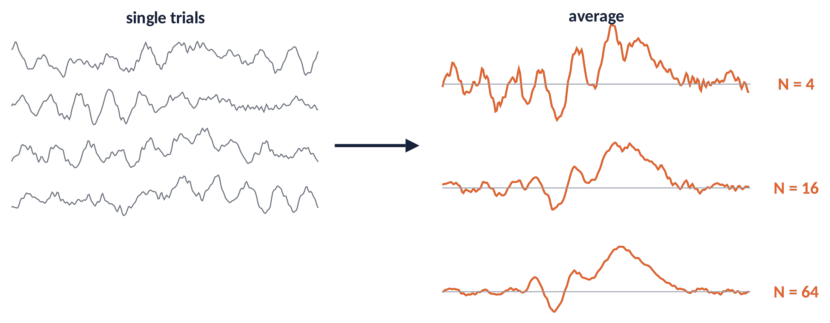
WHAT IS AN ERP?
Averaging lifts a small response out of the EEG
The ERP (≈ 1–10 µV) is buried in the ongoing EEG (≈ 20–50 µV).
Average many trials time-locked to the event: what is locked stays, the rest cancels.
ERPs have ms resolution: they tell when processing differs between conditions.
Metaphor a long exposure at night: moving cars vanish, the street lamp that is always there appears.
Brain Imaging · EEG · Lecture 7 · Event-related potentials
3
Notes:
Dawson (1954) first averaged evoked responses; the ERP is typically 1–10 µV, the ongoing EEG 20–50 µV. Averaging N time-locked trials reduces uncorrelated noise by √N.

Slide 4
01
From trials to ERPs
4

Slide 5
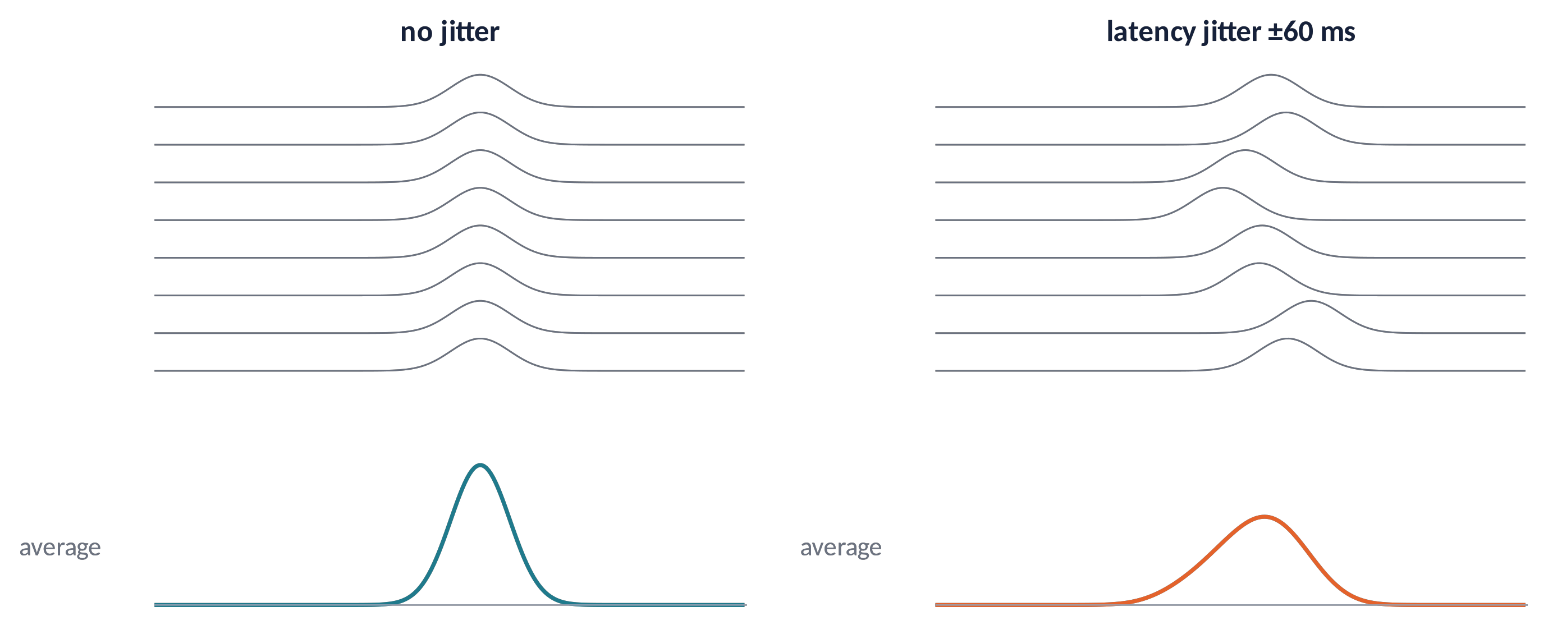
AVERAGING (1)
What averaging assumes — and latency jitter
x_{k}(t) = s(t) + n_{k}(t)
Same signal s(t) in every trial.
Noise with zero mean, independent of the event.
If latency jitters, the average is smaller and wider (not the typical single trial).
Remedies: response-locked averages, Woody filter, single-trial methods.
Brain Imaging · EEG · Lecture 7 · Event-related potentials
5
Notes:
The signal-plus-noise model: x_k(t) = s(t) + n_k(t). If latency varies across trials, the average is the signal convolved with the latency distribution: smaller and broader (Luck, 2014, ch. 8). Remedies: response-locking, Woody filter, single-trial latency estimation (e.g. RIDE: Ouyang et al., 2015).

Slide 6
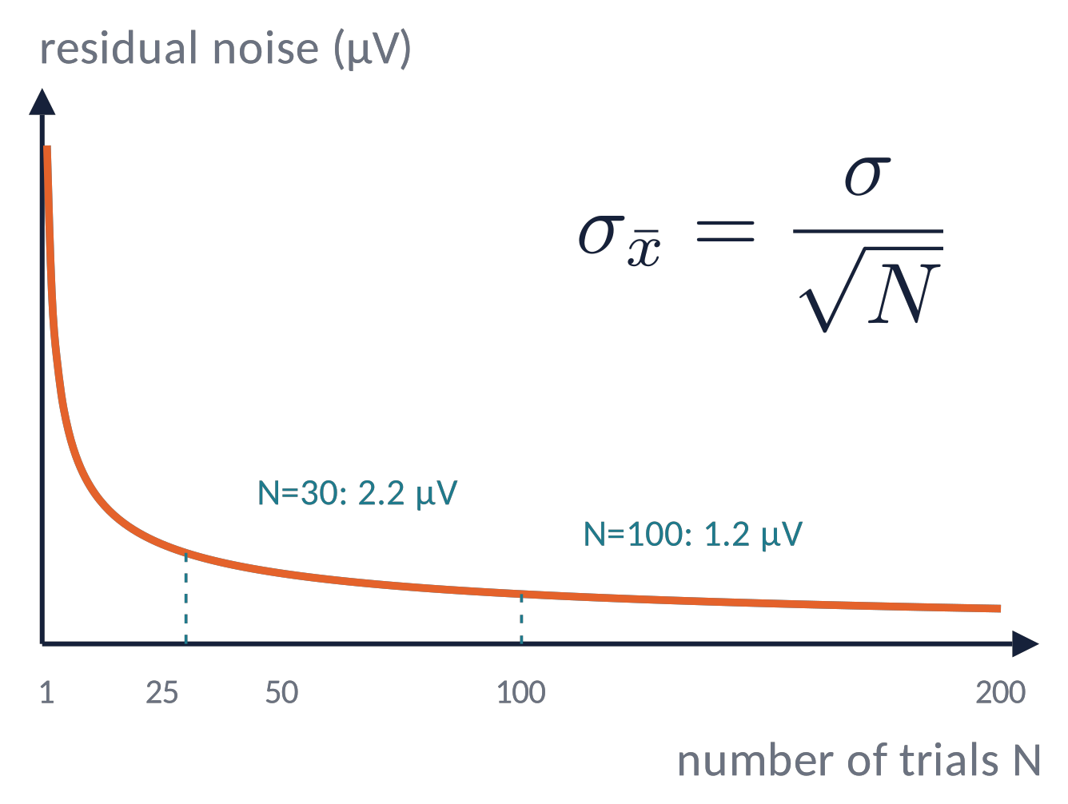
AVERAGING (2)
How many trials? Noise falls with √N
Residual noise ∝ 1/√N: to halve the noise you need 4× the trials.
Rules of thumb: large components (P3) ≈ 30–40 trials; small ones (N2pc, MMN, ERN) often 100+.
More participants and more trials trade off (Boudewyn et al., 2018).
Report data quality: the SME (standardized measurement error, Luck et al., 2021).
Brain Imaging · EEG · Lecture 7 · Event-related potentials
6
Notes:
Boudewyn et al. (2018) Psychophysiology 55:e13049 — trials needed depend on component and effect size. Luck et al. (2021) Psychophysiology 58:e13793 — standardized measurement error (SME) as a data-quality metric.

Slide 7
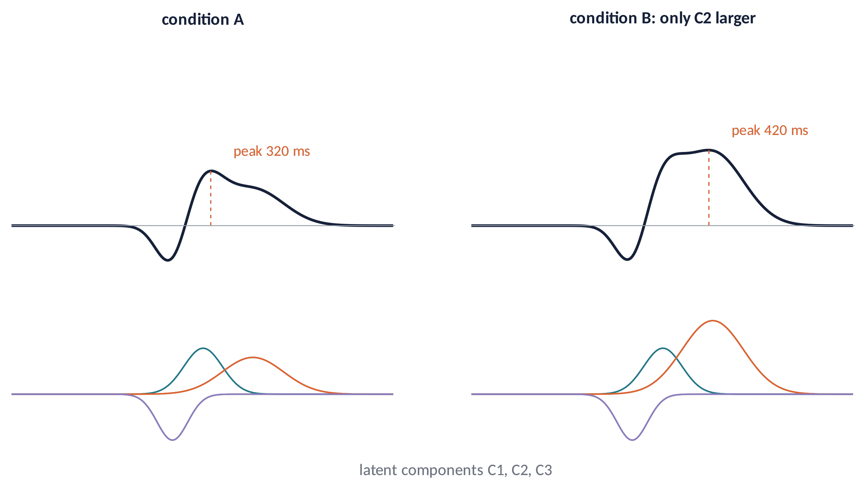
AVERAGING (3)
Peaks are not components
The ERP is a sum of latent components that overlap in time and space.
Only C2 changed — yet the peak latency moved. A latency change of a peak ≠ a slower process.
Use difference waves, topographies and converging manipulations to isolate components.
Brain Imaging · EEG · Lecture 7 · Event-related potentials
7
Notes:
Luck (2005/2014) 'Ten simple rules' — rule 1: peaks and components are not the same thing. The observed waveform is the sum of overlapping latent components with different scalp distributions; a change in one component can move peaks of the sum.

Slide 8
02
The ERP component zoo
8

Slide 9
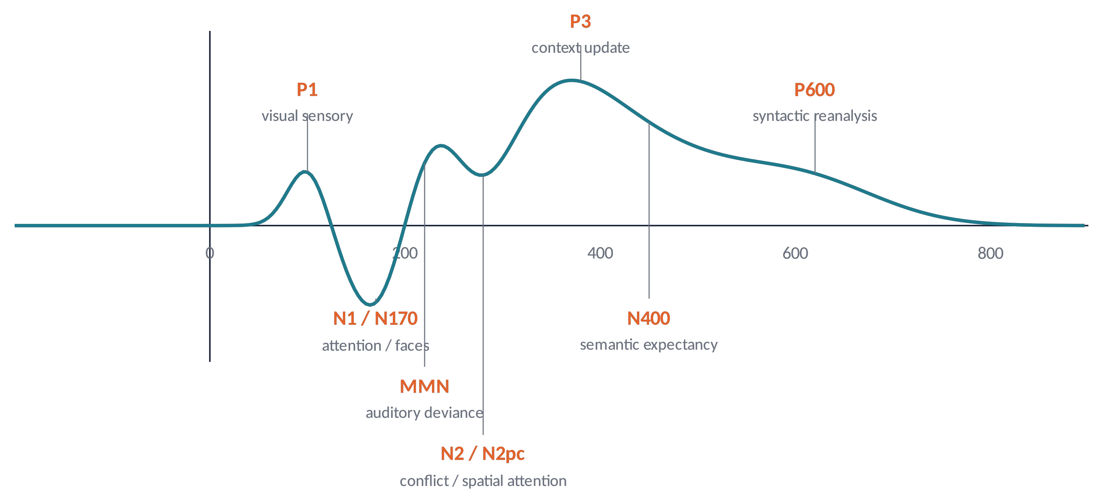
COMPONENTS (1)
A timeline of classic ERP components
Name = polarity (P/N) + order or latency. Defined by latency, polarity, topography and what modulates it.
Brain Imaging · EEG · Lecture 7 · Event-related potentials
9
Notes:
Naming: polarity (P/N) + order or latency (P1, N170, P300). Components are defined by polarity, latency, scalp distribution and sensitivity to experimental manipulations (Donchin et al., 1978; Kappenman & Luck, 2012).

Slide 10
COMPONENTS (2)
Early components: sensation, attention, prediction
P1 / N1 (80–200 ms)
visual/auditory sensory responses; larger for attended locations (Hillyard et al., 1973; Mangun & Hillyard, 1991).
N170 (≈ 170 ms)
occipito-temporal, larger for faces than objects (Bentin et al., 1996).
MMN (150–250 ms)
fronto-central negativity to a deviant sound in a regular sequence, even without attention (Näätänen et al., 2007).
Early components index sensory processing and how attention and predictions gate it.
Clinical use: MMN in schizophrenia and disorders of consciousness; auditory brainstem responses in newborn screening.
Brain Imaging · EEG · Lecture 7 · Event-related potentials
10
Notes:
Hillyard et al. (1973) Science 182:177 (N1 and auditory attention); Mangun & Hillyard (1991) (P1/N1 visual spatial attention); Bentin et al. (1996) J Cogn Neurosci 8:551 (N170); Näätänen et al. (1978, 2007) Clin Neurophysiol 118:2544 (MMN).

Slide 11
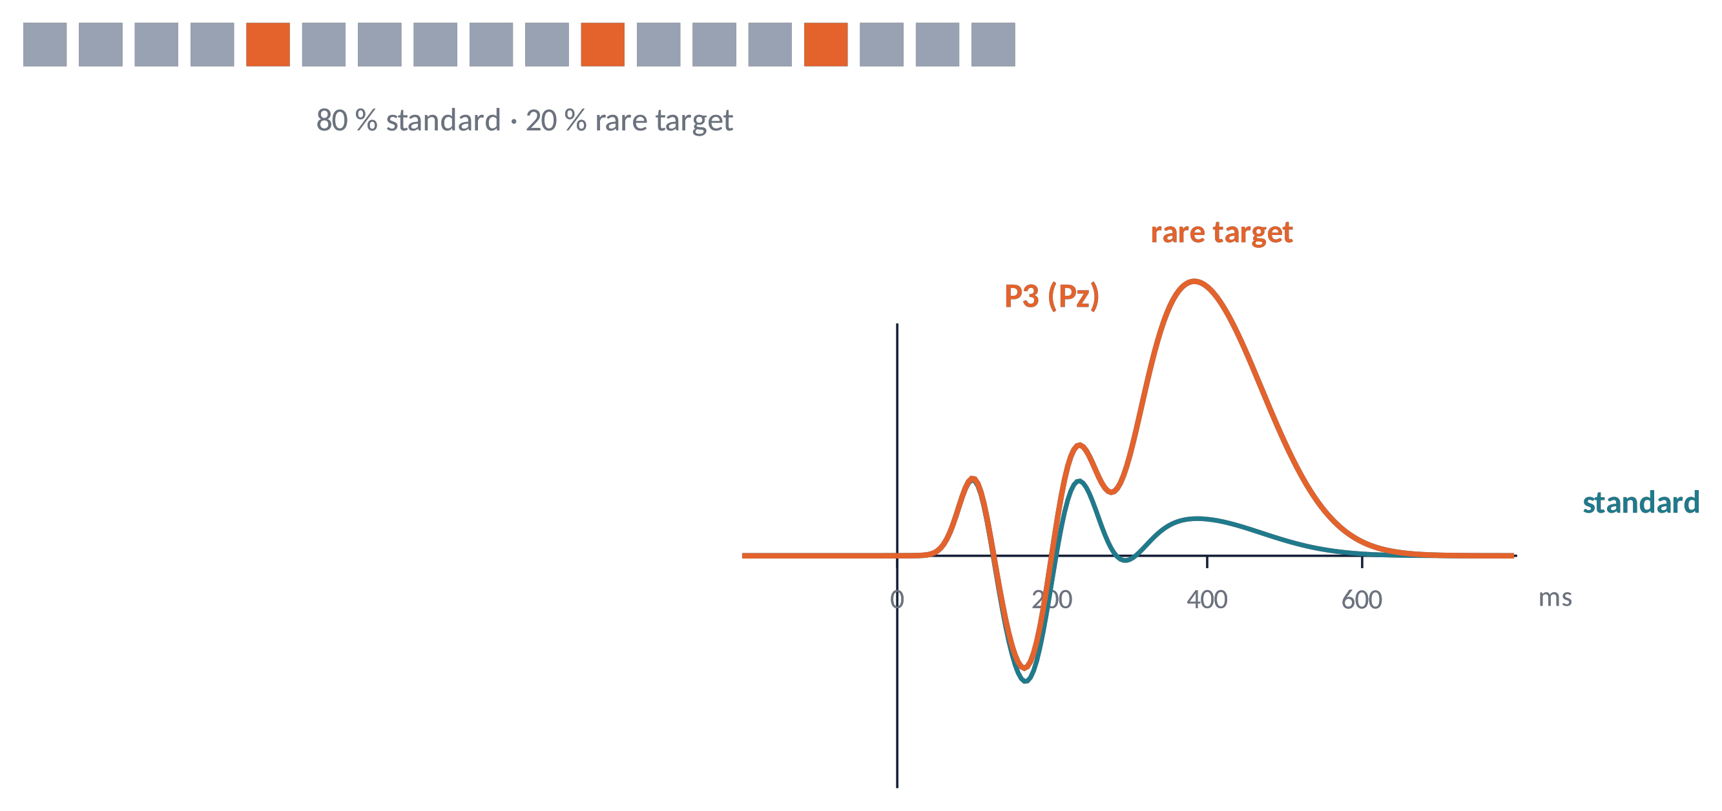
COMPONENTS (3)
The P3 and the oddball paradigm
Oddball: rare targets among frequent standards → large parietal positivity at 300–600 ms.
Amplitude grows with improbability and task relevance; latency tracks evaluation time.
P3a (novelty, fronto-central) vs P3b (targets, parietal) (Polich, 2007).
Workhorse of the P300 speller BCI (Farwell & Donchin, 1988).
Brain Imaging · EEG · Lecture 7 · Event-related potentials
11
Notes:
Sutton et al. (1965) Science 150:1187; Polich (2007) Clin Neurophysiol 118:2128. P3a (fronto-central, novelty) vs P3b (parietal, task-relevant targets). Amplitude ∝ improbability and relevance; latency ∝ stimulus evaluation time. Basis of the P300 speller BCI (Farwell & Donchin, 1988).

Slide 12
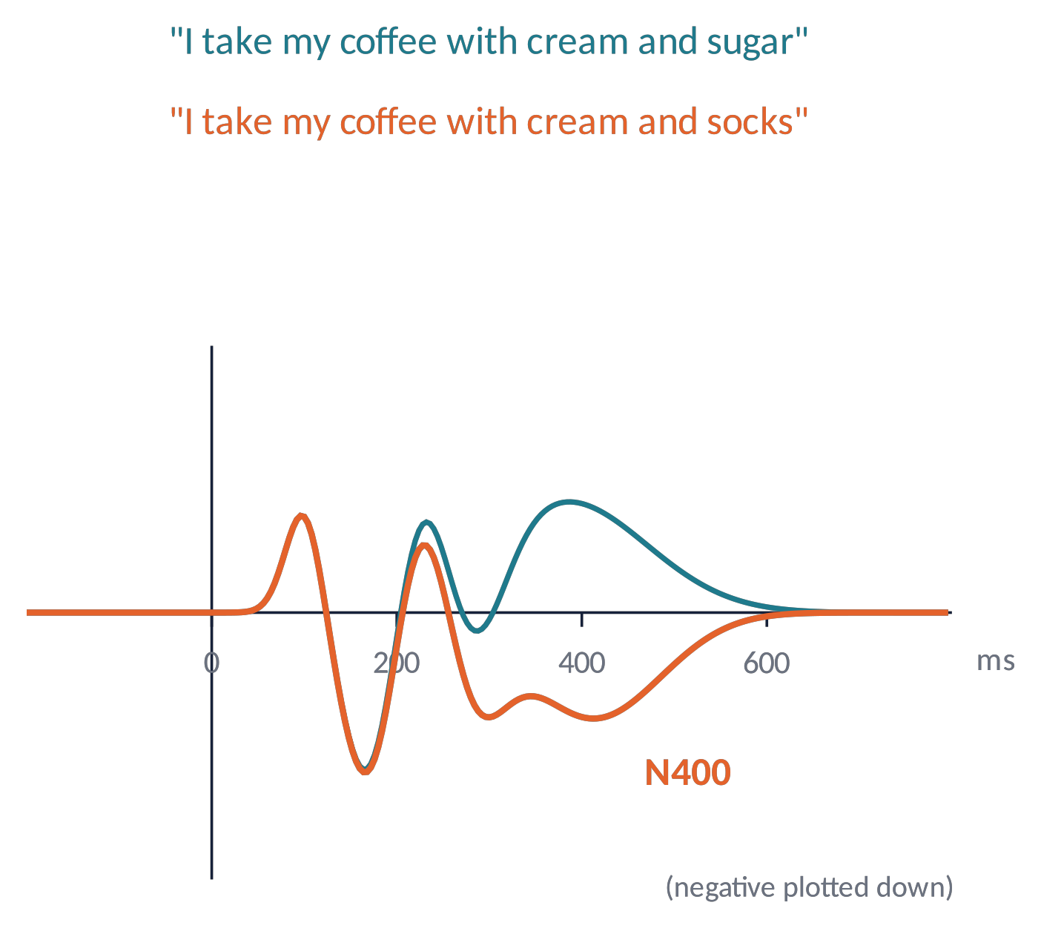
COMPONENTS (4)
Language: N400 and P600
N400: centro-parietal negativity ≈ 250–500 ms, larger for unexpected words (Kutas & Hillyard, 1980).
Graded by cloze probability: it indexes access to meaning and prediction, not just "errors".
P600: late positivity to syntactic violations and reanalysis (Osterhout & Holcomb, 1992).
Not only language: pictures, gestures, arithmetic facts.
Brain Imaging · EEG · Lecture 7 · Event-related potentials
12
Notes:
Kutas & Hillyard (1980) Science 207:203; Kutas & Federmeier (2011) Annu Rev Psychol 62:621 (thirty years of N400). P600: Osterhout & Holcomb (1992) — syntactic anomalies and reanalysis.

Slide 13
COMPONENTS (5)
Preparing and monitoring actions
CNV
slow negativity between a warning and an imperative stimulus: anticipation (Walter et al., 1964).
Readiness potential / LRP
builds up before voluntary movements; the lateralized part (C3/C4) shows which hand is prepared.
ERN / Pe
fronto-central negativity ≈ 50–100 ms after an error, then a positivity (Pe) linked to error awareness (Gehring et al., 1993).
Response-locked averages: time zero = button press, not stimulus onset.
Brain Imaging · EEG · Lecture 7 · Event-related potentials
13
Notes:
Walter et al. (1964) Nature 203:380 (CNV); Kornhuber & Deecke (1965) (Bereitschaftspotential); Coles (1989) (LRP); Falkenstein et al. (1991), Gehring et al. (1993) Psychol Sci 4:385 (ERN/Ne); Pe: Overbeek et al. (2005).

Slide 14
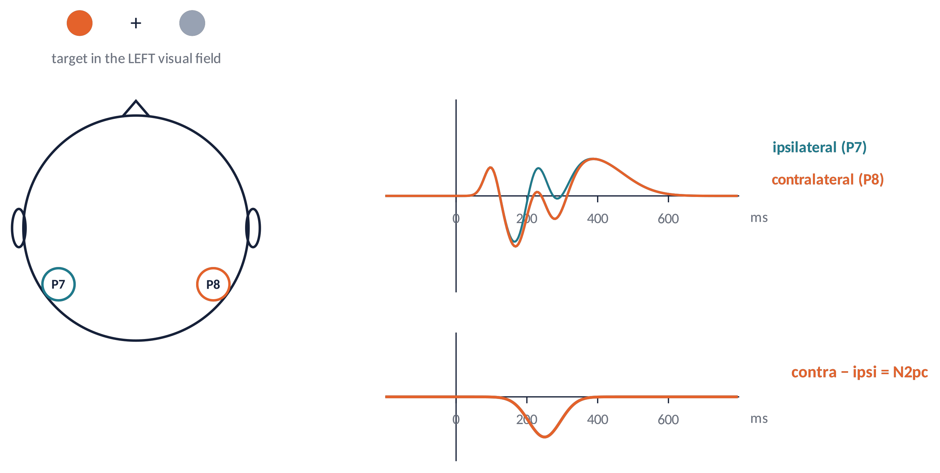
COMPONENTS (6)
N2pc: tracking spatial attention with a subtraction
Target on the left: posterior electrodes on the right (contralateral) become more negative at ≈ 200–300 ms.
Contra − ipsi removes everything non-lateralised: a clean marker of attentional selection.
Same logic: LRP (hands), CDA (visual working memory).
Brain Imaging · EEG · Lecture 7 · Event-related potentials
14
Notes:
Luck & Hillyard (1994) Psychophysiology 31:291; Eimer (1996) Electroencephalogr Clin Neurophysiol 99:225. Contralateral minus ipsilateral at posterior sites (PO7/PO8) cancels everything that is not lateralised with respect to the attended item.

Slide 15
03
Measuring ERPs
15

Slide 16
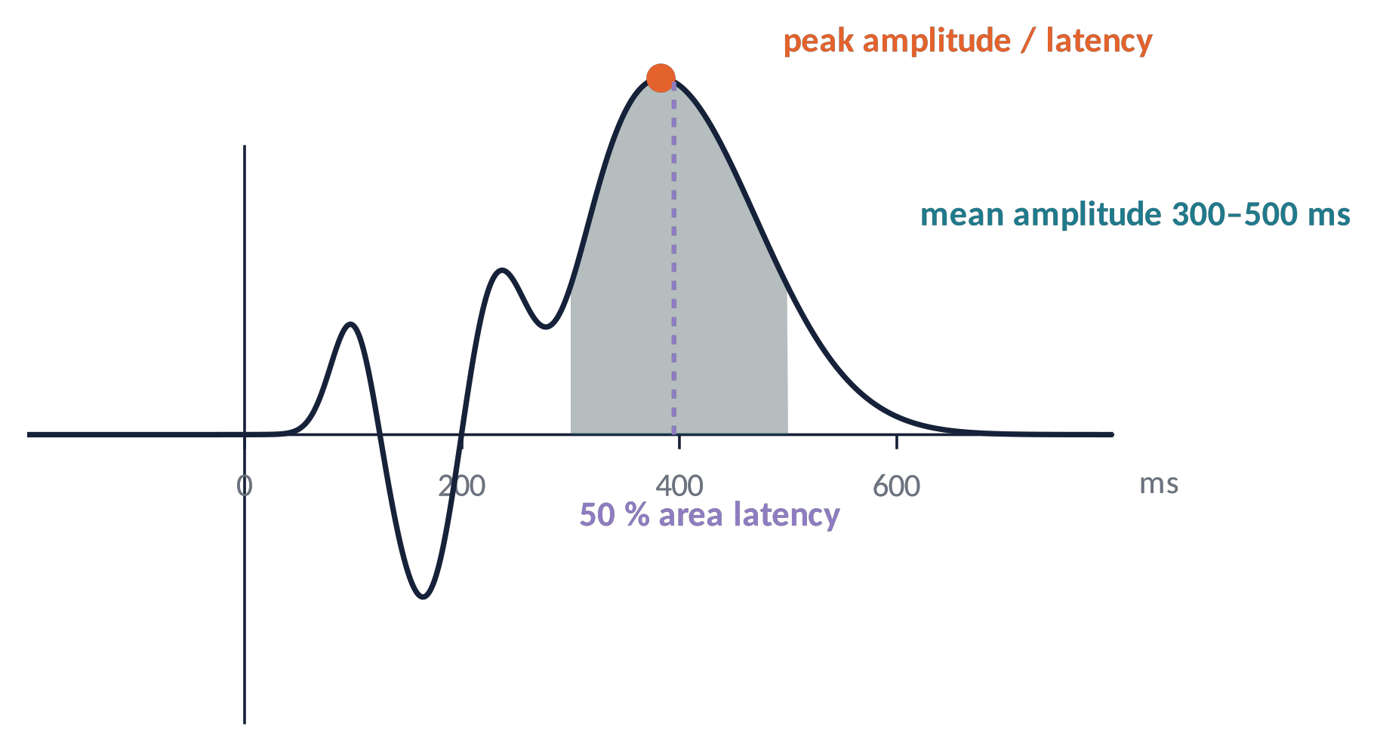
MEASUREMENT (1)
Amplitude and latency measures
Mean amplitude in a window: robust to noise, not biased by the number of trials — preferred.
Peak amplitude: sensitive to noise; biased upward with fewer trials.
Latency: fractional-area (50 %) or fractional-peak latency, with jackknifing for group comparisons (Kiesel et al., 2008).
Brain Imaging · EEG · Lecture 7 · Event-related potentials
16
Notes:
Luck (2014) ch. 9; Clayson, Baldwin & Larson (2013) Psychophysiology 50:174 (peak vs mean amplitude); Kiesel et al. (2008) Psychophysiology 45:250 (latency measures, jackknifing).

Slide 17
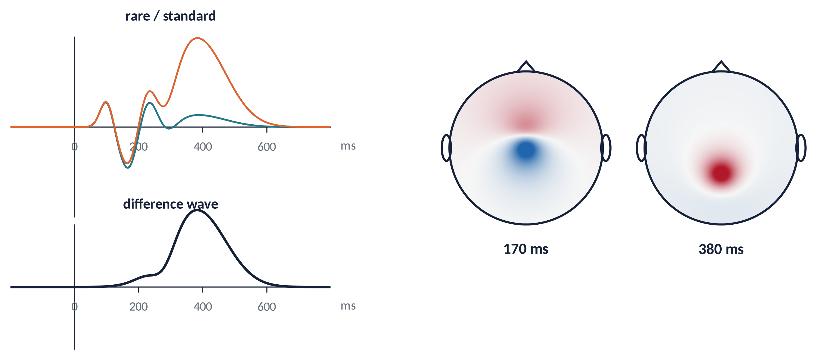
MEASUREMENT (2)
Difference waves, topographies — and circularity
1
Difference wave (B − A) isolates what the manipulation changes; its topography helps identify the component.
2
⚠ Choosing the window/electrodes after looking at the effect inflates false positives (double dipping).
3
Use a priori windows, a collapsed localiser (average of conditions), or mass-univariate tests (Luck & Gaspelin, 2017).
Brain Imaging · EEG · Lecture 7 · Event-related potentials
17
Notes:
Luck & Gaspelin (2017) Psychophysiology 54:146 'How to get statistically significant effects in any ERP experiment (and why you shouldn't)'. Kriegeskorte et al. (2009) Nat Neurosci 12:535 on double dipping. Use a priori windows, collapsed localisers or mass-univariate tests.

Slide 18
04
Statistics for ERPs
18

Slide 19
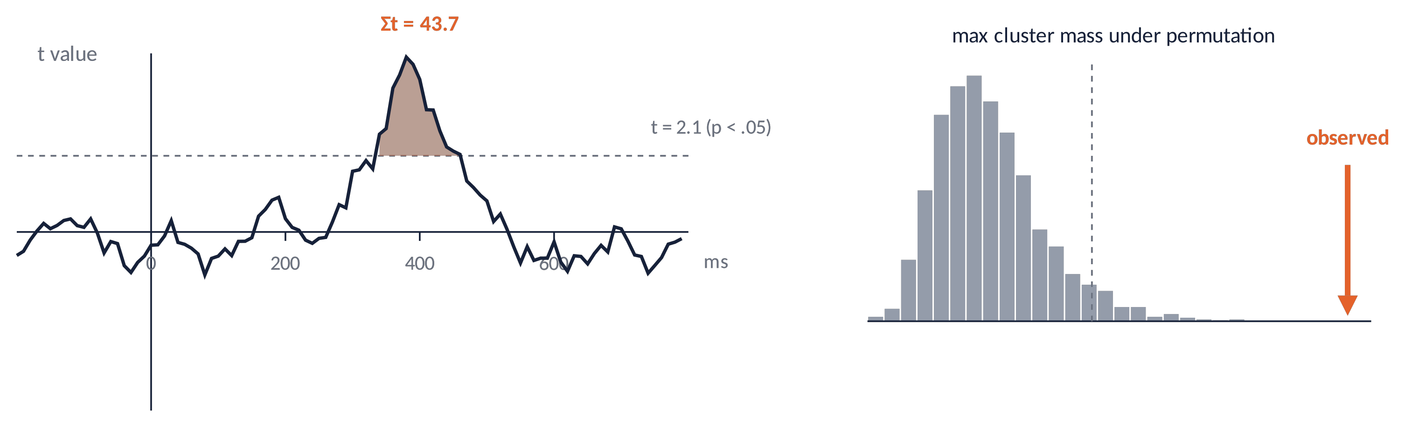
STATISTICS (1)
Mass-univariate tests and cluster-based permutation
1
Test every time point × channel → thousands of tests → multiple-comparison problem.
2
Cluster permutation: group adjacent supra-threshold points, sum their t (cluster mass), compare with the max-cluster distribution from shuffled labels.
3
⚠ It says there is an effect, not exactly where/when it starts (Sassenhagen & Draschkow, 2019).
Brain Imaging · EEG · Lecture 7 · Event-related potentials
19
Notes:
Maris & Oostenveld (2007) J Neurosci Methods 164:177; Groppe, Urbach & Kutas (2011) Psychophysiology 48:1711 (tutorial). The cluster test controls the family-wise error at the level of the whole data space but does not localise effects precisely in time or space (Sassenhagen & Draschkow, 2019 Psychophysiology 56:e13335).

Slide 20
STATISTICS (2)
Beyond averages: single-trial and regression models
Hierarchical GLM (LIMO)
fit single trials per subject, then test betas across subjects (Pernet et al., 2011).
Mixed models
subjects and items as random effects; continuous predictors (Frömer et al., 2018).
Regression ERPs (rERP)
the ERP as a regression coefficient over time (Smith & Kutas, 2015).
Deconvolution
separate overlapping responses (stimulus, saccade, button) with fast event rates (Unfold: Ehinger & Dimigen, 2019).
Averages hide trial-by-trial variability: models use it — and use all the data.
Brain Imaging · EEG · Lecture 7 · Event-related potentials
20
Notes:
LIMO EEG: Pernet et al. (2011) Comput Intell Neurosci; linear mixed models: Frömer, Maier & Abdel Rahman (2018) Front Neurosci 12:48; regression ERPs: Smith & Kutas (2015) Psychophysiology 52:157; deconvolution of overlapping responses: Ehinger & Dimigen (2019) PeerJ 7:e7838 (Unfold toolbox).

Slide 21
05
ERPs in practice
21

Slide 22
IN MATLAB
ERPs, difference waves and a permutation test
A = pop_loadset('sub-01_std.set'); B = pop_loadset('sub-01_dev.set');
ch = find(strcmpi({A.chanlocs.labels}, 'Pz')); t = A.times; % ms
erpA = mean(A.data(ch,:,:), 3); erpB = mean(B.data(ch,:,:), 3); % averages
dw = erpB - erpA; % difference wave
win = t >= 300 & t <= 500; % a priori window
mA = squeeze(mean(A.data(ch,win,:), 2)); mB = squeeze(mean(B.data(ch,win,:), 2));
obs = mean(mB) - mean(mA); % mean-amplitude effect
all = [mA; mB]; nA = numel(mA); nPerm = 5000; null = zeros(nPerm,1);
for p = 1:nPerm
idx = randperm(numel(all));
null(p) = mean(all(idx(nA+1:end))) - mean(all(idx(1:nA)));
end
pval = (sum(abs(null) >= abs(obs)) + 1) / (nPerm + 1);
plot(t, erpA, t, erpB, t, dw, 'k', 'LineWidth', 2); set(gca,'YDir','normal');
xlabel('time (ms)'); ylabel('\muV'); legend('standard','deviant','difference');
Brain Imaging · EEG · Lecture 7 · Event-related potentials
22
Notes:
Plain MATLAB on EEGLAB epoched datasets (one per condition). For group-level cluster tests use FieldTrip ft_timelockstatistics (cfg.method = 'montecarlo', cfg.correctm = 'cluster') or ERPLAB/LIMO.

Slide 23
GOOD PRACTICE
Reporting ERP studies
Trials per condition after rejection; data quality (SME).
1
Reference, filters (type, cut-off, order), baseline window.
2
Measurement windows and electrodes justified a priori.
3
Show waveforms and topographies, not only bar plots.
4
Share data (BIDS) and code; pre-register when possible.
5
Brain Imaging · EEG · Lecture 7 · Event-related potentials
23
Notes:
Keil et al. (2014) Psychophysiology 51:1–21; Keil et al. (2022) update; Luck (2014) ch. 13; Pernet et al. (2020) COBIDAS MEEG.

Slide 24
CHECK YOUR UNDERSTANDING
Three questions
With 40 trials the residual noise is 2 µV. How many trials to reach 1 µV?
1
Patients show a smaller, wider P3 than controls. Give an explanation that is not "less P3".
2
You pick the 50-ms window where conditions differ most, then test it. What is wrong?
3
Brain Imaging · EEG · Lecture 7 · Event-related potentials
24
Notes:
(1) 4× trials (√4 = 2). (2) Latency jitter reduces and smears the average; use response-locked or single-trial methods. (3) Circular analysis: windows chosen on the effect inflate false positives.

Slide 25
TAKE-HOME MESSAGES
Take-home messages
Averaging: noise ∝ 1/√N; assumes a constant, time-locked signal.
1
Peaks ≠ components: use difference waves and topographies.
2
Components (P1/N1, N170, MMN, P3, N400, ERN, N2pc) index specific processes.
3
Prefer mean amplitude and fractional-area latency; windows a priori.
4
Correct for multiple comparisons (cluster permutation) or model single trials.
5
Brain Imaging · EEG · Lecture 7 · Event-related potentials
25

Slide 26
SUGGESTED READING
Suggested reading
Luck S.J. (2014) An Introduction to the Event-Related Potential Technique, 2nd ed. MIT Press.
Kappenman E.S., Luck S.J. (eds) (2012) The Oxford Handbook of Event-Related Potential Components. OUP.
Sutton S. et al. (1965) Evoked-potential correlates of stimulus uncertainty. Science 150:1187–1188.
Polich J. (2007) Updating P300: an integrative theory of P3a and P3b. Clin Neurophysiol 118:2128–2148.
Kutas M., Federmeier K.D. (2011) Thirty years and counting: finding meaning in the N400. Annu Rev Psychol 62:621–647.
Näätänen R. et al. (2007) The mismatch negativity (MMN) in basic research of central auditory processing. Clin Neurophysiol 118:2544–2590.
Luck S.J., Hillyard S.A. (1994) Electrophysiological correlates of feature analysis during visual search. Psychophysiology 31:291–308.
Gehring W.J. et al. (1993) A neural system for error detection and compensation. Psychol Sci 4:385–390.
Luck S.J., Gaspelin N. (2017) How to get statistically significant effects in any ERP experiment (and why you shouldn't). Psychophysiology 54:146–157.
Groppe D.M., Urbach T.P., Kutas M. (2011) Mass univariate analysis of event-related brain potentials/fields I. Psychophysiology 48:1711–1725.
Maris E., Oostenveld R. (2007) Nonparametric statistical testing of EEG- and MEG-data. J Neurosci Methods 164:177–190.
Luck S.J. et al. (2021) Standardized measurement error: a universal metric of data quality for averaged ERPs. Psychophysiology 58:e13793.
Brain Imaging · EEG · Lecture 7 · Event-related potentials
26

