Slide 1

MSC IN COMPUTATIONAL COGNITIVE SCIENCE
Brain Imaging – Methods and Applications
Module: Electroencephalography (EEG)
Lecture 8
Spatial analysis
and EEG microstates
Pierpaolo Croce
A.Y. 2026-2027

Slide 2
LECTURE 8
Today: looking at the whole map, not single electrodes
Limits of single-channel analysis; reference-free descriptors.
1
Global Field Power and Global Map Dissimilarity.
2
Microstates: clustering (k-means, modified k-means, TAAHC), choosing k, back-fitting.
3
Microstate metrics and their neural meaning (fMRI networks, sources).
4
Applications: cognition, sleep, anaesthesia, psychiatry, brain stimulation.
5
Brain Imaging · EEG · Lecture 8 · Spatial analysis and microstates
2
Notes:
Main reference: Michel & Koenig (2018) NeuroImage 180:577 — review on EEG microstates; Murray, Brunet & Michel (2008) Brain Topogr 20:249 — topographic ERP analyses.

Slide 3
WHY SPATIAL ANALYSIS?
From many waveforms to one map per instant
Channel-wise analysis
spectra, envelopes, TF, connectivity on selected electrodes: depends on the reference and on the choice of channels.
Map-wise analysis
each instant = one scalp map; the map shape does not change with the reference.
Physical logic
different map shape ⇒ different active generators; same shape, different strength ⇒ same generators, more/less active.
Metaphor a weather map: meteorologists do not compare single stations, they look at the whole pressure pattern.
Brain Imaging · EEG · Lecture 8 · Spatial analysis and microstates
3
Notes:
Traditional spontaneous-EEG analyses (spectral, envelope, time-frequency, connectivity) are channel-wise and reference-dependent. A topographic approach treats each instant as a map: a change of map shape implies a change of the active generators (Lehmann, 1987; Michel et al., 2009 'Electrical Neuroimaging').

Slide 4
01
The scalp field as a map
4

Slide 5
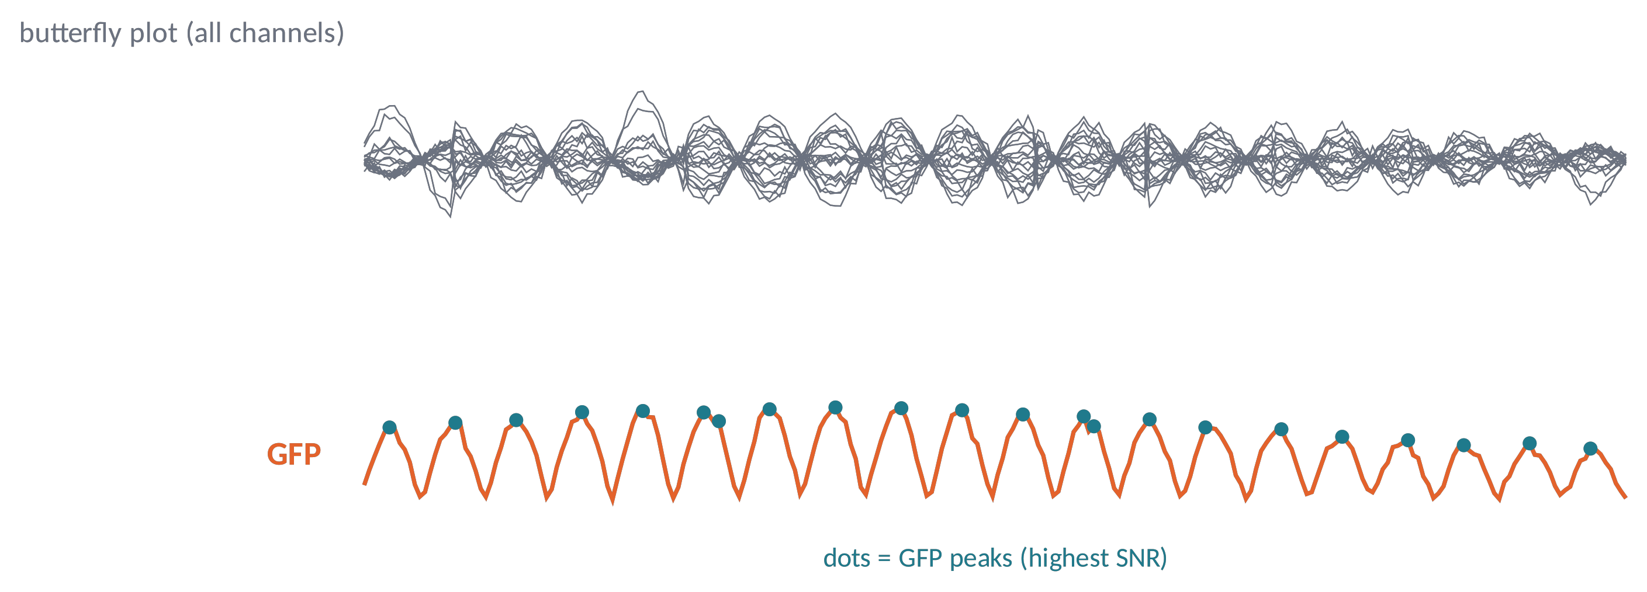
SPATIAL DESCRIPTORS (1)
Global Field Power: the strength of the map
GFP(t) = √[ (1/N) Σ_{i} (V_{i}(t) − V̄(t))² ]
GFP = spatial standard deviation across electrodes (Lehmann & Skrandies, 1980).
Reference-free: one number per instant, the "hilliness" of the map.
GFP peaks: highest SNR, most stable topographies → used for clustering.
Brain Imaging · EEG · Lecture 8 · Spatial analysis and microstates
5
Notes:
Lehmann & Skrandies (1980) Electroencephalogr Clin Neurophysiol 48:609. GFP is the spatial standard deviation of the average-referenced map; it is reference-free. GFP peaks are moments of high signal-to-noise and maximal topographic stability.

Slide 6
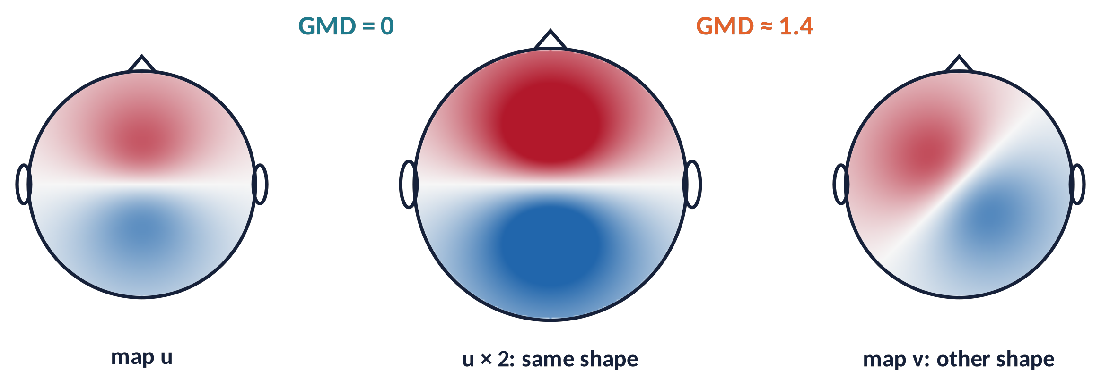
SPATIAL DESCRIPTORS (2)
Global Map Dissimilarity: the shape of the map
GMD = √[ 2 (1 − r_{uv}) ]
Compare maps after normalising by GFP: strength is removed, only shape remains.
0 = identical shape; 2 = inverted polarity.
TANOVA: permutation test of GMD between conditions (Murray et al., 2008).
Two orthogonal questions: how strong (GFP) and which generators (GMD).
Brain Imaging · EEG · Lecture 8 · Spatial analysis and microstates
6
Notes:
Lehmann & Skrandies (1980); GMD = √(2(1−r)) with r the spatial correlation of GFP-normalised maps (range 0–2). TANOVA tests GMD between conditions by permutation (Murray et al., 2008; Koenig et al., 2011 RAGU, Comput Intell Neurosci).

Slide 7
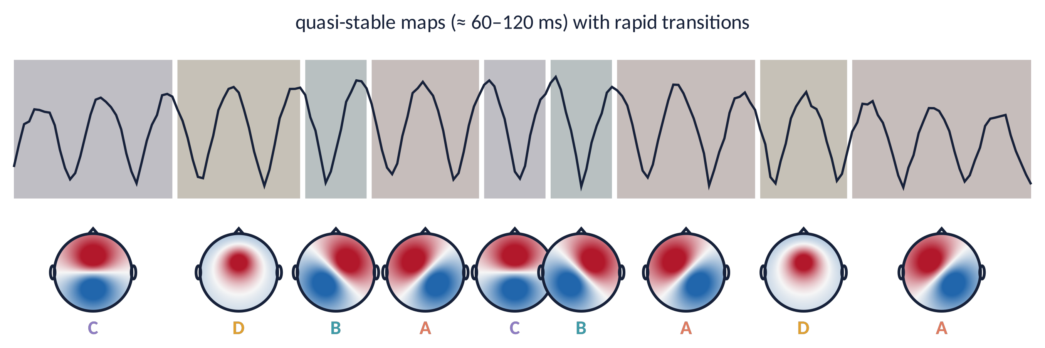
MICROSTATES (1)
The EEG as a sequence of quasi-stable maps
The map shape stays stable for ≈ 60–120 ms and then switches abruptly (Lehmann et al., 1987).
Polarity may reverse with the oscillation: only the shape counts.
These periods are microstates: "atoms of thought", building blocks of spontaneous mentation.
Metaphor a slide show: each slide stays on screen for a moment, then the projector jumps to the next.
Brain Imaging · EEG · Lecture 8 · Spatial analysis and microstates
7
Notes:
Lehmann et al. (1987) Electroencephalogr Clin Neurophysiol 67:271 — 'atoms of thought'. The map topography stays stable for ~60–120 ms, while its polarity may reverse with the oscillation, and then changes abruptly.

Slide 8
02
Microstate analysis
8

Slide 9
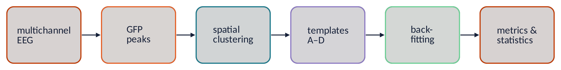
MICROSTATES (2)
The analysis pipeline
1
Preprocess: band-pass 1–40 Hz, artifact removal, average reference.
2
Take maps at GFP peaks (highest SNR).
3
Cluster per subject, then cluster the individual templates at group level.
4
Back-fit group templates to every sample; compute metrics and statistics.
Brain Imaging · EEG · Lecture 8 · Spatial analysis and microstates
9
Notes:
Standard pipeline (Michel & Koenig, 2018): band-pass 1–40 Hz, average reference, GFP peaks, clustering per subject, then group-level clustering of individual templates, back-fitting to all samples, computation of temporal parameters and statistics.

Slide 10
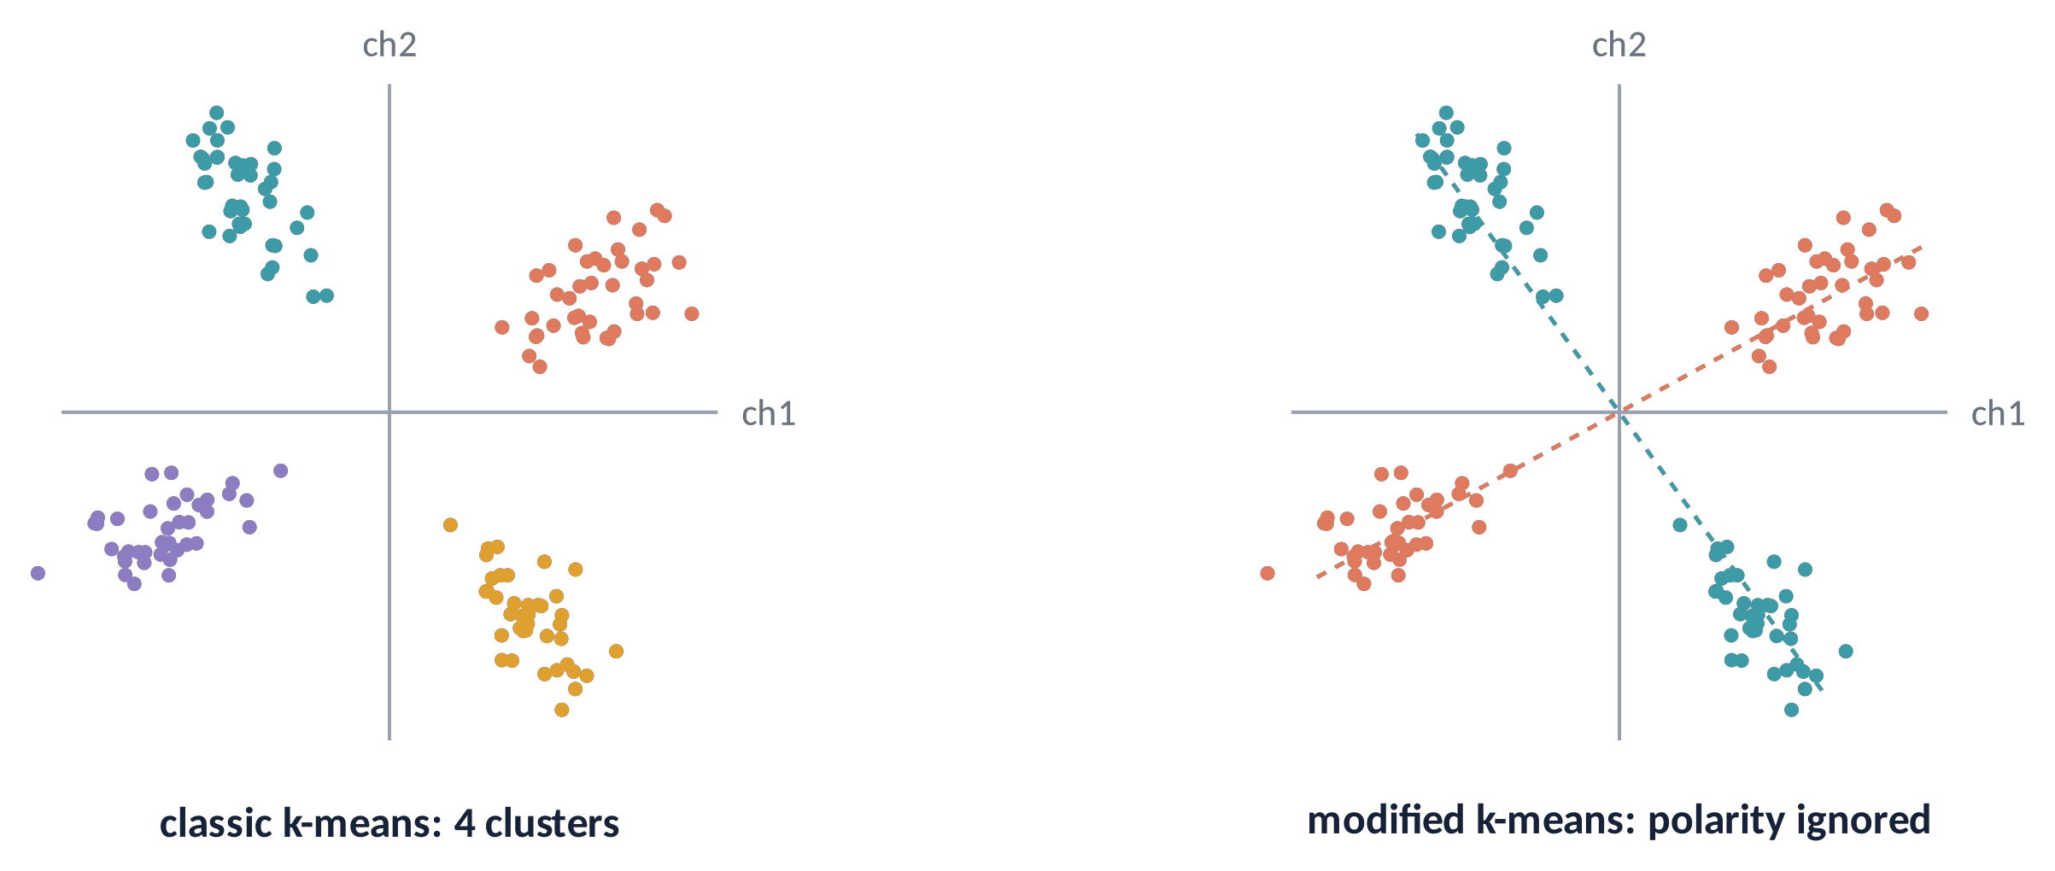
CLUSTERING (1)
k-means and modified k-means
Each map is a point in N-dimensional space (N = channels).
k-means: assign each map to the nearest centre, update centres, repeat.
Modified k-means (Pascual-Marqui et al., 1995): similarity = |spatial correlation| → opposite polarities = same state.
Random starts: repeat 50–100 times, keep the best GEV.
Brain Imaging · EEG · Lecture 8 · Spatial analysis and microstates
10
Notes:
Pascual-Marqui, Michel & Lehmann (1995) IEEE Trans Biomed Eng 42:658 — modified k-means for EEG: maps are assigned by absolute spatial correlation (polarity ignored), cluster centres are the first principal component of the assigned maps. Several random initialisations; keep the solution with the highest GEV.

Slide 11
CLUSTERING (2)
Hierarchical alternatives: AAHC and TAAHC
AAHC
Atomize and Agglomerate Hierarchical Clustering: start with every map as a cluster; repeatedly dissolve the worst cluster and redistribute its maps (Murray et al., 2008).
TAAHC
Topographic AAHC: the worst cluster is the one with the lowest summed correlation with its members (Khanna et al., 2014).
Pros & cons
Deterministic and gives all k at once; slower on large datasets. k-means is fast but depends on initialisation.
In practice both methods give very similar templates: what matters more is data quality and the choice of k.
Brain Imaging · EEG · Lecture 8 · Spatial analysis and microstates
11
Notes:
AAHC: Murray et al. (2008) Brain Topogr 20:249; TAAHC: Khanna et al. (2014) Brain Topogr 27:540 (Microstates in resting-state EEG: current status and future directions, Khanna et al. 2015 Neurosci Biobehav Rev 49:105). Deterministic: no random initialisation.

Slide 12
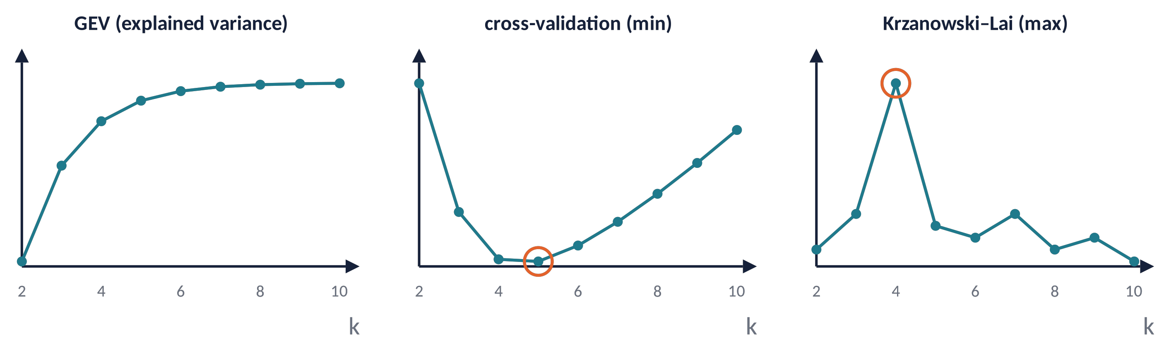
CLUSTERING (3)
How many microstates? Criteria of fit
GEV = Σ_{t} [GFP(t) · corr(V_{t}, M_{k(t)})]² / Σ_{t} GFP(t)²
GEV always grows with k: look for the elbow. CV has a minimum, KL a maximum at the optimal k.
Resting EEG: 4 maps explain ≈ 70–80 % of the variance; high-density data may support 5–7 maps (Custo et al., 2017).
Brain Imaging · EEG · Lecture 8 · Spatial analysis and microstates
12
Notes:
GEV: sum over time of GFP²·corr² divided by sum of GFP². Cross-validation criterion (Pascual-Marqui et al., 1995), Krzanowski–Lai criterion (Krzanowski & Lai, 1988 Biometrics 44:23). Meta-criterion combining several indices: Bréchet et al. (2019) NeuroImage; Custo et al. (2017) found 7 maps with high-density EEG.

Slide 13
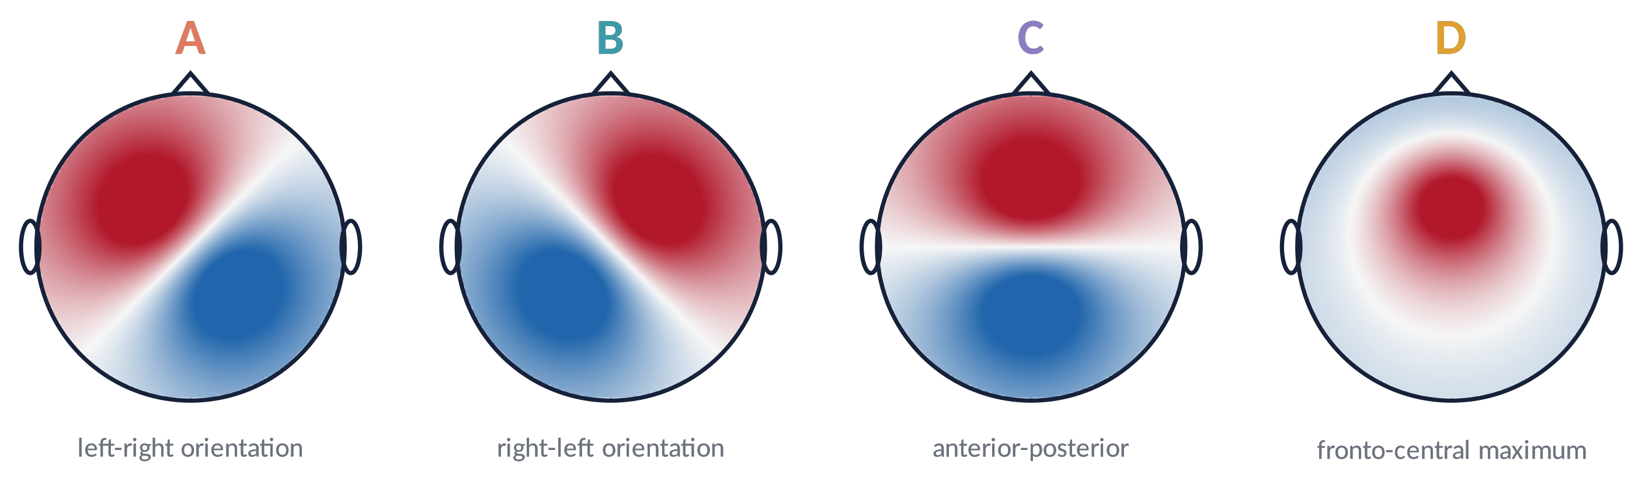
TEMPLATES
The four canonical microstate classes
Classes A–D are remarkably reproducible across labs, montages and ages (Koenig et al., 2002).
Example from our data: 62 ch → GEV ≈ 78 % (Zappasodi et al., 2019); 128 ch → GEV ≈ 83 %.
Labels follow map shape (by convention), not function.
Brain Imaging · EEG · Lecture 8 · Spatial analysis and microstates
13
Notes:
Koenig et al. (2002) NeuroImage 16:41 (normative data across age, 6–80 years); Michel & Koenig (2018). Classes A–D are highly replicated across labs; in the user's own datasets: Zappasodi et al. 2019 (62 ch, 20 subj, 1–40 Hz, GEV ≈ 78 %) and Croce et al. 2020 (128 ch, 30 subj, 1–40 Hz, GEV ≈ 83 %).

Slide 14
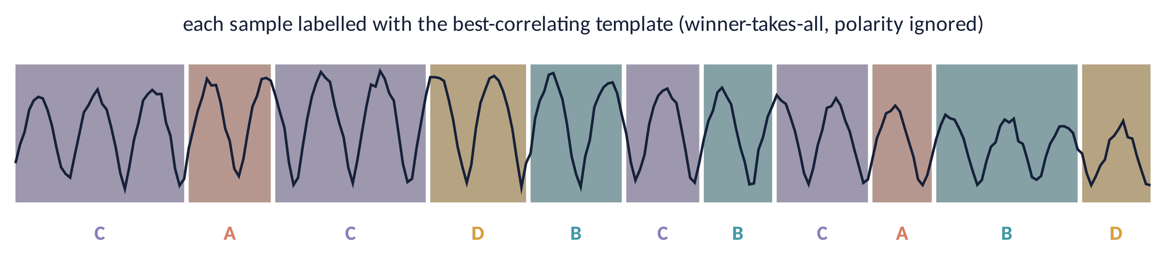
BACK-FITTING
Labelling every time point
Each sample gets the label of the template with the highest |spatial correlation| (winner-takes-all).
Temporal smoothing: reject segments shorter than ≈ 20–30 ms; low-GFP samples take the neighbour's label.
Result: the EEG becomes a symbolic sequence … B C A D A B D C …
Brain Imaging · EEG · Lecture 8 · Spatial analysis and microstates
14
Notes:
Winner-takes-all: each sample (or each GFP peak with interpolation between peaks) is labelled with the template of maximal absolute spatial correlation. Temporal smoothing (e.g. minimum segment duration, Pascual-Marqui 1995 smoothing) avoids spurious short segments. Low-GFP samples are unreliable.

Slide 15
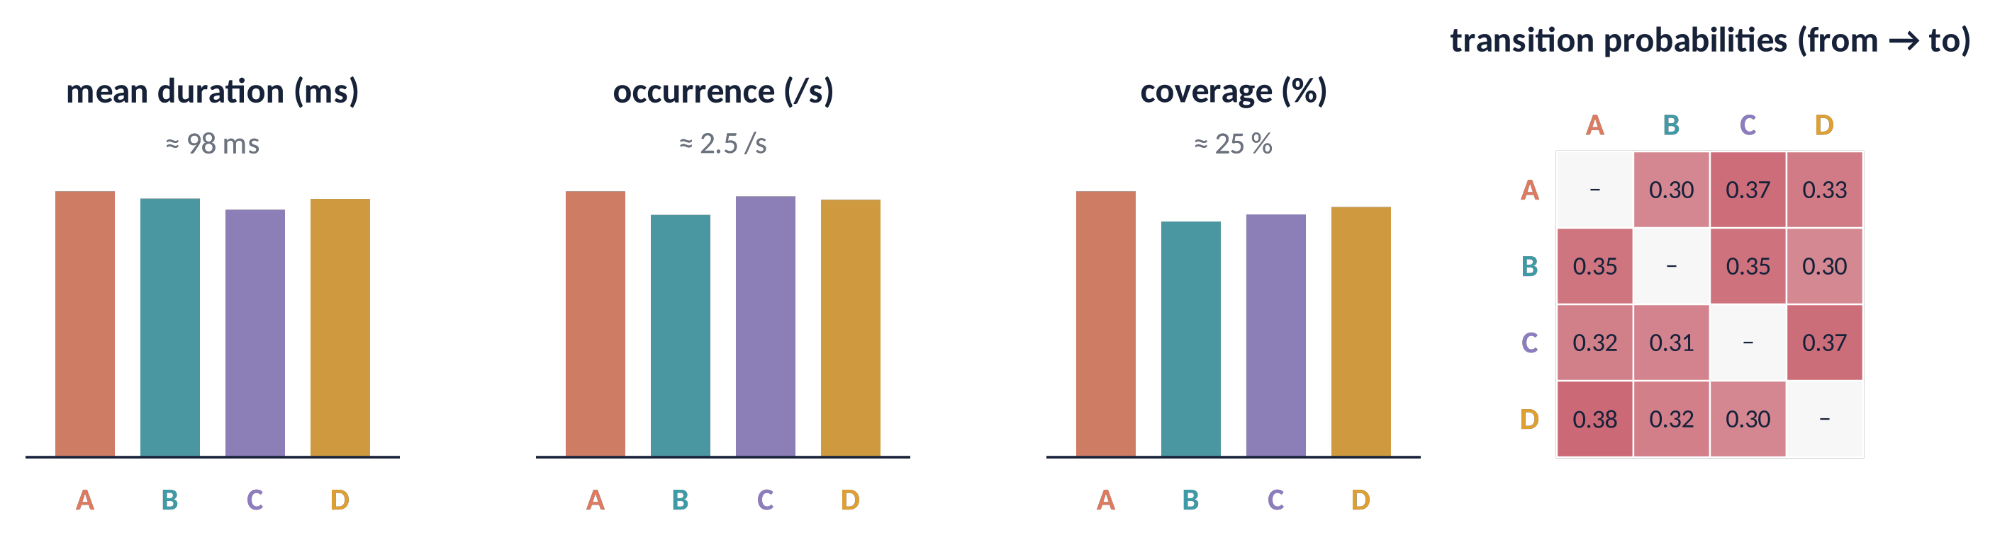
METRICS
Temporal parameters of microstates
Duration
mean time a state lasts (≈ 60–120 ms)
Occurrence
how often it appears per second (≈ 3–5 /s)
Coverage
fraction of time it dominates
GEV / transitions
variance explained; syntax of the sequence
Illustrative values from simulated data.
Brain Imaging · EEG · Lecture 8 · Spatial analysis and microstates
15
Notes:
Standard metrics: mean duration (ms), occurrence (per second), coverage (% of time), GEV per class, transition probabilities (compare with those expected from occurrence). Typical resting values: duration 60–120 ms, occurrence 3–5/s (Michel & Koenig, 2018).

Slide 16
03
What are microstates?
16

Slide 17
MEANING (1)
Microstates and fMRI resting-state networks
auditory / phonological
visual
salience / cognitive control
dorsal attention / fronto-parietal
Microstate time courses, convolved with the HRF, predict BOLD in resting-state networks (Britz et al., 2010; Musso et al., 2010).
Microstates are fast (≈ 100 ms), networks slow (seconds): the sequence shows scale-free dynamics bridging the two (Van De Ville et al., 2010).
⚠ The one-to-one mapping is debated.
Brain Imaging · EEG · Lecture 8 · Spatial analysis and microstates
17
Notes:
Britz, Van De Ville & Michel (2010) NeuroImage 52:1162; Musso et al. (2010) NeuroImage 52:1149; Yuan et al. (2012) NeuroImage 60:2062. Microstate time courses convolved with the HRF and used as GLM regressors correlate with BOLD resting-state networks. The mapping (A auditory, B visual, C salience, D attention) is debated and not one-to-one.

Slide 18
MEANING (2)
Where do microstates come from?
Each map reflects the synchronous activity of a distributed network, not a single dipole.
1
Source imaging (spatiotemporal regression) localises generators in insula, cingulate, occipital, parietal, prefrontal cortex (Custo et al., 2017).
2
With 256 channels, 7 classes are identified (A–G).
3
⚠ Same map ≠ same sources: inverse problem (next lecture).
4
Brain Imaging · EEG · Lecture 8 · Spatial analysis and microstates
18
Notes:
Custo et al. (2017) Brain Connect 7:671 — 7 microstate classes from 256-channel EEG, sources estimated by spatiotemporal regression (Custo et al., 2014 NeuroImage). Each microstate = distributed network, not a single source; the same map can arise from different source configurations (inverse problem, Lecture 9).

Slide 19
04
Applications
19

Slide 20
APPLICATIONS (1)
States of mind and brain
Cognition
serial subtraction vs rest changes C and D (Seitzman et al., 2017); microstates distinguish components of fluid reasoning (Zappasodi et al., 2019).
Sleep
microstate durations increase in deep sleep (Brodbeck et al., 2012).
Anaesthesia
with propofol, microstates become shorter and less variable as sedation deepens (Li et al., 2021).
Age
parameters change lawfully across the lifespan (Koenig et al., 2002).
Microstates are a sensitive, low-cost index of global brain state.
Brain Imaging · EEG · Lecture 8 · Spatial analysis and microstates
20
Notes:
Seitzman et al. (2017) NeuroImage 146:533 (task vs rest, eyes open/closed); Zappasodi et al. (2019) NeuroImage 189:560 (fluid reasoning); Brodbeck et al. (2012) NeuroImage 62:2129 (sleep); Bréchet et al. (2020) Sci Rep; Li et al. (2021) IEEE J Biomed Health Inform (propofol: microstates become shorter and less variable with sedation). Koenig et al. (2002) (age).

Slide 21
APPLICATIONS (2)
Psychiatry and brain stimulation
Schizophrenia: shorter class D, more frequent class C; a candidate endophenotype (da Cruz et al., 2020).
1
Bipolar disorder: altered microstate dynamics related to clinical state (Vellante et al., 2020).
2
Brain stimulation: rTMS over parietal cortex selectively changes specific microstates (Croce et al., 2018).
3
Also: dementia, epilepsy, neonatal EEG, disorders of consciousness.
4
Brain Imaging · EEG · Lecture 8 · Spatial analysis and microstates
21
Notes:
Schizophrenia: shorter D, more C — meta-analysis Rieger et al. (2016) Front Psychiatry; da Cruz et al. (2020) Nat Commun 11:3089 (candidate endophenotype). Bipolar disorder: Vellante et al. (2020) J Affect Disord. TMS: Croce, Zappasodi & Capotosto (2018) Sci Rep — offline stimulation of parietal cortex selectively affects microstates.

Slide 22
IN MATLAB
Microstates with a few lines of code
X = EEG.data - mean(EEG.data, 1); % average reference (ch x time)
gfp = std(X, 1, 1); % Global Field Power
[~, pk] = findpeaks(gfp); M = X(:, pk); % maps at GFP peaks
M = M ./ vecnorm(M); K = 4; best = -Inf;
for rep = 1:50 % random restarts
T = M(:, randperm(size(M,2), K));
for it = 1:100
[~, lab] = max(abs(T' * M)); % polarity-invariant assignment
for k = 1:K
[v,~] = eigs(M(:,lab==k) * M(:,lab==k)', 1); T(:,k) = v; % 1st PC
end
end
c = max(abs(T' * M)); gev = sum((gfp(pk).*c).^2) / sum(gfp(pk).^2);
if gev > best, best = gev; Tbest = T; end
end
Xn = X ./ vecnorm(X); [~, seq] = max(abs(Tbest' * Xn)); % back-fitting
Brain Imaging · EEG · Lecture 8 · Spatial analysis and microstates
22
Notes:
Didactic implementation of modified k-means (Pascual-Marqui et al., 1995). For real analyses use the Microstate EEGLAB toolbox (Poulsen et al., 2018) or Koenig's MICROSTATELAB plug-in, which include smoothing, group clustering and statistics.

Slide 23
PITFALLS
Pitfalls and open questions
Results depend on filter band, number of channels and clustering choices: report them.
1
k is a modelling choice, not a law of nature (4 vs 5–7).
2
Use group or normative templates to compare groups; beware circularity.
3
Class labels (A–D) across studies are matched by eye or correlation: check.
4
Functional interpretation of each class is still debated.
5
Brain Imaging · EEG · Lecture 8 · Spatial analysis and microstates
23
Notes:
von Wegner et al. (2018) NeuroImage (information-theoretic analysis of microstate sequences, non-Markovian dynamics); Koenig et al. (2024) review on standards (MICROSTATELAB); sensitivity to filter band and number of channels; circularity of templates computed on the same data used for statistics.

Slide 24
CHECK YOUR UNDERSTANDING
Three questions
Two conditions have maps with GMD = 0 but different GFP. What can you conclude about the generators?
1
Why does modified k-means ignore map polarity?
2
GEV is 75 % with k = 4 and 82 % with k = 8. Why is k = 8 not automatically better?
3
Brain Imaging · EEG · Lecture 8 · Spatial analysis and microstates
24
Notes:
(1) Same shape, different strength: GFP differs, GMD = 0 → same generators, different activation. (2) EEG oscillates: polarity reverses every half-cycle while the generator configuration is unchanged. (3) GEV always increases with k; use CV/KL or meta-criteria.

Slide 25
TAKE-HOME MESSAGES
Take-home messages
Maps are reference-free: GFP = strength, GMD = shape.
1
Spontaneous EEG = sequence of quasi-stable maps (microstates, ≈ 100 ms).
2
GFP peaks → modified k-means / TAAHC → templates → back-fitting → metrics.
3
Four classes (A–D) explain ≈ 70–80 % of variance; they relate to large-scale networks.
4
Sensitive to cognition, sleep, drugs, disease, stimulation.
5
Brain Imaging · EEG · Lecture 8 · Spatial analysis and microstates
25

Slide 26
SUGGESTED READING
Suggested reading
Michel C.M., Koenig T. (2018) EEG microstates as a tool for studying the temporal dynamics of whole-brain neuronal networks: a review. NeuroImage 180:577–593.
Lehmann D., Skrandies W. (1980) Reference-free identification of components of checkerboard-evoked multichannel potential fields. Electroencephalogr Clin Neurophysiol 48:609–621.
Lehmann D., Ozaki H., Pal I. (1987) EEG alpha map series: brain micro-states by space-oriented adaptive segmentation. Electroencephalogr Clin Neurophysiol 67:271–288.
Pascual-Marqui R.D., Michel C.M., Lehmann D. (1995) Segmentation of brain electrical activity into microstates. IEEE Trans Biomed Eng 42:658–665.
Murray M.M., Brunet D., Michel C.M. (2008) Topographic ERP analyses: a step-by-step tutorial review. Brain Topogr 20:249–264.
Koenig T. et al. (2002) Millisecond by millisecond, year by year: normative EEG microstates and developmental stages. NeuroImage 16:41–48.
Britz J., Van De Ville D., Michel C.M. (2010) BOLD correlates of EEG topography reveal rapid resting-state network dynamics. NeuroImage 52:1162–1170.
Van De Ville D., Britz J., Michel C.M. (2010) EEG microstate sequences in healthy humans at rest reveal scale-free dynamics. PNAS 107:18179–18184.
Custo A. et al. (2017) Electroencephalographic resting-state networks: source localization of microstates. Brain Connect 7:671–682.
Zappasodi F. et al. (2019) EEG microstates distinguish between cognitive components of fluid reasoning. NeuroImage 189:560–573.
Croce P., Zappasodi F., Capotosto P. (2018) Offline stimulation of human parietal cortex differently affects resting EEG microstates. Sci Rep 8:1287.
da Cruz J.R. et al. (2020) EEG microstates are a candidate endophenotype for schizophrenia. Nat Commun 11:3089.
Brain Imaging · EEG · Lecture 8 · Spatial analysis and microstates
26

