Slide 1

MSC IN COMPUTATIONAL COGNITIVE SCIENCE
Brain Imaging – Methods and Applications
Module: Electroencephalography (EEG)
Lecture 9
From scalp to brain:
sources and connectivity
Pierpaolo Croce
A.Y. 2026-2027

Slide 2
LECTURE 9
Today: where and how brain regions talk
Forward problem: head models and the lead field.
1
Inverse problem: why it is ill-posed and how priors solve it.
2
Dipole fitting, MNE, sLORETA/eLORETA, beamformers.
3
Connectivity: coherence, PLV, wPLI, Granger — and the volume-conduction trap.
4
Graph theory: the brain as a network.
5
Brain Imaging · EEG · Lecture 9 · Source imaging and connectivity
2
Notes:
Main references: Michel et al. (2004) Clin Neurophysiol 115:2195; Michel & Brunet (2019) Front Neurol 10:325 (EEG source imaging: a practical review); Bastos & Schoffelen (2016) Front Syst Neurosci 9:175 (connectivity tutorial).

Slide 3
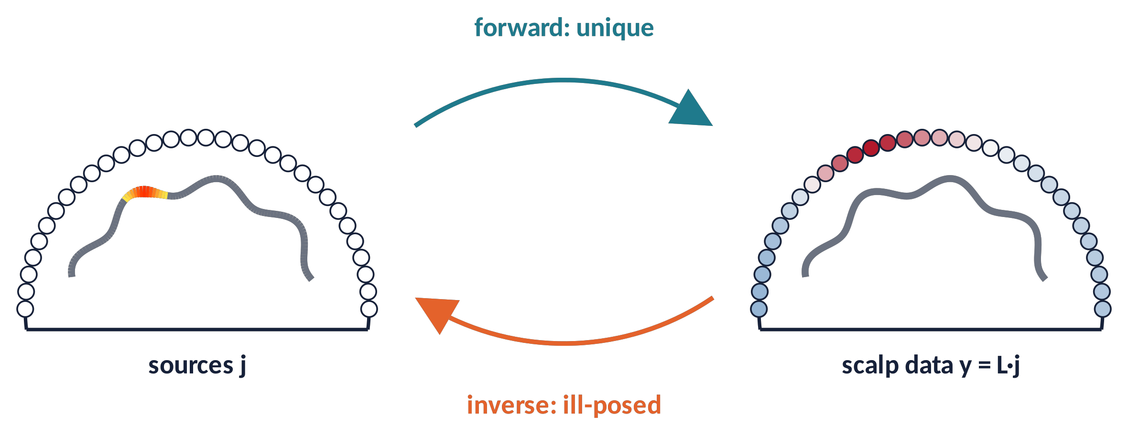
TWO PROBLEMS
Forward and inverse problems
y(t) = L · j(t) + n(t)
Forward: sources + head model → scalp map. Unique, pure physics.
Inverse: scalp map → sources. Not unique (Helmholtz, 1853): infinitely many source configurations give the same map.
Solutions need priors: few dipoles, minimum energy, smoothness, sparsity…
Metaphor hearing a chord and guessing which fingers pressed which keys: many answers are possible.
Brain Imaging · EEG · Lecture 9 · Source imaging and connectivity
3
Notes:
Forward: given sources and a head model, compute scalp potentials — unique solution (Helmholtz, 1853, showed the inverse is not). Inverse: given scalp data, estimate sources — infinitely many solutions without constraints.

Slide 4
01
The forward problem
4

Slide 5
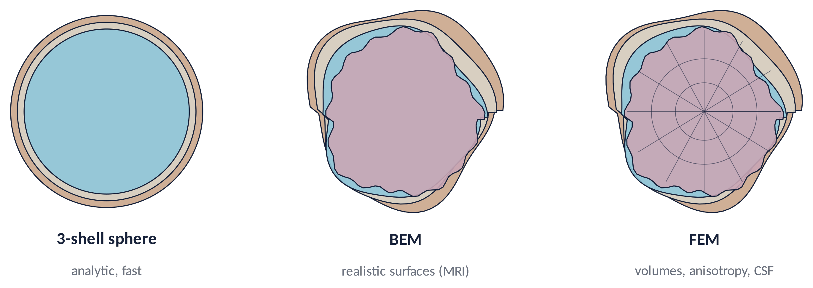
FORWARD (1)
Head models
1
Tissues differ in conductivity: the skull (≈ 0.01 S/m) is ≈ 30–50× less conductive than scalp and brain (Lecture 3).
2
Individual MRI or a template (MNI) head; digitised electrode positions.
3
Main uncertainty: skull conductivity and holes; FEM can include CSF and anisotropy (Vorwerk et al., 2014).
Brain Imaging · EEG · Lecture 9 · Source imaging and connectivity
5
Notes:
Spherical models: Berg & Scherg (1994). BEM: Fuchs et al. (2002), OpenMEEG (Gramfort et al., 2010). FEM: Vorwerk et al. (2014) NeuroImage 100:590 — including CSF and grey/white distinction matters; skull conductivity is the main uncertainty. Template head (MNI) if no individual MRI; digitised electrode positions improve accuracy.

Slide 6
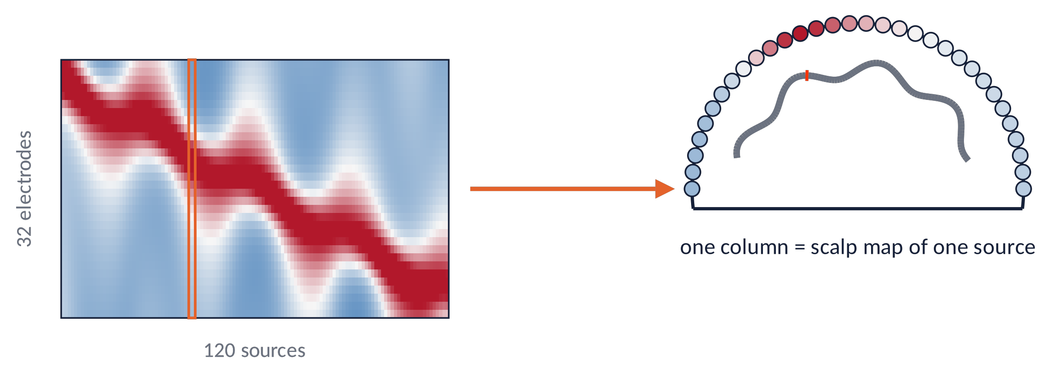
FORWARD (2)
The lead field matrix
Source space: thousands of dipoles on the cortical surface (orientation normal to it) or on a 3D grid.
L (electrodes × sources): column k = scalp map of a unit dipole at k.
Superficial sources have large columns, deep ones small: a built-in depth bias.
N_{el} ≈ 64–256 ≪ N_{src} ≈ 5 000–15 000
Brain Imaging · EEG · Lecture 9 · Source imaging and connectivity
6
Notes:
Source space: a few thousand dipoles on the cortical surface (orientation fixed normal to cortex) or on a volumetric grid (3 orientations each). L has size N_electrodes × N_sources; each column is the scalp topography produced by a unit dipole. Computed once per subject/head model.

Slide 7
02
The inverse problem
7

Slide 8
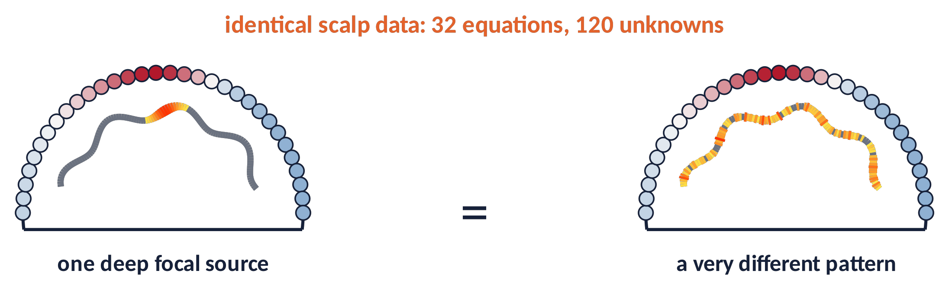
INVERSE (1)
An ill-posed problem
Far fewer equations (electrodes) than unknowns (sources).
"Silent" source patterns (null space of L) can be added without changing the data.
Every method = a prior about what solutions are plausible.
⚠ Results are estimates with limited spatial resolution (≈ cm).
Brain Imaging · EEG · Lecture 9 · Source imaging and connectivity
8
Notes:
Underdetermined linear system: any vector in the null space of L can be added to a solution without changing the data. Plus: noise, head model errors. Constraints (priors) select one solution; different priors → different answers.

Slide 9
INVERSE (2)
Equivalent current dipoles
min_{pos} ‖ y − L(pos) · q ‖² → residual variance, GOF
Idea
assume one or few dipoles; search position and orientation that best explain the map.
When it works
focal activity: early evoked components, interictal spikes in epilepsy.
Limits
number of dipoles must be chosen a priori; local minima; fails for extended sources.
Goodness of fit (GOF) > 90 % is necessary but not sufficient: a wrong model can fit well.
Brain Imaging · EEG · Lecture 9 · Source imaging and connectivity
9
Notes:
Scherg & Von Cramon (1985); Mosher, Lewis & Leahy (1992) IEEE TBME 39:541. Non-linear search of position (and linear estimate of moment) minimising residual variance. Works well for focal activity (early ERP components, interictal spikes). Requires the number of dipoles a priori; local minima.

Slide 10
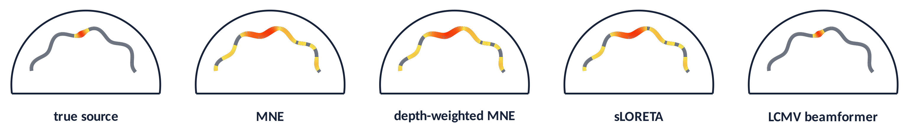
INVERSE (3)
Distributed solutions: MNE, sLORETA, beamformers
ĵ = W Lᵀ (L W Lᵀ + λ I)⁻¹ y
MNE
smallest-energy solution; biased to the surface; use depth weighting (W).
sLORETA / eLORETA
standardised MNE; zero localisation error for single sources (in theory); blurred.
LCMV / DICS beamformer
spatial filter per location using the data covariance; focal, but fails with correlated sources.
Sparse / Bayesian
MxNE, MSP, Champagne: favour few active sources.
Brain Imaging · EEG · Lecture 9 · Source imaging and connectivity
10
Notes:
MNE: Hämäläinen & Ilmoniemi (1994) Med Biol Eng Comput 32:35; LORETA: Pascual-Marqui et al. (1994) Int J Psychophysiol 18:49; sLORETA: Pascual-Marqui (2002) Methods Find Exp Clin Pharmacol 24D:5; eLORETA: Pascual-Marqui (2007) arXiv; LCMV beamformer: Van Veen et al. (1997) IEEE TBME 44:867. Simulated 2D model: one source at 10 Hz plus noise.

Slide 11
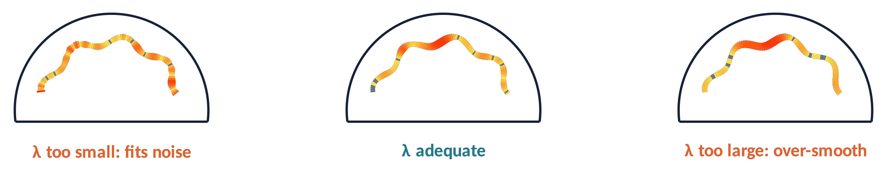
INVERSE (4)
Regularisation and what limits accuracy
1
λ trades fit to the data against smoothness/energy: too small fits noise, too large blurs.
2
Accuracy needs ≥ 64 electrodes with full head coverage (inferior temporal and occipital too) (Michel & Brunet, 2019).
3
Plus: good head model, digitised positions, noise covariance from baseline.
4
Validate with simulations and, when possible, intracranial data.
Brain Imaging · EEG · Lecture 9 · Source imaging and connectivity
11
Notes:
λ is often set from the SNR (MNE-Python default λ² = 1/SNR² with SNR = 3). Accuracy: number and positions of electrodes (≥ 64, full coverage incl. inferior: Michel & Brunet, 2019; Song et al., 2015 NeuroImage), head model, noise covariance. Validation with intracranial recordings or simulations.

Slide 12
03
Functional connectivity
12

Slide 13
CONNECTIVITY (1)
Structural, functional, effective
Structural
anatomical links (white-matter tracts, DTI).
Functional
statistical dependence between signals: correlation, coherence, phase locking. No direction.
Effective
directed influence: Granger causality, PDC/DTF, dynamic causal modelling (Friston, 2011).
1
Amplitude-based: correlation of band-limited envelopes (orthogonalised; Hipp et al., 2012).
2
Phase-based: coherence, PLV, imaginary coherence, PLI/wPLI.
3
Directed: Granger, PDC, DTF (multivariate autoregressive models).
Brain Imaging · EEG · Lecture 9 · Source imaging and connectivity
13
Notes:
Friston (2011) Brain Connect 1:13 — functional (statistical dependence) vs effective (causal influence) connectivity. Bastos & Schoffelen (2016). Metrics families: amplitude-based (envelope correlation), phase-based (coherence, PLV, PLI/wPLI), directed (Granger, PDC, DTF), model-based (DCM).

Slide 14
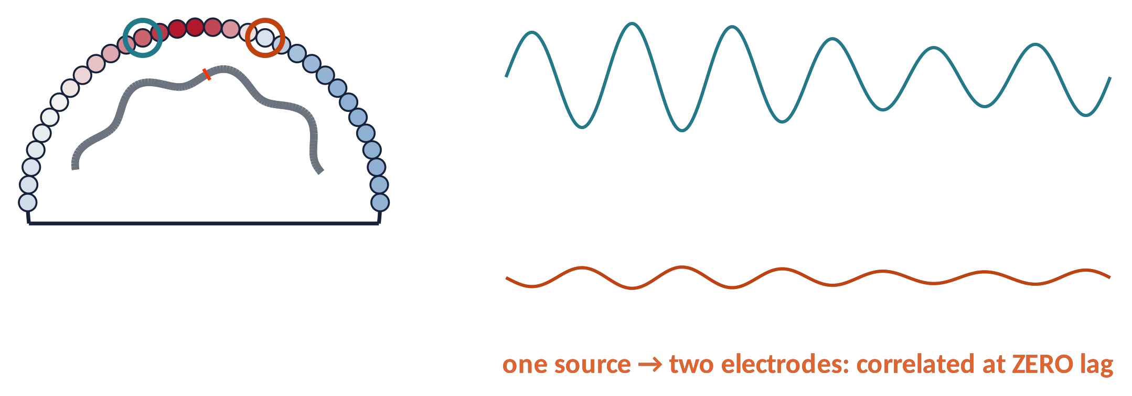
CONNECTIVITY (2)
The volume-conduction trap
1
One source is seen by many electrodes at the same instant → spurious zero-lag coupling.
2
The reference adds its own common signal to all channels.
3
Remedies: source-level analysis + lag-based metrics (imaginary coherence, wPLI) or orthogonalisation.
Brain Imaging · EEG · Lecture 9 · Source imaging and connectivity
14
Notes:
Nolte et al. (2004) Clin Neurophysiol 115:2292; Schoffelen & Gross (2009) Hum Brain Mapp 30:1857; Palva et al. (2018) NeuroImage 173:632 (ghost interactions). Volume conduction is instantaneous at EEG frequencies (quasi-static approximation), so it produces zero-lag correlations. Source-level analysis reduces but does not remove leakage.

Slide 15
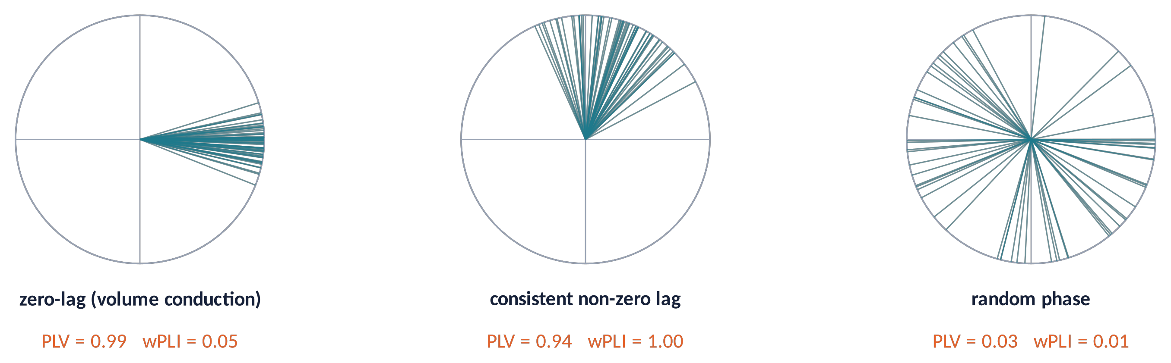
CONNECTIVITY (3)
Coherence, PLV and lag-based measures
PLV = | ⟨ e^{iΔφ} ⟩ | wPLI = | ⟨ Im S_{xy} ⟩ | / ⟨ | Im S_{xy} | ⟩
Coherence / PLV: consistency of the phase difference — high also at zero lag (volume conduction!).
Imaginary coherence, PLI, wPLI: use only the non-zero-lag part → insensitive to instantaneous mixing (but also to true zero-lag coupling).
Brain Imaging · EEG · Lecture 9 · Source imaging and connectivity
15
Notes:
Coherence: |S_xy|²/(S_xx S_yy). PLV: Lachaux et al. (1999) Hum Brain Mapp 8:194. Imaginary coherence: Nolte et al. (2004). PLI: Stam et al. (2007) Hum Brain Mapp 28:1178. wPLI: Vinck et al. (2011) NeuroImage 55:1548 (debiased version recommended). All are biased by the number of trials.

Slide 16
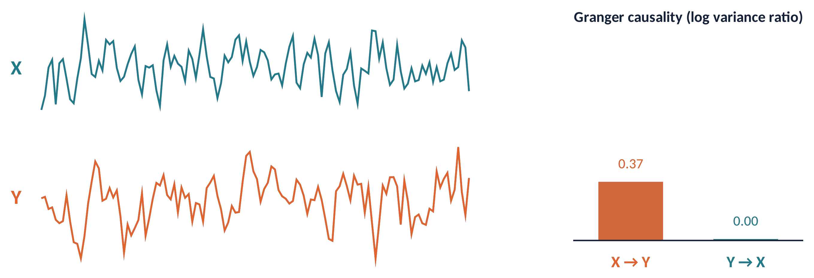
CONNECTIVITY (4)
Directed connectivity: Granger causality
X "Granger-causes" Y if the past of X improves the prediction of Y beyond Y's own past (Granger, 1969).
Estimated with autoregressive models; spectral versions: PDC, DTF, spectral Granger.
⚠ Prediction ≠ causation: common inputs, filtering and volume conduction can create spurious directions (Seth et al., 2015).
Brain Imaging · EEG · Lecture 9 · Source imaging and connectivity
16
Notes:
Granger (1969) Econometrica 37:424; Seth, Barrett & Barnett (2015) J Neurosci 35:3293 (Granger causality analysis in neuroscience); DTF: Kamiński & Blinowska (1991) Biol Cybern 65:203; PDC: Baccalá & Sameshima (2001) Biol Cybern 84:463. Caveats: stationarity, model order, common inputs, volume conduction and filtering can create spurious causality.

Slide 17
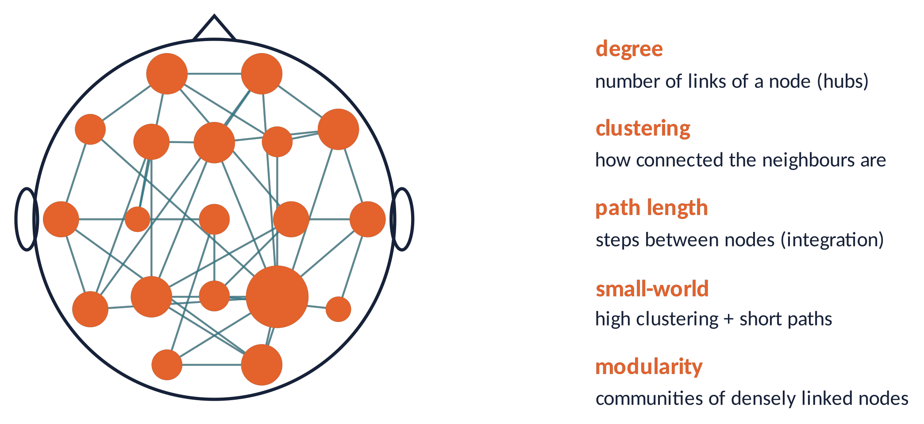
NETWORKS
The brain as a graph
Nodes = electrodes or regions; edges = connectivity values (thresholded or weighted).
Brain networks are small-world and modular with hubs (Bullmore & Sporns, 2009).
⚠ Metrics depend on density and thresholds: compare with null models.
MATLAB: Brain Connectivity Toolbox (Rubinov & Sporns, 2010).
Brain Imaging · EEG · Lecture 9 · Source imaging and connectivity
17
Notes:
Bullmore & Sporns (2009) Nat Rev Neurosci 10:186; Rubinov & Sporns (2010) NeuroImage 52:1059 (Brain Connectivity Toolbox, MATLAB). Watts & Strogatz (1998) Nature 393:440 (small world). Graph metrics depend on thresholding, density, number of nodes: compare networks with matched density and null models.

Slide 18
04
In practice
18

Slide 19
IN MATLAB
Source imaging and wPLI with FieldTrip
load standard_bem; elec = ft_read_sens('standard_1020.elc'); % template head
cfg = []; cfg.headmodel = vol; cfg.elec = elec;
cfg.sourcemodel = ft_read_headshape('cortex_5124.surf.gii');
lf = ft_prepare_leadfield(cfg, data); % forward
cfg = []; cfg.covariance = 'yes'; cfg.keeptrials = 'yes';
tl = ft_timelockanalysis(cfg, data);
cfg = []; cfg.method = 'eloreta'; cfg.sourcemodel = lf; cfg.headmodel = vol;
cfg.eloreta.keepfilter = 'yes'; cfg.eloreta.lambda = 0.05;
src = ft_sourceanalysis(cfg, tl); % inverse
cfg = []; cfg.method = 'mtmfft'; cfg.taper = 'dpss'; cfg.tapsmofrq = 2;
cfg.foi = 8:1:13; cfg.output = 'fourier'; cfg.keeptrials = 'yes';
freq = ft_freqanalysis(cfg, data); % sensor or virtual channels
cfg = []; cfg.method = 'wpli_debiased';
conn = ft_connectivityanalysis(cfg, freq); % lag-based connectivity
W = squeeze(mean(conn.wpli_debiasedspctrm, 3)); % channel x channel
C = clustering_coef_wu(abs(W)); % Brain Connectivity Toolbox
Brain Imaging · EEG · Lecture 9 · Source imaging and connectivity
19
Notes:
FieldTrip (Oostenveld et al., 2011 Comput Intell Neurosci). Template files ship with FieldTrip (standard_bem.mat, standard_1020.elc, cortex_5124.surf.gii). For resting data use a frequency-domain beamformer (DICS) or eLORETA; for connectivity at source level, project single trials with the common filter.

Slide 20
GOOD PRACTICE
A checklist for sources and connectivity
≥ 64 channels, full coverage, digitised positions, good head model.
1
Report inverse method, regularisation, source space, noise covariance.
2
Connectivity: prefer source level + lag-based or orthogonalised metrics.
3
Equalise trial numbers and SNR between conditions (bias!).
4
Test against surrogates/permutations; interpret "where" at the cm scale.
5
Brain Imaging · EEG · Lecture 9 · Source imaging and connectivity
20
Notes:
Michel & Brunet (2019); Bastos & Schoffelen (2016); Pernet et al. (2020) COBIDAS MEEG; Colclough et al. (2016) NeuroImage 138:284 (reliability of connectivity measures); Miljevic et al. (2022) (resting EEG connectivity reproducibility).

Slide 21
CHECK YOUR UNDERSTANDING
Three questions
Why can two very different source configurations produce exactly the same scalp map?
1
Fz and FCz show coherence 0.9 in alpha. Is this evidence of communication? What would you compute instead?
2
Two bilateral auditory sources are perfectly synchronous. Why might a beamformer miss them?
3
Brain Imaging · EEG · Lecture 9 · Source imaging and connectivity
21
Notes:
(1) Null space: infinitely many solutions; priors. (2) Volume conduction/common reference create zero-lag coherence; use imaginary coherence/wPLI at source level. (3) Beamformers suppress correlated sources (they cancel each other).

Slide 22
TAKE-HOME MESSAGES
Take-home messages
Forward is unique (y = L·j); inverse is ill-posed and needs priors.
1
Dipoles for focal sources; MNE/sLORETA/eLORETA for distributed; beamformers for uncorrelated sources.
2
Accuracy needs electrodes, coverage and head models.
3
Sensor-level coherence is contaminated by volume conduction: use lag-based metrics at source level.
4
Granger = prediction, not causation; graphs summarise network organisation.
5
Brain Imaging · EEG · Lecture 9 · Source imaging and connectivity
22

Slide 23
SUGGESTED READING
Suggested reading
Michel C.M. et al. (2004) EEG source imaging. Clin Neurophysiol 115:2195–2222.
Michel C.M., Brunet D. (2019) EEG source imaging: a practical review of the analysis steps. Front Neurol 10:325.
Hämäläinen M.S., Ilmoniemi R.J. (1994) Interpreting magnetic fields of the brain: minimum norm estimates. Med Biol Eng Comput 32:35–42.
Pascual-Marqui R.D. (2002) Standardized low-resolution brain electromagnetic tomography (sLORETA). Methods Find Exp Clin Pharmacol 24D:5–12.
Van Veen B.D. et al. (1997) Localization of brain electrical activity via linearly constrained minimum variance spatial filtering. IEEE Trans Biomed Eng 44:867–880.
Vorwerk J. et al. (2014) A guideline for head volume conductor modeling in EEG and MEG. NeuroImage 100:590–607.
Nolte G. et al. (2004) Identifying true brain interaction from EEG data using the imaginary part of coherency. Clin Neurophysiol 115:2292–2307.
Vinck M. et al. (2011) An improved index of phase-synchronization for electrophysiological data. NeuroImage 55:1548–1565.
Bastos A.M., Schoffelen J.-M. (2016) A tutorial review of functional connectivity analysis methods. Front Syst Neurosci 9:175.
Seth A.K., Barrett A.B., Barnett L. (2015) Granger causality analysis in neuroscience and neuroimaging. J Neurosci 35:3293–3297.
Bullmore E., Sporns O. (2009) Complex brain networks: graph theoretical analysis. Nat Rev Neurosci 10:186–198.
Oostenveld R. et al. (2011) FieldTrip: open source software for advanced analysis of MEG, EEG and invasive electrophysiological data. Comput Intell Neurosci 2011:156869.
Brain Imaging · EEG · Lecture 9 · Source imaging and connectivity
23

