Slide 1
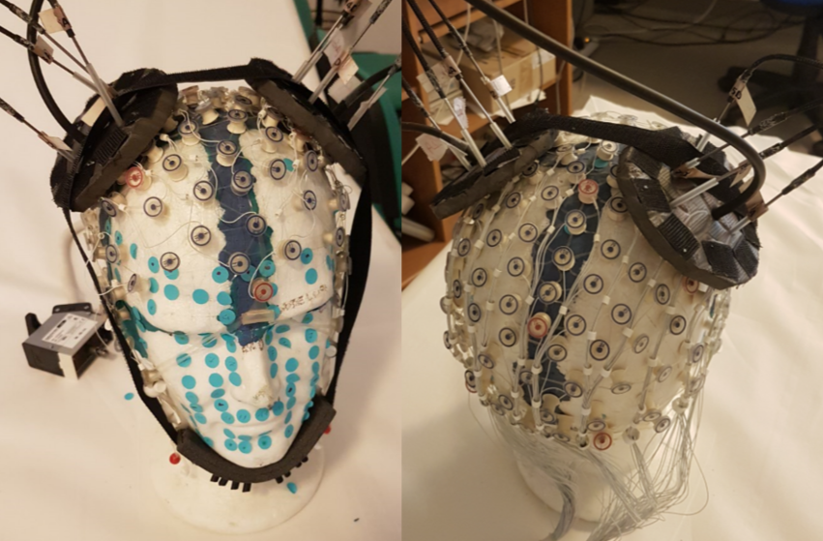
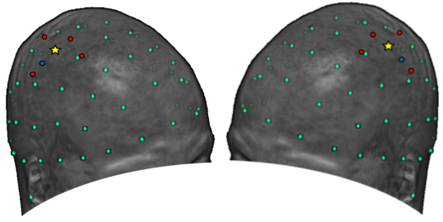
a)
b)
Source
Detector
C3,4
3.5 cm
1.5 cm
c)
C4
C3
Sensor-EEG
Source-fNIRS
Detector-fNIRS

Slide 2

Rest
10 s
Right MI
5 s
Rest
10 s
Right MI
5 s
Rest
10 s
Left MI
5 s
Time
Rest
10 s
Right MI
5 s
20 Right MI
20 Left MI

Slide 3
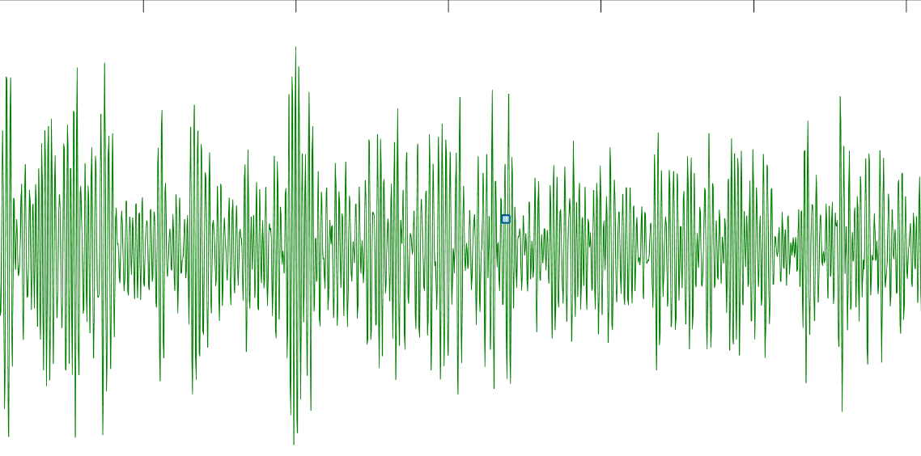
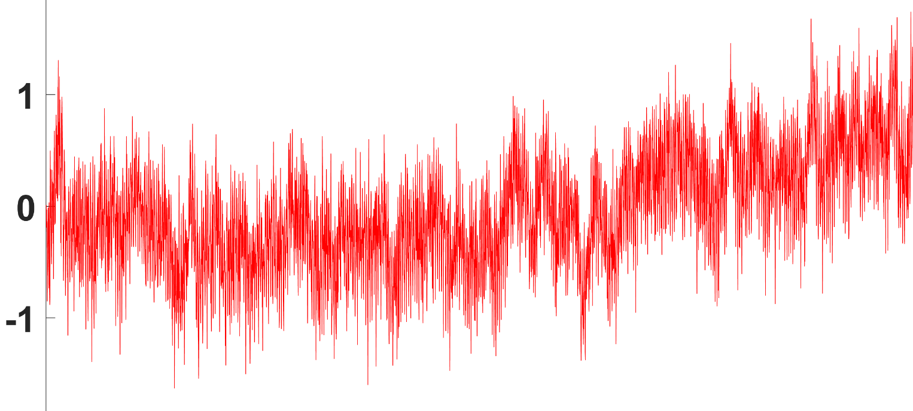
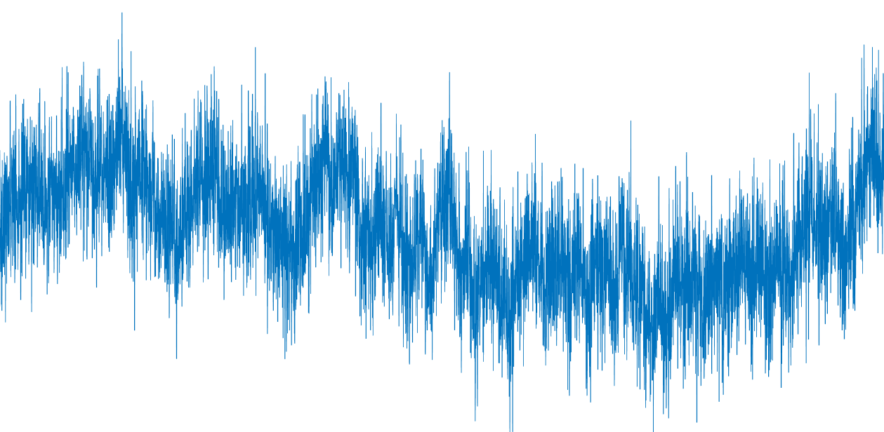
Input Layer
123 or 139 N.
Beta Band Square
Average
Hidden Layers
(ReLU)
Output Layer
(SoftMax)
Raw EEG
123 Ch.
64 N.
32 N.
1 sec
16 N.
8 N.
Average
Raw HbO
8 Ch.
2 N.
P_{Right}
P_{Left}
1 sec
Average
Raw Hb 8 Ch.
1 sec

Slide 4
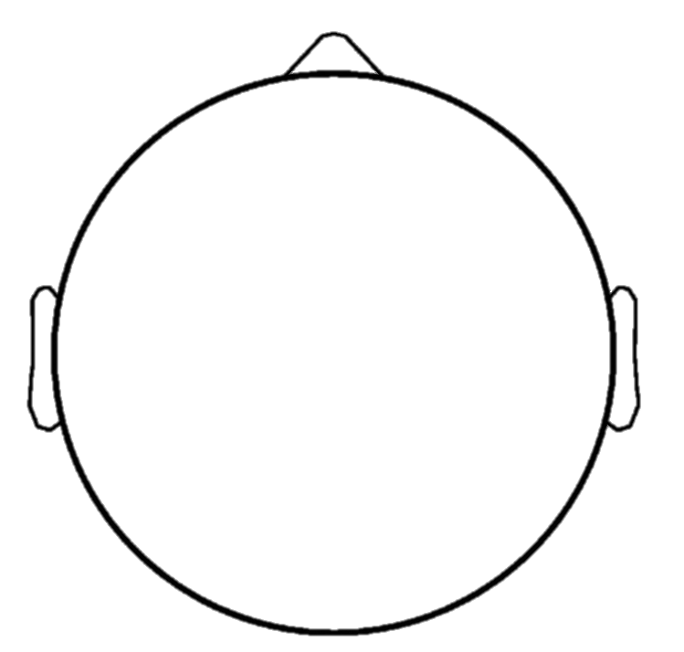
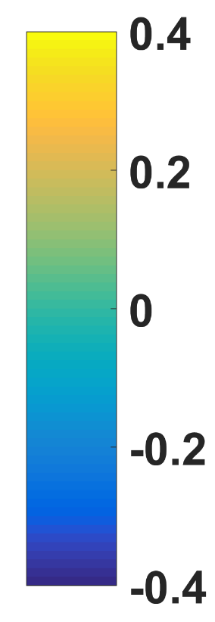
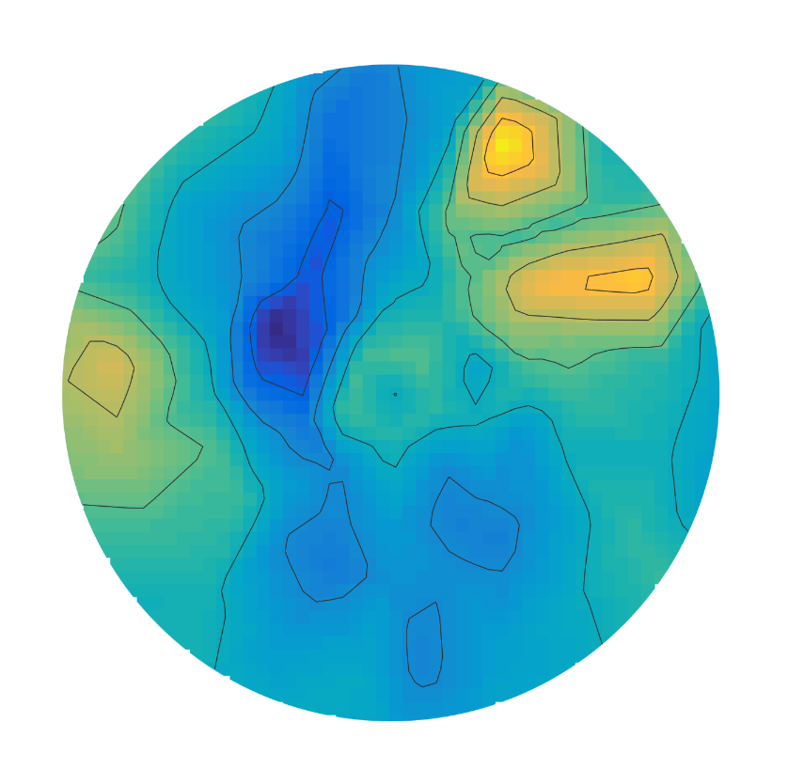
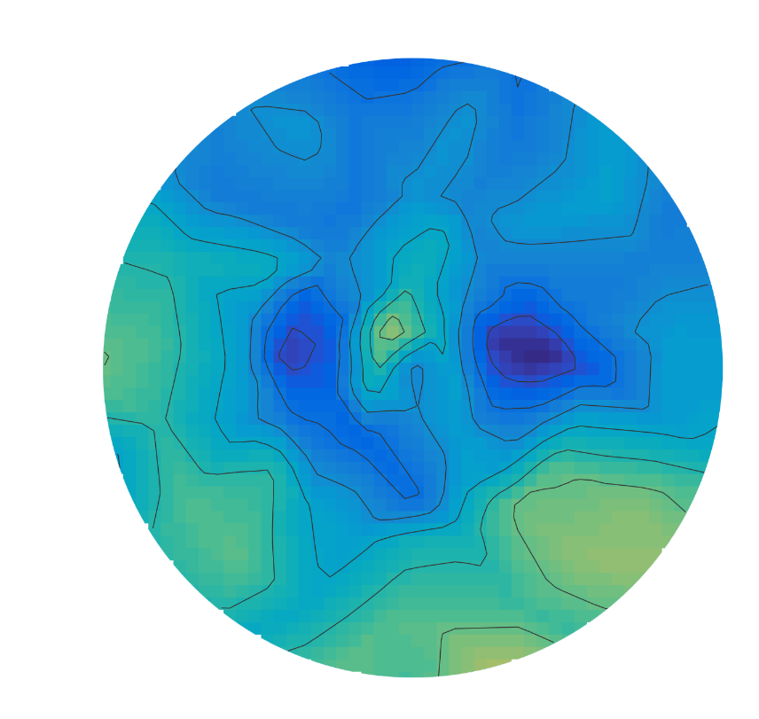
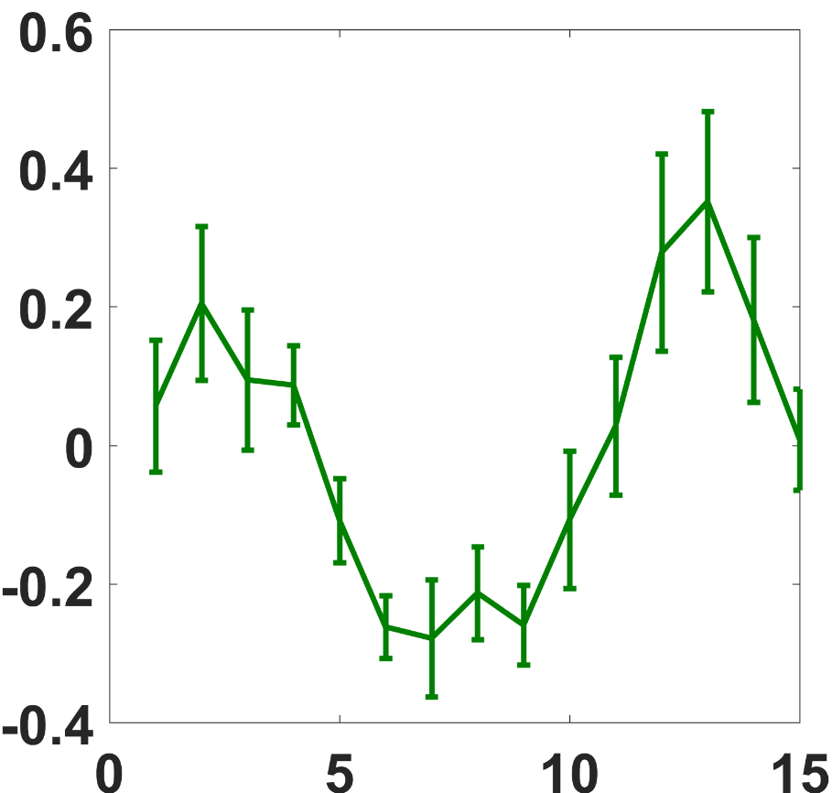
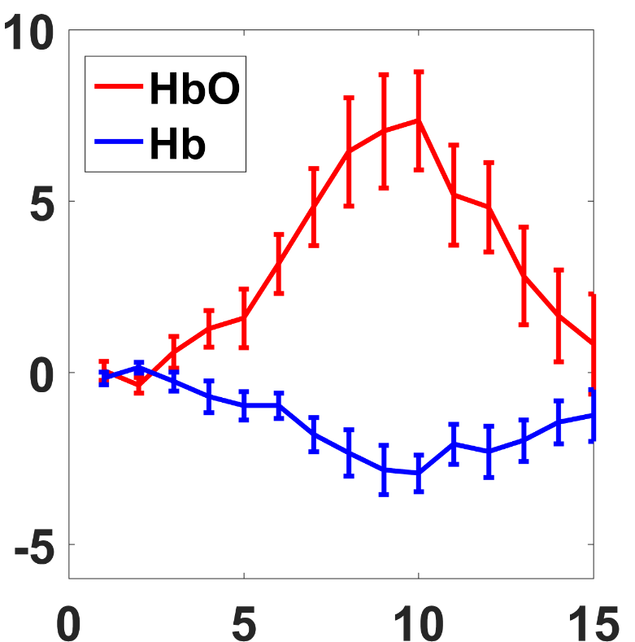
a)
ERD/ERS Rel. Change
Left MI
Right MI
b)
c)
ERD/ERS Relative Change
Concentration (μM)
Time (s)
Time (s)

Slide 5

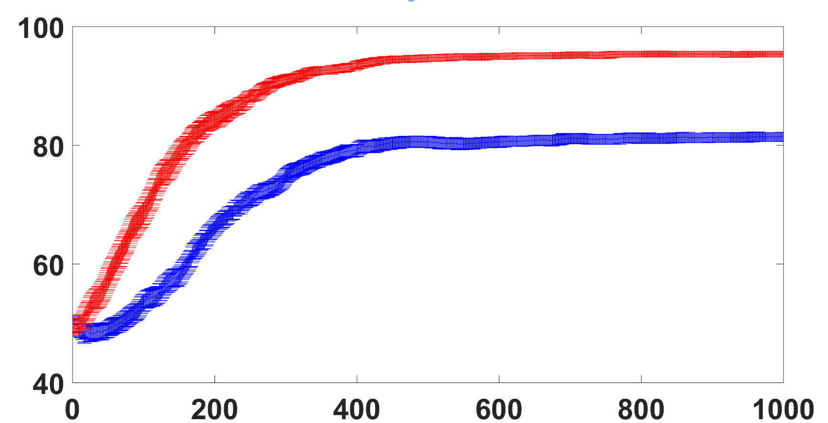
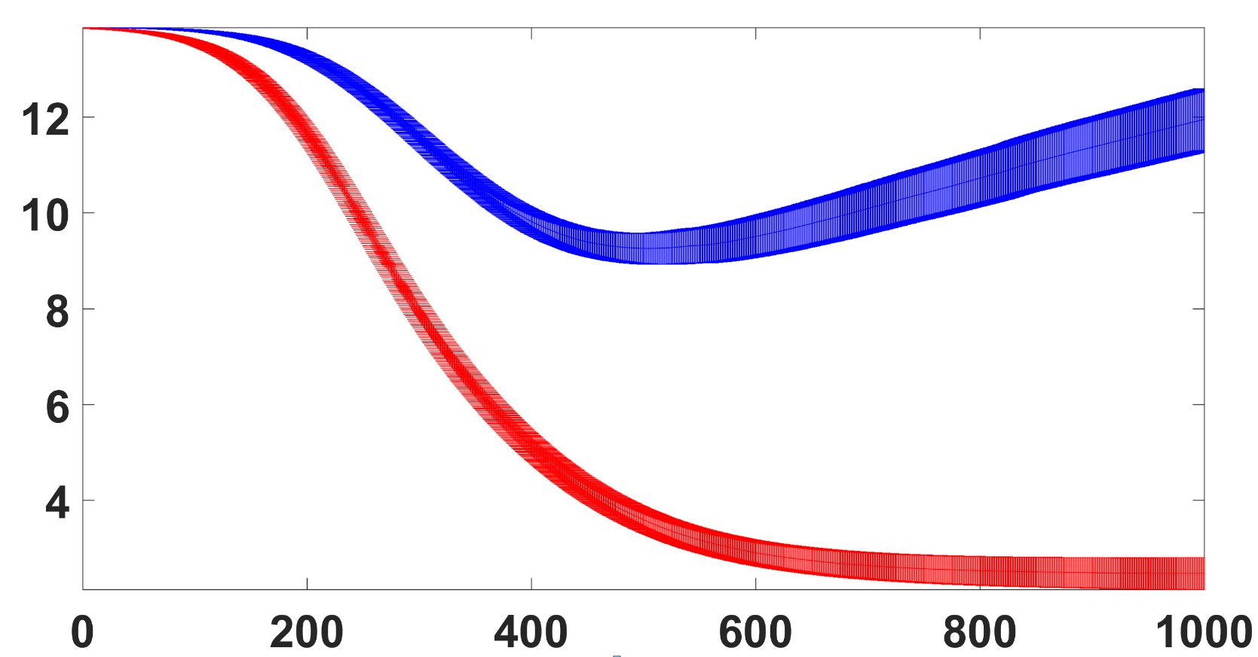
LDA
SVM
DNN
EEG
EEG+fNIRS
Accuracy (%)
CrossEntropy
Epoch

Slide 6
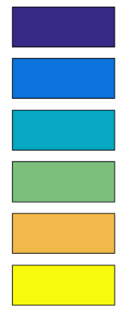
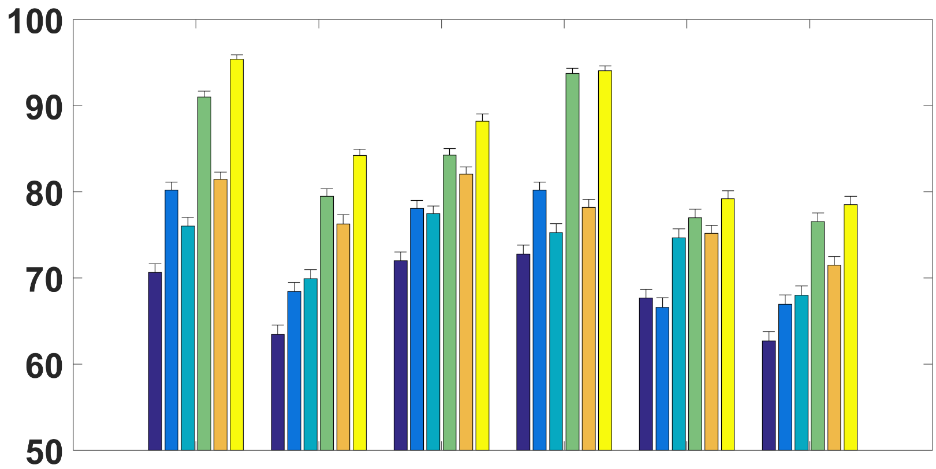
EEG-LDA
EEG+fNIRS-LDA
EEG-SVM
EEG+fNIRS-SVM
EEG-DNN
EEG+fNIRS-DNN
Accuracy (%)
Sbj. 1
Sbj. 2
Sbj. 3
Sbj. 4
Sbj. 5
Sbj. 6

Slide 8
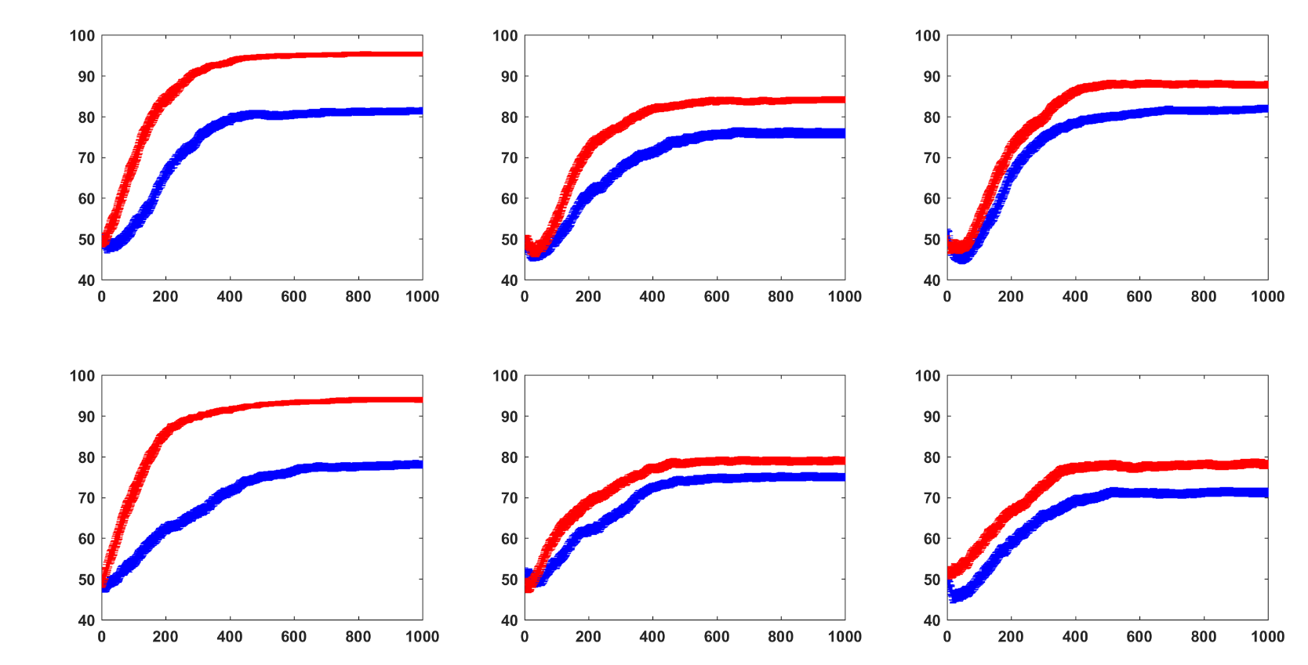
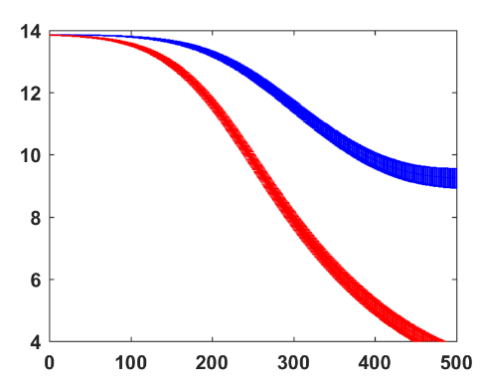
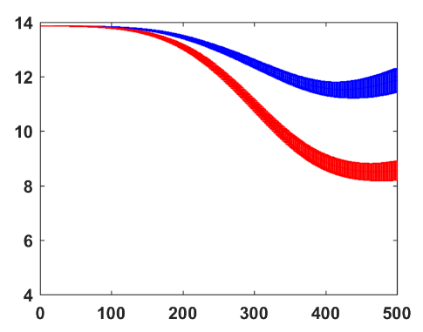
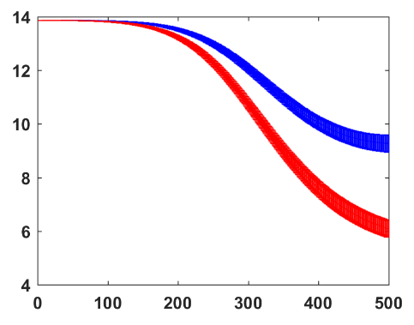
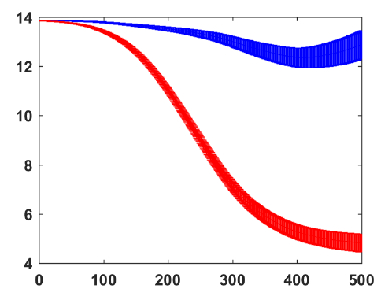
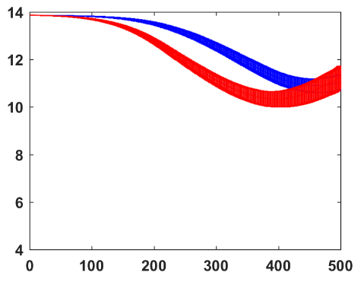
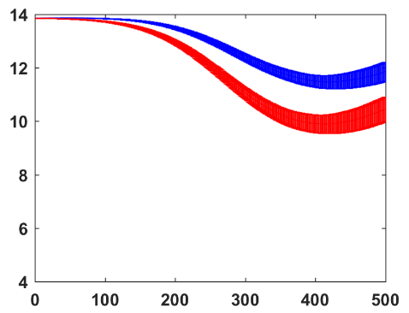
EEG-DNN
EEG+fNIRS-DNN
Accuracy (%)
CrossEn
CrossEn
CrossEn
Accuracy (%)
CrossEn
CrossEn
CrossEn
Epoch
Epoch
Epoch

Slide 9
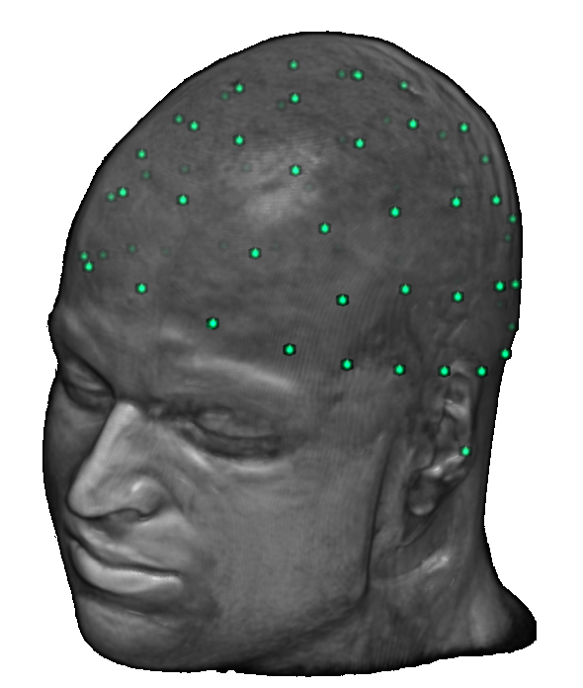
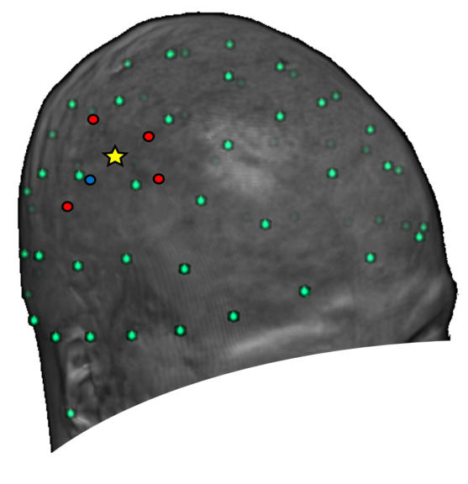
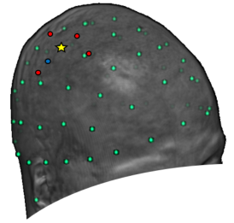
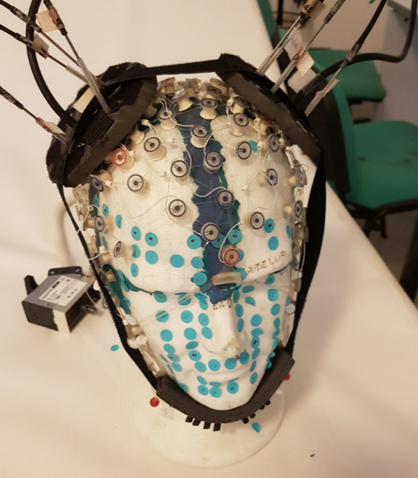
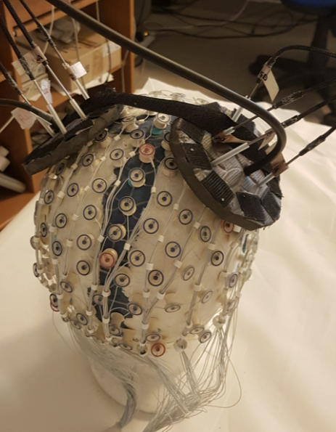

Slide 10
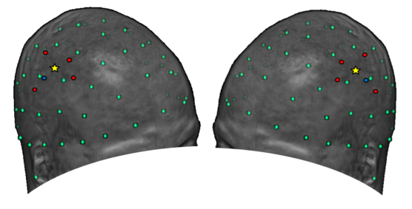
a)
b)
Source
Detector
C3,4
3.5 cm
1.5 cm
c)
C4
C3
Sensor-EEG
Source-fNIRS
Detector-fNIRS

