Slide 1
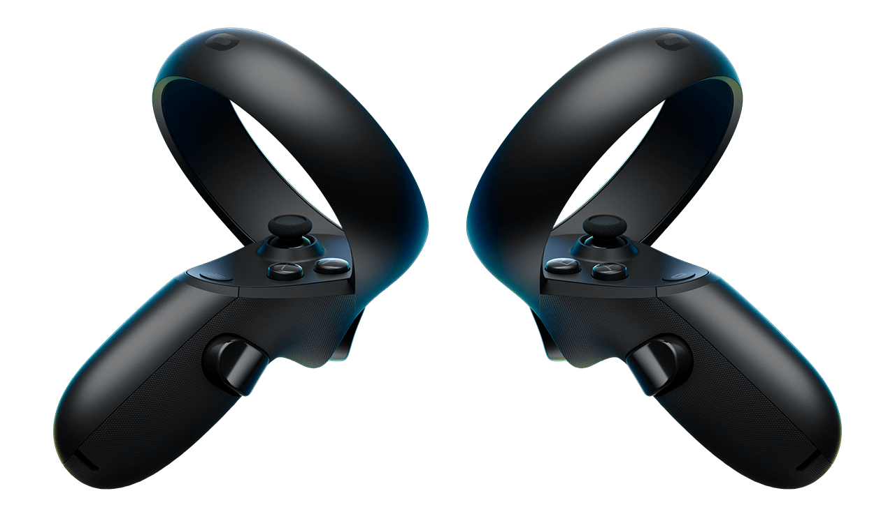
Welcome !
Ready for some physics ?
No ?
up,
down,
turn left,
turn right
forward,
backward,
left,
right
click
Be brave, it will be fun !
hold

