Slide 1












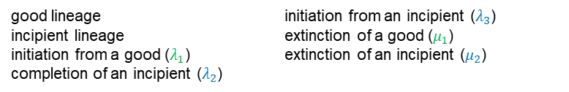





good lineage
incipient lineage
initiation from a good ($λ_{1}$)
completion of an incipient ($λ_{2}$)
initiation from an incipient ($λ_{3}$)
extinction of a good ($μ_{1}$)
extinction of an incipient ($μ_{2}$)
$$×$$
Starting with a good lineage:
$$×$$
0
$$×$$
$$×$$
$$×$$
$$×$$
$$×$$
$$×$$
$$×$$
$$×$$
$$×$$
$$×$$
$$×$$
$$×$$
$$×$$
$$×$$
t
Extinction
$$p_{E}^{G}\left(t\right)$$
Speciation
$$p_{S}^{G}\left(t\right)$$
No extinction or speciation
$$p_{N}^{G}\left(t\right)$$
time
Starting with an incipient lineage:
0
$$×$$
$$×$$
$$×$$
$$×$$
$$×$$
$$×$$
$$×$$
$$×$$
$$×$$
$$×$$
$$×$$
$$×$$
$$×$$
$$×$$
$$×$$
t
Extinction
$$p_{E}^{I}\left(t\right)$$
Completion
$$p_{C}^{I}\left(t\right)$$
No extinction or completion
$$p_{N}^{I}\left(t\right)$$
time

Slide 2

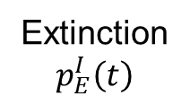



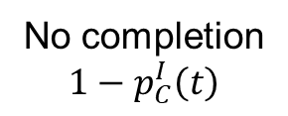
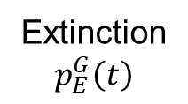










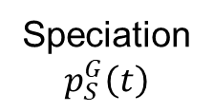
(a) (b) (c) (d) (e)
0
0
u
u
$$×$$
$$×$$
$$×$$
$$×$$
$$×$$
$$×$$
$$×$$
$$p_{E}^{I}\left(t−u\right)$$
$$×$$
$$1−p_{C}^{I}\left(t−u\right)$$
$$×$$
$$p_{E}^{I}\left(t−u\right)$$
$$1−p_{C}^{I}\left(t−u\right)$$
t
t
No extinction or completion
$$p_{N}^{I}\left(t\right)$$
Extinction
$$p_{E}^{I}\left(t\right)$$
No completion
$$1−p_{C}^{I}\left(t\right)$$
(a) (b) (c) (d)
0
0
u
u
u
$$×$$
$$×$$
$${1−p}_{C}^{I}\left(t−u\right)$$
$$p_{E}^{G}\left(t−u\right)$$
$$×$$
$$p_{E}^{I}\left(t−u\right)$$
$$p_{C}^{I}\left(t−u\right)$$
$$p_{S}^{G}\left(t−u\right)$$
t
t
Extinction
$$p_{E}^{G}\left(t\right)$$
Speciation
$$p_{S}^{G}\left(t\right)$$

