Slide 1
COMPUTATION OF SEAMLESS VIDEO LOOPS
Video Communication _Final Project
李天智, 李啟維
2016/6/17

Slide 2
Computation of Seamless Video Loop
李天智 p04922005
李啟維 r04922125
Group 4

Slide 3
Outline
Problem
Algorithm
Result
Demo
Ref

Slide 4
Problem definition
Motivate by cinemagraphic
Target: Seamless loop video
Static, loopable, unloopable
Focus on each pixel
Algorithm
Decide the category of pixel
Downsample reason & parameter
Video frame upper & lower in a range (threshold)
Draw a intersection picture to identify which region is belong to each pixel
Why smoothing is worth able
Illustrate the picture meaning
Get the individual pixel
Decide pixel {s, p}
Focus on loopable pixel, leave all the remaining pixel to stable {p=1}
Use brutal method to calculate error
Choose the min error to be the whole pixel {s, p}
Experimental results
Using different method to achieve and its result
Demo
Discussions

Slide 5
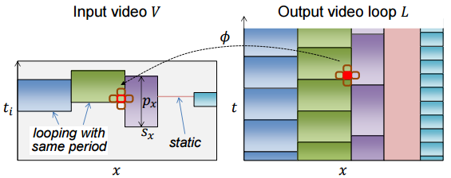
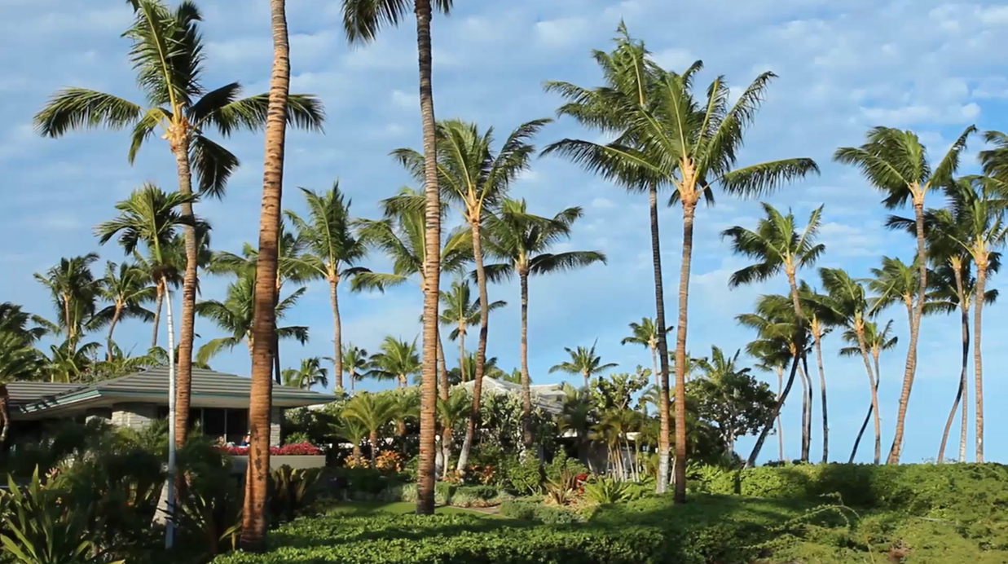
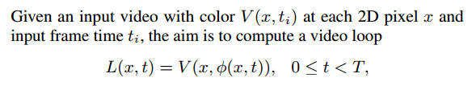

Problem- Definition

Slide 6
Algorithm: Overview
Downsample
Classification of loopable pixel
Create Video Loop Decide {s, p}
Seamless loop video
Video

Slide 7
Algorithm: Downsampling
Frame Rate/4
Scaling=1/2
480x270x37
Reduce computation time
The temporal scaling factor is 4
The spatial scaling factor is 2
For example, an input video with resolution 960×540×150 is scaled to 480×270×37

Slide 8
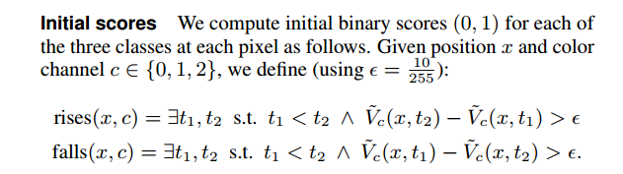
Algo:Classification of loopable pixels
Classify each pixel into one of 3 classes: unchanging, unloopable, or loopable
Rises
time
Falls

Slide 9
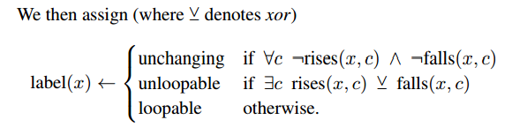

Slide 10
Classification of loopable pixels
Unloopable
Unchanging
Check RGB channel to get label(x)
Next we will focus on Loopable pixel.
Leave unloopable, unchanging pixel into static.
rises
falls
Loopable

Slide 11
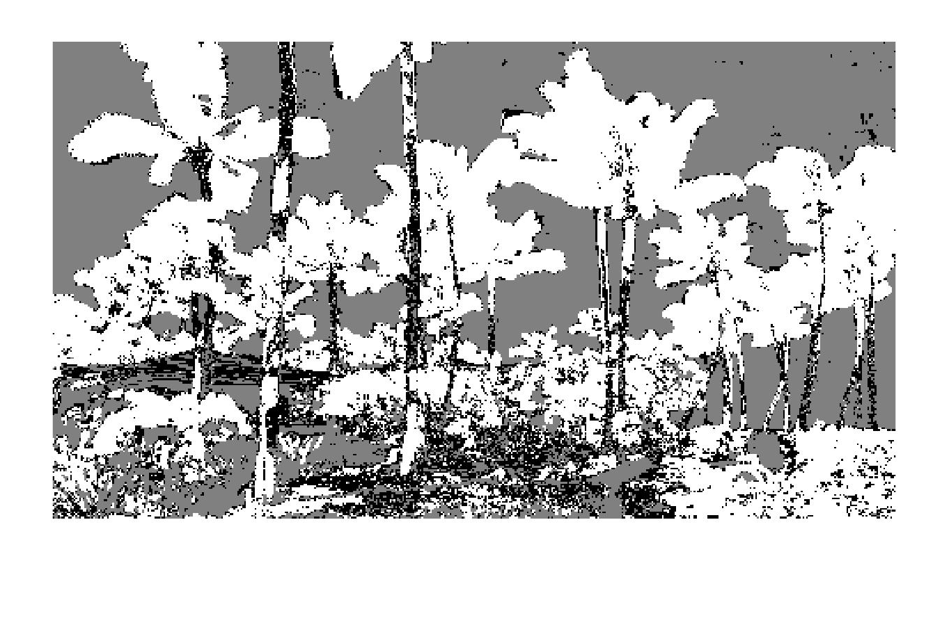

Classification of loopable pixels: Smooth
Result without smoothing
Smoothed by Gaussian filter (σ = 2 pixels)

Slide 12
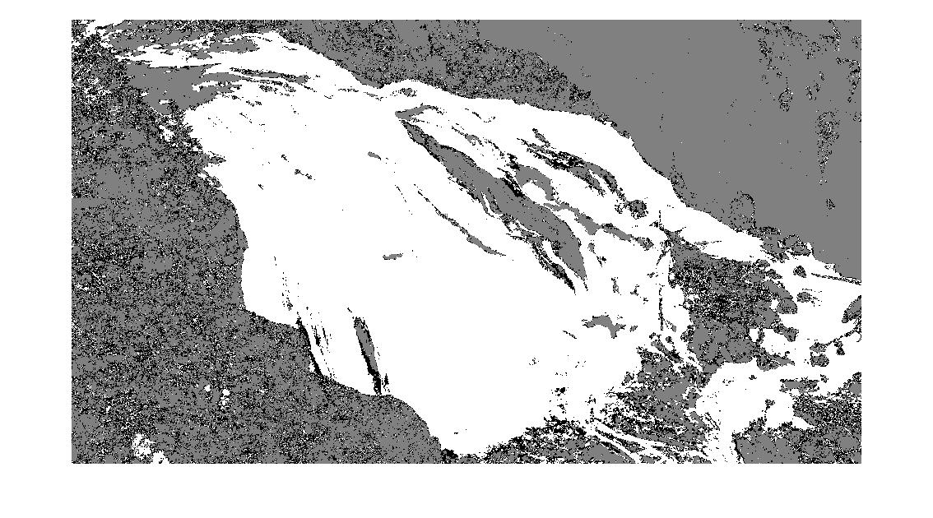
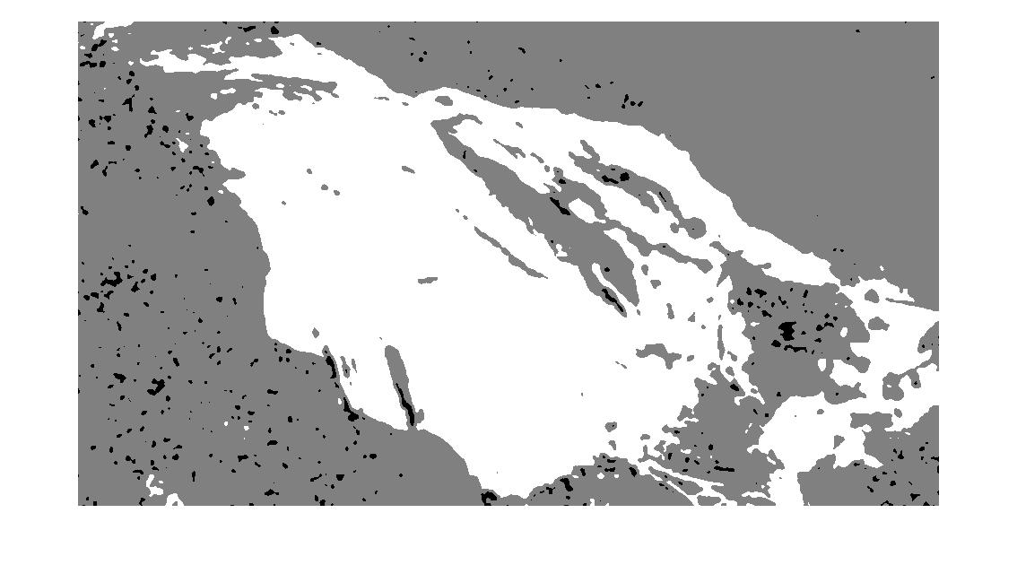
Classification of loopable pixels: Smooth
Result without smoothing
Smoothed by Gaussian filter (σ = 2 pixels)

Slide 13
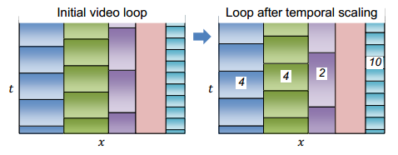

Create Video Loop
For each loopable pixel (white) , we want to find the best start frame s, and best period p
Consider all possible periods {p} and start frames {s}
Our target: minimize the energy

Slide 14
Create Video Loop
all possible periods {p} and start frames {s}
S=0,1,…,37 | p=1 ; s=0,1,…,29 | p=8 ; s = 0,1,…,28 | p=9 ; …; s=0|p=37
It results in a multi label graph cut with 502 labels (Liao et al. 2013)
In the paper of (Liao et al. 2015), they prune the set of 502 labels to 21 candidates with two dominant periods and 9 nearest start frames, plus a static frame (p=1)
Apply Poisson Blending (Liao et al. 2015) to reduce discrepancies at the stitching boundaries

Slide 15
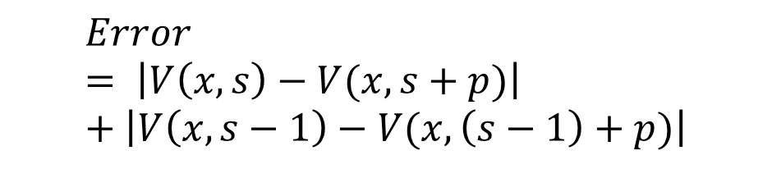
Create Video Loop - Our Approach
480×270×37
Without multi label graph cut
We use candidates {s, p} of p=8,9,…,30, s = 2,3,…,37-p
For each input video frame we calculate the absolute error over the loopable pixels with all possible p, s
We find the s, p with minimum error
p=8,9,…,30, s = 2,3,…,37-p
P=8,9,10…30
S= 2,3,…,37-p
Error
$$Error= \left|V\left(x,s\right)−V(x,s+p)\right|+\left|V\left(x,s−1\right)−V(x,\left(s−1\right)+p)\right|$$
S
S-1
S+P
S-1+p

Slide 16
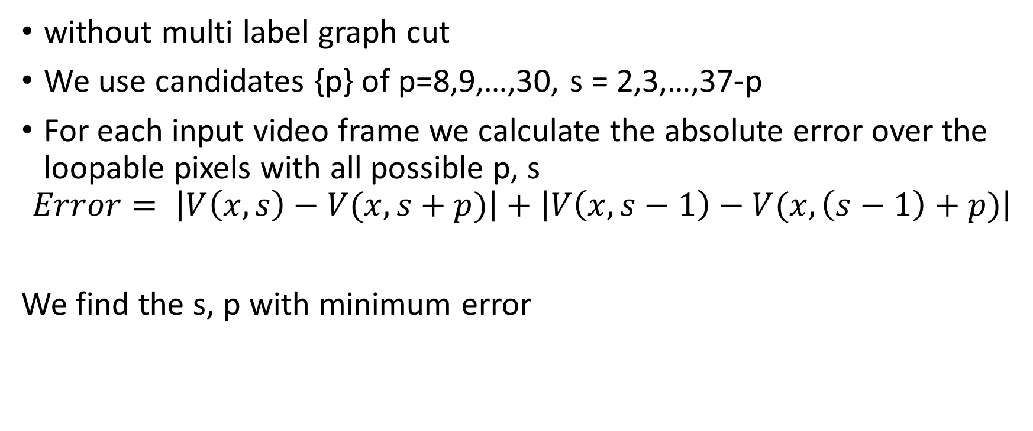
Create Video Loop - Our Approach
without multi label graph cut
We use candidates {p} of p=8,9,…,30, s = 2,3,…,37-p
For each input video frame we calculate the absolute error over the loopable pixels with all possible p, s
$$Error= \left|V\left(x,s\right)−V(x,s+p)\right|+\left|V\left(x,s−1\right)−V(x,\left(s−1\right)+p)\right|$$
We find the s, p with minimum error

Slide 17
Demo

Slide 18
Reference
•LIAO, Z., JOSHI, N., and HOPPE, H. 2013. Automated video looping with progressive dynamism. ACM Trans. Graph., 32(4)
•LIAO, J., Finch, M., and HOPPE, H. 2015. Fast computation of seamless video loops. ACM Trans. Graph., 34(6)

