Slide 1
Computation of Seamless Video Loop
李天智 p04922005
李啟維 r04922125
Group 4

Slide 2
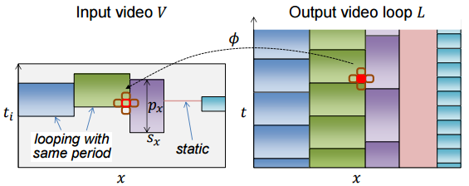
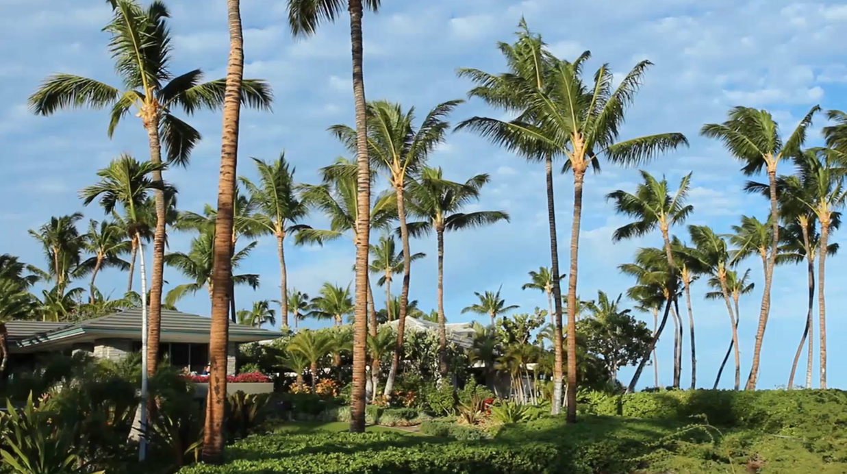
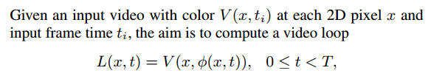

Problem- Definition

Slide 3
Algorithm: Overview
Downsample
Classification of loopable pixel
Create Video Loop Decide {s, p}
Seamless loop video
Video

Slide 4
Algorithm: Downsampling
Frame Rate/4
Scaling=1/2
480x270x37
Reduce computation time
The temporal scaling factor is 4
The spatial scaling factor is 2
For example, an input video with resolution 960×540×150 is scaled to 480×270×37

Slide 5
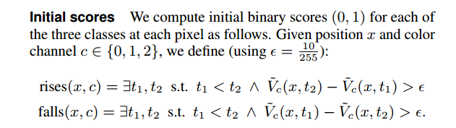
Algo:Classification of loopable pixels
Classify each pixel into one of 3 classes: unchanging, unloopable, or loopable
Rises
time
Falls

Slide 6
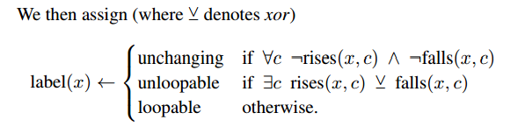

Slide 7
Classification of loopable pixels
Unloopable
Unchanging
Check RGB channel to get label(x)
Next we will focus on Loopable pixel.
Leave unloopable, unchanging pixel into static.
rises
falls
Loopable

Slide 8
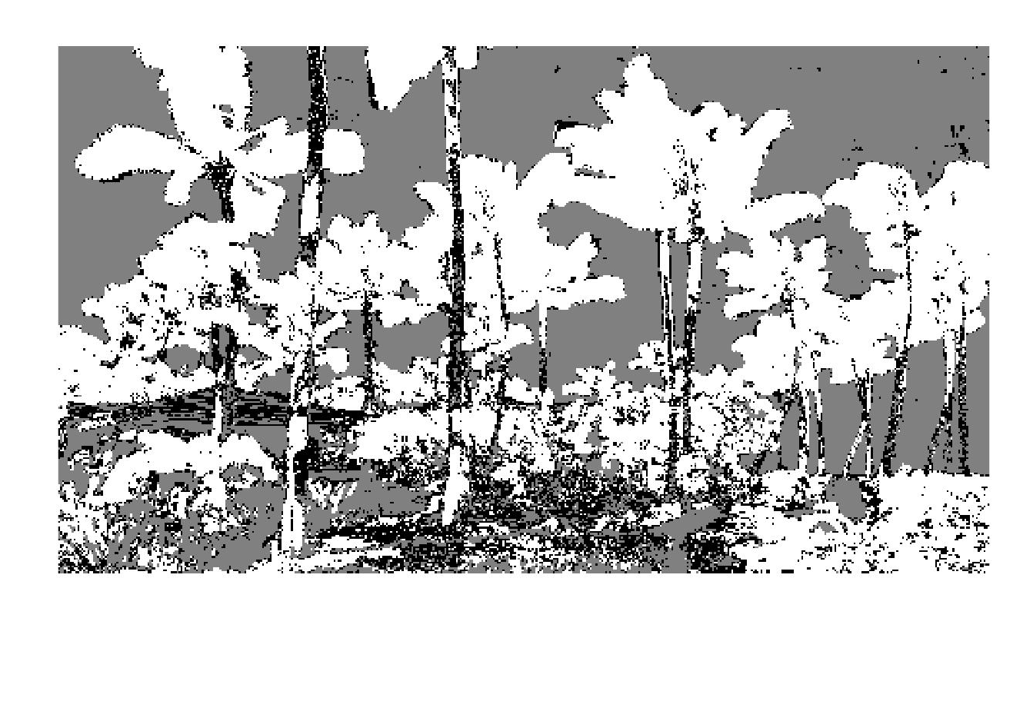

Classification of loopable pixels: Smooth
Result without smoothing
Smoothed by Gaussian filter (σ = 2 pixels)

Slide 9
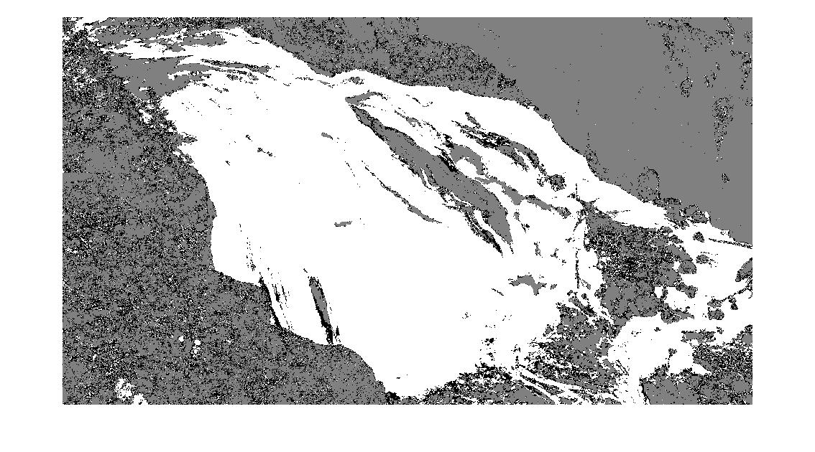
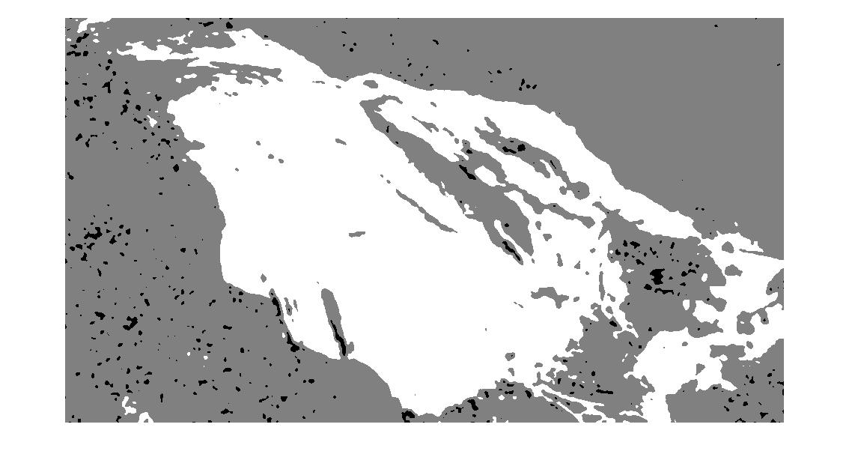
Classification of loopable pixels: Smooth
Result without smoothing
Smoothed by Gaussian filter (σ = 2 pixels)

Slide 10
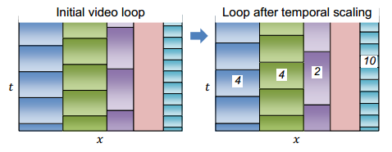

Create Video Loop
For each loopable pixel (white) , we want to find the best start frame s, and best period p
Consider all possible periods {p} and start frames {s}
Our target: minimize the energy

Slide 11
Create Video Loop
all possible periods {p} and start frames {s}
S=0,1,…,37 | p=1 ; s=0,1,…,29 | p=8 ; s = 0,1,…,28 | p=9 ; …; s=0|p=37
It results in a multi label graph cut with 502 labels (Liao et al. 2013)
In the paper of (Liao et al. 2015), they prune the set of 502 labels to 21 candidates with two dominant periods and 9 nearest start frames, plus a static frame (p=1)
Apply Poisson Blending (Liao et al. 2015) to reduce discrepancies at the stitching boundaries

Slide 12
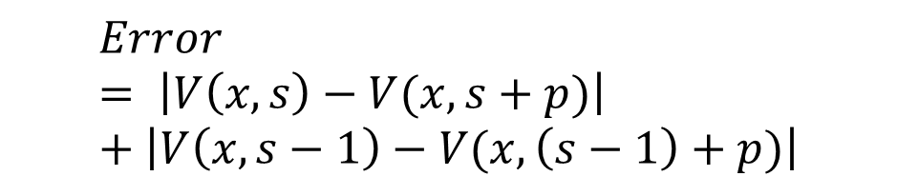
Create Video Loop - Our Method 1
480×270×37
Without multi label graph cut
We use candidates {s, p} of p=10,…,30, s = 2,3,…,37-p (357 labels)
For each possible p, s we calculate the absolute error over the loopable pixels
We find the s, p with minimum error for all pixels
p=8,9,…,30, s = 2,3,…,37-p
P=10…30
S= 2,3,…,37-p
Error
$$Error= \left|V\left(x,s\right)−V(x,s+p)\right|+\left|V\left(x,s−1\right)−V(x,\left(s−1\right)+p)\right|$$
S
S-1
S+P
S-1+p

Slide 13
Create Video Loop - Our Method 2
Without multi label graph cut
We use candidates {s, p} of p=10,…,30, s = 2,3,…,37-p (357 labels)
For each possible p, s we calculate the absolute error over the loopable pixels
We find the s, p with minimum error for each pixel
p=8,9,…,30, s = 2,3,…,37-p
P=10…30
S= 2,3,…,37-p
$$Error= \left|V\left(x,s\right)−V(x,s+p)\right|$$

Slide 14
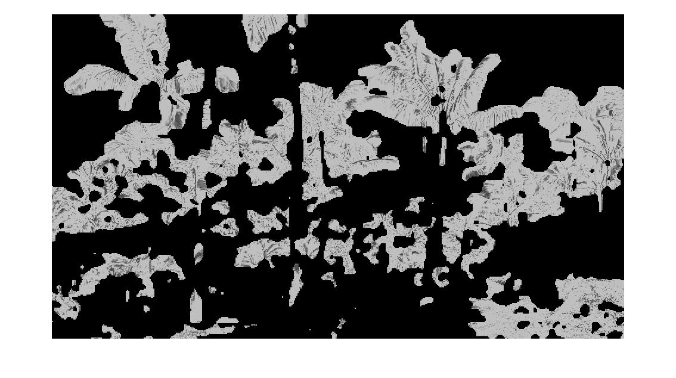
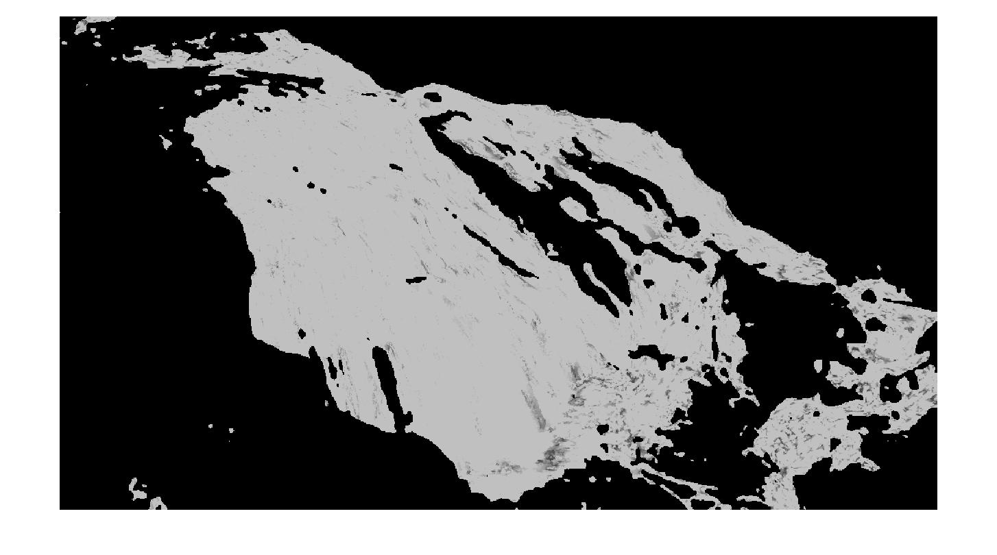
S, P Labeling Result
Our method 2 try to label each pixel with the s, p that has minimum error

Slide 15
Demo
palmtrees_loop1.mp4
palmtrees_loop2.mp4

Slide 16
Discussion
Method 1
- assign all loopable pixels with same s and p
- the temperal consistency is good, but the spatial consistency is bad
- we can see the discontinuity between each loop period
Method 2
- assign all loopable pixels with different s and p
- the temperal consistency bad, but the spatial consistency is better
- we can see the discontinuity between start frame and end frame
Graph cut approach will produce better results

Slide 17
Reference
•LIAO, Z., JOSHI, N., and HOPPE, H. 2013. Automated video looping with progressive dynamism. ACM Trans. Graph., 32(4)
•LIAO, J., Finch, M., and HOPPE, H. 2015. Fast computation of seamless video loops. ACM Trans. Graph., 34(6)

