Slide 1
COMPUTATION OF SEAMLESS VIDEO LOOPS
李天智, 李啟維
2016/6/17

Slide 2
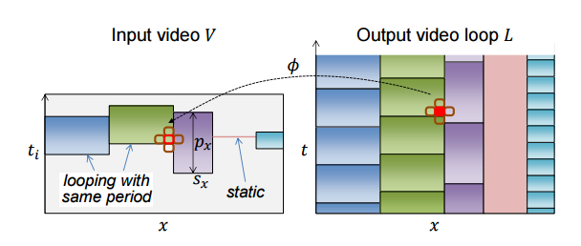
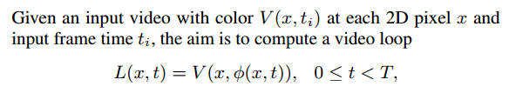

Problem

Slide 3
Spatiotemporal downsampling
The temporal scaling factor is 4
The spatial scaling factor is 2
For example, an input video with resolution 960×540×150 is scaled to 480×270×37

Slide 4
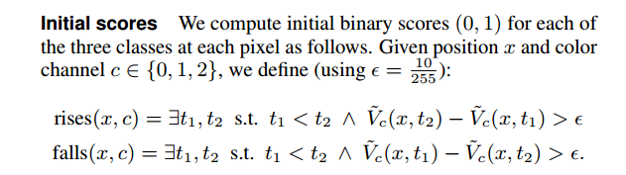
Classification of loopable pixels
classify each pixel into one of 3 classes: unchanging, unloopable, or loopable

Slide 5
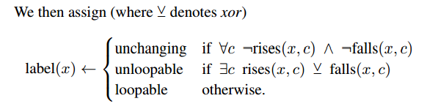
Classification of loopable pixels

Slide 6
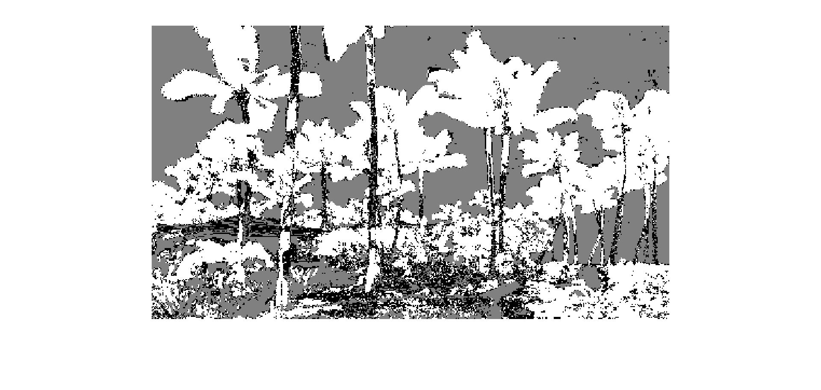

Classification of loopable pixels
Result without smoothing
Smoothed by Gaussian filter (σ = 2 pixels)

Slide 7
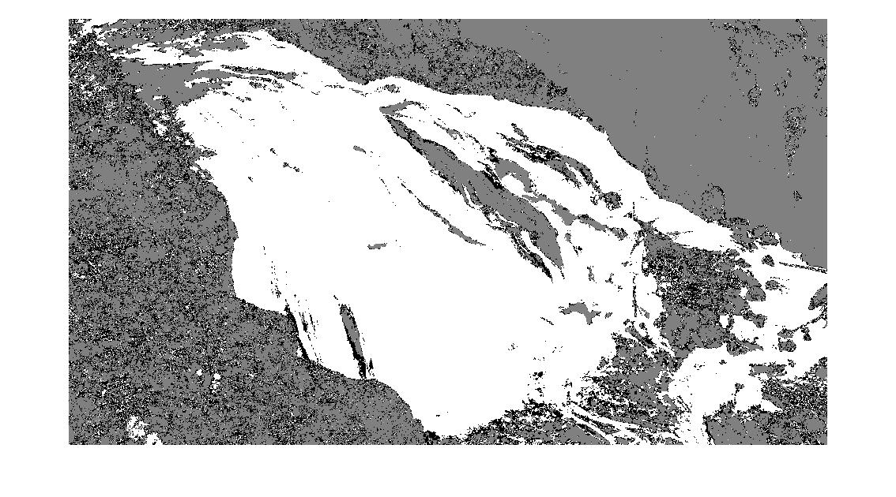
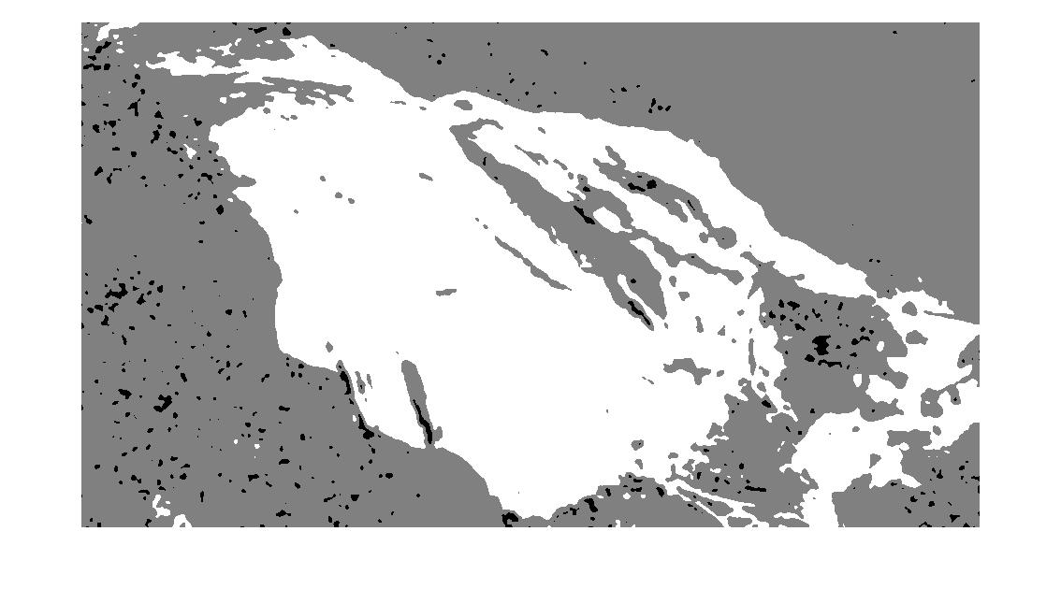
Classification of loopable pixels
Result without smoothing
Smoothed by Gaussian filter (σ = 2 pixels)

Slide 8

Create Video Loop
For each loopable pixel, we want to find the best start frame s, and best period p
Consider all possible periods {p} and start frames {s}
S=0,1,…,37 | p=1; s=0,1,…,29 | p=8; s = 0,1,…,28 | p=9; …; s=0|p=37
It results in a multi label graph cut with 502 labels (Liao et al. 2013)
The energy to minimize

Slide 9
Create Video Loop
In the paper of (Liao et al. 2015), they prune the set of 502 labels to 21 candidates with two dominant periods and 9 nearest start frames, plus a static frame (p=1)
Apply Poisson Blending (Liao et al. 2015) to reduce discrepancies at the stitching boundaries

Slide 10
Create Video Loop - Our Approach
without multi label graph cut
We use candidates {p} of p=8,9,…,30, s = 2,3,…,37-p
For each input video frame we calculate the absolute error over the loopable pixels with all possible p, s
error =|V(.,s) – V(.,s+p)| + |V(.,s-1) – V(.,s+p-1)|
We find the s, p with minimum error

Slide 11
Demo

Slide 12
Reference
•LIAO, Z., JOSHI, N., and HOPPE, H. 2013. Automated video looping with progressive dynamism. ACM Trans. Graph., 32(4)
•LIAO, J., Finch, M., and HOPPE, H. 2015. Fast computation of seamless video loops. ACM Trans. Graph., 34(6)

