Slide 1



HGP Team
Hyunho Park , Gianni M. Ricciardi, Pierre Alauzet
CS642 - Distributed Systems

Slide 2

Introduction & Scenario
Motivations
Problem definition
Design Considerations
Conclusion

Slide 3
Spontaneous network definition
  Application oriented network deployed when some users meet together for some common purpose
  No pre-existing infrastructure (no server or connection point)
  Features such as address allocation, name resolution, service location, authentication, and so on have to be provided without pre-configuration or centralized services
Possible spontaneous network examples
  Interactive presentations
  Document sharing
  Collaborative editing
  Games

Slide 4
Spontaneous network merging
  How can we merge 2 different networks but a same application?
  Do we keep previous communications & data ?
  How can we manage the security in merging networks ?
Spontaneous network separation
  What is happening when some users leave a spontaneous network ?
  Do we wish 2 independant spontaneous networks ?
  How can we maintain the previous shared data, communication, etc.

Slide 5
Spontnet: Experiences in Configuring and Sequring Small Ad Hoc Network
  In paper[5], we found a comprehensive discussion about the setting of a spontaneous network using session keys shared among users, but they don't consider different groups, each one with its own network, desiring to join all together in only one network;
Network merging at MANET
  In paper [4], they propose a realistic model about permanent or transient merging of MANET, but from a low level point of view (networking, routing, etc.), without considering session keys management as we propose;

Slide 6
We suppose to be in the case of networking established using spontaneous VPN (i.e. a VPN among nodes, built using a shared session key).
A session key is a single-use symmetric key used for encrypting all messages in one communication session
Normally, keys must be distributed securely before encryption can be established, in order to get a secure network.

Slide 7
Merging problems
  Session key management (security management)
    Do we create a new session key ?
    Do we use a proxy node ?
    …
  Considering other aspects such as naming, addressing or authentication
Separation problems
  Session key management (security management)
    Do we use the previous key ?
    Do we wish to separate independent networks ? In this case, are data, communication, etc. now independent ?

Slide 8
How to create session key?
  Using cryptographic keys as session keys.
  Advantages
    Globally unique session key at any time without reference to central authorities.
    A node’s session can be remains valid as long as desired.
    The node can retain its session key when it moves or the surrounding network topology change.
    Multiple session keys can be generated simultaneously.
    Independent of centralized public key infrastructure.
How to distribute session key?
  For the initial session key a secure channel have to be used to transfer the key (e.g. IrDa, memory card storing the key, etc.)
  After the mother spontaneous network has been deployed, to create child ones the required session keys can be shared using the mother network, before this one disappears.

Slide 9
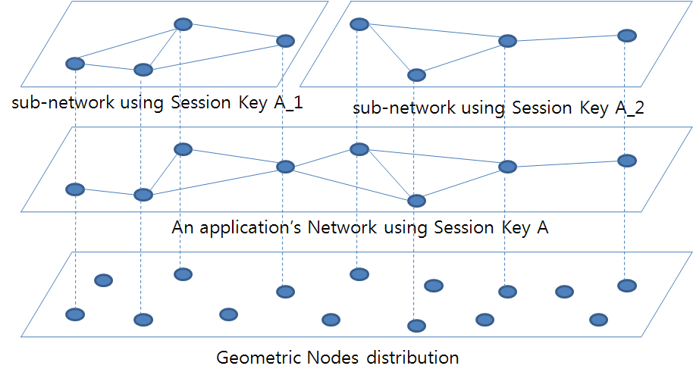
How to manage merging and separation?
  Necessary a key generating algorithm that allows a key to be merged with other key to make a common key that can be used on the merged network.
  Necessary addressing, naming scheme which support network merging.

Slide 10
Thank you for your attention !
Any question ?
HGP Team
Hyunho Park , Gianni M. Ricciardi, Pierre Alauzet
CS642 - Distributed Systems

Slide 11

“Establishing trust in pure ad-hoc networks”, Asad Amir Pirzada, Chris McDonald January 2004 ACSC '04: Proceedings of the 27th Australasian conference on Computer science - Volume 26 , Volume 26 (ACM Portal)
“Spontaneous networks: Trust in a world of equals”, Gilaberte, R.L.; Herrero, L.P.; Networking and Services, 2006. ICNS '06. International conference on 16-18 July 2006 Page(s):42 - 42 (IEEE Xplore)
“Security management for ad-hoc networked resource-limited mobile devices” Sedov, I.; Speicher, S.; Cap, C.; Vehicular Technology Conference, 2004. VTC2004-Fall. 2004 IEEE 60th Volume 5, 26-29 Sept. 2004 Page(s):3262 - 3266 Vol. 5 (IEEE Xplore)
“Implicit merging of overlapping spontaneous networks [mobile ad hoc networks]”, Legendre, F.; de Amorim, M.D.; Fdida, S.; Vehicular Technology Conference, 2004. VTC2004-Fall. 2004 IEEE 60th Volume 4, 26-29 Sept. 2004 Page(s):3050 - 3054 Vol. 4 (IEEE Xplore)
"Spontnet: experiences in configuring and securing small ad hoc networks”, Feeney, L.M.; Ahlgren, B.; Westerlund, A.; Dunkels, A.; Networked Appliances, 2002.

