Slide 1
Virtual Private Ad Hoc Networking
Jeroen Hoebeke, Gerry Holderbeke, Ingrid Moerman, Bard Dhoedt and Piet Demeester
2006
July 15, 2009

Slide 2
Overview
Problem
  How communication is evolving towards future large-scale and high-speed, enabling interconnectivity between a massive amount of devices and users anywhere, at anytime and from any device?
  It Will overwhelm the user with available information, applications and services, a characteristic that is not always desired by the end user and that can result in potential security risk.
  It is expected that an evolution towards network virtualization will take place, imposing a logical structure onto the one large-scale IP network.
Requirement & Characteristic
  Membership configuration and management, Distributed Operation, Security, Self-organization and mobility management, Application support, Local private address space, Ad hoc routing and tunnel management, Scalability
Related Works
  VLAN, VPN, P2P Overlay, Virtual distributed environment(VIOLIN)
Proposed Scheme
  Virtual private ad hoc networks(VPAN)
    Provide secure and self-organizing overlay networks on top of existing IP infrastructure that use ad hoc networking techniques to enable network connectivity.
Challenges
  VPAN definition and management, Security, VPAN formation and self-organization, Addressing and routing, Member mobility management, Application middleware

Slide 3
Problem
How communication is evolving towards future large-scale and high-speed, enabling interconnectivity between a massive amount of devices and users anywhere, at anytime and from any device?
  It will overwhelm the user with available information, applications and services, a characteristic that is not always desired by the end user and that can result in potential security risk.
  It is expected that an evolution towards network virtualization will take place, imposing a logical structure onto the one large-scale IP network.
The virtual networks will form a shielded and trusted environment for their participants, with its own internal routing, naming, and addressing solutions, using the underlying base network as the enabler of connectivity and carrier of data.
They combine the network virtualization and ad hoc networking techniques (self-creating, self-organizing and self-administering).

Slide 4
Requirement & Characteristic
Membership configuration and management
  Mechanisms to initialize new VPANs and to define, configure and manage its membership information are required.
Distributed Operation
  Distributed members discovery and VPAN formation and maintenance are required.
Security
Self-organization and mobility management
  Be able to discover each other and form a secure overlay without user intervention.
Application support
  User should be able to specify which applications, services, data are reachable through or have access to a specific VPAN.
Local private address space
  Each VPAN will have its own local private address space, separated from the global IP address space.
  why?
  => Applications running within a VPAN use this private address independent of changes in the global address of the node due to node mobility.

Slide 5
Requirement & Characteristic(cont.)
Ad hoc routing and tunnel management
  As the composition and the topology of the VPAN can be dynamic, ad hoc routing techniques will be used for efficient internal routing.
  In many cases links between members are logical links, spanning multiple physical hops by tunnel mechanisms.
  => VPAN forwarding should encompass the notion of tunnels.
Scalability
  The number of members forming the VPAN can become quite large.

Slide 6
Related Works
 | VLAN | VPN | P2P Overlay | Virtual distributed environment(VIOLOIN)
Protocol stack layer | Layer 2 | Layer 3 | Application Layer | Application Layer
Membership configuration and management | Based on switch port or Layer 3 information. Manual, semi-automated or fully automatic configuration | Statically configured in tunnel endpoints. Central tunnel management in LeetNet | Running P2P software | By the owner of the VIOLIN, having administrator privileges.
Distributed Operation | Limited to on Ethernet system. | Tunnel endpoints are distributed | Distributed system, sometimes supported by centralized facilities. | Distributed overlay of virtual machines.
Security | Access based on VLAN membership. Traffic containment within VLAN. No other security mechanisms. | Authentication of tunnel endpoints, confidentiality and authenticity of data transferred between these endpoint. | In some case authentication, trust, anonymity, overlay access control can be offered. | Depends on the network protocol used within the VIOLIN, as their packets are transferred over UDP tunnels.
Self-organization and mobility management | Automatically formed and maintained. Support mobility within the same Ethernet system. | No mobility management. Some aspects of self-organization in dynamic VPNs. | Self-organization through direct or indirect discovery of other peers for overlay formation. | On-demand creation of virtual machines and the interconnecting virtual IP network. Dynamic topology adaptation possible.

Slide 7
Related Works(cont.)
 | VLAN | VPN | P2P Overlay | Virtual distributed environment(VIOLOIN)
Application support | X | X | O | O
Local private address space(session continuity) | All members share a common address space. | Depend on schemes deployed in networks behind the endpoints | Public IP addresses are used | Private IP addresses are used in order to confine all communication within the VIOLIN
Dynamic internal routing and tunnel management | Layer2 switching, no routing involved. | O | Public IP address are used to obtain end-to-end P2P connectivity. No tunneling needed. | Has Virtual routers for internal routing. Topology adaptation.

Slide 8
Proposed Scheme
Virtual private ad hoc networks(VPAN)
  Secure and self-organizing overlay networks on top of existing IP infrastructure that use ad hoc networking techniques to enable network connectivity.
  Creates a transparent, shielded and trusted environment for the applications and services running on the participants' devices.

Slide 9
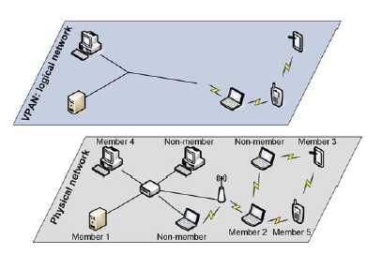
High-level Network architecture
Localized VPAN
  All members are interconnected either wired or wireless without using any non-member nodes.

Slide 10
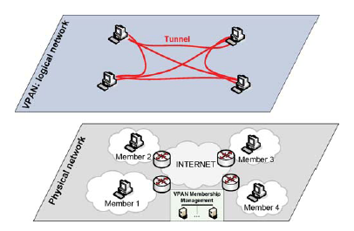
High-level Network architecture(cont.)
Distributed infrastructured VPAN
  The members are interconnected over the Internet, using nodes in the infrastructure a relay.
  Tunneling needed.
  Infrastructure support can assist the VPAN membership management, member discovery, formation, routing and mobility management.

Slide 11
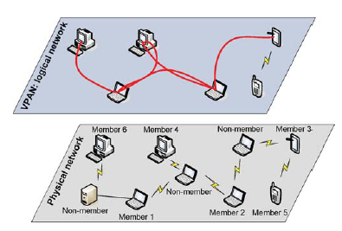
High-level Network architecture(cont.)
Distributed Ad Hoc VPAN
  Non-member ad hoc nodes are used as relays.
  VPAN membership management, member discovery, formation, routing and mobility management has to be done in a completely distributed manner.

Slide 12
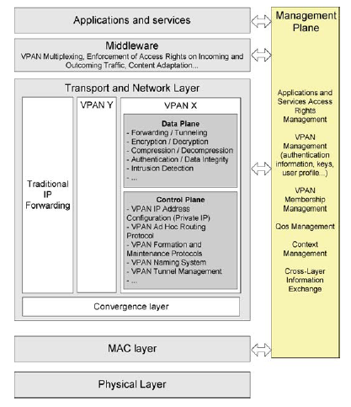
High-level node architecture
Middleware
  Firewall
  Content adaptation according to the capabilities of service.
Convergence Layer
  De-multiplexing incoming packets to the corresponding VPAN and forwarding outgoing packets to the corresponding interface.
Management Plane
  Management of the access right of the application and services.
  Management of the VPAN and its member
  Management and exchange of context and cross-layer information
Data Plane
  Managing data
Control Plane
  Managing VPAN configuration

Slide 13
Challenges
VPAN definition and management
  At first, its policies and its members, or its membership rules, to be defined.
    Who is the creator of the VPAN?
    How and where is the VPAN definition and membership information stored and/or distributed?
    When can the VPAN be formed and become operational?
    How are new members added to the VPAN(membership policies)?
    Member authentication?
  Possible Solutions
    Service provider, individual person.
    One of the members invite or request join to creator.
    Define membership rules and automating the process of member addition.
Security
  Member identification and authentication
  Authentication of communication between VAPN members.
  Confidentiality of communication between VPAN members.

Slide 14
Challenges(cont.)
VPAN formation and self-organization
  Member discovery mechanisms form the basis of the formation of the VPAN overlay, as it is needed for secure link and tunnel establishment between member nodes.
Addressing and routing
  Each VPAN will have its own local address space and each member is assigned one address, independent of its number of interfaces.
  All applications and services that communicate within the VPAN will use the local address and it is invisible to the outside world by tunneling or link encryption.
  When running multiple VPANs within the same device, their need to be distinguishable => Different VPAN using different address prefix.
  Overlay ad hoc routing depend on multiple factors: application requirements, traffic, on-demand or always-on VPAN formation, context…
Member mobility management
  Localized VPAN
    Member discovery and link break detection mechanisms can improve VPAN maintenance.
  Other
    Member mobility => change of public IP address => breakdown of tunnels established between members of the VPAN overlay => require dynamic tunnel reestablishment mechanisms and interaction with the membership management or member discovery framework.

Slide 15
Challenges(cont.)
Application middleware
  The main functionality of this component is to act as a firewall for the resources and services at the higher layer.
  Provides VPAN members to be able to specify to what extent their applications and services have access to the VPAN
  Provides VPAN members to be able to specify to what extent other VPAN members have rights to access these applications and services.
Etc
  Naming, QoS, context information to improve networking and management, intrusion detection, dealing with multiple or event hierarchical VPANs, traffic optimization.

