Slide 1



HGP Team
Alauzet Pierre, Park Hyunho , Ricciardi Gianni M.
CS642 - Distributed Systems

Slide 2

Background & problem definition
Design specifications
Implementation
Comparisons & conclusions

Slide 3
1. Proposal review
2. Design specifications
3. Implementation
In the context of spontaneous networks, we focused on session key management during the merger of two networks and when a user leaves the network
Refering to some paper about GKA, we compared this solution to our own and started developing our Skemasnet idea
Using GKA and Skemasnet algorithms, we runned some tests thru ns2 simulator and got some results

Slide 4
1. Proposal review
2. Design specifications
3. Implementation
In the private networks they are using common session keys for secure communication,
  When merging network(s) it needs to manage session keys.
    Creating a new session key or choosing one of them for the merged network.
    Share the new session key to all members.
Related works
  GKA(Group Key Agreement)-key paper
    A mechanism to create a common session key for a group of users.
    Each member provide a public contribution for creating a common session key.
    It can share a common session key without the use of a secure channel.
  Problem
    Require creation of a new session key at every times when the network members are changed (join, leave, merge, separating)
    Requires 2n messages exchanges for creation and distribution of a new session key.
    Each message for exchange a session key is in size of encrypting SizeOfSessionKey*2*n
      Ex) if the key size is 256bit, and size of node is 100=> 256*100*2 = 51200 bit = 6.4kbytes.

Slide 5
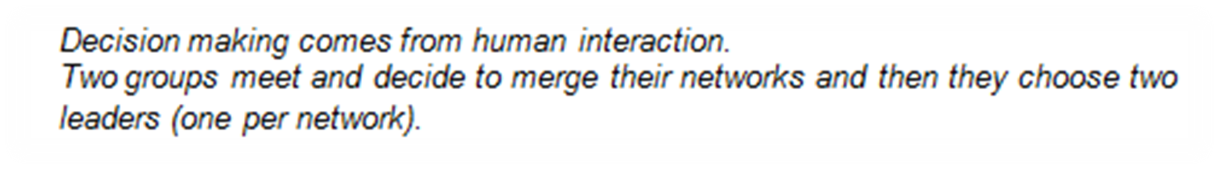
1. Proposal review
2. Design specifications
3. Implementation
Preface

Slide 6
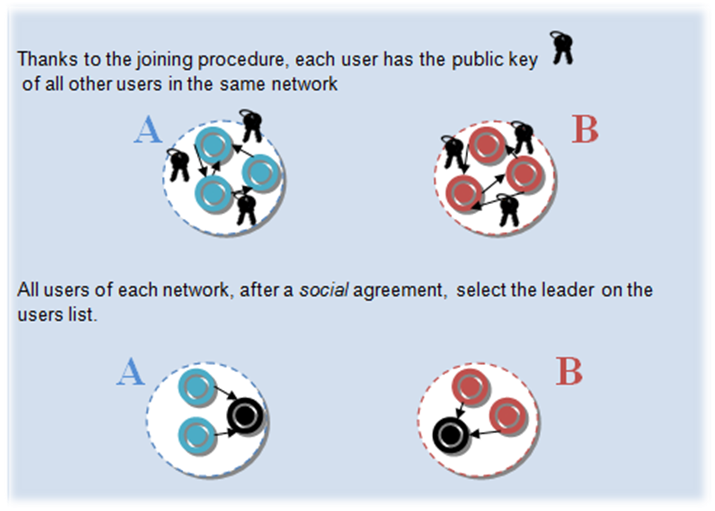
1. Proposal review
2. Design specifications
3. Implementation
Initial phase

Slide 7
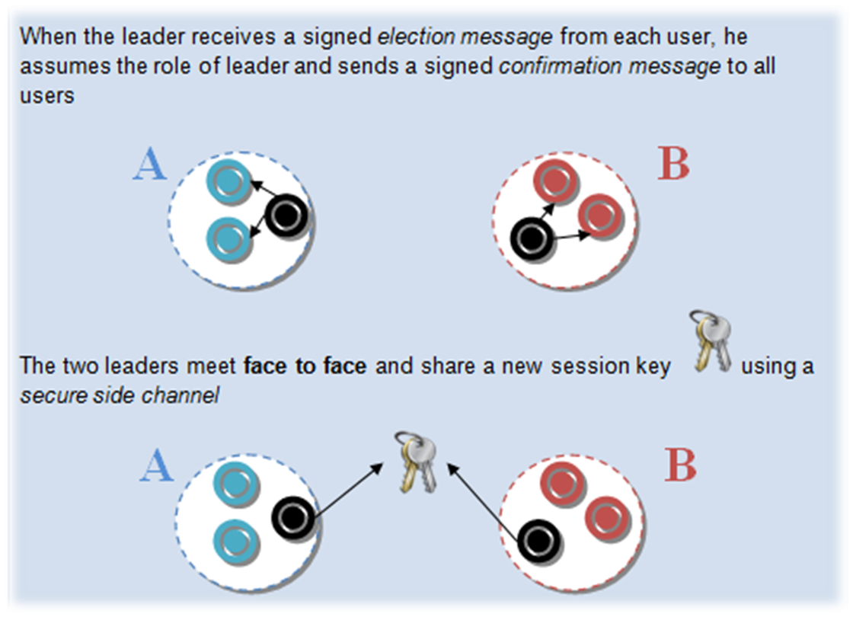
1. Proposal review
2. Design specifications
3. Implementation
Initial phase (cont.)

Slide 8
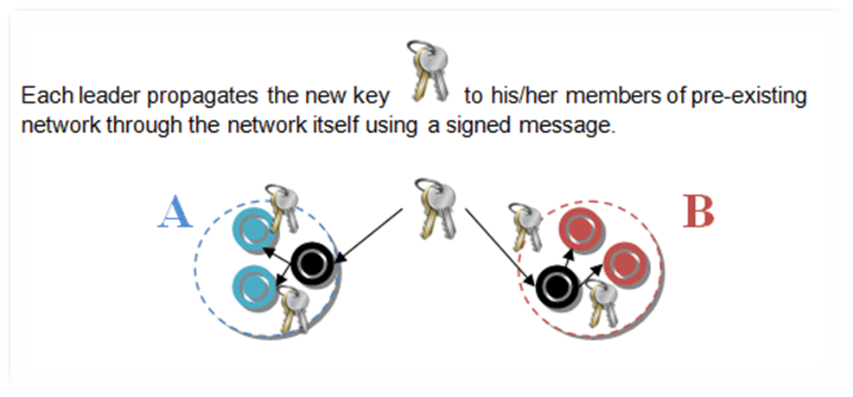
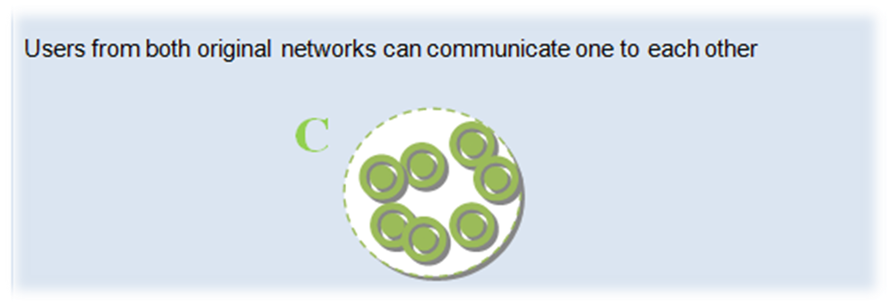
1. Proposal review
2. Design specifications
3. Implementation
Propagation phase
Communication phase

Slide 9
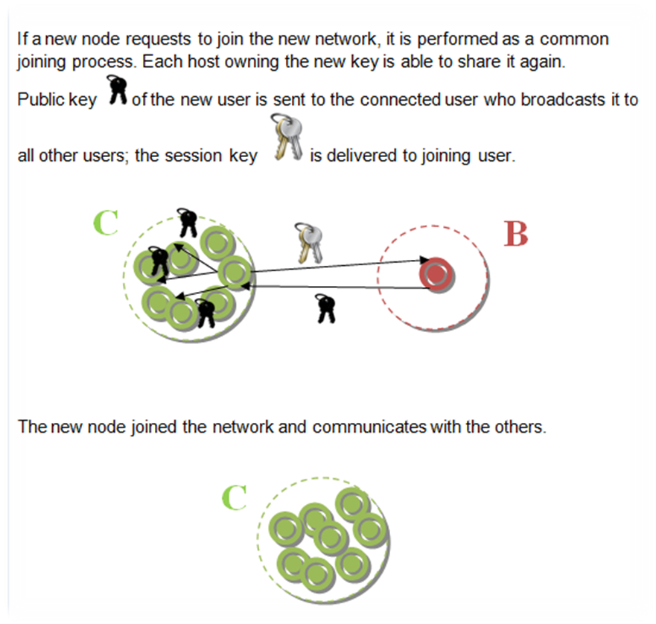
1. Proposal review
2. Design specifications
3. Implementation
Joining phase

Slide 10
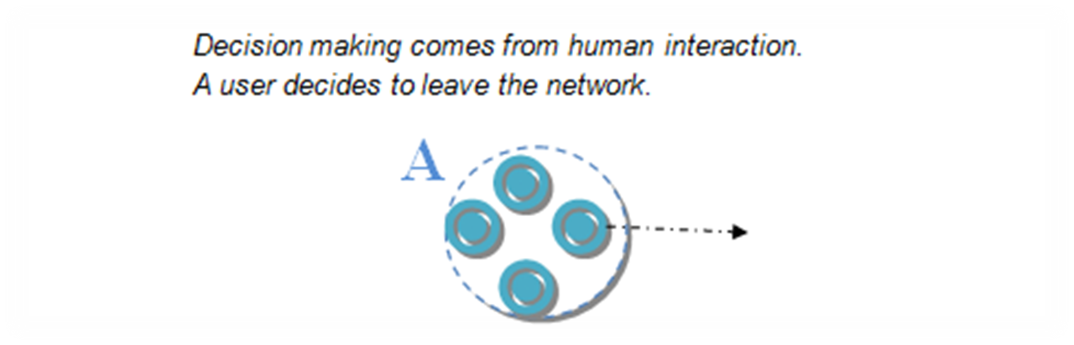
1. Proposal review
2. Design specifications
3. Implementation
Preface
Initial phase
  Idem that for the first design case: merging 2 networks

Slide 11
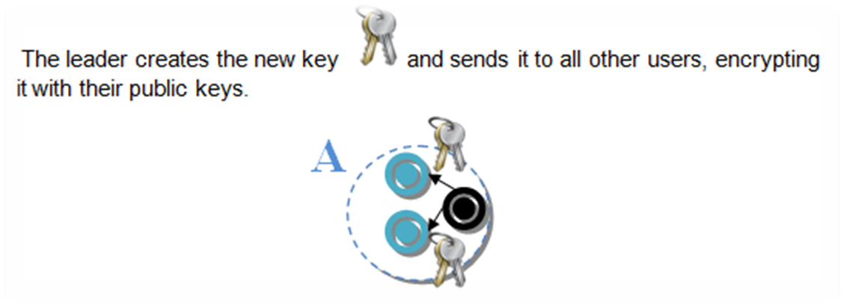
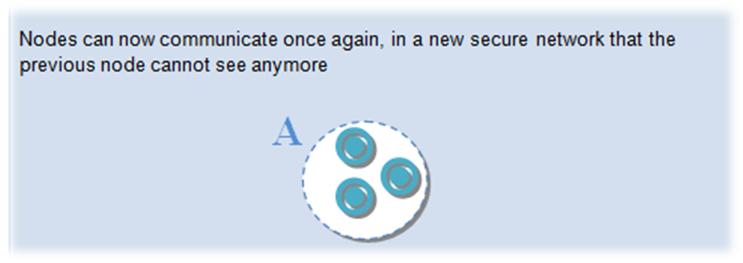
1. Proposal review
2. Design specifications
3. Implementation
Propagation phase
Communication phase

Slide 12
1. Proposal review
2. Design specifications
3. Implementation
Number of exchanged messages
 | GKA | Skemasnet
Merging Networks | 2*Max(N1, N2)+(N-1) | 3(N-1)
Leaving User | (2N-1)+(N-1) | 2(N-1) + (N-1)
Joining User | (2N-1)+(N-1) | N-1

Slide 13
1. Proposal review
2. Design specifications
3. Implementation
Size of exchanged messages to deliver a new session key
GKA | SizeOfSessionKey * 2 * N
Skemasnet | SizeOfSessionKey + max(N1, N2)*SizeOfPubKey

Slide 14
1. Proposal review
2. Design specifications
3. Implementation
We use ns-2 (Network Simulator version 2) in order to
  Implement our Skemasnet and the GKA algorithm
  Simulate 3 scenarios: merging between 2 networks, the joining and the leaving of several nodes
  Compare our implementation with GKA in term of number & size of exchanging messages
We did not implement encryption algorithm: our concern is number and size of messages even if current implementation does not reflect this

Slide 15
1. Proposal review
2. Design specifications
3. Implementation
Merging
  2 networks with the same number of nodes: 10 to 50 nodes / network
Joining
  Considering the join of each user: 10 to 50 nodes / network
Leaving
  Considering one leaving user in a network of 10 to 50 nodes

Slide 16
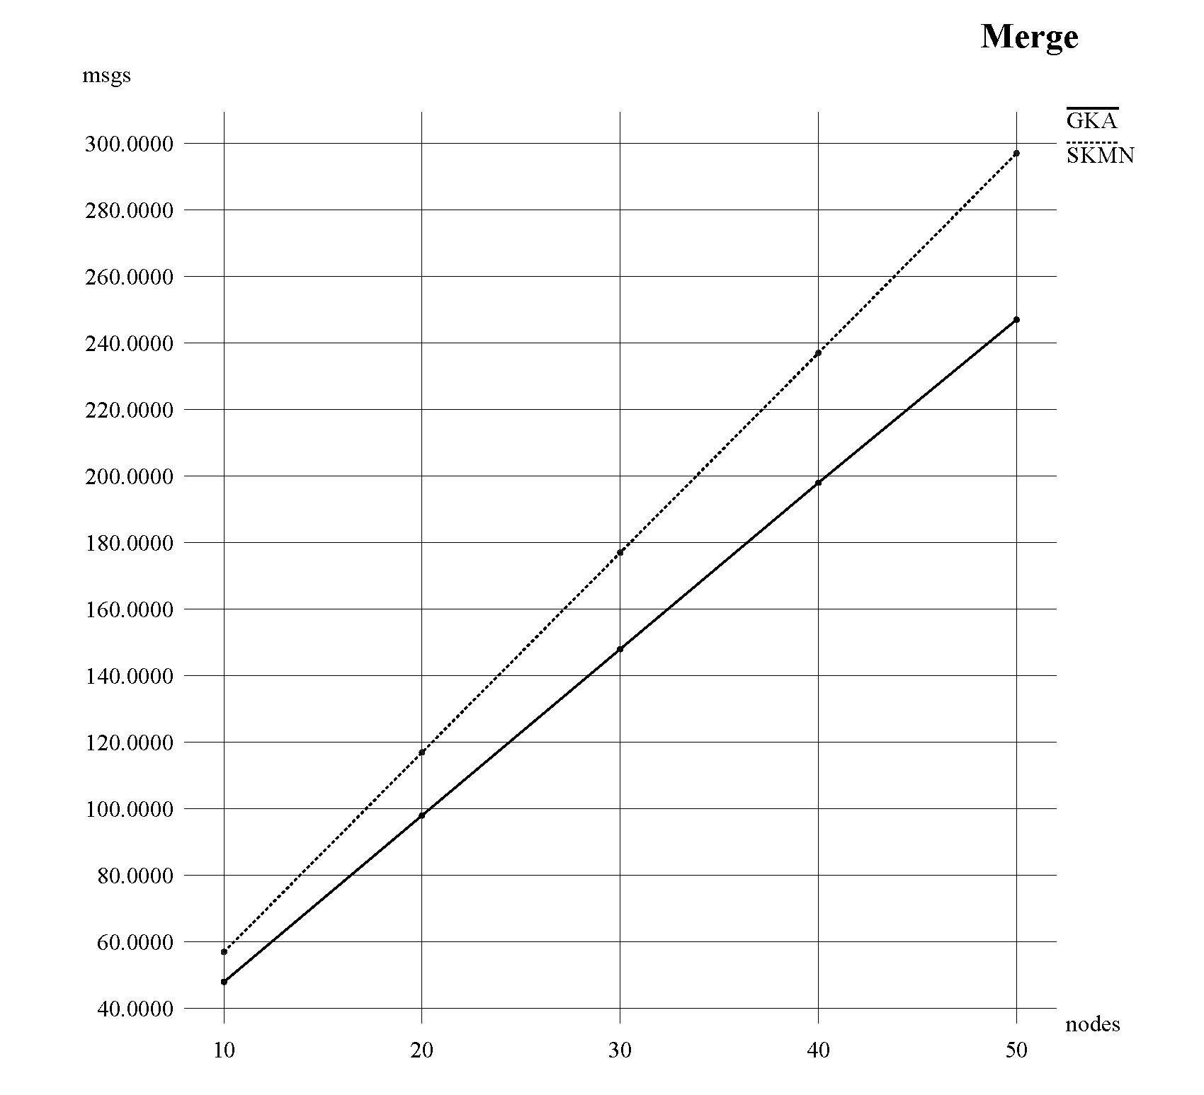
1. Proposal review
2. Design specifications
3. Implementation

Slide 17
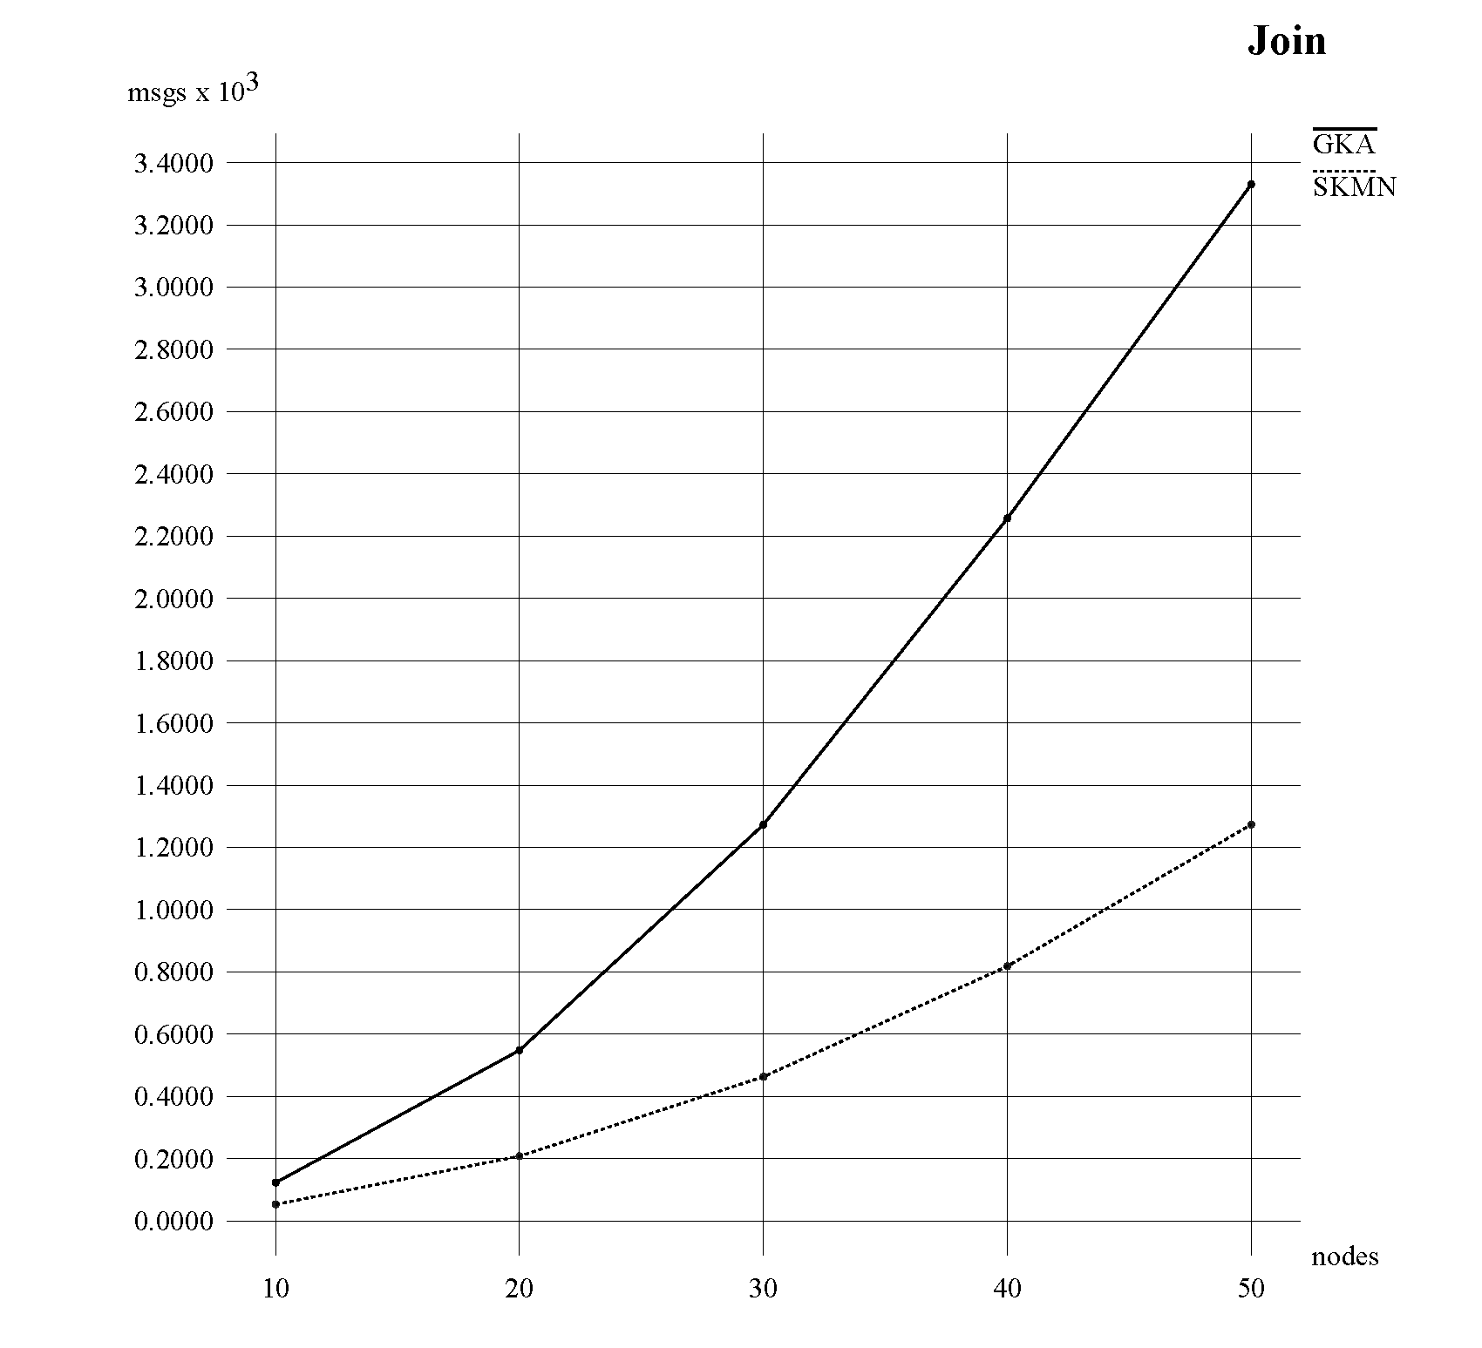
1. Proposal review
2. Design specifications
3. Implementation

Slide 18
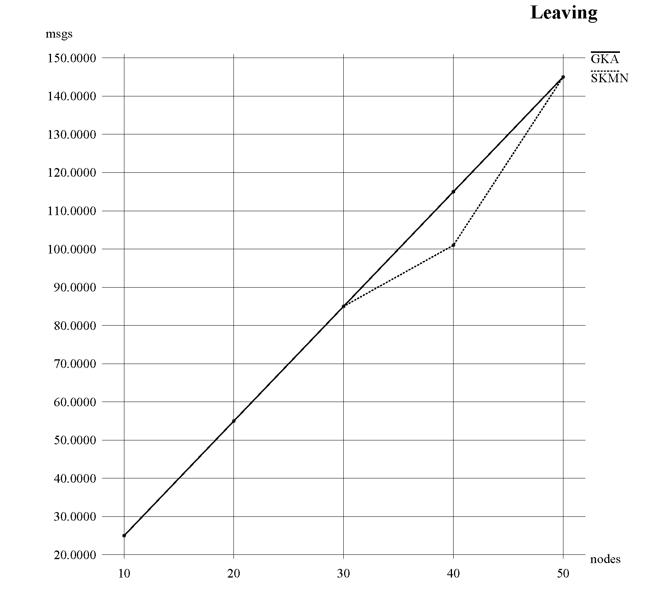
1. Proposal review
2. Design specifications
3. Implementation

Slide 19
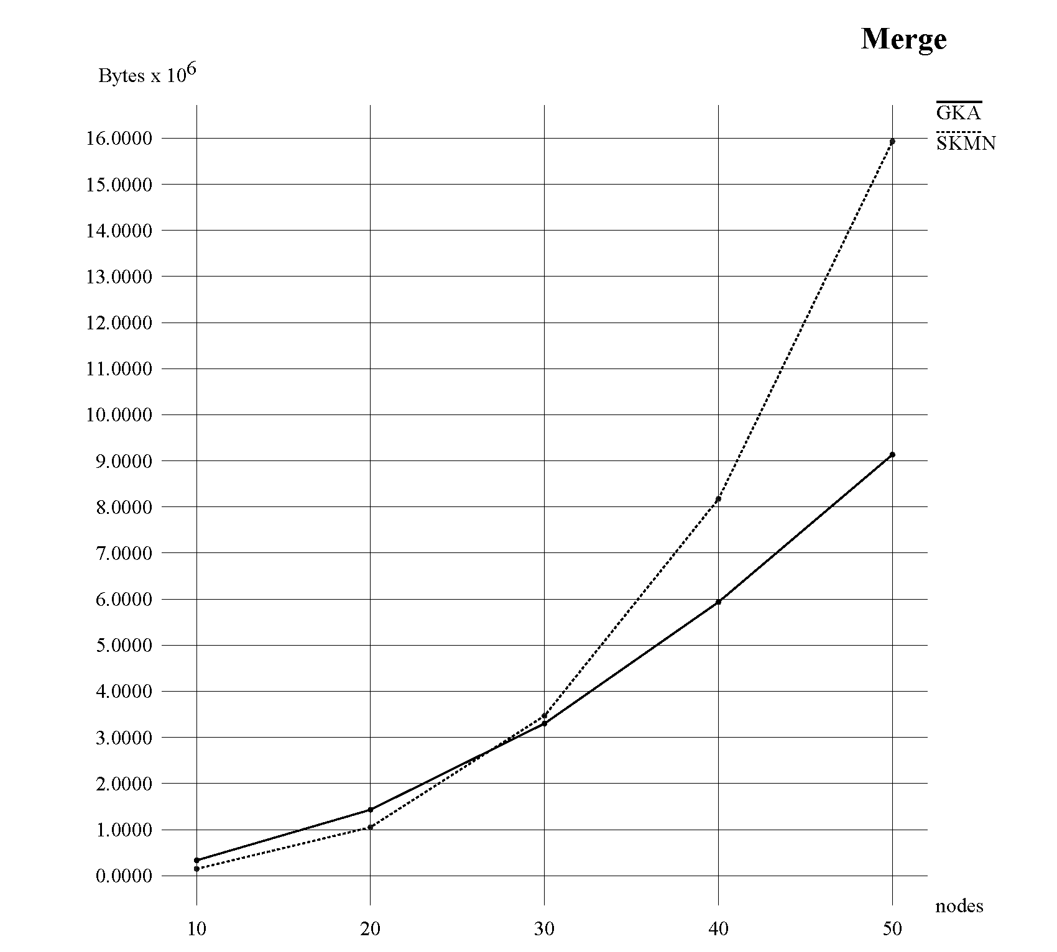
1. Proposal review
2. Design specifications
3. Implementation

Slide 20
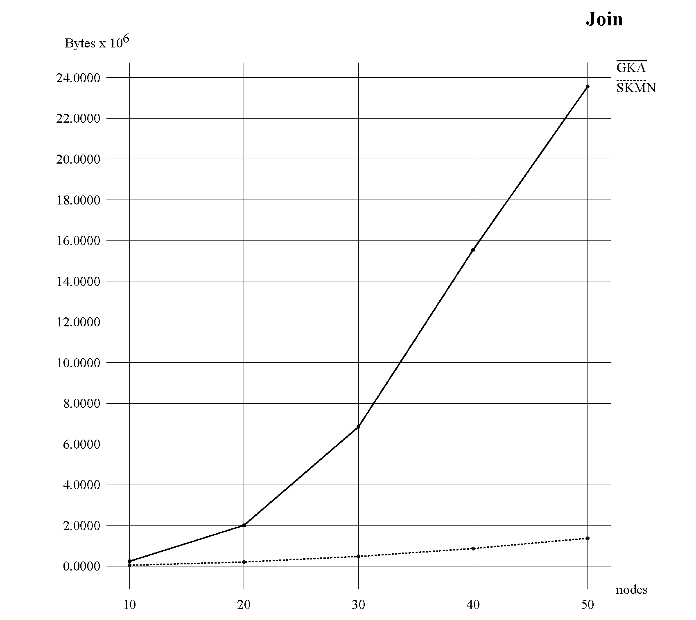
1. Proposal review
2. Design specifications
3. Implementation

Slide 21
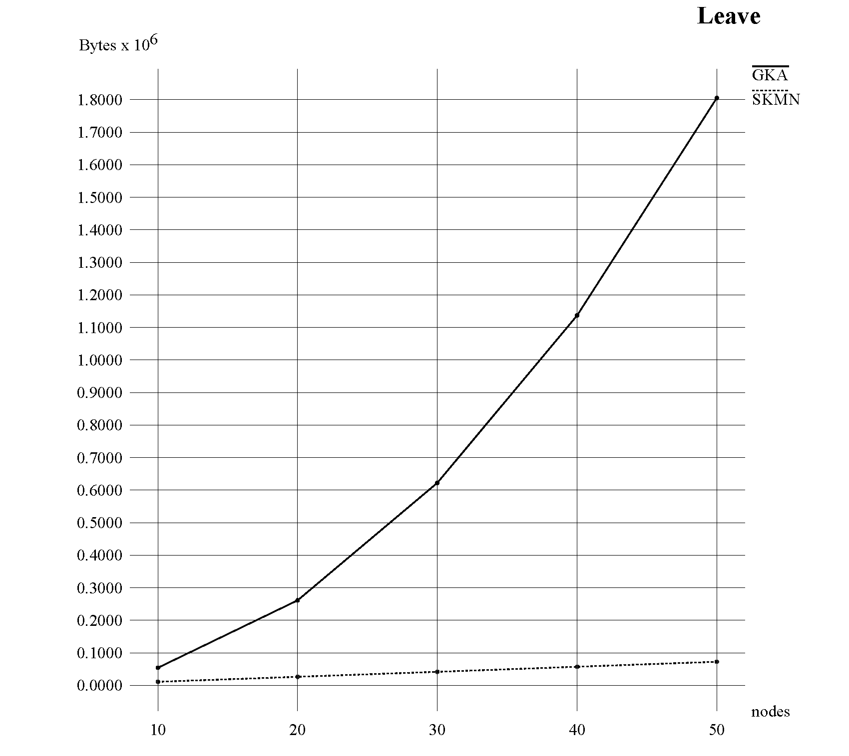
1. Proposal review
2. Design specifications
3. Implementation

Slide 22
Goods results in Skemasnet scheme
  Using smaller messages
  Using less messages
Skemasnet algorithm can be applied to specific cases
  Considering social face to face agreement and trust (security)
  Small number of nodes (<150)
Skesmasnet may become a good alternative to GKA in specific situations, but cannot replace general schemes like this one

Slide 23
Thank you for your attention !
Any question ?
HGP Team
Hyunho Park , Gianni M. Ricciardi, Pierre Alauzet
CS642 - Distributed Systems

Slide 24

“Establishing trust in pure ad-hoc networks”, Asad Amir Pirzada, Chris McDonald January 2004 ACSC '04: Proceedings of the 27th Australasian conference on Computer science - Volume 26 , Volume 26 (ACM Portal)
“Spontaneous networks: Trust in a world of equals”, Gilaberte, R.L.; Herrero, L.P.; Networking and Services, 2006. ICNS '06. International conference on 16-18 July 2006 Page(s):42 - 42 (IEEE Xplore)
“Security management for ad-hoc networked resource-limited mobile devices” Sedov, I.; Speicher, S.; Cap, C.; Vehicular Technology Conference, 2004. VTC2004-Fall. 2004 IEEE 60th Volume 5, 26-29 Sept. 2004 Page(s):3262 - 3266 Vol. 5 (IEEE Xplore)
“Implicit merging of overlapping spontaneous networks [mobile ad hoc networks]”, Legendre, F.; de Amorim, M.D.; Fdida, S.; Vehicular Technology Conference, 2004. VTC2004-Fall. 2004 IEEE 60th Volume 4, 26-29 Sept. 2004 Page(s):3050 - 3054 Vol. 4 (IEEE Xplore)
"Spontnet: experiences in configuring and securing small ad hoc networks”, Feeney, L.M.; Ahlgren, B.; Westerlund, A.; Dunkels, A.; Networked Appliances, 2002.
Johann Van Der Merwe, Dawoud Dawoud, and Stephen Mcdonald
A Survey on Peer-to-Peer Key Management for Mobile Ad Hoc Networks
Dirk Balfanz, D. K. Smetters, Paul Stewart and H. Chi Wong
Talking To Strangers: Authentication in Ad-Hoc Wireless Networks
Michael Steiner, Gene Tsudik, Michael Waidner
Diffie-Hellman Key Distribution Extended to Group Communication
Daniel Augot, Raghav Bhaskar, Valerie Issarny and Daniele Sacchetti
An Efficient Group Key Agreement Protocol for Ad hoc Network
http://www.isi.edu/nsnam/ns/
Official website of ns-2 simulator, accessed on November 29th 2009

