Slide 1



HGP Team
Hyunho Park , Gianni M. Ricciardi, Pierre Alauzet
CS642 - Distributed Systems

Slide 2

Proposal review
Design specifications
Next Plan

Slide 3
In the context of spontaneous networks, we focused on session key management during the merger of two networks and when a user leaves the network
We surveyed some paper about GKA to compare it to our idea
We started to simulate our idea using the ns2 simulator

Slide 4
1. Proposal review
2. Design specifications
3. Next plan
We are interest in the case of:
  Two private spontaneous networks decide to merge together
We wish to find an efficient way for merging multiple private networks in terms of number of messages and size of the message.

Slide 5
1. Proposal review
2. Design specifications
3. Next plan
In the private networks they are using common session keys for secure communication,
  When merging network(s) it needs to manage session keys.
    Creating a new session key or choosing one of them for the merged network.
    Share the new session key to all members.
Related works
  GKA(Group Key Agreement)-key paper
    A mechanism to create a common session key for a group of users.
    Each member provide a public contribution for creating a common session key.
    It can share a common session key without the use of a secure channel.
  Problem
    Require creation of a new session key at every times when the network members are changed(join, leave, merge, separating)
    Requires 2n messages exchanges for creation and distribution of a new session key.
    Each message for exchange a session key is in size of encrypting SizeOfSessionKey*2*n
      Ex) if the key size is 256bit, and size of node is 100=> 256*100*2 = 51200 bit = 6.4kbytes.

Slide 6
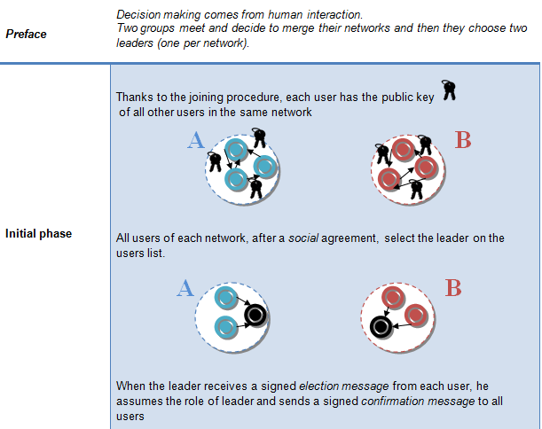

Slide 7
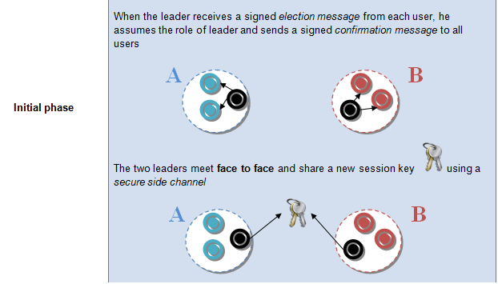

Slide 8
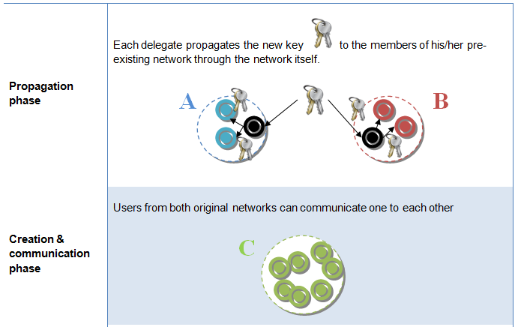

Slide 9
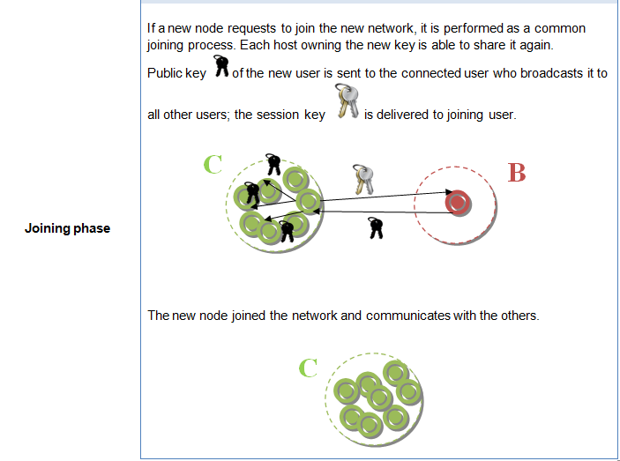

Slide 10
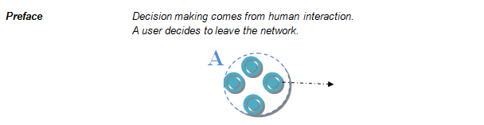

Slide 11
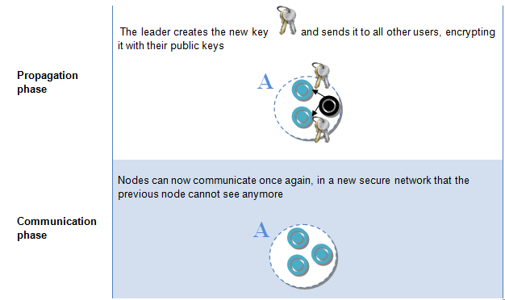

Slide 12
Number of exchanged messages
 | GKA | Skemasnet
Merging Networks | 2*(2N-1) | 2(N-1) + (N-2)
Leaving User | 2*(2N-1) | 2(N-1) + (N-1)

Slide 13
Size of exchanged messages to deliver a new session key
GKA | SizeOfSessionKey * 2 * N
Skemasnet | SizeOfSessionKey + max(N1, N2)*SizeOfPubKey

Slide 14
1. Proposal review
2. Design specifications
3. Next plan
Related works(cont.)
Protocol | # of messages for creating and sharing a common session key. | Size of a message
GKA | O(N) | 2*N*sizeOfSessionKey
Dynamic Group Diffie-Hellman Key Exchange | O(N^{^2}) | sizeOfSessionKey
Scalable Protocols for authenticated Group Key exchange | O(N) | …
Simple and Fault-Tolerant Key Agreement for Dynamic Collaborative Groups | O(LogN*(N)) | …
Our Idea | O(N) for leave, merging O(1) for join | Join, Merge: sizeOfSessionKey Leave: N*sizeOfSessionKey

Slide 16
Thank you for your attention !
Any question ?
HGP Team
Hyunho Park , Gianni M. Ricciardi, Pierre Alauzet
CS642 - Distributed Systems

Slide 17

[1] Johann Van Der Merwe, Dawoud Dawoud, and Stephen Mcdonald
A Survey on Peer-to-Peer Key Management for Mobile Ad Hoc Networks
[2] Dirk Balfanz, D. K. Smetters, Paul Stewart and H. Chi Wong
Talking To Strangers: Authentication in Ad-Hoc Wireless Networks
[3] Michael Steiner, Gene Tsudik, Michael Waidner
Diffie-Hellman Key Distribution Extended to Group Communication
[4] Daniel Augot, Raghav Bhaskar, Valerie Issarny and Daniele Sacchetti
An Efficient Group Key Agreement Protocol for Ad hoc Networks

