Slide 1



HGP Team
Alauzet Pierre, Park Hyunho , Ricciardi Gianni M.
CS642 - Distributed Systems

Slide 2

Proposal review
Design specifications
Implementation

Slide 3
1. Proposal review
2. Design specifications
3. Implementation
In the context of spontaneous networks, we focused on session key management during the merger of two networks and when a user leaves the network
We surveyed some paper about GKA to compare it to our idea
We started to simulate our idea using the ns2 simulator

Slide 4
1. Proposal review
2. Design specifications
3. Implementation
In the private networks they are using common session keys for secure communication,
  When merging network(s) it needs to manage session keys.
    Creating a new session key or choosing one of them for the merged network.
    Share the new session key to all members.
Related works
  GKA(Group Key Agreement)-key paper
    A mechanism to create a common session key for a group of users.
    Each member provide a public contribution for creating a common session key.
    It can share a common session key without the use of a secure channel.
  Problem
    Require creation of a new session key at every times when the network members are changed(join, leave, merge, separating)
    Requires 2n messages exchanges for creation and distribution of a new session key.
    Each message for exchange a session key is in size of encrypting SizeOfSessionKey*2*n
      Ex) if the key size is 256bit, and size of node is 100=> 256*100*2 = 51200 bit = 6.4kbytes.

Slide 5
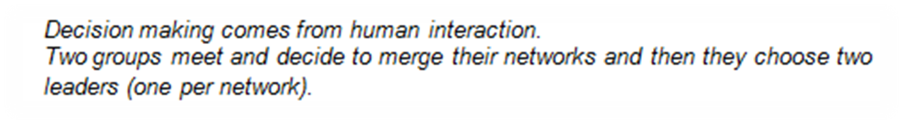
1. Proposal review
2. Design specifications
3. Implementation
Preface

Slide 6
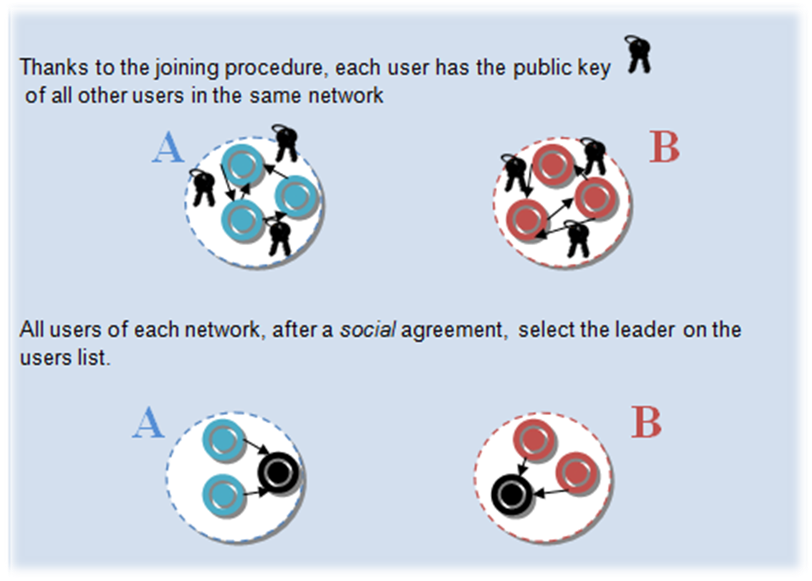
1. Proposal review
2. Design specifications
3. Implementation
Initial phase

Slide 7
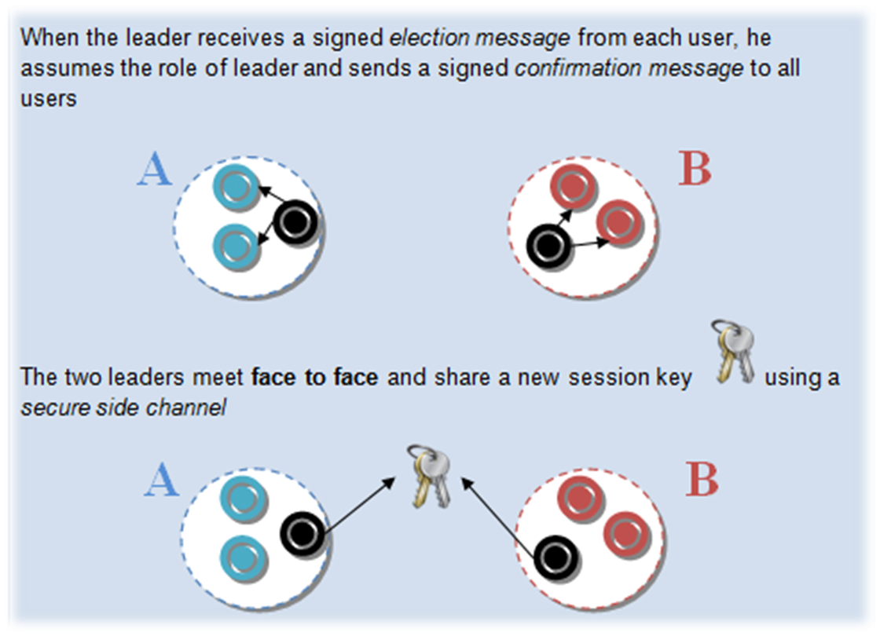
1. Proposal review
2. Design specifications
3. Implementation
Initial phase (cont.)

Slide 8
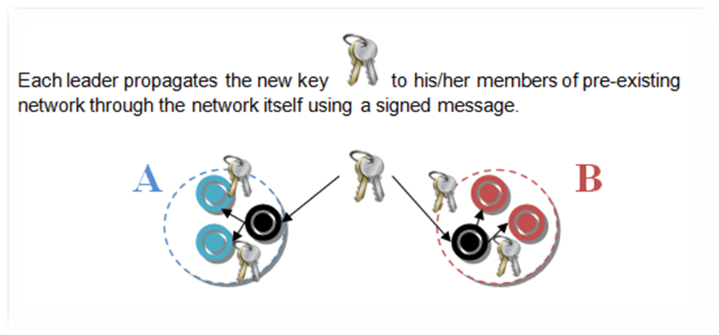
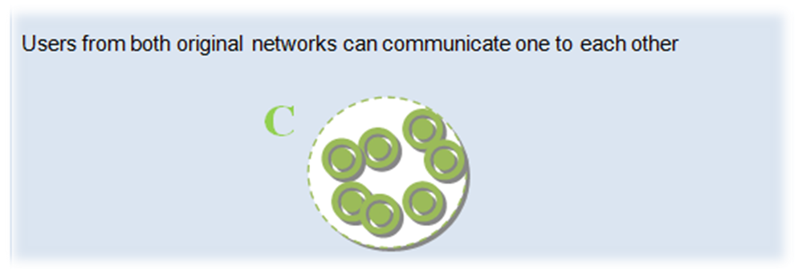
1. Proposal review
2. Design specifications
3. Implementation
Propagation phase
Communication phase

Slide 9
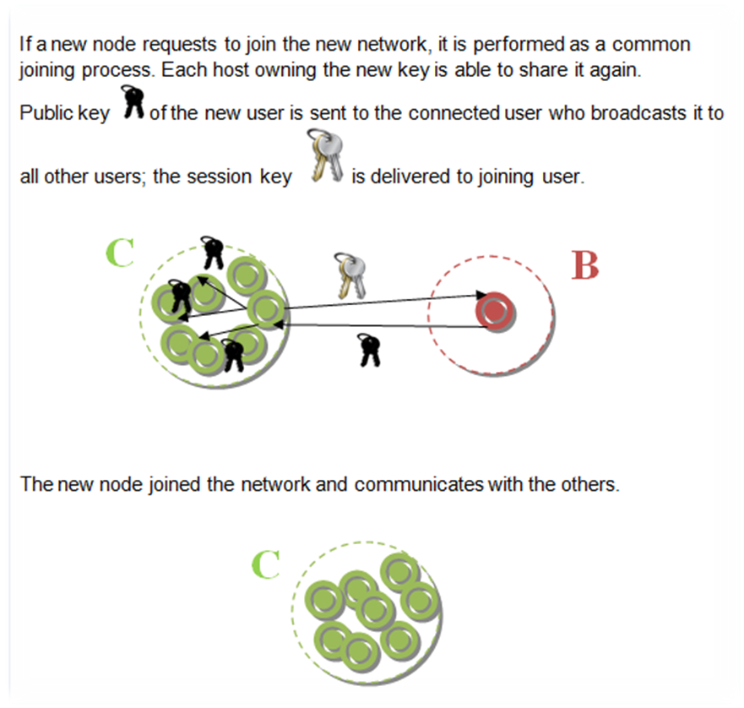
1. Proposal review
2. Design specifications
3. Implementation
Joining phase

Slide 10
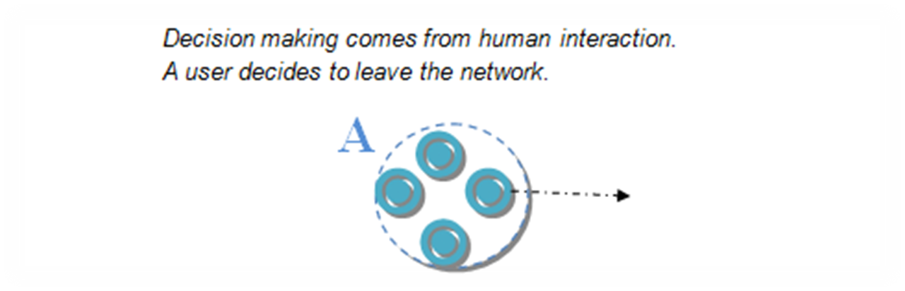
1. Proposal review
2. Design specifications
3. Implementation
Preface
Initial phase
  Idem that for the first design case: merging 2 networks

Slide 11
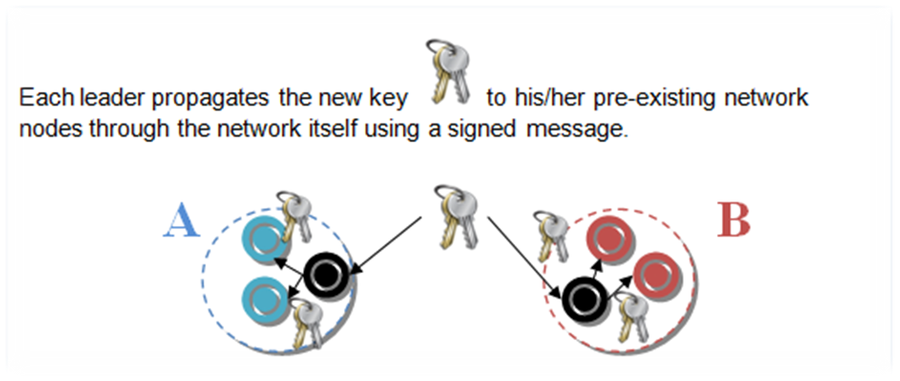
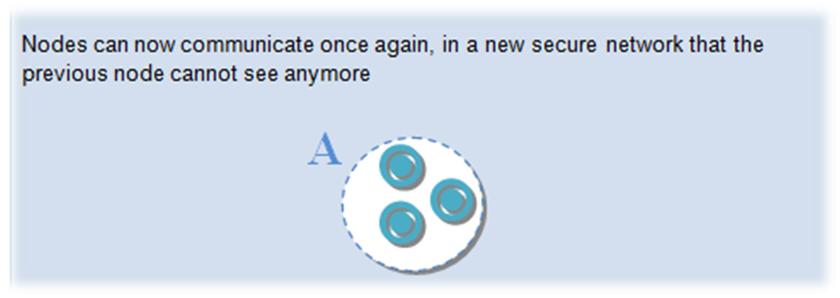
1. Proposal review
2. Design specifications
3. Implementation
Propagation phase
Communication phase

Slide 12
1. Proposal review
2. Design specifications
3. Implementation
Number of exchanged messages
 | GKA | Skemasnet
Merging Networks | 2*(2N-1) | 2(N-1) + (N-2)
Leaving User | 2*(2N-1) | 2(N-1) + (N-1)

Slide 13
1. Proposal review
2. Design specifications
3. Implementation
Size of exchanged messages to deliver a new session key
GKA | SizeOfSessionKey * 2 * N
Skemasnet | SizeOfSessionKey + max(N1, N2)*SizeOfPubKey

Slide 14
1. Proposal review
2. Design specifications
3. Implementation
We use ns-2 (Network Simulation version 2) in order to
  Implement our Skemasnet algorithm
  Emulate a bunch of spontaneous networks
  Simulate a merging between 2 networks, the joining and the leaving of several nodes
  Compare our implementation with GKA in term of number & size of exchanging messages
We implemented joining, leaving and merging phase for the GKA protocol (without election phase)
We are not implementing encryption algorithm: our concern is number and size of messages even if current implementation does not reflect this

Slide 15
1. Proposal review
2. Design specifications
3. Implementation
Implement the election phase in GKA
Implement all the Skemasnet algorithm phases
Emulate a bunch of spontaneous networks
Simulate a merging between 2 networks, the joining and the leaving of several nodes
Compare our implementation with GKA in term of number & size of exchanging messages

Slide 16
Thank you for your attention !
Any question ?
HGP Team
Hyunho Park , Gianni M. Ricciardi, Pierre Alauzet
CS642 - Distributed Systems

Slide 17

[1] Johann Van Der Merwe, Dawoud Dawoud, and Stephen Mcdonald
A Survey on Peer-to-Peer Key Management for Mobile Ad Hoc Networks
[2] Dirk Balfanz, D. K. Smetters, Paul Stewart and H. Chi Wong
Talking To Strangers: Authentication in Ad-Hoc Wireless Networks
[3] Michael Steiner, Gene Tsudik, Michael Waidner
Diffie-Hellman Key Distribution Extended to Group Communication
[4] Daniel Augot, Raghav Bhaskar, Valerie Issarny and Daniele Sacchetti
An Efficient Group Key Agreement Protocol for Ad hoc Networks
[5] http://www.isi.edu/nsnam/ns/
Official website of ns-2 simulator, accessed on November 29th 2009

