Slide 1



HGP Team
Hyunho Park , Gianni M. Ricciardi, Pierre Alauzet
CS642 - Distributed Systems

Slide 2

Review our proposal
Design specification
Next Plan

Slide 3
We are interest in the cases of:
  Two spontaneous private networks decide to merge together
  A subset of users in a spontaneous private network decide to create their own private network, independent of original one
We wish to find a transparent and secure way to let users perform such kind of operation.

Slide 4
In the private networks they are using session keys for secure communication,
  When merging/separating network(s) it needs to manage session keys.
    Creating a new session key or choosing one of them.
    Propagate the new session key to all members.
What kinds of related works are existing that solve this problem.
GKA
  What is GKA?
    A mechanism to create a common session key for a group of users, each one providing a public contribution, without the use of a secure channel
  Problem
    GKA is not flexible enough (in the case of new users or temporary isolated users of previous network) and not suitable for small devices (it requires some computing resources)

Slide 5
Leveraging pre-existing secure networks to share new keys, in order to propagate them in an automatic, transparent and secure way for users

Slide 6
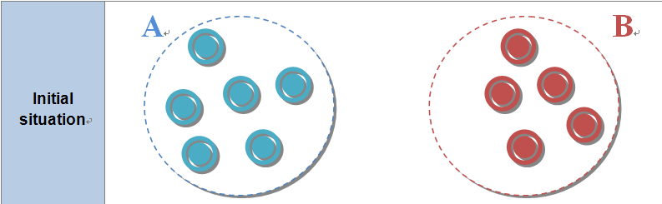
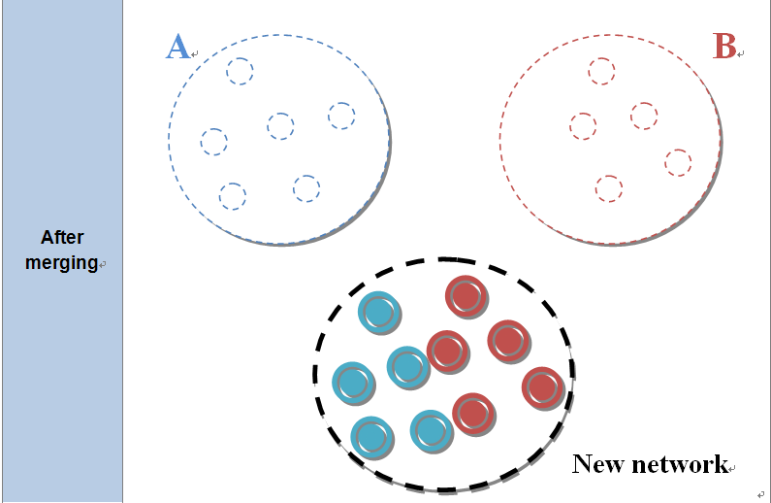
We consider two scenarios
  Merging

Slide 7
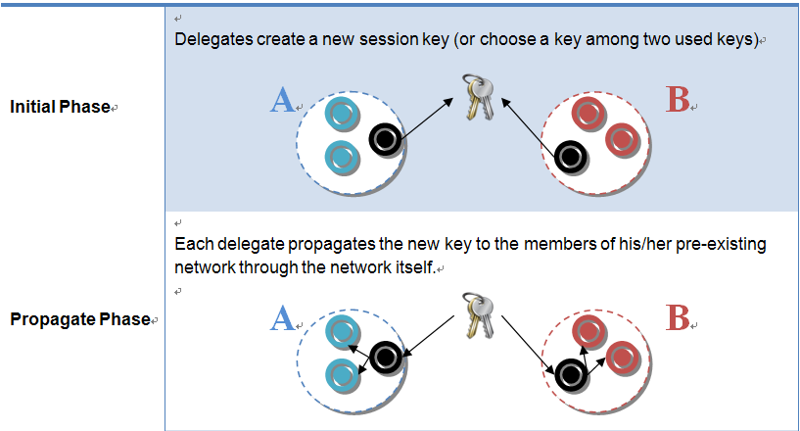
  Merging(cont.)

Slide 8
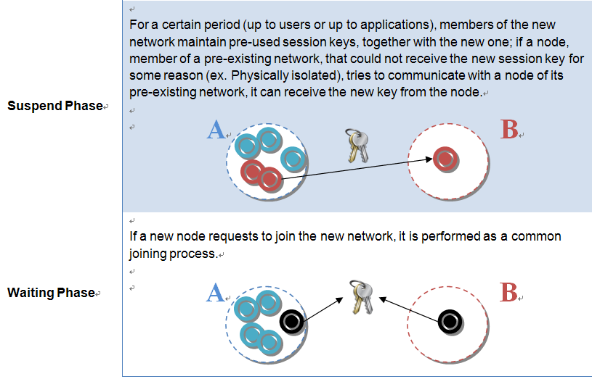
  Merging(cont.)

Slide 9
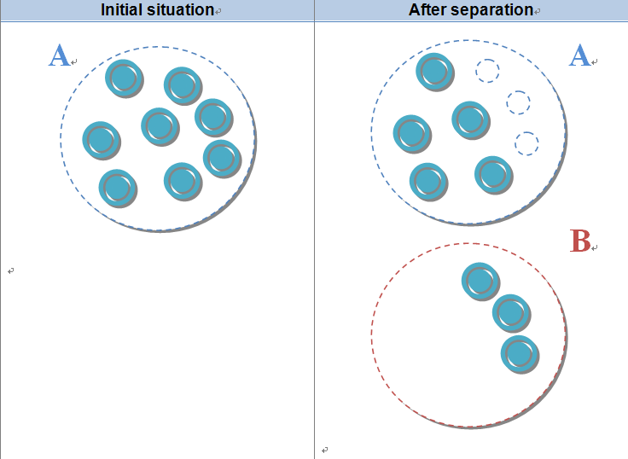
  Separating

Slide 10
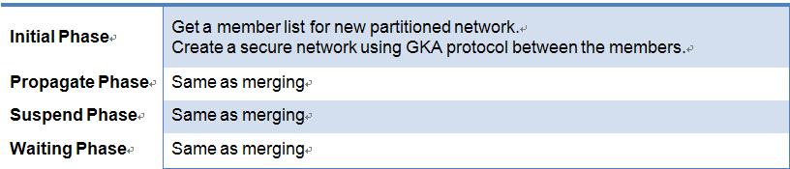
  Separating(cont.)

Slide 11
Compare various key generating algorithms to find appropriate one for our protocol.
Implementation
  Implement our protocol on NS-2 simulator.
Evaluation
  Measure message overhead when joining, dropping, merging, partitioning.
  Compare with GKA protocols (if we find any protocol implemented on ns-2)

Slide 12
Thank you for your attention !
Any question ?
HGP Team
Hyunho Park , Gianni M. Ricciardi, Pierre Alauzet
CS642 - Distributed Systems

Slide 13

“Establishing trust in pure ad-hoc networks”, Asad Amir Pirzada, Chris McDonald January 2004 ACSC '04: Proceedings of the 27th Australasian conference on Computer science - Volume 26 , Volume 26 (ACM Portal)
“Spontaneous networks: Trust in a world of equals”, Gilaberte, R.L.; Herrero, L.P.; Networking and Services, 2006. ICNS '06. International conference on 16-18 July 2006 Page(s):42 - 42 (IEEE Xplore)
“Security management for ad-hoc networked resource-limited mobile devices” Sedov, I.; Speicher, S.; Cap, C.; Vehicular Technology Conference, 2004. VTC2004-Fall. 2004 IEEE 60th Volume 5, 26-29 Sept. 2004 Page(s):3262 - 3266 Vol. 5 (IEEE Xplore)
“Implicit merging of overlapping spontaneous networks [mobile ad hoc networks]”, Legendre, F.; de Amorim, M.D.; Fdida, S.; Vehicular Technology Conference, 2004. VTC2004-Fall. 2004 IEEE 60th Volume 4, 26-29 Sept. 2004 Page(s):3050 - 3054 Vol. 4 (IEEE Xplore)
"Spontnet: experiences in configuring and securing small ad hoc networks”, Feeney, L.M.; Ahlgren, B.; Westerlund, A.; Dunkels, A.; Networked Appliances, 2002.
“A survey on peer-to-peer key management for mobile ad hoc networks.“, van der Merwe, J., Dawoud, D., and McDonald, S. 2007. ACM Comput. Surv. 39, 1, Article 1 (April 2007)

Slide 14
“An Efficient Session Key Generation Protocol”, Chin-Chen Chang, Chi-Yien Chung, Proceedings of ICCTZOO3
“An Efficient Group Key Agreement Protocol for Ad hoc Networks” Daniel Augot, Raghav Bhaskar, Val ? rie Issarny and Daniele Sacchetti Proceedings of the First International IEEE WoWMoM Workshop on Trust, Security and Privacy for Ubiquitous Computing - Volume 03
“Self-organised Group Key Management for Ad Hoc Networks”, Ling Luo, Rei Safavi-Naini, Joonsang Baek and Willy Susilo, ASIAN ACM Symposium on Information, Computer and Communications Security archive Proceedings of the 2006 ACM Symposium on Information, computer and communications security Taipei, Taiwan

