Slide 1



HGP Team
Hyunho Park , Gianni M. Ricciardi, Pierre Alauzet
CS642 - Distributed Systems

Slide 2

Problem definition
Key Idea and Design
Releted works and References

Slide 3
1. Proposal review
2. Design specifications
3. Next plan
Scenario: users belonging to two spontaneous networks decide to merge in one network
In the private networks they are using session keys for secure communication,
  When merging networks it needs to manage session keys.
    Creating a new session key or choosing one of them.
    Propagate the new session key to all members.

Slide 4
1. Proposal review
2. Design specifications
3. Next plan
Leveraging pre-existing secure networks to share new keys, in order to propagate them in an automatic way for users
Users in each network elect a leader in their own group: they talk to each other (social delegation) and vote for him/her in the list of all connected users (application level delegation)
When the leader node receives the voting messages from all users, it considers itself authorized to generate a new session key and distribute to the rest of users, and sends back a confirmation message
After receiving the confirmation message, other nodes will trust a message coming from the leader with a new session key
Trusted leaders of the two groups meet face to face (visual authentication) and share a new session key using a side channel
The new key is then propagated automatically to all users of both groups

Slide 5
1. Proposal review
2. Design specifications
3. Next plan
During the leader selection phase, 2(N-1) messages are sent by all users in each group to the future leader of that group, and from the latter to them as confirmation
After the two leaders created and shared a new session key, they share it with the rest of users in their own group, sending (N-1) messages
The total number of exchanged messages is 3(N-1) in each group

Slide 6
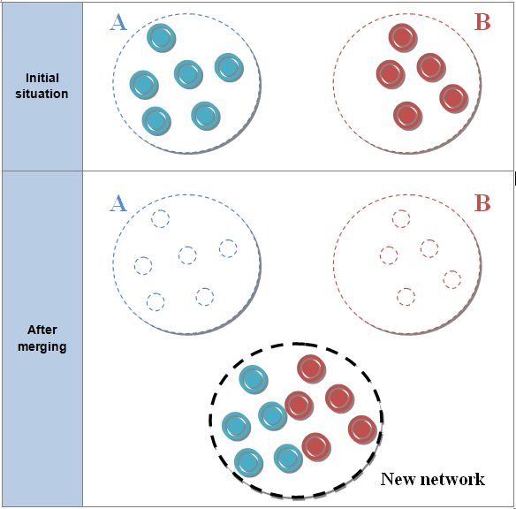
1. Proposal review
2. Design specifications
3. Next plan
Merging scenario

Slide 7
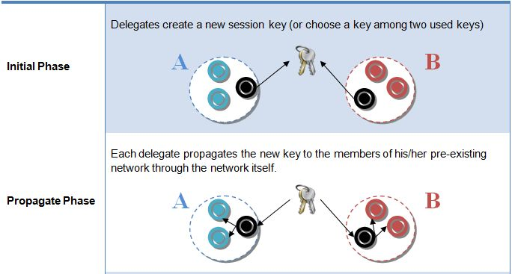
1. Proposal review
2. Design specifications
3. Next plan
  Merging(cont.)

Slide 8
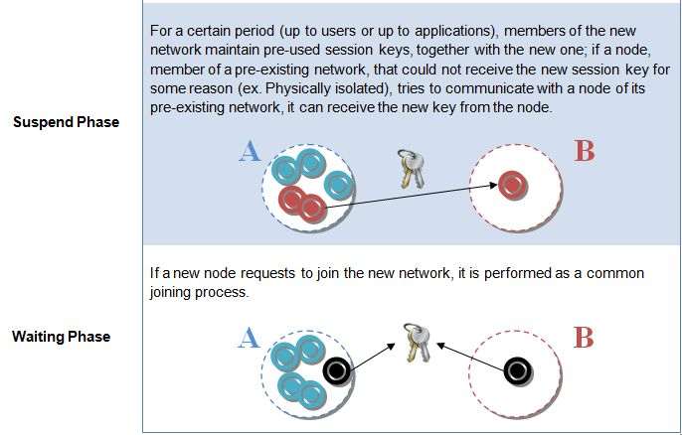
1. Proposal review
2. Design specifications
3. Next plan
  Merging(cont.)

Slide 9

“Establishing trust in pure ad-hoc networks”, Asad Amir Pirzada, Chris McDonald January 2004 ACSC '04: Proceedings of the 27th Australasian conference on Computer science - Volume 26 , Volume 26 (ACM Portal)
“Spontaneous networks: Trust in a world of equals”, Gilaberte, R.L.; Herrero, L.P.; Networking and Services, 2006. ICNS '06. International conference on 16-18 July 2006 Page(s):42 - 42 (IEEE Xplore)
“Security management for ad-hoc networked resource-limited mobile devices” Sedov, I.; Speicher, S.; Cap, C.; Vehicular Technology Conference, 2004. VTC2004-Fall. 2004 IEEE 60th Volume 5, 26-29 Sept. 2004 Page(s):3262 - 3266 Vol. 5 (IEEE Xplore)
“Implicit merging of overlapping spontaneous networks [mobile ad hoc networks]”, Legendre, F.; de Amorim, M.D.; Fdida, S.; Vehicular Technology Conference, 2004. VTC2004-Fall. 2004 IEEE 60th Volume 4, 26-29 Sept. 2004 Page(s):3050 - 3054 Vol. 4 (IEEE Xplore)
"Spontnet: experiences in configuring and securing small ad hoc networks”, Feeney, L.M.; Ahlgren, B.; Westerlund, A.; Dunkels, A.; Networked Appliances, 2002.
“A survey on peer-to-peer key management for mobile ad hoc networks.“, van der Merwe, J., Dawoud, D., and McDonald, S. 2007. ACM Comput. Surv. 39, 1, Article 1 (April 2007)

Slide 10
“An Efficient Session Key Generation Protocol”, Chin-Chen Chang, Chi-Yien Chung, Proceedings of ICCTZOO3
“An Efficient Group Key Agreement Protocol for Ad hoc Networks” Daniel Augot, Raghav Bhaskar, Val ? rie Issarny and Daniele Sacchetti Proceedings of the First International IEEE WoWMoM Workshop on Trust, Security and Privacy for Ubiquitous Computing - Volume 03
“Self-organised Group Key Management for Ad Hoc Networks”, Ling Luo, Rei Safavi-Naini, Joonsang Baek and Willy Susilo, ASIAN ACM Symposium on Information, Computer and Communications Security archive Proceedings of the 2006 ACM Symposium on Information, computer and communications security Taipei, Taiwan

