Slide 1



HGP Team
Hyunho Park , Gianni M. Ricciardi, Pierre Alauzet
CS642 - Distributed Systems

Slide 2

Proposal review
Design specifications
Implementation

Slide 3
1. Proposal review
2. Design specifications
3. Implementation
In the context of spontaneous networks, we focused on session key management during the merger of two networks and when a user leaves the network
We surveyed some paper about GKA to compare it to our idea
We started to simulate our idea using the ns2 simulator

Slide 4
1. Proposal review
2. Design specifications
3. Implementation
In the private networks they are using common session keys for secure communication,
  When merging network(s) it needs to manage session keys.
    Creating a new session key or choosing one of them for the merged network.
    Share the new session key to all members.
Related works
  GKA(Group Key Agreement)-key paper
    A mechanism to create a common session key for a group of users.
    Each member provide a public contribution for creating a common session key.
    It can share a common session key without the use of a secure channel.
  Problem
    Require creation of a new session key at every times when the network members are changed(join, leave, merge, separating)
    Requires 2n messages exchanges for creation and distribution of a new session key.
    Each message for exchange a session key is in size of encrypting SizeOfSessionKey*2*n
      Ex) if the key size is 256bit, and size of node is 100=> 256*100*2 = 51200 bit = 6.4kbytes.

Slide 5
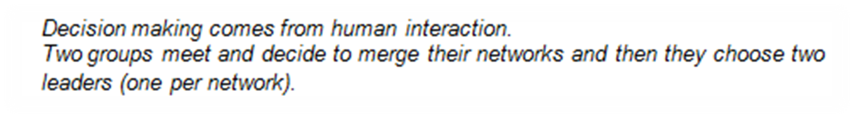
1. Proposal review
2. Design specifications
3. Implementation
Preface

Slide 6
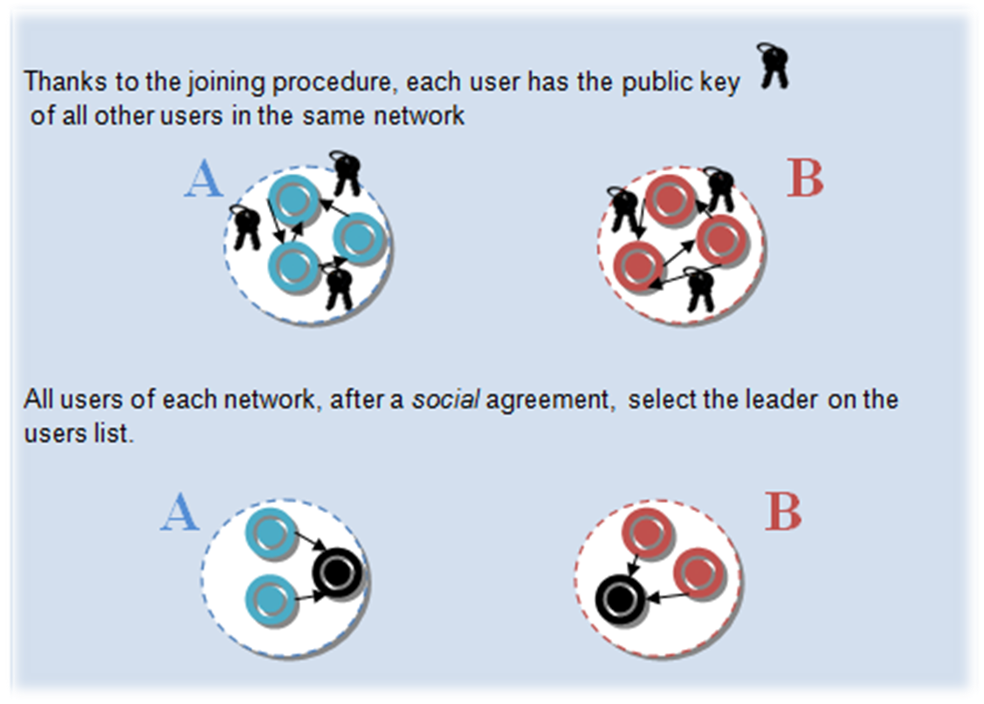
1. Proposal review
2. Design specifications
3. Implementation
Initial phase

Slide 7
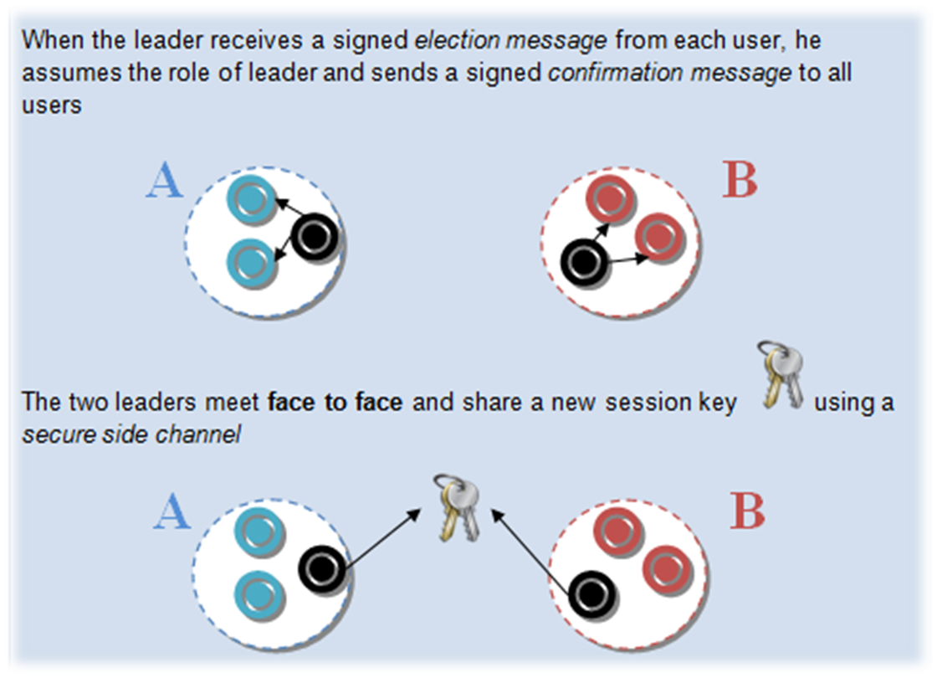
1. Proposal review
2. Design specifications
3. Implementation
Initial phase (cont.)

Slide 8
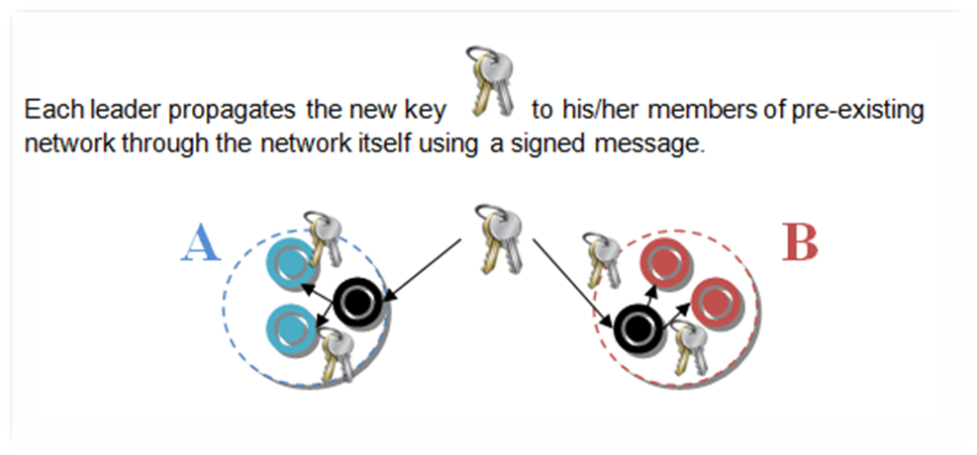
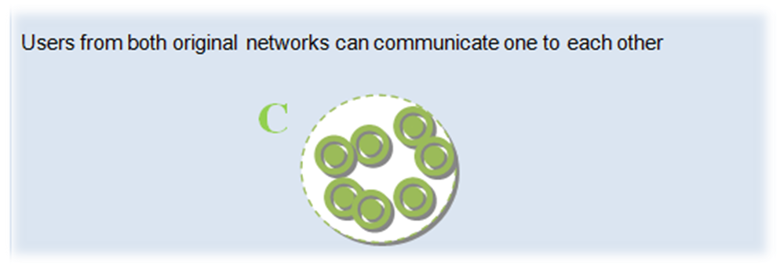
1. Proposal review
2. Design specifications
3. Implementation
Propagation phase
Communication phase

Slide 9
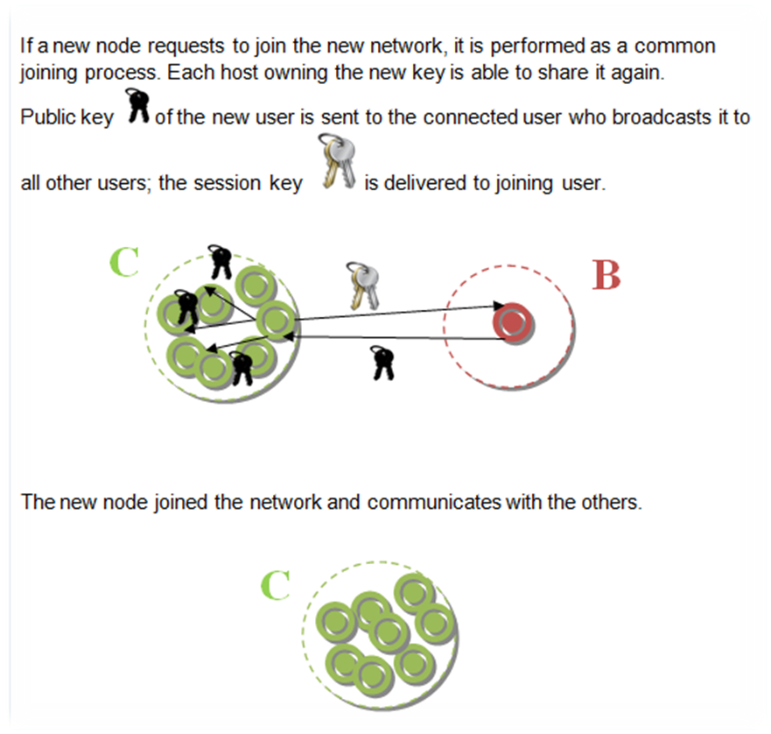
1. Proposal review
2. Design specifications
3. Implementation
Joining phase

Slide 10
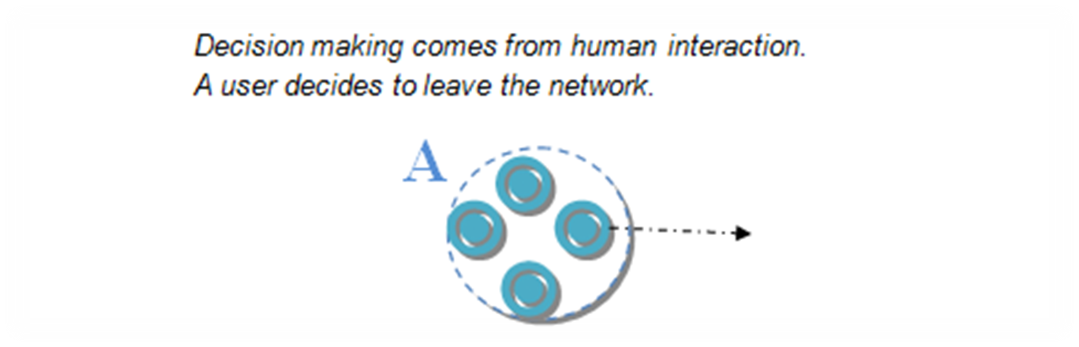
1. Proposal review
2. Design specifications
3. Implementation
Preface
Initial phase
  Idem that for the first design case: merging 2 networks

Slide 11
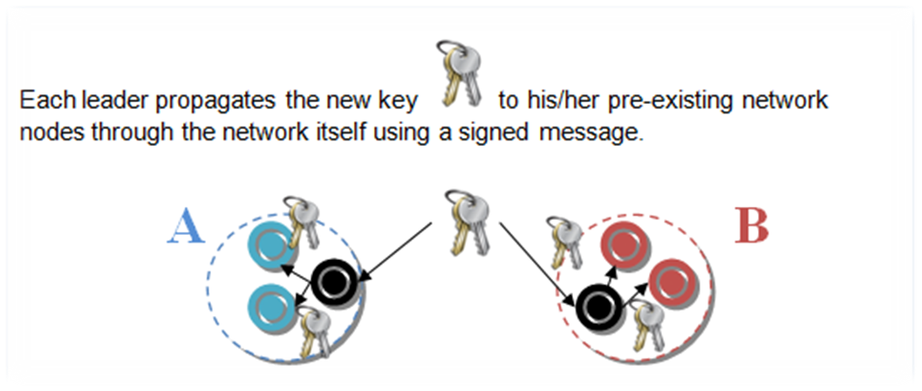
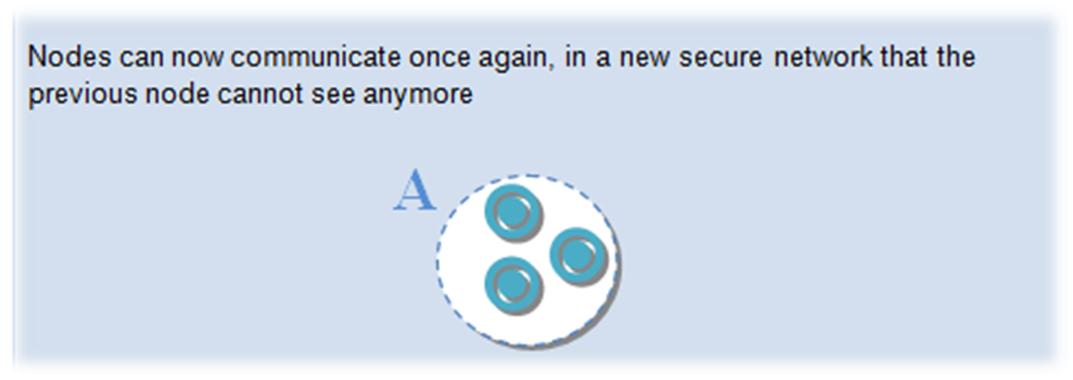
1. Proposal review
2. Design specifications
3. Implementation
Propagation phase
Communication phase

Slide 12
1. Proposal review
2. Design specifications
3. Implementation
Number of exchanged messages
 | GKA | Skemasnet
Merging Networks | 2*(2N-1) | 2(N-1) + (N-2)
Leaving User | 2*(2N-1) | 2(N-1) + (N-1)

Slide 13
1. Proposal review
2. Design specifications
3. Implementation
Size of exchanged messages to deliver a new session key
GKA | SizeOfSessionKey * 2 * N
Skemasnet | SizeOfSessionKey + max(N1, N2)*SizeOfPubKey

Slide 14
1. Proposal review
2. Design specifications
3. Implementation

Slide 15
Thank you for your attention !
Any question ?
HGP Team
Hyunho Park , Gianni M. Ricciardi, Pierre Alauzet
CS642 - Distributed Systems

Slide 16

[1] Johann Van Der Merwe, Dawoud Dawoud, and Stephen Mcdonald
A Survey on Peer-to-Peer Key Management for Mobile Ad Hoc Networks
[2] Dirk Balfanz, D. K. Smetters, Paul Stewart and H. Chi Wong
Talking To Strangers: Authentication in Ad-Hoc Wireless Networks
[3] Michael Steiner, Gene Tsudik, Michael Waidner
Diffie-Hellman Key Distribution Extended to Group Communication
[4] Daniel Augot, Raghav Bhaskar, Valerie Issarny and Daniele Sacchetti
An Efficient Group Key Agreement Protocol for Ad hoc Networks

