Slide 1
Lecture 1 CSC 126 Introduction to Computer Science
Prof: Pierre S Louis-Jacques

Slide 2
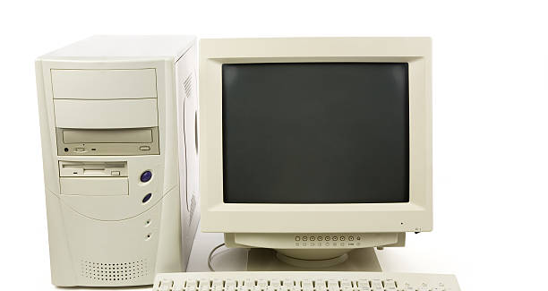
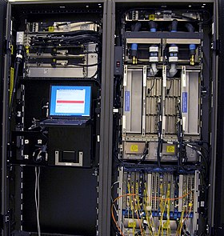
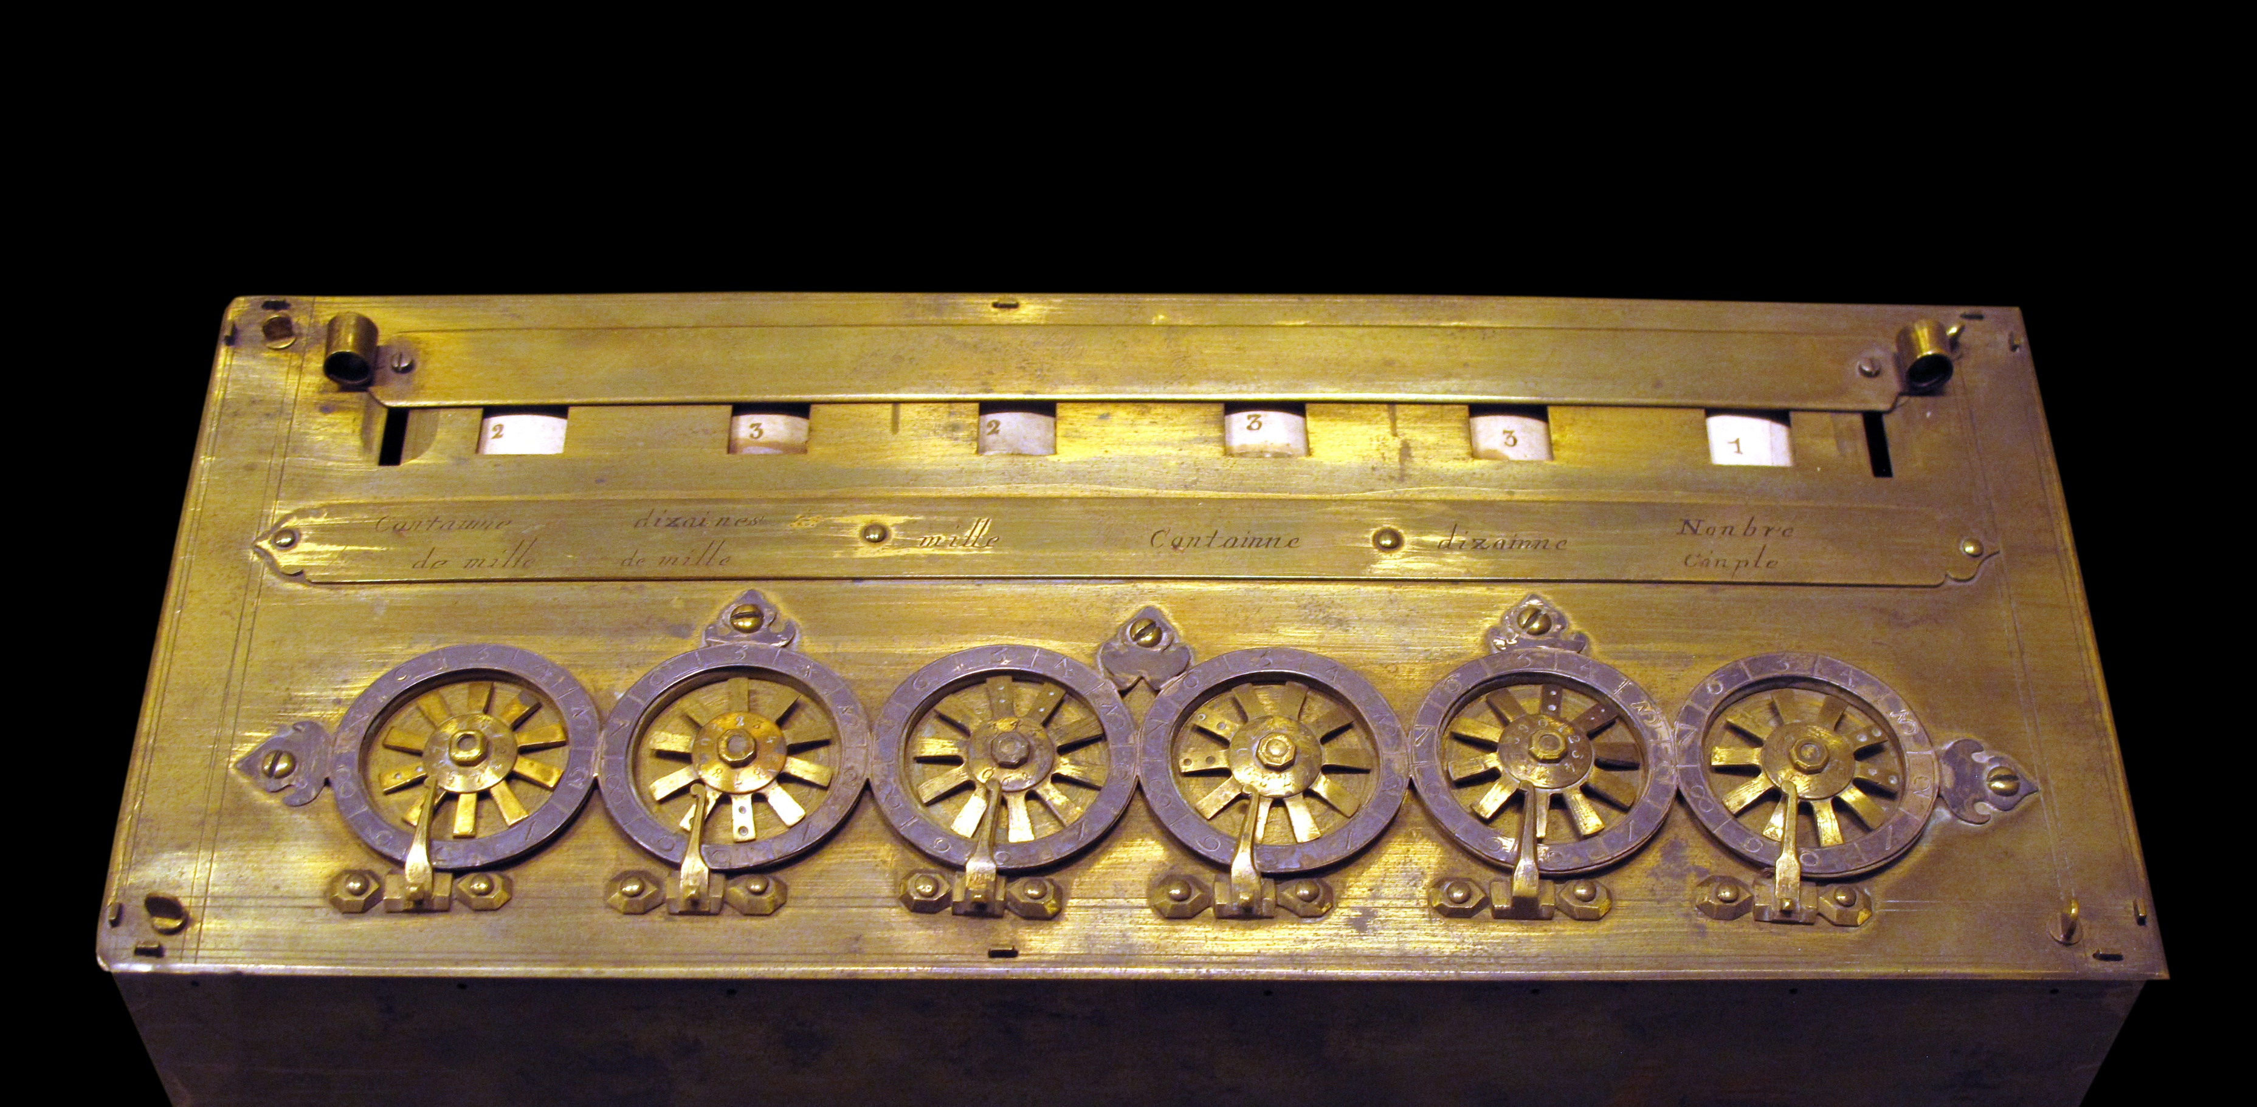

Slide 3
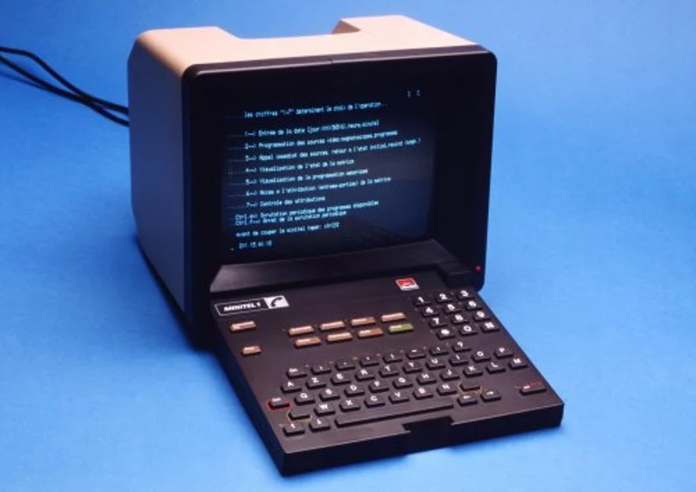
WHAT ARE COMPUTERS USED FOR?
a) surf internet, search, communicate, a) computer
compute, navigate, expert system, trade
b) Pascaline, difference engine, analytical
engine, Mark I, UNIVAC
c) arithmetic logic unit, control unit, memory
input/output device
d) instruction and data in same memory
e) vacuum tube, transistors, chips
f) central process unit on one chip b) microprocessor
https://www.youtube.com/watch?v=4ObouwCHk8w&t=33s

Slide 4
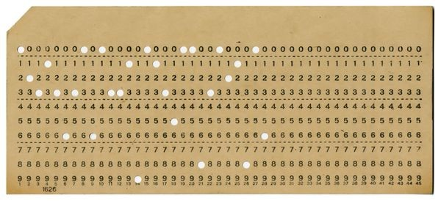
WHAT ALL COMPUTERS HAVE IN COMMON?
a) electronic device, perform commands a) computer
b) hardware, software
c) CPU (central processing unit), main memory(RAM),
input(keyboard, mouse, camera)
output(screen, printer, secondary storage)
d) ordered cells, unique location or address, bits b) main memory
e) programs during execution
f) permanent storage
g) hard disk, flash drive, CD-ROMs c) secondary storage
h) specific tasks d) software
i) system, applications
j) manage memory, input/output, storage
k) operating system
https://www.youtube.com/watch?v=YnnGbcM-H8c

Slide 5

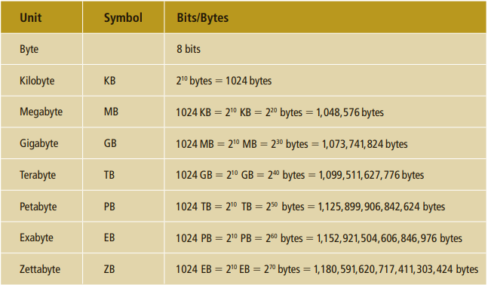
HOW DO WE TALK TO A COMPUTER?
a) continuous a) analog signal
b) sequence of 0's and 1's b) digital signal
c) machine language, binary number
c) reliable, exact copy c) binary digit/bit
d) 0 or 1

Slide 6
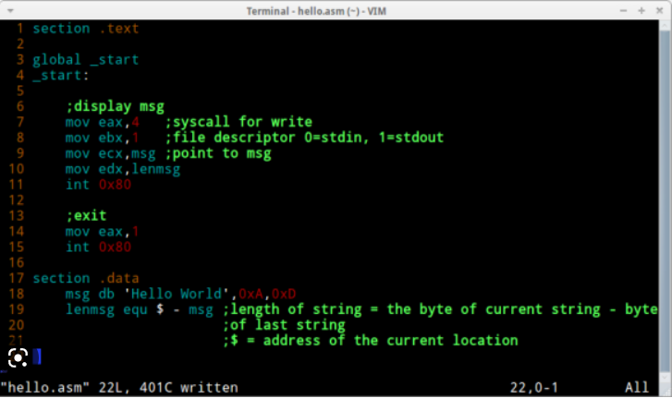
HOW DO WE TALK TO A COMPUTER?
a) instructions in bits a) machine language
b) opcode, address
c) mnemonic b) assembly language
d) assembly language to
machine language c) assembler
e) close to natural language d) high level language
d) FORTRAN, COBOL, C++, C, PYTHON,
PHP, JAVASCRIPT, JAVA, C#

Slide 7
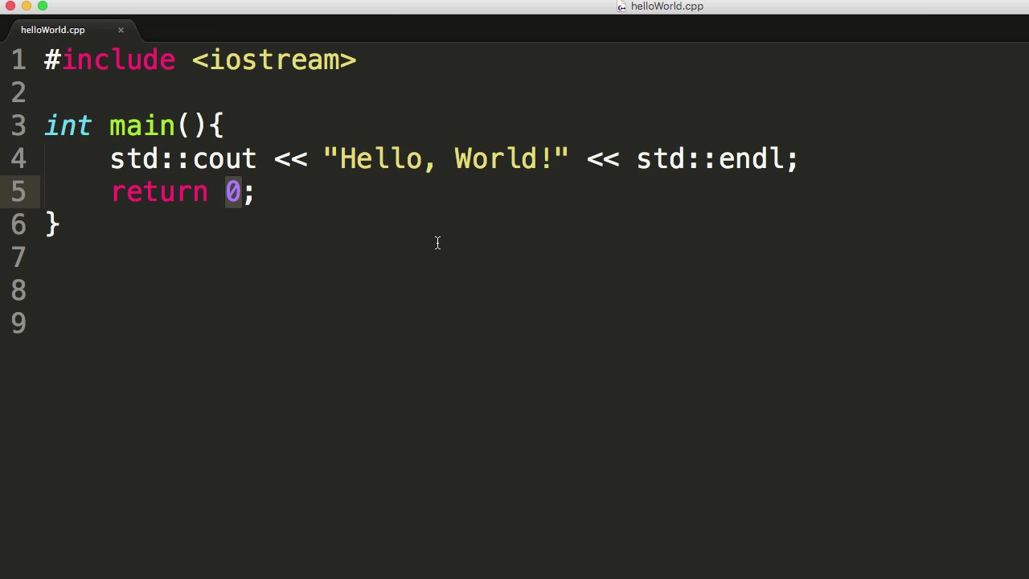
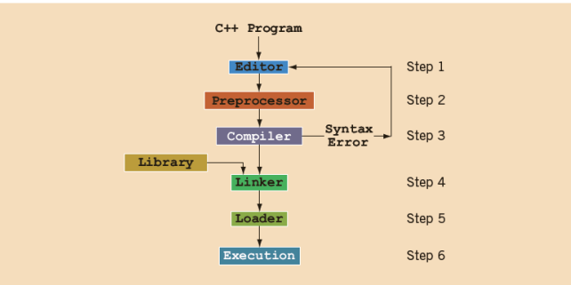
WHAT LANGUAGE WE WILL USE?
a) program written in a high level language a) source code
b) syntax rules b) compiler
c) object program = machine language
d) prewritten code c) linker

Slide 8
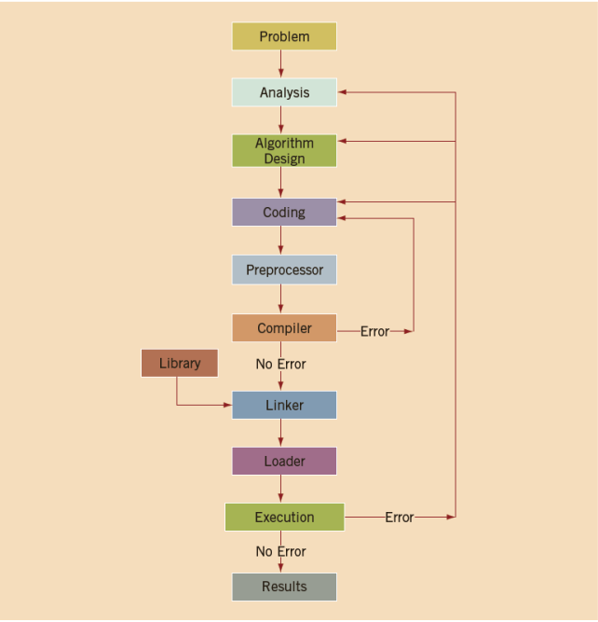
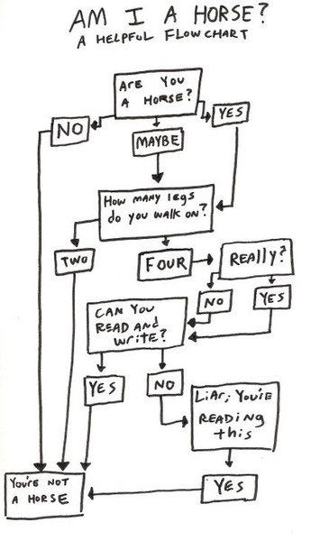
HOW DO WE SOLVE OUR PROBLEMS?

Slide 9
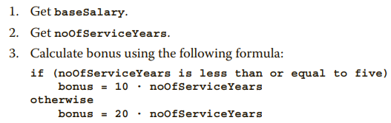
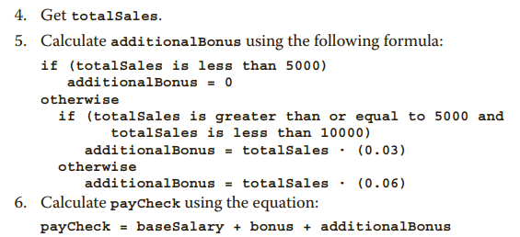
HOW DO WE SOLVE OUR PROBLEMS?
ALGORITHMS
step-by-step problem-solving process in which a solution is arrived at in a finite amount of time.

Slide 10
(15) C++ Tutorial: Write your First Program using Visual Studio Community 2022 (for beginners) – YouTube

Slide 11
WHAT IS COMPUTER SCIENCE ?

