Slide 1
Lecture 3 csc 126/ Introduction to Computer Science
Prof. Pierre S Louis-Jacques

Slide 2
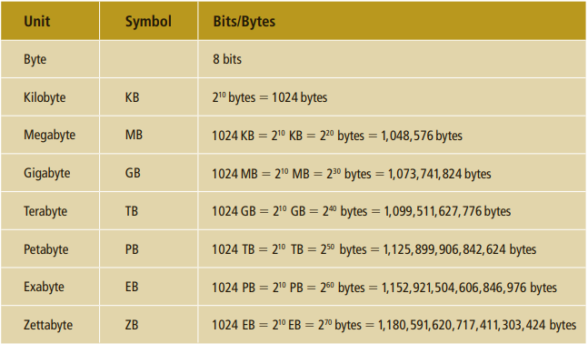
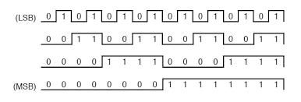
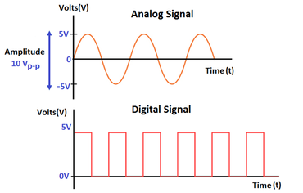
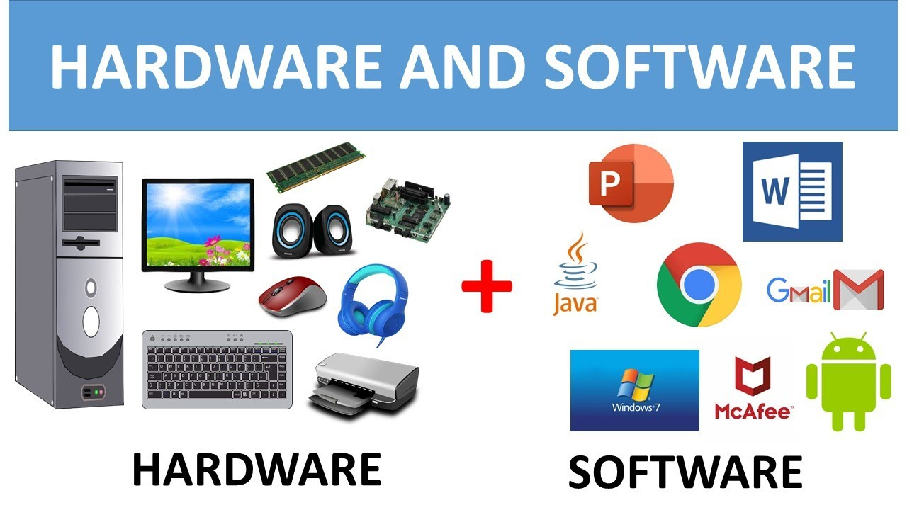
What does the computer see?
Analog vs Digital

Slide 3
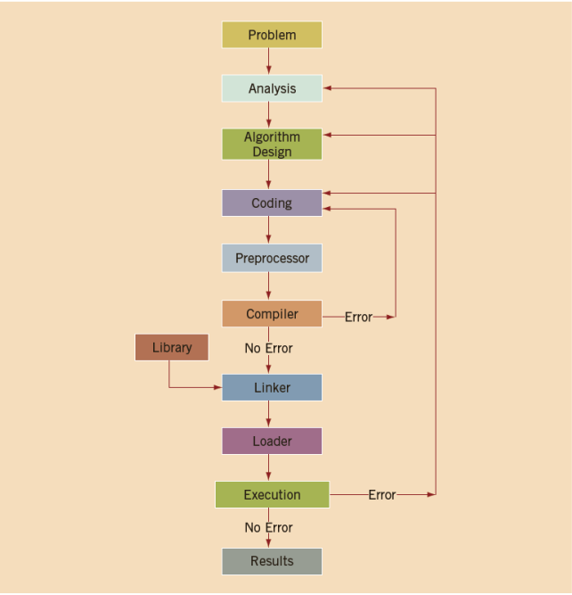
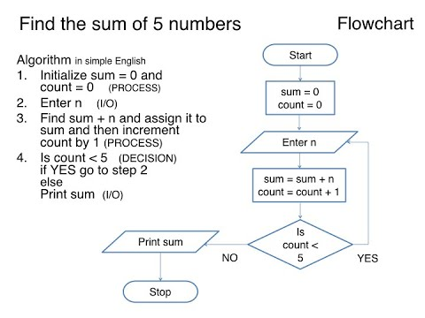
The STEPS

Slide 4
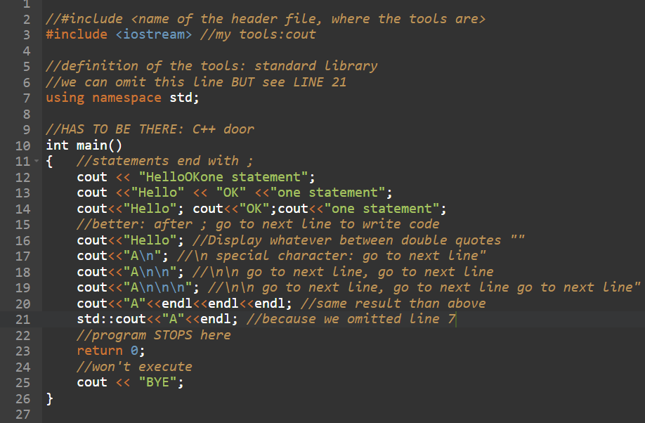
LET US DISPLAY SOMETHING!!!

Slide 5
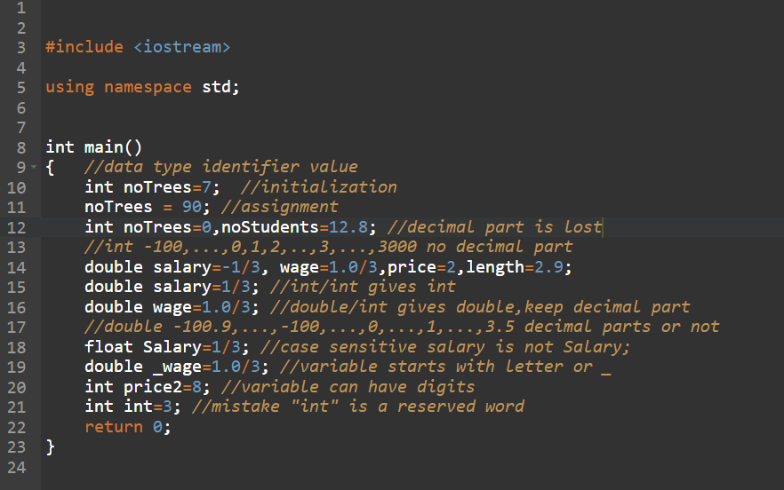
RULES AND TYPES!

Slide 6
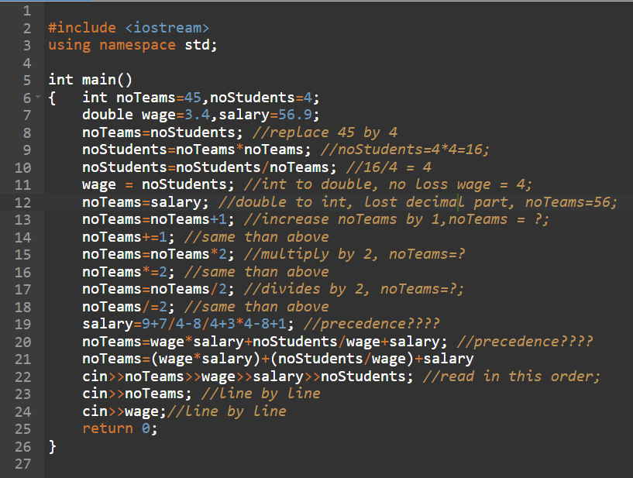
ASSIGNMENTS

