Slide 1
Lecture 2 CSC 126/Introduction to Computer Science
Prof. Pierre S Louis-Jacques

Slide 2
REVIEW: https://forms.gle/4tKdnweDEqg3JNPt5

Slide 3
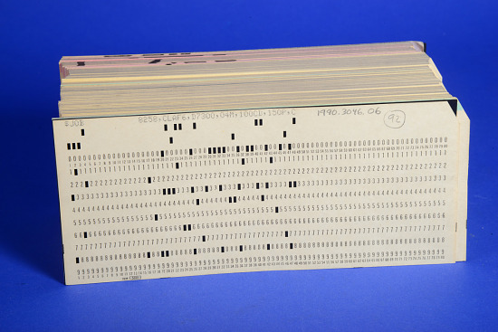
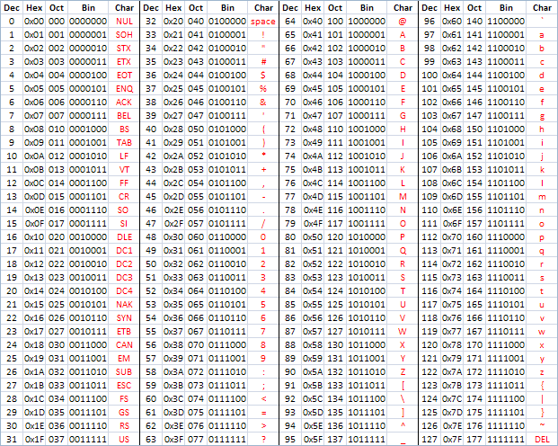
WHAT DOES THE COMPUTER SEE?
ASCII TABLE

Slide 4
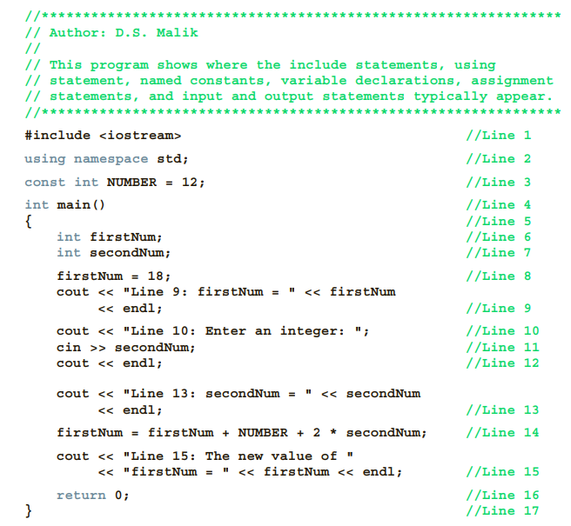
STRUCTURE OF A C++ PROGRAM
WHAT TOOLS I WILL BE USING?
WHERE ARE THESE TOOLS?
C++ DOOR
MY CODE
SHUT THE DOOR

Slide 5
WHERE DO WE STORE OUR INFORMATION?
a)arithmetic, string a)expression
b)collection of functions b)C++ program
c)statements, accomplish something c)function
d)purpose of programs d) comments
e)stream insertion operator e)<<
f)memory location whose content f)variable
can be changed
g)declare, initialize, assign

Slide 6
RULES!
a)collection of one or more a)C++ program
subprograms, functions
b)collection of statement, b)function
accomplish something
c)predefined, standard c)main
d)valid statements d)syntax rules
e)single line comment e)//
f)+ - * / f)special symbol
. ; ? ,
<= != == >=
g)int float double char g) reserved words
const void return
h)letters, digits, underscore, h)identifier
begin with letter or underscore
i)predefined identifiers i)cout, cin
j)case sensitive j)C++

Slide 7
WHAT DATA TYPE SHOULD I USE?
a) set of values, allowed operation a)data type
b)simple, structured, pointer
c)integral, floating point, b)simple data type
enumeration
d)char, short, int, long, bool, unsigned char
unsigned short, unsigned int, unsigned long,
long long, unsigned long long

