Slide 1
Detection of Cardiac Arrhythmias from ECG
Yinbo Shi
www.linkedin.com/in/yinbo-shi/
github.com/pierrecurie13/capstone

Slide 2
Motivation
Heart disease is the leading cause of death
ECG/EKG = electrocardiogram
An ECG machine records electrical signals from the heart
~10000 people for every cardiologist in the USA
Enter machine learning

Slide 3
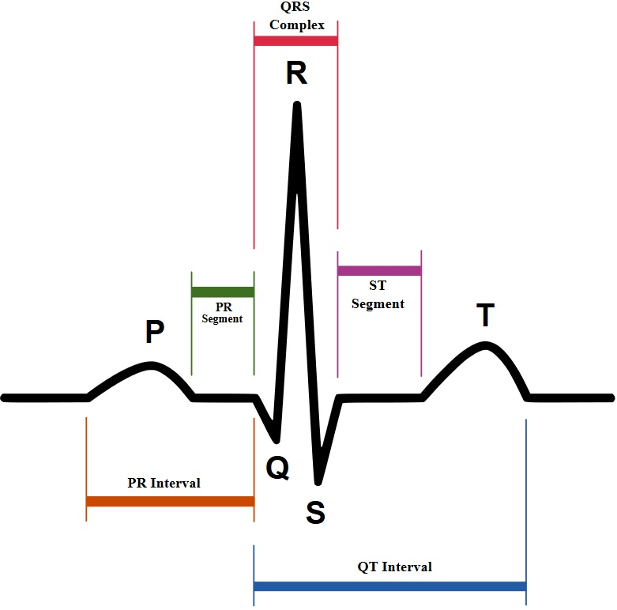

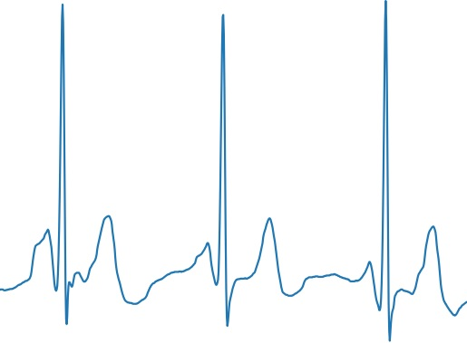
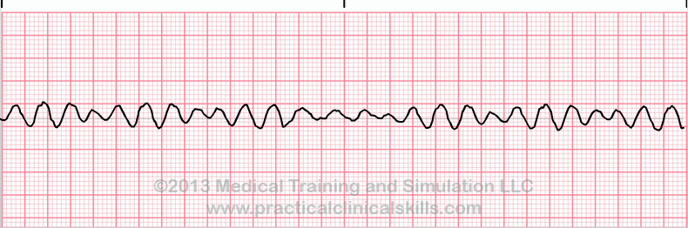
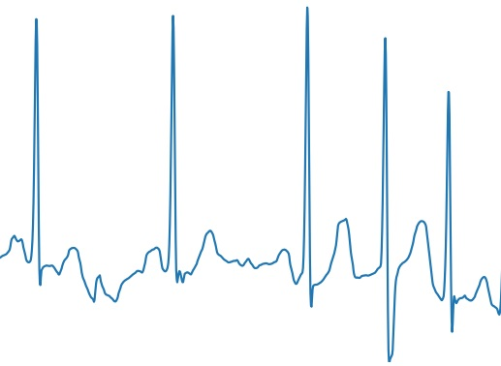
ECG Samples
Theoretical
Normal
✔
AFib
🐌💀
(atrial fibrillation)
VTach
❗
(ventricular tachycardia)
VFib
🐇💀
💀💀
(ventricular fibrillation)

Slide 4
Data
~8500 samples of ECG lead I @300Hz
9-61 seconds in duration
normal, atrial fibrillation, noise, or other
For consistency, the samples were either looped or cut into chunks of ~13.7 seconds.
~12700 samples

Slide 5
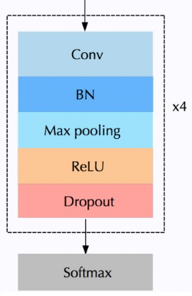
Models
Baseline:
exclude “other” category
gradient boosted tree model
features: statistics of the RR intervals
Final model:
4 layer 1D convolutional neural network
batch normalization, dropout, max pooling, ReLU activation

Slide 6
Results
Mostly want arrhythmia vs not arrhythmia
AUC without other:
AFib vs noise/normal
Gradient boost: .974
CNN: .983
AUC full classification:
AFib/other vs noise/normal
CNN: .861

Slide 7
Next Steps
More data
Fancier CNN
More types of arrhythmias
Consider STFT/spectrograms
Time series
2D CNNs

Slide 8
Thanks!
Yinbo Shi
www.linkedin.com/in/yinbo-shi/
github.com/pierrecurie13/capstone

