Slide 1
Detection of Cardiac Arrhythmias from ECG
Yinbo Shi

Slide 2
Motivation
Heart disease is the leading causes of death
An ECG machine records electrical signals from the heart
~10000 people for every cardiologist in the USA
Enter machine learning

Slide 3
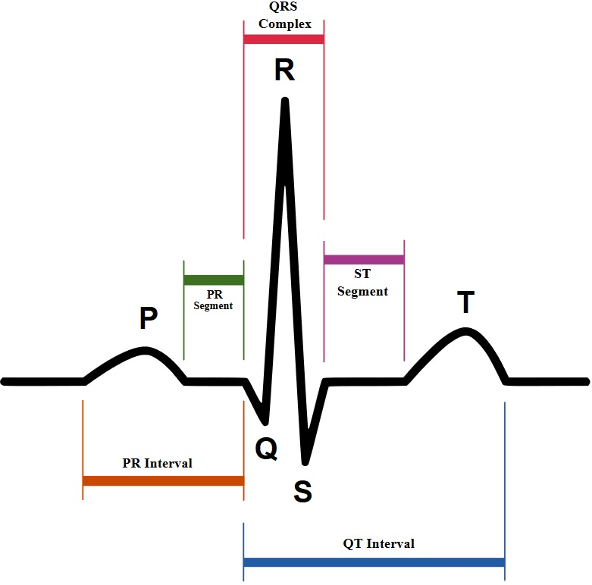

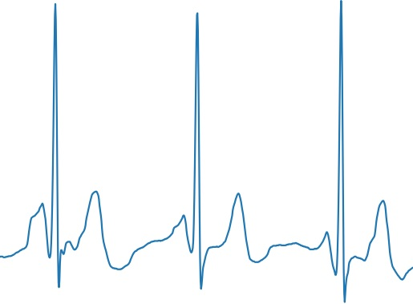
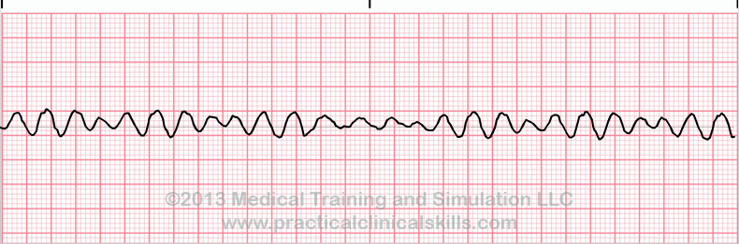
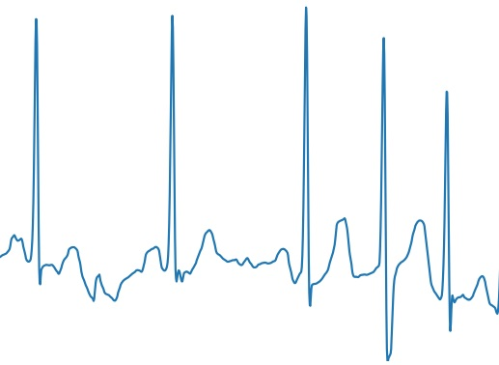
ECG Samples
Theoretical
Actual
✔
Afib
🐌💀
VTach
❗
Vfib
💀💀

Slide 4
Data
~8500 samples of ECG lead I @300Hz
9-61 seconds in duration
normal, atrial fibrillation, noise, or other
For consistency, the samples were either looped or cut into chunks of ~13.7 seconds.
~12700 samples

Slide 5
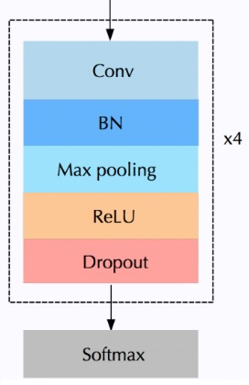
Models
Baseline:
exclude “other” category
gradient boosted tree model
features: statistics of the RR intervals
Final model:
4 layer 1D convolutional neural network
batch normalization, dropout, max pooling, ReLU activation

Slide 6
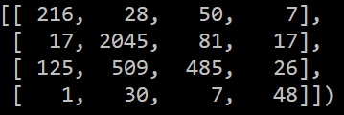
Results
Without other:
Ignore noise AUC: .986
AFib vs noise/normal AUC: .983
Full Classification:
F1 scores:
AFib: .6545, Normal: .8571
Other: .5486, noise: .5217
Avg F1: .6455
Arrhythmia vs noise/normal AUC: .8612
Remove other, noise; Afib vs normal AUC: .9839

Slide 7
Next Steps
More data
More types of arrhythmias
Fancier CNN
Consider STFT/spectrograms
Time series
2D CNNs

