Slide 1
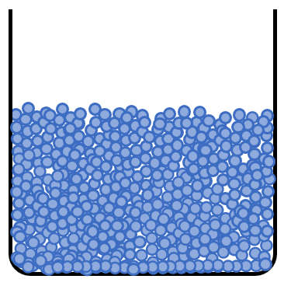
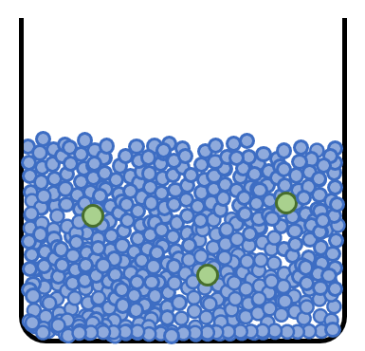
Solution A
Solution B
Solution C
Solution D

Slide 2
