Slide 2
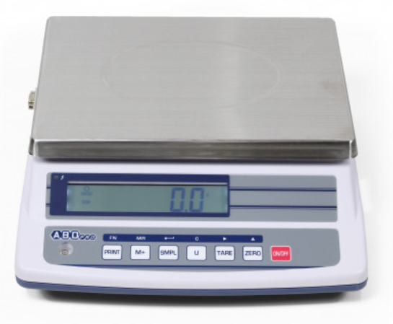


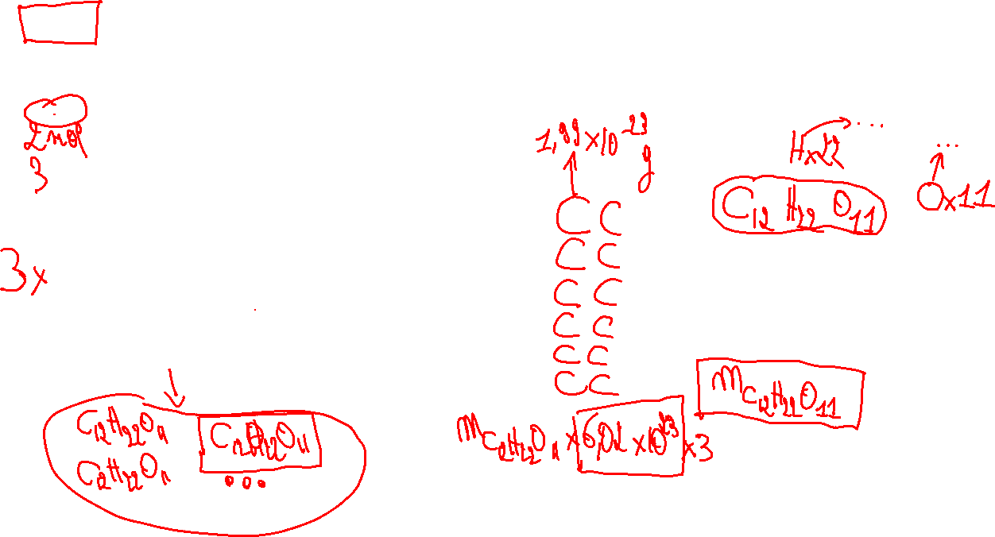
$2,6$mol de saccharose($C_{12}H_{22}O_{11})$
en gramme (g)
Exemple plus simple :
$1$mol de saccharose ${(C}_{12}H_{22}O_{11})$
en gramme (g)
$$6,02×{10}^{23} C_{12}H_{22}O_{11}$$

