Slide 1
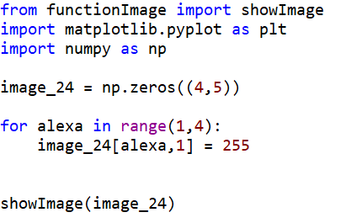

Slide 2
Importation de fonctions

Slide 3
Importation de fonctions
#0
#1
#2
#3
#4
image_24
#0
0 | 0 | 0 | 0 | 0
0 | 0 | 0 | 0 | 0
0 | 0 | 0 | 0 | 0
0 | 0 | 0 | 0 | 0
#1
#2
#3

Slide 4
Importation de fonctions
#0
#1
#2
#3
#4
image_24
#0
0 | 0 | 0 | 0 | 0
0 | 0 | 0 | 0 | 0
0 | 0 | 0 | 0 | 0
0 | 0 | 0 | 0 | 0
#1
#2
#3
alexa = 1

Slide 5
Importation de fonctions
#0
#1
#2
#3
#4
image_24
#0
0 | 0 | 0 | 0 | 0
0 | 255 | 0 | 0 | 0
0 | 0 | 0 | 0 | 0
0 | 0 | 0 | 0 | 0
#1
#2
#3
alexa = 1

Slide 6
Importation de fonctions
#0
#1
#2
#3
#4
image_24
#0
0 | 0 | 0 | 0 | 0
0 | 255 | 0 | 0 | 0
0 | 0 | 0 | 0 | 0
0 | 0 | 0 | 0 | 0
#1
#2
#3
alexa = 2

Slide 7
Importation de fonctions
#0
#1
#2
#3
#4
image_24
#0
0 | 0 | 0 | 0 | 0
0 | 255 | 0 | 0 | 0
0 | 255 | 0 | 0 | 0
0 | 0 | 0 | 0 | 0
#1
#2
#3
alexa = 2

Slide 8
Importation de fonctions
#0
#1
#2
#3
#4
image_24
#0
0 | 0 | 0 | 0 | 0
0 | 255 | 0 | 0 | 0
0 | 255 | 0 | 0 | 0
0 | 0 | 0 | 0 | 0
#1
#2
#3
alexa = 3

Slide 9
Importation de fonctions
#0
#1
#2
#3
#4
image_24
#0
0 | 0 | 0 | 0 | 0
0 | 255 | 0 | 0 | 0
0 | 255 | 0 | 0 | 0
0 | 255 | 0 | 0 | 0
#1
#2
#3
alexa = 3

Slide 10
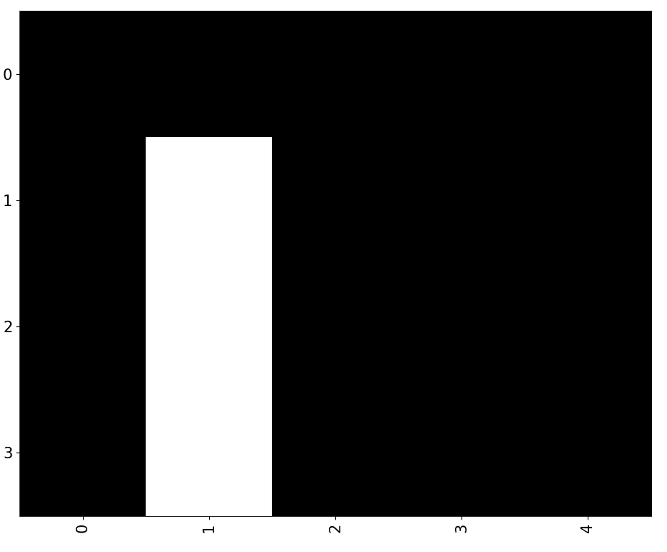
Importation de fonctions
#0
#1
#2
#3
#4
image_24
#0
0 | 0 | 0 | 0 | 0
0 | 255 | 0 | 0 | 0
0 | 255 | 0 | 0 | 0
0 | 255 | 0 | 0 | 0
#1
#2
#3
alexa = 3

Slide 11
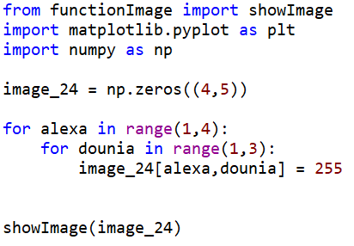

Slide 12
Importation de fonctions

Slide 13
Importation de fonctions
#0
#1
#2
#3
#4
image_24
#0
0 | 0 | 0 | 0 | 0
0 | 0 | 0 | 0 | 0
0 | 0 | 0 | 0 | 0
0 | 0 | 0 | 0 | 0
#1
#2
#3

Slide 14
Importation de fonctions
#0
#1
#2
#3
#4
image_24
#0
0 | 0 | 0 | 0 | 0
0 | 0 | 0 | 0 | 0
0 | 0 | 0 | 0 | 0
0 | 0 | 0 | 0 | 0
#1
#2
#3

Slide 15
Importation de fonctions
#0
#1
#2
#3
#4
image_24
#0
0 | 0 | 0 | 0 | 0
0 | 0 | 0 | 0 | 0
0 | 0 | 0 | 0 | 0
0 | 0 | 0 | 0 | 0
#1
#2
#3

Slide 16
Importation de fonctions
#0
#1
#2
#3
#4
image_24
#0
0 | 0 | 0 | 0 | 0
0 | 0 | 0 | 0 | 0
0 | 0 | 0 | 0 | 0
0 | 0 | 0 | 0 | 0
#1
#2
#3
alexa = 1

Slide 17
Importation de fonctions
#0
#1
#2
#3
#4
image_24
#0
0 | 0 | 0 | 0 | 0
0 | 0 | 0 | 0 | 0
0 | 0 | 0 | 0 | 0
0 | 0 | 0 | 0 | 0
#1
#2
#3
alexa = 1

