Slide 1
C4 Fundamental Score meets NLP - Intro
Nov 2024

Slide 2
TOC
LLMs Processing Bond Prospectuses (Idea)
PDF Prospectuses - Scraping
PDF Prospectuses - Processing
LLM Modelling – Strategy (Background)
LLM Modelling – Base Experiment
LLM Modelling – Initial Results
LLM Modelling – The Practical
Next Steps / Goals

Slide 3
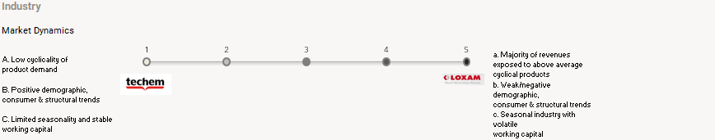
LLMs Processing Bond Prospectuses
Current Fundamental Scoring Process
Fundamental Score is 1-5, There are 7 sub-scores [Business Model, Competitive Positioning, Market Dynamics, …].
Each sub-score has explanatory labels.
For example, Market Dynamics has labels A-C, a-c
- A. Low cyclicality of product demand
- B. Positive demographic, consumer & structural trends
- C. Limited seasonality and stable working capital
- a. Majority of revenues exposed to above average cyclical products
- b. Weak/negative demographic, consumer & structural trends
- c. Seasonal industry with volatile working capital
My Research Motivation
I believe LLMs can derive sub-score labels from bond prospectuses.

Slide 4
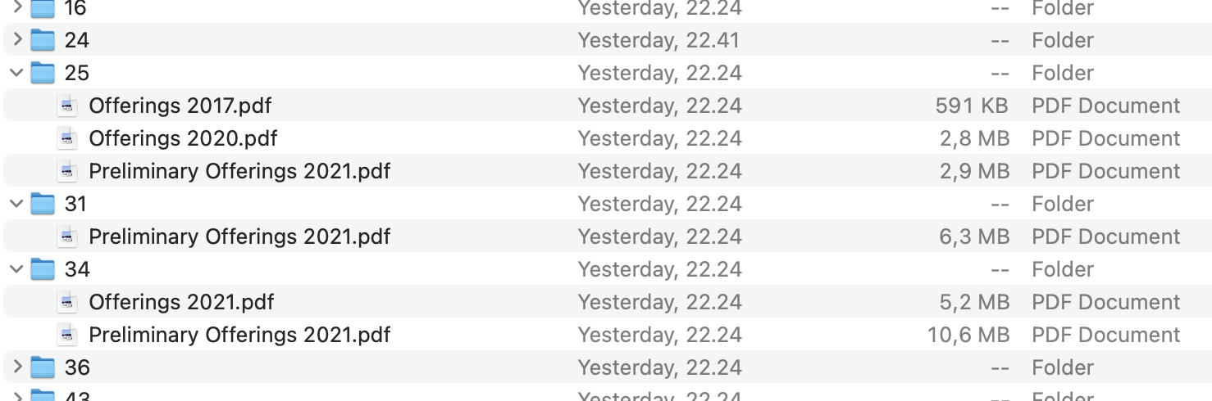
PDF Prospectuses - Scraping
Dataset
Need prospectuses on European Bond names with C4 Fundamental Score.
~631 names in total have Fundamental Score
I now have a Dataset with ~150 names with C4 Analyst Scores.
SharePoint Findox
Wrote code to extract documents from C4 SharePoint Portal (from Findox)
Scraped while linking to RmsId so that we can link to all relevant data in DB (e.g. Fundamental Score).
Esma (The European Securities and Markets Authority)
Web-scraping based on ISIN.
(Open to suggestions on how to capture more prospectuses before manually going to each company website)

Slide 5
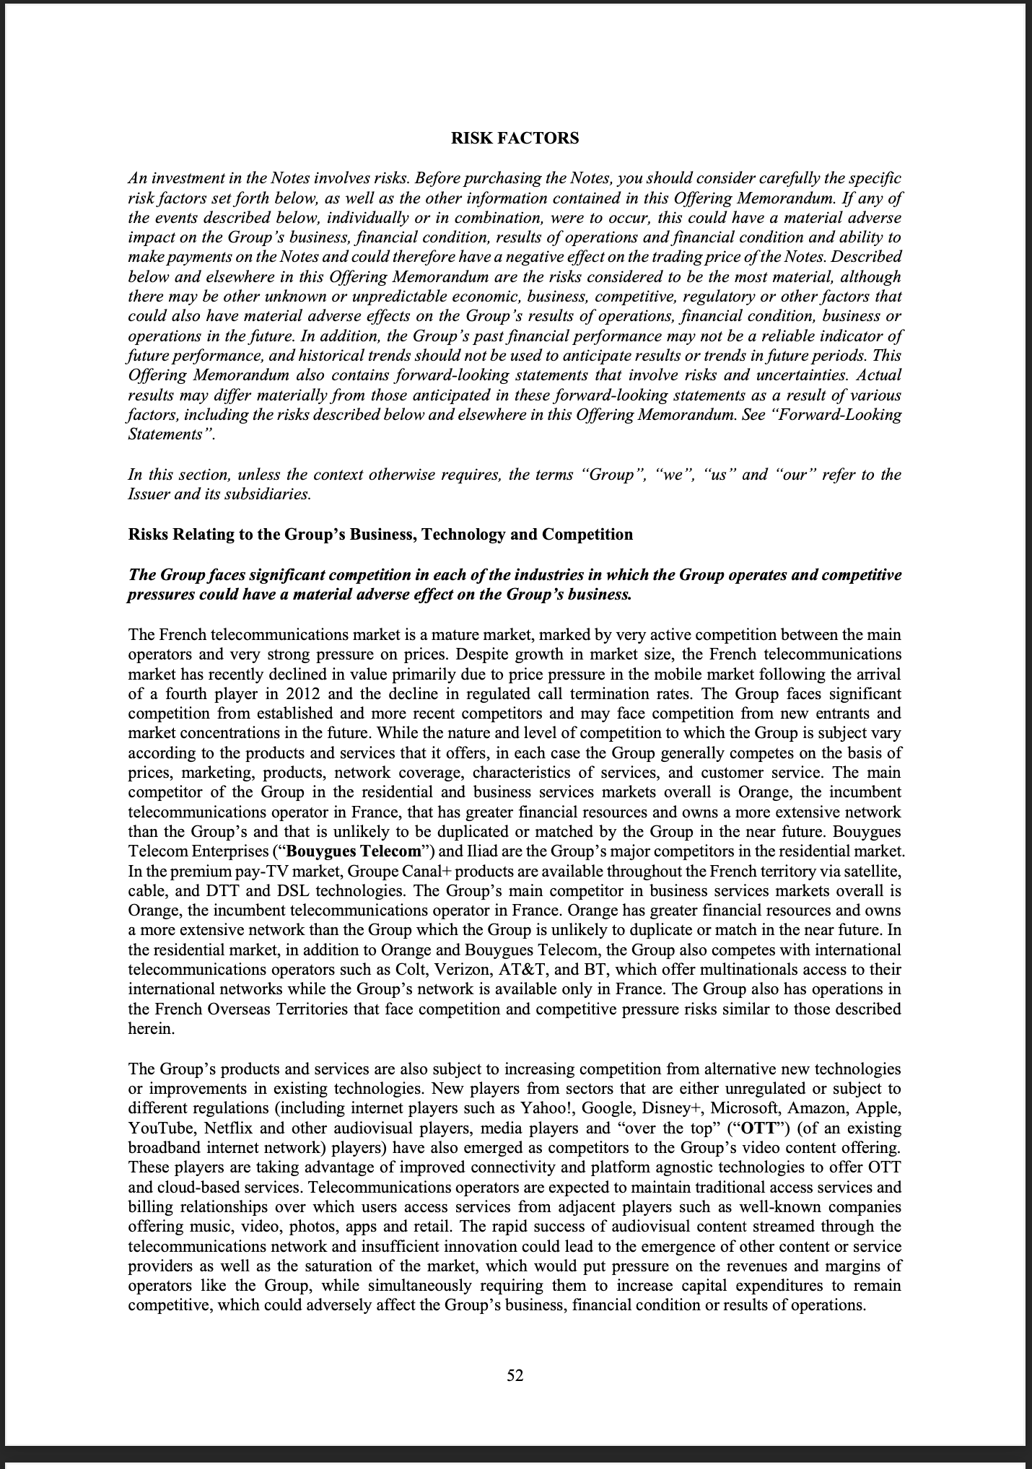
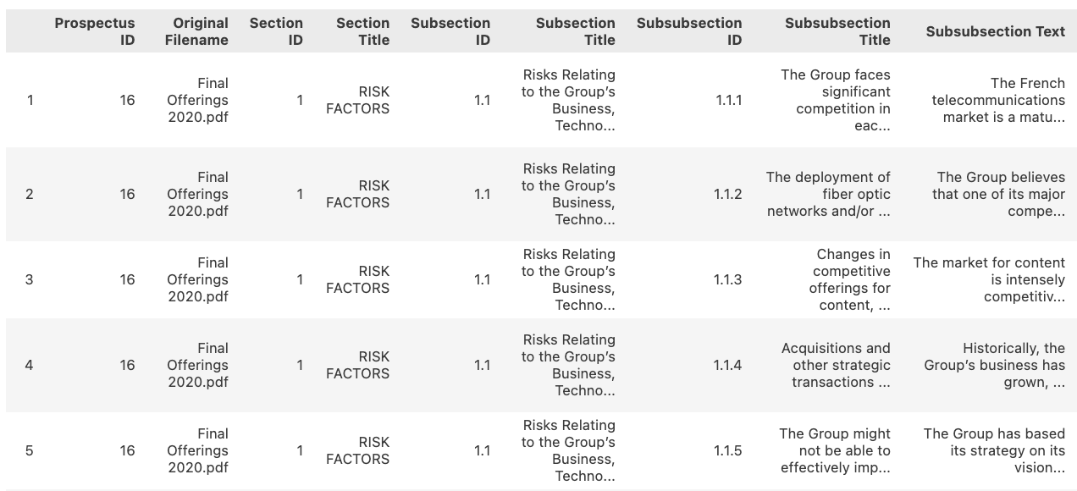
PDF Prospectuses - Processing
**RISK FACTORS**
_An investment in the Notes involves risks. Before purchasing the Notes, you should consider carefully the specific_
_risk factors set forth below, as well as the other information contained in this Offering Memorandum. If any of_
_the events described below, individually or in combination, were to occur, this could have a material adverse_
_impact on the Group’s business, financial condition, results of operations and financial condition and ability to_
_make payments on the Notes and could therefore have a negative effect on the trading price of the Notes._ _In this section, unless the context otherwise requires, the terms “Group”, “we”, “us” and “our” refer to the_
_Issuer and its subsidiaries._
**Risks Relating to the Group’s Business, Technology and Competition**
**_The Group faces significant competition in each of the industries in which the Group operates and competitive_**
**_pressures could have a material adverse effect on the Group’s business._**
The French telecommunications market is a mature market, marked by very active competition between the main
operators and very strong pressure on prices. Despite growth...
The parsing process catches around 70%-80% of Prospectuses.
First transforming pdf into markdown, then processing document hierarchy, and then into DataFrame.
Each row is a Sub Sub Section.

Slide 6
LLM Modelling – Strategy
Recall, what was the original idea?
“From this section of text: {SECTION OF TEXT}, is sub-score label a/b/c present?”
Ask the LLM to confirm the presence of specific sub-score labels within a text segment, prompting for a clear "yes" or "no.“
When the answer is "yes," request that the LLM cites the exact phrases or sentences where the characteristic is mentioned, enhancing transparency and traceability.
Sub-score labels
I chose to focus on negative sub-score labels (risks).
Out of the 23 negative sub-score labels, I have chosen 10 to focus on.
How to define ground truth?
Scope Limitation: We limit the evaluation to the "Risk Factors" section of bond prospectuses. This is a subset of all credit risk information on each issuer/company. We assume that the analysts have used a set that is larger than or equal to the risk factors subset to assess risk factors.
C4 Analyst as Ground Truth: The human analysts’ identification of risk factors is treated as the definitive benchmark against which the LLM’s performance is measured.
How to Evaluate LLM Performance?
Confusion Matrix. TP, FP, TN, FN.
If analyst gave specific label and LLM also found that label: TP
If analyst did not give specific label but LLM found that label: FP
Etc.

Slide 7
LLM Modelling – Base Experiment
Prompt
prompt = f""" For the following question and text, judge whether the text is "Highly Relevant", "Somewhat Relevant", or "Not Relevant". Question:{question} Text:
Subsubsection Title: {row['Subsubsection Title']}
Subsubsection Text: {row['Subsubsection Text']} Please provide your answer in the following JSON format: {{
"Relevance": "Highly Relevant", "Somewhat Relevant", or "Not Relevant",
"Evidence": "The exact phrases or sentences from the document that support your assessment; otherwise, leave blank."
}}
In the prompt, {row[‘Subsubsection Title’]} and {row[‘Subsubsection Text’]} are directly from the Risk Factors section. The {questions} is a specific sub-score label.
questions_market_dynamics = {
"Market Dynamics - a": "Does the text mention that the company is exposed to risks associated with cyclical products?",
"Market Dynamics - b": "Does the text mention risks related to demographic or structural trends affecting the market?",
"Market Dynamics - c": "Does the text mention risks due to seasonal volatility in the industry?"
}
Sub-score labels
I wrote out the sub-score labels to be more explicit to improve LLM performance, e.g.:
"Market Dynamics - a": "Exposure to cyclical products", I turned into:
"Market Dynamics - a": "Does the text mention that the company is exposed to risks associated with cyclical products?",

Slide 8
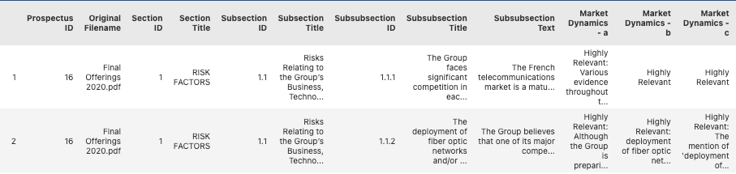
LLM Modelling – Base Experiment Results
Concrete Example
Below example shows LLM output for Market Dynamics –a for RmsId 16 based on the first row (first Subsubsection Title/Text)
The Risk Factors section is 50 pages long in that prospectus giving us a total of 88 rows.
This first row (first Subsubsection Title/Text) looks at 3 pages of text.
Concrete Example Output
df_LLM[df_LLM["Prospectus ID"]=="16"]["Market Dynamics - a"].values[0]
'Highly Relevant: Various evidence throughout the document highlighting intense competition in each market segment, such as
business services-B2B, wholesale, cable pay-TV, and satellite distribution.’
*Disclaimer
I’ve only run the modelling with Meta Llama 3.2. I’ve only run full modelling on 3-level relevance generation (and not “Yes”/”No”).

Slide 9
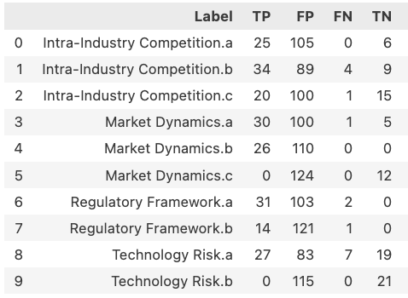
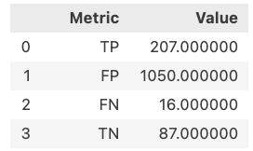
LLM Modelling – Base Experiment Results
Conclusion
LLM is over-identifying risks, leading to a high number of false positives.
*Disclaimer
I’ve only run the modelling with Meta Llama 3.2. I’ve only run full modelling on 3-level relevance generation (and not “Yes”/”No”).

Slide 10
LLM Modelling – The Practical
The Models
I’ve run the Llama 3.2 text-only with 3B parameters.
I want to test more offline models, e.g.: Llama 3.1-8B, Mistral 7B
Ollama
Ollama is a tool that streamlines the use of LLMs: downloading, running, and switching between different models.
Running ollama pull <model_name>, downloads the specified model's components to local machine, enabling to run the model offline. This involves retrieving model weights, confg files (model architecture, tokenizer settings, other hyperparameters)
Could easily use HuggingFace directly.
Running on DTU HPC
Access to Tesla V100/A100 GPUs (16 GB-80GB GPU VRAM) of memory:
Will allow me to run inference on larger LLMs. Realistically, at least a 30B-70B parameter LLM (depending on model Floating Point precision).
Running on Open AI ChatGPT-4o ($2.50 per 1M tokens)
~50 USD per 100 PDF Prospectuses (risk factors section)

Slide 11
Next Steps / Goals
Proof of Concept
Goal: Give PMs and my analyst colleagues an idea of what this technology is capable of.
LLM Modelling
Shortfalls of current approach: LLM over identifies risk.
Conduct experiments to improve performance based on research:
- Experiment with other LLMs.
- Experiment with different prompting techniques.
Prospectus Parsing Processing
Current approach: I have a parsing process that catches around 70%-80% of Prospectuses. I.e. 70-80% of all prospectuses follow exactly same format.
Shortfalls of current approach: After logging parsing errors, remaining fail due to mostly slightly different formatting (different markdown so that we can’t identify hierarchical structure).
Goal: Develop robust parsing process that turns Bond Prospectuses into a data source for future C4 projects.
Developing Prospectus Processing / Modelling Tool (demo) for C4 Analysts / Thesis
Identify how to integrate with existing c4 workflows (PBI).
Lookup LLM-scored companies. Choose a company, for each identified risk, take to section of actual PDF where risk is present.
Upload new unseen pdf prospectus, process, parse and model for sub-score labels.
Streamlit app.

