Slide 1
C4 Fundamental Score meets NLP
October 2024

Slide 2
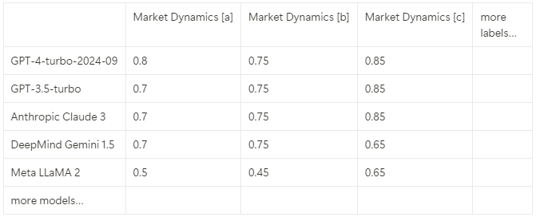
LLMs Analyzing Bond Prospectuses - General Idea
Current Fundamental Scoring Process
Fundamental Score is 1-5, There are 7 sub-scores [Business Model, Competitive Positioning, Market Dynamics, …], Each sub-score has explanatory labels.
For example, Market Dynamics has labels A-C, a-c
- A. Low cyclicality of product demand
- B. Positive demographic, consumer & structural trends
- C. Limited seasonality and stable working capital
- a. Majority of revenues exposed to above average cyclical products
- b. Weak/negative demographic, consumer & structural trends
- c. Seasonal industry with volatile working capital
My Research Motivation
I believe LLMs can derive sub-score labels from bond prospectuses.
What LLMs are/aren’t good at
LLMs are good at processing and interpreting textual data, e.g., scanning bond prospectuses to identify specific
characteristics or keywords related to our sub-score labels.
LLMs are not designed to generate precise numerical outputs. They can recognize numbers within a text, but assigning accurate
numerical scores (e.g., a Fundamental Score from 1 to 5) based solely on qualitative analysis is challenging.
Instead, using LLMs to derive sub-score labels can be a binary problem:
“From this section of text: {SECTION OF TEXT}, is sub-score label a/b/c present?”
To leverage LLMs effectively, we need to develop precise prompts that guide the model to
Directly Address the Query: Ask the LLM to confirm the presence of specific sub-score labels within a text segment, prompting for a clear "yes" or "no.“
Provide Justifications: When the answer is "yes," request that the LLM cites the exact phrases or sentences where the characteristic is mentioned, enhancing transparency and traceability.
My MSc Thesis more specifically
Use analyst sub-score labels to find best performing LLMs
Research the strengths and limitations of LLMs on this task
Try approaches from the literature to improve performance

Slide 3
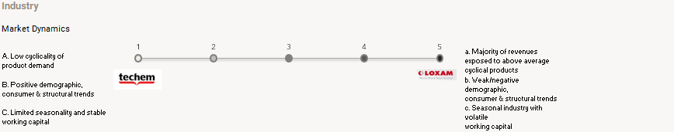
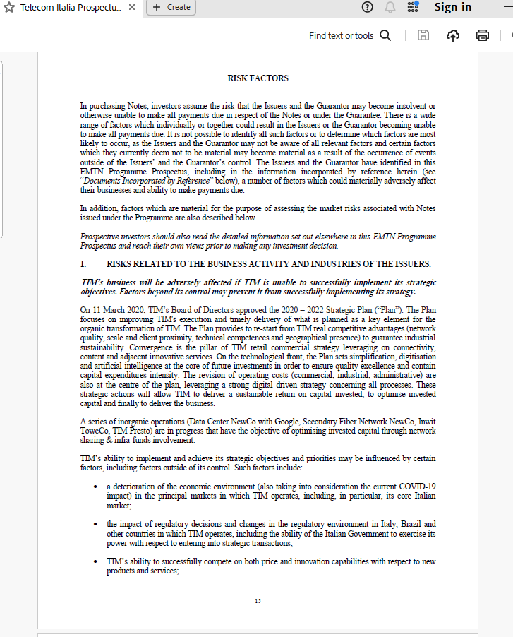

Example - Market Dynamics, Analyst vs LLM
Example – Random Prospectus
Is there anything in this risk factors section referring to any of these positives/risks?
- A. Low cyclicality of product demand
- B. Positive demographic, consumer & structural trends
- C. Limited seasonality and stable working capital
- a. Majority of revenues exposed to above average cyclical products
- b. Weak/negative demographic, consumer & structural trends
- c. Seasonal industry with volatile working capital
[Copy/Pasted the entire RISK FACTORS Section]
Yes, the risk factors section refers to some of the risks listed:
a. Majority of revenues exposed to above average cyclical products
"EDP's profitability may be affected by significant changes in energy demand in each of the countries in which it operates."
"Significant changes in the demand for electricity and natural gas in the markets in which EDP operates may have a material impact on the profitability of EDP’s business activities, such as generation and supply activities."
"Any decrease in power demand or decrease in the rate of demand growth whether due to lower electrification of the economy, increased energy efficiency, the impact of the COVID-19 pandemic or other unexpected events or otherwise could adversely impact the demand for new renewable projects or otherwise have a material adverse effect on EDP’s business, financial condition, results of operations and prospects."
b. Weak/negative demographic, consumer & structural trends
"EDP is exposed to the uncertainty of the macroeconomic, political and social environment.“
Etc. etc.

Slide 4








Capital Four Collaboration
(If this is something C4 wants to look further into)
Data Pipeline
Analytical Framework
Integration with Existing Systems
Automating Data Acquisition
Text Segmentation
Identify LLM possibilities / limitations
Continuous Improvement
Database Synchronization
Data Availability - PBI Dashboard
Scrape from ESMA / SEC / Findox
Split prospectus into sections
Store in DB
Find best performing model compared to C4 analysts
Setup process to regularly test new models against 500+ analyst scores
Integrate LLM outputs into DB
Allow analysts to interact with outputs
Either way, the data pipeline step will prepare prospectuses for future research!

