Slide 1

React.js
Practical Training
Preparation :
Pierre al-khoury
Supervisor:
d.Mohammed hayyan alsibai

Slide 2
What is React.js?
Open-source JavaScript library created by Meta (Facebook)
Used to build dynamic user interfaces
Based on components (reusable building blocks)
a Virtual DOM for fast rendering
Makes apps interactive, efficient, and scalable
one of the most popular tools for modern web development

Slide 3
Why I Chose React.js for My Loan Project ?
Feature | With React | Without React (Vanilla JS)
Component Reuse | ✅ Reusable components for forms and lists | ❌ Need to write duplicate code for similar UI
UI Updates | ✅ Fast, only updates changed parts (Virtual DOM) | ❌ Slow, may require full page refresh or manual DOM manipulation
State Handling | ✅ useState makes managing input and loan data easy | ❌ Harder to track changes across multiple UI elements
Navigation | ✅ React Router simplifies page switching | ❌ Must manually handle DOM changes or use full page reloads
Scalability | ✅ Easy to add new features, components, or pages | ❌ Becomes messy and error-prone as app grows
Reusable Components: build LoanForm, LoanList, LoanItem once, reuse everywhere
Fast Updates: Virtual DOM updates only the changed parts → instant feedback
State Management: manage form inputs, loans, and edits smoothly
Routing Made Easy: React Router handles page navigation (FirstApp → SecApp)
Large Community & Ecosystem: easy to find solutions and libraries

Slide 4
Problem : & solution :
Manual tracking leads to mistakes and
inefficiency
Loan applications can be confusing and error-prone
Existing systems are often complex and not user-friendly
Built a React.js Loan Portal for employees
Features:
Enter personal info (name, phone, age, employment, salary)
Submit loan applications (amount, reason)
View, edit, and delete submitted loans
Provides a fast, accurate, and interactive experience

Slide 5
Technology Stack :
React.js → Build UI with reusable components (LoanForm, LoanForm2, LoanList, LoanItem)
React Router → Navigate between pages (FirstApp → SecApp)
useState Hook → Manage form inputs, loan data, and editing states
useNavigate Hook → Redirect users after validation
Props & Component Structure → Pass data and handler functions between components
CSS (style.css) → Custom styling for forms, buttons, and layout

Slide 6
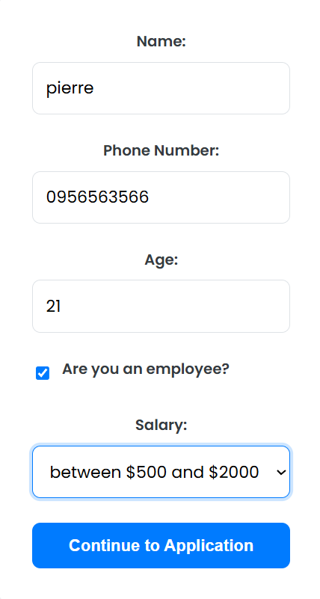
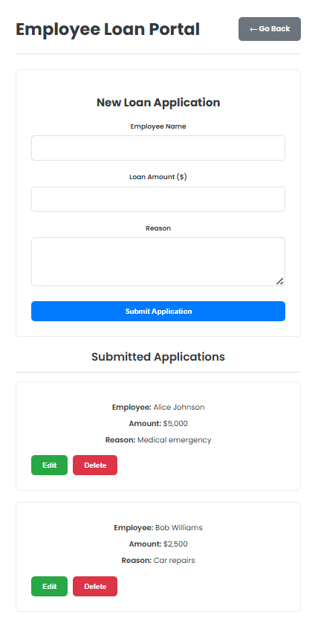
Main Features:
User Validation:
Collects name, phone number, age, employment status, and salary
Ensures age and phone number are valid before proceeding
Navigation:
Redirects to loan portal (SecApp) after successful validation
Loan Management:
Add new loan applications (LoanForm2)
View submitted loans (LoanList & LoanItem)
Edit or delete loans dynamically
Dynamic UI:
Updates reflected immediately using React state
Conditional Rendering:
Shows success/error messages and edit forms only when needed

Slide 7
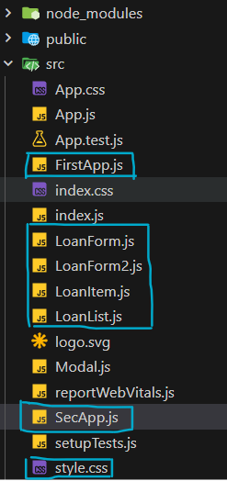
How It Works:
FirstApp (LoanForm)
Collects personal information (name, phone, age, employment, salary)
Validates inputs before proceeding
Uses useNavigate to redirect to /SecApp
SecApp (Loan Portal)
LoanForm2 → Submit new loan applications (amount, reason)
LoanList → Displays all submitted loans
LoanItem → Edit or delete individual loans
State Management
Centralized in SecApp to share loan data between components
useState handles inputs, loans array, and editing states
Conditional Rendering
Shows edit forms when isEditing is true
Displays success/error messages only when needed

Slide 8
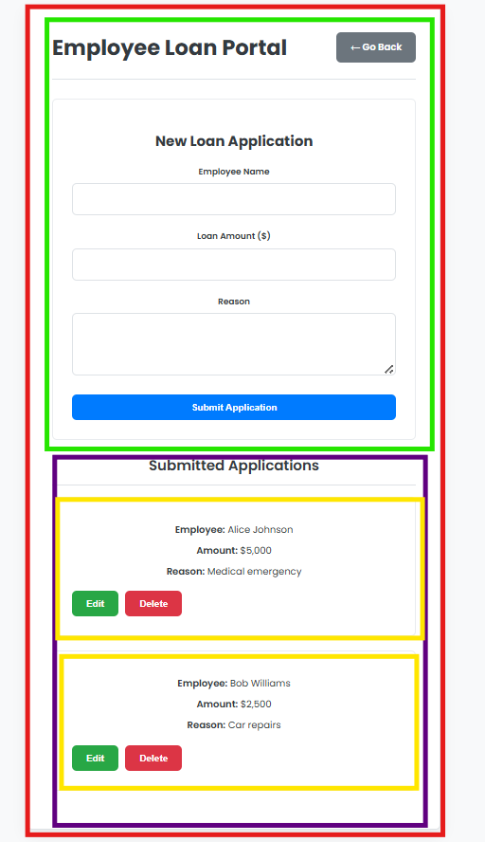

1-Components :
🧩
Axis: Components
Usage: Built LoanForm, LoanForm2, LoanItem, LoanList, FirstApp, SecApp
Challenge: Managing multiple forms and lists without repeating code
Solution (Code Snippet):

Slide 9
2-Props :
📤
Axis: Props
Usage: Pass functions (onAddLoan, onDeleteLoan, onUpdateLoan) and data (loan) between components
Challenge: Sharing state between SecApp and LoanForm2 / LoanList
Solution (Code Snippet):

Slide 10
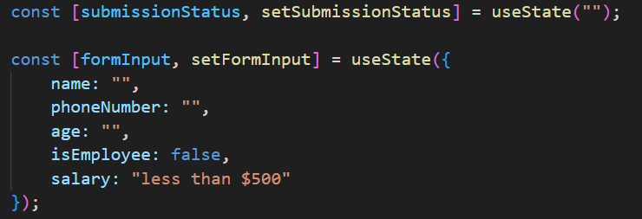
3-useState Hook :
⚡
Axis: useState
Usage: Manage form inputs, loans array, and editing states
Challenge: Updating multiple fields dynamically and reflecting changes immediately
Solution (Code):

Slide 11
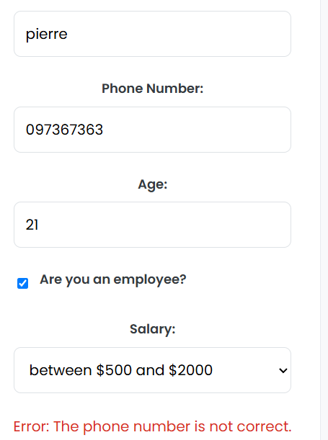
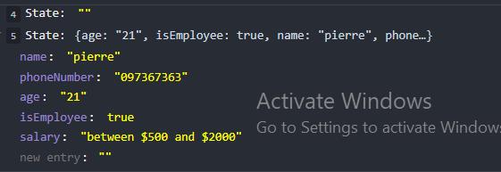
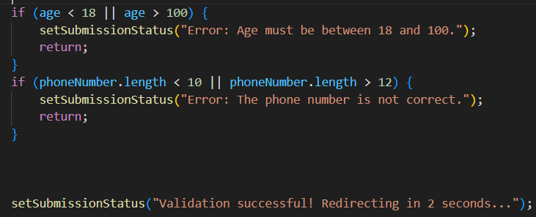

Slide 12
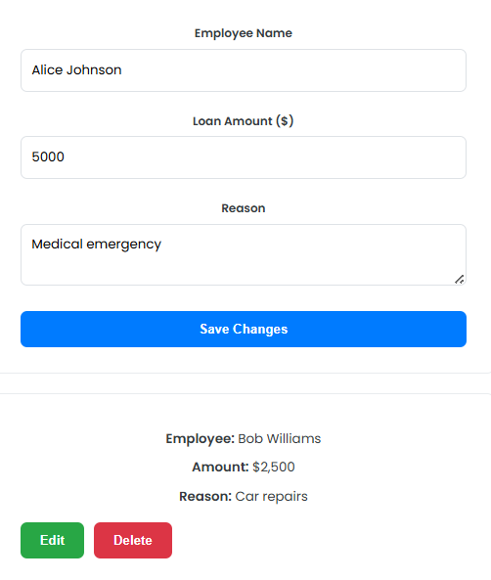
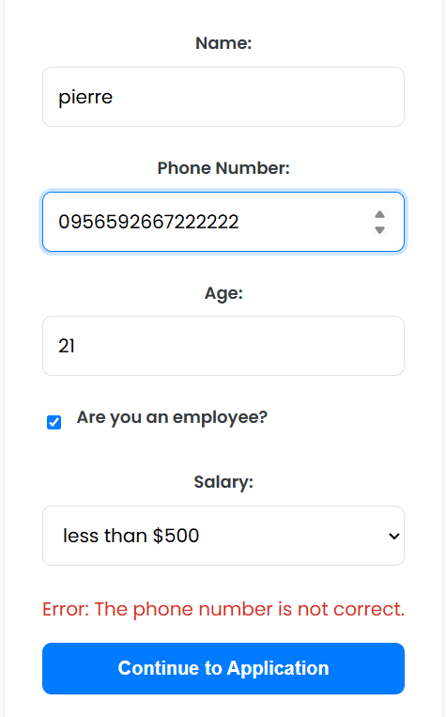
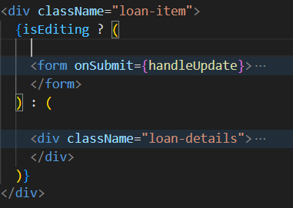

4-Conditional Rendering:
🔄
Axis: Rendering & Conditional Rendering
Usage: Show edit forms only when editing; display messages only when present
Challenge: Toggle between viewing and editing loans
Solution (Code):

Slide 13
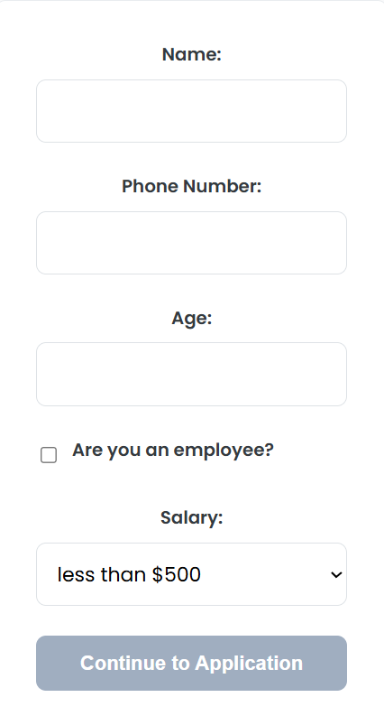
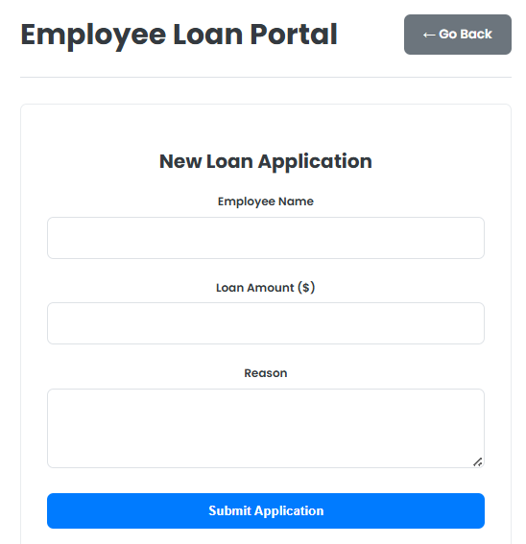
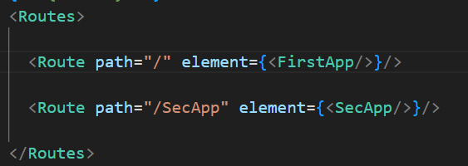

5-React Router:
🛣️
Axis: Router
Usage: Navigate from FirstApp to SecApp after validation
Challenge: Redirect users seamlessly without page reload
Solution (Code):

Slide 14
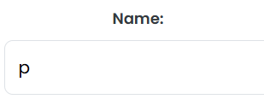
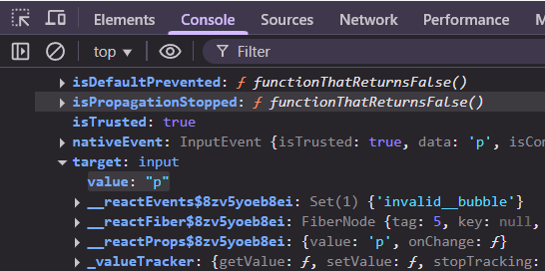
6-Form Handling:
📝
Axis: Forms & Controlled Components
Usage: LoanForm and LoanForm2 manage user inputs via state
Challenge: Keep input values and state in sync
Solution (Code):

Slide 15
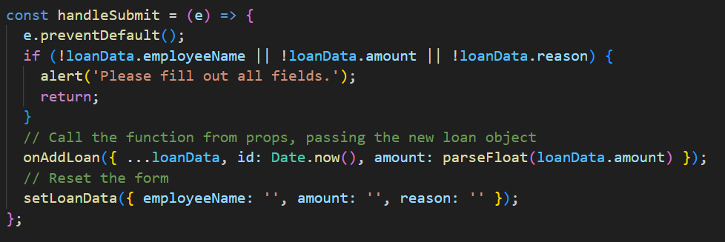
7-Event Handling:
🖱️
Axis: Event Handling
Usage: Submit forms, edit loans, delete loans, checkboxes
Challenge: Prevent default browser behavior and update state correctly
Solution (Code):
Result: Form submission triggers state updates without page reload

Slide 16
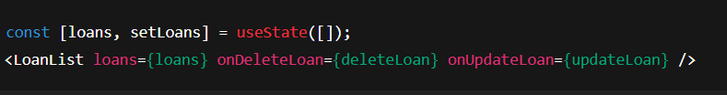
Lifting State & Data Flow:
🔼
Axis: Lifting State Up
Usage: Store loans in SecApp and share with LoanForm2 and LoanList
Challenge: Keep all components in sync when loans are added, edited, or deleted
Solution (Code):

Slide 17
Thank you

