Slide 1
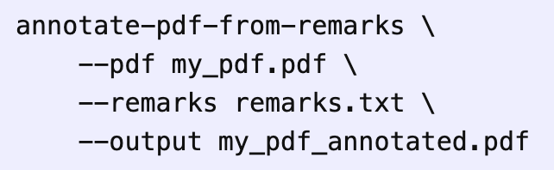
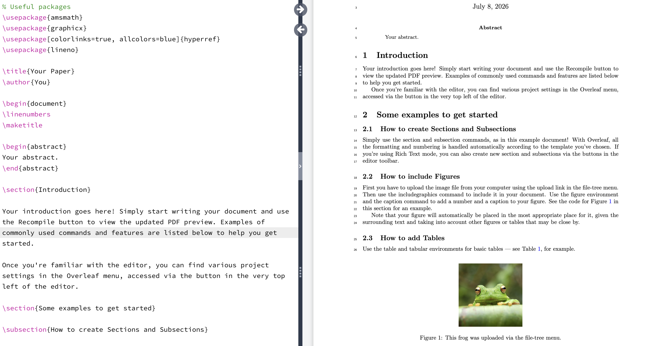
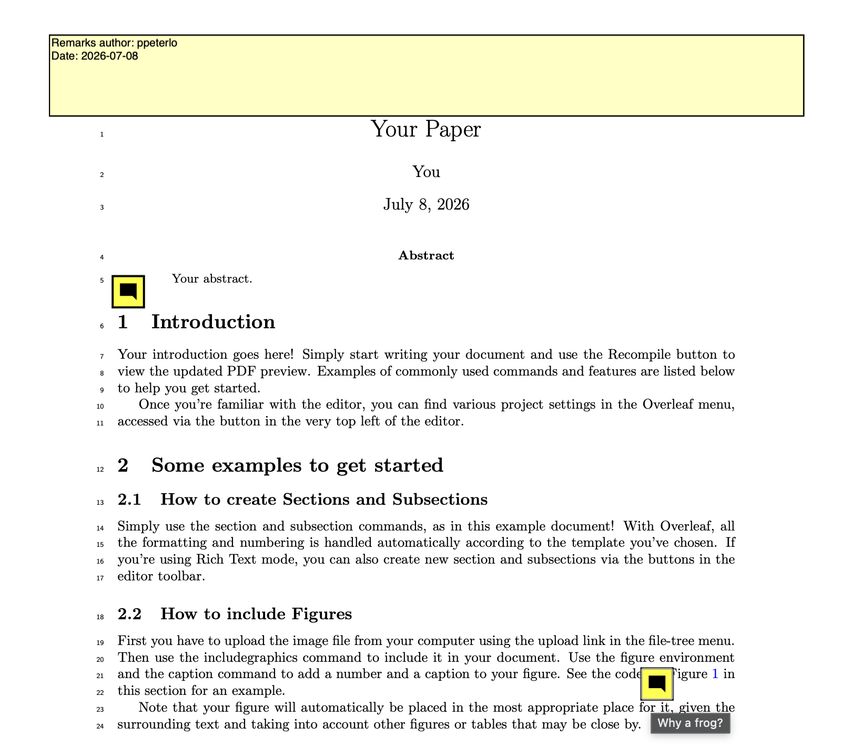
Run annotate_pdf_from_md_remarks
Input
ORIGINAL PDF WITH LINE NUMBERS
Output: annotated pdf
+
REMARK TEXT FILE
l5: the abstract is empty
find:"Figure 1": Why a frog?

