Slide 1

Computacion Visual Interactiva - 2019-2: Final project Pierre Raimbaud A WebGL screensaver using random cubic Bezier curves
Pierre Raimbaud

Slide 2
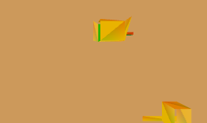
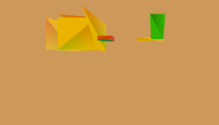
A WebGL screensaver using random cubic Bezier curves
Motivation
Figure 1 and 2 Animated Objects
Animation = translations and rotations
Pierre Raimbaud

Slide 3
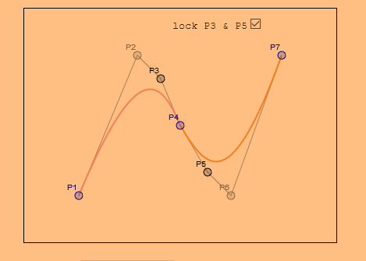
A WebGL screensaver using random cubic Bezier curves
Motivation
Figure 3: Bezier and points of control (source : https://webglfundamentals.org/webgl/lessons/webgl-3d-geometry-lathe.html)
Pierre Raimbaud

Slide 4
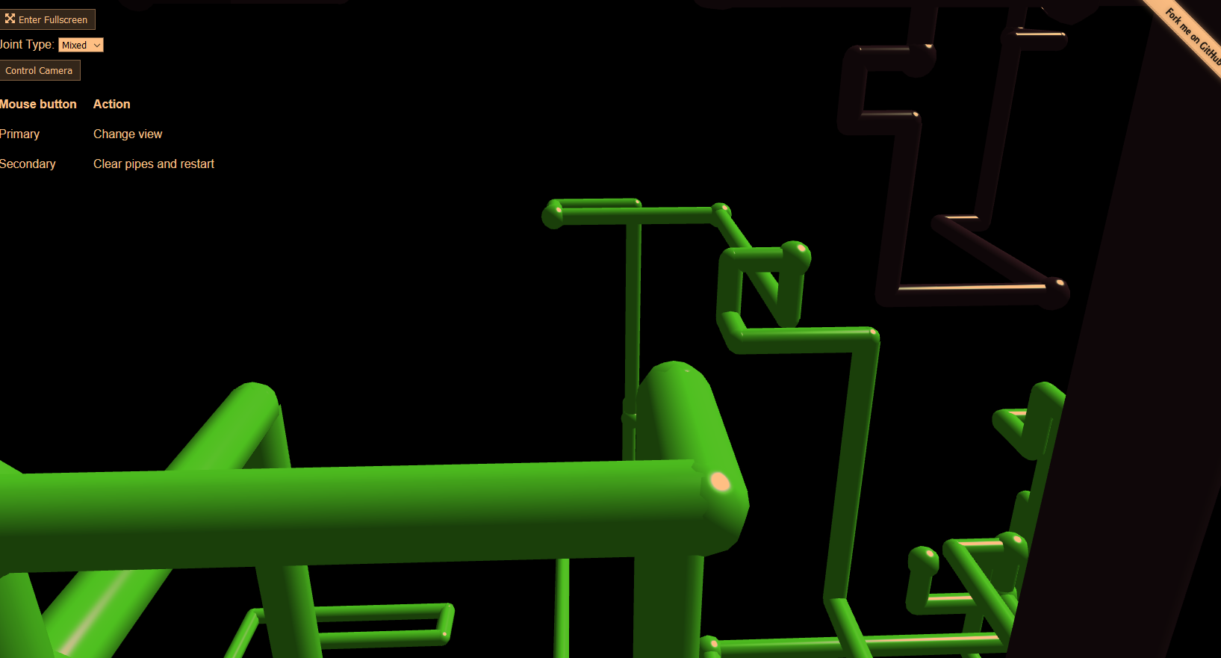
A WebGL screensaver using random cubic Bezier curves
Motivation
Figure 4: WebGL screen saver
(source : https://1j01.github.io/pipes/)
Pierre Raimbaud

Slide 5
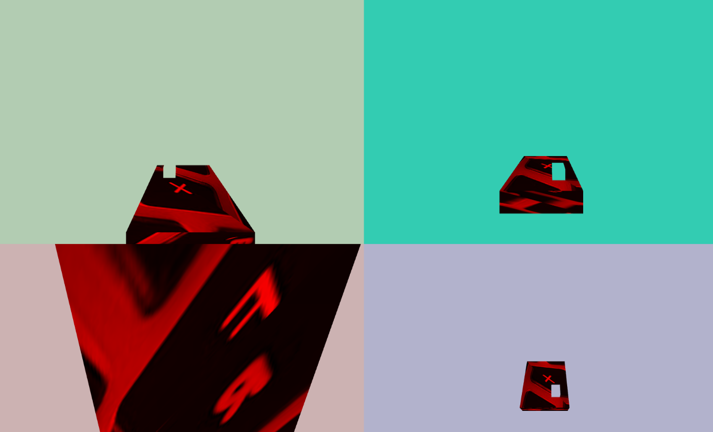
A WebGL screensaver using random cubic Bezier curves
Contribution
Figure 5: My screen saver
Pierre Raimbaud

Slide 6

A WebGL screensaver using random cubic Bezier curves
Contribution
Random curves
One curve follows the previous one
4 points of views
2 objects following different curves
Textures and colours
Bash file for auto launch and F11 (screen saver mode)
Figure 5: My screen saver
Pierre Raimbaud

