Slide 1
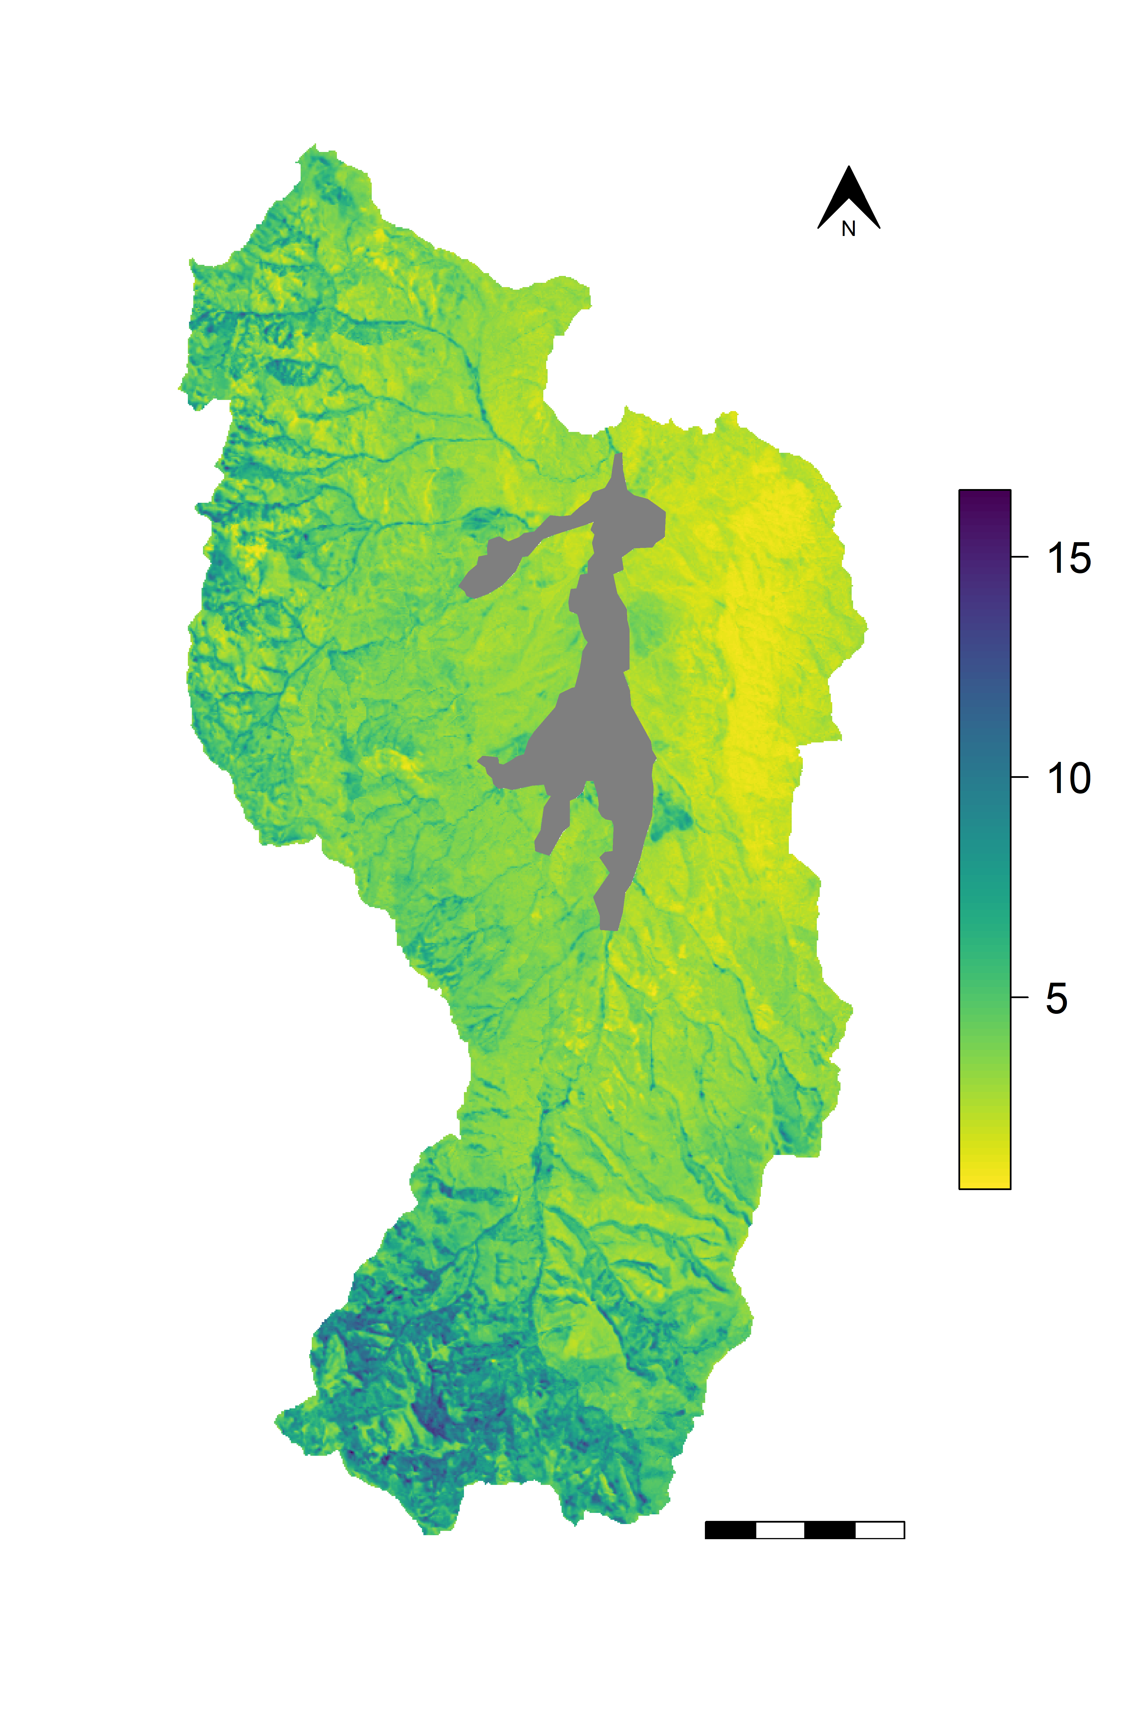
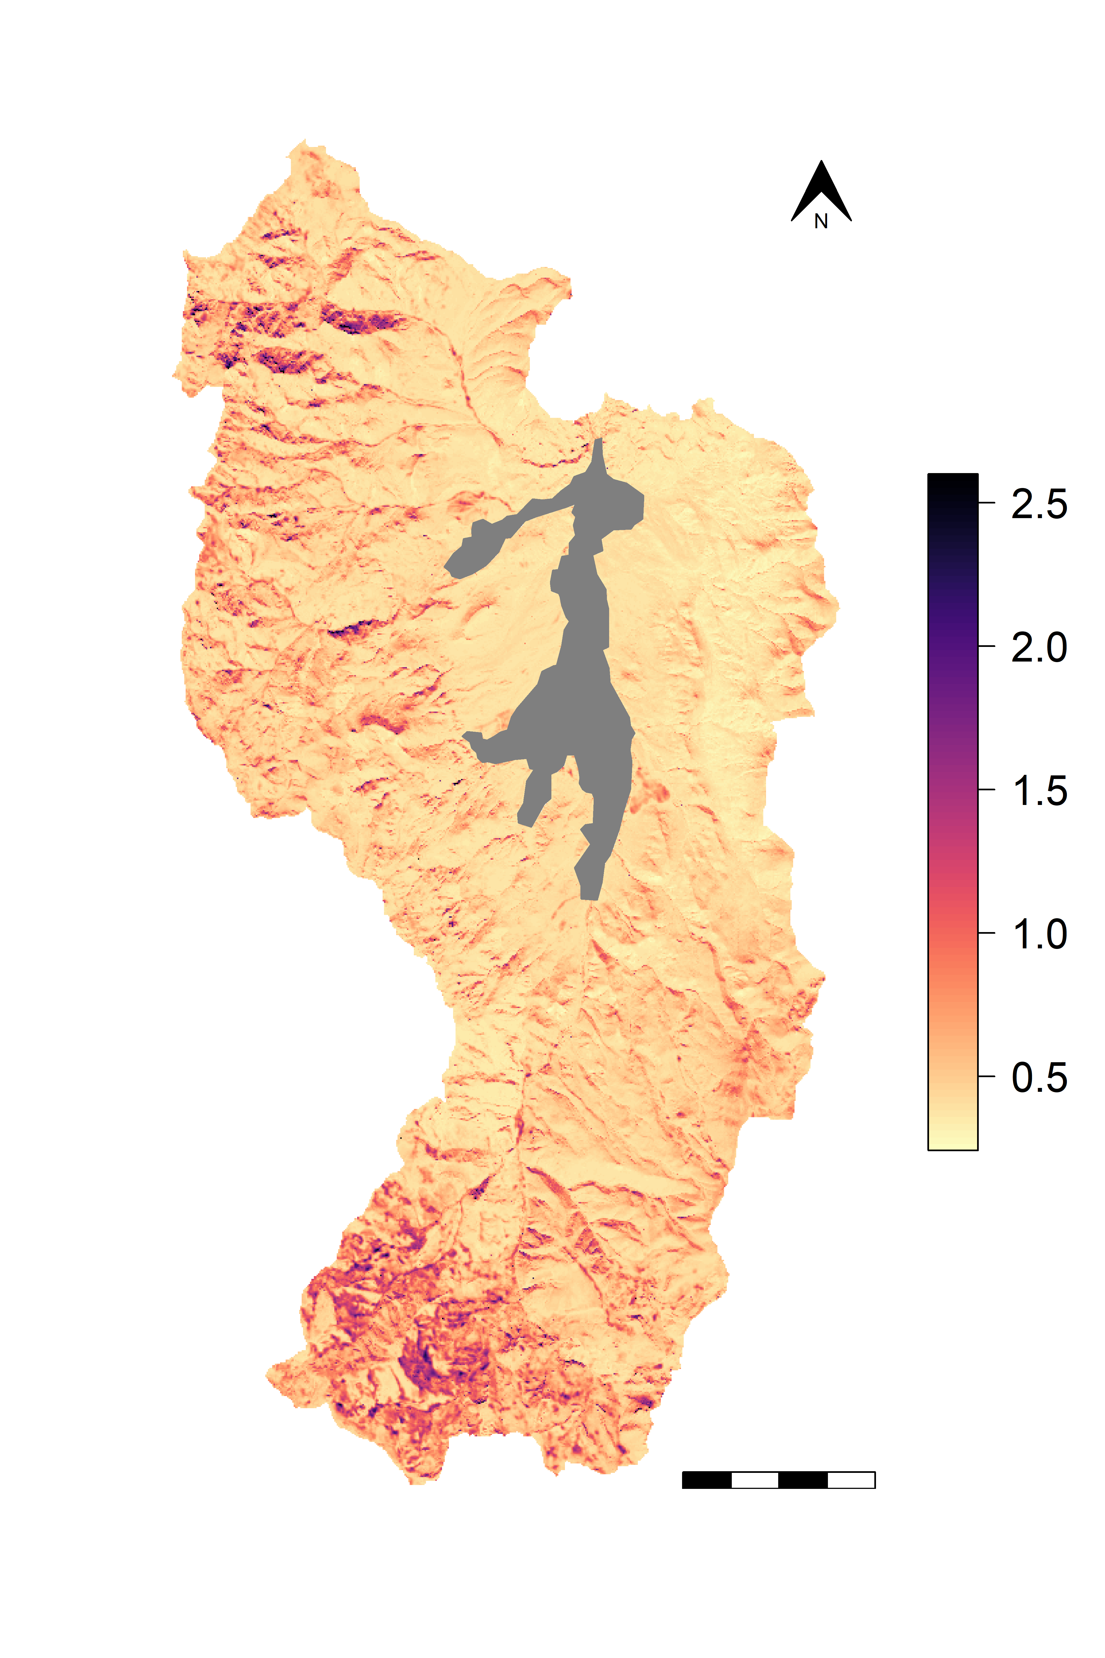

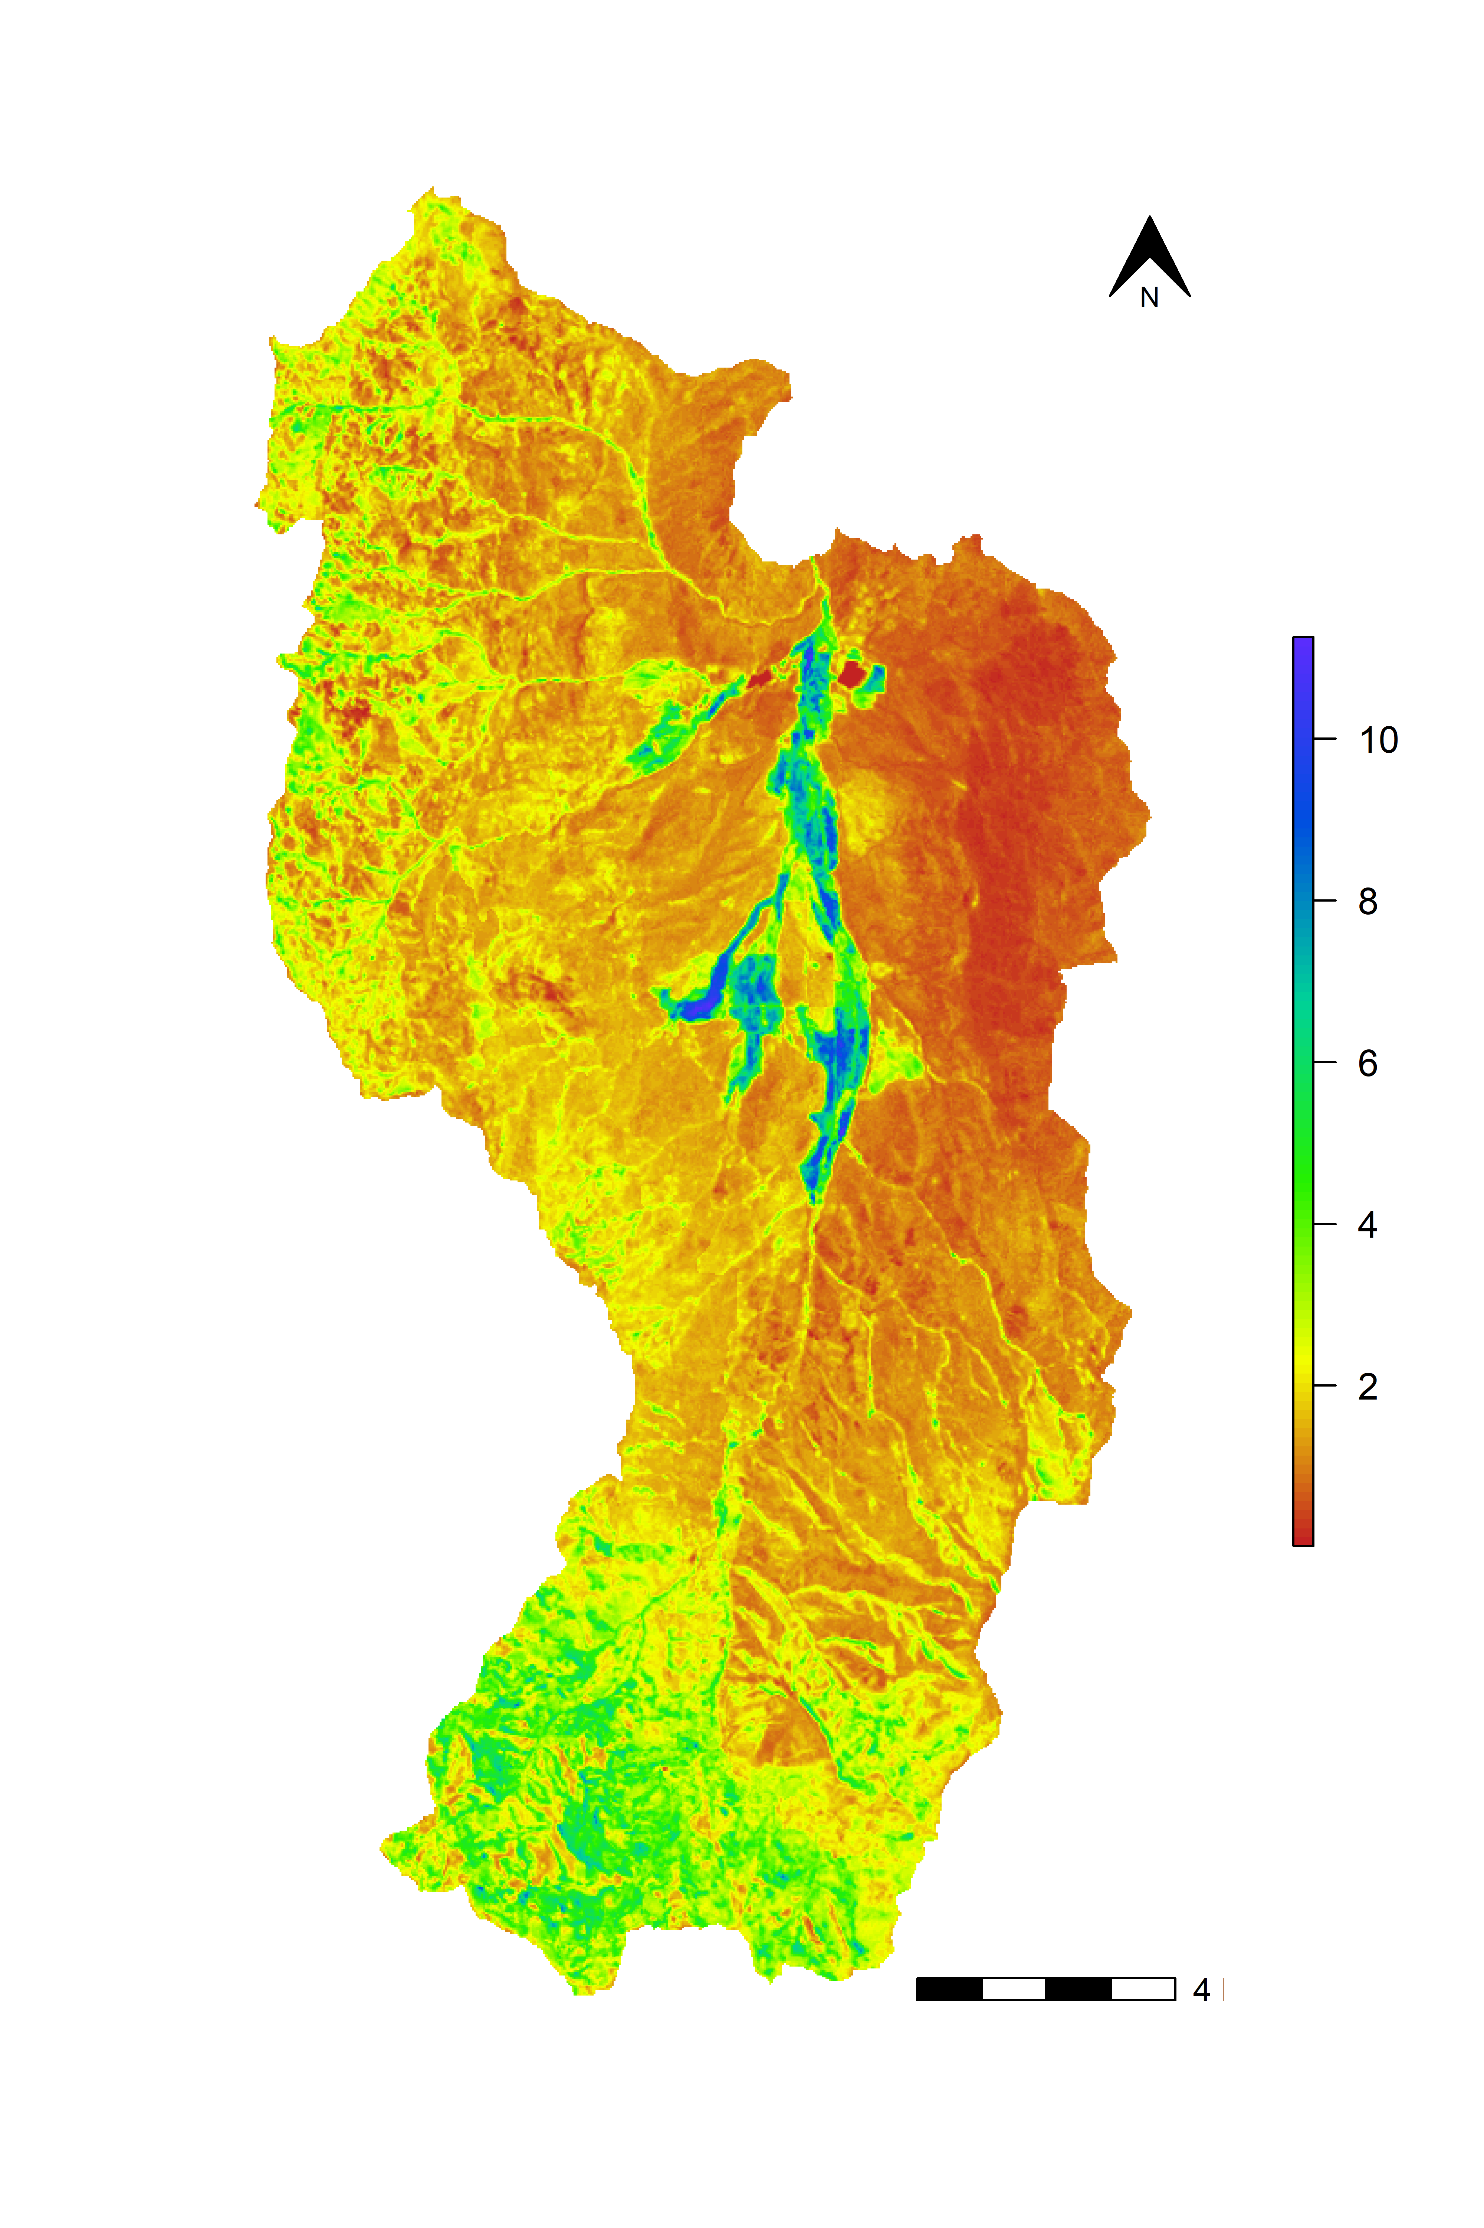
MIMICS 0-30 cm Soil Organic Carbon Stock (kg m⁻²)
MIMICS 0-30 cm Soil Organic Carbon Std. Deviation (kg m⁻²)
Agricultural Land
NA
4 km

