Slide 1
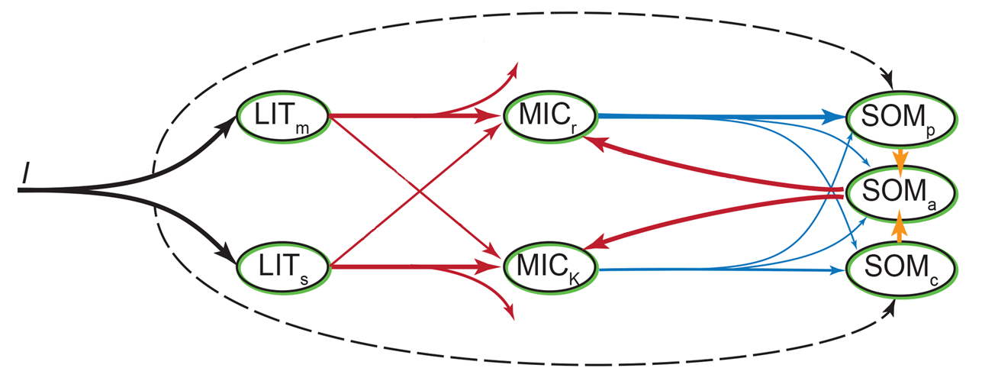
1-MGE
Microbial Decomposition
τ, f_{p}
Organic matter input
MGE
D
Partitioning by litter quality
V_{slope}, V_{int}
K_{slope}, K_{int}
MGE
τ
1-MGE

