Slide 1
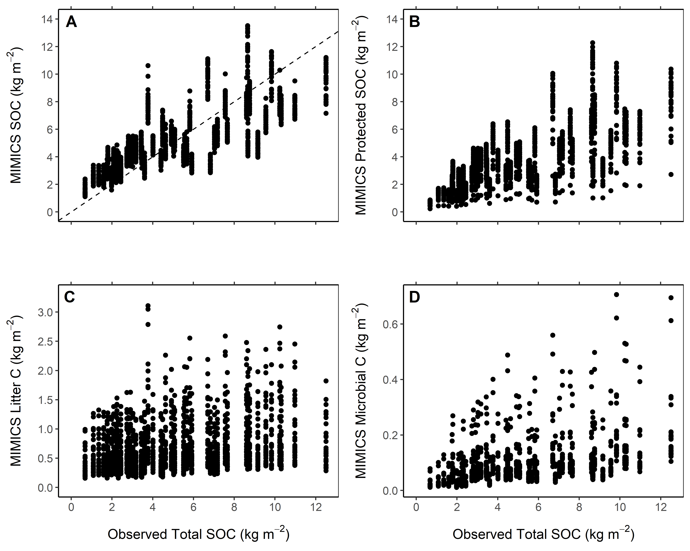
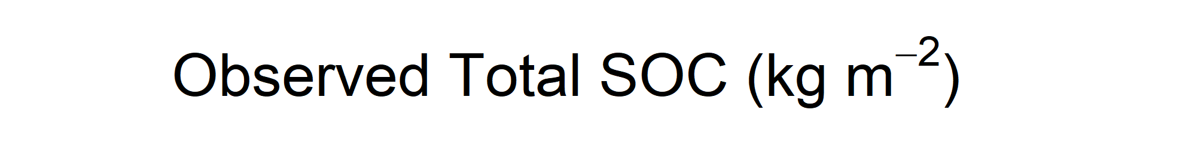

Slide 2
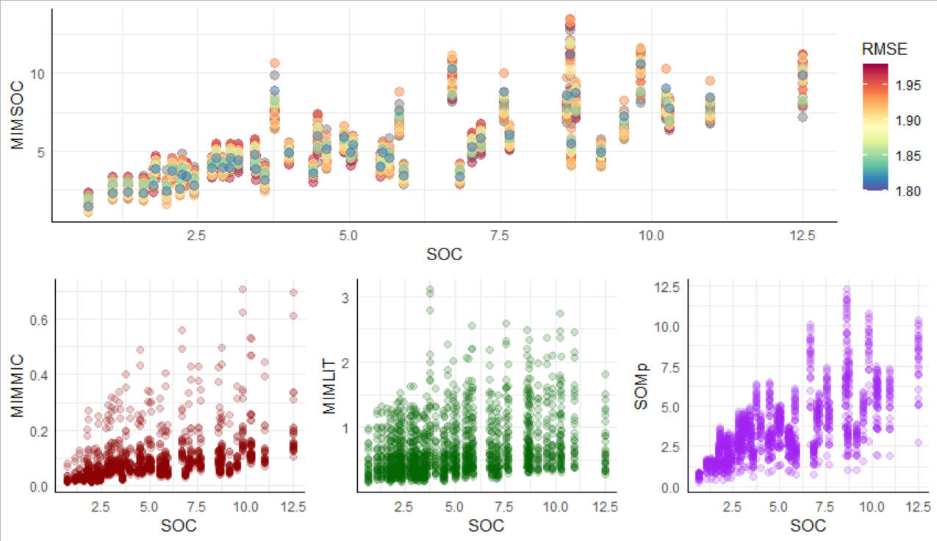
Estimate variability for bulk SOC stocks and underlying SOC pools for a sample set of MIMICS model parameterizations (n=30) with a bulk SOC stock estimate RMSE < 2.
Microbial C
Litter C
Protected SOC

