Slide 1
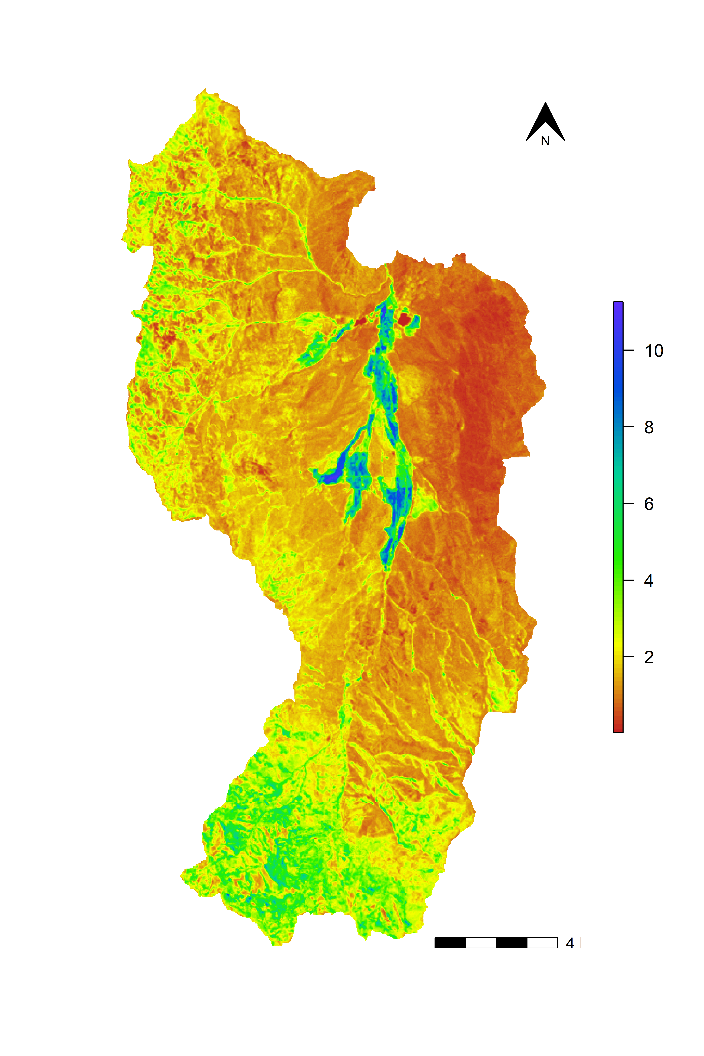
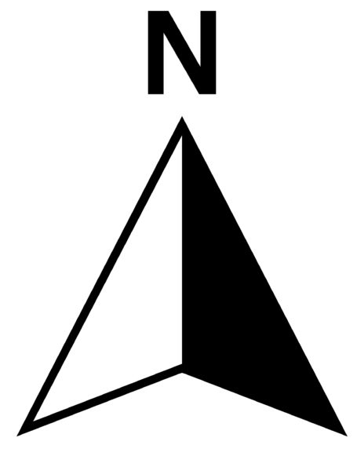
Soil Organic Carbon (kg m⁻²)
4 km

