Slide 1
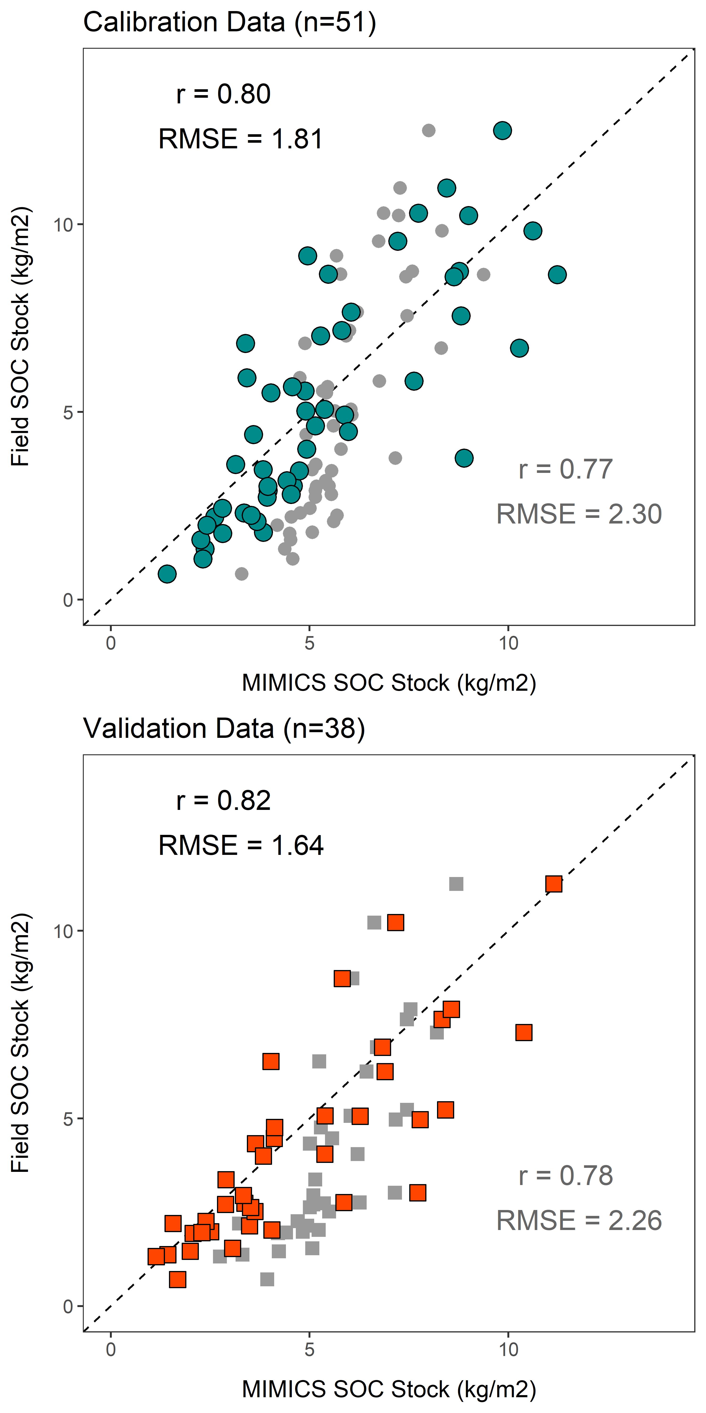
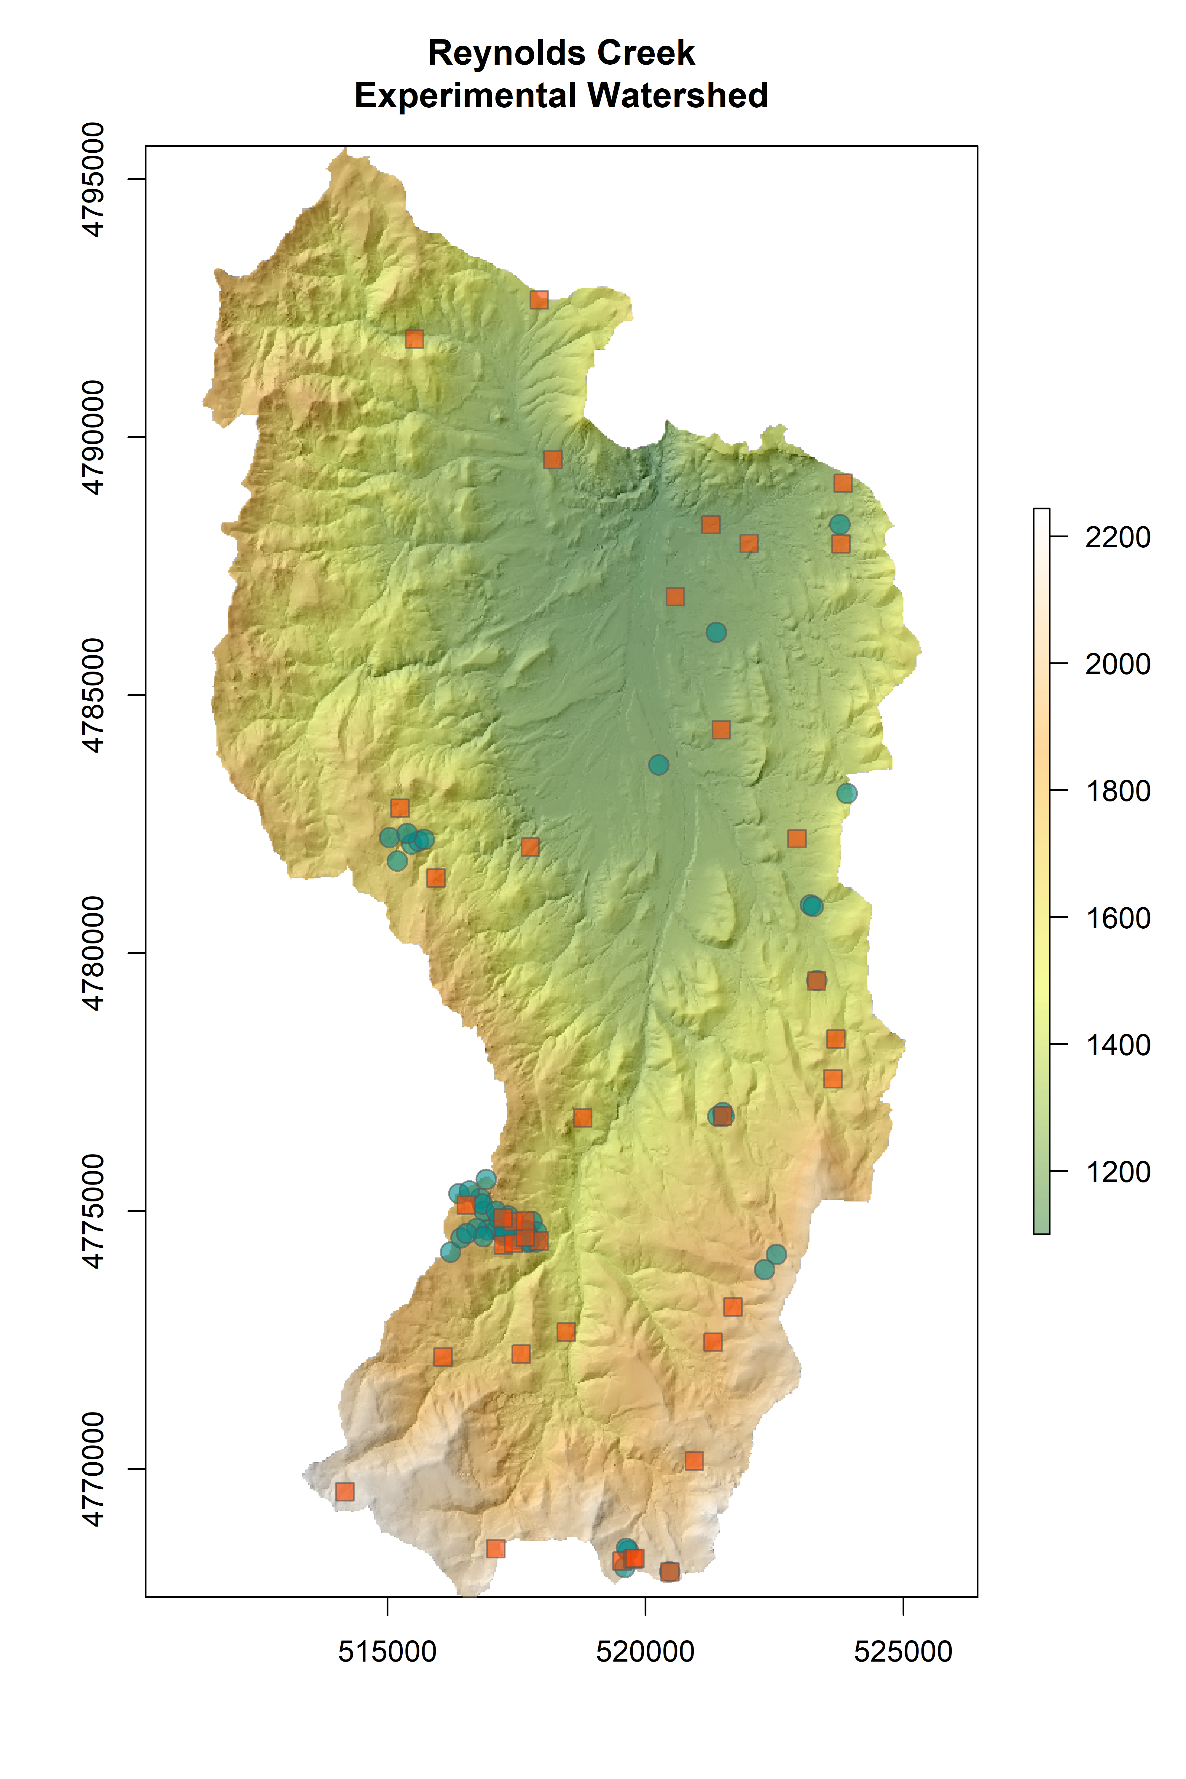
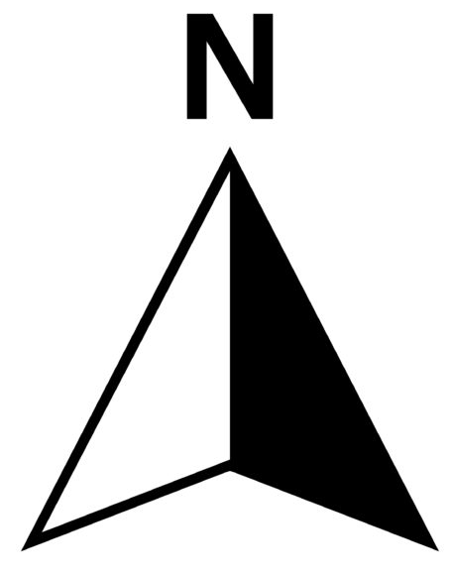
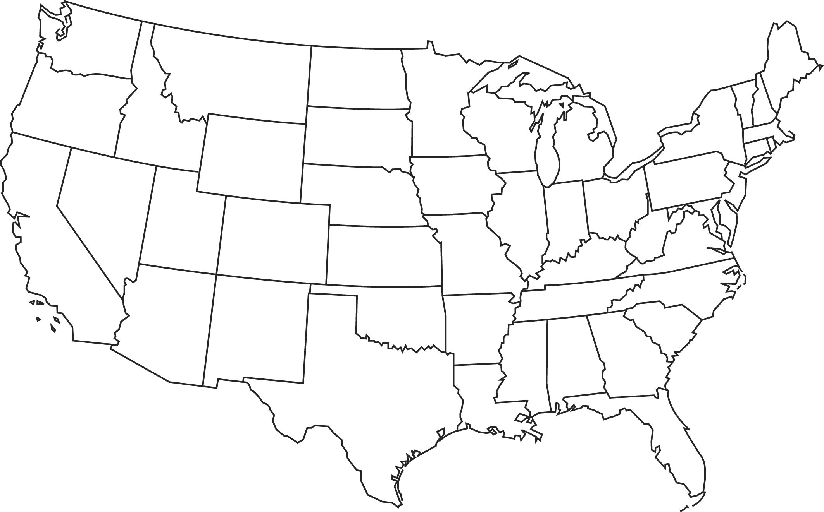
A
Elevation (m)
Field SOC Stock (kg m⁻²)
MIMICS SOC Stock (kg m⁻²)
B
Field SOC Stock (kg m⁻²)
United States of America
MIMICS SOC Stock (kg m⁻²)

Slide 2
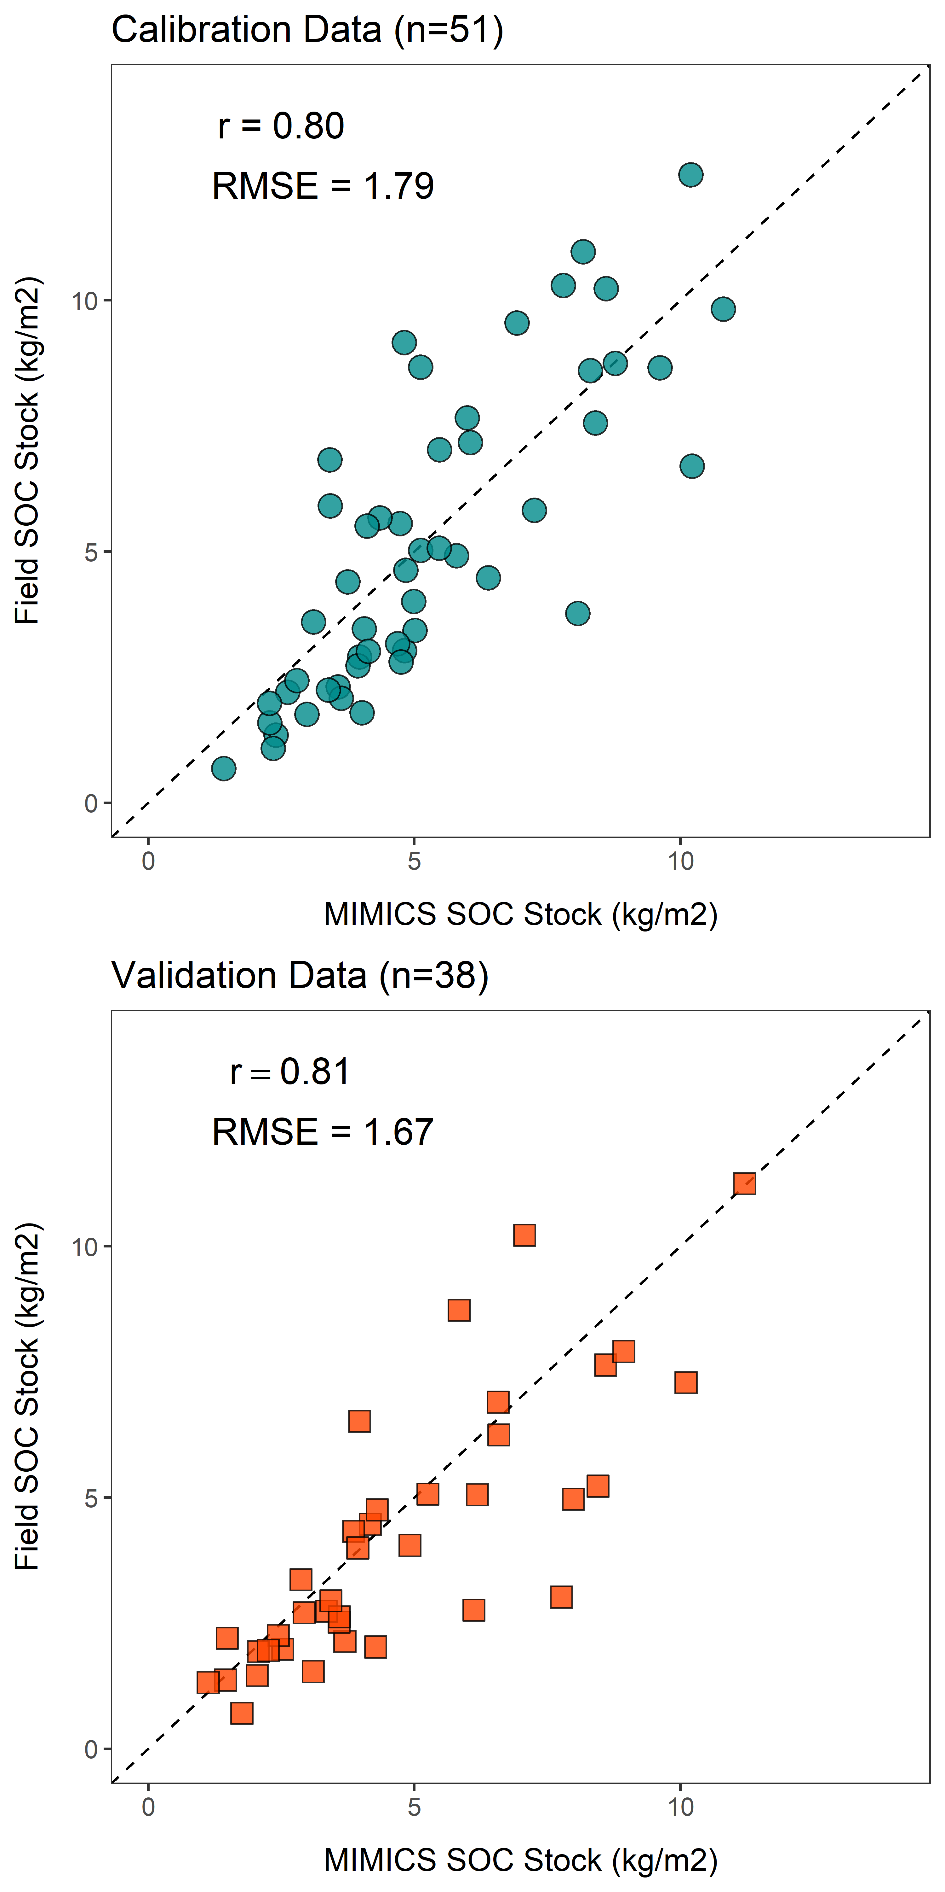
A
Elevation (m)
Field SOC Stock (kg m⁻²)
MIMICS SOC Stock (kg m⁻²)
B
Field SOC Stock (kg m⁻²)
MIMICS SOC Stock (kg m⁻²)

