Slide 1
Untitled

Slide 2
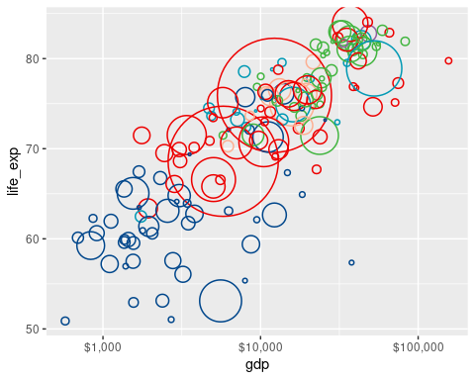
R Markdown

