Slide 1
Master’s degree in Artificial Intelligence and Data Engineering Data Mining and Machine Learning Crypto Predictor
Enrico Nello, Matteo Pierucci

Slide 2
Application Highlights
Crypto Predictor is a tool which aim is to help users in crypto currencies trading, providing a trend prediction for a specified coin.
More specifically, it provides a prediction based on a Classifier trained upon financial Statistical indicator that are evaluated on a Time Series.
Users can select the preferred cryptocurrency from a list and period, then the application will show a graph of the historical values of the coin together with the trend prediction for the following days.

Slide 3
Dataset Description
Source: we scraped from Yahoo Finance API the crypto historical values of the last 5 years (between 2017 and 2022) for each of the 10 most popular currencies:
Ethereum
Bitcoin
Tether
Binance
USD
Description: This dataset contains information on the past financial values of the currencies, in particular: data from the past 5 years from 10 different currencies for a total of 18.860 (365 * 5 years * 10 currencies) different tuples.
XRP
Cardano
Solana
Terra
Avalanche

Slide 4
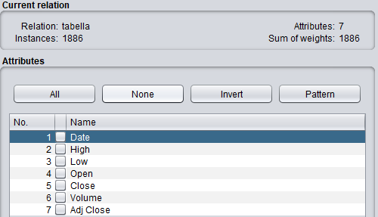
Dataset Description II
This dataset refers only to a single crypto-currency

Slide 5
Intuition
As we deal with Time Series Data, our intuition is to exploit the following concepts:
A moving average technique
The Financial Technical Approach
We then decided to exploit the exponential moving average that is a type of moving average that gives more weight to recent observations, which means it’s able to capture recent trends more quickly, in our case crypto trends.
An increasing trend signal is generated when the short-term average crosses the long-term average and rises above it, while a decreasing trend signal is triggered by a short-term average crossing long-term average and falling below it

Slide 6
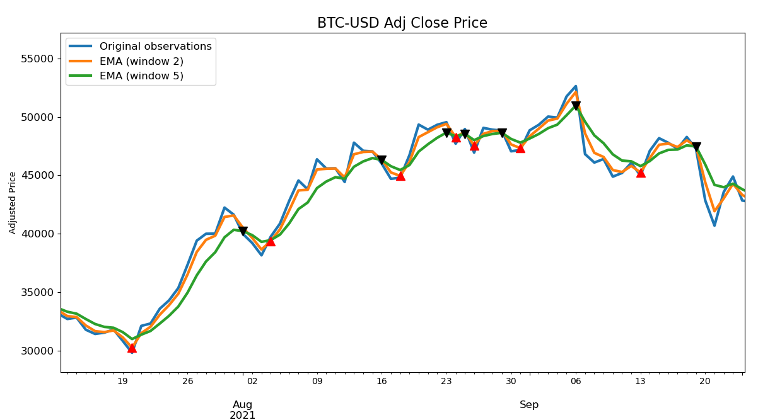

Slide 7
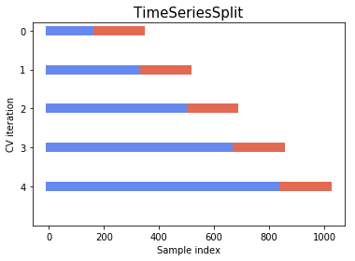
Cross Validation for Time Series

Slide 8
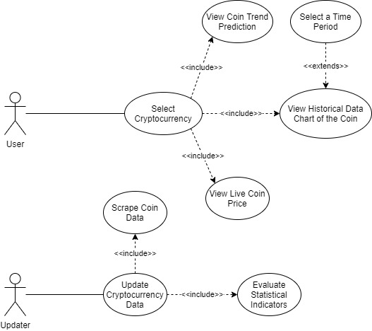
Use Case Diagram

Slide 9
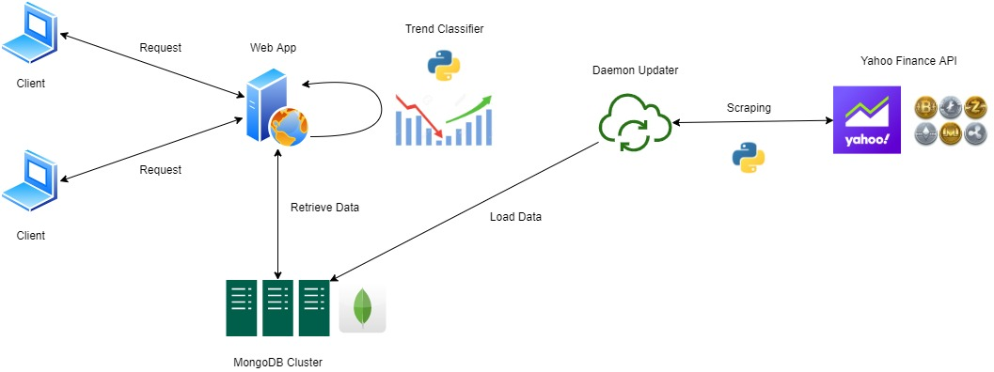
Implementation
The client-side of the application is developed as a modern Web App

