Slide 1


Spatial: A Language and Compiler for Application Accelerators
David Koeplinger
Matthew Feldman | Raghu Prabhakar | Yaqi Zhang | Stefan Hadjis | Tian Zhao
Ruben Fiszel | Luigi Nardi | Ardavan Pedram | Christos Kozyrakis | Kunle Olukotun
Notes:
The Four Components of Big Data Analytics
Big data analytics is the process of examining large data sets to uncover hidden patterns and unknown correlations to accelerate scientific discovery or market trends and customer preferences to develop business insights. This talk will describe four of the key components of big data analytics (1) Extraction Transform and Load (ETL) which takes unstructured data and translates it to structured (tabular) data, (2) Query processing which executes queries over structured data (3) Graph analytics for exploring complex relationships in big data, and (4) Machine learning for building statistical models from big data. For each of the four components we will look at example applications, examine the computational and memory access behavior of the core algorithms and understand how well heterogeneous hardware architectures (CPU, GPU, clusters) perform on these algorithms. This understanding will be used to determine how the hardware for future big-data systems should be architected.

Slide 2
Spatial Resources
Language documentation and tutorials:
spatial.stanford.edu
Spatial Google Group:
groups.google.com/forum/#!forum/spatial-lang-users
Spatial Github Repo:
github.com/stanford-ppl/spatial-lang
Notes:
Improve motivation here – story is (essentially):
1. Why do you want FPGAs/CGRAs?
2. Why is it hard to get them currently?
Also add slide showing where Spatial fits into DAWN flow

Slide 3
Increasing Demand for Reconfigurability
There is growing demand for reconfigurable architectures as application accelerators in data centers for performance and energy efficiency
Notes:
Improve motivation here – story is (essentially):
1. Why do you want FPGAs/CGRAs?
2. Why is it hard to get them currently?
Also add slide showing where Spatial fits into DAWN flow

Slide 4











Improvements in Performance, Energy Efficiency
Software Defined Accelerators for DNNs
Distributed real-time deep learning on FPGAs
[HotChips ‘14]
XPU: Programmable FPGA Accelerator
[HotChips ‘17]
2 – 4x perf vs. CPU/GPU
2 – 3x perf/W vs. CPU/GPU
64x perf vs. CPU
25x perf/W vs. CPU
Catapult “Configurable Cloud”
Distributed application and network acceleration
“…already been deployed at hyperscale and is how
most new Microsoft data center servers are configured.” [Caulfield et. al. Micro ’16]
~10x perf vs. CPU
~ 9x perf/W vs. CPU
Project Brainwave
Distributed real-time deep learning on FPGAs
[HotChips ‘17]
CGRA for Parallel Patterns
[ISCA ‘17]
Up to 95x perf vs. FPGA
Up to 75x perf/W vs. FPGA

Slide 5





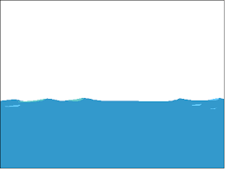


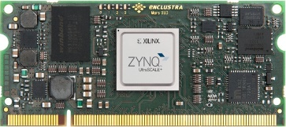
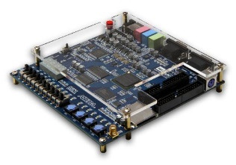
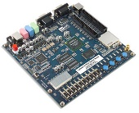

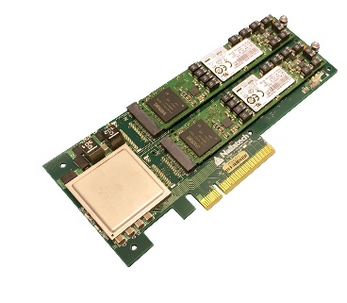


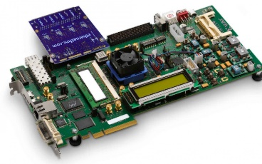
Accessing Reconfigurable Architectures
Productivity
Efficiency
Performance
Applications
Reconfigurable
Architectures

Slide 6

Accessing Reconfigurable Architectures
Productivity
Efficiency
Performance
Applications
Reconfigurable
Architectures
Spatial

Slide 7
Key Programming Challenges
Pipeline timing
Fine-grained timing of control signals
Management of multiple clock domains
Disjoint memory spaces
No hardware-managed cache
Requires manual data partitioning and timing of memory operations
Limited compute and memory resources
Huge parameter design spaces
Grows exponentially - even relatively small designs can have very large spaces
Parameters are interdependent and can change runtime by orders of magnitude
Manual exploration is tedious and usually suboptimal

Slide 8
Key Programming Challenges (Continued..)
Quick verification
Hardware synthesis is too slow to be part of the debug loop
Writing test benches is challenging and requires waveform debugging
Managing host-accelerator interface
Tile transfers, register interfaces, data streams, etc.
Incorporating IP cores into design

Slide 9
Design Space Example
Algorithm: Dot Product of Vectors A and B
DRAM
A
FPGA
Tile A
+
acc
×
B
Tile B
Key
Small and simple, but slow!
Scratchpad
Reg
op

Slide 10
Important Parameters: Tile Sizes
Algorithm: Dot Product of Vectors A and B
DRAM
A
FPGA
Tile A
+
acc
×
B
Tile B
Key
Key
Increases length of DRAM accesses Runtime
Increases exploited spatial locality Runtime
Increases local memory sizes Area
Scratchpad
Scratchpad
Reg
Reg
op
op

Slide 11
Important Parameters: Pipelining
Algorithm: Dot Product of Vectors A and B
DRAM
A
FPGA
Stage 1
Stage 2
Tile A
+
acc
×
B
Tile B
Key
Double
Overlaps memory and compute Runtime
Increases local memory sizes Area
Adds synchronization logic Area
Buffer
Reg
op

Slide 12
Important Parameters: Parallelization
Algorithm: Dot Product of Vectors A and B
DRAM
A
FPGA
×
Tile A
+
+
acc
×
+
B
Tile B
×
Key
Improves element throughput Runtime
Duplicates compute resources Area
Scratchpad
Reg
op
Notes:
add legends

Slide 13
Important Parameters: Memory Banking
Algorithm: Dot Product of Vectors A and B
DRAM
A
FPGA
×
Tile A
+
+
acc
×
+
B
Tile B
×
Key
Improves element throughput Runtime
May duplicate memory resources Area
Scratchpad
Reg
op
Notes:
add legends

Slide 14
Language Requirements
Performs hardware optimizations for higher level frameworks
Productive language for “power” users (hardware programmers)
Produces efficient hardware
Performance
Productivity
Portability

Slide 15
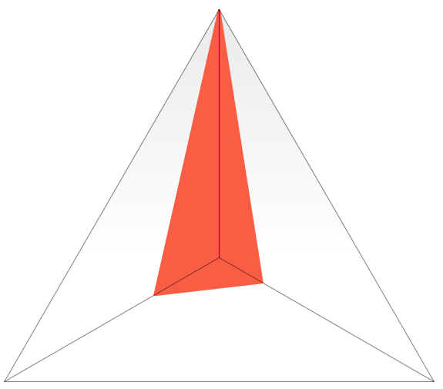
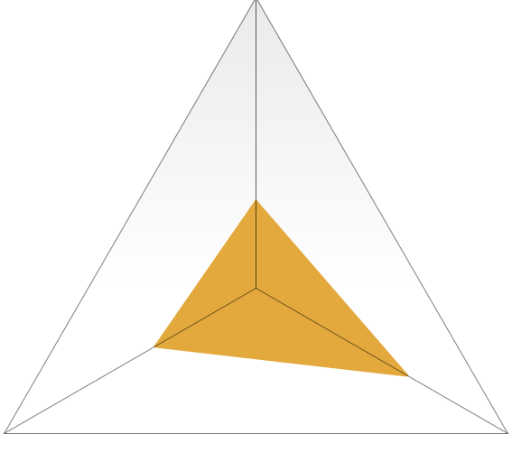
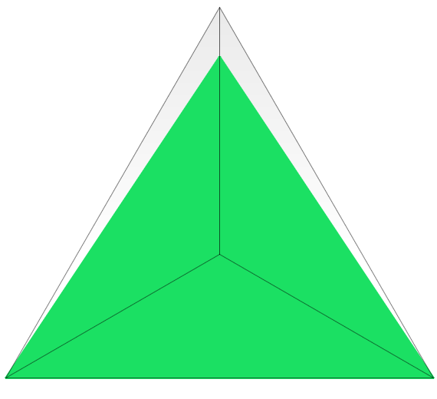
Language Comparisons
HDLs (Verilog, VHDL, Chisel, etc.)
High Level Synthesis (C, OpenCL)
Performance
Productivity
Performance
Productivity
✓ Arbitrary RTL
✘ No memory
hierarchy
✓ Nested loops
✘ No high-level
abstractions
✘ Difficult to tune
✘ No arbitrary
pipelining
Portability
Portability
Spatial
Performance
Productivity
✓ Memory hierarchy
✓ Nested loops
✓ Arbitrary pipelining
✓ Automatic memory banking/buffering
✘ Can’t write
arbitrary RTL
✓ Automated design tuning
✓ Simple host communication API
Portability
✓ Target-generic source

Slide 16




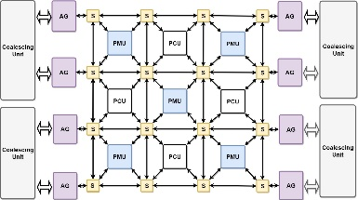

Spatial as an Intermediate Representation
Applications
Optimization/
Translation
Delite
Spatial IR
Spatial Compiler
Plasticine
CGRAs
FPGAs
Data-flow graphs converted to spatial hardware architectures
val data = LineBuffer[T](K, in_c)
val row = RegFile[T](K, K)
val weight_RF = RegFile[T](K, K)
weight_RF load w_DRAM(channel, 0::K, 0::K)
Foreach(0 until in_r) { r =>
data load i0_DRAM(channel, r, 0::in_c)
Foreach(0 until in_c) { c =>
Foreach(0 until K){
i => row(i, *) <<= data(i, c)
}
val window = Reduce(0 until K, 0 until K){
(i,j) => row(i,j) * weight_RF(i,j)
}{_+_}
conv_out(r, c) = window.value
}
}
From host DRAM
FPGA DRAM
Shift Reg
Line Buffer
x
Reg
File
x
x
Sliding Window
Computation
+
SRAM
Output feeds into next layer

Slide 17
The Spatial Language: Memory Abstractions
Typed storage templates
val accum = Reg[Double]
val fifo = FIFO[Float](D)
val lbuf = LineBuffer[Int](R,C)
val pixels = ShiftReg[UInt8](R,C)
Explicit memory hierarchy
val buffer = SRAM[UInt8](C)
val image = DRAM[UInt8](H,W)
Explicit transfers across memory hierarchy
Dense and sparse access
buffer load image(i, j::j+C)
out := x + y
buffer gather image(a, 10)
Streaming abstractions
val videoIn = StreamIn[RGB]
val videoOut = StreamOut[RGB]

Slide 18
The Spatial Language: Control Abstractions
Blocking/non-blocking
interaction with host
Accel { … }
Accel(*) { … }
FSM[Int]{s => s != DONE }{
case STATE0 =>
Foreach(C by 1){j => … }
case STATE1 => …
Reduce(0)(C by 1){i => … }
}{s => nextState(s) }
Arbitrary state machine / loop nesting with implicit control signals

Slide 19
The Spatial Language: Design Parameters
Spatial templates capture a variety of design parameters:
val P = 16 (1 → 32)
Reduce(0)(N by 1 par P){i =>
data(i)
}{(a,b) => a + b}
Implicit/Explicit parallelization factors
Stream.Foreach(0 until N){i =>
…
}
Implicit/Explicit control schemes
val B = 64 (64 → 1024)
val buffer = SRAM[Float](B)
Foreach(N by B){i =>
…
}
Explicit size parameters for stride
and buffer sizes
Implicit memory banking and buffering schemes for parallelized access
Foreach(64 par 16){i =>
buffer(i) // Parallel read
}
Notes:
Parts in italics are optional syntax. Default scheme for FSMs is Sequential, for all others is MetaPipe
Streaming is chaining

Slide 20
Dot Product in Spatial
val output = ArgOut[Float]
val vectorA = DRAM[Float](N)
val vectorB = DRAM[Float](N)
Accel {
Reduce(output)(N by B){ i =>
val tileA = SRAM[Float](B)
val tileB = SRAM[Float](B)
val acc = Reg[Float]
tileA load vectorA(i :: i+B)
tileB load vectorB(i :: i+B)
Reduce(acc)(B by 1){ j =>
tileA(j) * tileB(j)
}{a, b => a + b}
}{a, b => a + b}
}
DRAM
FPGA
Outer Reduce
A
Stage 1
Stage 2: Inner Reduce
tileA
+
acc
×
B
tileB
Stage 3
output
+
Notes:
0. Initial program written in OptiML
Declaration of off-chip memories
Outer loop of tiled reduction with implicit parallelization and pipelining parameters
Declaration of on-chip memories with explicit buffer size
Explicit loads from off-chip to onchip with implicit parallelization
On-chip reduction loop with implicit parallelization
Loads and inner reduction can be overlapped by outer reduce

Slide 21
Dot Product in Spatial
val output = ArgOut[Float]
val vectorA = DRAM[Float](N)
val vectorB = DRAM[Float](N)
Accel {
Reduce(output)(N by B){ i =>
val tileA = SRAM[Float](B)
val tileB = SRAM[Float](B)
val acc = Reg[Float]
tileA load vectorA(i :: i+B)
tileB load vectorB(i :: i+B)
Reduce(acc)(B by 1){ j =>
tileA(j) * tileB(j)
}{a, b => a + b}
}{a, b => a + b}
}
DRAM
FPGA
Outer Reduce
A
Stage 1
Stage 2: Inner Reduce
tileA
+
acc
×
B
tileB
Stage 3
output
+
Notes:
0. Initial program written in OptiML
Declaration of off-chip memories
Outer loop of tiled reduction with implicit parallelization and pipelining parameters
Declaration of on-chip memories with explicit buffer size
Explicit loads from off-chip to onchip with implicit parallelization
On-chip reduction loop with implicit parallelization
Loads and inner reduction can be overlapped by outer reduce

Slide 22
Dot Product in Spatial
val output = ArgOut[Float]
val vectorA = DRAM[Float](N)
val vectorB = DRAM[Float](N)
Accel {
Reduce(output)(N by B){ i =>
val tileA = SRAM[Float](B)
val tileB = SRAM[Float](B)
val acc = Reg[Float]
tileA load vectorA(i :: i+B)
tileB load vectorB(i :: i+B)
Reduce(acc)(B by 1){ j =>
tileA(j) * tileB(j)
}{a, b => a + b}
}{a, b => a + b}
}
DRAM
FPGA
Outer Reduce
A
Stage 1
Stage 2: Inner Reduce
tileA
+
acc
×
B
tileB
Stage 3
output
+
Notes:
0. Initial program written in OptiML
Declaration of off-chip memories
Outer loop of tiled reduction with implicit parallelization and pipelining parameters
Declaration of on-chip memories with explicit buffer size
Explicit loads from off-chip to onchip with implicit parallelization
On-chip reduction loop with implicit parallelization
Loads and inner reduction can be overlapped by outer reduce

Slide 23
Dot Product in Spatial
val output = ArgOut[Float]
val vectorA = DRAM[Float](N)
val vectorB = DRAM[Float](N)
Accel {
Reduce(output)(N by B){ i =>
val tileA = SRAM[Float](B)
val tileB = SRAM[Float](B)
val acc = Reg[Float]
tileA load vectorA(i :: i+B)
tileB load vectorB(i :: i+B)
Reduce(acc)(B by 1){ j =>
tileA(j) * tileB(j)
}{a, b => a + b}
}{a, b => a + b}
}
DRAM
FPGA
Outer Reduce
A
Stage 1
Stage 2: Inner Reduce
tileA
+
acc
×
B
tileB
Stage 3
output
+
Notes:
0. Initial program written in OptiML
Declaration of off-chip memories
Outer loop of tiled reduction with implicit parallelization and pipelining parameters
Declaration of on-chip memories with explicit buffer size
Explicit loads from off-chip to onchip with implicit parallelization
On-chip reduction loop with implicit parallelization
Loads and inner reduction can be overlapped by outer reduce

Slide 24
Dot Product in Spatial
val output = ArgOut[Float]
val vectorA = DRAM[Float](N)
val vectorB = DRAM[Float](N)
Accel {
Reduce(output)(N by B){ i =>
val tileA = SRAM[Float](B)
val tileB = SRAM[Float](B)
val acc = Reg[Float]
tileA load vectorA(i :: i+B)
tileB load vectorB(i :: i+B)
Reduce(acc)(B by 1){ j =>
tileA(j) * tileB(j)
}{a, b => a + b}
}{a, b => a + b}
}
DRAM
FPGA
Outer Reduce
A
Stage 1
Stage 2: Inner Reduce
tileA
+
acc
×
B
tileB
Stage 3
output
+
Notes:
0. Initial program written in OptiML
Declaration of off-chip memories
Outer loop of tiled reduction with implicit parallelization and pipelining parameters
Declaration of on-chip memories with explicit buffer size
Explicit loads from off-chip to onchip with implicit parallelization
On-chip reduction loop with implicit parallelization
Loads and inner reduction can be overlapped by outer reduce

Slide 25
Dot Product in Spatial
val output = ArgOut[Float]
val vectorA = DRAM[Float](N)
val vectorB = DRAM[Float](N)
Accel {
Reduce(output)(N by B){ i =>
val tileA = SRAM[Float](B)
val tileB = SRAM[Float](B)
val acc = Reg[Float]
tileA load vectorA(i :: i+B)
tileB load vectorB(i :: i+B)
Reduce(acc)(B by 1){ j =>
tileA(j) * tileB(j)
}{a, b => a + b}
}{a, b => a + b}
}
DRAM
FPGA
Outer Reduce
A
Stage 1
Stage 2: Inner Reduce
tileA
+
acc
×
B
tileB
Stage 3
output
+
Notes:
0. Initial program written in OptiML
Declaration of off-chip memories
Outer loop of tiled reduction with implicit parallelization and pipelining parameters
Declaration of on-chip memories with explicit buffer size
Explicit loads from off-chip to onchip with implicit parallelization
On-chip reduction loop with implicit parallelization
Loads and inner reduction can be overlapped by outer reduce

Slide 26
Dot Product in Spatial
val output = ArgOut[Float]
val vectorA = DRAM[Float](N)
val vectorB = DRAM[Float](N)
Accel {
Reduce(output)(N by B){ i =>
val tileA = SRAM[Float](B)
val tileB = SRAM[Float](B)
val acc = Reg[Float]
tileA load vectorA(i :: i+B)
tileB load vectorB(i :: i+B)
Reduce(acc)(B by 1){ j =>
tileA(j) * tileB(j)
}{a, b => a + b}
}{a, b => a + b}
}
DRAM
FPGA
Outer Reduce
A
Stage 1
Stage 2: Inner Reduce
tileA
+
acc
×
B
tileB
Stage 3
output
+
Notes:
0. Initial program written in OptiML
Declaration of off-chip memories
Outer loop of tiled reduction with implicit parallelization and pipelining parameters
Declaration of on-chip memories with explicit buffer size
Explicit loads from off-chip to onchip with implicit parallelization
On-chip reduction loop with implicit parallelization
Loads and inner reduction can be overlapped by outer reduce

Slide 27
Dot Product in Spatial
val output = ArgOut[Float]
val vectorA = DRAM[Float](N)
val vectorB = DRAM[Float](N)
Accel {
Reduce(output)(N by B){ i =>
val tileA = SRAM[Float](B)
val tileB = SRAM[Float](B)
val acc = Reg[Float]
tileA load vectorA(i :: i+B)
tileB load vectorB(i :: i+B)
Reduce(acc)(B by 1){ j =>
tileA(j) * tileB(j)
}{a, b => a + b}
}{a, b => a + b}
}
Tile Size (B)
Banking strategy
Parallelism factor #3
DRAM
FPGA
Outer Reduce
A
Stage 1
Stage 2: Inner Reduce
tileA
+
acc
×
B
tileB
Stage 3
output
+
Parallelism factor #2
Parallelism factor #1
Pipelining toggle
Notes:
0. Initial program written in OptiML
Declaration of off-chip memories
Outer loop of tiled reduction with implicit parallelization and pipelining parameters
Declaration of on-chip memories with explicit buffer size
Explicit loads from off-chip to onchip with implicit parallelization
On-chip reduction loop with implicit parallelization
Loads and inner reduction can be overlapped by outer reduce

Slide 28
Design Tuning Performance
Spatial:
Benchmark | Designs | Search Time
Dot Product | 5,426 | 5.3 ms / design
Outer Product | 1,702 | 30 ms / design
TPCHQ6 | 5,426 | 8.2 ms / design
Blackscholes | 572 | 27 ms / design
Matrix Multiply | 70,740 | 11 ms / design
K-Means | 75,200 | 20 ms / design
GDA | 42,800 | 17 ms / design
6500x Speedup Over HLS!
Vivado HLS:
 | Designs | Search Time
GDA | 250 | 1.85 min / design
Notes:
Add comparison with Vivado HLS exploration time, 6533x speedup

Slide 29
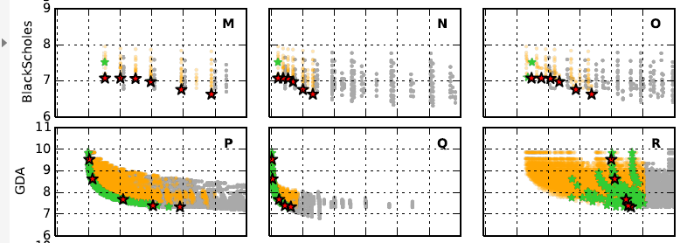
GDA Design Space
Performance limited by available BRAMs
10¹⁰
10⁹
10⁸
10⁷
Cycles (Log Scale)
20% 60% 100% 20% 60% 100% 20% 60% 100%
LUTs DSPs BRAMs
Resource Usage (% of maximum)
Space for GDA spans
four orders of magnitude
Valid design point Pareto-optimal (ALMs/cycles) design
Invalid design point Synthesized pareto design point
Notes:
Other benchmarks: 2 – 4 orders of magnitude across resource usage spectrum
ALMS: adaptive logic modules

Slide 30
Preview: TensorFlow to Spatial
Weight
Dataflow graph of
domain-specific operators
Weight
Application
Input Data
Conv
Pool
Each node in the DFG has a corresponding optimized Spatial template
Conv
Norm
Sum
Spatial
Scripted
Optimizations
+ Translation
val data = LineBuffer[T](K, in_c)
val row = RegFile[T](K, K)
val weight_RF = RegFile[T](K, K)
weight_RF load w_DRAM(channel, 0::K, 0::K)
Foreach(0 until in_r) { r =>
data load i0_DRAM(channel, r, 0::in_c)
Foreach(0 until in_c) { c =>
Foreach(0 until K){
i => row(i, *) <<= data(i, c)
}
val window = Reduce(0 until K, 0 until K){
(i,j) => row(i,j) * weight_RF(i,j)
}{_+_}…
Delite
Hierarchical dataflow
graph of tiled pipelines
with memory hierarchy
Spatial IR
Cross-node communication uses SRAM and registers to minimize DRAM bandwidth
Spatial Compiler
Synthesizable
hardware design
Chisel
DRAM
Line Buffer
x
x
+
SRAM
Synthesis Tools
Reg File
Shift Reg
x
Bitstream
Data-flow graphs converted to spatial hardware architectures
val data = LineBuffer[T](K, in_c)
val row = RegFile[T](K, K)
val weight_RF = RegFile[T](K, K)
weight_RF load w_DRAM(channel, 0::K, 0::K)
Foreach(0 until in_r) { r =>
data load i0_DRAM(channel, r, 0::in_c)
Foreach(0 until in_c) { c =>
Foreach(0 until K){
i => row(i, *) <<= data(i, c)
}
val window = Reduce(0 until K, 0 until K){
(i,j) => row(i,j) * weight_RF(i,j)
}{_+_}
conv_out(r, c) = window.value
}
}
From host DRAM
FPGA DRAM
Shift Reg
Line Buffer
x
Reg
File
x
x
Sliding Window
Computation
+
SRAM
Output feeds into next layer

Slide 31
Preview: TensorFlow to Spatial
Benefits
Makes Spatial easier to program
Automatically benefit from TensorFlow optimizations (e.g. constant folding, fusion, quantization for low precision)
Current support:
Convolutional Neural Networks
Recurrent Neural Networks (GRU, LSTM)
General matrix algebra computations
Same DFG mapping can be applied to other front-ends
Not specific to TensorFlow

Slide 32
Spatial’s Advantages
Automatic Design-Space Exploration
Parallelization selection to balance pipelines
Tile size selection to balance on-chip memory, bandwidth
Automatic memory banking
Agnostic to hardware vendor, Cloud/Embedded, FPGA/CGRA
Preliminary results: within 20% of DNNWeaver (DNN hardware library)
For inferences/s of a small network (LeNet) on the Zynq ZC702
Ongoing work to close 20% gap by further optimizing templates

Slide 33
Future Work
Low precision DNN training
Residual Networks
Applications
Unify and support more frontends above Spatial
Optimization/
Translation
Delite
Expand set of optimizations done by Spatial compiler
Spatial IR
Optimizer
Spatial Compiler
DSE
Expand backends supported by Spatial
Plasticine
CGRAs
FPGAs

Slide 34
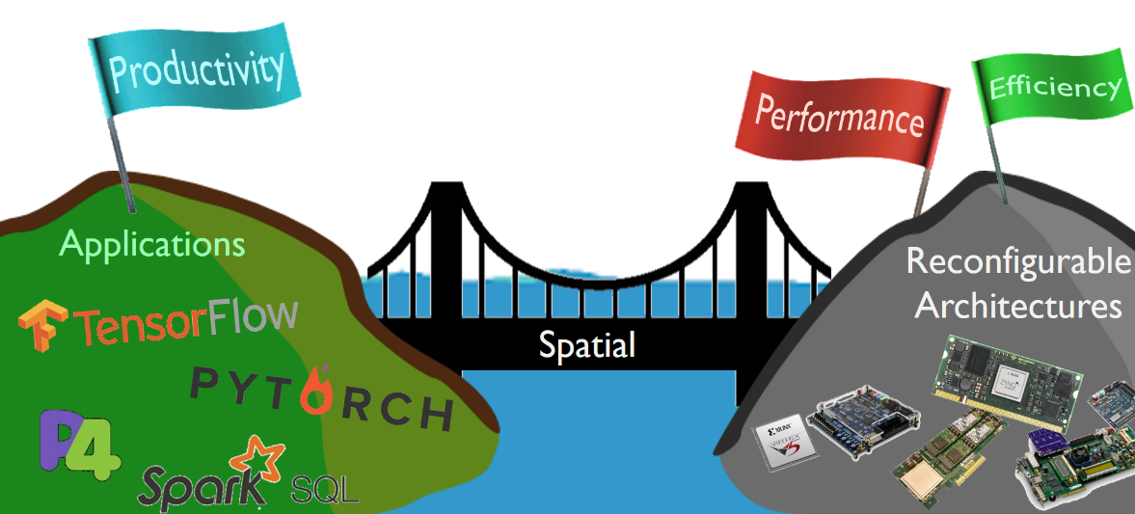
Conclusion
Orders of magnitude improvements in performance and energy efficiency are possible with reconfigurable architectures
Spatial’s intermediate representation can be used as a bridge to reconfigurable architectures
The Spatial language includes abstractions for performance, productivity, and portability
Spatial’s design tuning is ~6500x faster than that possible with Vivado HLS
Preliminary results within 20% of manual HDL on CNN implementations
Performance
Productivity
We’re always looking for new users and feedback!
Open source at: spatial.stanford.edu
Portability

Slide 35
Nuts and Bolts of a Full Spatial Application
Continue to see the bird’s eye view of how to write a full application
Visit the website tutorial for more detailed examples:
http://spatial-lang.readthedocs.io/en/latest/tutorial/starting.html

Slide 36
Spatial App Template
1
2
3
4
5
6
7
8
9
10
11
12
13
14
15
16
17
18
import spatial._
import org.virtualized._
object HelloSpatial extends SpatialApp {
@virtualize
def main(): Unit = {
val input = args(0).to[Int]
val in = ArgIn[Int]
val out = ArgOut[Int]
setArg(in, input)
Accel {
out := in + 4
}
println(“Output: ” + getArg(out))
}
}
AppName
ARM Host Code (setup)
FPGA Code
ARM Host Code (teardown)

Slide 37
Spatial App Template
1
2
3
4
5
6
7
8
9
10
11
12
13
14
15
16
17
18
import spatial._
import org.virtualized._
object HelloSpatial extends SpatialApp {
@virtualize
def main(): Unit = {
val input = args(0).to[Int]
val in = ArgIn[Int]
val out = ArgOut[Int]
setArg(in, input)
Accel {
out := in + 4
}
println(“Output: ” + getArg(out))
}
}
AppName
Define FPGA peripherals
Send data from ARM to FPGA
- Define FPGA operations
- Get data from the FPGA

Slide 38
Hello Spatial!
1
2
3
4
5
6
7
8
9
10
11
12
13
14
15
16
17
18
import spatial._
import org.virtualized._
object HelloSpatial extends SpatialApp {
@virtualize
def main(): Unit = {
val input = args(0).to[Int]
val in = ArgIn[Int]
val out = ArgOut[Int]
setArg(in, input)
Accel {
out := in + 4
}
println(“Output: ” + getArg(out))
}
}

Slide 39
Spatial is Embedded in Scala
1
2
3
4
5
6
7
8
9
10
11
12
13
14
15
16
17
18
import spatial._
import org.virtualized._
object HelloSpatial extends SpatialApp {
@virtualize
def main(): Unit = {
val input = args(0).to[Int]
val in = ArgIn[Int]
val out = ArgOut[Int]
setArg(in, input)
Accel {
out := in + 4
}
println(“Output: ” + getArg(out))
}
}
Spatial can be thought of as a Scala library

Slide 40
Spatial is Embedded in Scala
1
2
3
4
5
6
7
8
9
10
11
12
13
14
15
16
17
18
import spatial._
import org.virtualized._
object HelloSpatial extends SpatialApp {
@virtualize
def main(): Unit = {
val input = args(0).to[Int]
val in = ArgIn[Int]
val out = ArgOut[Int]
setArg(in, input)
Accel {
out := in + 4
}
println(“Output: ” + getArg(out))
}
}
Semicolons are optional

Slide 41
Import Statements
1
2
3
4
5
6
7
8
9
10
11
12
13
14
15
16
17
18
import spatial._
import org.virtualized._
object HelloSpatial extends SpatialApp {
@virtualize
def main(): Unit = {
val input = args(0).to[Int]
val in = ArgIn[Int]
val out = ArgOut[Int]
setArg(in, input)
Accel {
out := in + 4
}
println(“Output: ” + getArg(out))
}
}
Same in every Spatial program
(Similar idea to #include in C,
Identical to import in Java, Python)

Slide 42
Import Statements
1
2
3
4
5
6
7
8
import spatial._
import org.virtualized._
object HelloSpatial extends SpatialApp {
@virtualize
def main(): Unit = {
val input = args(0).to[Int]
Spatial-specific classes
(primarily SpatialApp)
Useful macros for nicer syntax (more later)

Slide 43
Application Object Declaration
1
2
3
4
5
6
7
8
9
10
11
12
13
14
15
16
17
18
import spatial._
import org.virtualized._
object HelloSpatial extends SpatialApp {
@virtualize
def main(): Unit = {
val input = args(0).to[Int]
val in = ArgIn[Int]
val out = ArgOut[Int]
setArg(in, input)
Accel {
out := in + 4
}
println(“Output: ” + getArg(out))
}
}
Spatial applications are always objects

Slide 44
Application Object Declaration
1
2
3
4
5
6
7
8
9
10
11
12
13
14
15
16
17
18
import spatial._
import org.virtualized._
object HelloSpatial extends SpatialApp {
@virtualize
def main(): Unit = {
val input = args(0).to[Int]
val in = ArgIn[Int]
val out = ArgOut[Int]
setArg(in, input)
Accel {
out := in + 4
}
println(“Output: ” + getArg(out))
}
}
Name of application
All Spatial applications inherit from (“extends”) SpatialApp

Slide 45
“@virtualize” Annotation
1
2
3
4
5
6
7
8
9
10
11
12
13
14
15
16
17
18
import spatial._
import org.virtualized._
object HelloSpatial extends SpatialApp {
@virtualize
def main(): Unit = {
val input = args(0).to[Int]
val in = ArgIn[Int]
val out = ArgOut[Int]
setArg(in, input)
Accel {
out := in + 4
}
println(“Output: ” + getArg(out))
}
}
All functions in Spatial should have this annotation
(Allows overloading Scala constructs like if-then-else)

Slide 46
Spatial’s Entry Function: “main()”
1
2
3
4
5
6
7
8
9
10
11
12
13
14
15
16
17
18
import spatial._
import org.virtualized._
object HelloSpatial extends SpatialApp {
@virtualize
def main(): Unit = {
val input = args(0).to[Int]
val in = ArgIn[Int]
val out = ArgOut[Int]
setArg(in, input)
Accel {
out := in + 4
}
println(“Output: ” + getArg(out))
}
}
Spatial’s entry function

Slide 47
Spatial’s Entry Function: “main()”
1
2
3
4
5
6
7
8
9
10
11
12
13
14
15
16
17
18
import spatial._
import org.virtualized._
object HelloSpatial extends SpatialApp {
@virtualize
def main(): Unit = {
val input = args(0).to[Int]
val in = ArgIn[Int]
val out = ArgOut[Int]
setArg(in, input)
Accel {
out := in + 4
}
println(“Output: ” + getArg(out))
}
}
Starts a function declaration
Function return type
(Unit: same as void)

Slide 48
Val Definitions
1
2
3
4
5
6
7
8
9
10
11
12
13
14
15
16
17
18
import spatial._
import org.virtualized._
object HelloSpatial extends SpatialApp {
@virtualize
def main(): Unit = {
val input = args(0).to[Int]
val in = ArgIn[Int]
val out = ArgOut[Int]
setArg(in, input)
Accel {
out := in + 4
}
println(“Output: ” + getArg(out))
}
}
Declares an immutable value named
“input” (value can’t be modified later)

Slide 49
Val Definitions
1
2
3
4
5
6
7
8
9
10
11
12
13
14
15
16
17
18
import spatial._
import org.virtualized._
object HelloSpatial extends SpatialApp {
@virtualize
def main(): Unit = {
val input: Int = args(0).to[Int]
val in = ArgIn[Int]
val out = ArgOut[Int]
setArg(in, input)
Accel {
out := in + 4
}
println(“Output: ” + getArg(out))
}
}
Value types are optional in Scala.

Slide 50
Val Definitions
1
2
3
4
5
6
7
8
9
10
11
12
13
14
15
16
17
18
import spatial._
import org.virtualized._
object HelloSpatial extends SpatialApp {
@virtualize
def main(): Unit = {
val input = args(0).to[Int]
val in = ArgIn[Int]
val out = ArgOut[Int]
setArg(in, input)
Accel {
out := in + 4
}
println(“Output: ” + getArg(out))
}
}
Scala is statically typed (like C, Java)
Without the “: Int”, the type of this value is inferred by the compiler.

Slide 51
Method Calls
1
2
3
4
5
6
7
8
9
10
11
12
13
14
15
16
17
18
import spatial._
import org.virtualized._
object HelloSpatial extends SpatialApp {
@virtualize
def main(): Unit = {
val input = args(0).to[Int]
val in = ArgIn[Int]
val out = ArgOut[Int]
setArg(in, input)
Accel {
out := in + 4
}
println(“Output: ” + getArg(out))
}
}
Round brackets ( ) for value parameters
Square brackets [ ] are for type parameters

Slide 52
Spatial Command-Line Arguments
1
2
3
4
5
6
7
8
9
10
11
12
13
14
15
16
17
18
import spatial._
import org.virtualized._
object HelloSpatial extends SpatialApp {
@virtualize
def main(): Unit = {
val input = args(0).to[Int]
val in = ArgIn[Int]
val out = ArgOut[Int]
setArg(in, input)
Accel {
out := in + 4
}
println(“Output: ” + getArg(out))
}
}
Spatial app’s command-line arguments
ARM
FPGA
out
in
+
Conversion from String to Int
4
int main(int argc, char **argv) {
int in = atoi(argv[1]);
printf(“Output: %d\n", out);
return 0;
}

Slide 53
Input Arguments (ArgIn)
1
2
3
4
5
6
7
8
9
10
11
12
13
14
15
16
17
18
import spatial._
import org.virtualized._
object HelloSpatial extends SpatialApp {
@virtualize
def main(): Unit = {
val input = args(0).to[Int]
val in = ArgIn[Int]
val out = ArgOut[Int]
setArg(in, input)
Accel {
out := in + 4
}
println(“Output: ” + getArg(out))
}
}
Creates a new register to capture a scalar argument from the ARM
ARM
FPGA
out
in
+
4

Slide 54
Output Arguments (ArgOut)
1
2
3
4
5
6
7
8
9
10
11
12
13
14
15
16
17
18
import spatial._
import org.virtualized._
object HelloSpatial extends SpatialApp {
@virtualize
def main(): Unit = {
val input = args(0).to[Int]
val in = ArgIn[Int]
val out = ArgOut[Int]
setArg(in, input)
Accel {
out := in + 4
}
println(“Output: ” + getArg(out))
}
}
Creates a new scalar argument to the ARM from the FPGA
ARM
FPGA
out
out
in
+
4

Slide 55
Scalar Transfers (ARM → FPGA)
1
2
3
4
5
6
7
8
9
10
11
12
13
14
15
16
17
18
import spatial._
import org.virtualized._
object HelloSpatial extends SpatialApp {
@virtualize
def main(): Unit = {
val input = args(0).to[Int]
val in = ArgIn[Int]
val out = ArgOut[Int]
setArg(in, input)
Accel {
out := in + 4
}
println(“Output: ” + getArg(out))
}
}
ARM
FPGA
out
in
+
input
4
Tells the host ARM to write input to scalar argument in on the FPGA

Slide 56
Accel Block
1
2
3
4
5
6
7
8
9
10
11
12
13
14
15
16
17
18
import spatial._
import org.virtualized._
object HelloSpatial extends SpatialApp {
@virtualize
def main(): Unit = {
val input = args(0).to[Int]
val in = ArgIn[Int]
val out = ArgOut[Int]
setArg(in, input)
Accel {
out := in + 4
}
println(“Output: ” + getArg(out))
}
}
Defines an FPGA computation scope. Everything in here goes on the FPGA
ARM
FPGA
out
in
+
4

Slide 57
Accel Block
1
2
3
4
5
6
7
8
9
10
11
12
13
14
15
16
17
18
import spatial._
import org.virtualized._
object HelloSpatial extends SpatialApp {
@virtualize
def main(): Unit = {
val input = args(0).to[Int]
val in = ArgIn[Int]
val out = ArgOut[Int]
setArg(in, input)
Accel {
out := in + 4
}
println(“Output: ” + getArg(out))
}
}
The types of operations that can be done in this scope are limited to synthesizable Spatial
ARM
FPGA
out
in
+
4

Slide 58
Accel Block
1
2
3
4
5
6
7
8
9
10
11
12
13
14
15
16
17
18
import spatial._
import org.virtualized._
object HelloSpatial extends SpatialApp {
@virtualize
def main(): Unit = {
val input = args(0).to[Int]
val in = ArgIn[Int]
val out = ArgOut[Int]
setArg(in, input)
Accel {
out := in + 4
}
println(“Output: ” + getArg(out))
}
}
Accel handles control signals for you.
It implicitly creates:
- a start signal (ARM → FPGA)
- a done signal (FPGA → ARM)
done
ARM
FPGA
out
in
+
4
start

Slide 59
Implicit Register Reads
1
2
3
4
5
6
7
8
9
10
11
12
13
14
15
16
17
18
import spatial._
import org.virtualized._
object HelloSpatial extends SpatialApp {
@virtualize
def main(): Unit = {
val input = args(0).to[Int]
val in = ArgIn[Int]
val out = ArgOut[Int]
setArg(in, input)
Accel {
out := in + 4
}
println(“Output: ” + getArg(out))
}
}
Implicitly creates a wire from the register (ArgIn) in
ARM
FPGA
out
in
+
4

Slide 60
Register Writes
1
2
3
4
5
6
7
8
9
10
11
12
13
14
15
16
17
18
import spatial._
import org.virtualized._
object HelloSpatial extends SpatialApp {
@virtualize
def main(): Unit = {
val input = args(0).to[Int]
val in = ArgIn[Int]
val out = ArgOut[Int]
setArg(in, input)
Accel {
out := in + 4
}
println(“Output: ” + getArg(out))
}
}
:= creates a write of the value
in + 4 to the register out
ARM
FPGA
out
in
+
4

Slide 61
Accel Block Scheduling
1
2
3
4
5
6
7
8
9
10
11
12
13
14
15
16
17
18
import spatial._
import org.virtualized._
object HelloSpatial extends SpatialApp {
@virtualize
def main(): Unit = {
val input = args(0).to[Int]
val in = ArgIn[Int]
val out = ArgOut[Int]
setArg(in, input)
Accel {
out := in + 4
}
println(“Output: ” + getArg(out))
}
}
Accel guarantees that FPGA execution completes after all operations in this block complete
done
ARM
FPGA
out
in
+
4

Slide 62
Scalar Transfers (FPGA → ARM)
1
2
3
4
5
6
7
8
9
10
11
12
13
14
15
16
17
18
import spatial._
import org.virtualized._
object HelloSpatial extends SpatialApp {
@virtualize
def main(): Unit = {
val input = args(0).to[Int]
val in = ArgIn[Int]
val out = ArgOut[Int]
setArg(in, input)
Accel {
out := in + 4
}
println(“Output: ” + getArg(out))
}
}
ARM
FPGA
Gets the value of the ArgOut out
from the FPGA back to the ARM
out
in
+
4

Slide 63
Printing in Spatial**
1
2
3
4
5
6
7
8
9
10
11
12
13
14
15
16
17
18
import spatial._
import org.virtualized._
object HelloSpatial extends SpatialApp {
@virtualize
def main(): Unit = {
val input = args(0).to[Int]
val in = ArgIn[Int]
val out = ArgOut[Int]
setArg(in, input)
Accel {
out := in + 4
}
println(“Output: ” + getArg(out))
}
}
** Printing in Spatial isn’t synthesizable,
but it can be used in host code and in
debugging (more in future lectures)
ARM
FPGA
out
in
+
Prints the output to the terminal
4
int main(int argc, char **argv) {
int in = atoi(argv[1]);
…
printf(“Output: %d\n", out);
return 0;
}

Slide 64
Hello Spatial!
1
2
3
4
5
6
7
8
9
10
11
12
13
14
15
16
17
18
import spatial._
import org.virtualized._
object HelloSpatial extends SpatialApp {
@virtualize
def main(): Unit = {
val input = args(0).to[Int]
val in = ArgIn[Int]
val out = ArgOut[Int]
setArg(in, input)
Accel {
out := in + 4
}
println(“Output: ” + getArg(out))
}
}

Slide 65
Custom Types in Spatial
Now what if we want an ArgIn value that isn’t an Int?
Other options:
Custom fixed point types
Custom floating point types
Structs
Vectors

Slide 66
Custom Types
1
2
3
4
5
6
7
8
9
10
11
12
13
14
15
16
17
18
val input = args(0).to[Int]
val in = ArgIn[Int]
setArg(in, input)

Slide 67
Custom Fixed Point Types
1
2
3
4
5
6
7
8
9
10
11
12
13
14
15
16
17
18
type Q8_8 = FixPt[FALSE,_8,_8]
val input = args(0).to[Int]
val in = ArgIn[Int]
setArg(in, input)
_N = # of fraction bits
(N from 0 to 128)
TRUE = Signed
FALSE = Unsigned
_N = # of integer bits
(N from 1 to 128)
0b00000000.00000000
Integer bits
Fraction bits

Slide 68
Custom Fixed Point Examples
1
2
3
4
5
6
7
8
9
10
11
12
13
14
15
16
17
18
type Q8_8 = FixPt[FALSE,_8,_8]
type UInt8 = FixPt[FALSE,_8,_0]
type LongLong = FixPt[TRUE,_128,_0]
0b00000000.00000000
Integer bits
Fraction bits

Slide 69
Custom Fixed Point Types
1
2
3
4
5
6
7
8
9
10
11
12
13
14
15
16
17
18
type UInt8 = FixPt[FALSE,_8,_0]
val input = args(0).to[UInt8]
val in = ArgIn[UInt8]
setArg(in, input)

Slide 70
Custom Floating Point Types
1
2
3
4
5
6
7
8
9
10
11
12
13
14
15
16
17
18
type Float = FltPt[_23,_11]
val input = args(0).to[Int]
val in = ArgIn[Int]
setArg(in, input)
_N = # of exponent bits
(N from 0 to 128)
_N = # of significand bits + 1
(N from 1 to 128)
Includes sign bit!
0 00000000 x 2^00000000
Significand bits
Exponent bits
Sign bit

Slide 71
Custom Floating Point Types
1
2
3
4
5
6
7
8
9
10
11
12
13
14
15
16
17
18
type Half = FltPt[_11,_5]
val input = args(0).to[Half]
val in = ArgIn[Half]
setArg(in, input)

Slide 72
Predefined Type Aliases
1
2
3
4
5
6
7
8
9
10
11
12
13
14
15
16
17
18
type Char = FixPt[TRUE,_8,_0]
type Short = FixPt[TRUE,_16,_0]
type Int = FixPt[TRUE,_32,_0]
type Long = FixPt[TRUE,_64,_0]
type Half = FltPt[_11,_5] // 754 Half
type Float = FltPt[_24,_8] // 754 Single
type Double = FltPt[_53,_11] // 754 Double

Slide 73
Note About Booleans
1
2
3
4
5
6
7
8
9
10
11
12
13
14
15
16
17
18
val input = args(0).to[Boolean]
val in = ArgIn[Boolean]
setArg(in, input)
Note: For API purposes,
Boolean is NOT the same as single bit fixed point number
Uses “false” and “true”
rather than 0 and 1

Slide 74
Custom Structs
1
2
3
4
5
6
7
8
9
10
11
12
13
14
15
16
17
18
@struct class MyStruct(
red: Int,
green: Int,
blue: Int
)
Declares a new Struct type with the given list of fields

Slide 75
Custom Structs
1
2
3
4
5
6
7
8
9
10
11121314
15
16
17
18
@struct class MyStruct(
red: Int,
green: Int,
blue: Int
)
val bus = MyStruct(147, 192, 125)
147
125
192
32
32
32
96
Allocates an instance of the struct.
Note: NO new keyword used
bus
In hardware, a struct instance is just a concatenation of wires

Slide 76
Custom Structs
1
2
3
4
5
6
7
8
9
10
11121314
15
16
17
18
@struct class MyStruct(
red: Int,
green: Int,
blue: Int
)
val bus = MyStruct(147, 192, 125)
val red = bus.red
val blue = bus.blue
147
125
192
32
32
32
96
bus
Creates a reference to the struct field (equivalent to a bit slice)
32
red
blue

Slide 77
Custom Structs
1
2
3
4
5
6
7
8
9
10
11121314
15
16
17
18
@struct class MyStruct(
red: Int,
green: Int,
blue: Int
)
val bus = MyStruct(147, 192, 125)
bus.blue = 45
147
125
192
32
32
32
96
bus
Note: Allocated structs are immutable!
We can’t write to them or change the contents!

Slide 78
Nesting Structs
1
2
3
4
5
6
7
8
9
10
11121314
15
16
17
18
@struct class RGB(
red: Int,
green: Int,
blue: Int
)
@struct class RGBA(
rgb: RGB,
alpha: Int
)

Slide 79
Registers of Custom Types
1
2
3
4
5
6
7
8
9
10
11
12
13
14
15
16
17
18
@struct class MyStruct(
red: Int,
green: Int,
blue: Int
)
val in = ArgIn[MyStruct]
in.red
Creates an ArgIn register which holds a value of type MyStruct
Note: Registers can hold structs as long as the fields are primitive values (FixPt, FltPt, Boolean) or other primitive-based structs

