Slide 1
AI AND MACHINE LEARNING
Hands-on introductory course

Slide 2
to do...
principles, stump splits, non-linear decision boundaries...
Binary decision trees
Preventing overfitting, hyperparameters
Boosting

Slide 3
Decision trees for classification

Slide 4
Recap: logistic regression
= Linear classifier
Learn linear decision boundaries
Supervised

Slide 5
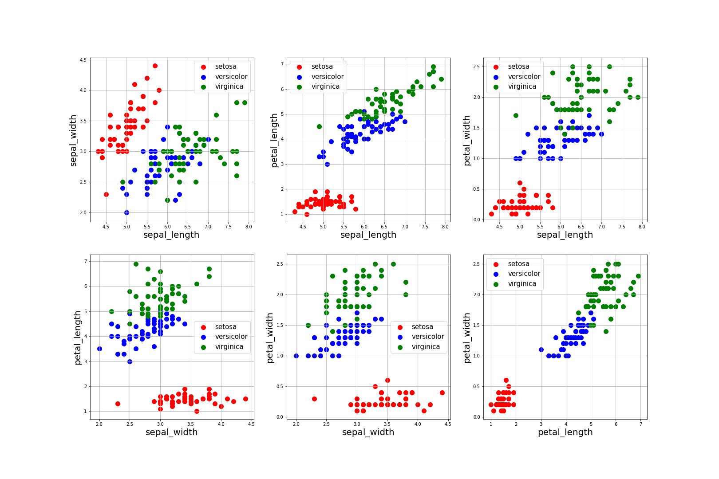
Recap: logistic regression

Slide 6
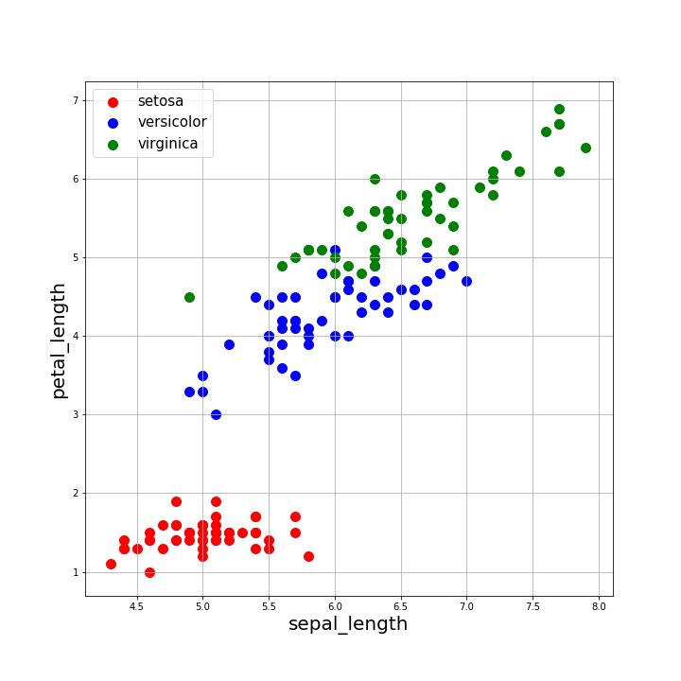
Recap: logistic regression
Linear decision boundaries
We only looked at binary classification tasks in-depth
Multiclass classification with logistic regression is possible with softmax activation
Notes:
In this part about decision trees, we will do both binary and multiclass classification. We will solve the iris problem.
classification with logistic regression for 3 classes allows you draw 2 straight lines in this graph.

Slide 7
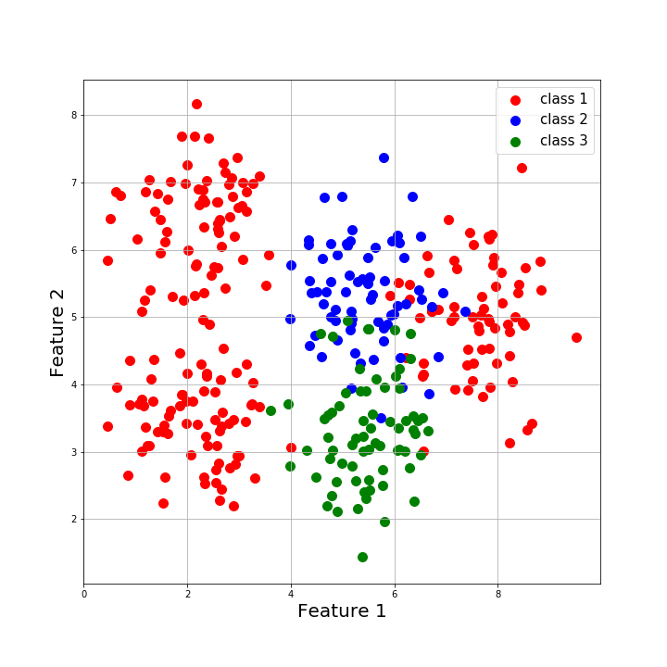
Decision trees
Predict class 2
Non-linear decision boundaries
Predict class 1
Predict class 1
Predict class 3

Slide 8
Decision trees: flight delay example
visibility
>= 5
Carrier | Visibility | Wind speed | Airport | delay (target)
(cat) | (cont) | (cont) | (cat)
1 | 1,2 | 4,0 | 1 | no
2 | 2,3 | 9 | 2 | yes
1 | 6,0 | 21,0 | 3 | yes
3 | 0,0 | 10,0 | 4 | yes
5 | 10,0 | 5,0 | 1 | no
2 | 9,3 | 1,0 | 3 | no
... | ... | ... | ... | ...
< 5
wind speed
carrier
> 20
< 20
1
2
...
yes
yes
airport
wind speed
1
> 10
2
...
< 10
yes
no
no
yes
Continuous: split on threshold
Categorical: one brach per option
Notes:
You can split multiple times on same feature, for different stumps
for continuous variables in particular, this allows to break linearity
can’t show all options for the categorical values on the diagram, but when splitting on a categorical value there is one branch for every possible value
In practice, we will still have to one-hot-encode our categorical values because ML algorithms cannot handle categorical inputs.

Slide 9

Learning decision trees
(100)
yes: 80
no: 20
visibility
Which feature do we split on first?
Choose feature that results in best split = lowest error for that stump, if it would be last stump
i.e. choose the feature that best distincts the classes
< 5
>= 5
(64)
yes: 35
no: 29
predict ‘yes’
(36)
yes: 6
no: 30
predict ‘no’
$$error= \frac{6+29 }{100}=0,35$$
...

Slide 10

Learning decision trees
(100)
yes: 80
no: 20
wind speed
Which feature do we split on first?
Choose feature that results in best split = lowest error for that stump, if it would be last stump
i.e. choose the feature that best distincts the classes
< 20
>= 20
(6)
yes: 4
no: 2
predict ‘yes’
(94)
yes: 45
no: 49
predict ‘no’
$$error= \frac{45+2 }{100}=0,47$$
...

Slide 11
Learning decision trees
split on visibility: error = 0,35
split on wind speed: error = 0,47
→ split on visibility

Slide 12
Learning decision trees
(100)
yes: 80
no: 20
visibility
For continuous variables, what threshold do we pick?
Choose threshold that results in best split = lowest error for that stump, if it would be last stump
i.e. choose the threshold that best distincts the classes
< 10
>= 10
(64)
yes: 35
no: 29
predict ‘yes’
(36)
yes: 6
no: 30
predict ‘no’
$$error= \frac{6+29 }{100}=0,35$$
...

Slide 13

Learning decision trees
(100)
yes: 80
no: 20
visibility
For continuous variables, what threshold do we pick?
Choose threshold that results in best split = lowest error for that stump, if it would be last stump
i.e. choose the threshold that best distincts the classes
Question: how many thresholds do we have to consider?
< 10
>= 10
(55)
yes: 29
no: 26
predict ‘yes’
(45)
yes: 15
no: 30
predict ‘no’
$$error= \frac{15+26 }{100}=0,41$$
...
Notes:
when there are N data examples, you must consider maximum N-1 thresholds:
-sort datapoints on this continuous variable
-split on any thresholds that falls between two datapoints

Slide 14
Learning decision trees
visibility threshold = 5 : error = 0,35
visibility threshold = 10: error = 0,41
→ pick threshold 5

Slide 15
Learning decision trees
(100)
yes: 80
no: 20
visibility
Learning the next step
→ repeat for every stump
< 10
>= 10
(55)
yes: 29
no: 26
(45)
yes: 15
no: 30
<feature>
...
Notes:
when there are N data examples, you must consider maximum N-1 thresholds:
-sort datapoints on this continuous variable
-split on any thresholds that falls between two datapoints

Slide 16
Learning a decision tree
Recursive and greedy algorithm
“Greedy” algorithm?
Pick the best option at the current step (at this stump)
Don’t look at future options
End solution can be sub-optimal
Same algorithm for multiclass classification
Notes:
For this illustration we use the simple error metric. Different error metrics are possible.
“Greedy algorithm”: it picks the best possible option for that step (for that stump) without “looking the future”, so the learned decision tree might not be the best possible one in the end.
analogy with stepping stones:

Slide 17
Overfitting
visibility
Stop splitting if all datapoints in this node are of same class
For deeper trees, tree will fit training data very well
Keep splitting until every leaf node has only datapoints of same class → training error is 0
>= 5
< 5
wind speed
carrier
> 20
< 20
1
2
...
yes
yes
airport
wind speed
1
> 10
2
< 10
yes
no
no
yes
Notes:
In the extreme case, you just keep splitting until all leaf nodes are of same class → training error 0

Slide 18
Decision trees
If we keep splitting, we keep drawing lines on this plot...
Then we can make all dots fit into a “perfect” classifier
→ overfitting

Slide 19
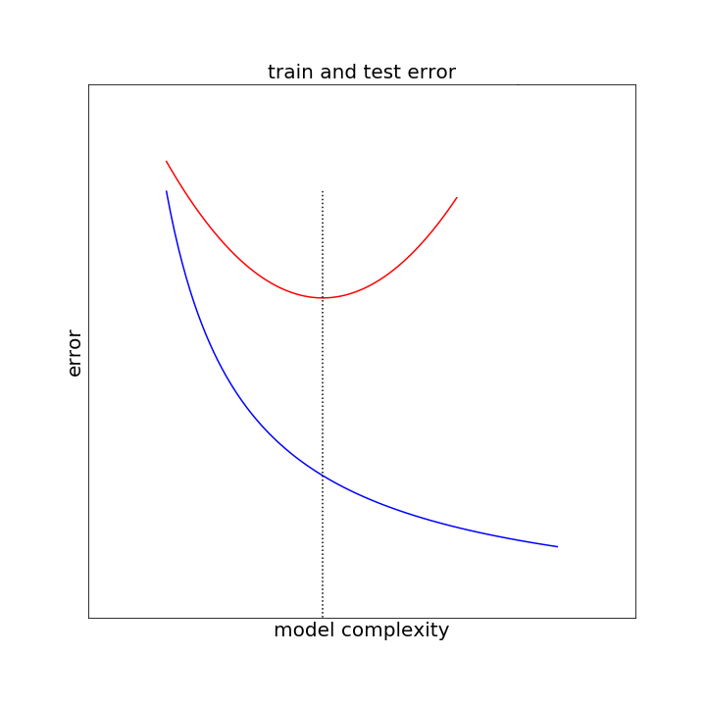
Overfitting
sweet spot
Shallow trees
Deep trees
̴ tree depth
Notes:
instead of lambda, tree depth determines “complexity”

Slide 20
Preventing overfitting: simplify the tree
Early stopping: stop splitting before tree becomes to complex
Option 1: limit maximum depth
Option 2: stop splitting if classification error does not decrease by more than ε
Option 3: stop when data points in a node < N_{min}
Hyperparameter tuning!
Notes:
regularization of decision trees

Slide 21
Overfitting
sweet spot
Low max depth
High ε
High N_{min}
High max depth
Low ε
Low N_{min}
Notes:
deep tree = more overfitting
lower Nmin = more overfitting
lower epsilon = more overfitting
and vice versa

Slide 22
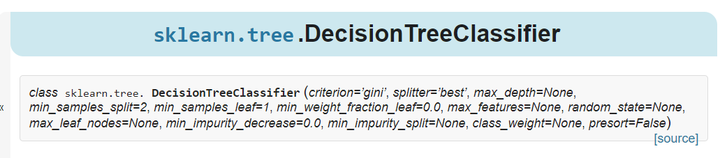
Preventing overfitting in Sklearn
max_depth
min_samples_split
min_samples_leaf
max_leaf_nodes
min_impurity_decrease
min_impurity_split
Notes:
in linear and logistic regression, there was only one hyperparameter lambda for regularization
Here, there are more hyperparameters to tune

Slide 23
Preventing overfitting: simplify the tree
Early stopping: stop splitting before tree becomes to complex
Option 1: limit maximum depth
Option 2: stop splitting if classification error does not decrease by more than ε
Option 3: stop when data points in a node < N_{min}
Hyperparameter tuning!
Challenges:
Option 1: one fixed maximum depth for all branches
Option 2: what if one split does not decrease error, but the next split would reduce error a lot (short-sighted)
Option 3: one fixed N_{min} for all branches
Notes:
option 2: plot of decreasing error with lower epsilon might not be smooth, could do some weird things
Could be that one split does not decrease error (or even slightly increases it), but the split after that one could decrease error.
i.e. a “bad” split is followed by a “good split”

Slide 24
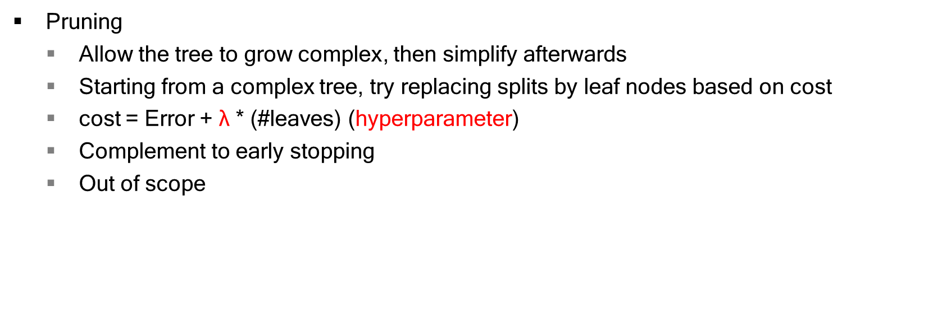
Preventing overfitting: pruning
Pruning
Allow the tree to grow complex, then simplify afterwards
Starting from a complex tree, try replacing splits by leaf nodes based on cost
cost = Error + $\text{λ}$ * (#leaves) (hyperparameter)
Complement to early stopping
Out of scope

Slide 25
Boosting
Based on two principles:
Combining multiple weak models into a stronger one
Focus on the ‘difficult’ points

Slide 26
Boosting
Combining multiple weak models into a stronger one
Example: ensemble classifier
→ take weighted result of different classifiers: Y = W₁Y_{i,1} + W₂Y_{i,2} + ... + W_{T}Y_{i,T}
X_{i}
...
W₁
W₂
W_{T}
Classifier 1
Classifier 2
Classifier T
Y_{i,1}
Y_{i,2}
Y_{i,T}
Notes:
apply a weight to each individual classifier (can be any kind of classifier)
How do we choose the weights???

Slide 27
Boosting
Focus on the ‘difficult’ points
Weighted data: weights on ‘difficult’ points are higher
Every (X_{i}, Y_{i}) gets a a_{i}
When calculating the loss, multiply the contribution L_{i} of every (X_{i}, Y_{i}) with a_{i}
Notes:
How to we pick the weights? What are “difficult” points? How do we pick data point weights
IMPORTANT: there are now two notions of “weight”, one for the data points and one for the classifiers.

Slide 28
Adaboost
(unweighted) training data
t = 1
Learn classifier 1
Make predictions
weighted training data
Learn classifier 2
t = 2
Make predictions
weighted training data
....
continue up to ‘T’ classifiers
Notes:
“classifier” is general here, but often done for decision trees.
See also sklearn, where you first create a classifier with your own chosen settings, and then pass this classifier as an argument to the adaboost function.

Slide 29
Adaboost
(unweighted) training data
t = 1
When done, combine all classifiers in one
take weighted result of different classifiers
Y = W₁Y_{i,1} + W₂Y_{i,2} + ... + W_{T}Y_{i,T}
Question: how do we pick the classifier weights?
Y>0 →predict ‘1’
Y<0 →predict ‘0’
W₁
Learn classifier 1
Make predictions
weighted training data
W₂
Learn classifier 2
t = 2
Make predictions
weighted training data
....
continue up to ‘T’ classifiers

Slide 30

Adaboost
(unweighted) training data
t = 1
When done, combine all classifiers in one
take weighted result of different classifiers
Y = W₁Y_{i,1} + W₂Y_{i,2} + ... + W_{T}Y_{i,T}
Give higher weights to the best classifiers
W₁
Learn classifier 1
Make predictions
weighted training data
W₂
Learn classifier 2
t = 2
$$W=\frac{1}{2}ln⁡(\frac{1 −weightedError(classifier t)}{weightedError(classifier t)})$$
Make predictions
weightedError = high | W = low
weightedError = 0,5 | W = 0
weightedError = low | W = high
weighted training data
....
continue up to ‘T’ classifiers
Notes:
weightedError is between 0 and 1.
For every data point be say error = 0 or error = 1, but then we weight the errors with the weights, and the sum of the weights is one!
(sum of weights is one because we normalize, see later)

Slide 31
Adaboost
(unweighted) training data
t = 1
Update weights
Question: how do we update the weights of the data points?
Learn classifier 1
Make predictions
weighted training data
Learn classifier 2
t = 2
Make predictions
weighted training data
....
continue up to ‘T’ classifiers

Slide 32
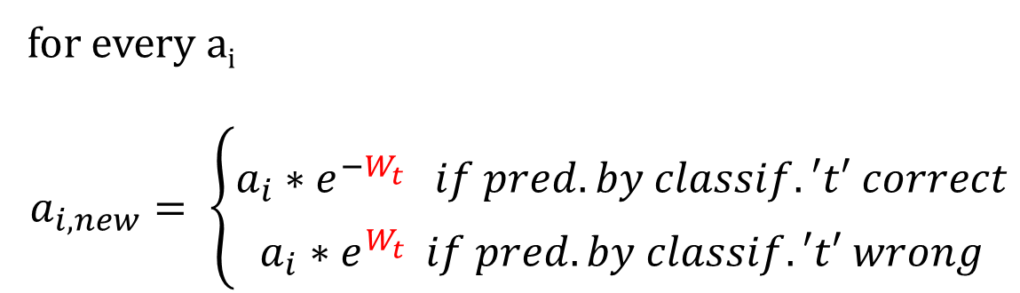
Adaboost
(unweighted) training data
t = 1
Update weights
Focus on the ‘difficult’ points
Learn classifier 1
Make predictions
weighted training data
Learn classifier 2
t = 2
for every a_{i}
$$a_{i,new}= \left\{\begin{aligned}a_{i}∗e^{−W_{t}^{}} if pred. by classif. ′t′ correct \\ a_{i}∗e^{W_{t}^{}}if pred. by classif. ′t′ wrong\end{aligned}\right.$$
Make predictions
weighted training data
....
continue up to ‘T’ classifiers
Notes:
intuition!
if prediction is wrong for many times, weight can become very high
and vice versa
→ harms numerical stabitlity

Slide 33
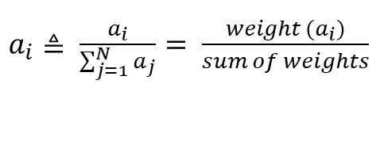
Adaboost
(unweighted) training data
t = 1
Update weights
Just one more thing...
Normalize the weights for numerical stability
As a result, the sum of the weights becomes 1
Learn classifier 1
Make predictions
weighted training data
$a_{i}≜ \frac{a_{i}}{\sum_{j=1}^{N}{a_{j}}}= \frac{weight (a_{i})}{sum of weights}$
Learn classifier 2
t = 2
Make predictions
weighted training data
....
continue up to ‘T’ classifiers
Notes:
as a result, the weighted error of every classifier (to be minimized when learning that classifier) is between 0 and 1

Slide 34
Adaboost
When T is high, adaboost might overfit in some circumstances
but... adaboost is relatively robust to overfitting
number of classifiers (T) is hyperparameter
Notes:
Overfitting: adaboost could overfit to a training error of zero “in some circumstances” (ask a mathematician).
In general, relatively robust to overfitting
tune hyperparameter on the dev (validation) set or cross-validtion

Slide 35
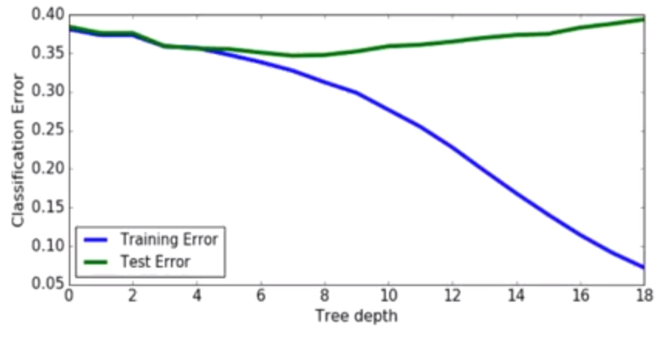
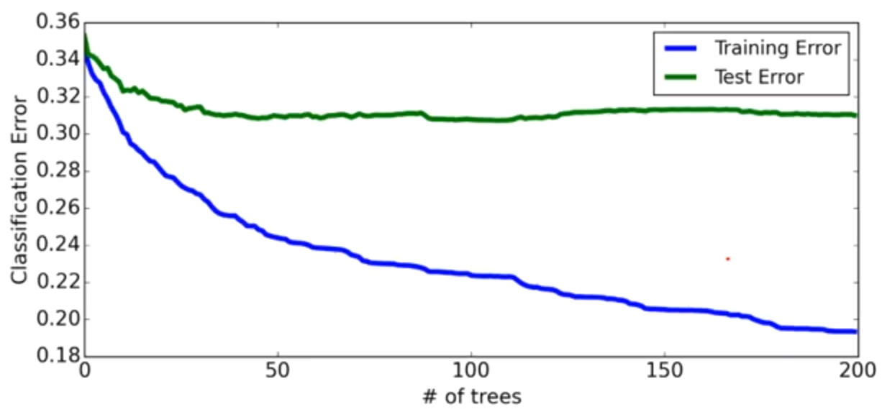
Adaboost
Overfitting results on a real dataset (loan data)
(Carlos Guestrin, University of Washington)
Decision tree
Boosted decision stumps
Notes:
boosted decision stump
= the “boosted” classifier is just a decision stump, i.e. a tree of depth = 1
#iterations = T
for large T, the test error does not decrease fast starting from some point. difference in test error of T = 100 to T = 200 is low. (But at some point for very high T, it will increase again)
also note that test error is lower

