Slide 1

LD4
How MapComplete uses Wikidata
h

Slide 2
Who am I?
Pieter Vander Vennet
Studied informatics
Heavy OSM-contributor
Working for a small company on mobility (with OSM)
Built an OpenStreetMap-editing website as freelancer

Slide 3
What is
OpenStreetMap?

Slide 4


Slide 5


Slide 6
What is
OpenStreetMap?

Slide 7
Geospatial data

Slide 8
Geospatial data
Lines and dots
+
Some information
on each line and dot

Slide 9
What is
OpenStreetMap?

Slide 10

Freedom to add data

Slide 11
Freedom to add data
As long as it is verifiable on the ground
As long as it is somewhat permanent
As long as no copyright is infringed
Go add your specific needs!

Slide 12
What is
OpenStreetMap?

Slide 13
Crowdsourced

Slide 15


Slide 16


Slide 17


Slide 18


Slide 19


Slide 20


Slide 21
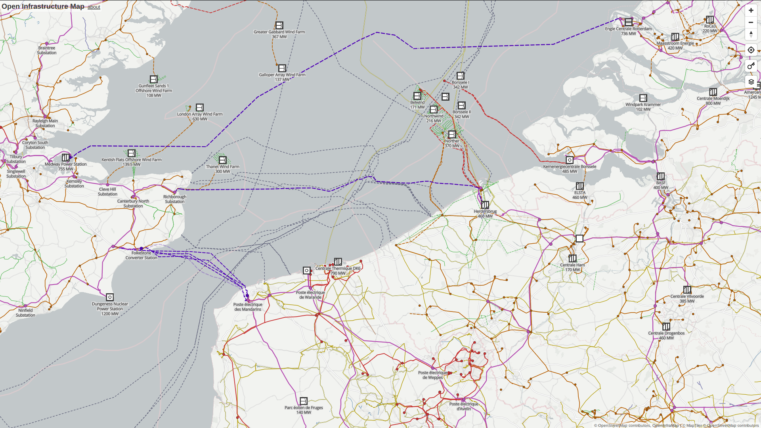

Slide 22
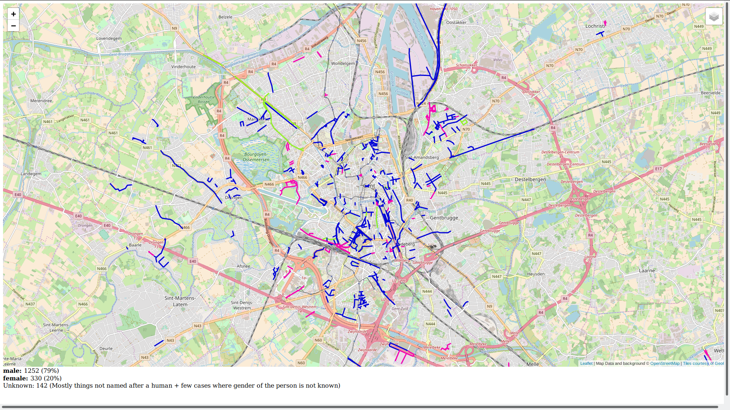


Slide 23
What is
OpenStreetMap?

Slide 24

A license: ODbL
Open Database License
You can use the data how you like
as long as you give attribution
and keep the data open

Slide 25
What is
MapComplete?

Slide 26
Many programs exist to edit OpenStreetMap
Some have tons of features and are hard to use
Others don’t allow to do everything, but can thus keep things simple to use

Slide 27
Many programs exist to edit OpenStreetMap
MapComplete is a website where you can easily edit OSM-attributes and add new points
Instead of showing everything, there are many
”themes” to choose from, all focused on one
topic

Slide 28
Many programs exist to edit OpenStreetMap
MapComplete is a website where you can easily edit OSM-attributes and add new points
Instead of showing everything, there are many
”themes” to choose from, all focused on one
topic

Slide 29
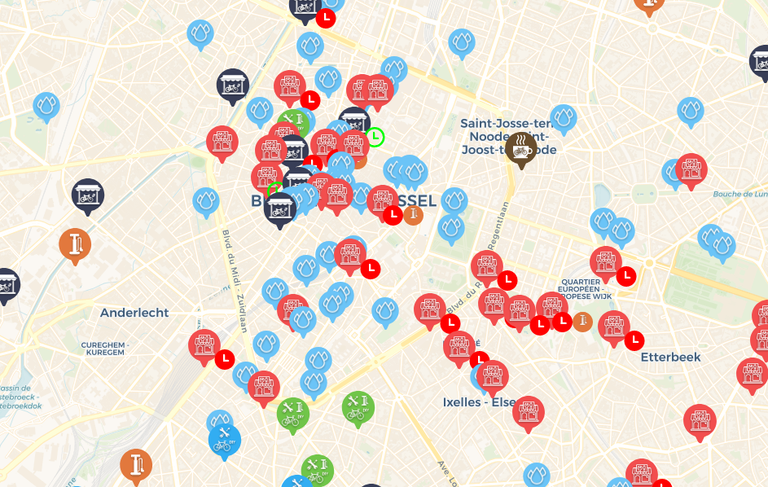

Slide 30
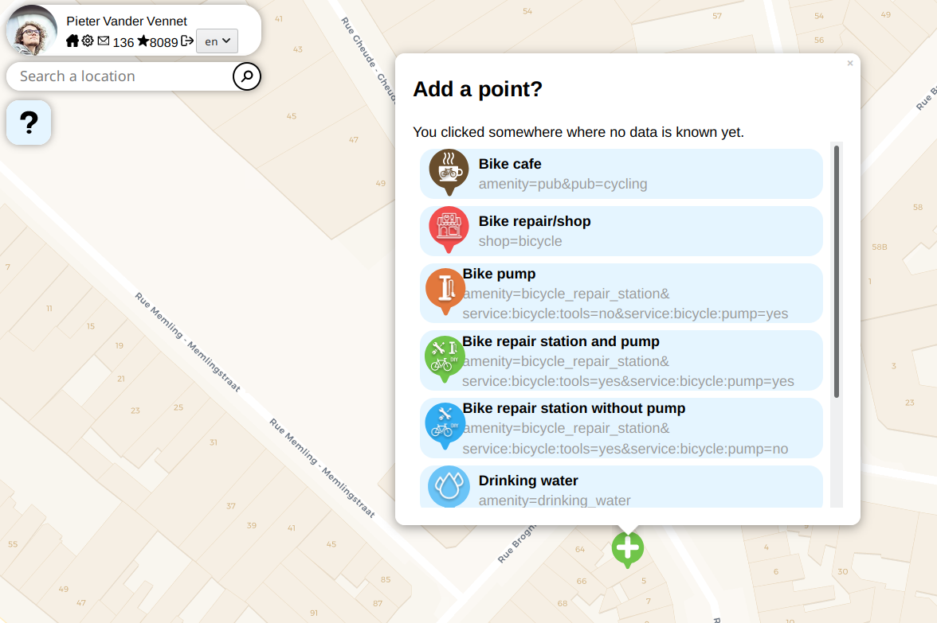

Slide 31
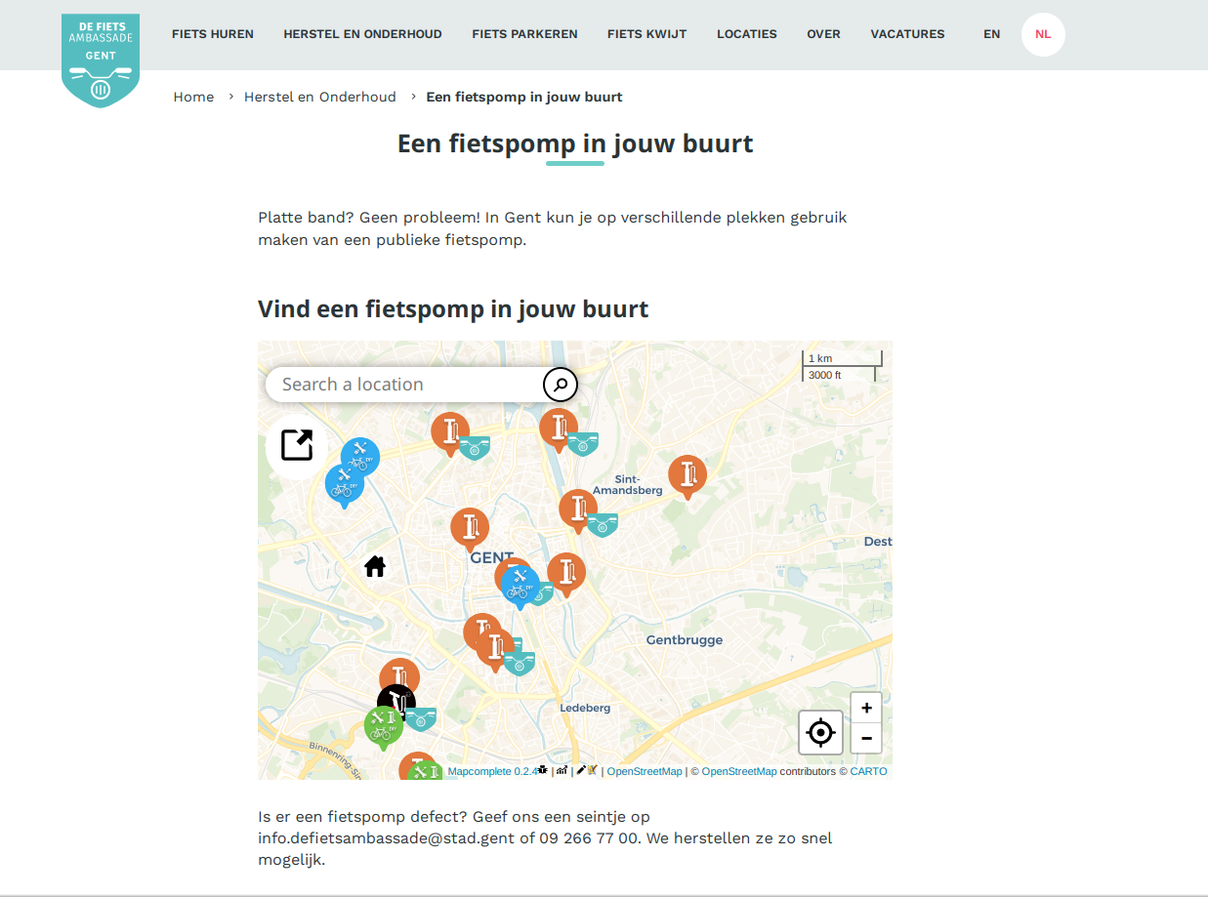

Slide 32
MapComplete.osm.be and Wikidata

Slide 33
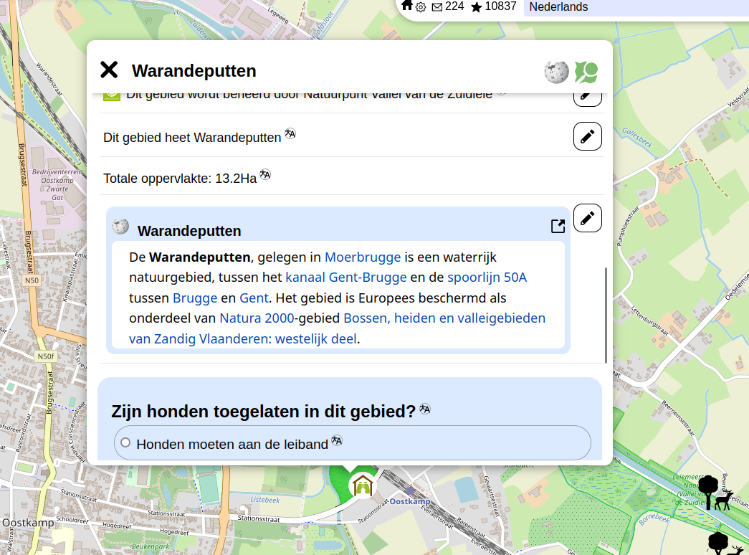

Slide 34
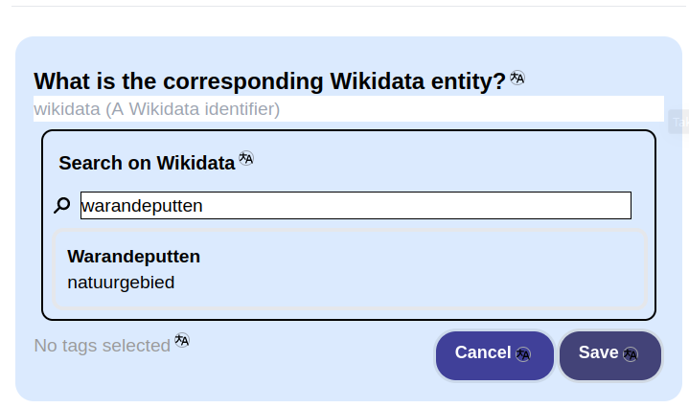

Slide 35
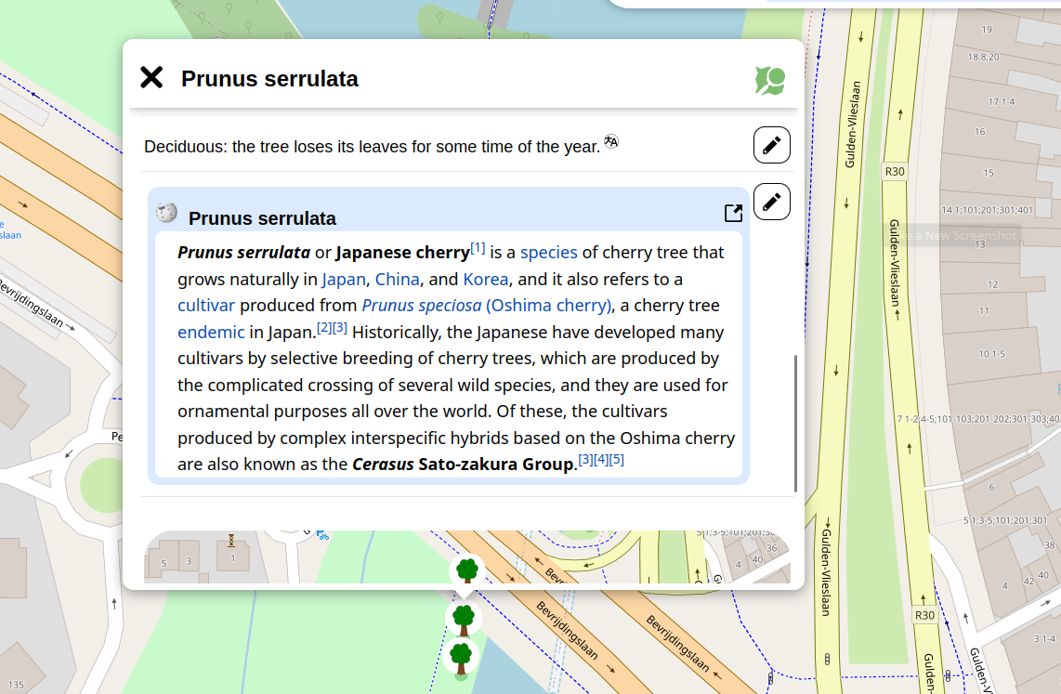

Slide 36
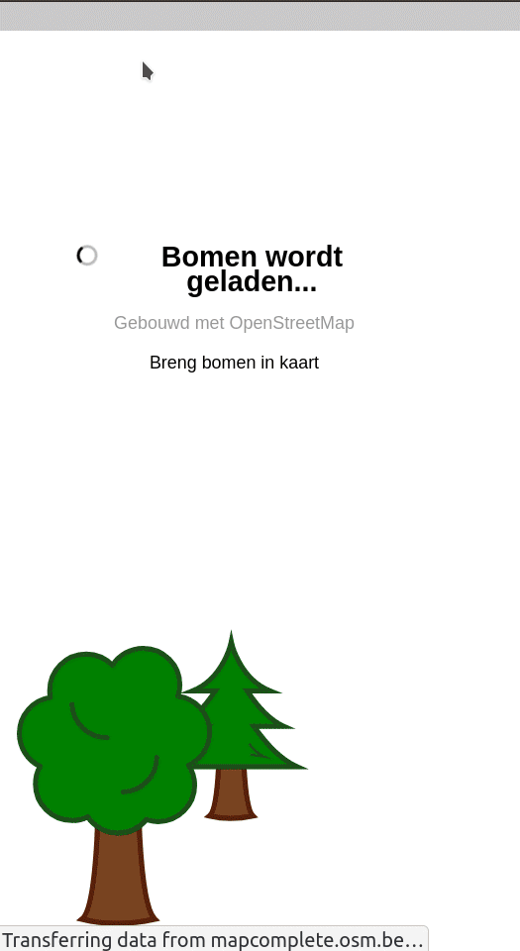

Slide 37
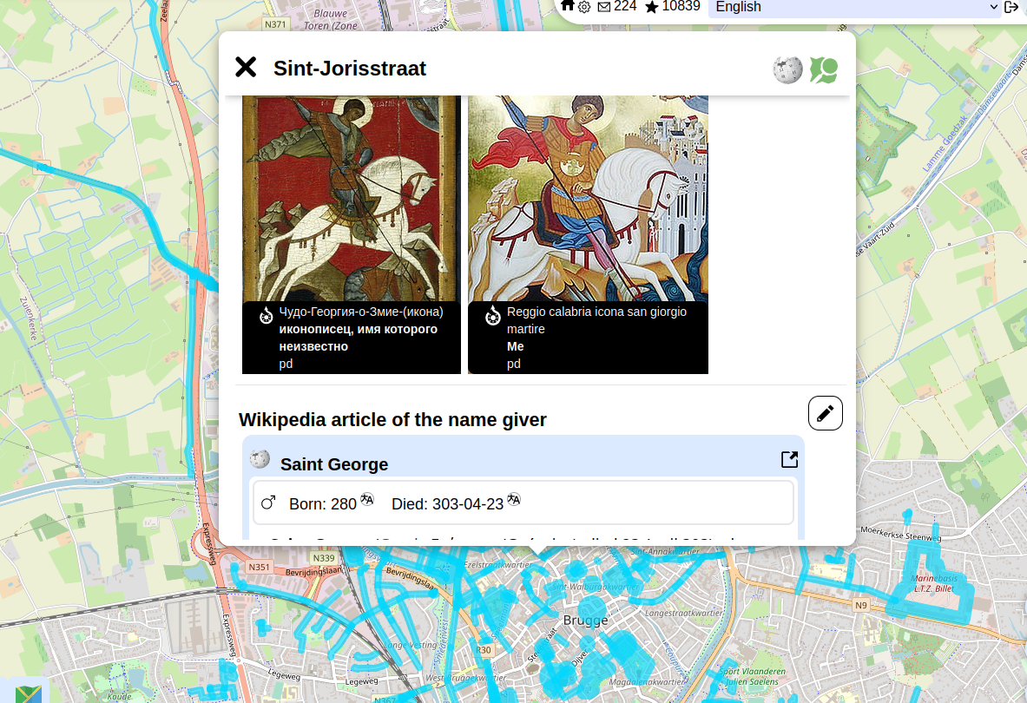

Slide 38
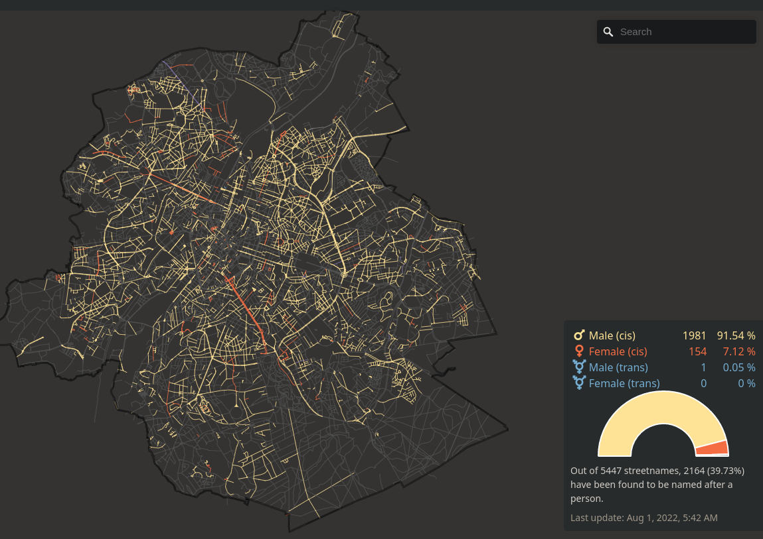
Equalstreetnames.eu

Slide 39
Links with Wikipedia articles
Show info of the relevant object (infobox/article)
Search for the relevant object (in order to link it)
Show/link info about other attributes, such as the entity something was named after or the species of tree

Slide 40
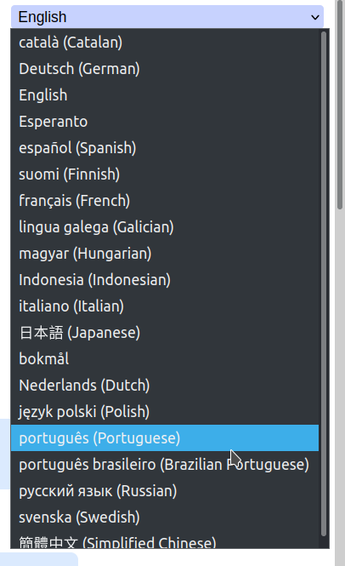
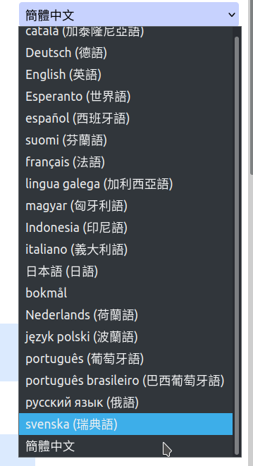
Native languages

Slide 41
More fun with languages
We want to map schools in bilingual (and multilingual) areas
This should be placed in the OSM-database with language=<ISO-CODE>
Which languages exist worldwide? What is their ISO-Code (if any)?
Can we offer smart default choices people can pick? (We know the country a school is located in)

Slide 42
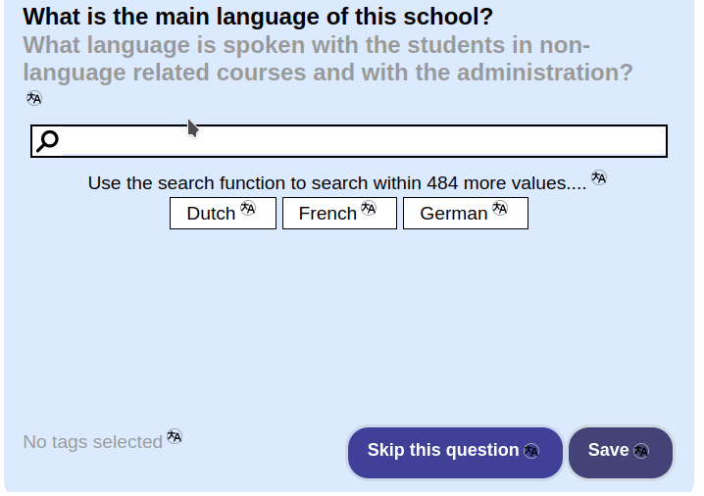

Slide 43
More fun with languages
With a script doing a few queries to Wikidata, I created an overview of
All the existing languages
What their ISO-code is (that should be assigned)
In what countries they are official languages (and are offered as a default)

Slide 44
Future ideas

Slide 45
Future ideas
Is smoking allowed in hotels, restaurants and cafés?
  For countries where it is not forbidden, I could ask the question wether or not smoking is allowed
  I wanted to fetch this kind of data from Wikidata, but it is missing
Have templates which nag for information on Wikidata too, which ask for such information
  E.g., for a person: “When was this person born?”
  Maybe something for conze.pt ?

Slide 46
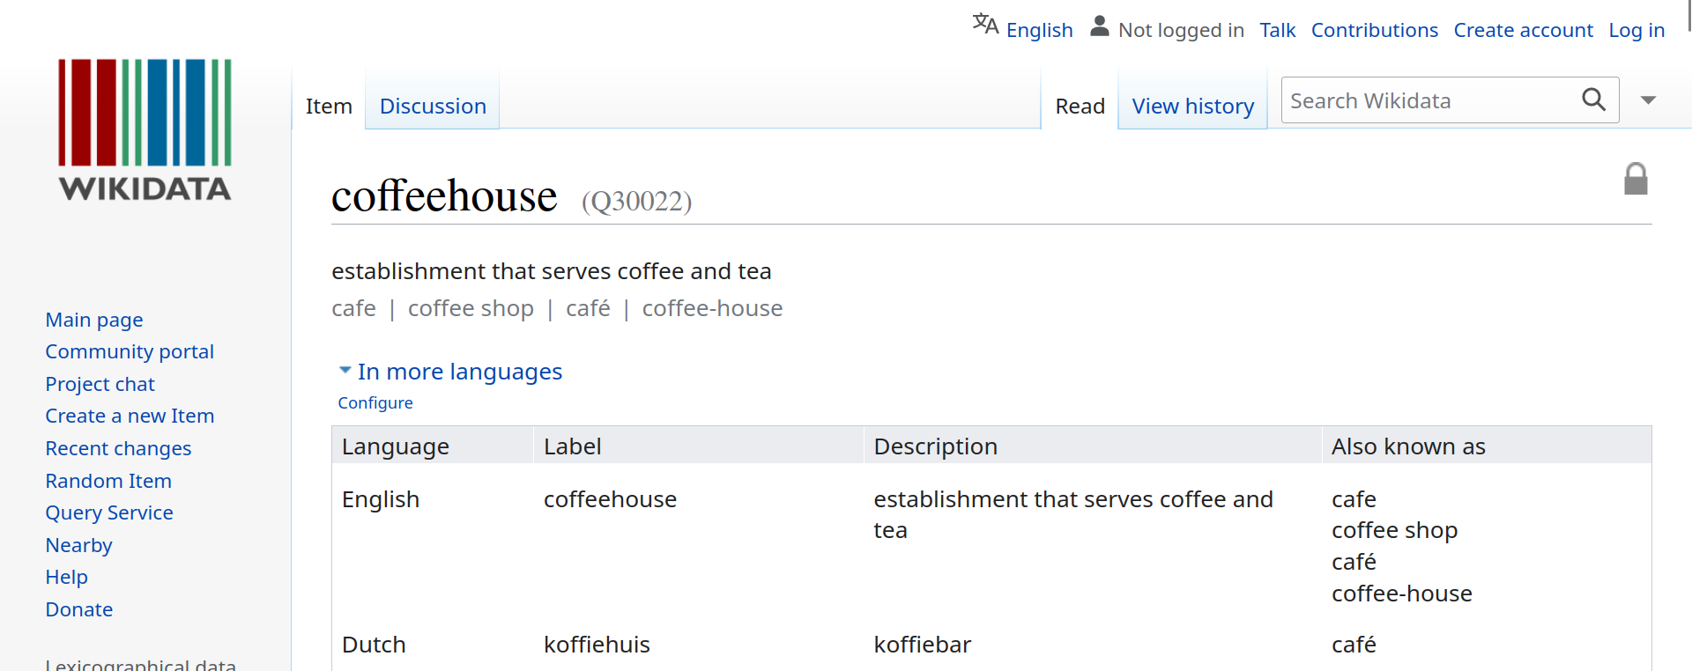

Future ideas
Automatically link OSM-features to Wikidata-articles
(The tag is often known
by Wikidata already)

Slide 47
Conclusion
Wikidata + OSM = <3

