Slide 1
Taming the
Mastodon
Healthier social media
By @pietervdvn@en.osm.town
CC-BY-SA

Slide 2
Current social media
A different approach
Getting started
Someone is annoying...

Slide 3

What are
social media?

Slide 4
A few examples
Of conventional social media

Slide 5
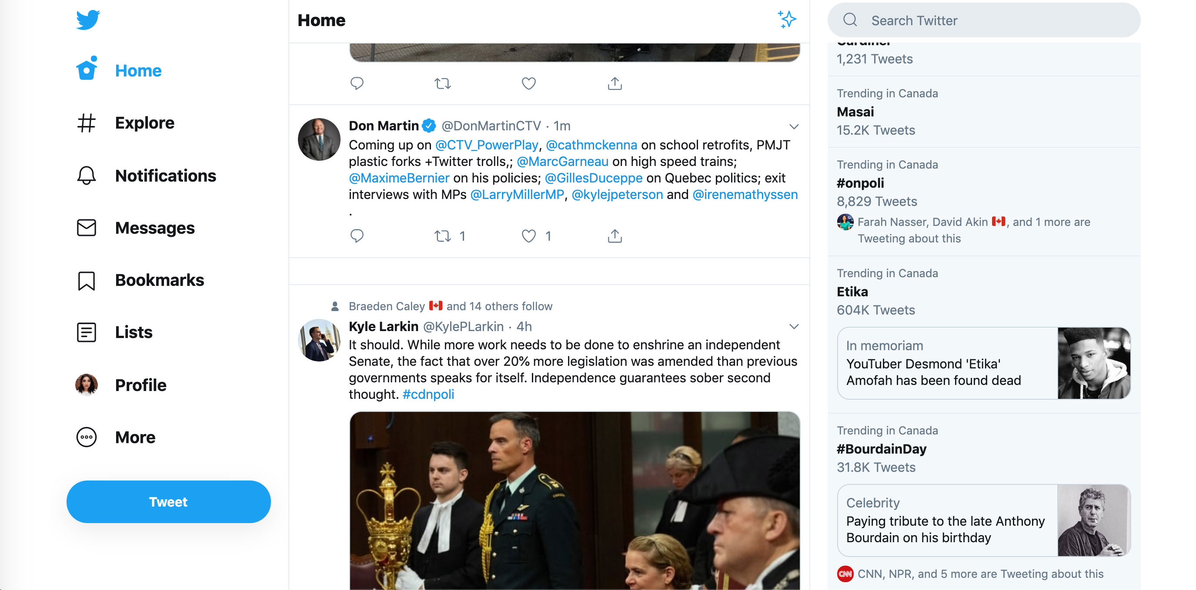
Twitter

Slide 6
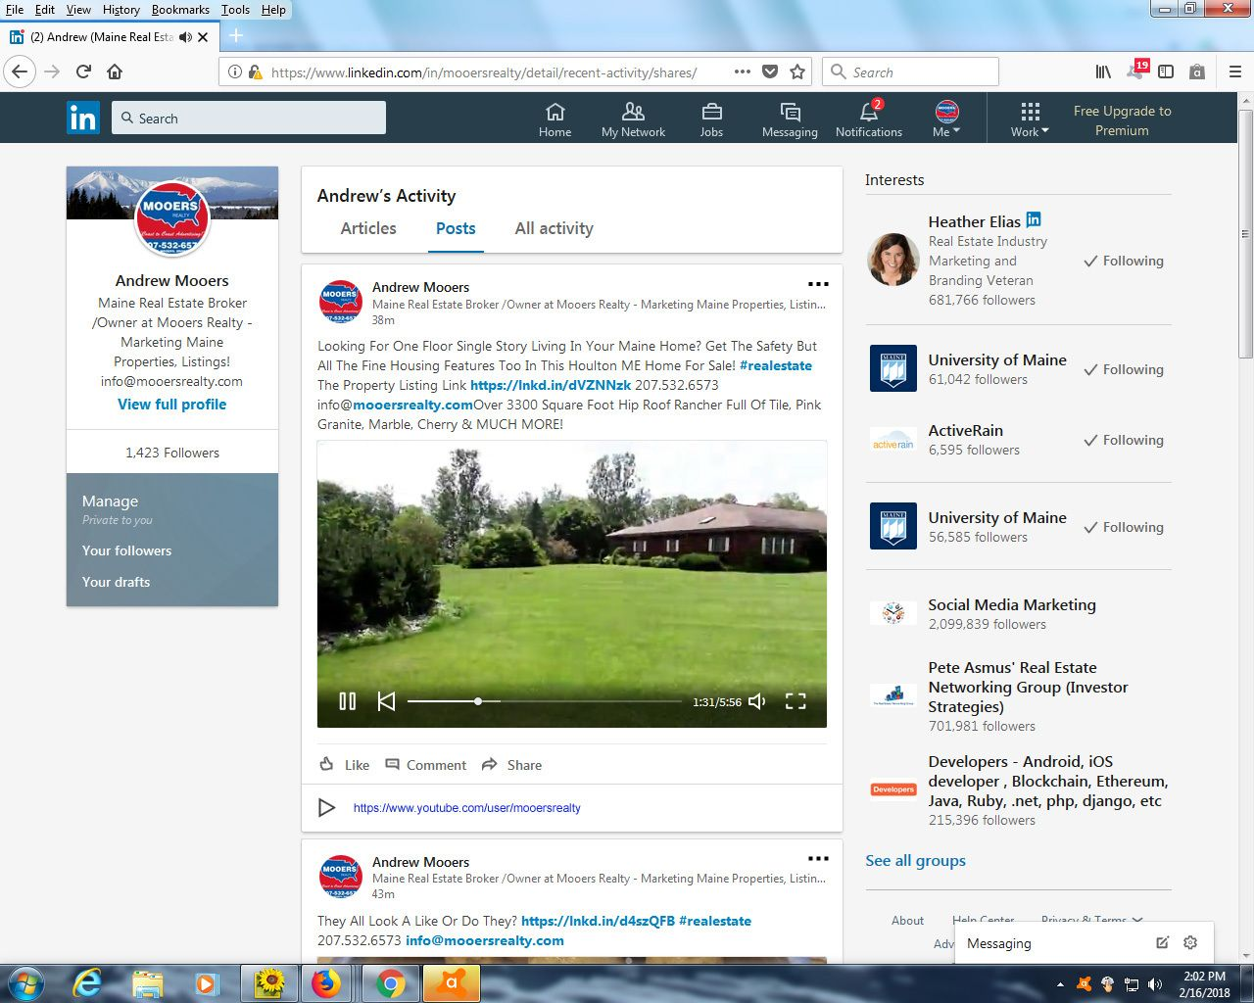
LinkedIn

Slide 7
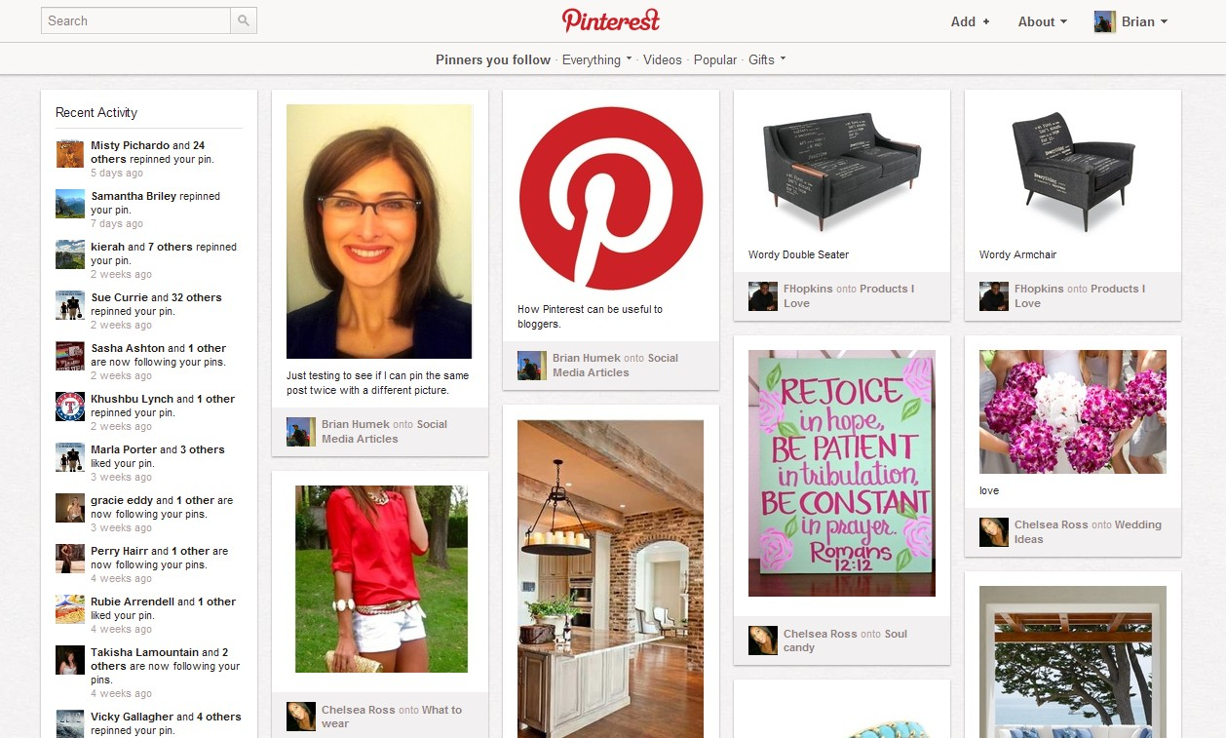
LinkedIn

Slide 8
What is social media?
A website/app/computerprogram where you can create an account (identity) which you can connect to different accounts
Once can share content (text messages, pictures, music and/or movies) with other
Every user gets to see a different selection of this content, based on their connections

Slide 9
Wha t are social media?
This is in contrast with conventional mass media (TV, newspapers) where everyone sees the same message

Slide 10
How do conventional social media work?

Slide 11
Conventional social media
One central computer
the server

Slide 12
Conventional social media
Sofie
Wouter
Edward
Miep
Millions of users
The central computer decides who sees what

Slide 13
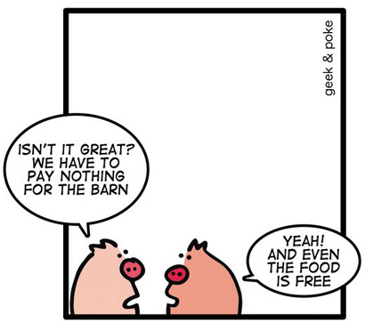
Commercial social media

Slide 14
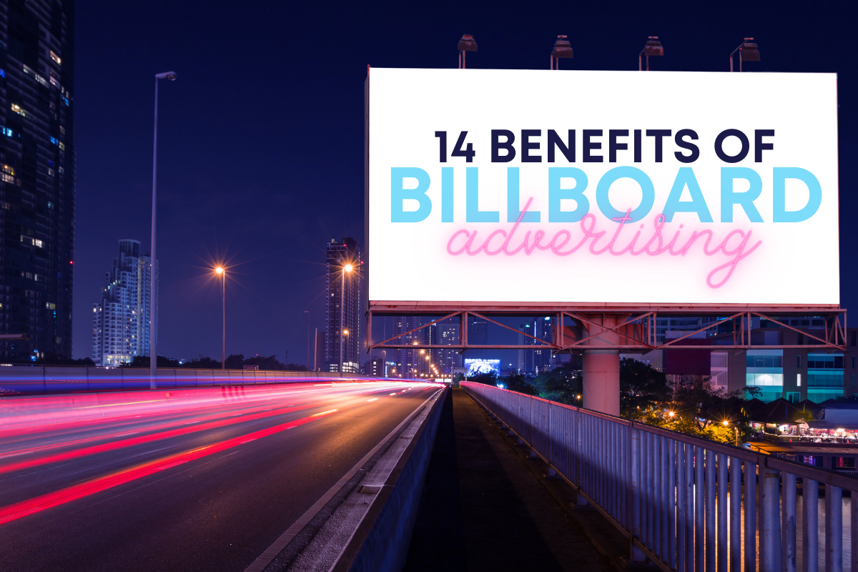
Commerciele sociale media

Slide 15

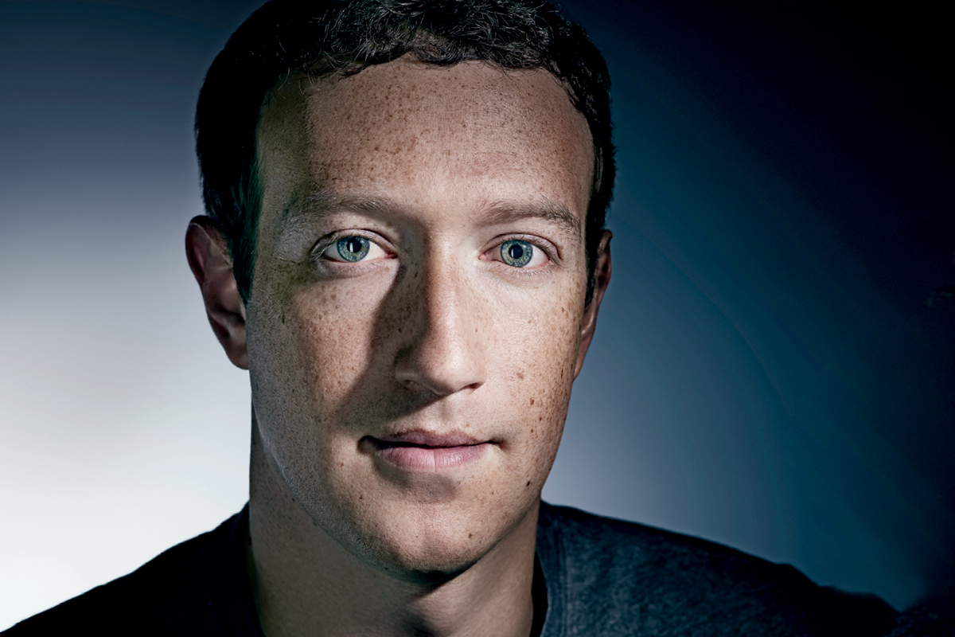
Meta Inc.
(Facebook inc)
People just submitted all this data.
They “trust me”
Dumb fucks
https://www.esquire.com/uk/latest-news/a19490586/mark-zuckerberg-called-people-who-handed-over-their-data-dumb-f/

Slide 16
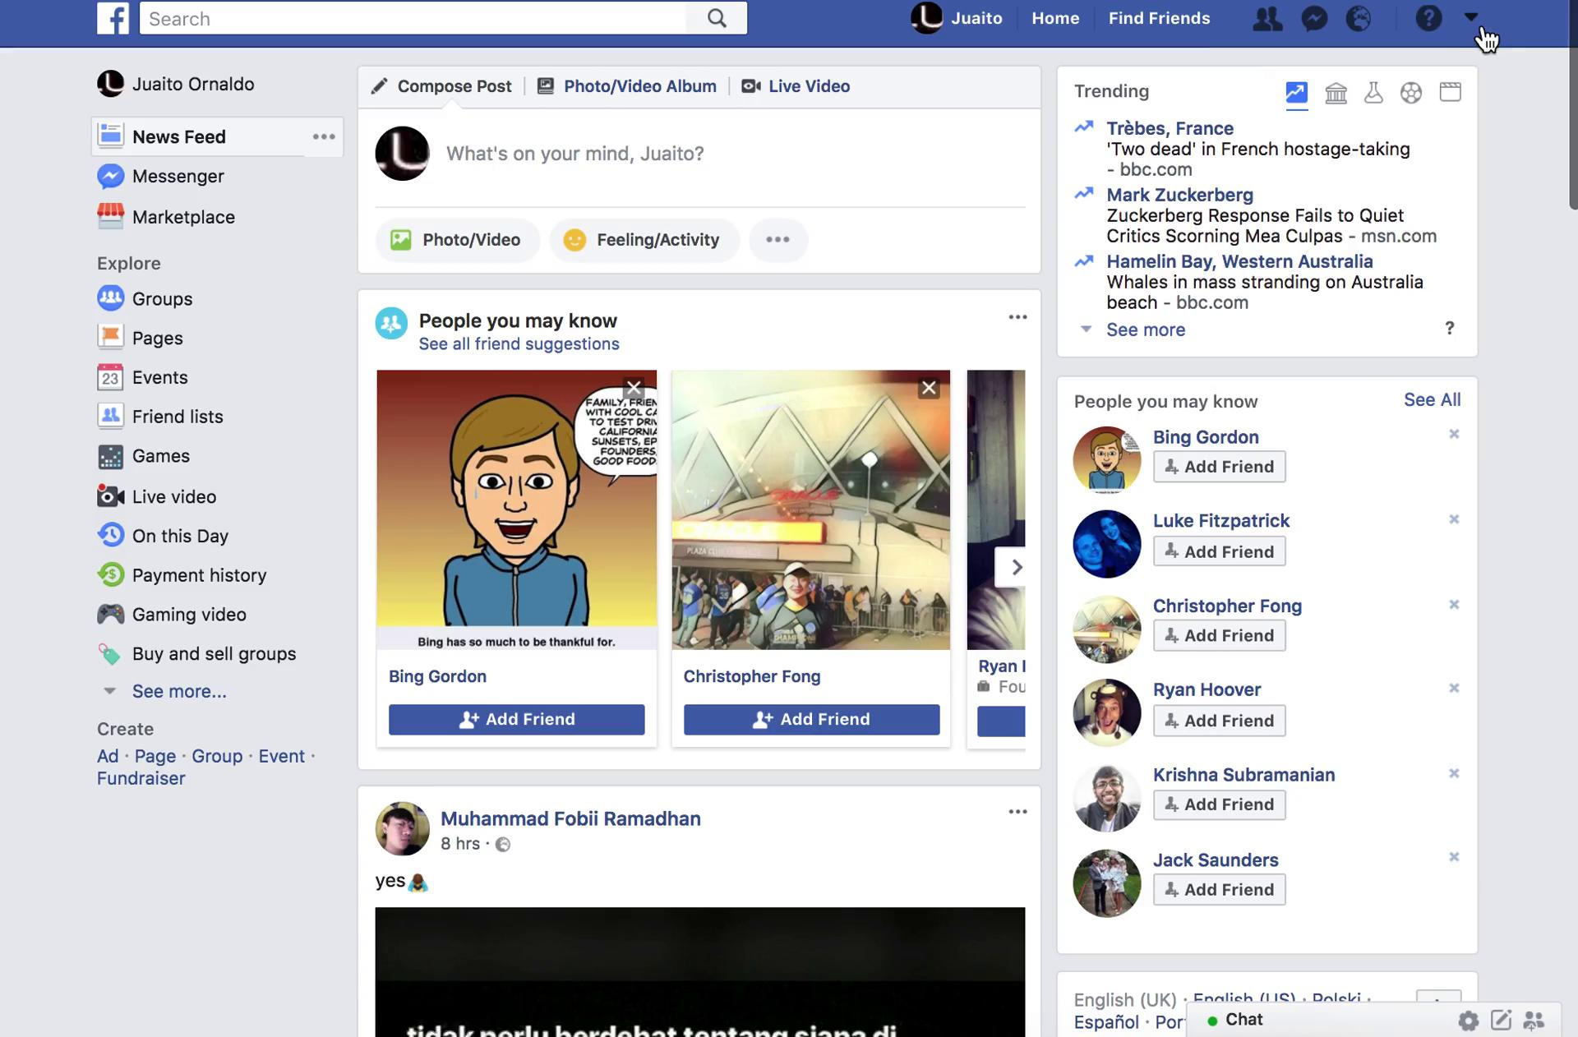
Facebook (the blue product)
$60’000’000’000
Revenue in 2021
https://www.businessofapps.com/data/facebook-statistics/
$39’300’000’000
Profits in 2021
(Bron: zie hierboven)
2’910’000’000
Monthly active user accounts

Slide 17
Facebook Ad Library
https://www.facebook.com/ads/library/report/?source=archive-landing-page&country=BE
Had to be opened by regulators afters Trump’s controversial election
Contains how much each political party spends on Facebook ads
Quiz:
Welke zijn de top 3 partijen?
How much did they spend on ads (since april ‘19)?

Slide 18
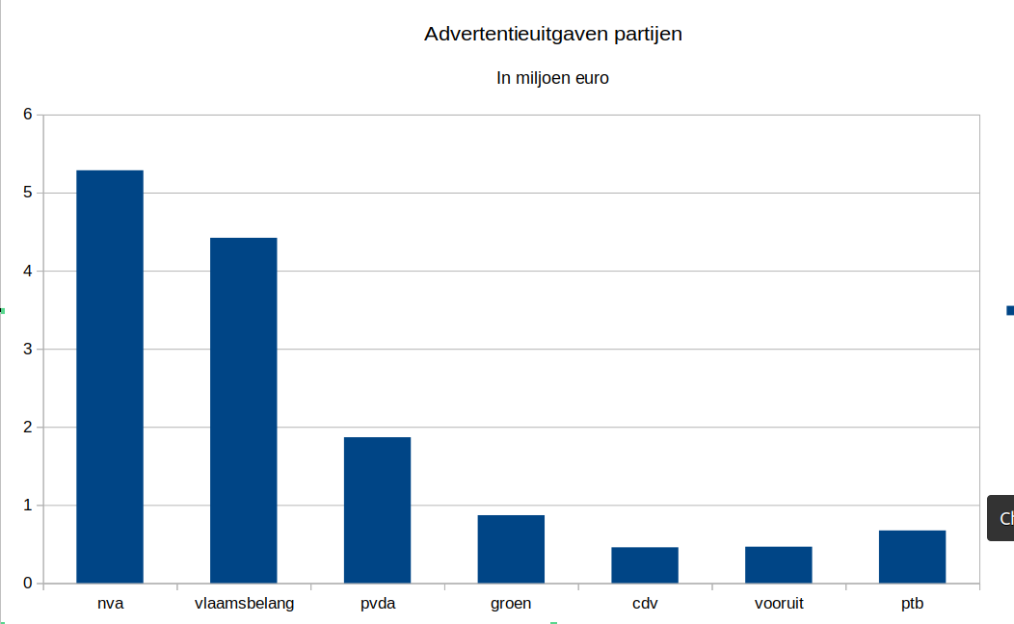
Disclaimer: quick research by me in 2023
I might have missed a few
Facebook Ad Library

Slide 19
Meta Inc.
I want all communication!

Slide 20
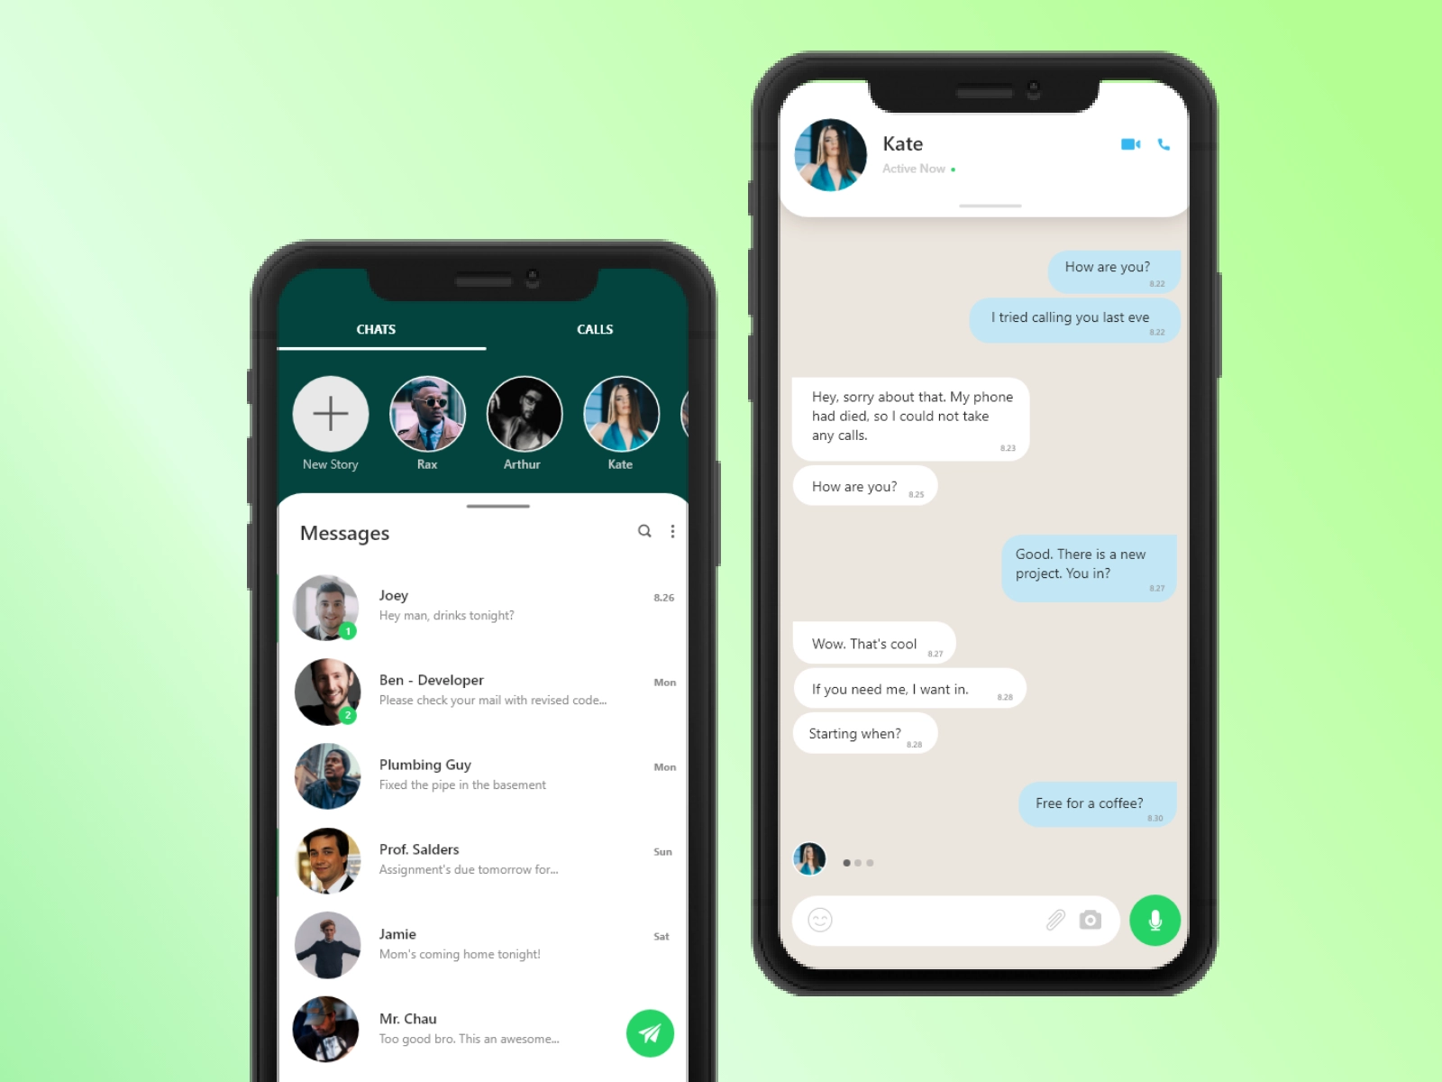
Whatsapp
$19’000’000’000
Bought by Facebook in 2014
https://fortunly.com/statistics/whatsapp-statistics/
$298’000’000
Profits in 2021
Via ‘Whatsapp Business’
2’240’000’000
Monthly active user accounts

Slide 21
Meta Inc.
I want all communication!

Slide 22
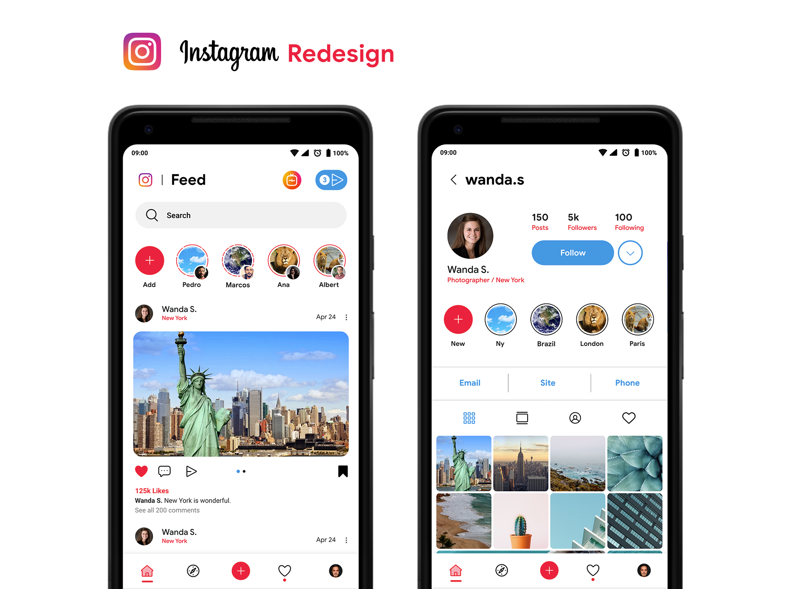
Instagram
$1’000’000’000
Bought by Facebook in 2012
$26’460’000’000
Profits in 2021
https://www.omnicoreagency.com/instagram-statistics/
1’074’000’000
Monthly active user accounts

Slide 23
Meta Inc.
I want to grow!

Slide 24
Growth hacking
Diverse psychological techniques to capture more users and to retain them on the platform to
More users which spend more time on facebook == more advertisements that can be shown
This results in
- psychological tricks
- more and more aggressive, shocking and extreme content

Slide 25
Growth hacking
Infinite scroll (https://journals.sagepub.com/doi/abs/10.1111/j.1467-9280.2006.01738.x)
Notifications at random moments (Skinner box)
Designed to send stimuli back (like-button, poke)
Streaks (Snapchat)

Slide 26
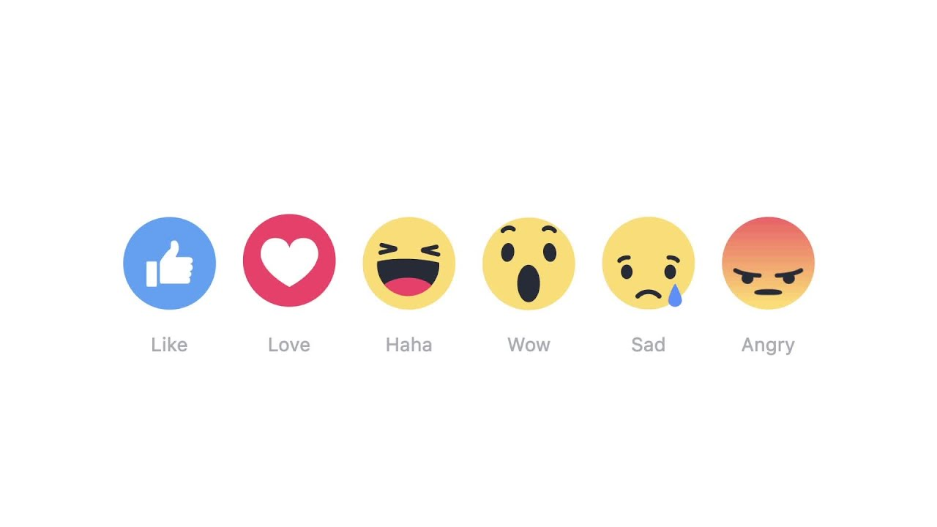

Slide 28
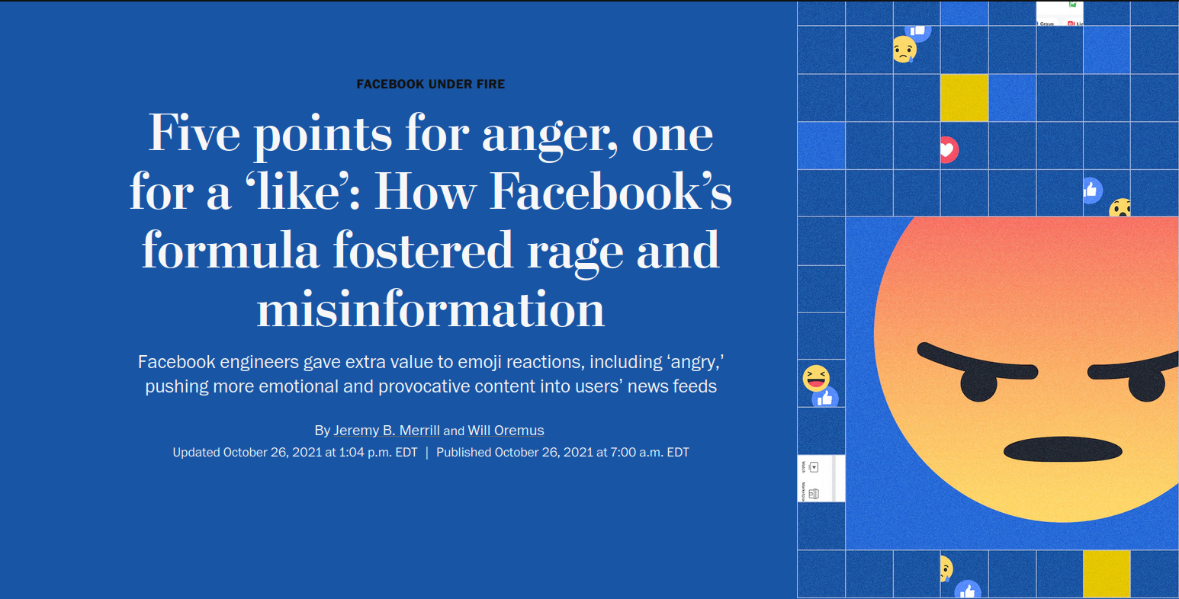
https://www.washingtonpost.com/technology/2021/10/26/facebook-angry-emoji-algorithm/

Slide 29
Behind the scenes, Facebook programmed the algorithm that decides what people see in their news feeds to use the reaction emoji as signals to push more emotional and provocative content — including content likely to make them angry.
Starting in 2017, Facebook’s ranking algorithm treated emoji reactions as five times more valuable than “likes”, internal documents reveal. The theory was simple: Posts that prompted lots of reaction emoji tended to keep users more engaged, and keeping users engaged was the key to Facebook’s business.
The company’s data scientists confirmed in 2019 that posts that sparked angry reaction emoji were disproportionately likely to include misinformation, toxicity and low-quality news.
https://www.washingtonpost.com/technology/2021/10/26/facebook-angry-emoji-algorithm/

Slide 30
What are the effects?

Slide 31

Commercial social media
01
It makes us angry and unhappy
02
Moderation and manipulation
03
Spreads hate resulting in genocide

Slide 32
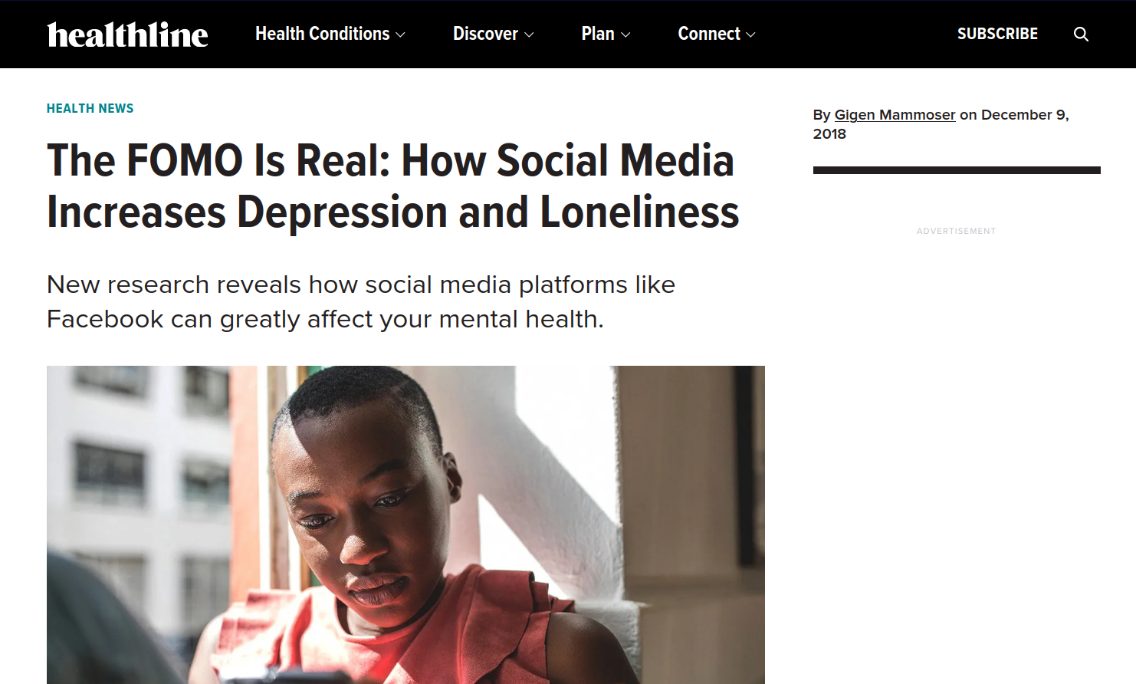
Growth hacking
Diverse tactieken om meer gebruikers aan te trekken
en op het platform te houden;
Meer gebruikers – meer advertenties die getoond kunnen worden
Steeds algemenere en aggresievere content;
Verschillende psychologische manipulaties
https://www.healthline.com/health-news/social-media-use-increases-depression-and-loneliness

Slide 33
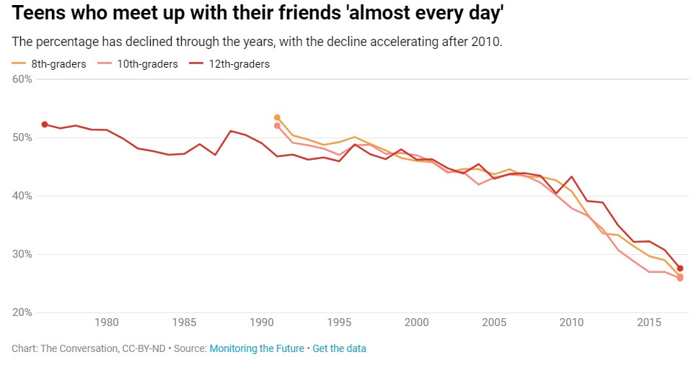
https://noahpinion.substack.com/p/honestly-its-probably-the-phones

Slide 34
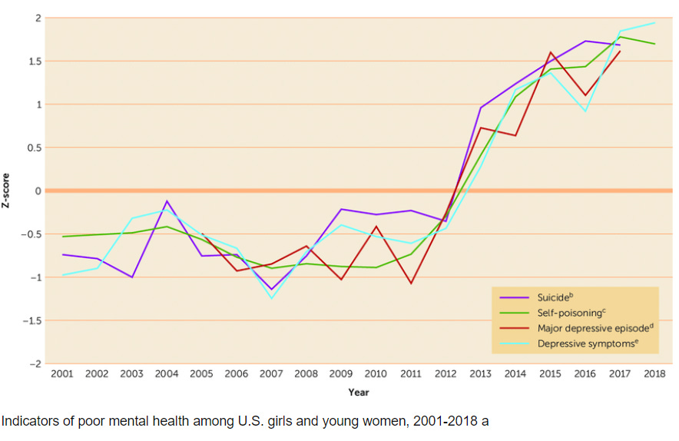
https://noahpinion.substack.com/p/honestly-its-probably-the-phones

Slide 35
Mood manipulation (2012)
We now know that’s exactly what happened two years ago. For one week in January 2012, data scientists skewed what almost 700,000 Facebook users saw when they logged into its service. Some people were shown content with a preponderance of happy and positive words; some were shown content analyzed as sadder than average. And when the week was over, these manipulated users were more likely to post either especially positive or negative words themselves.
https://www.theatlantic.com/technology/archive/2014/06/everything-we-know-about-facebooks-secret-mood-manipulation-experiment/373648/

Slide 36
Election manipulation (2012)
About 611,000 users (1%) received an 'informational message' at the top of their news feeds, which encouraged them to vote, provided a link to information on local polling places and included a clickable 'I voted' button and a counter of Facebook users who had clicked it. About 60 million users (98%) received a 'social message', which included the same elements but also showed the profile pictures of up to six randomly selected Facebook friends who had clicked the 'I voted' button. The remaining 1% of users were assigned to a control group that received no message.
Those who saw the social message were 2% more likely to click the 'I voted' button. The social message, the researchers estimate, directly increased turnout by about 60,000 votes.
https://www.scientificamerican.com/article/facebook-experiment-found-to-boost-us-voter-turnout/

Slide 37

https://www.brusselstimes.com/297850/good-move-far-right-vlaams-belang-attempts-to-divide-brussels-with-targeted-ads

Slide 38
Moderation?
How to moderate in a different language and culture?
The ‘system’ actively spread what should be moderated
Moderation must be as cheap as possible

Slide 39
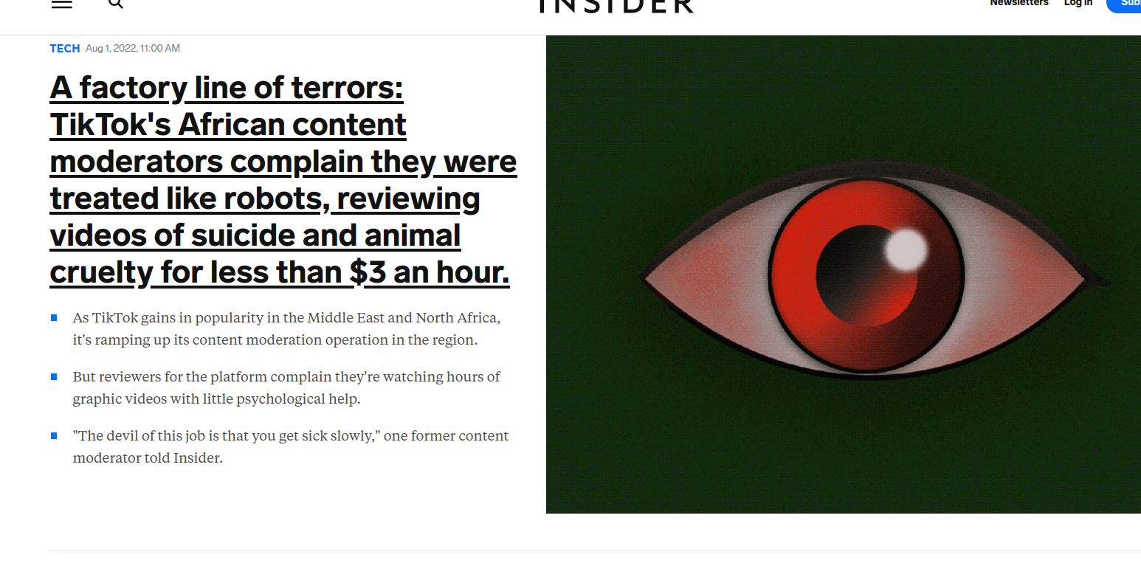
Hoe modereren als je de taal en cultuur niet kent
https://www.businessinsider.com/tiktoks-african-factory-line-of-terrors-2022-7?r=US&IR=T

Slide 40
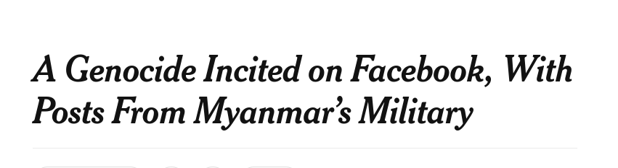
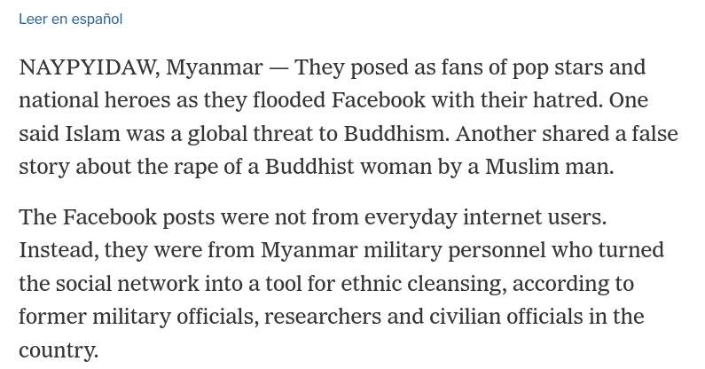
https://www.nytimes.com/2018/10/15/technology/myanmar-facebook-genocide.html

Slide 41
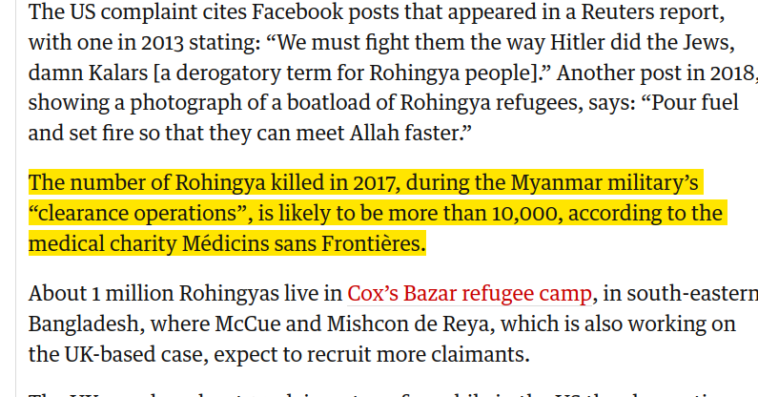
https://www.theguardian.com/technology/2021/dec/06/rohingya-sue-facebook-myanmar-genocide-us-uk-legal-action-social-media-violence

Slide 42
What if...?
Your political ideology gets banned from facebook?
What if the secret services would read your messages?
What could they learn from who you connect to?

Slide 43
Can we do better?
Just us, as humans between each other?

Slide 44
Ilja knows a bit about computers.
They set up a ‘mini-twitter’ from some friends

Slide 45
Anna sets up a similar mini-Twitter for their friends

Slide 47
Jos likes pictures more and sets up a mini-Instagram for their friends

Slide 48
Fediverse (Mastodon, Pixelfed, Mobilizon, ...)

Slide 49

Mastodon
Popular and crowded since Musk took over Twitter
Mostly for small, personal status updates (and a few pictures)

Slide 50
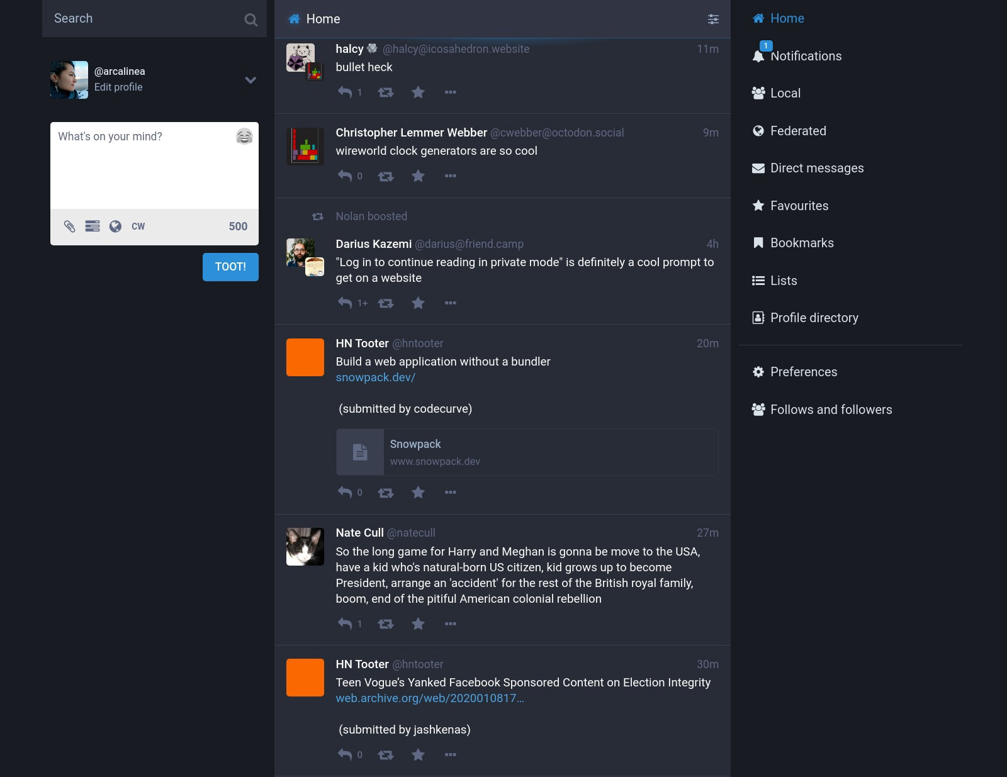

Slide 51
Home: timeline with messages from whom you are following
Post a status-update

Slide 52
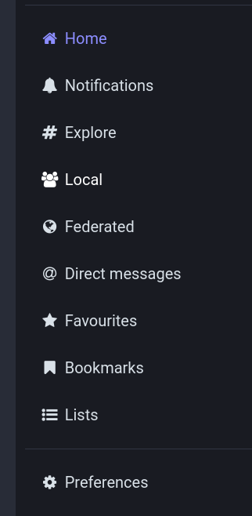
Home: see what is posted by people you follow
Notificatians: if you got mentionend, boosted or favorited
Local: all toots by people on your server
Federated: all toots from “friends of server inhabitors”

Slide 53
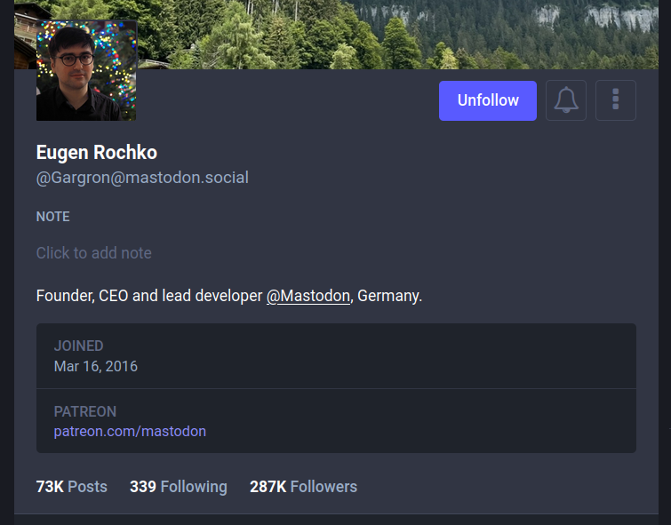
Volgen:
Berichtjes komen in je timeline
Belletje: krijg een notificatie bij een post

Slide 54
How to
2
Maak een account
4
Interactie
Kies een server waar je je thuis voelt.
Bonuspunten als je de admins kent en vertrouwt.
Zoniet: tussen 100 en 1000 personen
Schrijf een introductiepost.
Antwoord op berichtjes die je interesseren en die je aangaan
Boost en favoriet.
1
Verken servers
3
Ga shoppen
Er zijn duizenden servers met elk een eigen community.
Ga kijken op alle servers waar je interesse voor hebt,
Volg er mensen

Slide 55
Mastodon Server lists
https://mastodonservers.net/servers
https://joinmastodon.org/servers
Diverse servers per topic
Veel servers mag iedereen een account op maken,
Sommigen zijn gesloten
Anderen op aanvraag

Slide 56
Algemene, geografische servers Mastodon.vlaanderen Mastodon-belgium.be | Urbanisme en transport Urbanists.social, transportation.social Rail.chat en zug.network masto.bike (EN/FR) en Toot.bike (EN/DE)
Activisme Activism.openworlds.info social.rebellion.global (XR) kolektiva.social mastodon.pirateparty.be union.place (vakbonden) | Open source en tech Fosstodon.org en.osm.town (OpenStreetMap) mapstodon.space
Misc Tech.lgbt (gay programmeurs) Comics.town (kunst) Veganism.social Birds.town (vogelkijkers) indieauthors.social (auteurs) Disabled.social | Enkel officiele EU-instanties Social.network.europa.eu https://social.overheid.nl/about
Enkele pointers

Slide 57
#TwitterMigration
https://fedifinder.glitch.me/
https://debirdify.pruvisto.org/
https://twitodon.com
Leest wie je volgt op Twitter (“The bird site”)
Probeert om op je volgers een Mastodon-account te plakken
Zet je Mastodon-account in je bio en/of als profielnaam

Slide 58
#TwitterMigration
Twitter ↔ mastodon crossposter
Verschillende services die je toots tweeten en je tweets tooten
Goeie overgangsmaatregel

Slide 59
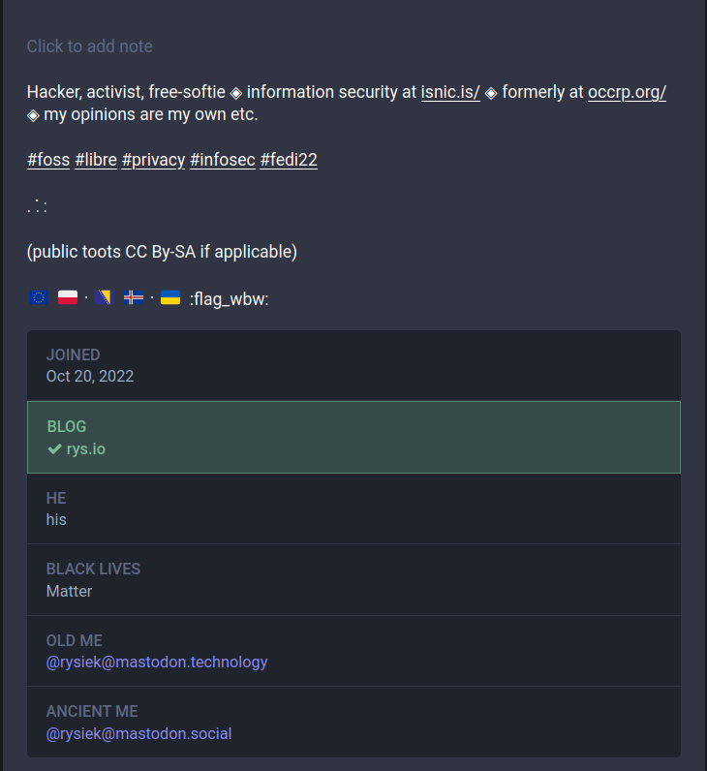
Hoe bewijs je dat je account ‘echt’ is?
Heb je een website of user account?
Plaats een speciale link naar je mastodon:
<a href=”mastodon.domain/@username” rel=”me”>mastodon</a>
Plaats in je profiel-metadata (een tabel) een link naar de pagina met je teruglink in de rechterkolom.
Je server zal dan zoeken naar die link en een vinkje tonen

Slide 60
#Plugin
FediAct: browser plugin om makkelijk te interageren met andere instanties
Enkel indien je één account beheert,
kan verwarrend zijn anders

Slide 61
#App
Tusky
Gebruiksvriendelijk
Goeie ondersteuning voor verschillende accounts
In de Play Store en of F-Droid
(Geeks: die geen Google Play Services hebben: eerst NFTY installeren)

Slide 62

Bluesky?
Dat andere “””gedecentraliseerde””” sociale medianetwerk

Slide 63
Bluesky
Not decentralized
  Only possible in theory
  Setting up a server will be expensive
American owned and hosted
Started by Venture Capital
  Investors: cryptocoin-rich

Slide 64
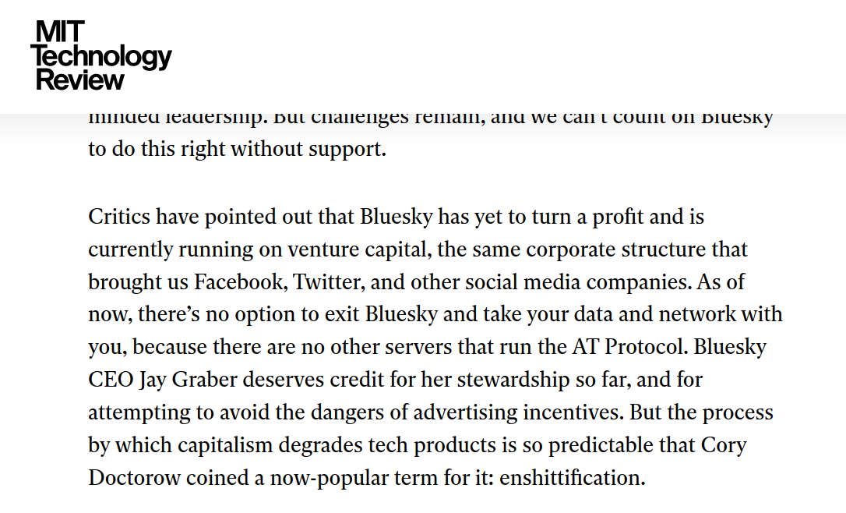
https://www.technologyreview.com/2025/01/17/1110063/we-need-to-protect-the-protocol-that-runs-bluesky/

Slide 65

No trolls allowed!
Van welke aanpak weten we dat het
positief gedrag aanmoedigt?

Slide 66
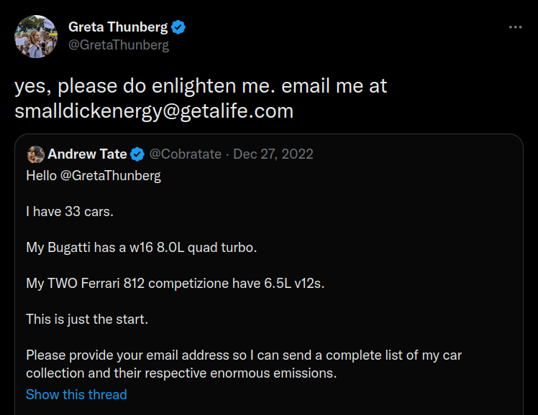

Slide 67
Don’t do this
Ik vond ‘t ook grappig, maar:
Is er iets mis met een kleine piemel hebben?
No body shaming please!
Dat helpt niemand vooruit
Greta heeft zo de spotlight op Andrew Tate gezet, alle tegenstanders ooit hebben nu iemand meer om te volgen.
Ook haar volgers worden nu met haat geconfronteerd
Denk ook aan Schild en Vriend. Dankzij de Pano-reportage zit Dries Van Langenhove in ‘t parlement

Slide 68

CC-BY-NC-SA
@Lokigwyn@pixelfed.fr

Slide 69
Moderatie
Persoonlijk
Je admin
Blokkeer personen die je lastigvallen
Rapporteer aan je admin
Ga nooit in discussie,
doe geen quote-tweets.
Dit geeft enkel meer zichtbaarheid aan de haat
Blokkeert personen
of volledige servers
voor de eigen server
Communiceert met andere admins voor
#fediblocks

Slide 70

#FediBlock

Slide 71
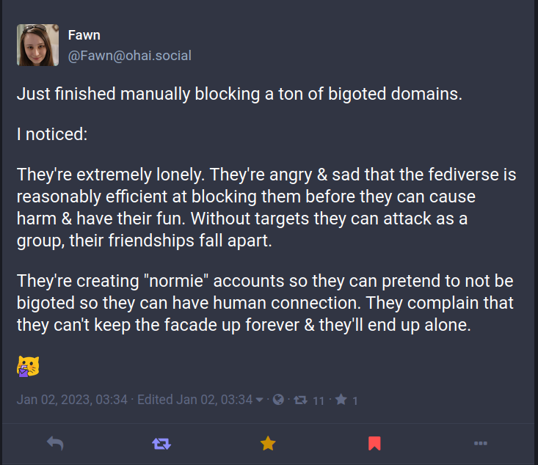

Slide 72
Wat als de server slijt?
Is de moderatie op je server slecht geworden?
Lijkt een andere server leuker?
Je kan verhuizen.
Mits juist in te stellen, zullen je volgers automatisch je nieuwe stek vinden.
Ook wie je volgt kan je meenemen.
Je toots blijven echter achter (maar er zijn wss tools om die ook mee te nemen)

Slide 73
There is more...

Slide 74
Gespecialiseerde servers
Mobilizon
Evenementen
Pixelfed
Foto’s – beetje Instagram-achtig
Peertube
Videos
Lemmy
Reddit-achtig

Slide 75
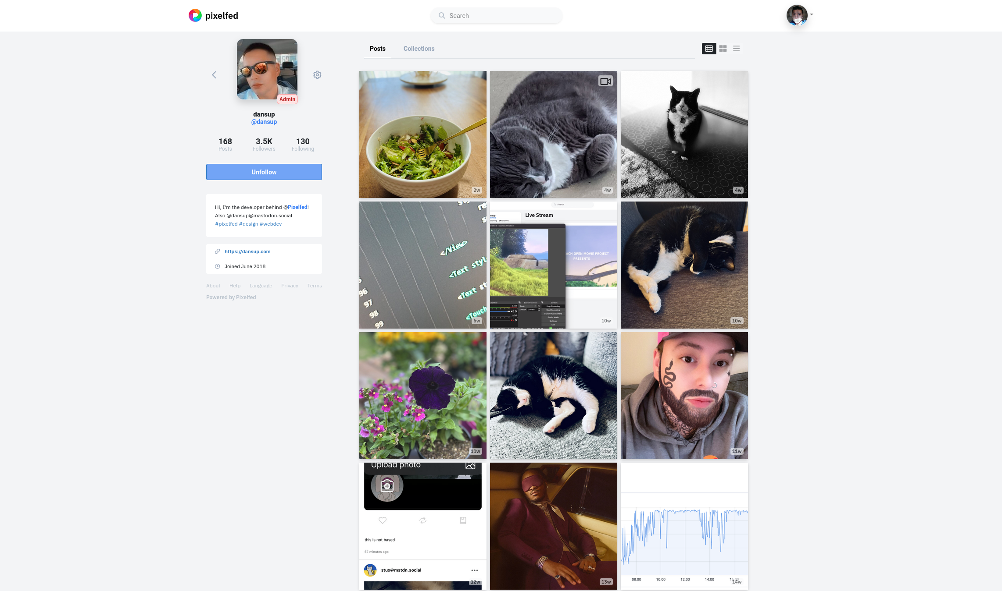
Pixelfed
Gericht op foto’s

Slide 76
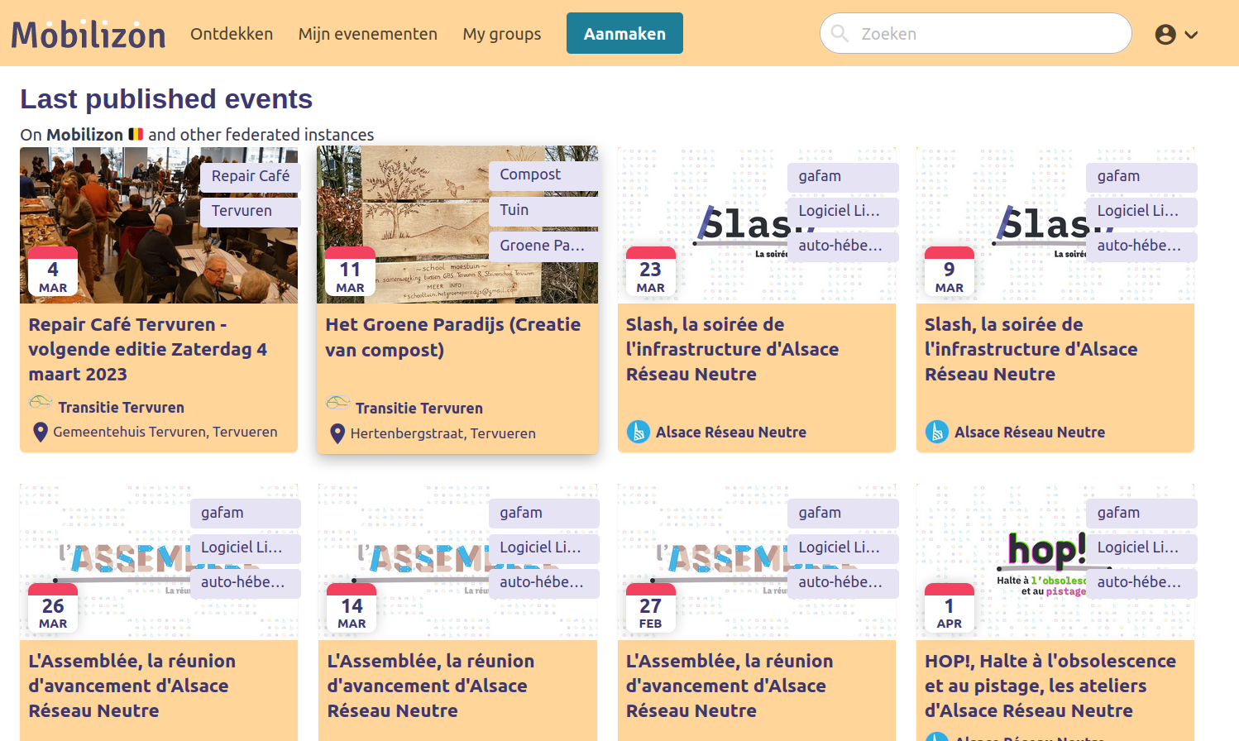
Mobilizon
Post evenementen online,
Gemaakt voor en door activisten

Slide 77
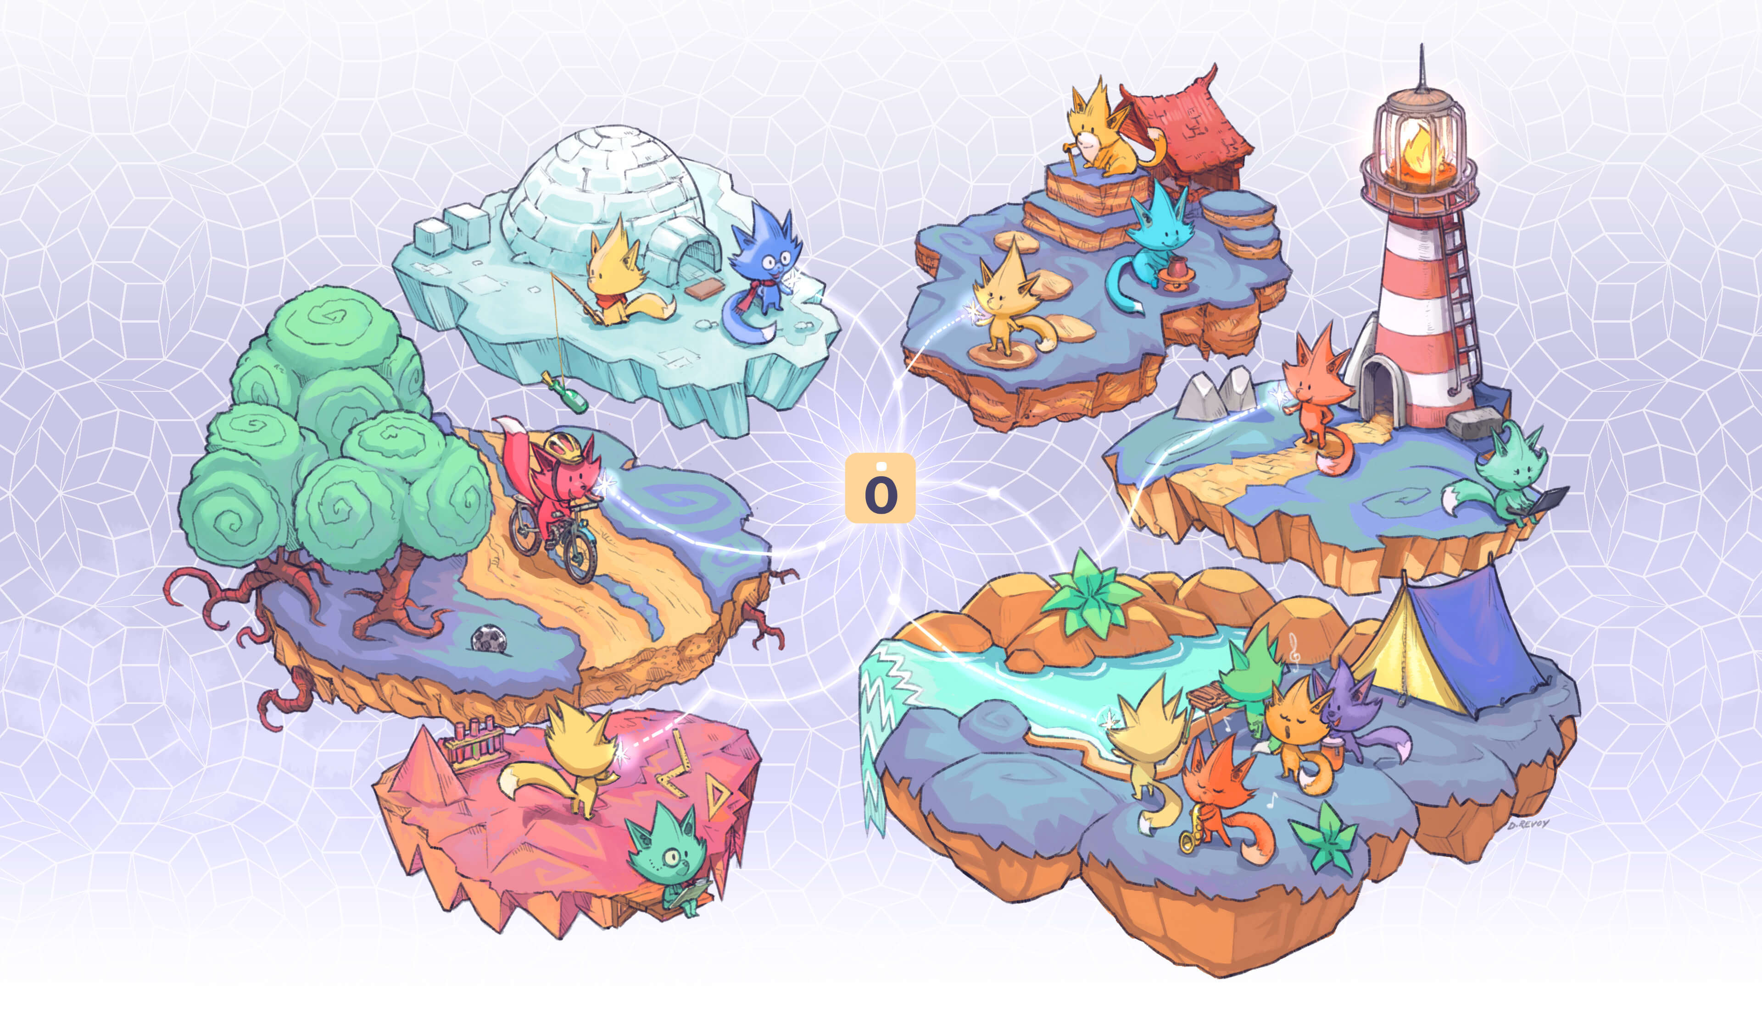
Publiceert automatisch op Mastodon
Verschillende servers instances.joinmobilizon.org
Nog veel bugs maar cute artwork <3
Voorbeeld

Slide 78
Samengevat
Growing Liberty by Budi Aryo @tokofoss

Slide 79
Autonoom en decentraal
Gezondere en
minder toxische interacties
Nodig voor een gezonde democratie en verandering
Sommige berichten nodigen uit tot diepe reflectie

Slide 80
Toot Toot!

Slide 81
Voor wie meer wilt
Metareview van diverse studieshttps://jonathanhaidt.substack.com/p/social-media-mental-illness-epidemic
https://ncase.me/trust/
https://ncase.me/crowds/
https://www.groene.nl/artikel/een-traditie-van-internetpionieren

