Slide 1
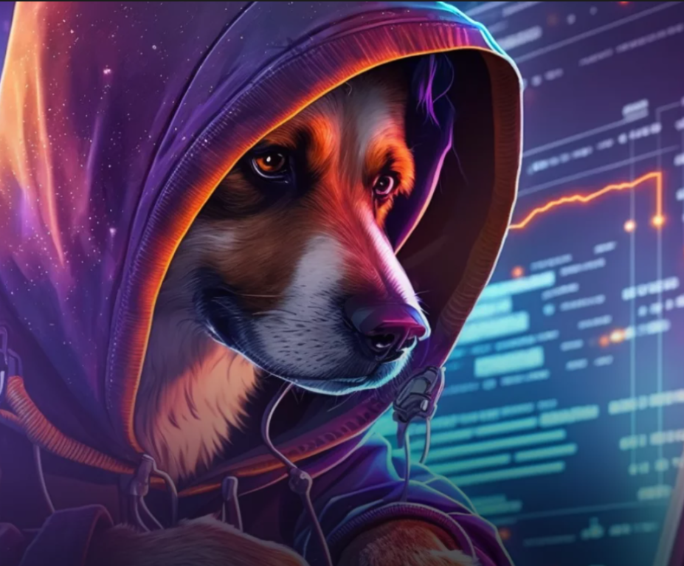


Fact-checking AI: Fighting Autism Disinformation Frogpt Team
14 - 15 czerwca 2023

Slide 2
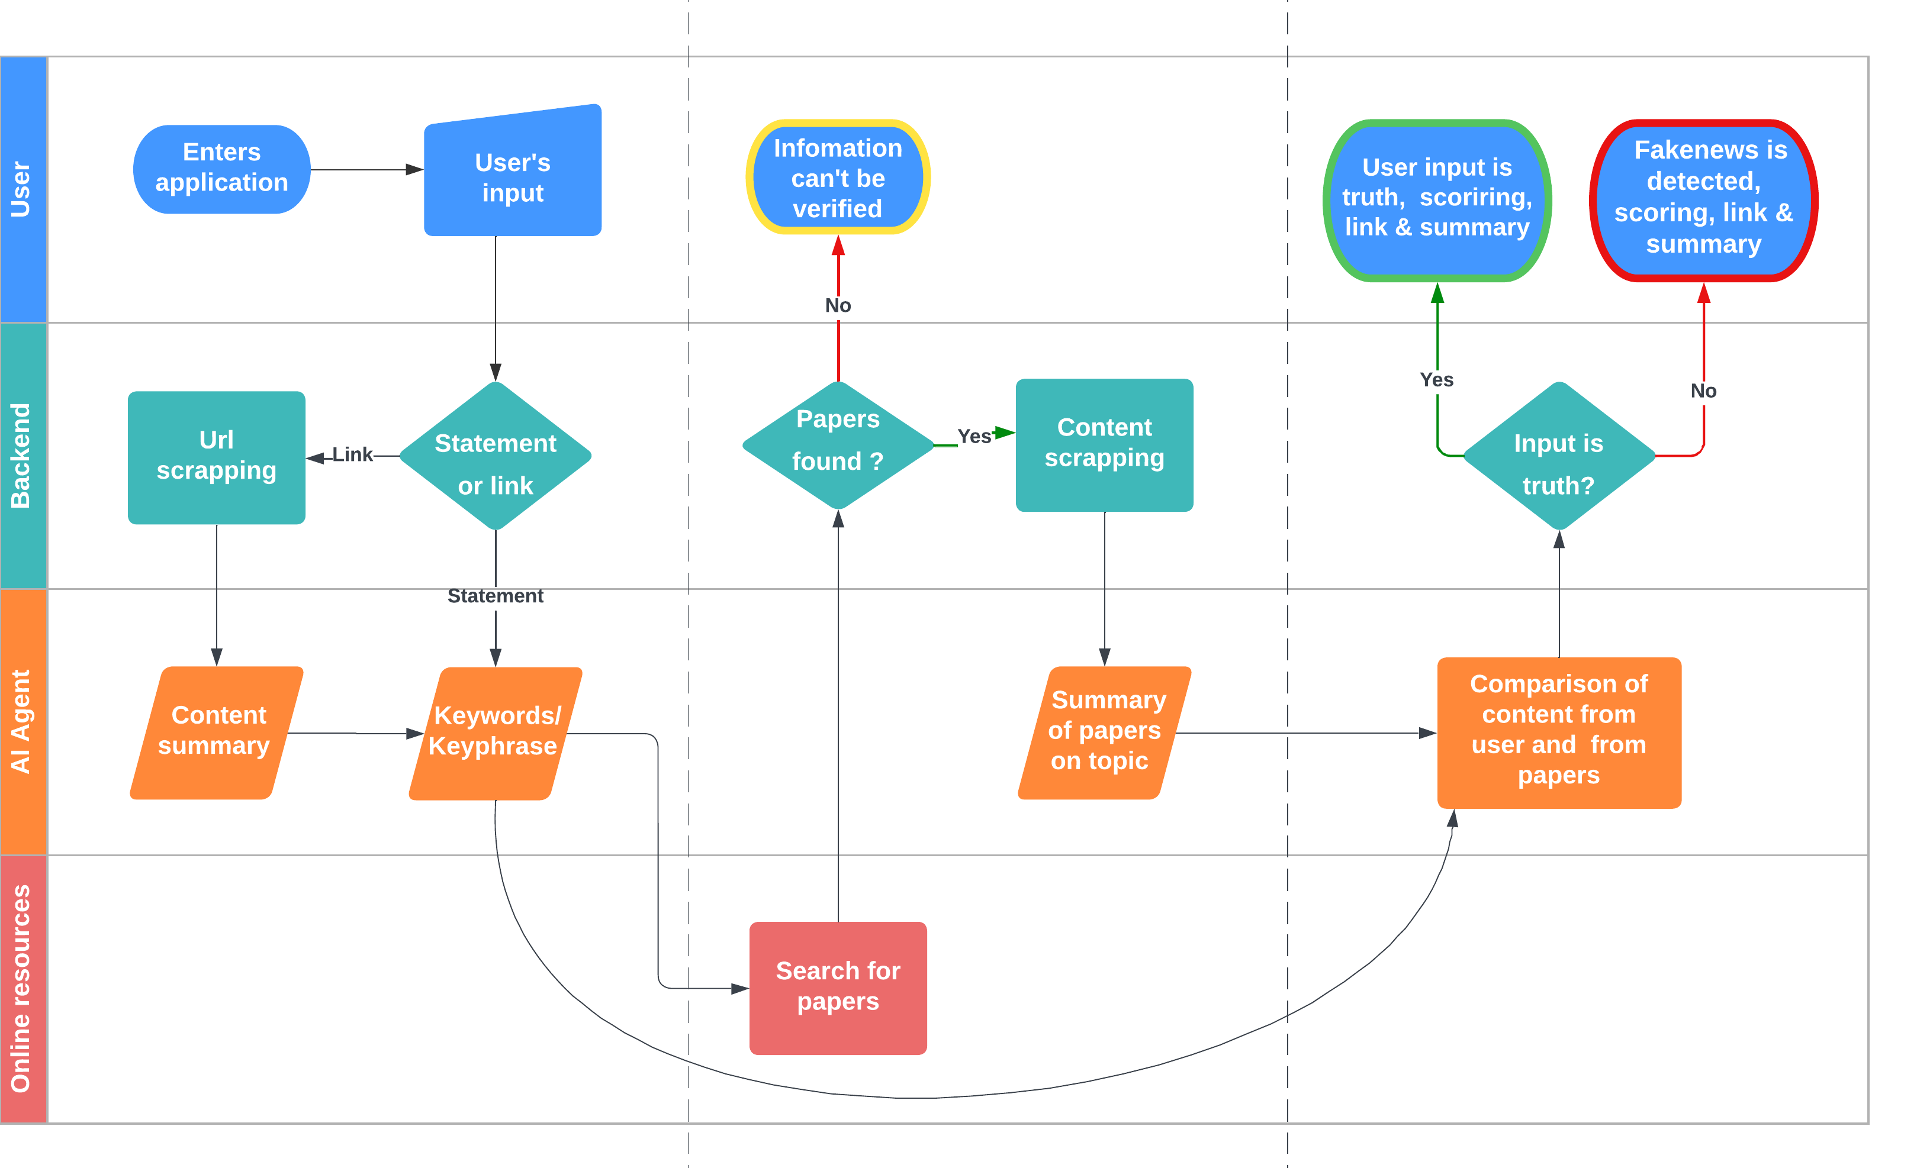



Technical approach – why and how it works?

Slide 3
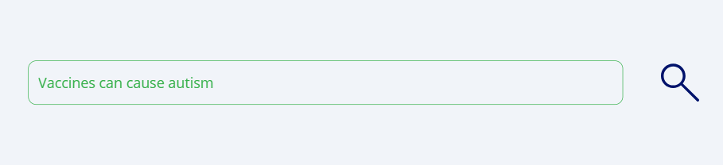

Converting user’s input into keywords for papers’ search
01
02A
Zespół Data Science
01
User input as statement or link
02
01
Processing input into keywords for search
application in Power Apps
01A
01
Url scrapping
Scrapping and preliminary cleaning of url content with python
Use of GPT4.0 to summarize the content of url in context of autism

Slide 4
Scrapping relevant research papers and summarization
03
02A
Zespół Data Science
01
Search for papers related to topic
Searching for papers in Google Scholar and PubMed
05
01
Content summarization
Summization of information from different papers to obtain verified
04
01
Content scrapping
Due to reduction of papers’ content to abstracts only we encounterd a problem of lack of information within the scrapped data which naturally affects performance of our solution
In demo due to token limitation scrapping reduced only to abstracts

Slide 5
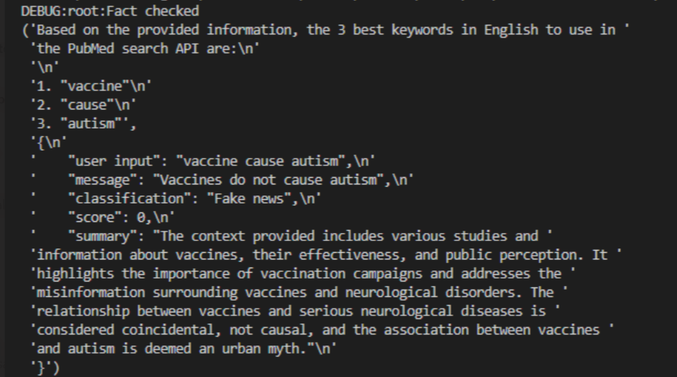
Comparing user’s input with relevant articles on a topic
02A
Zespół Data Science
06
01
Verification of original piece of information with data from papers

Slide 6
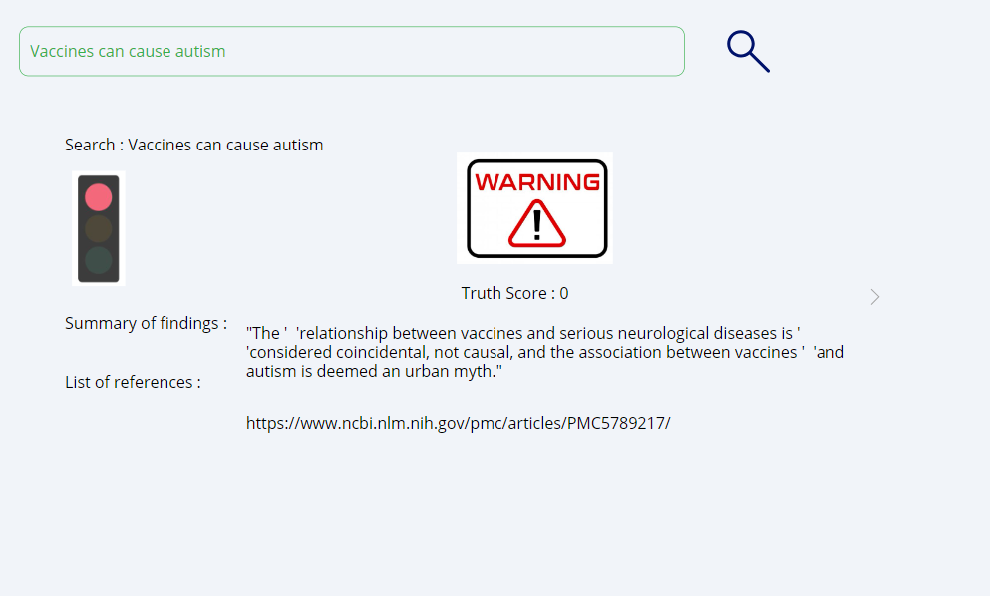
Response and feedback information for user

Slide 7
What are next steps for our demo?
01
Integration
02
Cross-chek for user input
03
Data from papers
What we managed to deliver in this demo is the semiautomated solution. Every module was delivered by us, but integration of them is essential for fully functional solution.
Foolproofing the solution by checking if the input is on autism and by engaging user in a conversation to get complex context on original request. Especially when no related papers are found.
Exploitinig full potential of papers to get more accurate information and adding more trusted sources to assure verification of input as often and well as possible

Slide 8

Thank you!
Fact-checking AI: Fighting Autism Disinformation
Frogpt team:
Kozak Mateusz kozak.mateusz@zabka.pl
Kurkowski Bartosz kurkowski.bartosz@zabka.pl
Mazurowski Sławomir mazurowski.slawomir@zabka.pl
Pietrzak Oliwia pietrzak.oliwia@zabka.pl
Szamborski Dariusz szamborski.dariusz@zabka.pl
Szmidt Mateusz szmidt.mateusz@zabka.pl

