Slide 1


Machine learning model to forecast food insecurity
ISI-WFP

Slide 2

Yemen
We analyzed daily food insecurity in 20 provinces from July 2018 to August 2020.

Slide 3

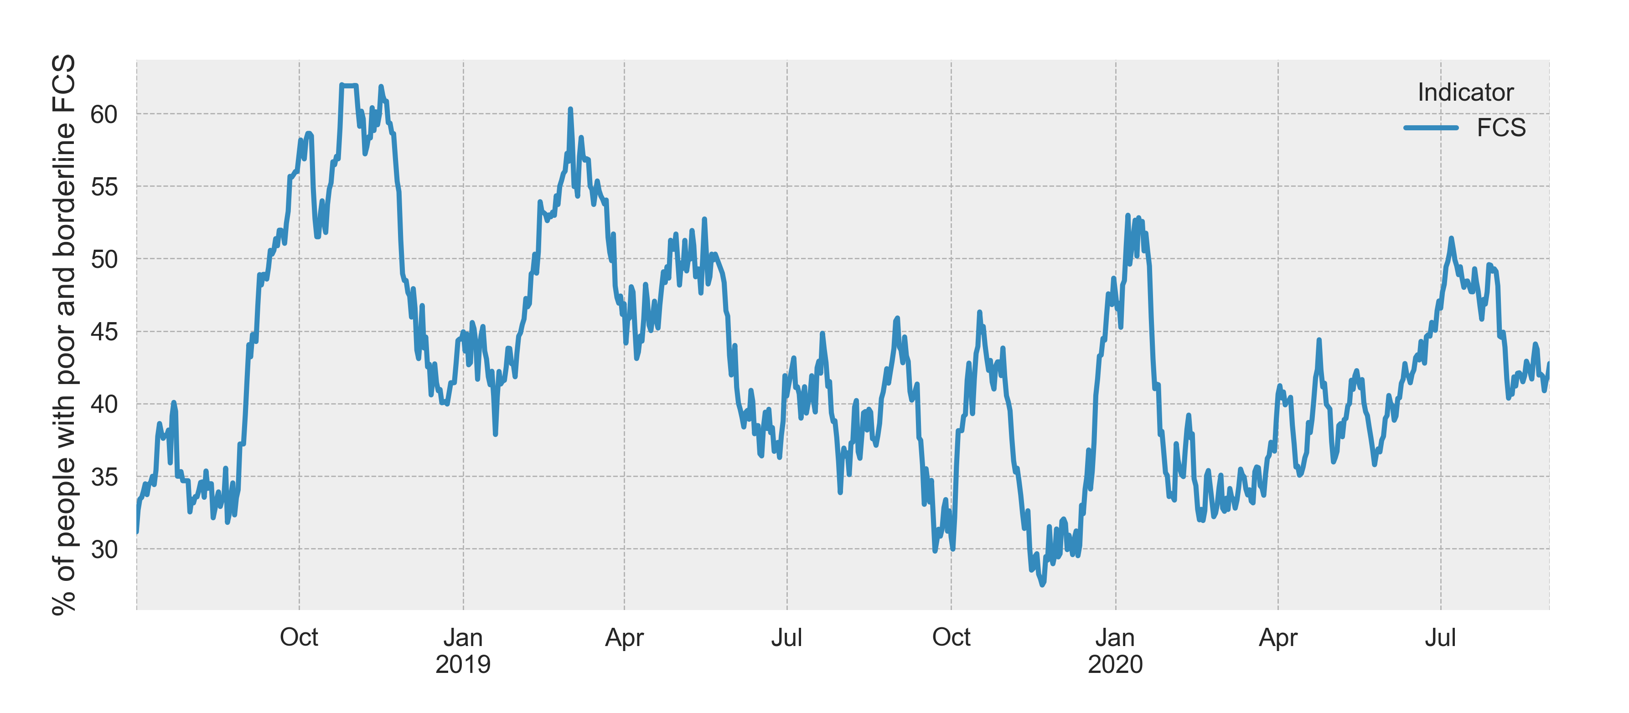

Example: Abyan

Slide 4
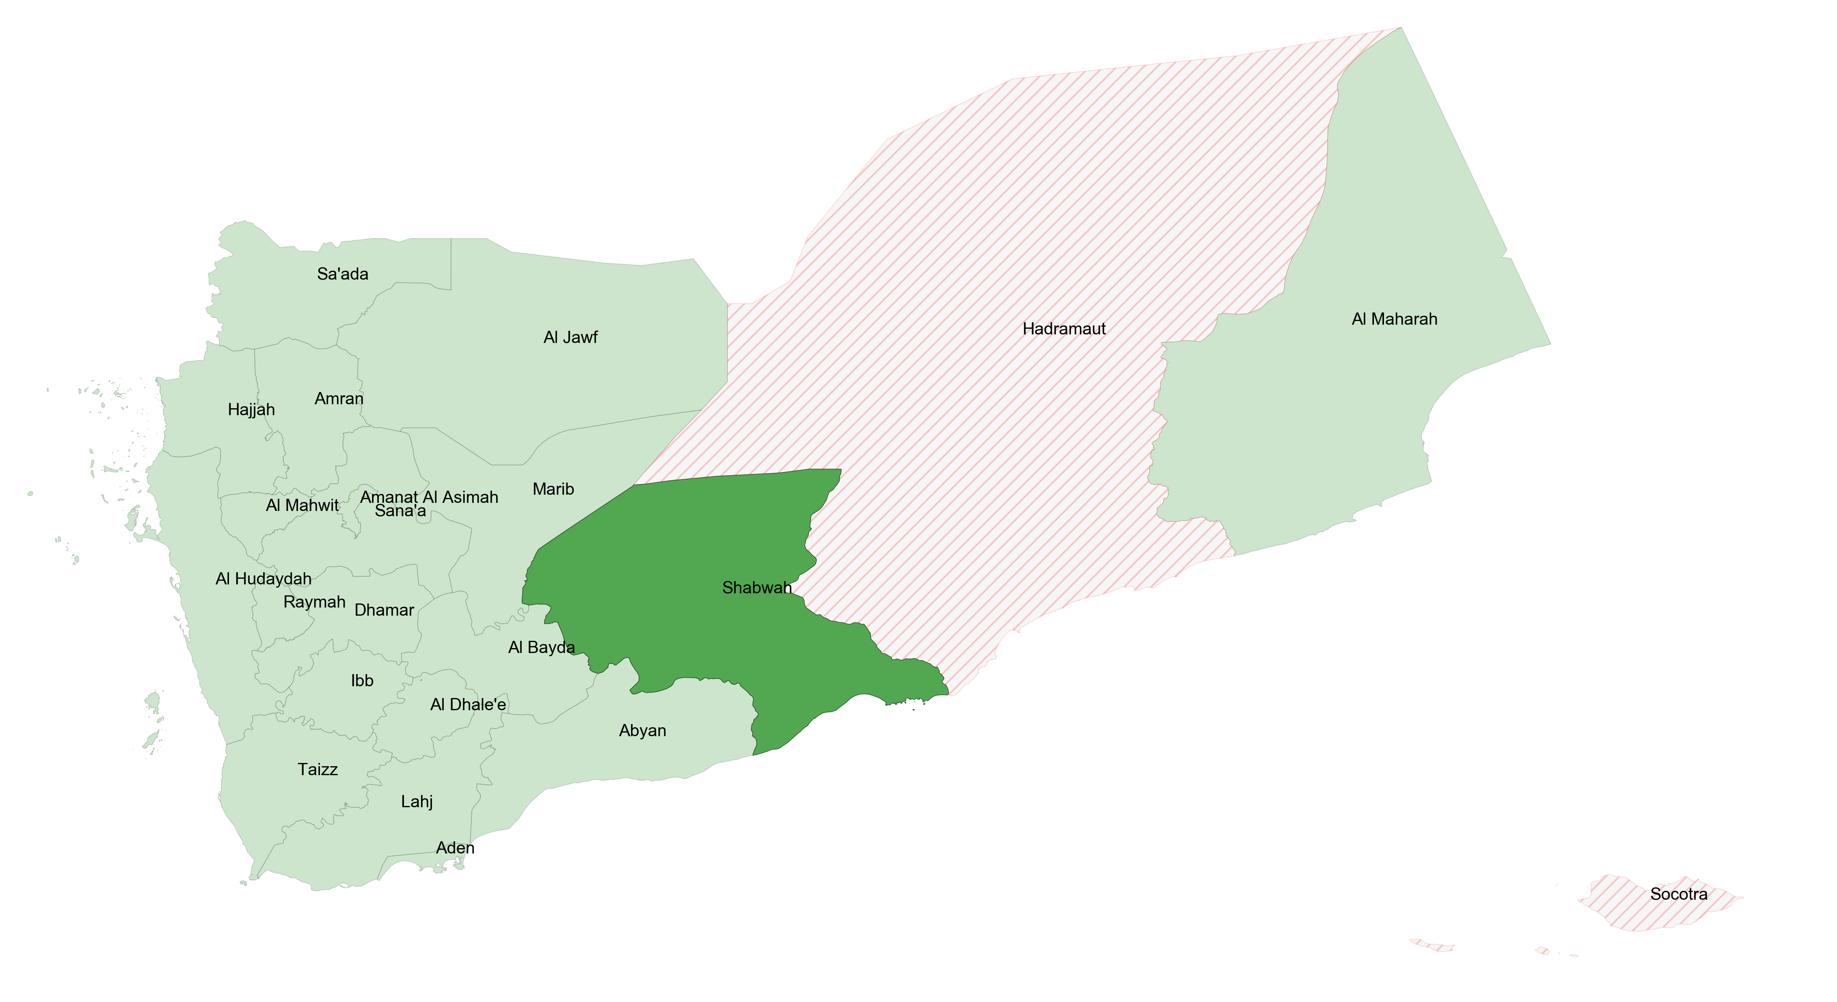
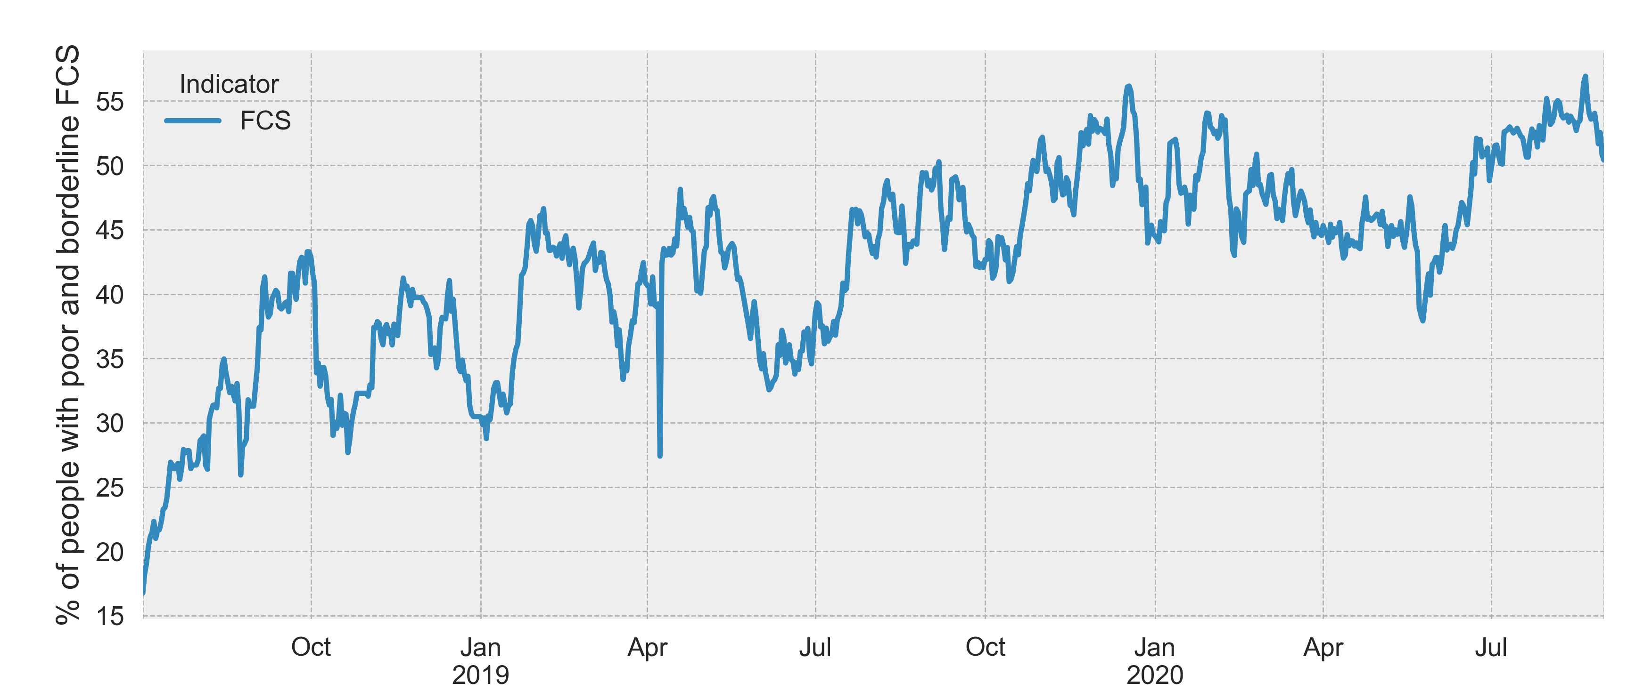
Example: Shabwah

Slide 5
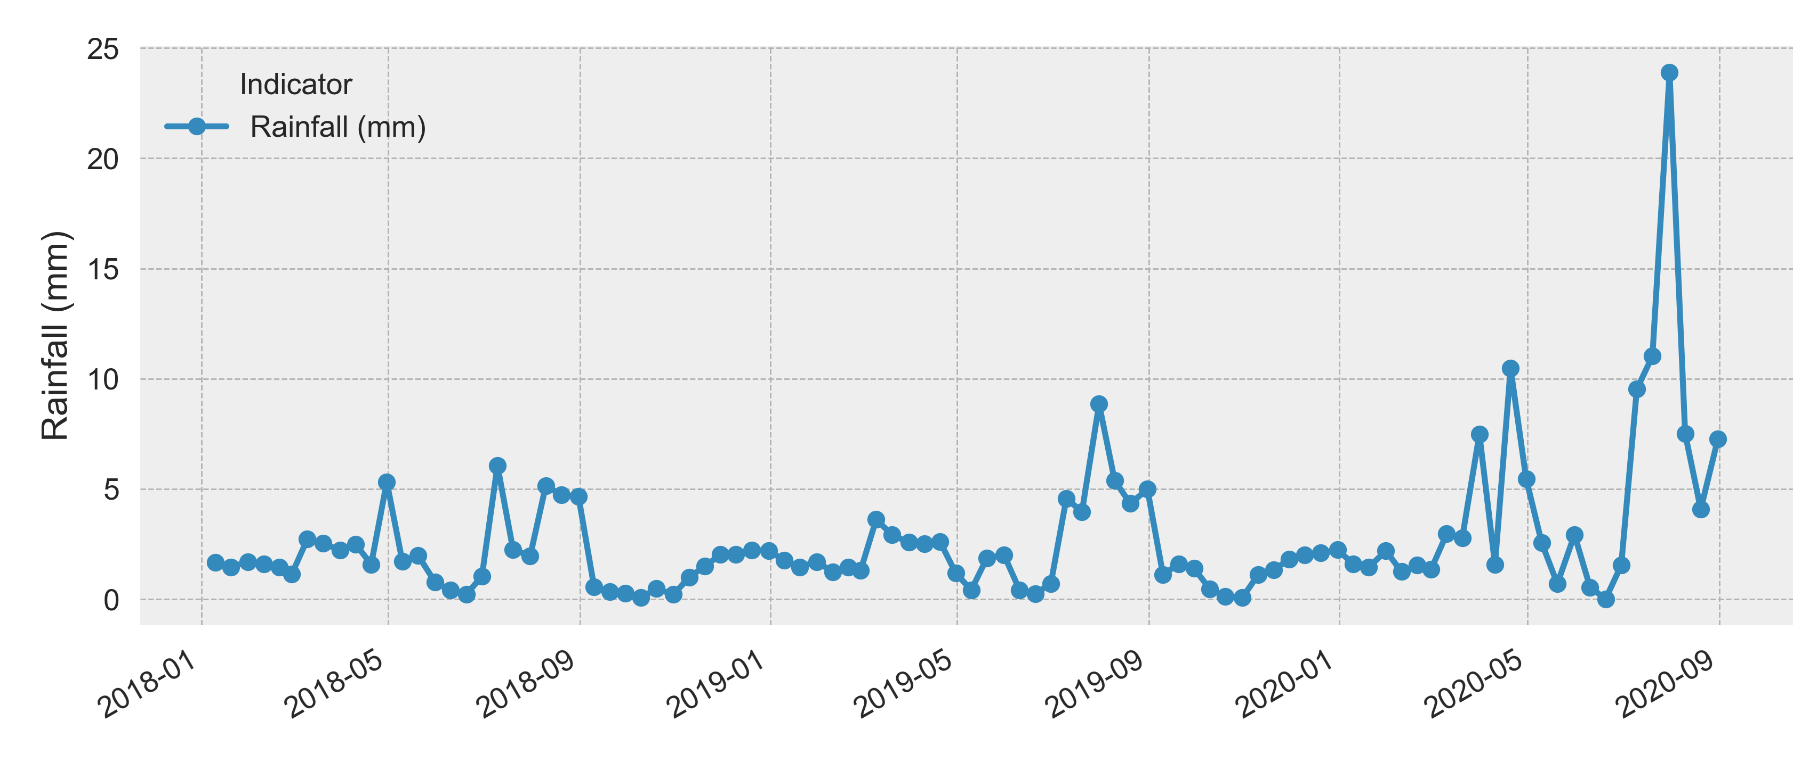
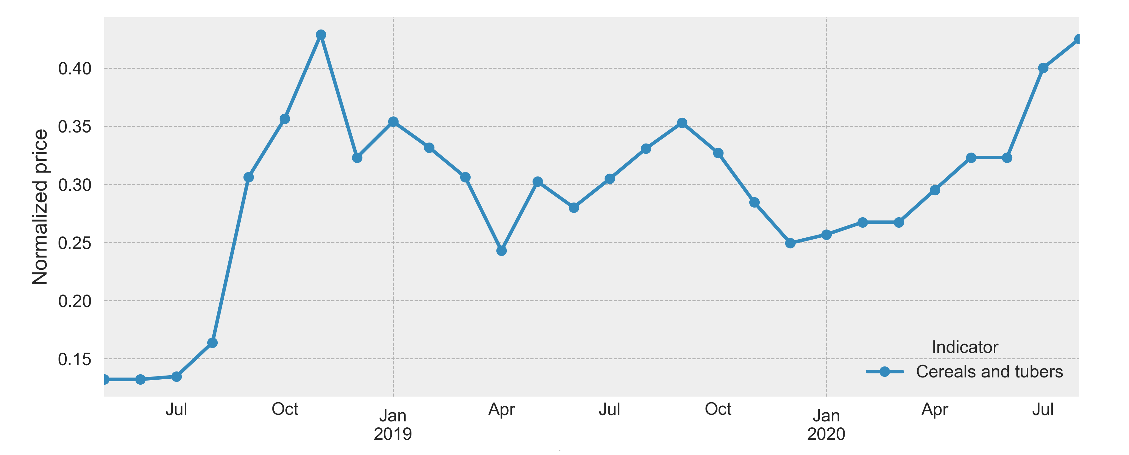


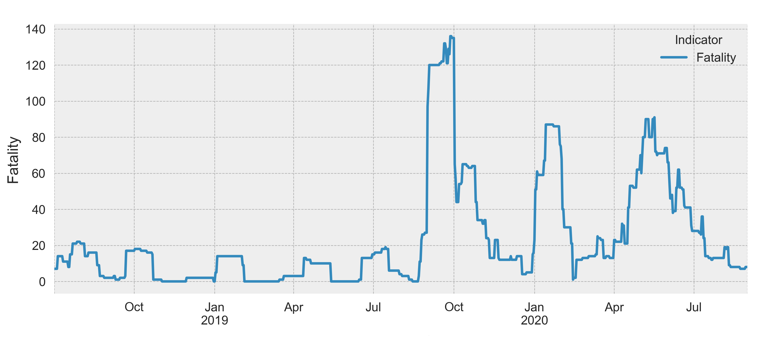

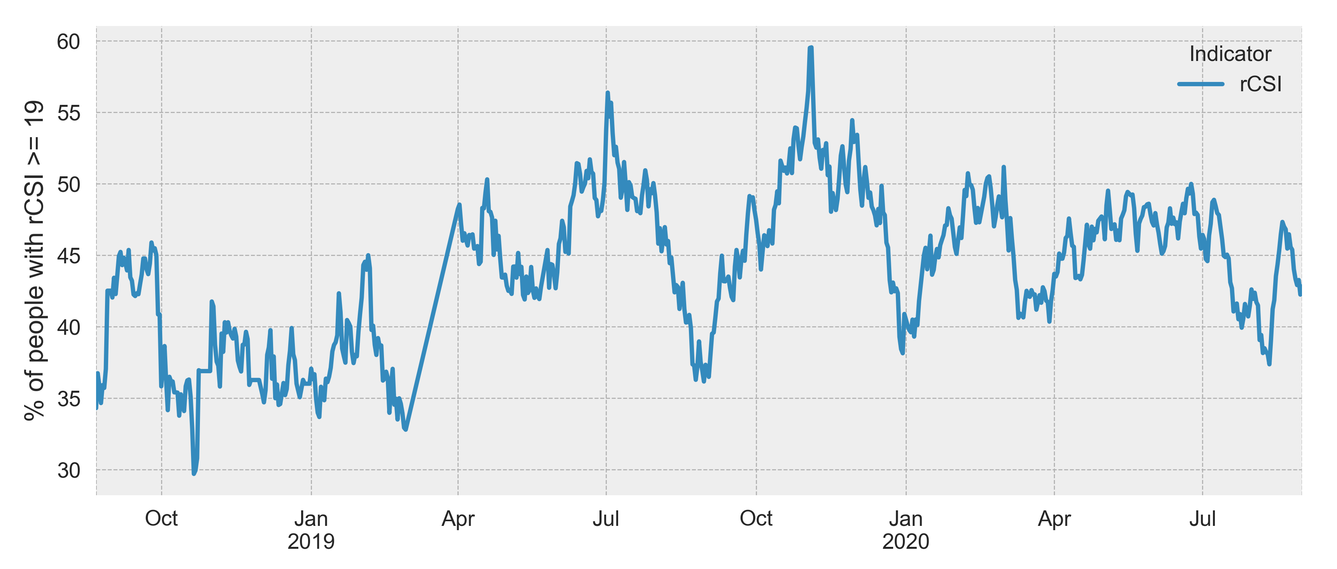

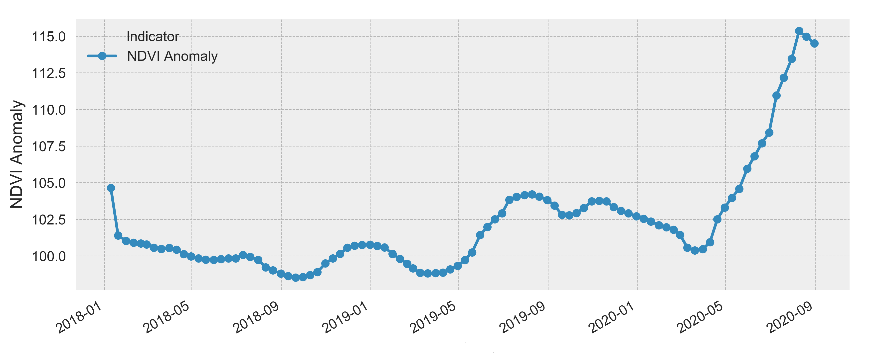

Exogenous information
WFP has been constantly monitoring the evolution of different events that researchers identify to affect food insecurity.

Slide 6
Forecast 30 days ahead in the future of the food insecurity
How to provide wfp with a result that can be easily interpreted in understanding the possibility of creating a real application?
Suppose we go back in time and find ourselves at the end of January 2020 with knowledge of the data history limited to that date.
We would like to predict food insecurity in the days between 2020-02-01 and 2020-03-01

Slide 7
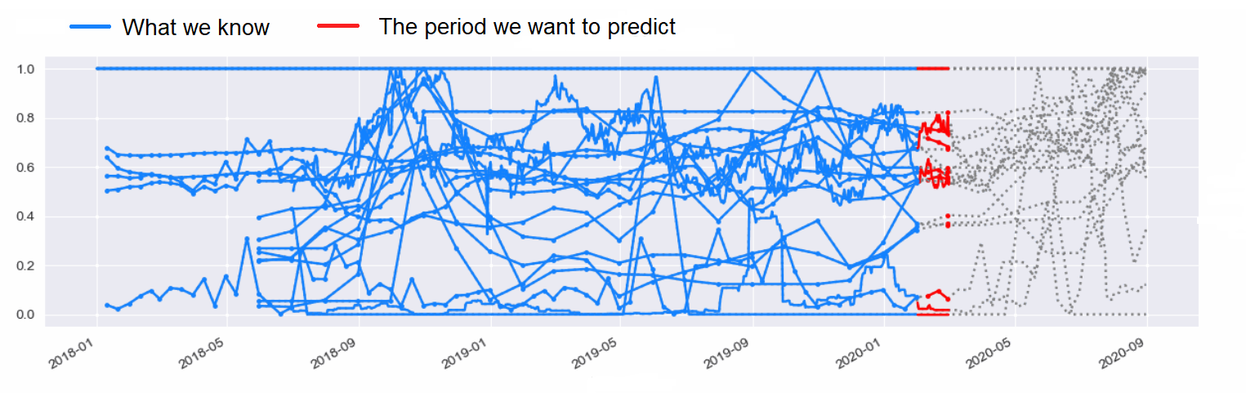
Example: Abyan
February 2020
2020-02-01 – 2020-03-01
We call this time jump as Split 1

Slide 8
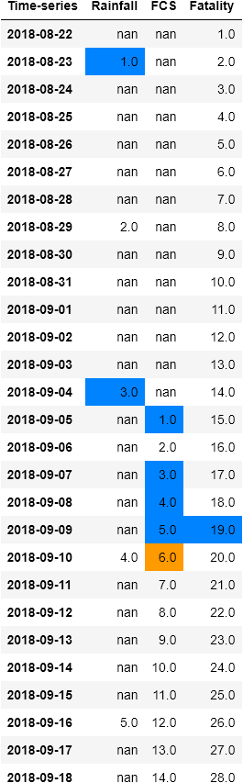
Forecasting of the February 2020 (Split 1) for all the provinces of Yemen
On the basis of what was known until the end of January 2020 the training points are created. The XGBoost model can then be trained to predict 30 days ahead in the future of the food insecurity (February 2020).
The model try to understand how the past influences the near future from the current history.

Slide 9
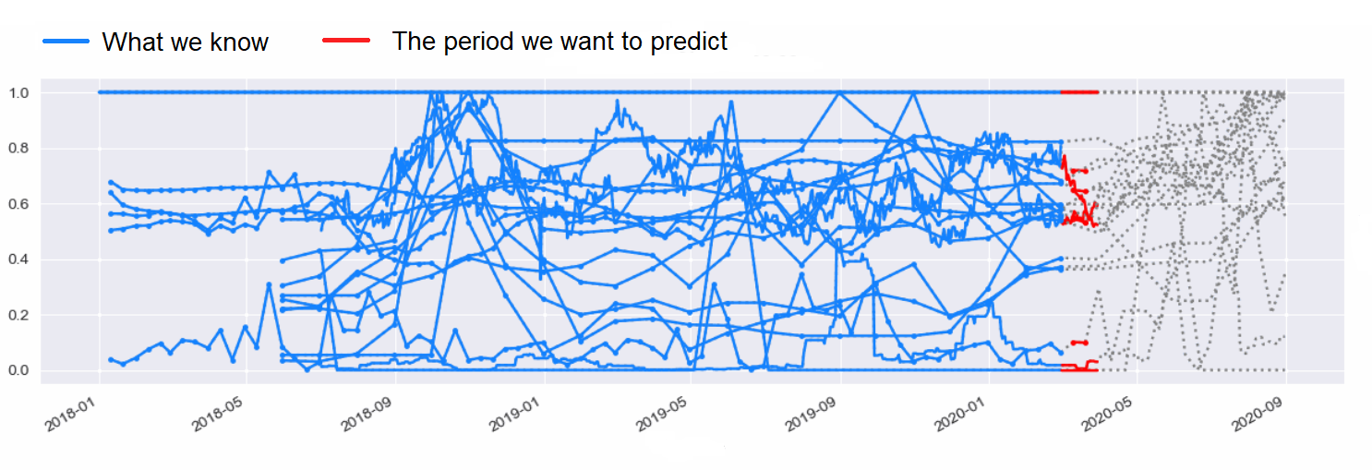
Now suppose that time passes and we reach the end of February 2020 ...
Now, we would like to predict food insecurity in the days between 2020-03-01 and 2020-03-30
In the meantime new real data will be updated to our dataset!
2020-03-01 – 2020-03-30
We call this time jump as Split 2

Slide 10
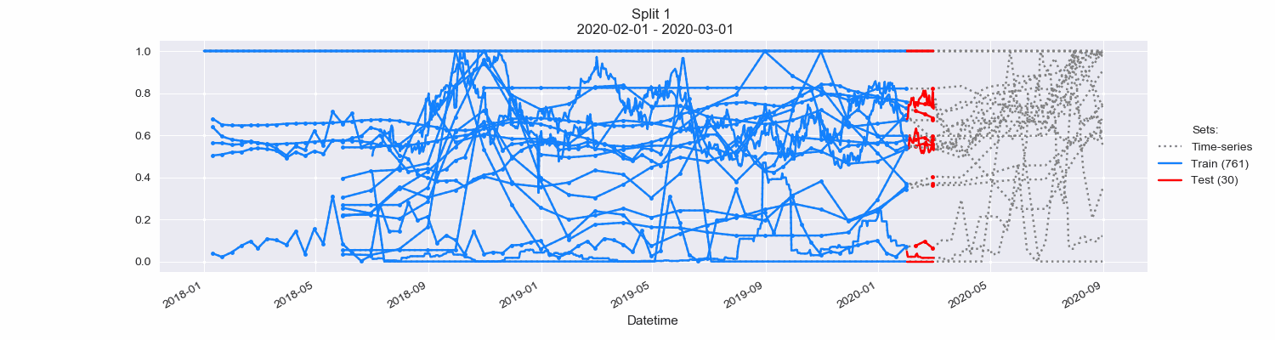
And so on until you have 7 splits designed to simulate a real time application:

Slide 11
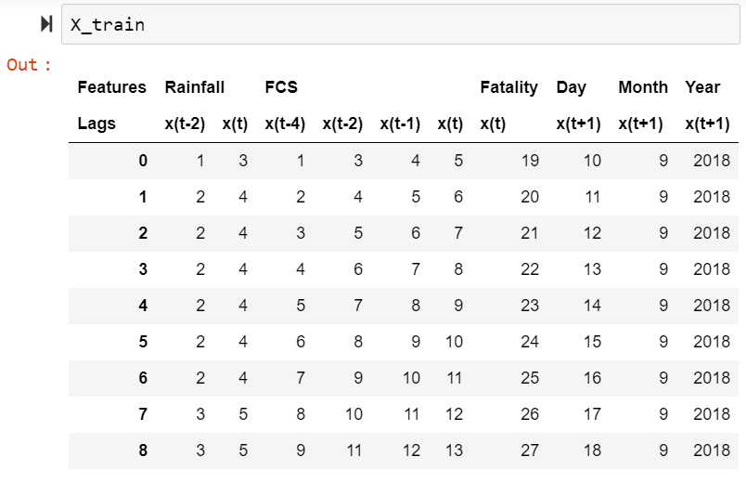
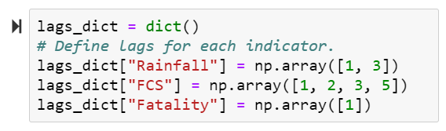
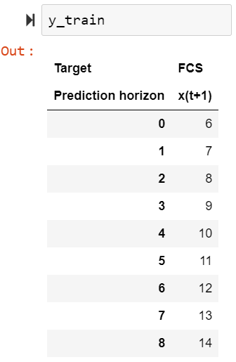
Returning to the creation of training points
Prediction horizon h = 1:
“How the past influences the near future from the current history”

Slide 12
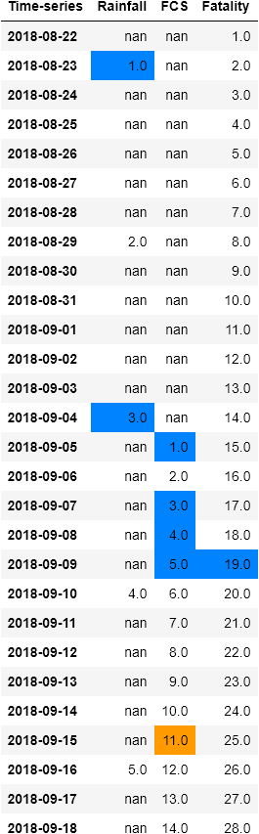
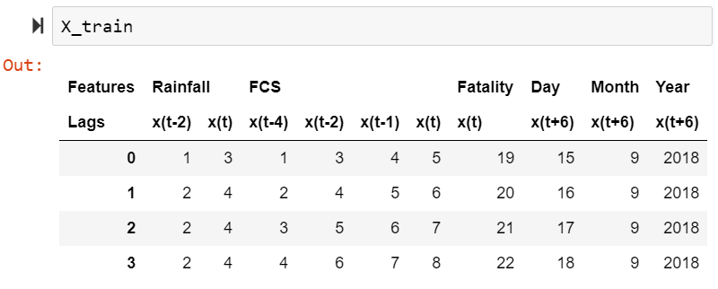
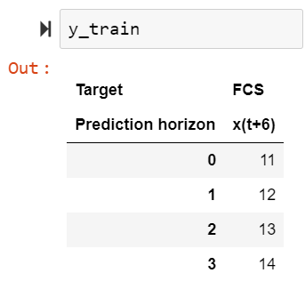
Returning to the creation of training points
Prediction horizon h = 6:
“How the past influences the near future from the current history”

Slide 13
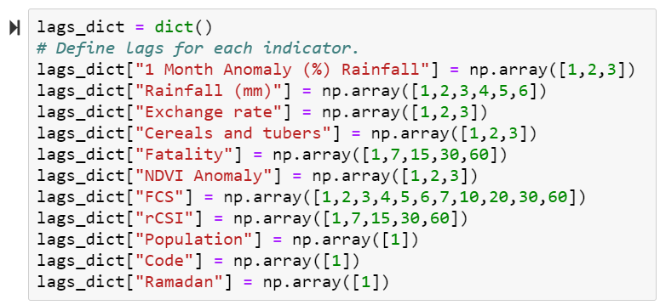
Lags dictionary
In practice we use the following time lags for our indicators:

Slide 14
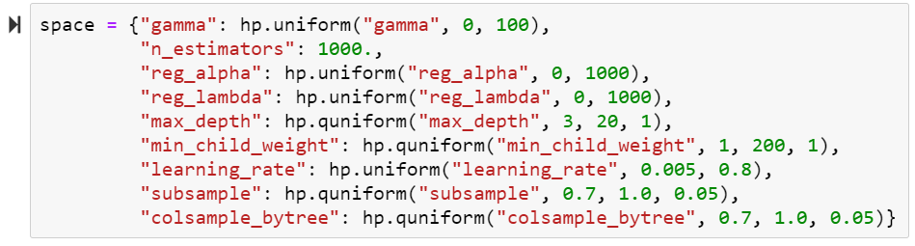
How to set the parameters of the model so that it performs at its best?
Grid search:
Creation of a training and a validation set for each split: 10% of the last points in chronological order are used to validate the model parameters:
loss_to_minimize = r2_difference*0.75 + penalty*0.25

Slide 15
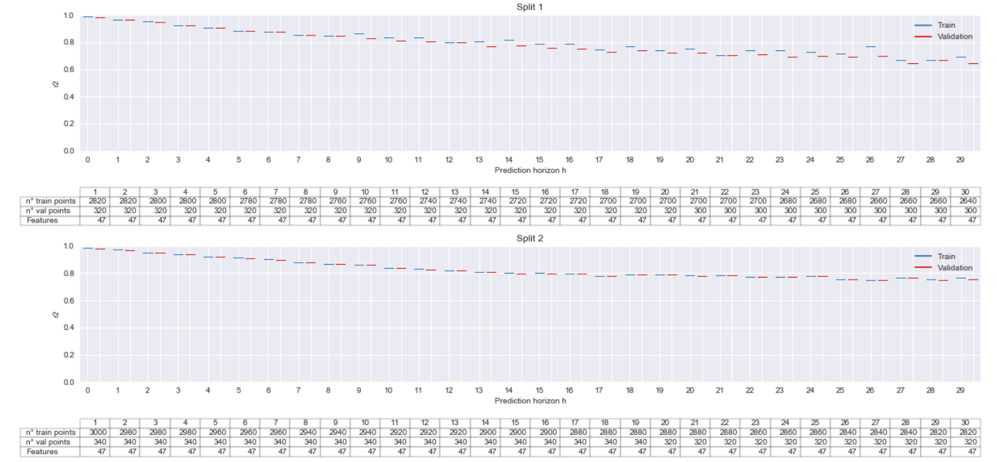
Grid search results

Slide 16
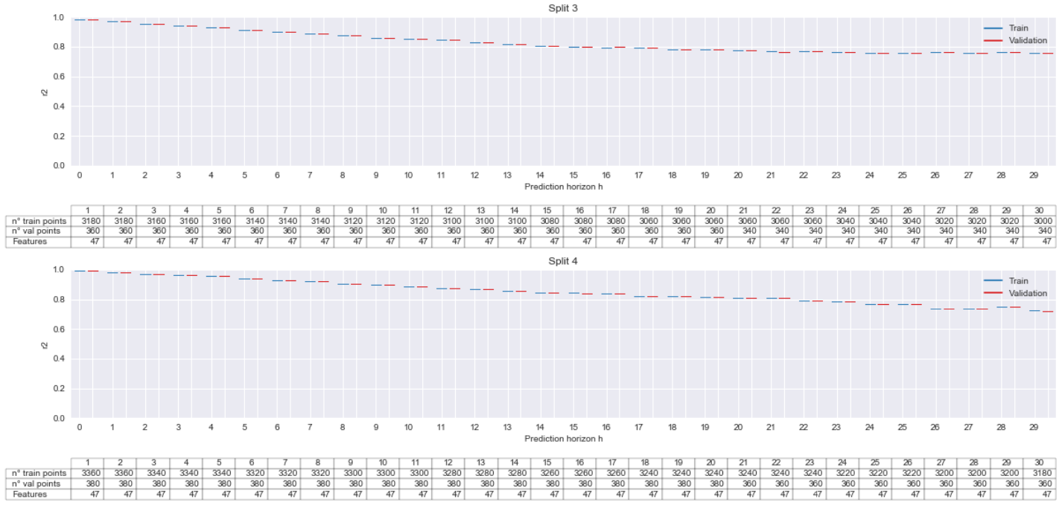

Slide 17
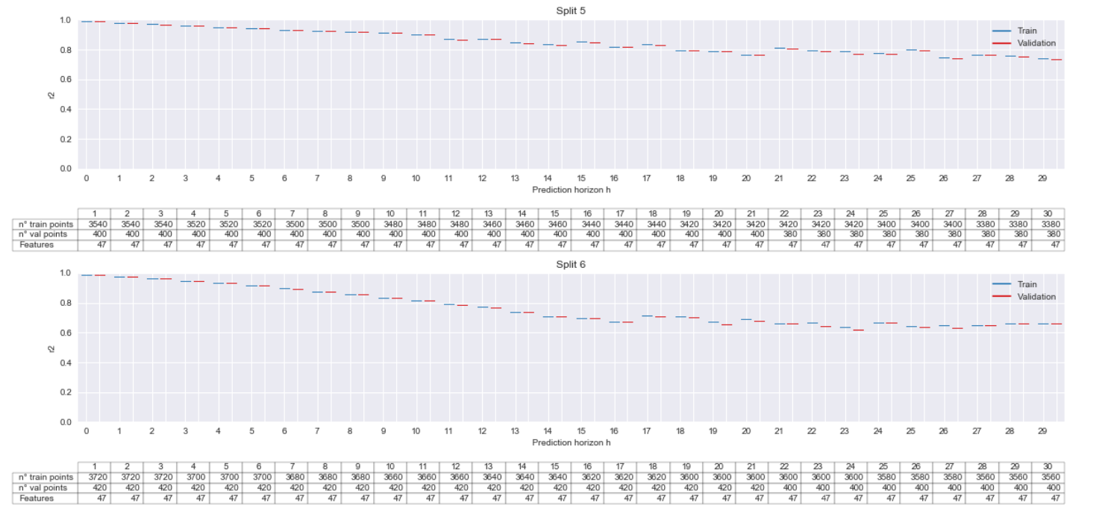

Slide 18
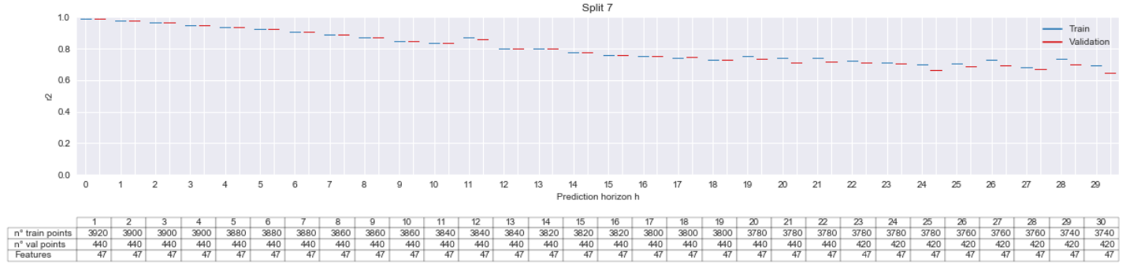
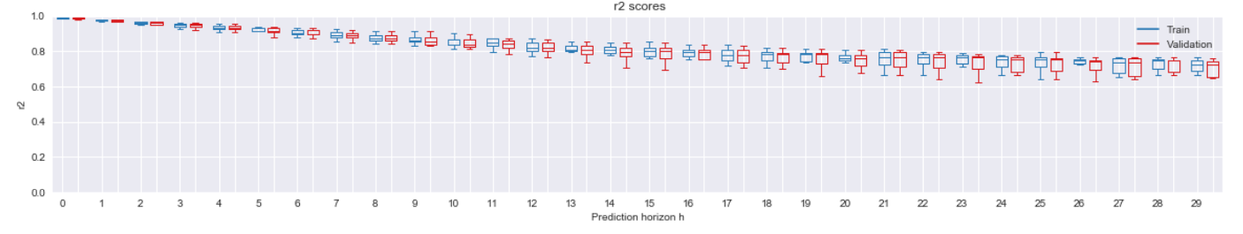

Slide 19
Now we can predict the test sets for each split using the best models for each prediction horizon

Slide 20
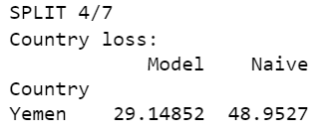
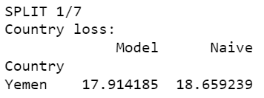
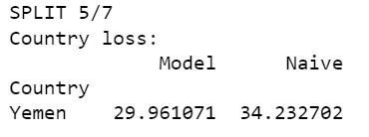
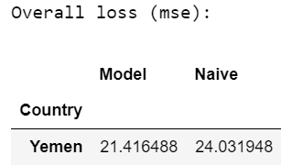
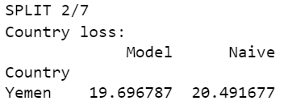
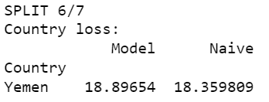
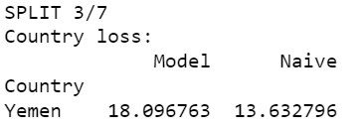
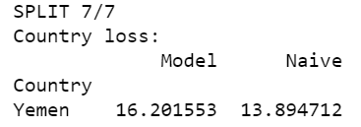
Results

Slide 21
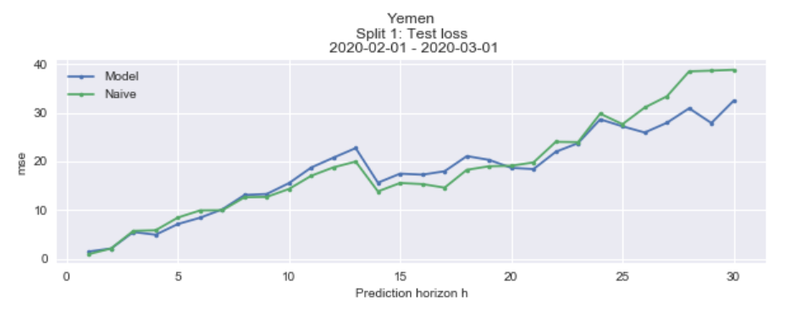
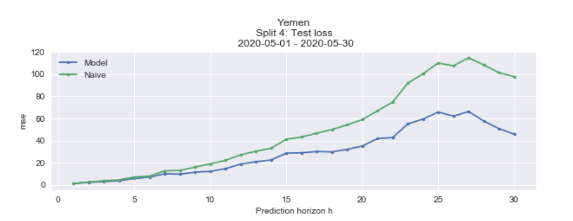
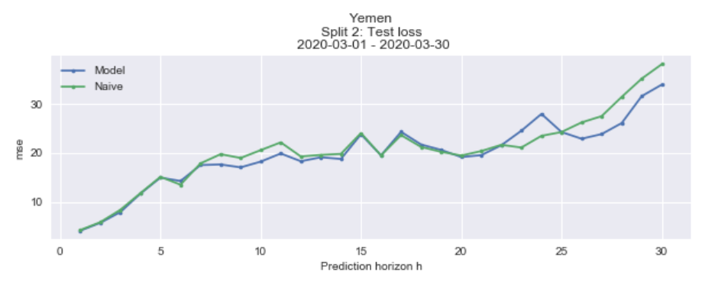
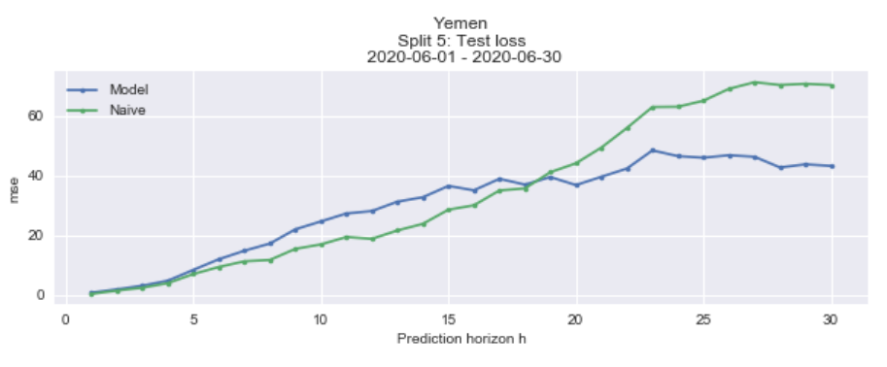
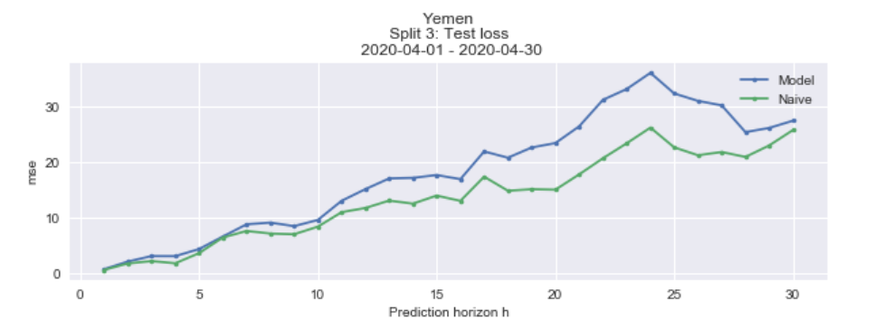
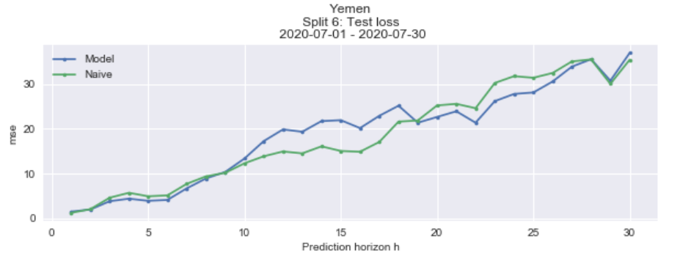
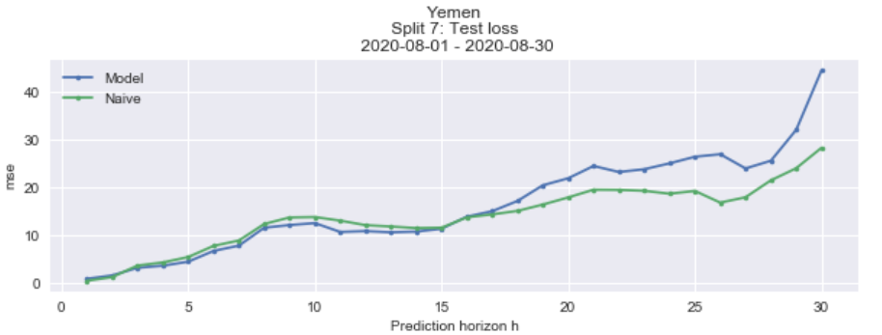

Slide 22
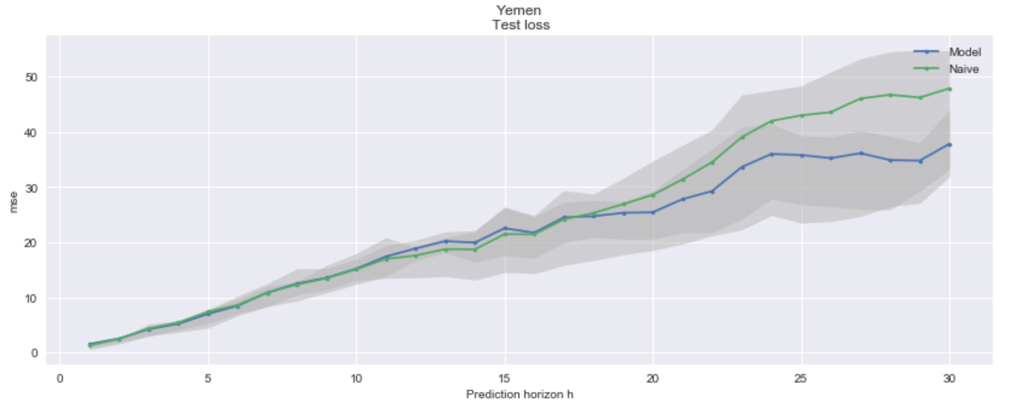

Slide 23
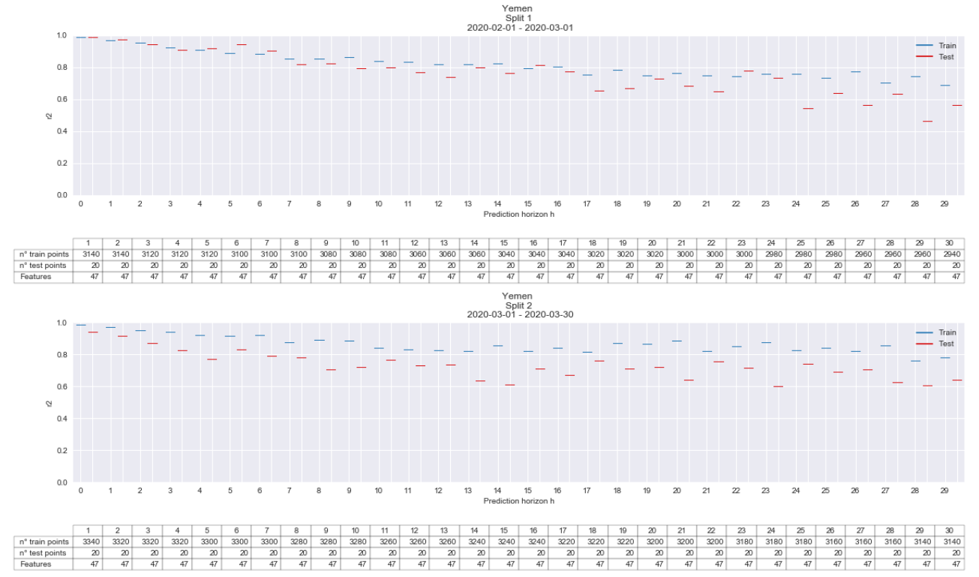

Slide 24
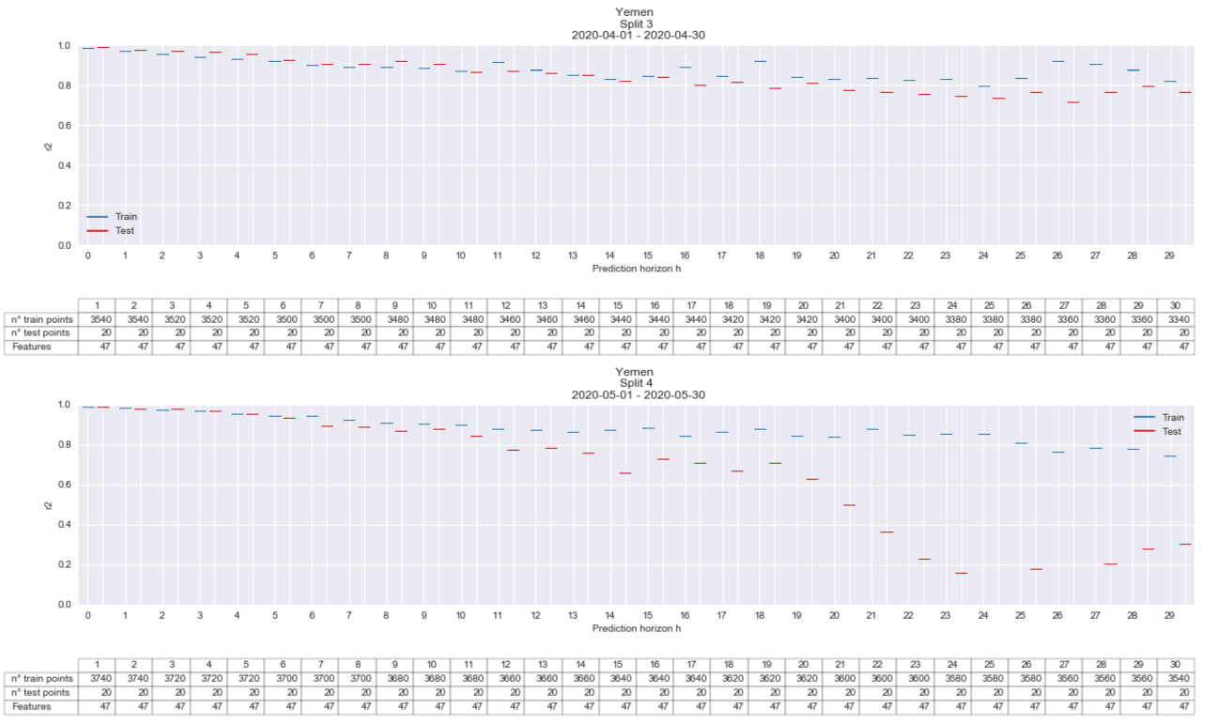

Slide 25
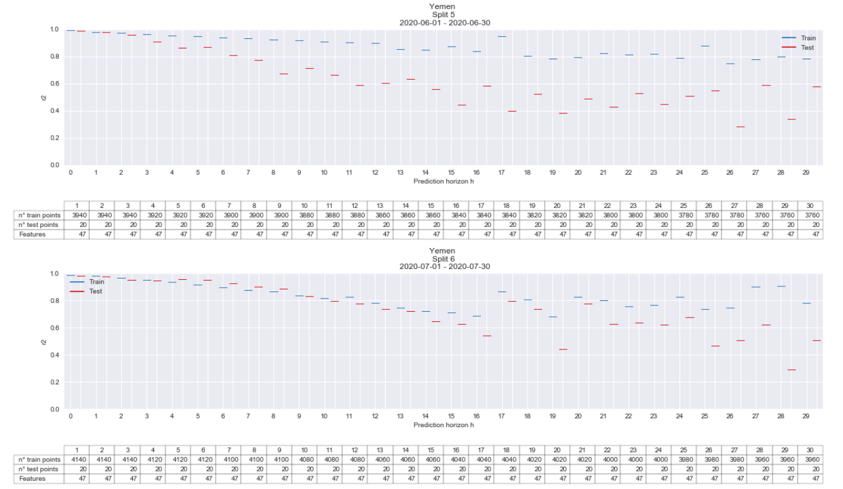

Slide 26


