Slide 1
WFP-ISI
Pietro Foini
02-07-2020

Slide 2
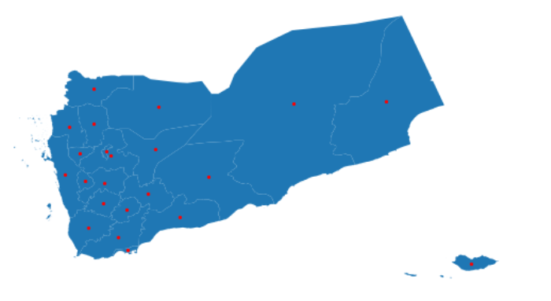
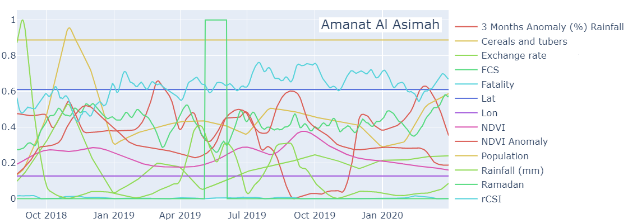
Data Sources
Yemen: 21 provinces (Socotra is included into Hadramaut province)
For each province, we have collected some explanatory time-series (features) that should help to predict food security trends described by some endogenous indicators released by WFP:
Dynamic features
FCS;
rCSI;
Rainfall;
Rainfall anomaly;
NDVI;
NDVI anomaly;
Fatalities;
Price of cereals and tubers;
Exchange rate;
Ramadan;
Static features
Latitude;
Longitude;
Population;
Example:

Slide 3
In our case…
FOOD SECURITY
Predicting
Food Consumption Score (FCS)
Before that…
Understanding the phenomenon
In order to do so, we need to answer the following questions:
Which indicator most influences the FCS?
To what extent the temporal lag of each indicator is useful for predicting tomorrow’s FCS performance?
Causality

Slide 4
Causality
Features importance;
Temporal lags importance;
Transfer Entropy (TE)
TE quantifies the directional flow of information between two time series, X and Y:
TE is equivalent to Granger causality for gaussian processes^{[1]};
An advantage to use TE despite Granger causality is to capture non-linear causalities^{[2]};
It detects causality without assuming any particular model for the interaction between the two systems of interest^{[3]}.
There are several techniques for estimating TE from observed data in order to apply it to real-world data problems. We use the robust and computationally fast technique of symbolization to estimate TE, the Symbolic Transfer Entropy (STE)^{[4]}:
STE discounts the relative magnitude of the time series;
STE can successfully analyze time-series which may be short and/or non-stationary.
[1]. "Equivalence of granger causality and transfer entropy: A generalization", K. Schindlerova, 2011.
[2]. "Transfer entropy as a variable selection methodology of cryptocurrencies in the framework of a high dimensional predictive model", García-Medina, González Farías, 2020.
[3]. "Transfer entropy—a model-free measure of effective connectivity for the neurosciences", Vicente R, Wibral M, Lindner M, Pipa G, 2010
[4]. "Symbolic transfer entropy", M. Staniek and K. Lehnertz, 2008.

Slide 5
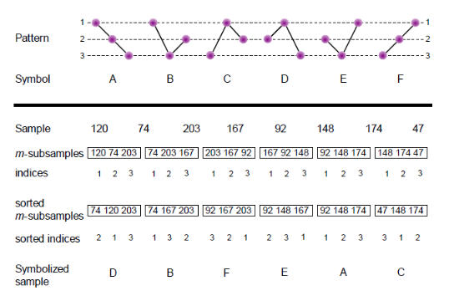
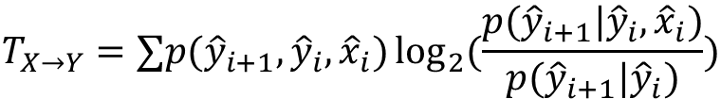
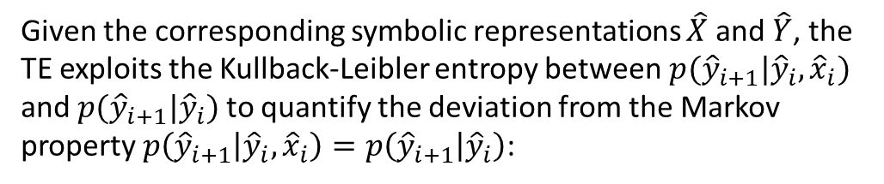

Symbolic Transfer Entropy
1) Symbolic:
Example of time-series:
Output:
$$X=\{120, 74, 203, 167, 92, 148, 174, 47\}$$
$$\hat{X}=\{D, B, F, E, A, C, …\}$$
2) Transfer Entropy:
Given the corresponding symbolic representations $\hat{X}$ and $\hat{Y}$, the TE exploits the Kullback-Leibler entropy between$p({\hat{y}}_{i+1}|{\hat{y}}_{i}, {\hat{x}}_{i})$ and $p({\hat{y}}_{i+1}|{\hat{y}}_{i})$ to quantify the deviation from the Markov property $p\left({\hat{y}}_{i+1} | {\hat{y}}_{i}, {\hat{x}}_{i}\right)=p\left({\hat{y}}_{i+1} | {\hat{y}}_{i}\right)$:
$$T_{X→Y}=∑p({\hat{y}}_{i+1}, {\hat{y}}_{i}, {\hat{x}}_{i})\log_{2}{(\frac{p({\hat{y}}_{i+1}|{\hat{y}}_{i}, {\hat{x}}_{i})}{p({\hat{y}}_{i+1}|{\hat{y}}_{i})})}$$
TE is non-negative and asymmetric, and any information transfer between the variables results in ${0≤T}_{X→Y}<∞$ . If the state ${\hat{x}}_{i}$ has no influence on the transition probabilities from ${\hat{y}}_{i}$ to ${\hat{y}}_{i+1}$, or if the two time-series are completely synchronized, the $T_{X→Y}=0$. If it is non-zero, you can conclude that $X$ influences $Y$ in some way.

Slide 6
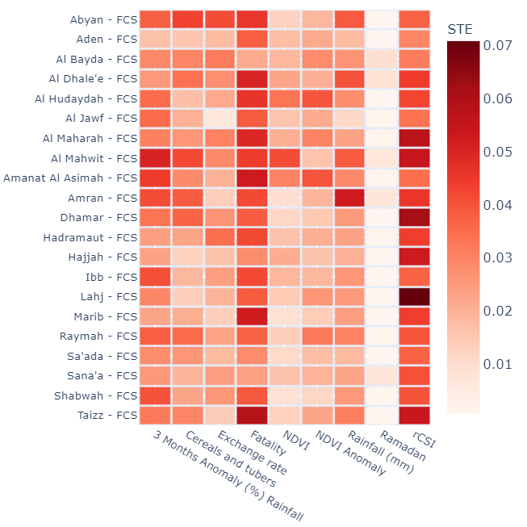
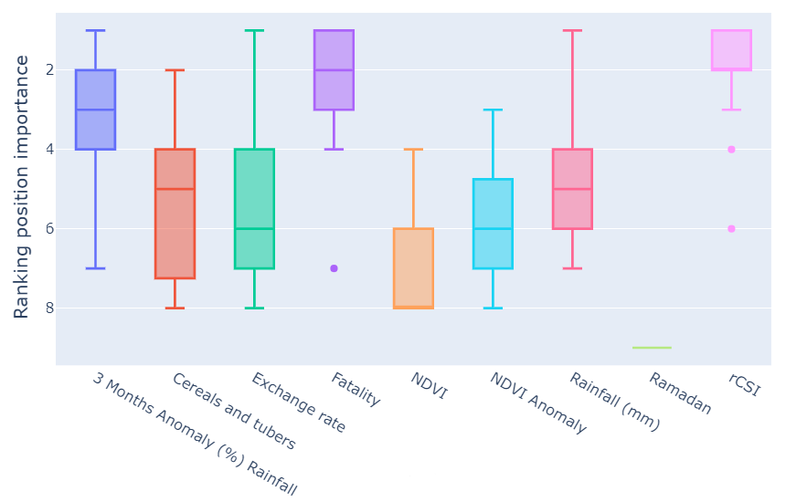
1. Which indicator most influences the FCS?
Now we can compute the TEs between the predictive indicators $X$ and the target indicator $Y$ (FCS indicator):
Predictive indicators
Target indicator

Slide 7
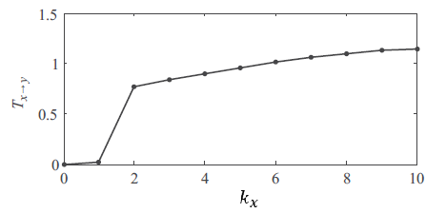
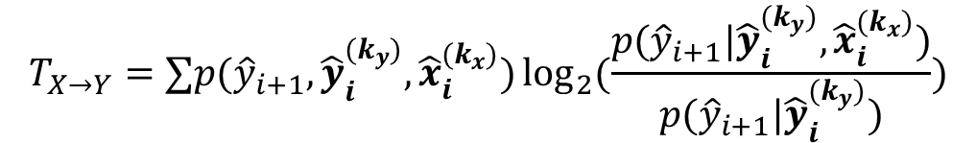
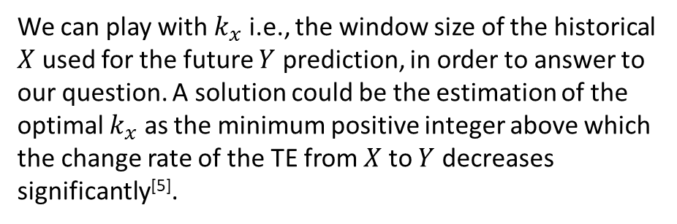
2. To what extent the temporal lag of each indicator is useful for predicting tomorrow’s FCS performance?
We can also define a generalized Markov property $p\left({\hat{y}}_{i+1} | {\hat{y}}_{i}^{(k_{y})}, {\hat{x}}_{i}^{(k_{x})}\right)=p\left({\hat{y}}_{i+1} | {\hat{y}}_{i}^{(k_{y})}\right)$ relying on the Kullback-Leibler distance, where ${\hat{y}}_{i}^{(k_{y})}=({\hat{y}}_{i}, {\hat{y}}_{i−1 }, …, {\hat{y}}_{i −(k_{y}−1)})$ and $k_{y}$is the temporal lag for the time-series $\hat{Y}$:
$$T_{X→Y}=∑p({\hat{y}}_{i+1},{\hat{y}}_{i}^{(k_{y})}, {\hat{x}}_{i}^{(k_{x})})\log_{2}{(\frac{p({\hat{y}}_{i+1}|{\hat{y}}_{i}^{(k_{y})}, {\hat{x}}_{i}^{(k_{x})})}{p({\hat{y}}_{i+1}|{\hat{y}}_{i}^{(k_{y})})})}$$
We can play with $k_{x}$ i.e., the window size of the historical $X$ used for the future $Y$ prediction, in order to answer to our question. A solution could be the estimation of the optimal $k_{x}$ as the minimum positive integer above which the change rate of the TE from $X$ to $Y$ decreases significantly^{[5]}.
[5]. "Direct Causality Detection via the Transfer Entropy Approach", Ping Duan, Fan Yang, 2013.

Slide 8
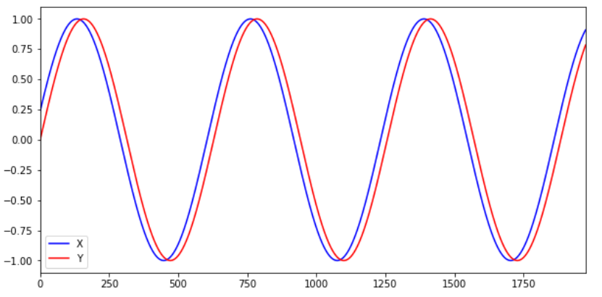
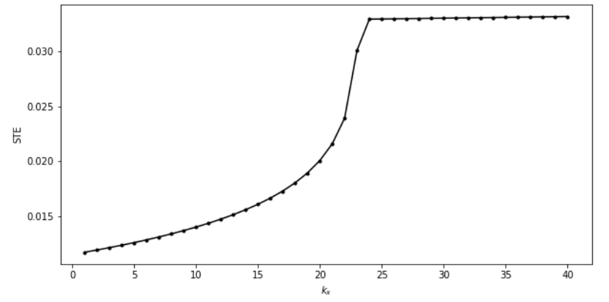


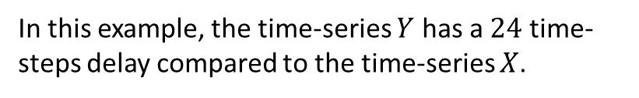
Toy models
Let’s take two simple time-series $X$ e $Y$ where we know of course that $X$ influences $Y$ for a given temporal lag:
In this example, the time-series $Y$ has a $24$ time-steps delay compared to the time-series $X$.
Playing with $k_{x}$ :
24

Slide 9
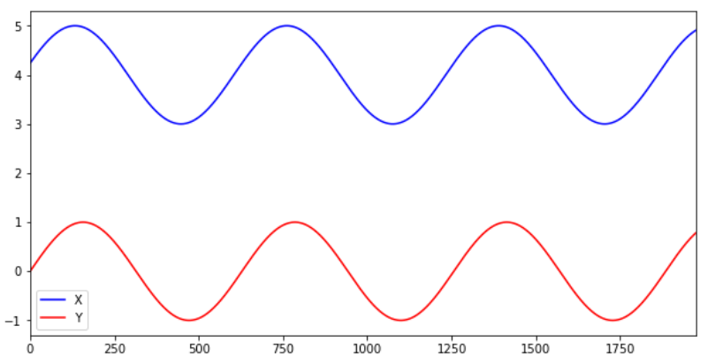
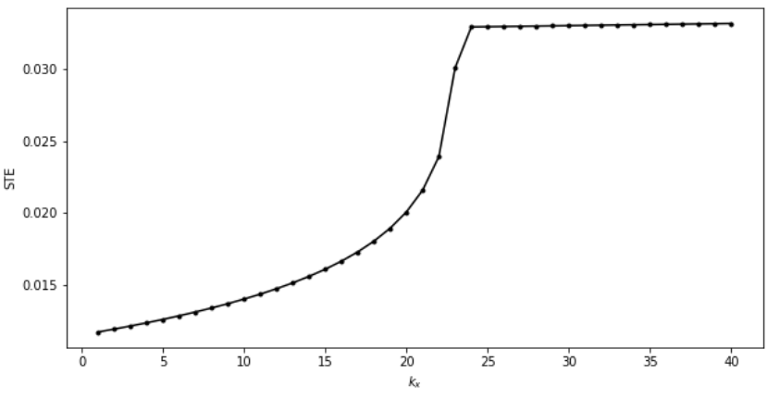
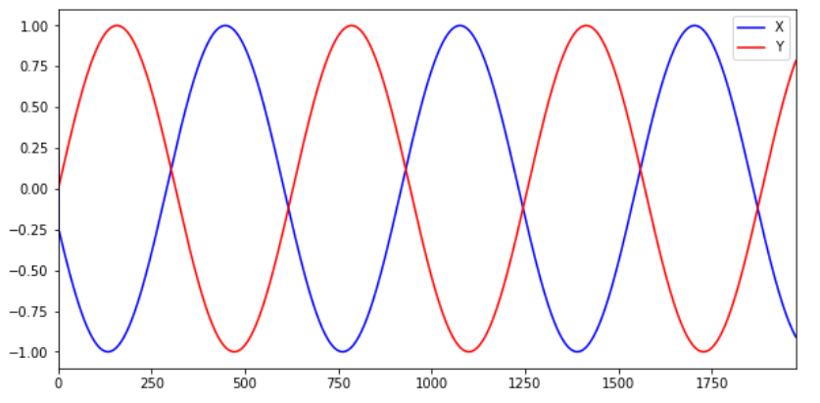
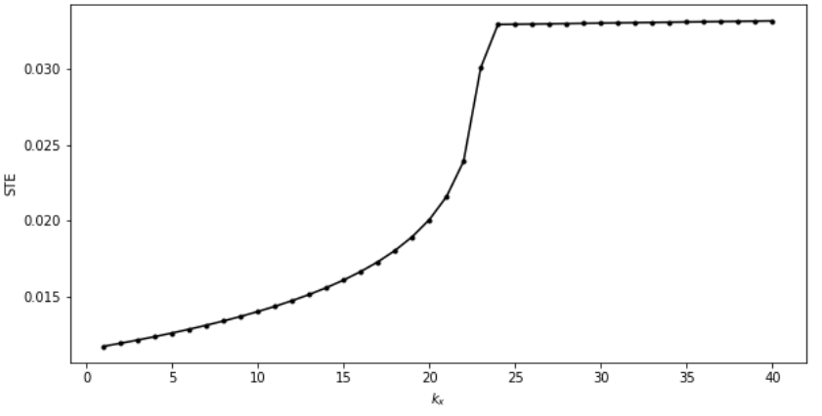
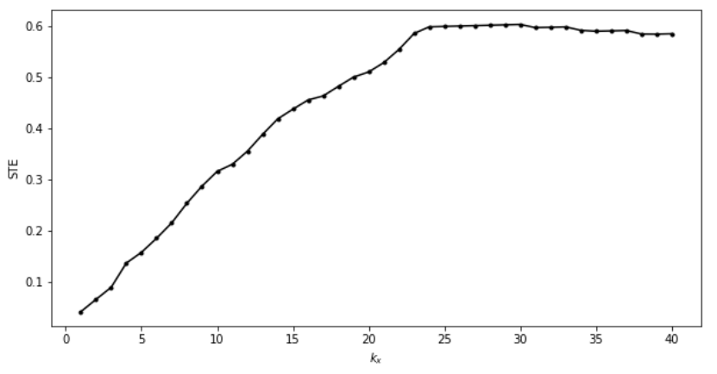
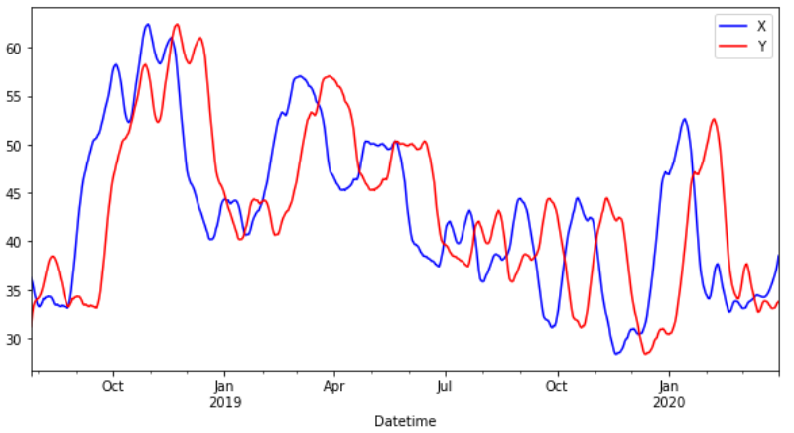
This method works well also with some variations…
24
24
24

Slide 10
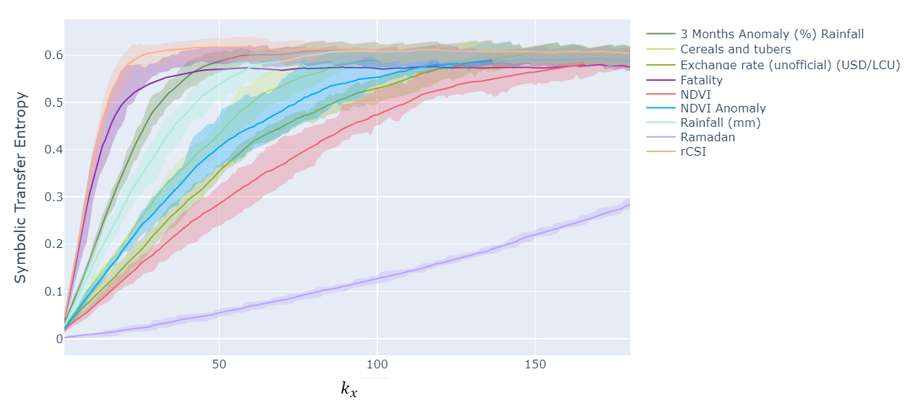
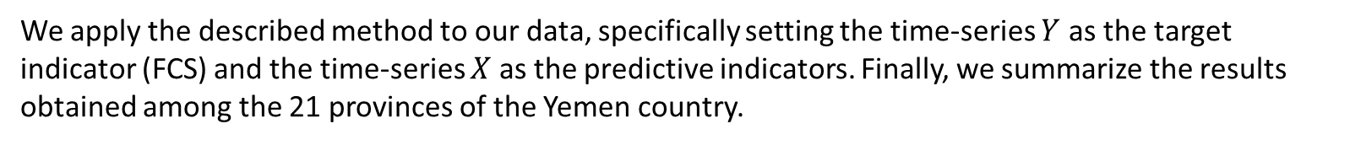
Returning to our data…
We apply the described method to our data, specifically setting the time-series $Y$ as the target indicator (FCS) and the time-series $X$ as the predictive indicators. Finally, we summarize the results obtained among the 21 provinces of the Yemen country.

